Slide 1
Julia for R-lovers
Ideas for a dual-language workflow

Slide 2
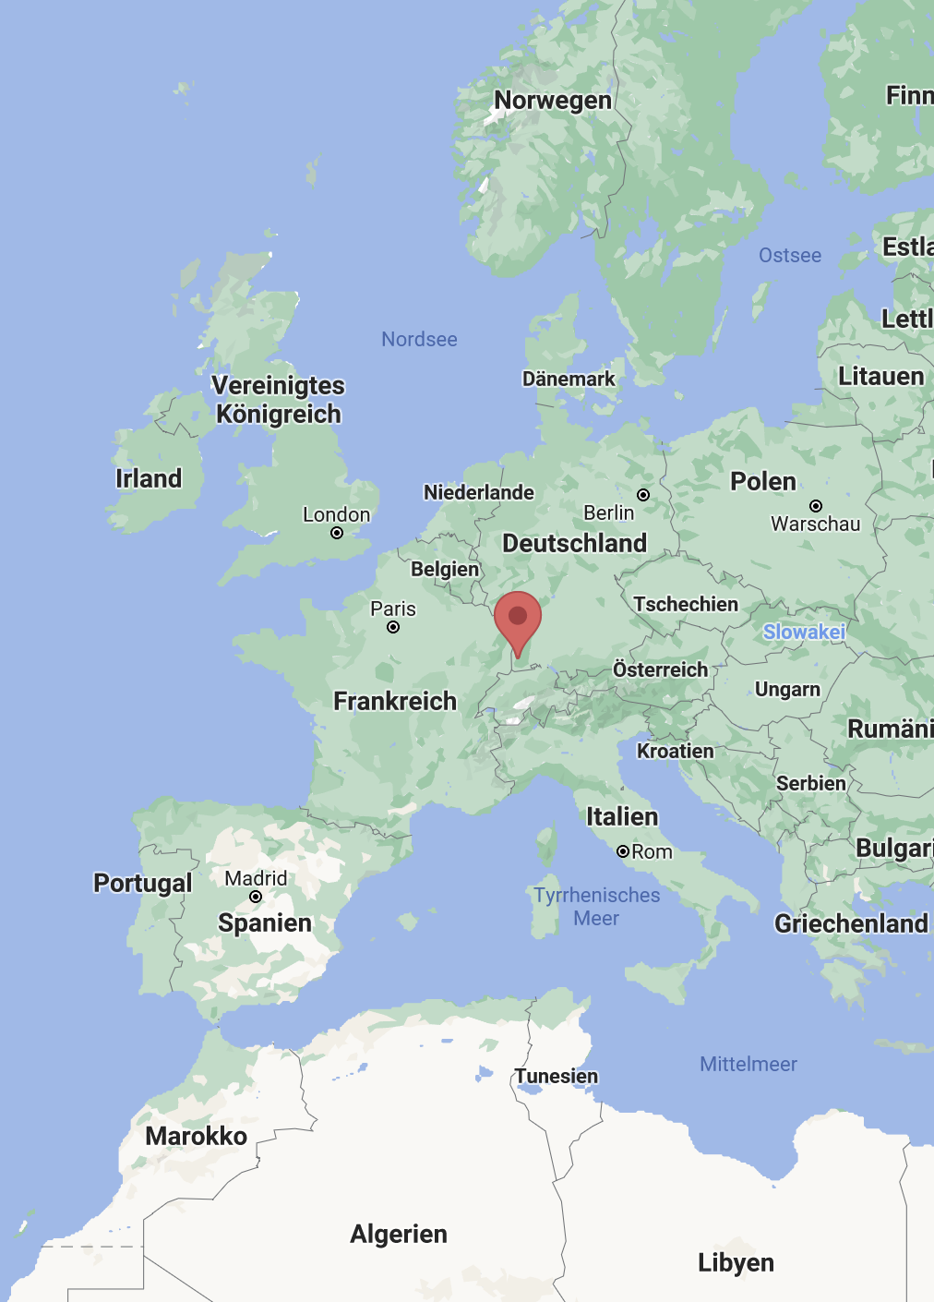
ABOUT ME
Kyla McConnell
PhD student in linguistics at the University of Freiburg
R-stats enthusiast, Co-organizer of @RLadiesFreiburg
Recently discovered the joys of Julia
My use case: academic research, linear mixed effects models

Slide 3
TODAY’S DEMO
What is Julia and why should you consider it?
Example: Fitting an LMM with MixedModels.jl
Julia Basics, using R & Julia, and Julia for Data Science

Slide 4
WHAT I WON’T COVER
Installing Julia, using iJulia for Jupyter Notebooks
01
https://www.youtube.com/watch?v=oyx8M1yoboY
Programming concepts in Julia -> Julia Academy
02
https://juliaacademy.com/p/julia-programming-for-nervous-beginners
https://juliaacademy.com/p/intro-to-julia
https://juliaacademy.com/p/julia-for-data-science
Statistical concepts or packages
03
https://juliastats.org/MixedModels.jl/dev/

Slide 5
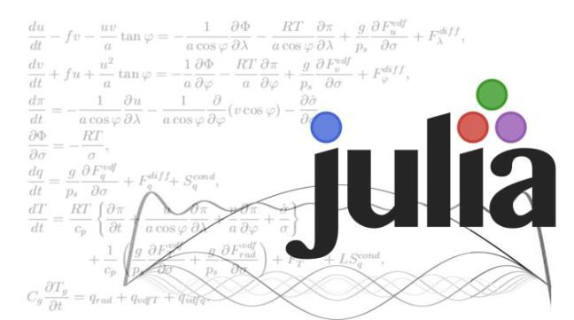
WHAT IS JULIA?
General-purpose programming language but popular in data science communities
Built with data science and machine learning in mind
Free & open source (like R and Python)
Developed to be readable like Python but compiled quickly like C
Young: < 10 years old (R is closer to 30 years old)

Slide 6
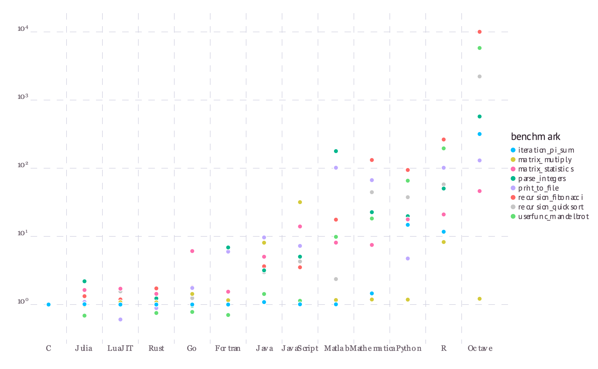
WHY JULIA?
Gains in:
Speed (but just-in-time compiler, i.e. package loading)¹
Model complexity
Without sacrificing:
Readability
Reproducibility
R packages that you know well
Tutorials and resources from the R community
Ability to share code with colleagues who don’t use Julia
1 : https://www.youtube.com/watch?v=FJeSa0Fr5VY
“These micro-benchmarks, while not comprehensive, do test compiler performance on a range of common code patterns, such as function calls, string parsing, sorting, numerical loops, random number generation, recursion, and array operations.”
single core, Julia 1.0.0
https://julialang.org/benchmarks/

Slide 7
WHY JULIA?
Gains in:
Speed (but just-in-time compiler, i.e. package loading)¹
Model complexity
Without sacrificing:
Readability
Reproducibility
R packages that you know well
Tutorials and resources from the R community
Ability to share code with colleagues who don’t use Julia
1 : https://www.youtube.com/watch?v=FJeSa0Fr5VY
“These micro-benchmarks, while not comprehensive, do test compiler performance on a range of common code patterns, such as function calls, string parsing, sorting, numerical loops, random number generation, recursion, and array operations.”
single core, Julia 1.0.0
https://julialang.org/benchmarks/

Slide 8
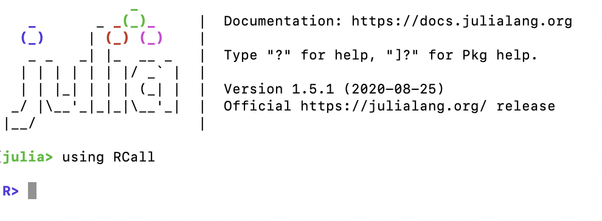
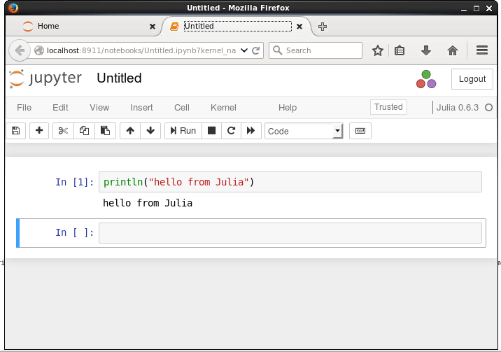
WORKING WITH R IN JULIA
Options:
REPL
R console
Julia script .jl
R script (.R)
Julia Markdown .jmd
R Markdown (.Rmd)
IDE like Visual Studio Code
R-Studio
Jupyter Notebooks .ipynb (or Pluto Notebooks)

