Slide 1
HOMELESSNESS & WEATHER
ALAN AHMATOVIC
COURTNEY MACDONALD
KYLA GELEV
JORGE CHAVEZ
Notes:
Courtney

Slide 2
OUR QUESTION: Do U.S. metropolitan counties with warmer weather have higher rates of homelessness than those with colder weather? HYPOTHESIS: IF the weather is warmer than average in a major U.S. metropolitan county THEN it will have a higher homelessness rate
Notes:
Courtney
The topic of homelessness in major U.S. metropolitan areas has received a great deal of attention over the past few years.
Without trying to understand the root cause of homelessness, we attempted to understand if weather plays a factor in the rates of homelessness across major U.S. metropolitan areas.

Slide 3
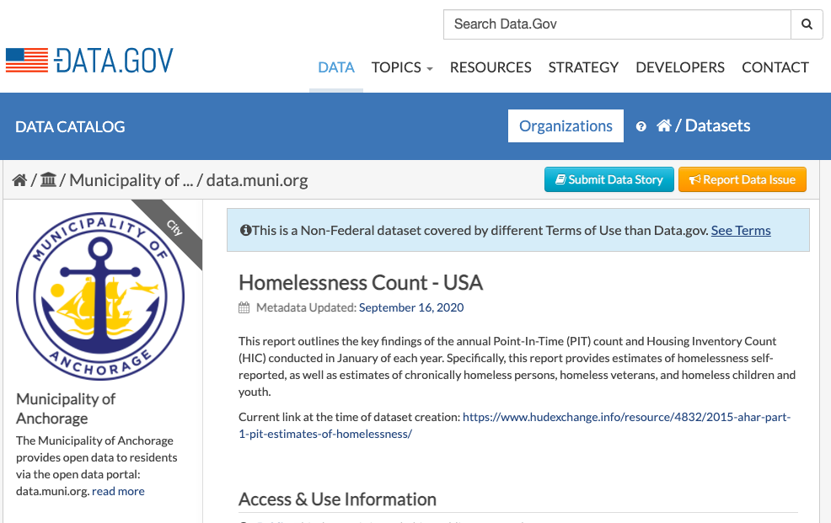
Notes:
Courtney-For our homelessness data, we used a data set on Data.gov which broke down homelessness by every county in the United States. This data was from the years 2014 and 2015.

Slide 4
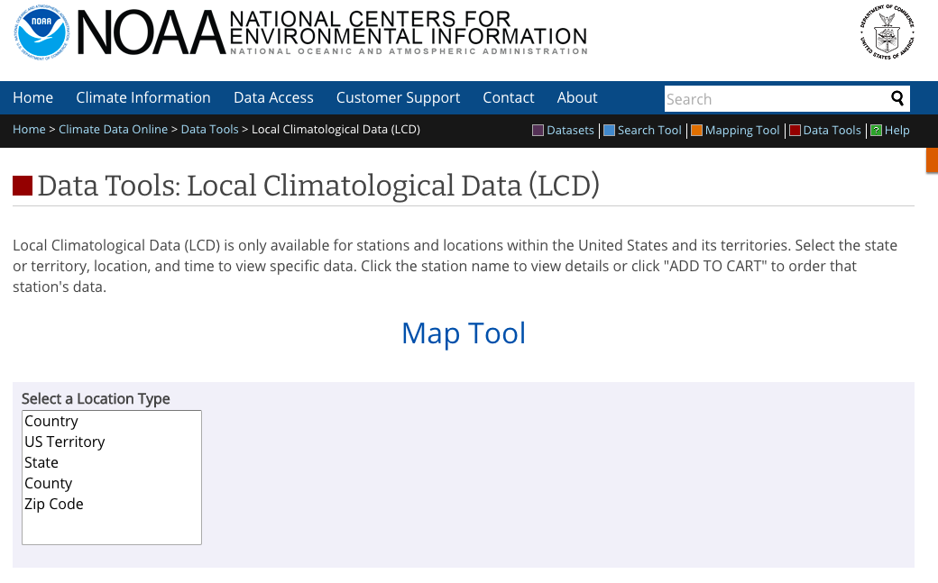
Notes:
Courtney-We got our climate data from the National Centers for environmental information, which upon request will send you data broken down by one specific weather station in your selected County of interest. This proved rather tedious, as we had to have them email us each dataset, then rename it as the county name.

Slide 5
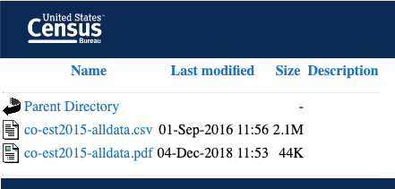

Slide 6
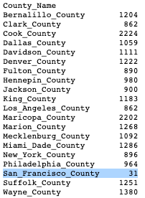
DATA CLEANUP & EXPLORATION
Exploration and cleanup process
Brainstormed different ideas
Explored government data sources, API’s and Kaggle
Obtained raw data as a group then assigned who cleaned what
Problems exploring the data
In the weather data, San Francisco had way less data
In the total population data, the 2014 population column header had a space
Running through csv file with a conditional statement when the truth value in a series was ambiguous
Notes:
Courtney
For Kyla to remember:
Truth value of a Series is ambiguous. Use a.empty, a.bool(), a.item(), a.all()

Slide 7
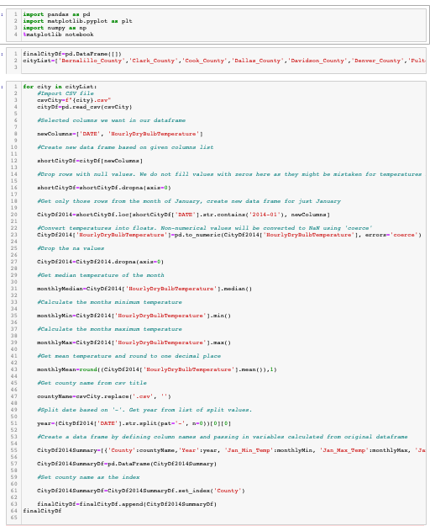
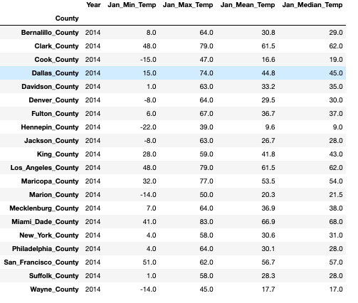
Notes:
Challenge was that weather data was all in individual CSVs based on county. Created a for loop to retrieve “Date” and “Hourly temperature” from each csv then calculated mean, median, max and min temperatures for only the month of January as the homeless data was recorded in January. This data was then made into a new data frame and each subsequent county was appended to this summary data frame. We used summary data for the gmap and the scatter plot.
Using the same logic, we also created a data frame that recorded all temperatures from each county and put them in a master data frame for our boxplot analysis.

Slide 8
DATA ANALYSIS
Steps to analyze data:
Broke our data collection into three separate categories:
Total number of homeless per county
Daily temperature and median temperature per county
Total population per county
Cleaned individual datasets and created pandas data frames
Built visuals to answer each individual sub-question
Combined data frames into one master data frame containing rate of homelessness per capita
Built scatter plot based on master data frame to test for correlation
Notes:
Courtney -

Slide 9
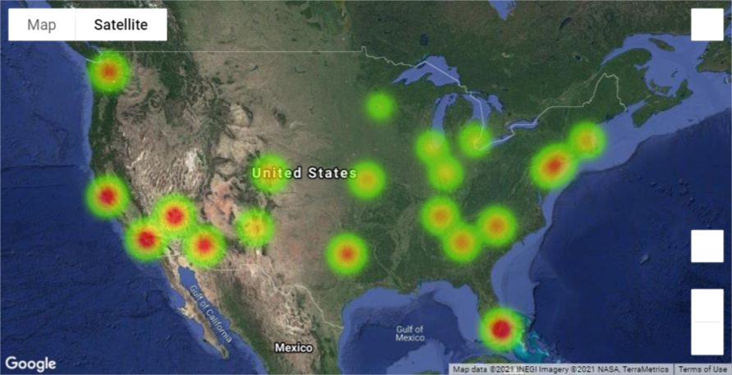
Is our weather data heterogenous enough to use as a sample?
Notes:
Alan

Slide 10
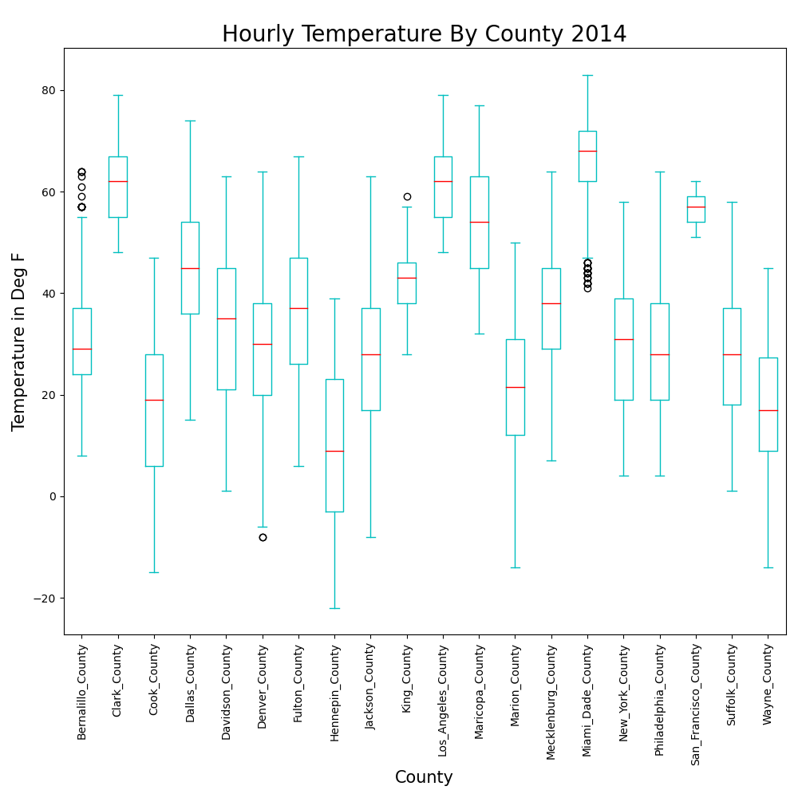
Is our weather data heterogenous enough to use as a sample?
Notes:
Courtney - we asked the question is our weather data in each county different enough to make a comparison? If our data is too homogenous, it wouldn’t make sense to make compare counties. Because our median temperature is different across each county, we can safely make the conclusion that we do have a good sample.

Slide 11
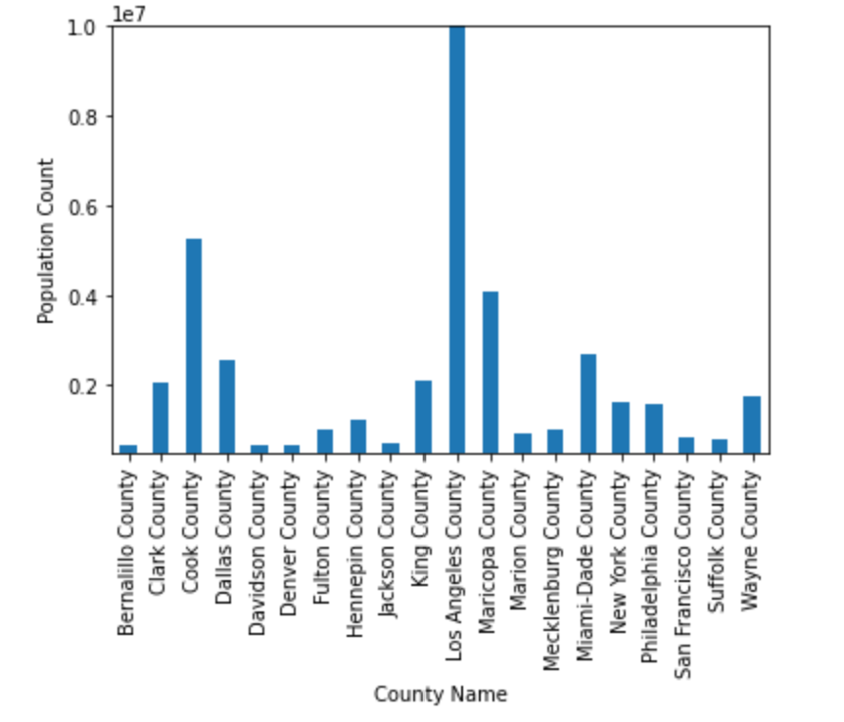
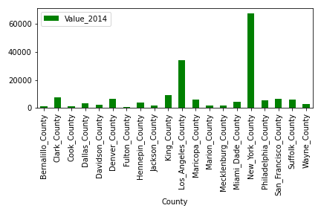
What is the population and number of homeless per county??
Bar Chart 1
Bar Chart 2
Notes:
Alan and Kyla
change to alphabetical for county list

Slide 12
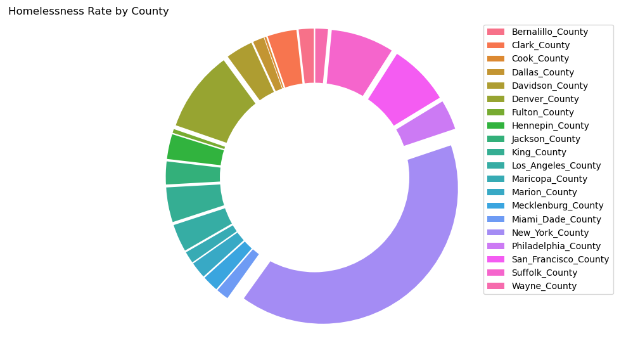
Is there a difference in homelessness rates across different U.S. metropolitan areas?
Notes:
Jorge-what is the homelessness rate for each county. New York has largest homeless population which was our first initial que that hypothesis might be wrong

Slide 13
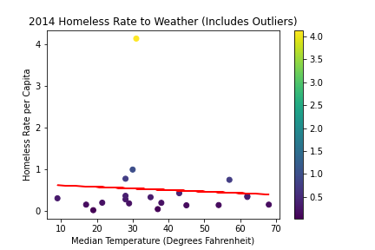
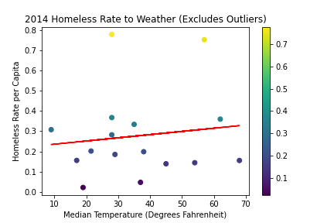
Does weather play a factor and is there any statistical significance?
The correlation coefficient is -0.07
The correlation coefficient is 0.13
Notes:
Kyla
After comparing the difference between 2014 and 2015 homelessness, decided to create boxplot to assess if there were any outliers.
From there, used conditional function to pull out county names that were greater than the upper bound and smaller than the lower bound
These were ['Los_Angeles_County', 'Denver_County', 'King_County', 'New_York_County']

Slide 14
Conclusion and Discussion
Summary of findings
Given the results of our analysis, there is no significant correlation between warmer weather and higher rates of homelessness in major U.S. metropolitan counties
Even after removing outliers from the dataset, we found that there was no significant correlation between weather and homelessness rate
By looking at the data we can conclude that:
There is not enough evidence to support the validity of our hypothesis
Therefore, our hypothesis is FALSE
Notes:
Everyone

Slide 15
Post-Mortem
Finding quality data that aligned with our hypothesis
Limited by the number of years we could explore based on the homelessness data we had (2014-2015)
In the future with more time for in depth research we could look for data from additional years
If weather doesn’t have an impact on homelessness, what factors do?
Median income
Local laws
Unemployment
Cost of living
Notes:
Everyone

Slide 16
Q&A

Slide 17
THANK YOU

