Slide 1
Gaussian Process Semi-Parametric Regression w/ Misspecified Models
Kyla Jones

Slide 2
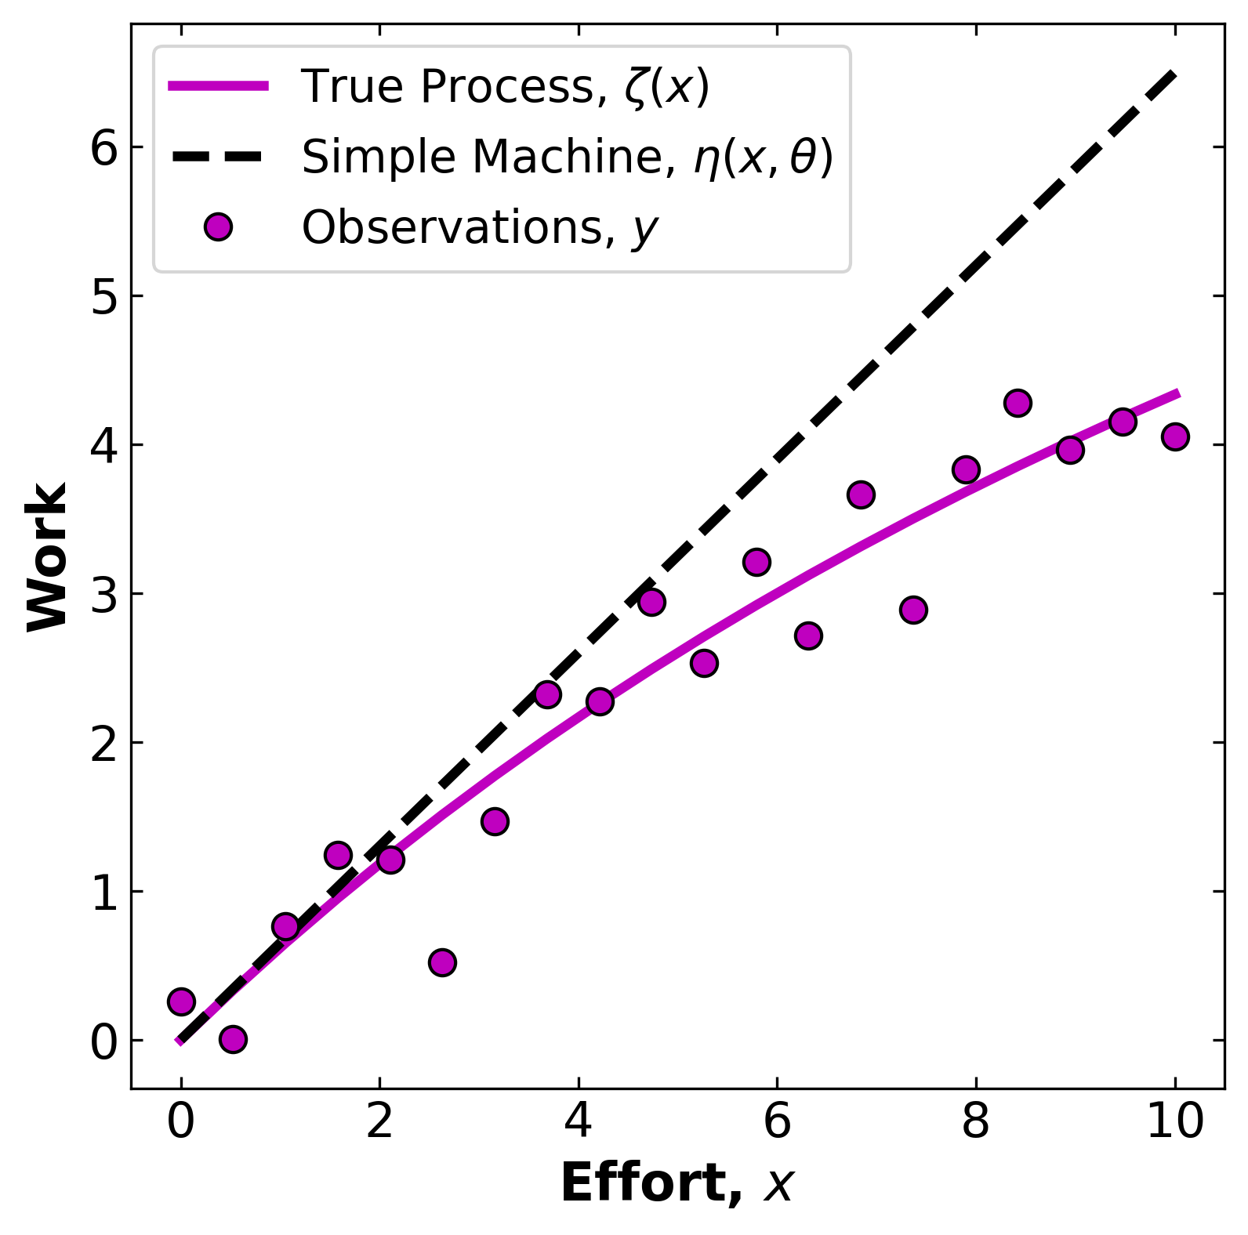
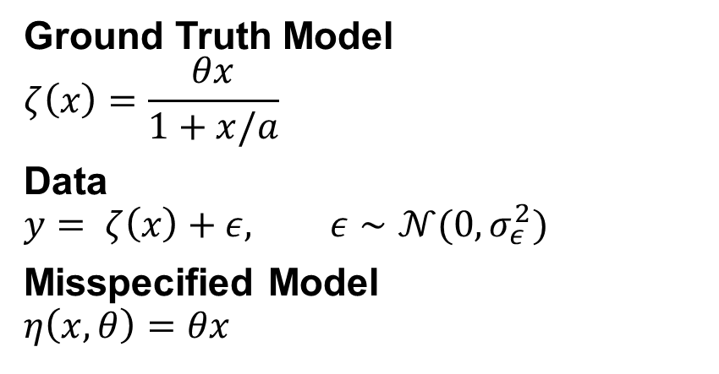
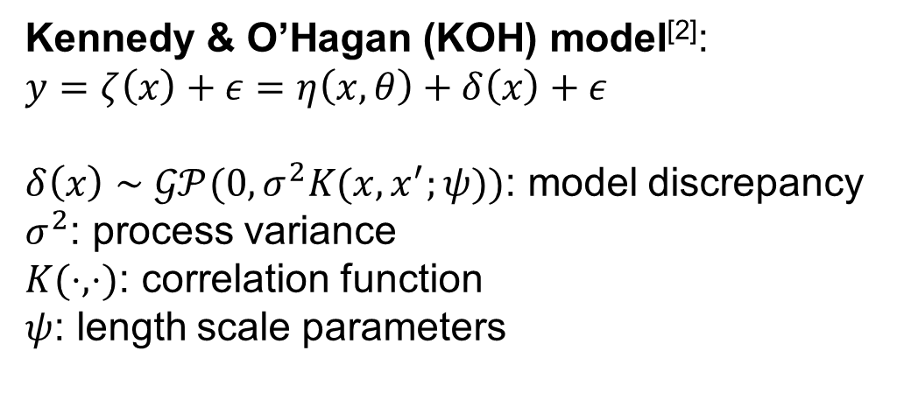
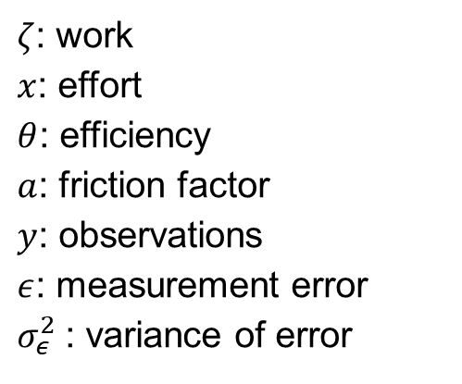
Motivating Example – The Simple Machine^{[1]}
Ground Truth Model
$$ζ\left(x\right)=\frac{θx}{1+x/a}$$
Data
$$y= ζ\left(x\right)+ε, ε∼𝒩(0,σ_{ε}^{2})$$
Misspecified Model
$$η\left(x,θ\right)=θx$$
$ζ$: work
$x$: effort
$θ$: efficiency
$a$: friction factor
$y$: observations
$ε$: measurement error
$σ_{ε}^{2}$: variance of error
How to learn model-form uncertainty ?
Kennedy & O’Hagan (KOH) model^{[2]}:
$$y=ζ\left(x\right)+ε=η\left(x,θ\right)+δ\left(x\right)+ε$$
$δ\left(x\right)∼𝒢𝒫(0,σ^{2}K(x,x^{′};ψ))$: model discrepancy
$σ^{2}$: process variance
$K(⋅,⋅)$: correlation function
$ψ$: length scale parameters
Objective: Find ($θ,σ_{ε}^{2},σ^{2},ψ)$ that best reproduce $y$.
Notes:
Marc C Kennedy and Anthony O’hagan. Bayesian calibration of computer models. Journal of the Royal Statistical Society: Series B (Statistical Methodology), 63(3):425–464, 2001.
Jenny Brynjarsdottir and Anthony O’hagan. Learning about physical parameters: The importance of model discrepancy. Technical report, 2014

Slide 3
Gaussian Process Semi-Parametric Regression
Notes:
Heping He and Thomas A. Severini. A flexible approach to inference in semiparametric regression models with correlated errors using Gaussian processes. Computational Statistics and Data Analysis, 103:316–329, 11 2016. ISSN 01679473. doi:10.1016/j.csda.2016.05.010.

Slide 4
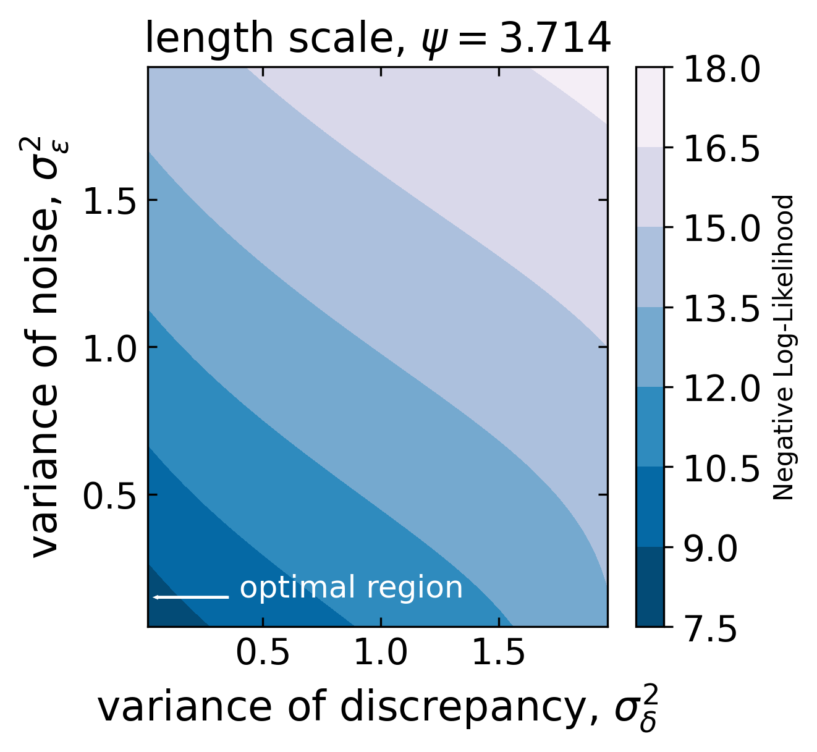
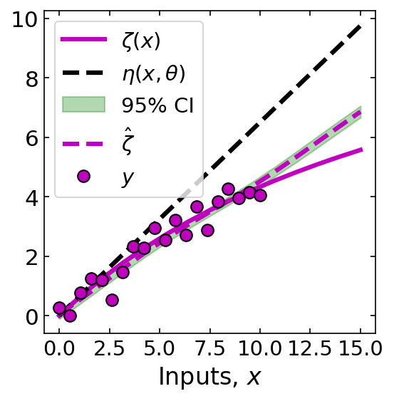

Slide 5
References

