Slide 1
Gaussian Process Semi-Parametric Regression w/ Misspecified Models
Kyla Jones
kjones29@nd.edu
Nonlinear & Stochastic Optimization: Final Presentation
May 8, 2023

Slide 2
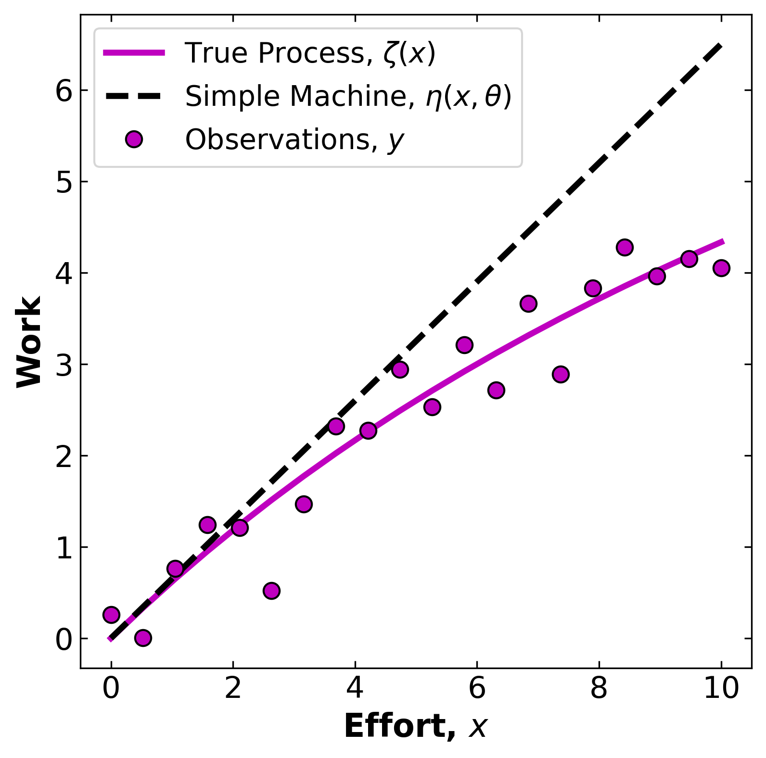
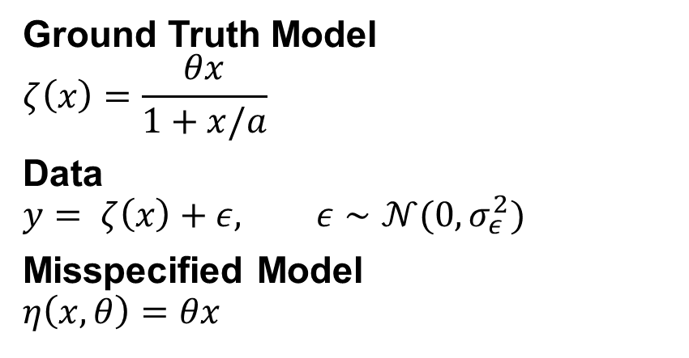
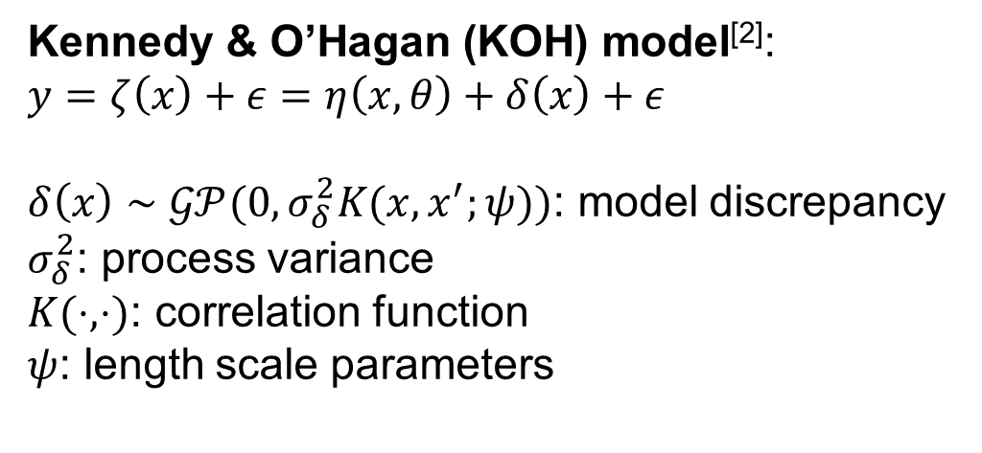
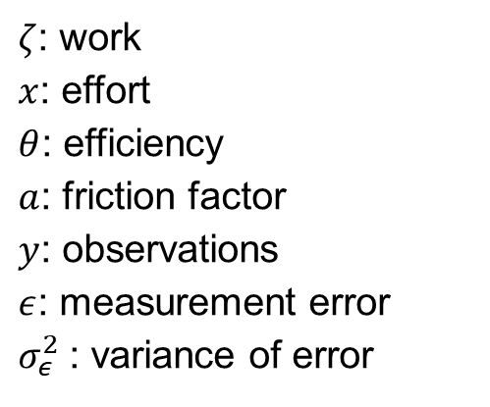
Motivating Example – The Simple Machine^{[1]}
Ground Truth Model
$$ζ\left(x\right)=\frac{θx}{1+x/a}$$
Data
$$y= ζ\left(x\right)+ε, ε∼𝒩(0,σ_{ε}^{2})$$
Misspecified Model
$$η\left(x,θ\right)=θx$$
How to learn model-form uncertainty ?
$ζ$: work
$x$: effort
$θ$: efficiency
$a$: friction factor
$y$: observations
$ε$: measurement error
$σ_{ε}^{2}$: variance of error
Kennedy & O’Hagan (KOH) model^{[2]}:
$$y=ζ\left(x\right)+ε=η\left(x,θ\right)+δ\left(x\right)+ε$$
$δ\left(x\right)∼𝒢𝒫(0,σ_{δ}^{2}K(x,x^{′};ψ))$: model discrepancy
$σ_{δ}^{2}$: process variance
$K(⋅,⋅)$: correlation function
$ψ$: length scale parameters
Objective: Find ($θ,σ_{ε}^{2},σ_{δ}^{2},ψ)$ that best reproduce $y$.
[1] Kennedy, M.C. & O’Hagan, A. (2001). JRSSB 63(3):425–464. [2] Brynjarsdóttir, J. & O’Hagan, A. (2014). Inverse Probl. 30(11): 114007.

Slide 3
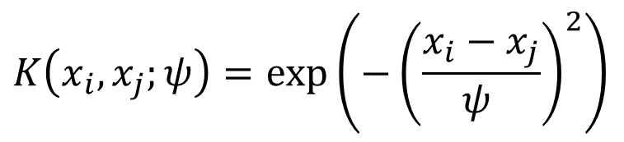
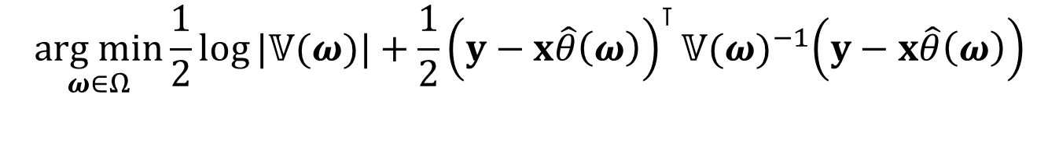
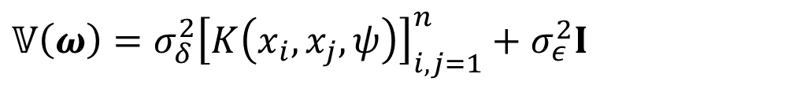



Gaussian Process Semi-Parametric Regression w/ Correlated Errors ^{[3]}
Parameter estimation as nested optimization:
$$\underset{ω∈Ω}{arg min}{\frac{1}{2}\log{|𝕍(ω)|}}+\frac{1}{2}{\left(y−x\hat{θ}\left(ω\right)\right)}^{⊺}𝕍{(ω)}^{−1}\left(y−x\hat{θ}\left(ω\right)\right)$$
negative log-likelihood
$$\text{s}\text{.}\text{t}\text{. }\hat{θ}\left(ω\right)={\left(x^{⊺}𝕍{\left(ω\right)}^{−1}x\right)}^{−1}x^{⊺}𝕍\left(ω\right)y$$
generalized least squares estimator
$$𝕍\left(ω\right)=σ_{δ}^{2}{\left[K\left(x_{i},x_{j},ψ\right)\right]}_{i,j=1}^{n}+σ_{ε}^{2}I$$
plug-in variance
$$K\left(x_{i},x_{j};ψ\right)=\exp\left(−{\left(\frac{x_{i}−x_{j}}{ψ }\right)}^{2}\right)$$
correlation function
$$x∈ℝ^{n},y∈ℝ^{n}$$
data (given)
$$ω=\left[σ_{ε}^{2},σ_{δ}^{2},ψ\right]∈Ω⊆ℝ_{+}^{3}$$
nuisance parameters (decision variables)
Problem size: 3 decision variables, 3 supporting equations, 44 data variables, 0 constraints
[3] He, H. & Severini, T.A. (2016). CSDA 103(3):316–329.

Slide 4
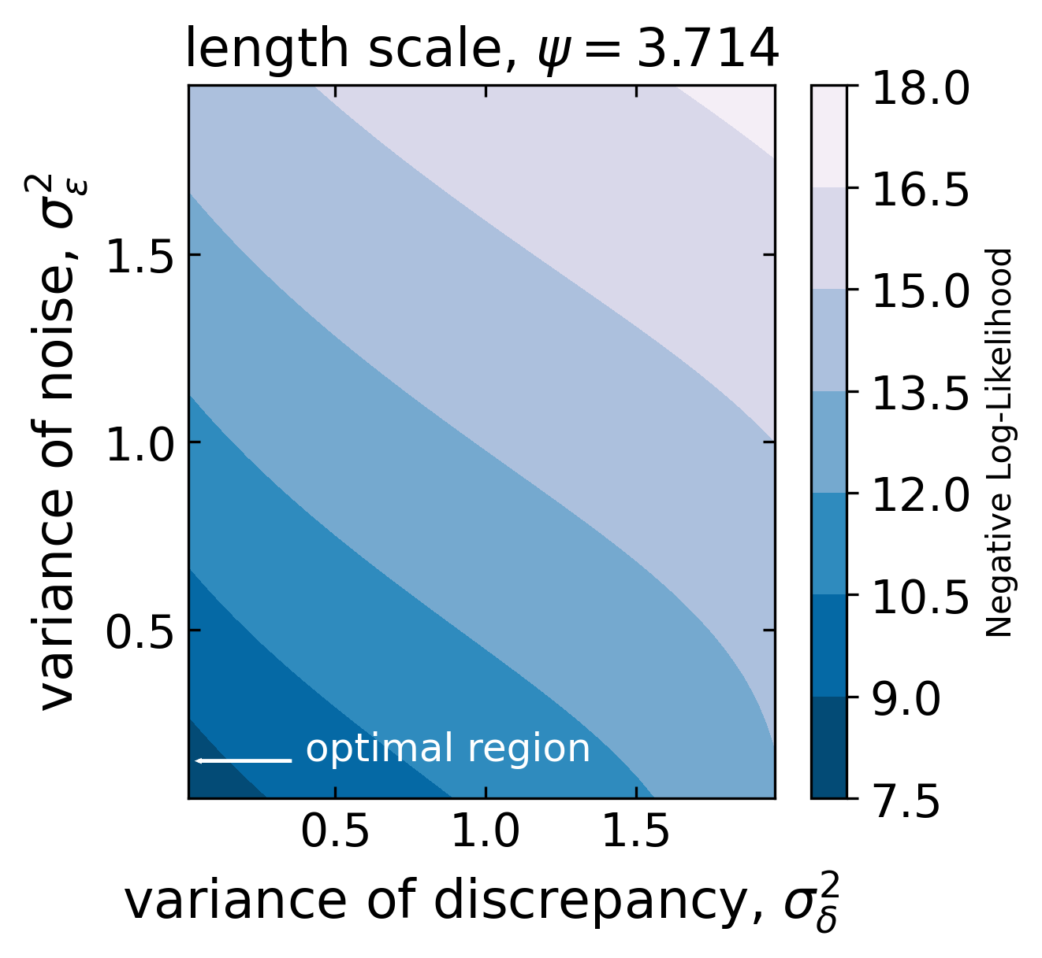
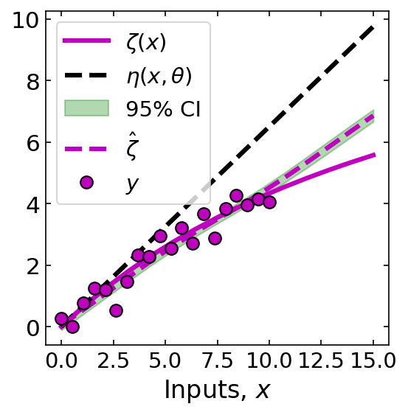
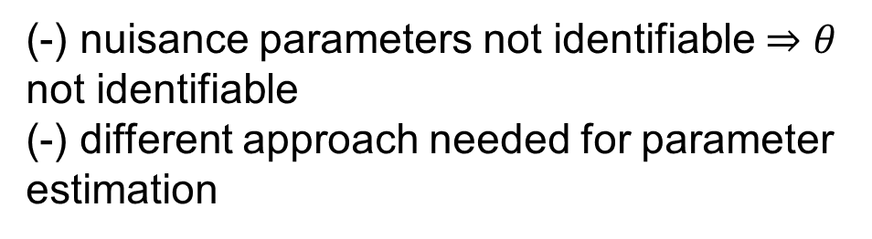
Results
KOH model:
(+) outperforms misspecified model
(-) is model better at interpolation than prediction
(-) nuisance parameters not identifiable $⇒θ$ not identifiable
(-) different approach needed for parameter estimation

Slide 5
Thank you for your attention! References:
[1] Kennedy, Marc C. & O’Hagan, Anthony. (2001). Bayesian calibration of computer models. Journal of the Royal Statistical Society Series B: Statistical Methodology 63(3):425–464.
[2] Brynjarsdóttir, Jenný & O’Hagan, Anthony. (2014). Learning about model parameters: the importance of model discrepancy. Inverse Problems 30(11): 114007.
[3] He, Heping & Severini, Thomas A. (2016). A flexible approach to inference in semi-parametric regression models with correlated errors using Gaussian processes. Computational Statistics & Data Analysis 103(3):316–329.

