Slide 1
COMP 4901K Project Presentation
Team 12
Lam Kwun Yuk (20512073)
Sha Yu Hin (20516835)

Slide 2
Part 1: Data Observations

Slide 3
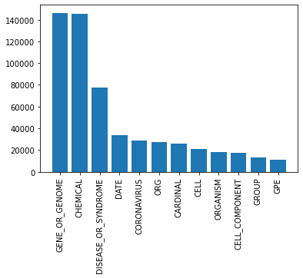
Occurrence of tags
Dominated by ‘O’ (null type), 69.9%
Occurrence of 12 most frequent tags
besides ‘O’ and ‘_w_pad_’
Exponential decrease.

Slide 4
Vocabulary size
Most excerpts in English, a few in other language like French
82275 words, 67255 if lower case only
38275 (56.9%) with more than one tag
Word with most tag: ‘And’
29 distinct tags, including ‘O’
When comparing with stopwords:
80 stopwords (~45%) are multi-tagged.
20 have more than 7 tags or more.

Slide 5
Tagging Examples
Unconventional tagging:
Word: “Korea”
Tags: “ORG”, “CELL”, “CHEMICAL”, “GENE_OR_GENOME”, …
Multiple tags within same document:
Example: val_dict[2]
“… and perhaps it is most important for those with septic shock. Septic shock is defined as a subset of sepsis in which particularly profound circulatory”
GENE_OR_GENOME
DISEASE_OR_SYNDROME

Slide 6
Preprecessing choices
Stemmed using Porter stemmer
Further reduce vocab size to 55469
Stopwords NOT removed
They carry information for multiple tags

Slide 7
Part 2: Model Selection

Slide 8
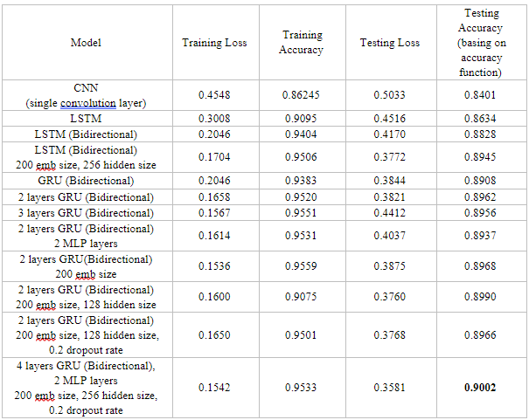
Model Use
CNN and RNN (LSTM and GRU)
Observations:
RNN gives a better result
More complicated model gives a better result

Slide 9
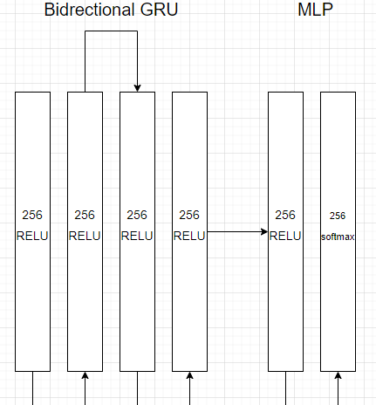
Best Model
Achieve 90.02% validation accuracy:
- 4 bidirectional GRU layers follow by 2 MLP layers with 256 hidden size
- 0.2 Dropout rate
- Activation function : Relu
- Optimizer: Adam
- Loss Model: Cross Entropy

