Slide 1
The Effect of Noise on Edge Detection in Digital Images
Kyla Bouldin
Washington-Lee High School
Arlington, Virginia
Notes:
Hello my name is Kyla Bouldin, I am a sophomore at Washington-Lee High School. My project was the effect of noise on edge detection in digital images.

Slide 2
Computer Vision
Shapes are determined by edges
Computer vision relies on an algorithm
Edge detection simulates vision
Therefore, edge detection is a foundation of computer vision
Notes:
The human mind is capable of identifying shapes based on observations we make with our eyes. We can clearly see the edges of shapes and from that are able to understand the structure of complex images. Computers, however, have to be programmed to be able to “see” the way a human can. Computers cannot “see”, so they rely on algorithms which give them data to analyze and make predictions about images. A shape is determined by its edges, so edge detection is one of the fundamental pieces of computer vision.

Slide 3
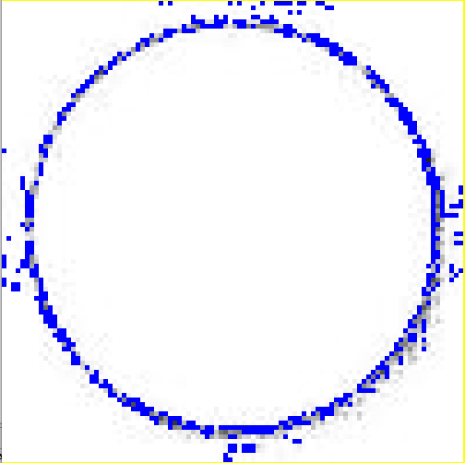
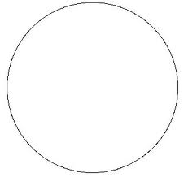
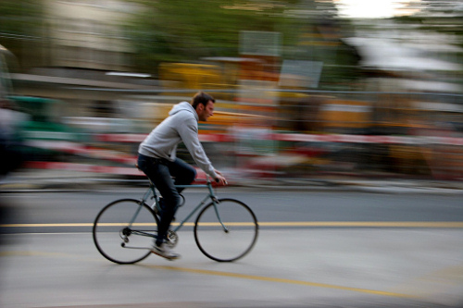
Edge Detection with Noise
Ideal Image
Noise
motion blur
The effect of noise on edge detection is important
because all real images contain noise
Notes:
The Image on the left displays an ideal image. However, all real images have noise. This noise may be due to things such as camera defects, shutter speed, or motion blur. The effect of noise on edge detection is important because all real images contain noise, as illustrated in the two images on the right. The noise in the image makes edge detection more difficult. In this project, noise was added to ideal images in a controlled way to mimic noise in real cases.

Slide 4
Edge Detection Math
∆y
∆x
Line, slope = (constant)
Curve, derivative = (continuously changing)
dy
dx
Image
Brightness
Brightness Derivative
Edges
Notes:
As everyone knows the slope of a line is found by the change of y divided by the change of x. The slope of a straight line is constant.
However, most image do not contain perfectly straight lines. Since the edges in an image are more jagged, the slope is found using a derivative. Unlike a slope of a line, which is constant, the derivative of a curve is continuously changing.
For example, in the image of the blue circle on a white background has a change in brightness from left to right. We can easily see the edges of the blue circle, but a computer uses the derivative of the brightness in order to find the image’s edges.
The brightness of color goes up at the edge of the circle from the color change It will then remain constant across the circle, and then return back down at the other edge of the circle.
The brightness derivative, however, first goes up from the color change between white and blue. Once the blue color is constant, the derivative goes back to 0. Once the blue changes to white, the derivative becomes negative.
[SPACE BAR]
These peaks in the derivative locate edges.

Slide 5
Edge Detection with Noise
No
Noise
Signal
Noise
Moderate Noise
Large
Noise
At some noise level, edge detection will fail
Notes:
The first line shows the derivative of the brightness with no noise added. In this line the peaks represent the signal which located the images edges. The next two lines show the original signal with increasing amounts of noise added.
When a moderate amount of noise is added to the image, the derivative changes, showing many new smaller peaks which are not detected as image edges. In this case, the true edges are still detectable because the noise level is low.
As more noise is added, it becomes difficult to tell the difference between an edge and a non edge. The new peaks made from the noise are detected as edges, because the noise peaks are as big as the signal peaks.
At some noise level, edge detection will fail by creating false edges.

Slide 6
Hypothesis
If the amount of noise increases, the effectiveness of the algorithm will decrease
The false signal from the noise is as large as the true signal from the edges.
Effectiveness =
True Edges Detected
False Edges Detected
True Edges = Edges in control image with no noise
False Edges = Total edges – edges in control image
Notes:
The hypothesis states that if the amount of noise increases, the effectiveness of the algorithm will decrease. The effectiveness will decrease because the false signal from the noise is as large as the true signal from the edges.
The effectiveness is found by calculating the signal to noise ratio. This ratio is the number of true edges detected divided by the false edges detected.
The number of true edges is found from the image with no noise. The number of false edges is found from the image with noise. The number of false edges is the total edge number minus the number of true edges.

Slide 7
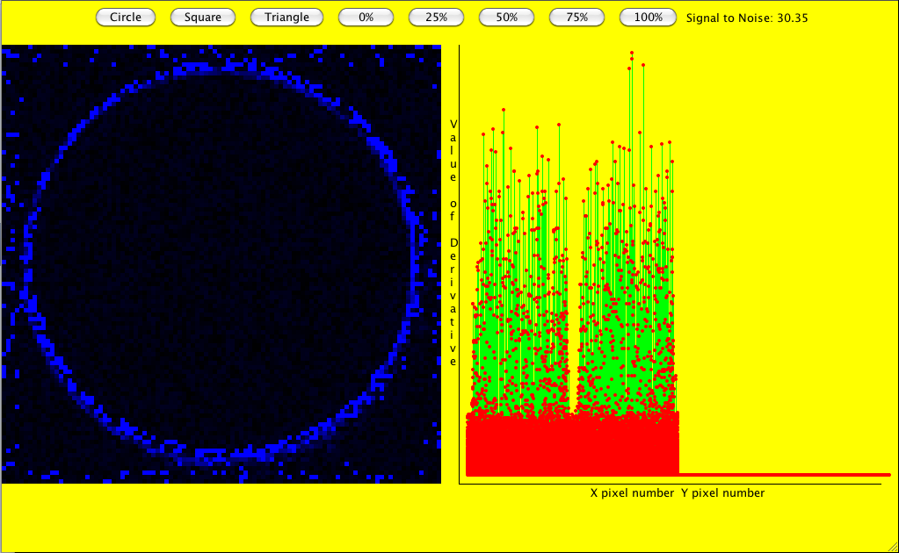
Procedure
Derivative
Values
X derivative
Signal
Y derivative
Noise
Notes:
To find the derivative, a program was written in Java. After an image and a percent noise are chosen, the program scans the image along its X axis and the Y axis, to find the derivatives
For each row and column of pixels, the slope between each two consecutive pixels were used to calculate the derivative. Once the row or column is complete, the maximum and minimum slope values are found. These maximum and minimum values represent the high and low peaks of the derivative. When a peak is found, the pixel at that spot changes color.
On the right, a graph is made to show the derivative values. The green portion represent the original edge points. The red points on the bottom represent the noise. As the noise level increases, the block of red points also increases making the signal to noise ratio lower and noticeable in the graph.

Slide 8
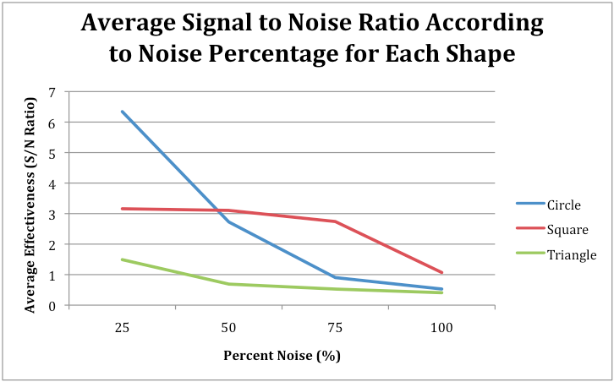
Results
Notes:
For the full procedure three shapes were used, a circle, a square, and a triangle. For each shape four values of noise were added, 25%, 50%, 75%, and 100%. This graph represents the average signal to noise ratio according to noise percentage for each shape. Along the horizontal axis, the percent noise values are shown. Along the vertical axis, the average Effectiveness of the algorithm is shown. As you can see, the effectiveness declines as noise is added regardless of shape.
The triangle started out with the lowest effectiveness, and also ended with the lowest effectiveness.
The square had an intermediate value of effectiveness, which persisted even as noise was added although it did decline slightly.
The circle started out with the highest effectiveness, but decreased steadily as nose was added.

Slide 9
Conclusions
The research data supported the hypothesis that as noise increased, the effectiveness of the algorithm decreased.
The increase in noise percentage reduced the distinction between edge and non-edge pixels.
Notes:
The research data supported the hypothesis that as noise increased, the effectiveness of the algorithm decreased. The increase in noise reduced the distinction between edge and non-edge pixels. Adding random nose obscured true edges and creates false ones.

Slide 10
Limitations
Limited number of shapes
Single shape images
Simple controlled experiment may not have captured complexity of real images
Notes:
The limitations in the experiment include the use of only three simple images and single shape images. More images could have been used to test the effectiveness of the algorithm of different shapes. All of the images used in this experiment were single shaped images making the edge detection easier.
This experiment focused on simple cases and may not have captured the complexity of real images such as the motion blur image shown

Slide 11
Further Research
Noise smoothing: averages pixels by using surrounding pixels. This cancels out random noise
2 dimensional derivative, not X and Y separately
Shape detection - using edges to detect shapes within images
Notes:
For further research a few things could be done to improve the project. Noise smoothing averages surrounding pixels, which cancel out random noise. Using a 2 dimensional derivative instead of X and Y separately will also find the edges in the diagonal direction. Shape detection would be the next step which uses the edge patterns to detect shapes within images.

Slide 12
Thank You
Notes:
THANK YOU! I’ll be happy to take any questions?

Slide 13
Variables and Constants
IV: noise level on the image
DV: effectiveness of the algorithm
Control: number of edges detect in the image with no noise
Constants: signal for each shape, algorithm, shape

Slide 14
Results
 | 25% | 50% | 75% | 100%
Circle | 6.3 | 2.7 | 0.9 | 0.5
Square | 3.2 | 3.1 | 2.7 | 1.1
Triangle | 1.5 | 0.7 | 0.5 | 0.4
Noise
Shape

Slide 15
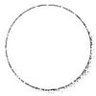


Images Used

Slide 16
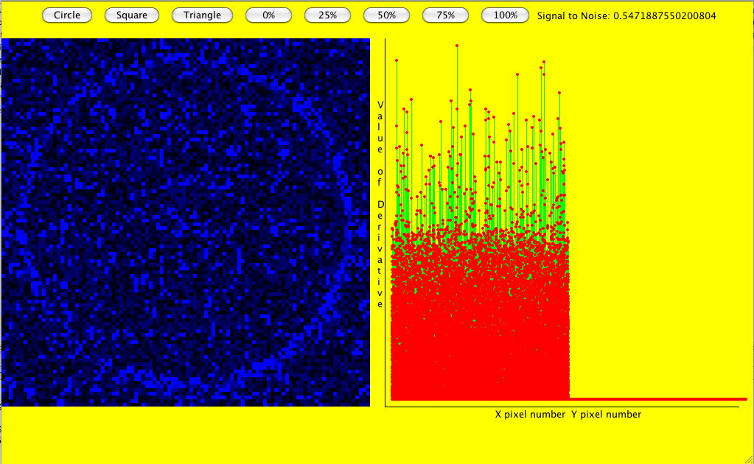
Procedure: High Noise
Derivative
Values
X derivative
Signal
Y derivative
Noise

