Slide 1
EC327 Final Project
Arianna Rodriguez & Kyla Wilson
arirod@bu.edu, kylaw@bu.edu

Slide 2
Functionality
This project has the requirement of portability, which is why we chose to split it up into a few different .cpp files and .hpp files
Assignment.cpp & Assignment.h → These files hold the assignment class
Date.cpp & Date.hpp → These files hold the Date class
OrganizeLife.cpp & OrganizeLife.hpp → These files hold the remainder of the functions used in main.cpp
Main.cpp → the main function of the program

Slide 3
testing
Instructions provided to user via cout statements in the code
Very user-friendly and intuitive design, allowing for seamless application of test cases while running the program
Test Case Examples on following page

Slide 4
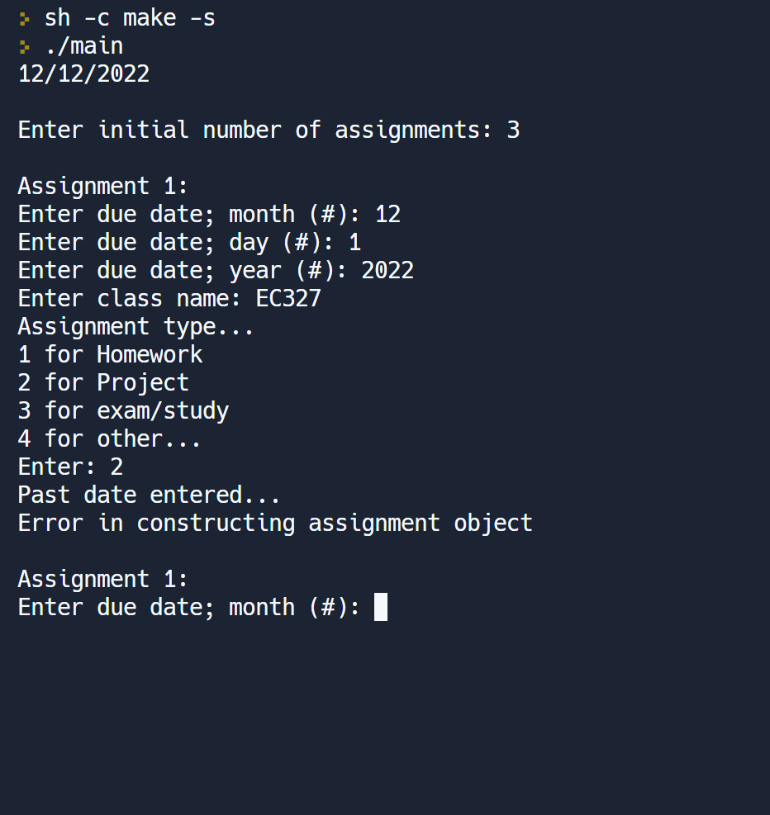
Test case I
This text case displays what would occur if the due date for an assignment were to be set before the present day
The error “Past date entered…
Error in constructing assignment object” would occur

Slide 5
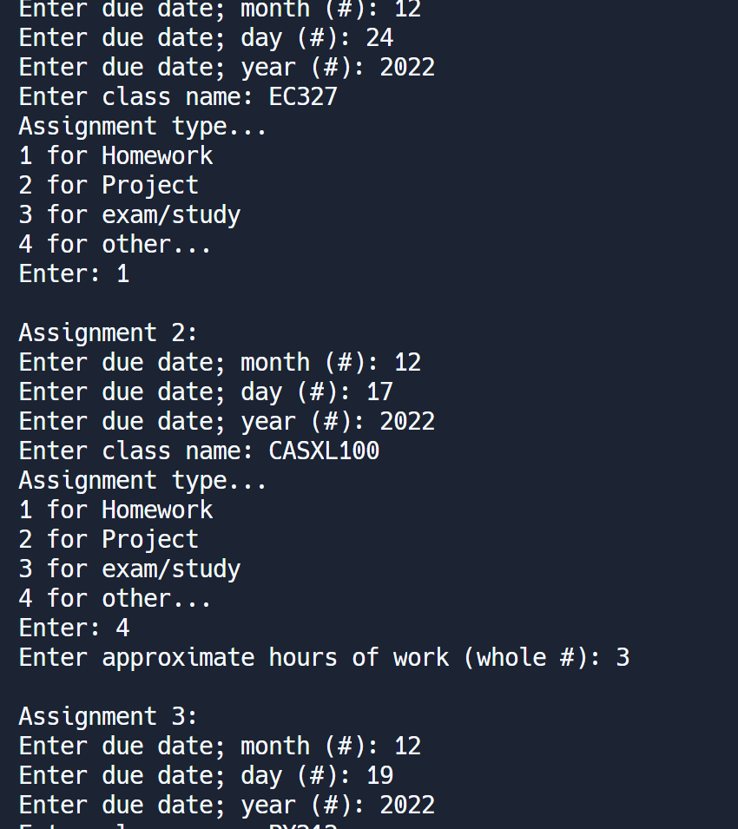
Test case II
This test case shows what would occur in the event that the program ran without errors
The user would input the number of assignment and would be prompted to enter a series of information about each assignment

Slide 6
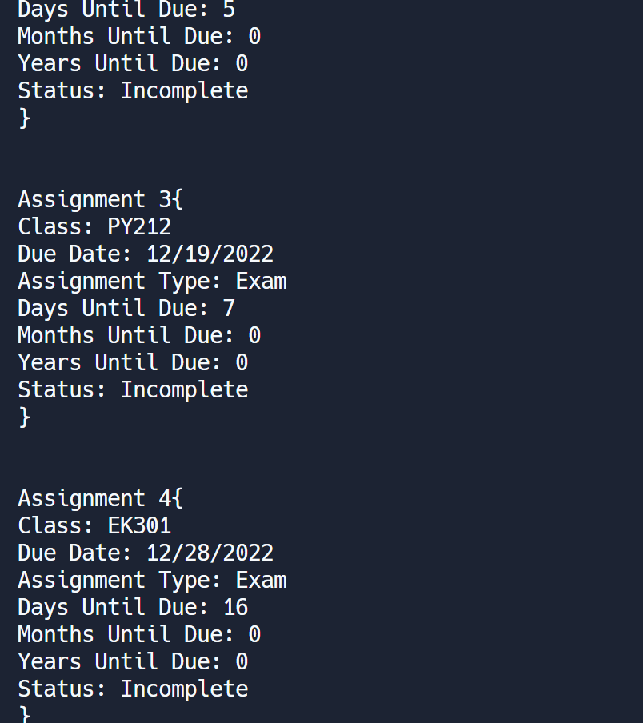
Test Case II Continue
As the program continues to run, the days until the assignment is due would be calculated and displayed.

Slide 7
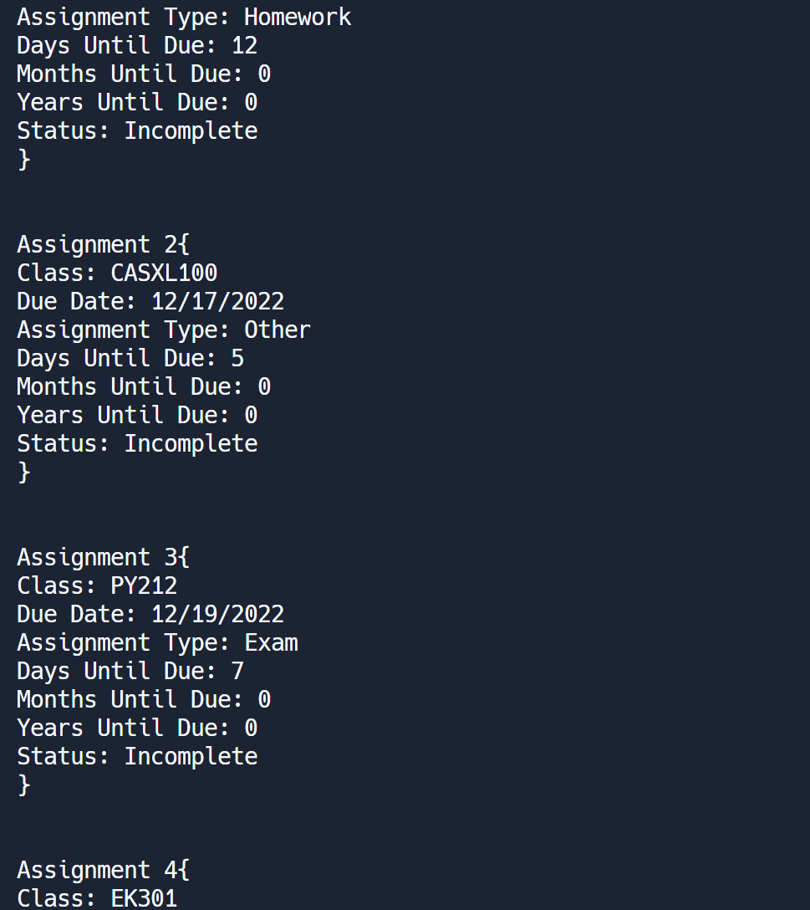
Test Case ii continued
The program will continue running until the days until due has been calculated and displayed for all declared assignments

Slide 8
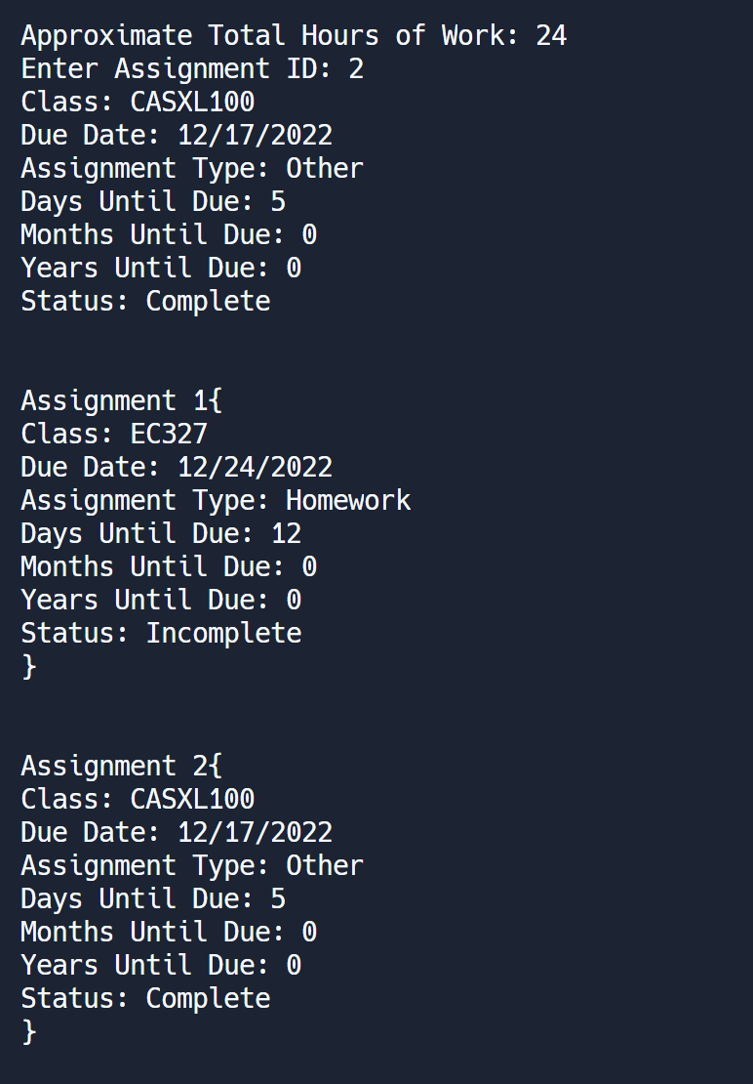
Test case ii continued
The user can prompt the program to mark assignments as completed and the status will be displayed below each assignment number

Slide 9
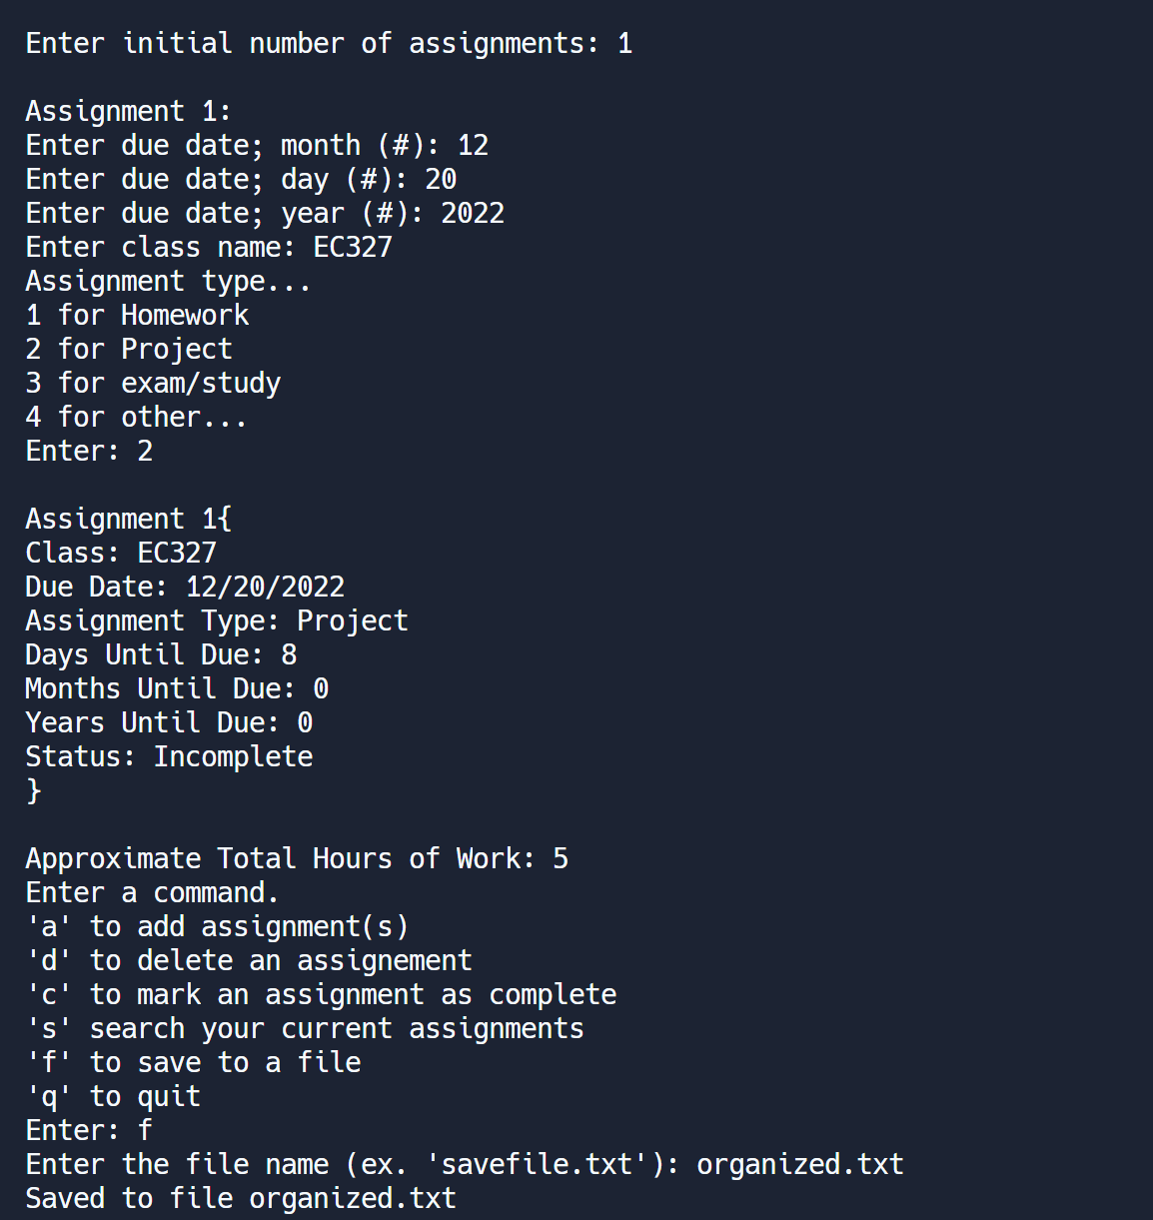
Test case III
This test case displays the process of saving the assignment list to a file

Slide 10
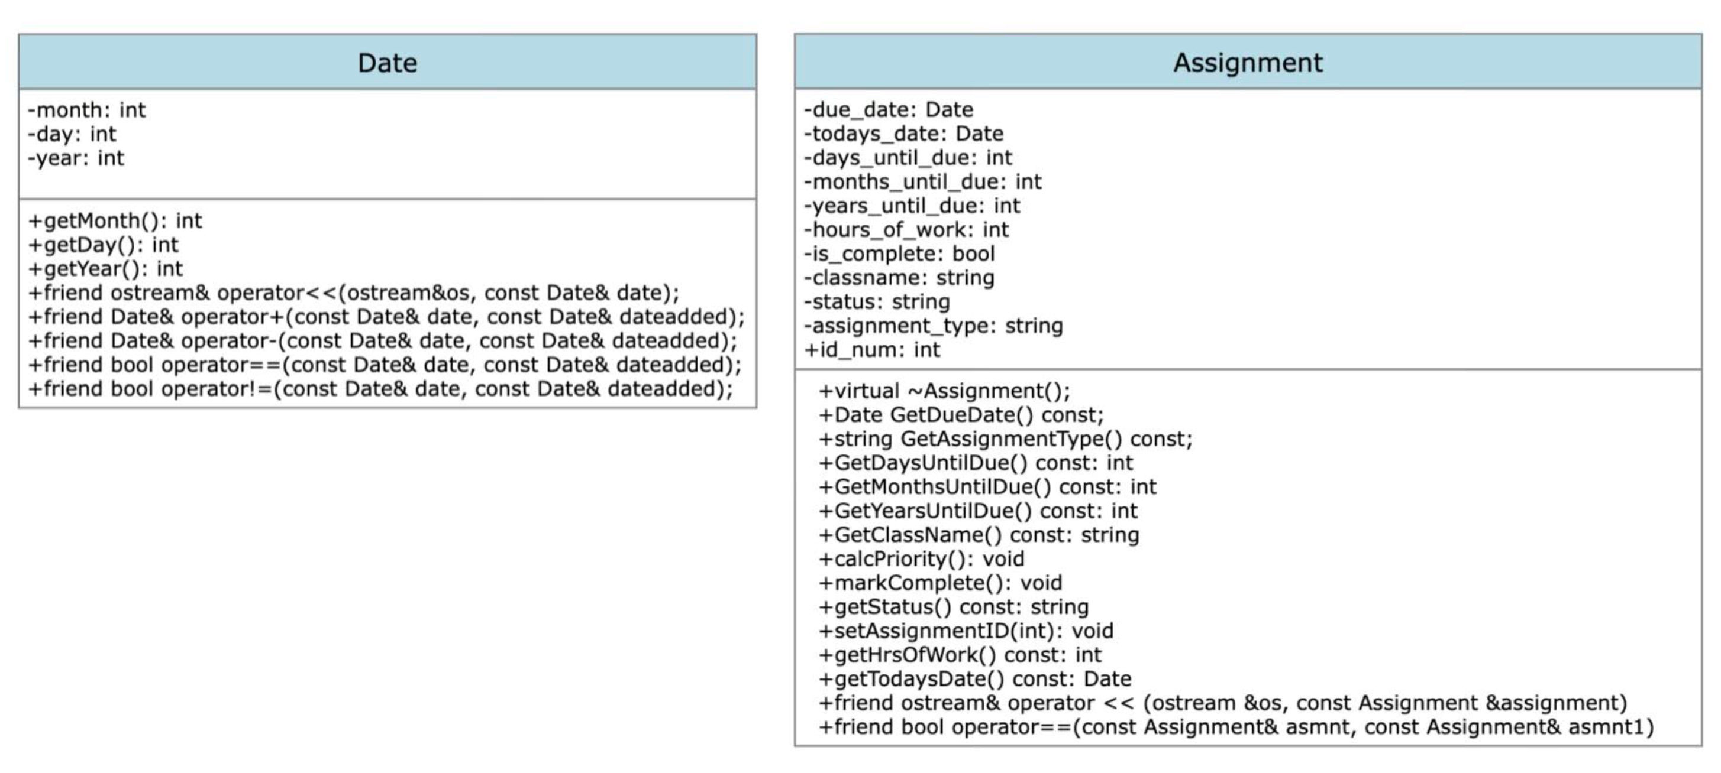
UML Diagram
UML diagram for both the date and assignment class

Slide 11
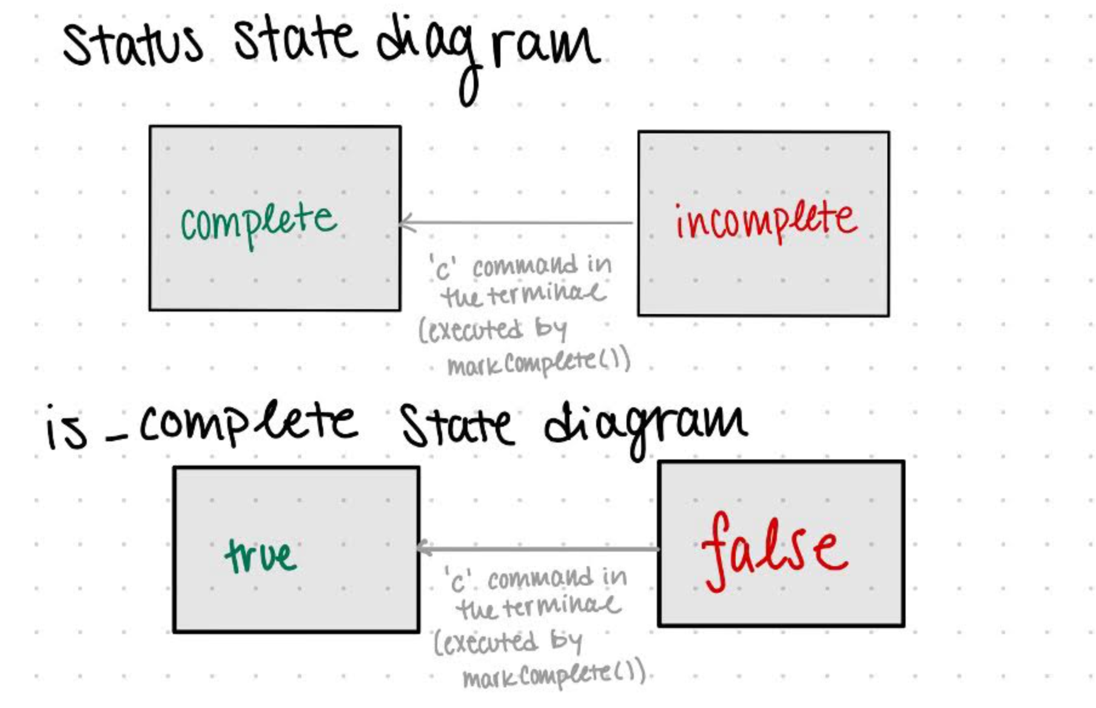
State Diagram

Slide 12
Software architecture
Used Pass By Reference whenever possible/it made sense to in order to use the smallest amount of storage possible
Attempted to keep the variables in main.cpp at a minimum and defer their responsibility to local variables in functions outside of main. This allowed for those variables to pop off the stack and free up memory after they were no longer actively being used.
Attempted to use switch statements more frequently than if and if-else statements
However, this was not completely avoidable → in order to maintain system logic and clarity, sometimes it was best to use a series of if-else statements when operating within a switch statement

Slide 13
Performance
The performance of our program is satisfactory
Due to the size of our group, we did not perform any performance analysis beyond using our own judgement

