Slide 1

The Para-Presidency
Jennifer Nou
Gedid Lecture
University of Chicago Law School
March 31, 2026

Slide 2
Agenda
Concept
  para-presidency: a domain of ex ante temporary governance that operates alongside, beyond and sometimes in tension with the institutional presidency
Types and examples
Implications
Reforms

Slide 3


Slide 4


Slide 5
Para-presidency characteristics
Created by the President, usually through executive order
Ex ante temporary
Plausibly quasi-private actors who maintain affiliations or positions in business, interest groups or academia

Slide 6
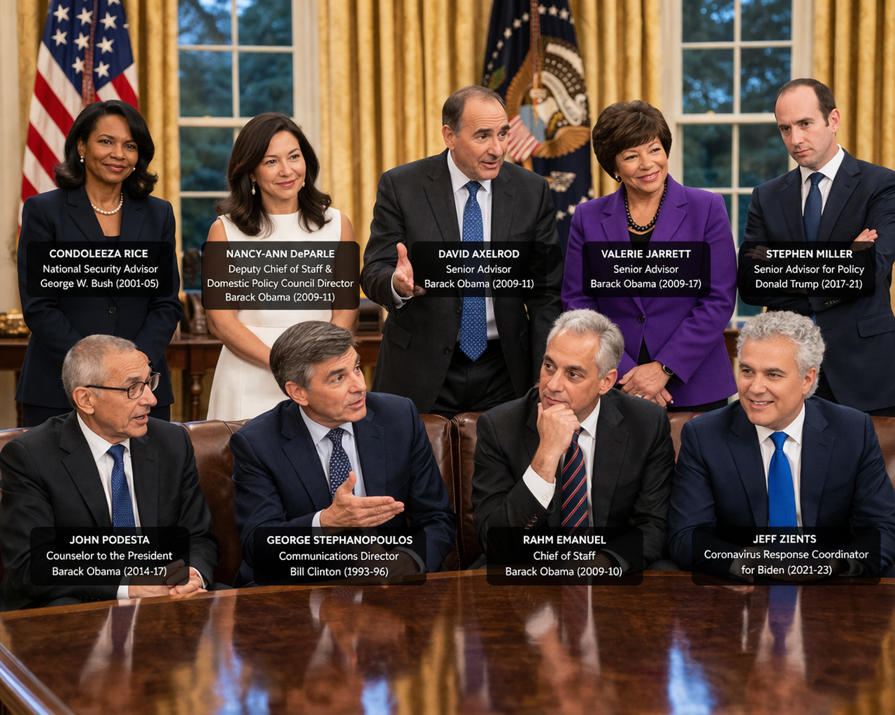
Generated by AI

Slide 7

Generated by AI

Slide 8
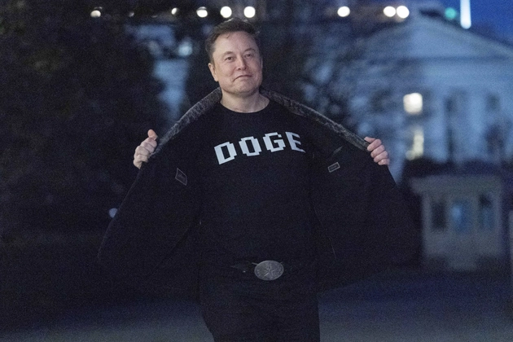

Slide 9
Types and Examples
Special Government Employees
Intergovernmental Personnel Act assignees (“IPAs”)
Detailees

Slide 10
Special Government Employees
18 U.S.C. § 202(a):
An “officer or employee of the executive or legislative branch… who is retained, designated, appointed, or employed to perform… temporary duties… with or without compensation, for not to exceed 130 days during any period of 365 consecutive days”

Slide 11


Beyond “advisors”?
Elon Musk and Katie Miller (DOGE)
Accessed payment systems to control expenditures and benefits
Terminated federal contracts
Dismantled agencies, e.g., CFPB and USAID
Steve Witkoff (Special Envoy to the Middle East)
Engaged in peace talks between Ukraine and Russia
Engaged in talks with Iranian negotiators
Brokering real estate deals between U.S. and Pakistan

Slide 12

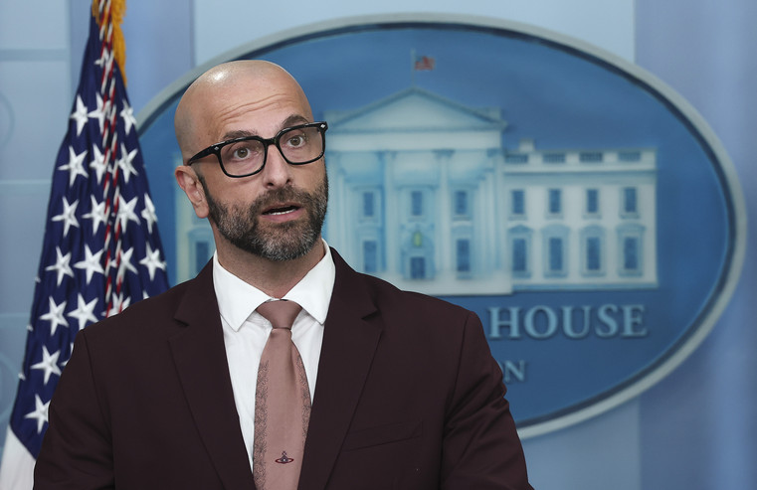

Detailees
3 U.S.C. § 112: “The head of any department, agency, or independent establishment of the executive branch of the Government may detail . . . employees . . . to the White House Office”

Slide 13
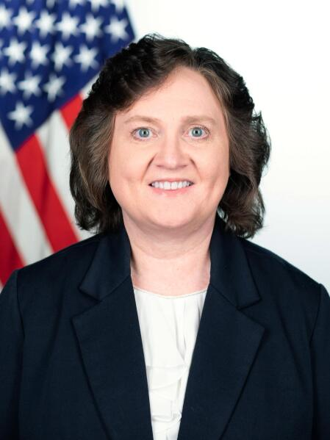
“IPAs” (Intergovenmental Personnel Act)
5 U.S.C. § 3372: “On request from or with the concurrence of a State or local government, and with the consent of the employee concerned, the head of a Federal agency may arrange for the assignment of [“an employee of an institution of higher education” or “other organization”] to his agency”

Slide 14
Implications
Corruption and conflicts-of-interest
Illegality
  Constitutional: Appointments Clause?
  Statutory: Ultra vires claims, Administrative Procedure Act, Freedom of Information Act, Privacy Act

Slide 15
Reforms
Transparency
Conflicts-of-interest reforms
Courts

Slide 16


