Slide 1


Slide 2


Slide 3
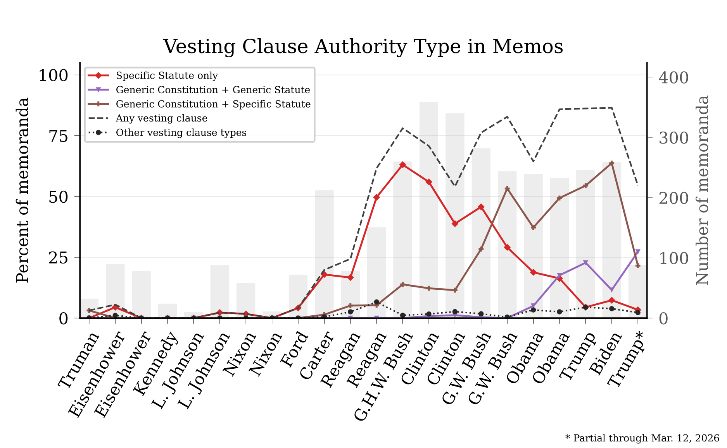

Slide 4


Slide 5
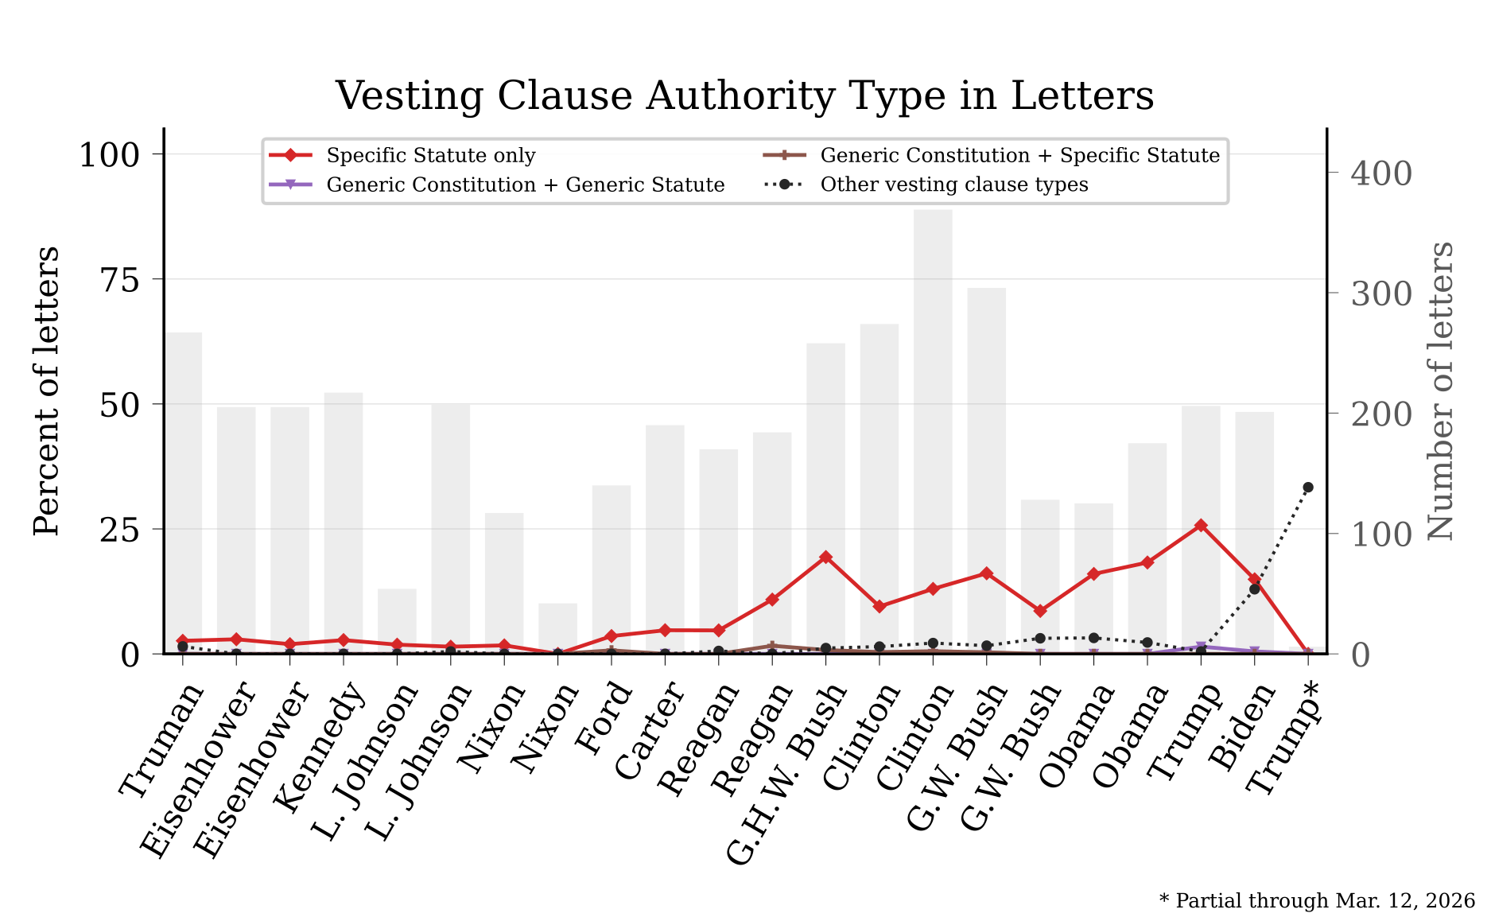

Slide 6
Specific authority, vague authority—and legal effect
EXECUTIVE ORDER
EXECUTIVE ORDER
Executive Order 13224
Executive Order 13505
September 23, 2001
March 9, 2009
Authority clause (verbatim)
Authority clause (verbatim)
By the authority vested in me as President by the Constitution and the laws of the United States of America, including the International Emergency Economic Powers Act (50 U.S.C. 1701 et seq.)(IEEPA), the National Emergencies Act (50 U.S.C. 1601 et seq.), section 5 of the United Nations Participation Act of 1945, as amended (22 U.S.C. 287c) (UNPA), and section 301 of title 3, United States Code, …
By the authority vested in me as President by the Constitution and the laws of the United States of America, it is hereby ordered as follows:
Operative text (verbatim)
Operative text (verbatim)
Section 1. Except to the extent required by section 203(b) of IEEPA (50 U.S.C. 1702(b)), or provided in regulations, orders, directives, or licenses that may be issued pursuant to this order, and notwithstanding any contract entered into or any license or permit granted prior to the effective date of this order, all property and interests in property of the following persons that are in the United States or that hereafter come within the United States, or that hereafter come within the possession or control of United States persons are blocked:
Sec. 5. Revocations. (a) The Presidential statement of August 9, 2001, limiting Federal funding for research involving human embryonic stem cells, shall have no further effect as a statement of governmental policy. (b) Executive Order 13435 of June 20, 2007, which supplements the August 9, 2001, statement on human embryonic stem cell research, is revoked.
Click 1: authority • Click 2: effect
Sources: EO 13224 (Sept. 23, 2001); EO 13505 (Mar. 9, 2009). Verbatim excerpts; ellipsis marks cropped continuation.

Slide 7
Consequential action under boilerplate authority
A substantive proclamation with no named constitutional or statutory provision
PROCLAMATION
Proclamation 9852 — Recognizing the Golan Heights as Part of the State of Israel
March 25, 2019
Now, Therefore, I, Donald J. Trump, President of the United States of America, by virtue of the authority vested in me by the Constitution and the laws of the United States, do hereby proclaim that, the United States recognizes that the Golan Heights are part of the State of Israel.
Source: Proclamation 9852 (Mar. 25, 2019). Full operative paragraph reproduced verbatim.

Slide 8
Both orders amend the first sentence of Executive Order
GENERIC
SPECIFIC
Executive Order 13087
Executive Order 13672
May 28, 1998
July 21, 2014
Authority clause (verbatim)
Authority clause (verbatim)
By the authority vested in me as President by the Constitution and the laws of the United States, and in order to provide for a uniform policy for the Federal Government to prohibit discrimination based on sexual orientation, it is hereby ordered that Executive Order 11478, as amended, is further amended as follows:
By the authority vested in me as President by the Constitution and the laws of the United States of America, including 40 U.S.C. 121, and in order to provide for a uniform policy for the Federal Government to prohibit discrimination and take further steps to promote economy and efficiency in Federal Government procurement by prohibiting discrimination based on sexual orientation and gender identity, it is hereby ordered as follows:
Operative text (verbatim)
Operative text (verbatim)
Section 1. The first sentence of section 1 is amended by substituting “age, or sexual orientation” for “or age”.
Section 1. Amending Executive Order 11478. The first sentence of section 1 of Executive Order 11478 of August 8, 1969, as amended, is revised by substituting “sexual orientation, gender identity” for “sexual orientation”.
Sources: EO 13087 (May 28, 1998); EO 13672 (July 21, 2014). Verbatim excerpts.

Slide 9
Trade policy: generic authority versus statutory detail
GENERIC
SPECIFIC
TPP withdrawal memorandum
Proclamation 10053 — USMCA
January 23, 2017
June 29, 2020
Authority clause (verbatim)
Authority clause (verbatim)
Based on these principles, and by the authority vested in me as President by the Constitution and the laws of the United States of America,
Now, Therefore, I, Donald J. Trump, President of the United States of America, by virtue of the authority vested in me by the Constitution and the laws of the United States of America, including sections 103(c), 105(a), 207, 324, and 611(a) of the USMCA Implementation Act; section 1206(a) of the 1988 Act; … section 604 of the 1974 Act; and section 301 of title 3, United States Code, do hereby proclaim:
Operative text (verbatim)
Operative text (verbatim)
I hereby direct you to withdraw the United States as a signatory to the Trans-Pacific Partnership (TPP), to permanently withdraw the United States from TPP negotiations, and to begin pursuing, wherever possible, bilateral trade negotiations to promote American industry, protect American workers, and raise American wages.
(1) In order to provide generally for the preferential tariff treatment being accorded under the USMCA … the HTS is modified as set forth in Annex I of Publication 5060 of the United States International Trade Commission.
Sources: TPP memorandum (Jan. 23, 2017); Proclamation 10053 (June 29, 2020). Verbatim excerpts; ellipses mark cropped continuation.

Slide 10
Immigration policy: generic authority versus a named statute
GENERIC
SPECIFIC
DACA preservation memorandum
Executive Order 13768
January 20, 2021
January 25, 2017
Authority clause (verbatim)
Authority clause (verbatim)
By the authority vested in me as President by the Constitution and the laws of the United States, it is hereby ordered as follows:
By the authority vested in me as President by the Constitution and the laws of the United States of America, including the Immigration and Nationality Act (INA) (8 U.S.C. 1101 et seq.), and in order to ensure the public safety of the American people in communities across the United States, as well as to ensure that our Nation's immigration laws are faithfully executed, I hereby declare the policy of the executive branch to be, and order, as follows:
Operative text (verbatim)
Operative text (verbatim)
The Secretary of Homeland Security, in consultation with the Attorney General, shall take all actions he deems appropriate, consistent with applicable law, to preserve and fortify DACA.
It is the policy of the executive branch to: (a) Ensure the faithful execution of the immigration laws of the United States, including the INA, against all removable aliens, consistent with Article II, Section 3 of the United States Constitution and with the INA;
Sources: DACA memorandum (Jan. 20, 2021); EO 13768 (Jan. 25, 2017). Verbatim excerpts.

Slide 11


Slide 12
Path dependency: policy text travels forward
High-confidence parent–child relationship • verbatim paragraph (1) from each proclamation
PARENT
CHILD
Proclamation 7996
Proclamation 8034
March 31, 2006
June 30, 2006
(1) In order to provide generally for the preferential tariff treatment being accorded under the Agreement to Honduras and Nicaragua, to provide certain other treatment to originating goods for the purposes of the Agreement, to provide tariff-rate quotas with respect to certain goods, to reflect the removal of Honduras and Nicaragua from the enumeration of designated beneficiary developing countries for purposes of the GSP, to reflect the removal of Honduras and Nicaragua from the enumeration of designated beneficiary countries for purposes of the CBERA and the CBTPA, and to make technical and conforming changes in the general notes to the HTS, the HTS is modified as set forth in Annex I of Publication 3845 of the United States International Trade Commission, entitled Modifications to the Harmonized Tariff Schedule of the United States to Implement the Dominican Republic-Central America-United States Free Trade Agreement With Respect to Honduras and Nicaragua (Publication 3845), which is incorporated by reference into this proclamation.
(1) In order to provide generally for the preferential tariff treatment being accorded under the Agreement to Guatemala, to provide certain other treatment to originating goods for the purposes of the Agreement, to provide tariff-rate quotas with respect to certain goods, to reflect the removal of Guatemala from the enumeration of designated beneficiary developing countries for purposes of the GSP, to reflect the removal of Guatemala from the enumeration of designated beneficiary countries for purposes of the CBERA and the CBTPA, to implement statistical monitoring relating to tariff provisions that the President previously proclaimed to implement the Agreement, and to make technical and conforming changes in the general notes to the HTS, the HTS is modified as set forth in the Annex of Publication 3861 of the United States International Trade Commission, entitled "Modifications to the Harmonized Tariff Schedule of the United States to Implement the Dominican Republic-Central America-United States Free Trade Agreement With Respect to Guatemala" (Publication 3861), which is incorporated by reference into this proclamation.
0.802 normalized 5-word reuse • 0.99 parent-selection confidence
Sources: Proclamation 7996 (Mar. 31, 2006) → Proclamation 8034 (June 30, 2006). Verbatim excerpts; vesting clauses excluded from matching.

Slide 13
Path dependency beyond the high-confidence set
Verbatim ethics-pledge excerpts • substantial reuse, but not a validated parent–child classification
EARLIER
LATER
Executive Order 13490
Executive Order 13989
January 21, 2009
January 20, 2021
Section 1. Ethics Pledge. Every appointee in every executive agency appointed on or after January 20, 2009, shall sign, and upon signing shall be contractually committed to, the following pledge upon becoming an appointee:
"As a condition, and in consideration, of my employment in the United States Government in a position invested with the public trust, I commit myself to the following obligations, which I understand are binding on me and are enforceable under law:
Section 1. Ethics Pledge. Every appointee in every executive agency appointed on or after January 20, 2021, shall sign, and upon signing shall be contractually committed to, the following pledge upon becoming an appointee:
"I recognize that this pledge is part of a broader ethics in government plan designed to restore and maintain public trust in government, and I commit myself to conduct consistent with that plan. I commit to decision-making on the merits and exclusively in the public interest, without regard to private gain or personal benefit. I commit to conduct that upholds the independence of law enforcement and precludes improper interference with investigative or prosecutorial decisions of the Department of Justice.
"Accordingly, as a condition, and in consideration, of my employment in the United States Government in a position invested with the public trust, I commit myself to the following obligations, which I understand are binding on me and are enforceable under law:
656 reused words in the earlier full-corpus alignment measure
Sources: EO 13490 (Jan. 21, 2009) → EO 13989 (Jan. 20, 2021). Verbatim excerpts; score is suggestive, not a validated genealogy.

Slide 14
One commission template, two policy destinations
Outside the automatic-parent set • verbatim institutional clauses
EARLIER
LATER
EO 10005 — Puerto Rico
EO 9981 — Military equality
All executive departments and agencies of the Federal Government are authorized and directed to cooperate with the Commission in its work and to furnish the Commission such information as the Commission may require in the performance of its duties.
July 26, 1948
All executive departments and agencies of the Federal Government are authorized and directed to cooperate with the Committee in its work, and to furnish the Committee such information or the services of such persons as the Committee may require in the performance of its duties.
The Committee shall continue to exist until such time as the President shall terminate its existence by Executive order.
LATER
EO 10013 — Military welfare
The Committee shall … confer and advise with the Secretary of Defense and the Secretaries of the Army, Navy, and Air Force … and make such recommendations to the President and the said Secretaries as it shall deem appropriate.
Sources: EO 9981 → EO 10005 and EO 10013. Verbatim excerpts; ellipses mark cropped continuation.

Slide 15
Suggestive reuse in committee-establishment letters
Outside the automatic-parent set • different policy fields, parallel drafting sequence
EARLIER
LATER
Cabinet Committee on Water Resources
Interdepartmental Committee on Migratory Labor
May 26, 1954
August 26, 1954
To meet the needs to which I have referred above, I am establishing a Cabinet Committee on Water Resources Policy. I am designating you the Chairman of the Cabinet Committee on Water Resources Policy.
The Secretary of Commerce, the Secretary of Health, Education and Welfare and the Director of the Bureau of the Budget will participate on an ad hoc basis.
As you have suggested, I am establishing an Interdepartmental Committee on Migratory Labor … I am designating you as Chairman.
There are other departments and agencies which have major interests in specific areas, and I shall expect you, as Chairman, to keep them informed and to invite their participation as needed.
Sources: Eisenhower letters establishing the Cabinet Committee on Water Resources Policy (May 26, 1954) and the Interdepartmental Committee on Migratory Labor (Aug. 26, 1954). Verbatim excerpts.

