Slide 1

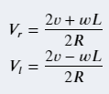
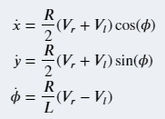
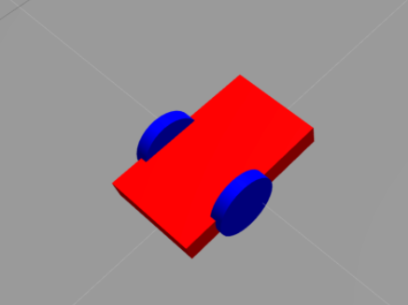
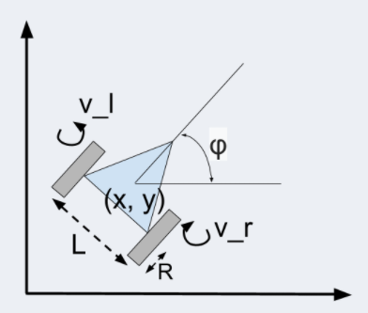

Slide 2
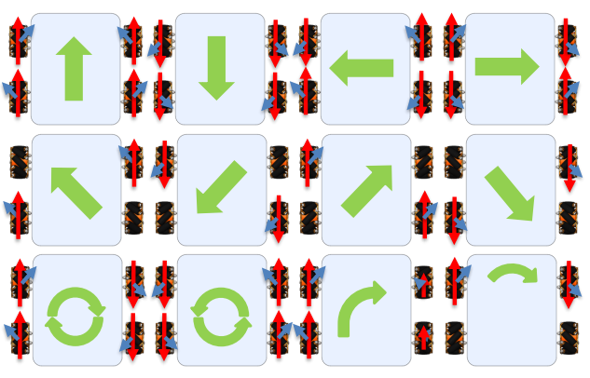
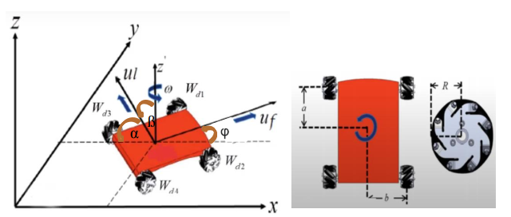

Slide 3
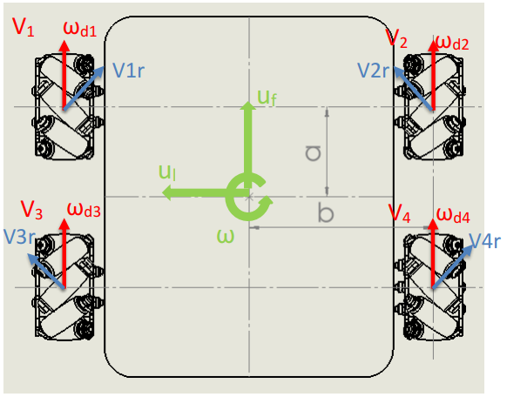
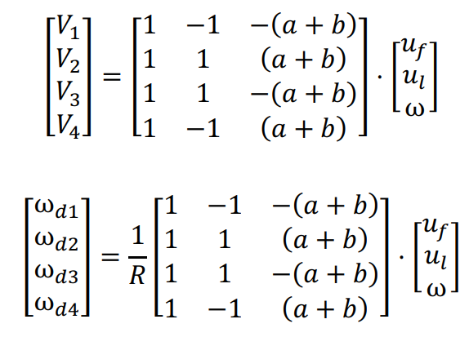
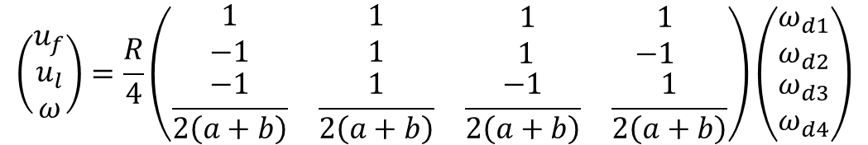
M1-A
M2-B
M3-C
M4-D
$$\left(\begin{matrix}u_{f} \\ u_{l} \\ ω\end{matrix}\right)=\frac{R}{4}\left(\begin{matrix}1 & 1 & \begin{matrix}1 & 1\end{matrix} \\ −1 & 1 & \begin{matrix}1 & −1\end{matrix} \\ \frac{−1}{2\left(a+b\right)} & \frac{1}{2\left(a+b\right)} & \begin{matrix}\frac{−1}{2\left(a+b\right)} & \frac{1}{2\left(a+b\right)}\end{matrix}\end{matrix}\right)\left(\begin{matrix}ω_{d1} \\ ω_{d2} \\ \begin{matrix}ω_{d3} \\ ω_{d4}\end{matrix}\end{matrix}\right)$$

Slide 4

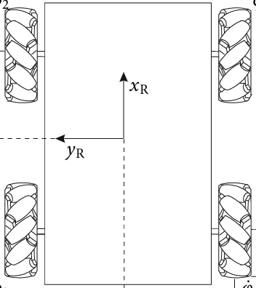
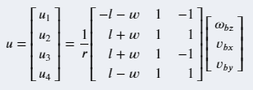
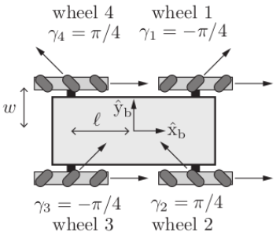
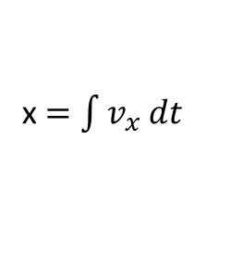
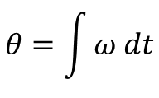
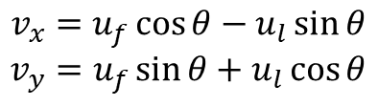
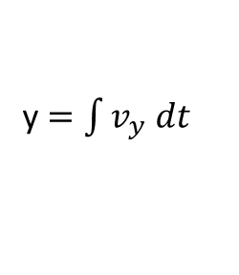
u_{f}
y
$$θ=\int{ω dt}$$
θ
u_{l}
θ
$$v_{x}=u_{f}\cos{θ−u_{l}\sin{θ}}$$
$$v_{y}=u_{f}\sin{θ+u_{l}\cos{θ}}$$
x $=\int{v_{x} dt}$
y $=\int{v_{y} dt}$
x

Slide 5
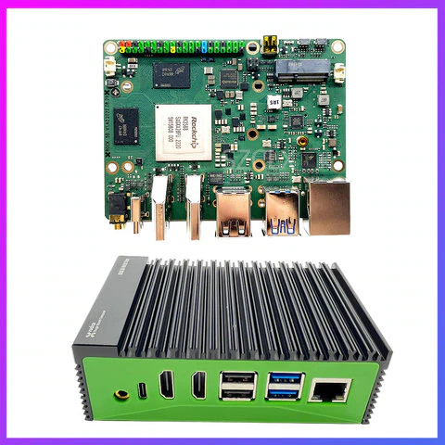

Slide 6
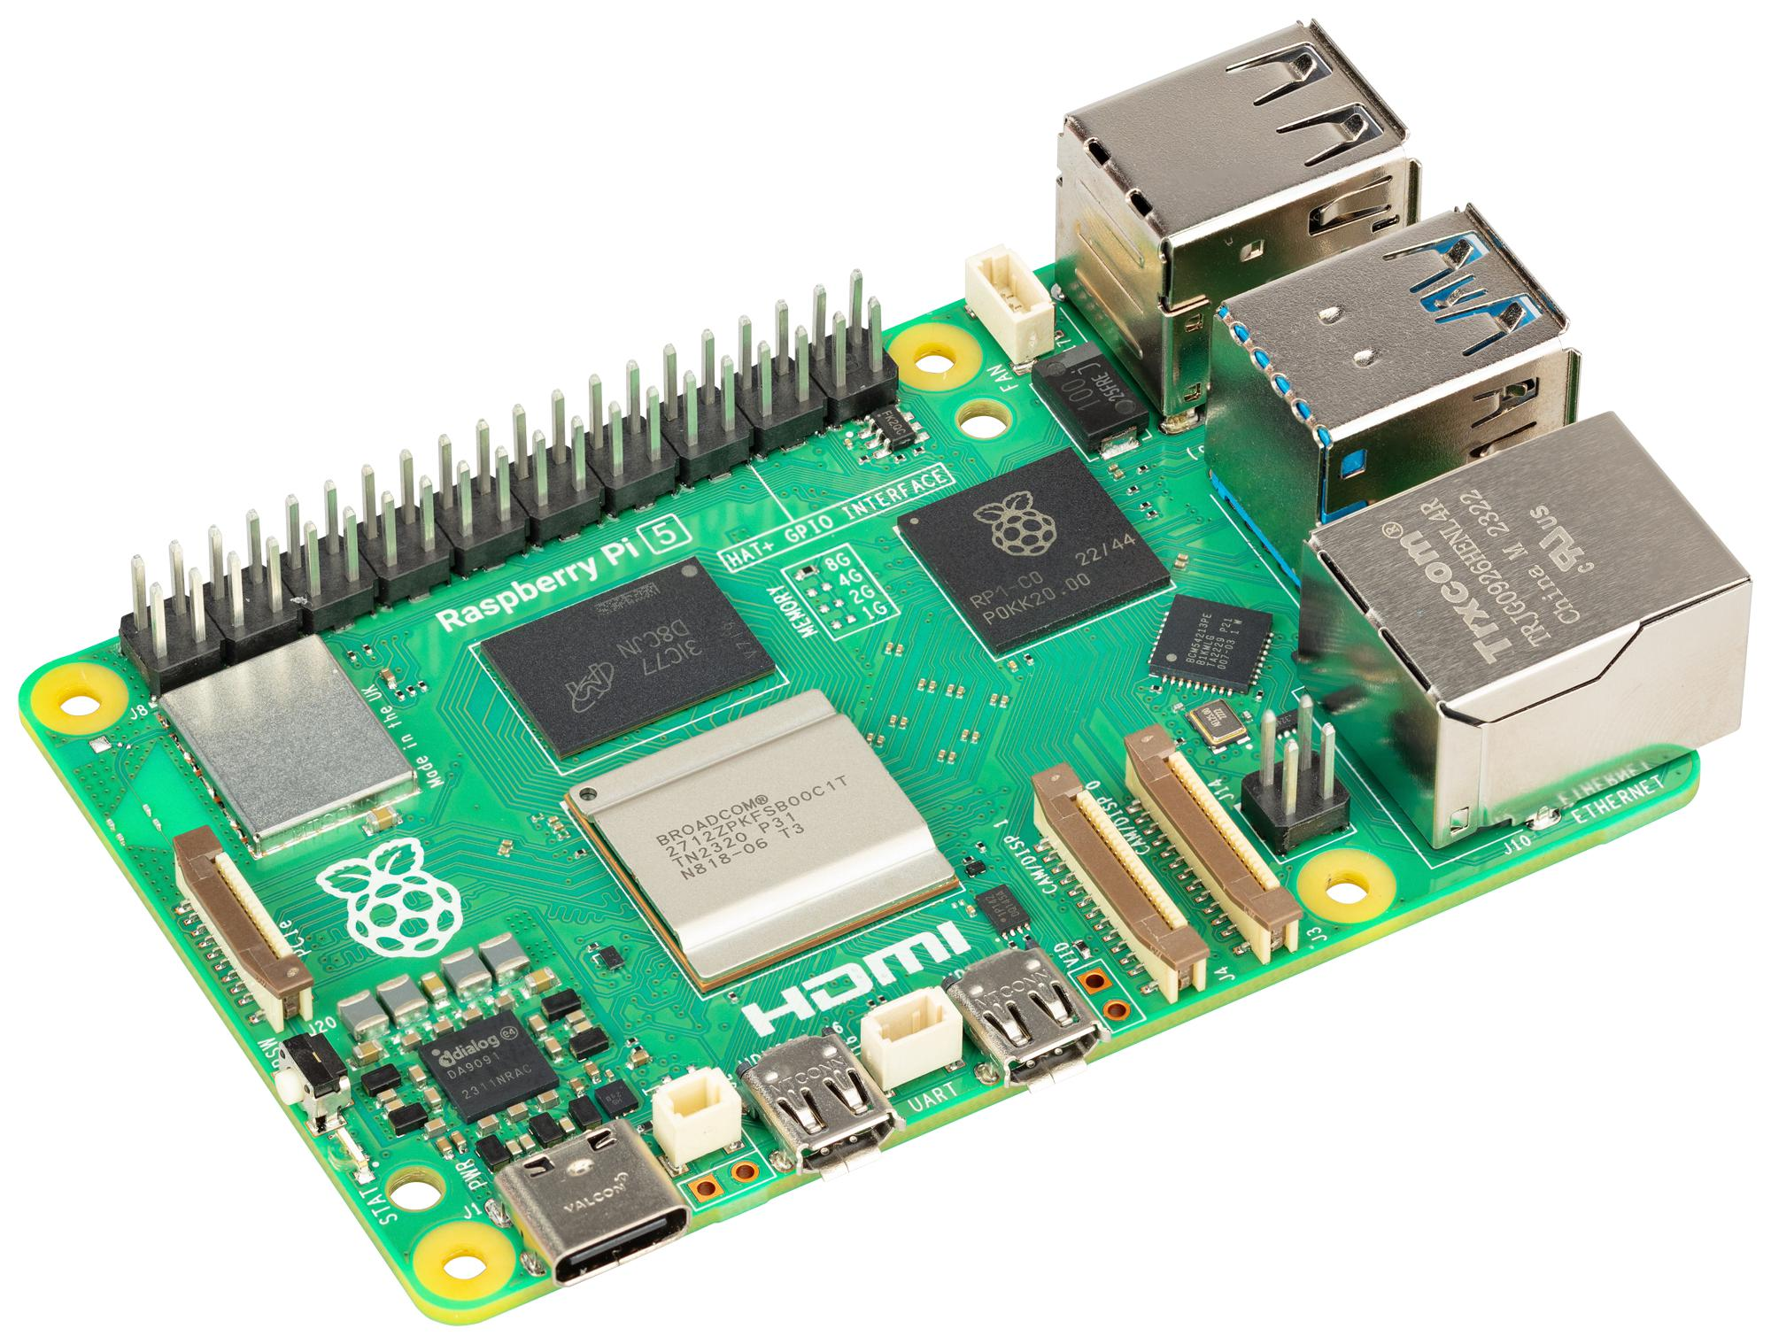
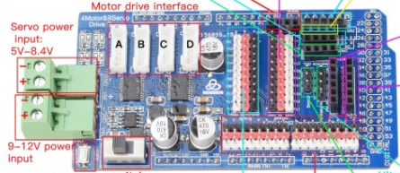
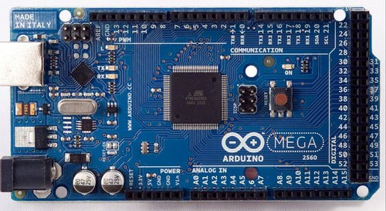
/usb_cam/image_raw
/usb_cam
Node
sensor_msgs/Image
/scan
/rplidarNode
Node
sensor_msgs/LaserScan
Node
/cmd_vel
/rUBot_nav
/serial_node
geometry_msgs/Twist
/odom
nav_msgs/Odometry

Slide 7
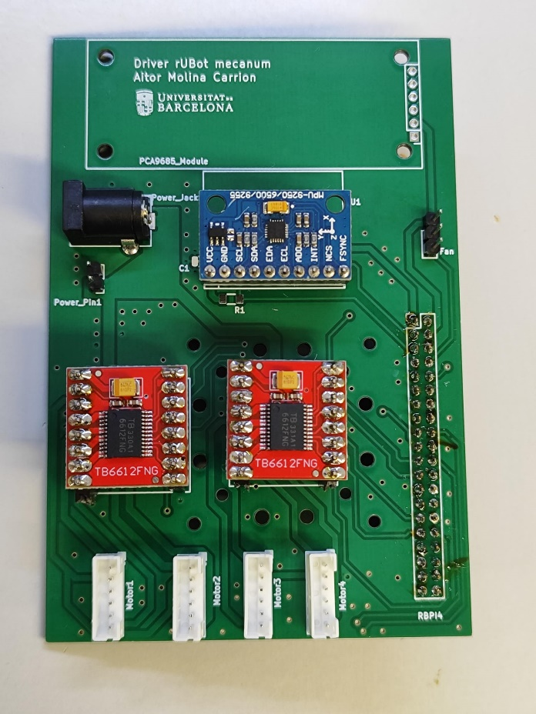
/usb_cam/image_raw
/usb_cam
Node
sensor_msgs/Image
/scan
/rplidarNode
Node
sensor_msgs/LaserScan
Node
/cmd_vel
/rUBot_nav
/serial_node
geometry_msgs/Twist
/odom
nav_msgs/Odometry

