Slide 1
CSE 412/598
DATABASE MANAGEMENT
COURSE NOTES
RELATIONAL ALGEBRA

Slide 2
RELATIONAL ALGEBRA
Query Language
We have already studied how to design a relational database so that the data in our enterprise is stored correctly, capturing the semantics of the application being modeled. Assuming that we have a properly designed relational database that is populated correctly, we will now start our investigation of how to retrieve data from the database.
Recall that a request for information from the database is called a query.
In this topic, we will study our first query language: relational algebra. Relational algebra is a formal and procedural language for querying relational databases. Understanding relational algebra is critical to understanding the industry-standard query language SQL, which we will study later in the course.

Slide 3
FIVE FUNDAMENTAL OPERATORS
  Let r and s be relations with schemas R and S, respectively
union: r ∪ s = { t | t ∈ r ∨ t ∈ s }
difference: r - s = { t | t ∈ r ∧ t ∉ s}
cartesian_product:
r × s = { t | t = t_{r} t_{s} where t_{r} ∈ r ∧ t_{s} ∈ s }
selection: σ _{P}(r)
projection: π _{A}(r)

Slide 4
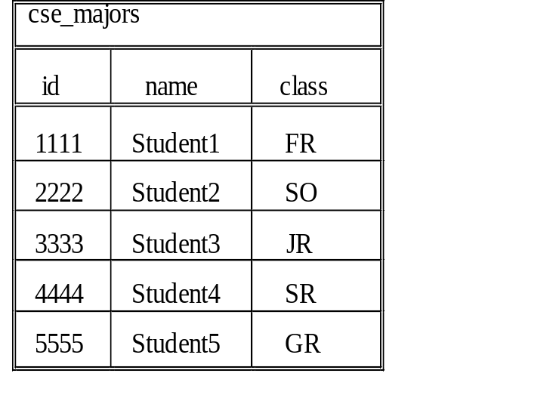
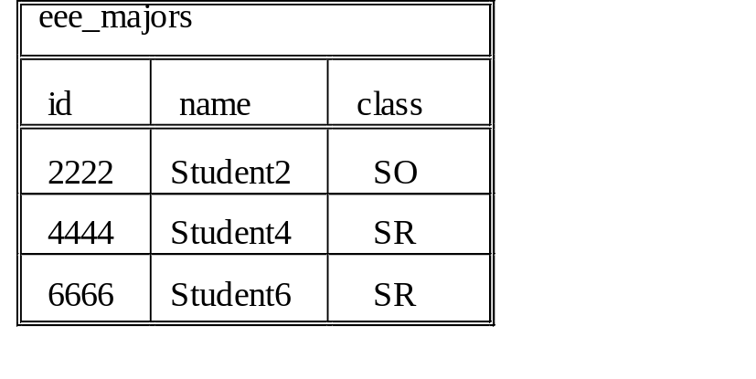
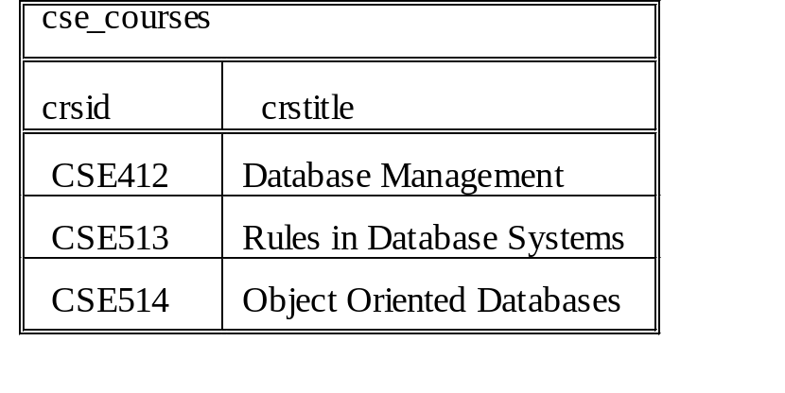
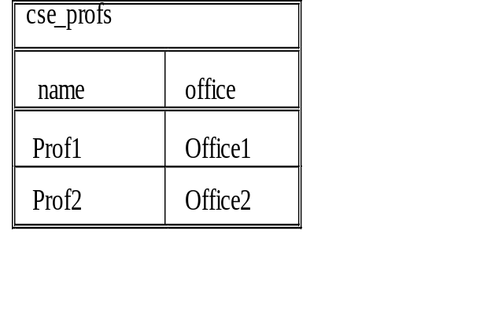
UNIVERSITY EXAMPLE
Schema & Instance

Slide 5
UNION r ∪ s = { t | t ∈ r ∨ t ∈ s }
Compatibility Restriction:
r and s must be compatible
  the relations r and s must be of the same arity (number of attributes)
  the domains of the ith attribute of r must be the same as the ith attribute of s
Philosophy:
You shouldn't union together relations that don't belong together.
EXAMPLE
Query:
List the student information for either computer science or electrical engineering majors.
Answer:
cse_majors ∪ eee_majors
Schema:
{ id, name, class }

Slide 6
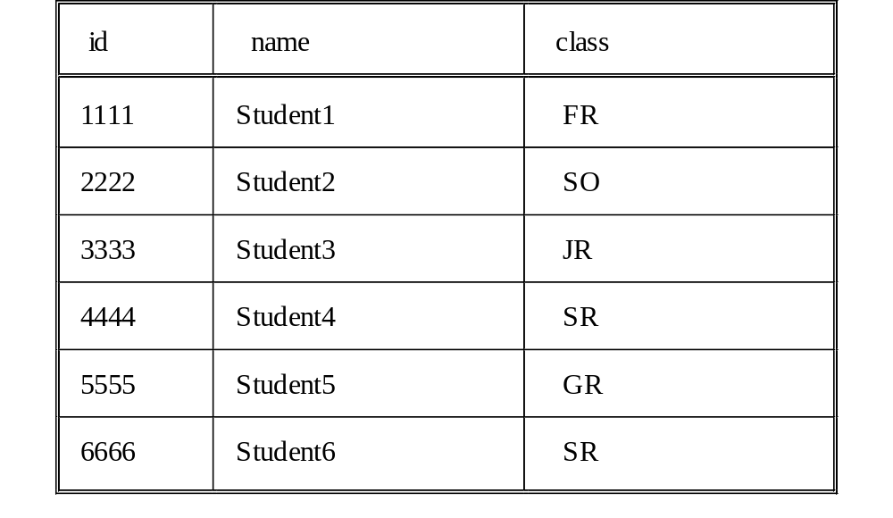
UNION
Example Query Result

Slide 7
DIFFERENCE r - s = { t | t ∈ r ∧ t ∉ s}
Restriction:
r and s must be compatible
EXAMPLE
Query:
List the student information for computer science majors, who are not double majors in electrical engineering.
Answer:
cse_majors - eee_majors
Schema:
{ id, name, class }

Slide 8
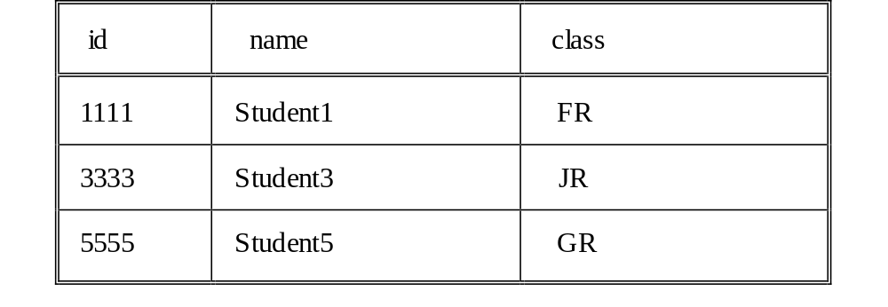
DIFFERENCE
Example Query Result

Slide 9
CARTESIAN PRODUCT r × s = { t | t = t_{r} t_{s} where t_{r} ∈ r ∧ t_{s} ∈ s }
Let n_{r} and n_{s} denote the number of tuples in r and s
There are n_{r} * n_{s} tuples in r × s
The relation scheme of r × s is the concatenation of the schemes for r and s, where attributes are qualified by the relation name from which it came, if necessary.
EXAMPLE
Query:
List all possible combinations of computer science professors teaching computer science courses.
Answer:
cse_profs × cse_courses
Schema:
{ name, office, crsid, crstitle }

Slide 10
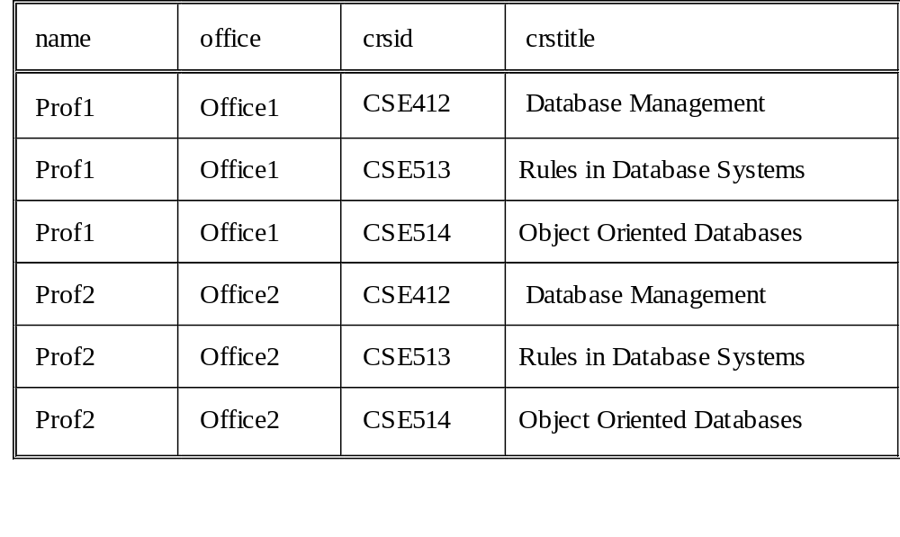
CARTESIAN PRODUCT
Example Query Result

Slide 11
SELECTION σ _{P}(r)
Selects tuples from r that satisfy P where P is a predicate involving attributes of r
EXAMPLE
Query:
List the student information for seniors who are majoring in computer science.
Answer:
σ_{class='SR'}(cse_majors)
Schema:
{ id, name, class }

Slide 12
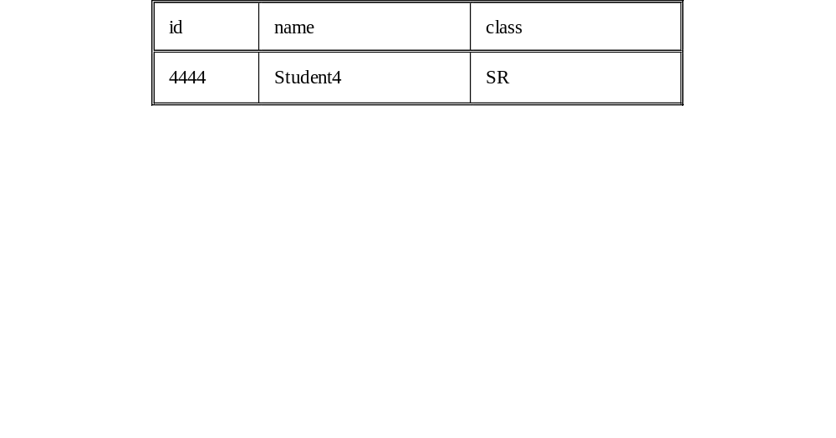
SELECTION
Example Query Result

Slide 13
PROJECTION π _{A}(r)
Projects attributes given by the set A from relation r where A is a subset of the attributes of r (i.e. A ⊆ R).
Note that if the key of the attribute is not in A, then elimination of duplicates is an implied operation.
EXAMPLE
Query:
List the name and id of students who are computer science majors.
Answer:
π_{id, name}(cse_majors)
Schema:
{ id, name }

Slide 14
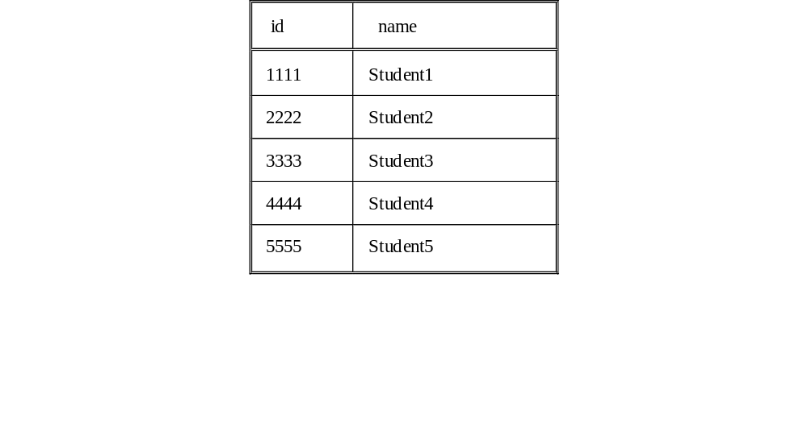
PROJECTION
Example Query Result

Slide 15
WinRDBI Checkpoint
Five Fundamental Operators
Read WinRDBI-related Course Documents
Install WinRDBI on your own computer
  http://www.eas.asu.edu/~winrdbi
Check the following relational algebra queries using the fundamental operators in WinRDBI:
  cse_majors union eee_majors;
  cse_majors difference eee_majors;
  cse_profs product cse_courses;
  select class=‘SR’ (cse_majors);
  project id, name (cse_majors);
The WinRDBI University database instance and queries are available under the Course Documents folder.

Slide 16
RELATIONAL ALGEBRA
Additional Operators
The following operators are shorthand notation for frequently used combinations of the five fundamental operators:
intersection:
r ∩ s ≡ r - (r - s)
θ-join:
r ⋈_{θ} s ≡ σ_{θ} (r × s)
natural_join:
r ⋈ s ≡ π _{(R ∪ S)} (r ⋈_{r.A1=s.A1∧...∧r.An=s.An} s)
where R ∩ S = {A1,...,An}
division:
r ÷ s = π_{R-S}(r) - π_{R-S}((π_{R-S}(r) × s) - r)

Slide 17
INTERSECTION r ∩ s ≡ r - (r - s)
Restriction:
r and s must be compatible
EXAMPLE
Query:
List the student information for those students who are double majoring in computer science and electrical engineering.
Answer:
cse_majors ∩ eee_majors
Schema:
{ id, name, class }

Slide 18
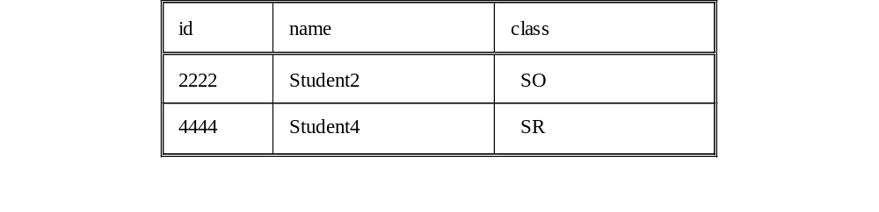
INTERSECTION
Example Query Result

Slide 19
θ-JOIN r ⋈_{θ} s ≡ σ_{θ} (r × s)
θ can be a boolean combination of comparison operators
EXAMPLE
Query:
List the professor information along with the information on the courses that the professor is currently teaching.
Answer:
cse_profs ⋈ _{name=tname} teaches
Schema:
{ name, office, tname, tcrsid }

Slide 20
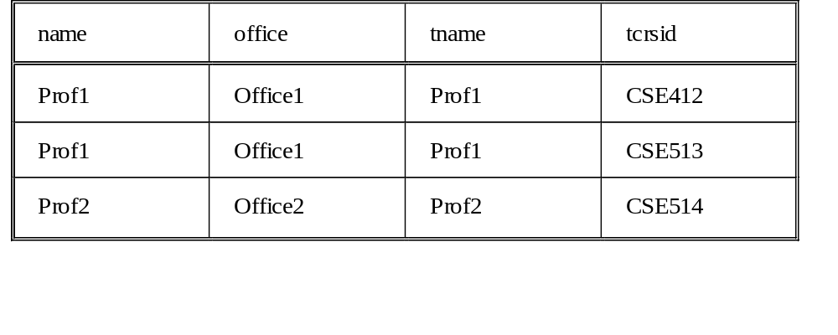
θ-JOIN
Example Query Result

Slide 21
NATURAL JOIN r ⋈ s ≡ π _{(R ∪ S)} (r ⋈ _{r.A1=s.A1∧...∧r.An=s.An} S)
r ⋈ s is a relation that is the projection onto R ∪ S of a θ-join where the θ predicate requires that r.A = s.A for each attribute A in R ∩ S = {A1,…An}.
When θ consists only of the equality operator (=), which is the case in a natural join, the join is called an "equi-join". So the natural join is a special case of an equi-join.
EXAMPLE
Assume the current semester’s teaching schedule is given by the table: teaches(name, crsid)
Query:
List the class schedule information for the current semester.
Answer: teaches ⋈
cse_courses ⋈ cse_profs
Schema:
{ name, office, crsid, crstitle }

Slide 22
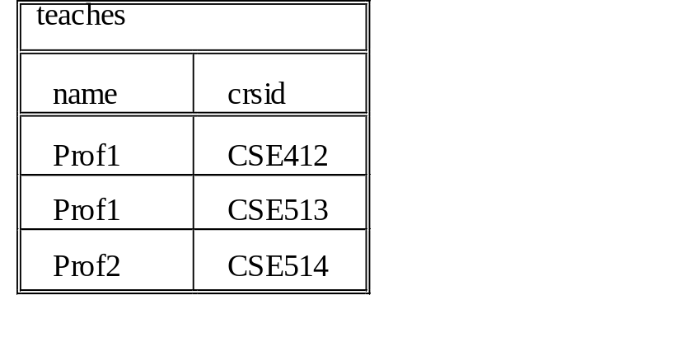
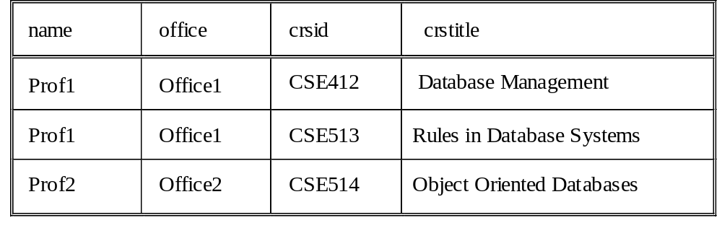
NATURAL JOIN
Example Query Results

Slide 23
DIVISION r ÷ s = π_{R-S}(r) - π_{R-S} ( (π_{R-S}(r) × s) - r)
r ÷ s is a relation on scheme R - S s.t. S ⊆ R where a tuple t is in r ÷ s if for every tuple t_{s} in s there is a tuple t_{r} in r such that t_{r}[S]=t_{s}[S] and t_{r}[R-S]=t[R-S]
EXAMPLE
Assume the following schema:
abTable(a, b)
bTable(b)
Query:
Find the a's that are related to all of the b's in the bTable
Answer:
abTable ÷ bTable
Schema:
{ a }

Slide 24
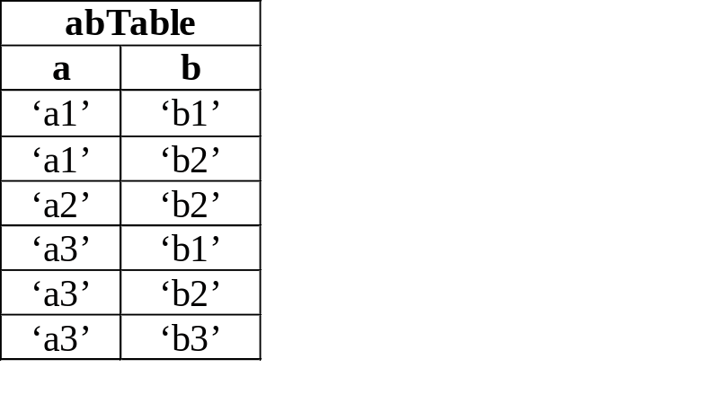
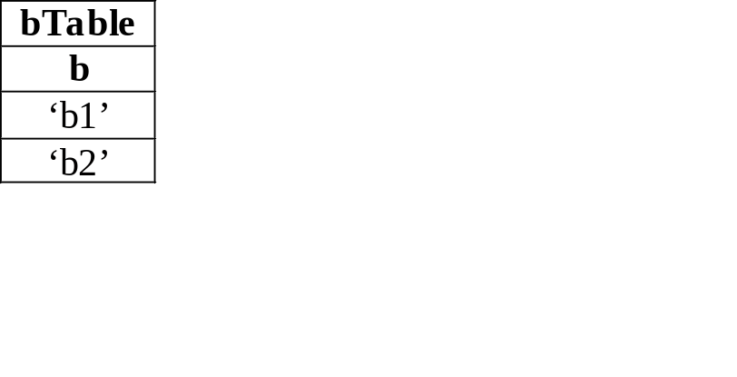
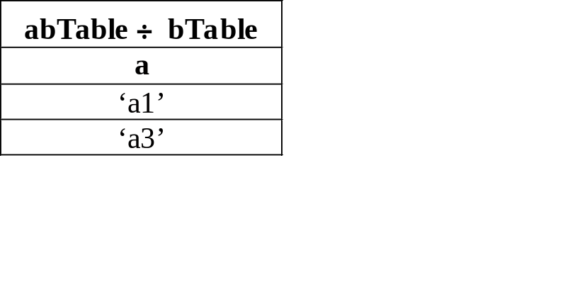
ABSTRACT DIVISION
Example Instance

Slide 25
ABSTRACT DIVISION EXAMPLE
One Step versus Multiple Steps
One Step:
abTable ÷ bTable =
π_{a}(abTable) - π_{a} ( (π_{a}(abTable) × bTable) - abTable)
Multiple Steps:
aTable := π _{a} (abTable);
allaWithAllb := aTable × bTable;
aNotRelatedToSomeb := π _{a} (allaWithAllb - abTable);
aRelatedToAllb := aTable - aNotRelatedToSomeb;

Slide 26
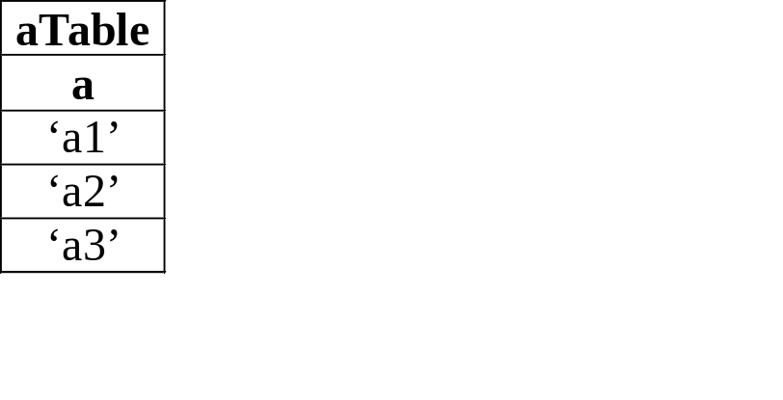
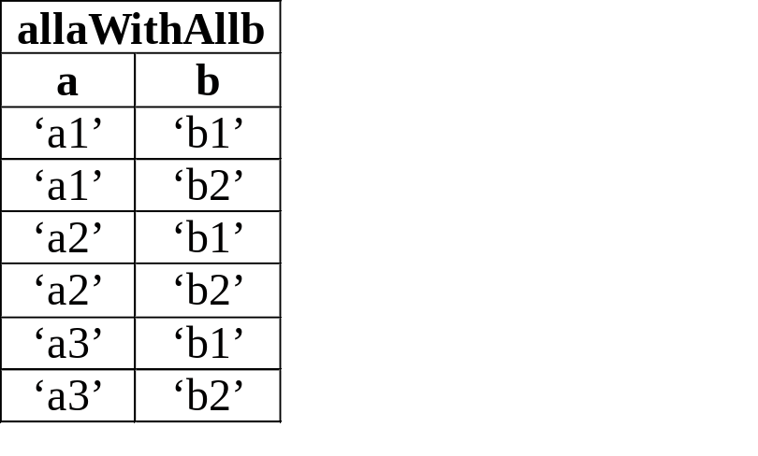
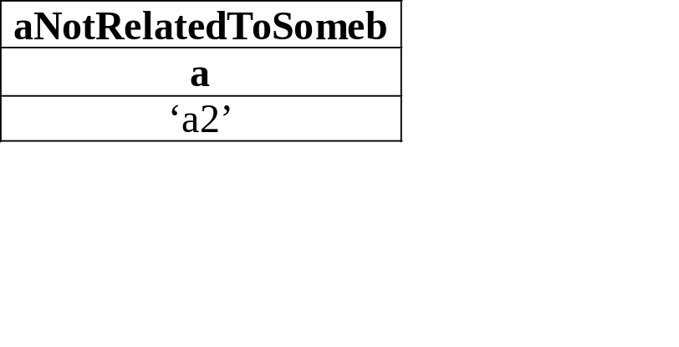
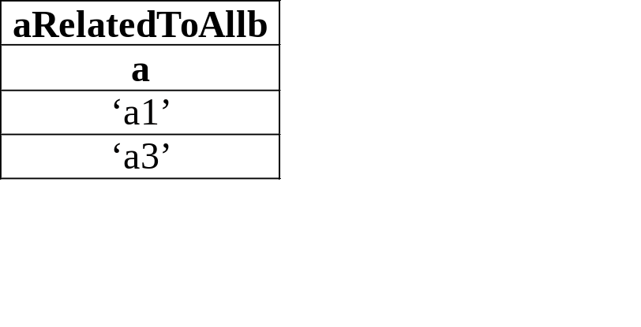
ABSTRACT DIVISION EXAMPLE
Table Instances for Multiple Steps

Slide 27
WinRDBI Checkpoint
Additional Operators
Check the following relational algebra queries using the additional operators in WinRDBI:
  cse_majors intersect eee_majors;
  teaches njoin cse_courses njoin cse_profs;
WinRDBI does not provide the join and division operators by design to reinforce the definition of these operators. Rewrite the following queries in terms of the fundamental operators and verify your results using WinRDBI.
  cse_profs ⋈ _{name=tname} teaches;
  abTable ÷ bTable;
The WinRDBI abstract division database instance is available under the Course Documents folder.

Slide 28
RELATIONAL ALGEBRA
Group Study Problem
Check the Assignments folder for the details on the group study problem.

Slide 29
AGGREGATE FUNCTIONS
MIN, MAX, SUM, COUNT, AVG
Although aggregation (min, max, sum, count, avg) is an important functionality of a database product, the standard relational algebra language described here does not inherently support aggregation. However, certain types of queries involving min, max and a limited form of counting (more than one/only one) are expressible using logic.
Consider the query:
"Find the employee(s) with the maximum salary"
over the simple schema:
emp(id, name, sal, superid, dno)

Slide 30
AGGREGATE FUNCTIONS
Example MAX Query
empSalary := π_{salary}(emp);
empSalaryCopy(salaryCopy) := empSalary;
% find the employees that don't earn the maximum salary;
notMaxSalary :=
π_{salary}(empSalary ⋈ _{salary < salaryCopy} empSalaryCopy);
maxSalary := empSalary – notMaxSalary;
% employee(s) with the maximum salary;
answer := emp ⋈ maxSalary;
See the Dietrich text for other examples…

Slide 31
RELATIONAL ALGEBRA
Individual Homework Assignment
Check the Assignments folder for the individual relational algebra assignment using WinRDBI.

