Slide 1
CSE 412/598
DATABASE MANAGEMENT
COURSE NOTES
2. DATABASE DESIGN
Department of Computer Science & Engineering
Arizona State University

Slide 2
DATABASE DESIGN PROCESS OVERVIEW
The development of a database is part of a larger information systems development process.
An information system includes:
° the data to be accessed
° the DBMS software
° computer hardware and storage media
° personnel who will use and manage the data
° applications software that will access and update the data
° applications programmers

Slide 3
INFORMATION SYSTEM LIFE CYCLE
1. Feasibility Analysis.
Determining potential application areas, performing cost benefit studies, and setting priorities among the different applications to be developed.
2. Requirements Collection and Analysis.
Potential users of an application are interviewed to determine problems and needs. A requirements specification document is produced.
3. Design.
The structure of the information system is specified. Design encompasses database design and applications design.

Slide 4
INFORMATION SYSTEM LIFE CYCLE (continued)
4. Implementation.
The database is constructed and populated with data. Application programs are developed and tested.
5. Validation and Acceptance Testing.
The system is tested against performance criteria and users evaluate the system against the requirements specification document.
6. Operation.
Operation is preceded by conversion from the old system to the new system. User training is performed. System maintenance is a continually activity during operation to adapt the system to changing user needs.

Slide 5
DATABASE APPLICATION LIFE CYCLE
Development of a database system is a micro life cycle within the macro life cycle of the larger information systems development process.
System Definition
Design
Implementation
Loading or Data Conversion
Application Conversion
Testing and Validation
Operation
Monitoring and Maintenance

Slide 6
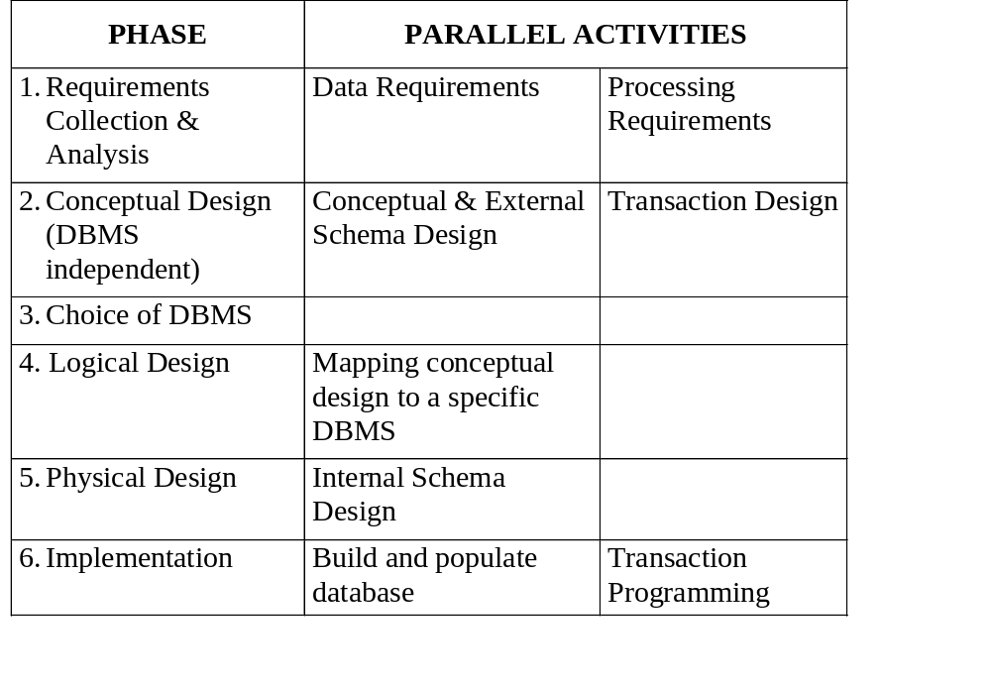
PHASES OF THE
DATABASE DESIGN PROCESS

Slide 7
DATABASE DESIGN PROCESS
Phase 1: Requirements Collection and Analysis
Major Activities:
° Identify groups that will use the application and key individuals that will participate in the requirements collection and analysis process.
° Examine existing documents concerning the application, including manuals, forms, reports, charts.
° Study the current operating environment. Determine the flow of information in the system. Identify specific transactions. Define when transactions are used and identify all input and output data.
° Interview key individuals of the user group. Determine user needs and establish priorities for the development process.

Slide 8
DATABASE DESIGN PROCESS
Phase 2: Conceptual Database Design
Conceptual design is DBMS-independent (i.e., an abstract view of what is to be implemented).
Activities include:
° conceptual schema design
° transaction design

Slide 9
DATABASE DESIGN PROCESS
Phase 2a: Conceptual Schema Design
Purpose:
° Emphasizes development of the semantic meaning of an application rather than implementation details.
° The conceptual description remains constant even though the DBMS implementation platform may change.
° Data models used for conceptual design are generally more expressive than data models of specific DBMS's.
The Entity-Relationship (ER) model is the high-level conceptual data modeling tool that is widely used in industry.

Slide 10
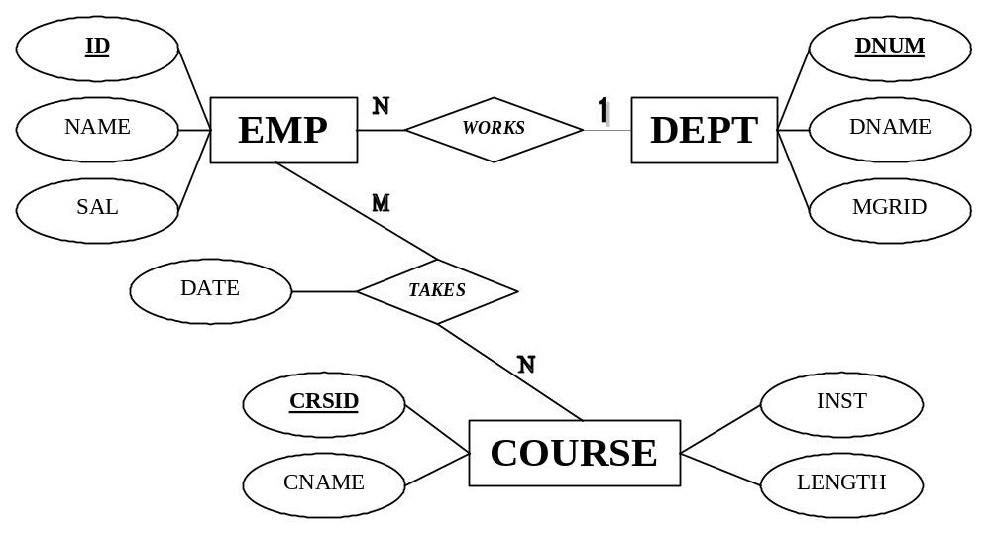
DATABASE DESIGN PROCESS
Phase 2a: Conceptual Schema Design - Example

Slide 11
DATABASE DESIGN PROCESS
Phase 2b: Transaction Design
Transaction design should be DBMS independent and include:
° input/output description
° functional behavior
Retrieval transactions:
Find all employees that earn more than $50,000 and work for the Human Resources department.
Update transactions:
Give the manager of the Advanced Technology department a 10% raise.
Mixed transactions:
Assign all employees that work for the Advanced Technology department to work on project number 120 and give each employee a 10% raise.

Slide 12
DATABASE DESIGN PROCESS
Phase 3: Choice of a DBMS
Cost factors in the selection of a DBMS:
° software cost
° maintenance cost
° hardware cost
° DB creation or conversion cost
° personnel cost
° training cost
° operating cost
The structure of the data to be stored also has an impact on the type of DBMS chosen: e.g., Relational, Object-Oriented, Object-Relational

Slide 13
DATABASE DESIGN PROCESS
Phase 4: Logical Database Design
This phase involves mapping a conceptual schema to the schema of a specific DBMS. Standard mapping procedures exist, but changes may be needed due to the features of different DBMSs.
Relational Schema
emp(id, name, sal, dnum)
dept(dnum, dname, mgrid)
course(crsid, cname, inst, length)
takes(id,crsid, date)

Slide 14
DATABASE DESIGN PROCESS
Phase 5: Physical Design
This phase involves the choice of specific storage structures for the internal representation of data, such as:
° B-trees
° hashed files
° linked structures
Physical design is concerned with issues such as response time, space utilization and transaction throughput.

Slide 15
DATABASE DESIGN PROCESS
Phase 6: Implementation
The implementation phase is concerned with:
° compiling the data definition language of the DBMS
° populating (or loading) the database with data
° possibly converting an older database to the new database structure
° development of access screens, reports, and transactions

Slide 16
DATABASE DESIGN PROCESS
DB design is primarily a data-driven approach, meaning that the focus of the design process is placed on data and the properties of data. Applications that use the database are developed after the database is defined.
Another design approach is the process-driven (or function-driven) approach. High-level descriptions of activities are created, indicating information flow between activities. Data is identified as a by-product of activities.
In the process-driven approach, the global view of data as a shared resource of the enterprise may be lost.
Our approach will be primarily data-driven, although it is generally agreed that data-driven and process-driven approaches are complementary and both approaches should be applied in parallel.

