Slide 1
CSE 412/598
DATABASE MANAGEMENT
COURSE NOTES
3. ENTITY-RELATIONSHIP
CONCEPTUAL MODELING
Department of Computer Science & Engineering
Arizona State University

Slide 2
ENTITY-RELATIONSHIP
Conceptual Model
Graphical representation of the overall (logical) structure of a database, which is independent of the DBMS in which the database is implemented.
Entity Type | an object that exists and is distinguishable from other objects (e.g., students); represented by a set of attributes (e.g., student-id, name, major)
Entity Extension | set of entities of the same type (e.g., instances of students); entity sets need not be disjoint (e.g., person & customer)
Relationship Type | an association among several entities (e.g., students taking classes)
Relationship Instance | a set of relationships of the same type (e.g., the instances of which students are taking what classes)

Slide 3
DIAGRAM
entity type
attributes
composite attributes
relationship type
links

Slide 4
MAPPING CARDINALITIES
Mapping cardinalities express the number of entities to which another entity can be associated via a relationship.
For a binary relationship set, there are several cardinality ratios:
1:1 (one-to-one)
1:N (one-to-many)
N:1 (many-to-one)
M:N (many-to-many)
The following examples of cardinality ratios are expressed using the abstract entity sets A and B.

Slide 5
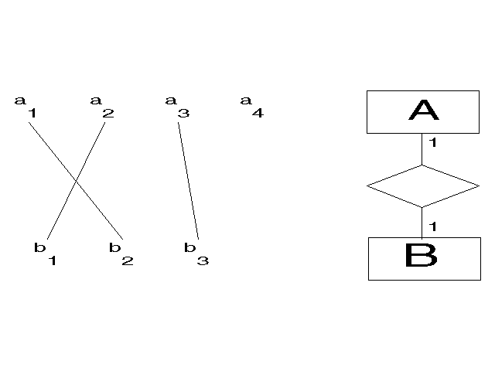
CARDINALITY RATIOS
1:1
1:1 An entity in A is associated with at most one entity in B.
An entity in B is associated with at most one entity in A.

Slide 6
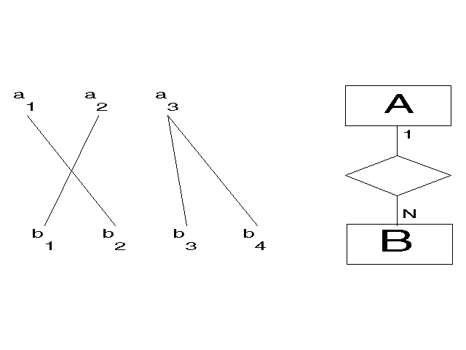
CARDINALITY RATIOS
1:N
1:N An entity in A is associated with any number of entities in B. An entity in B is associated with at most one entity in A.

Slide 7
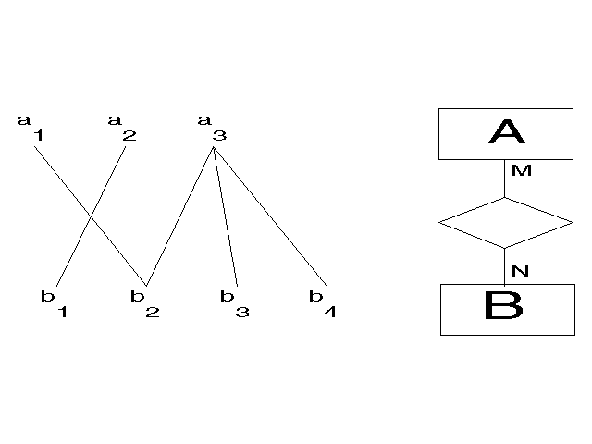
CARDINALITY RATIOS
M:N
M:N An entity in A is associated with any number of entities in B.
An entity in B is associated with any number of entities in A.

Slide 8
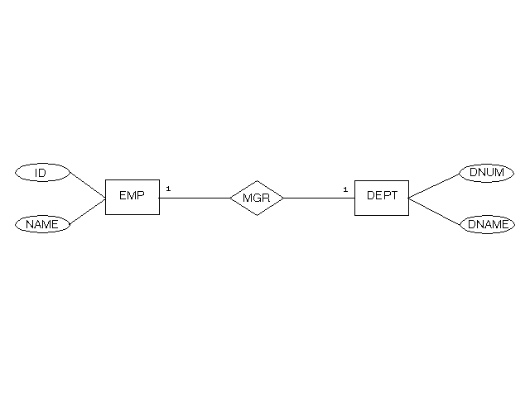
1:1 RELATIONSHIP
Example
Assumption: Each department has at most one manager and a manager is
the head of at most one department.

Slide 9
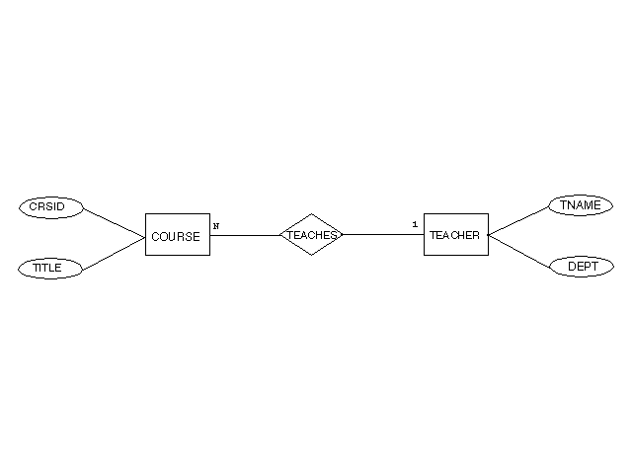
1:N RELATIONSHIP
Example
Assumption: Each course is taught by one teacher but a teacher can teach many courses.

Slide 10
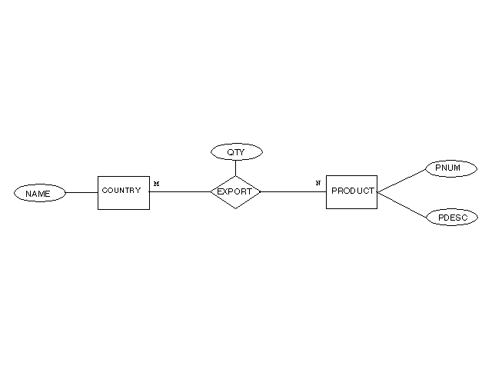
M:N RELATIONSHIP
Example
Assumption: A country exports more than one product and products can be exported by more than one country.

Slide 11
STRUCTURAL CONSTRAINT
Cardinality Ratio | determines the number of relationship instances that an entity participates in for a given relationship type, e.g., 1:1, 1:N, M:N
Participation Constraint | determines the existence dependence of an entity on its participation in a relationship instance total: e.g., an employee must work in a department (denoted by a double edge on ER diagram) partial: e.g., an employee may be a manager (denoted by a single edge on ER diagram)

Slide 12
MIN/MAX PAIRS
To add more meaning (semantics), associate a (min,max) pair with an entity type E in relationship type R
0=<min=<max and max>=1
An entity e in E must participate in at least min and at most max relationship instances in R at all times.
min = 0 : partial participation
min > 0 : total participation

Slide 13
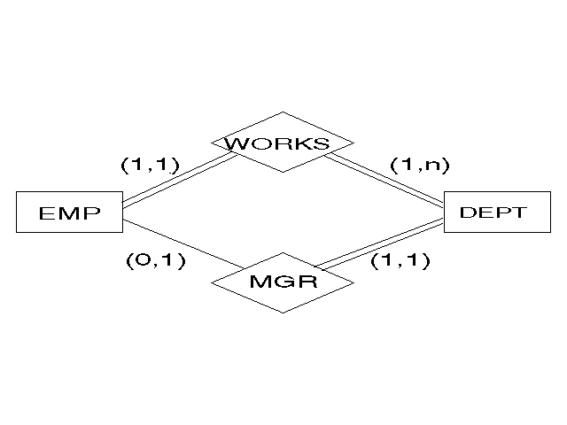
MIN/MAX EXAMPLE
      An employee need not be a manager but if a
      manager, manages exactly one department.
• A department must have exactly one manager.
• An employee works in exactly one department.
• A department must have at least one employee, but many
employees can work in a department.

Slide 14
KEYS
Since an entity is distinguishable from other objects, we need to specify a key, which is a set of attributes for an entity type that uniquely identifies an instance of that entity type.
Superkey | A set of one or more attributes, which, taken collectively, allow the unique identification of an entity in its entity type (e.g., {id}, {id name} ). A superkey may contain extra attributes.
Candidate Key | A superkey for which no proper subset is a superkey (e.g. {id}, {name address}).
Primary Key | A candidate key that is chosen by the DBA as the principal means of identifying entities.
On an ER diagram, we underline the attribute that is the candidate key for that entity.

Slide 15
STRONG vs. WEAK ENTITIES
Strong Entity: an entity that has a primary key
Weak Entity: an entity that does not have sufficient attributes to form a primary key
Consider as an example a dependent entity type with attributes firstname, birthdate and sex. Each dependent is unique for a given employee but different employees may have dependents with the same name and birthdate.
The primary key of a weak entity type is formed by the primary key of the strong entity on which it is existence dependent plus its discriminator (partial key), which is a set of attributes that distinguishes the entities in a weak entity set that depend on a strong entity.
dependent's primary key: {empid, firstname, birthdate}

Slide 16
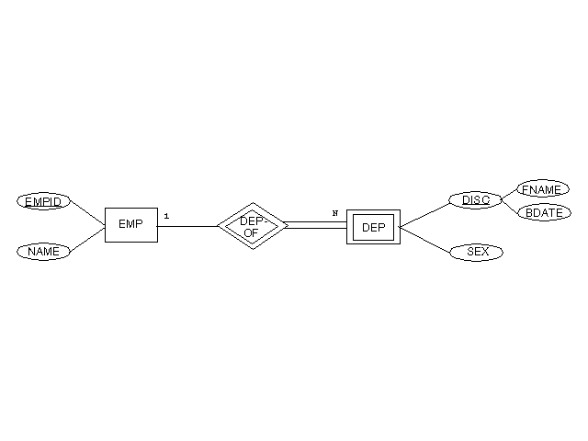
WEAK ENTITY EXAMPLE

Slide 17
ER EXERCISE
Consider a large company that wants to keep track of the training courses that its employees have taken. An employee has a name, identification number and salary. An employee works in at most one department. A department has a unique number, a name and the identification number of the manager of that department. An employee can take many training courses but can take a given course at most once. Each course is identified by a course number, descriptive name, its instructor and its length in hours. Since a particular course may be offered several times, the date that an employee takes a course is also recorded.
Give an ER diagram to represent this enterprise.

Slide 18
ER DIAGRAM
Your solution
Class solution

Slide 19
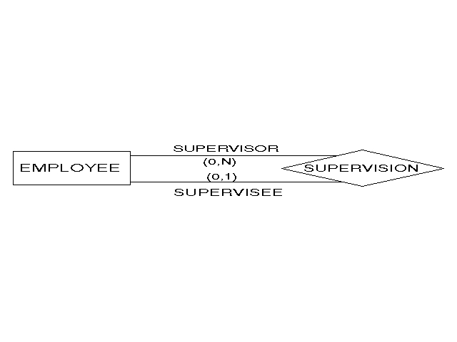
RECURSIVE RELATIONSHIPS

Slide 20
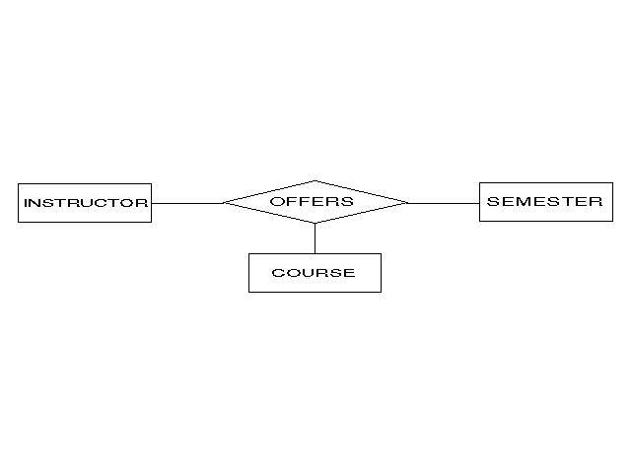
NON-BINARY RELATIONSHIPS

