Slide 1
CSE 412/598
DATABASE MANAGEMENT
COURSE NOTES
6. QUERY OPTIMIZATION
Department of Computer Science & Engineering
Arizona State University

Slide 2

QUERY TREE
a tree structure representing a relational algebra expression
leaf node - base relation
internal node - result of a relational algebra operation
Consider the following schema and query:
lives(PERSON,STREET,CITY,STATE,ZIP)
works(PERSON,COMPANY,SALARY,POSITION)
located(COMPANY,CCITY,CSTATE,CZIP)
Find the name and city of all people who earn more than 25,000 and work for a company located in the state of NY.
π _{PERSON, CITY} σ _{SALARY>25,000 Λ CSTATE=’NY’} ((lives works) located)

Slide 3
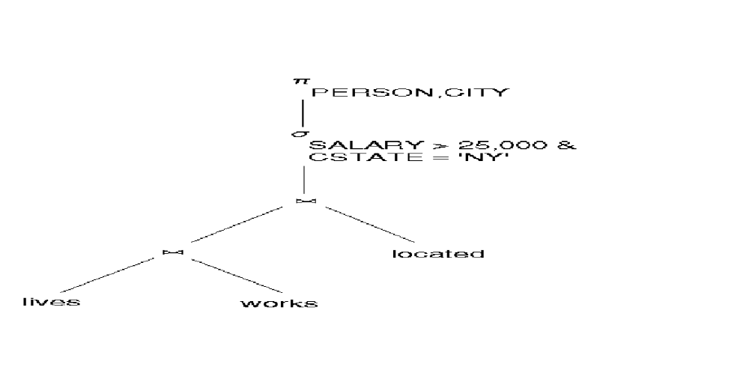
QUERY TREE EXAMPLE
π _{PERSON, CITY} σ _{SALARY>25,000 Λ CSTATE=’NY’} ((lives works) located)

Slide 4
QUERY OPTIMIZATION
Transform the query as entered by the user into an equivalent query that can be computed more efficiently.
Algebraic expressions may be transformed into equivalent expressions using transformation rules that preserve equivalence. These transformation rules are based on commutative properties of the relational algebra operators and conditions on the expression to be transformed.

Slide 5
TRANSFORMATION RULES σ and π
1. Cascade of σ:
σ_{C1 and C2 and ... and Cn} (R) ≡ σ_{C1} (σ_{C2} (... (σ_{Cn} (R)) ...) )
2. Commutativity of σ:
σ_{C1} (σ_{C2} (R)) ≡ σ_{C2} (σ_{C1} (R))
3. Cascade of π:
π_{list1} (π_{list2} (... (π_{listn} (R)) ...)) = π_{list1}(R)
4. Commuting σ with π: if C involves only attributes A₁, ..., A_{n} in the π list, they can be commuted.
π_{A1, A2, ..., An} (σ_{C} (R)) ≡ σ_{C} (π_{A1, A2, ..., An} (R))

Slide 6
TRANSFORMATION RULES and ×
5. Commutativity of (or ×):
R _{C} S ≡ S _{C} R
6. Commuting σ with (or ×):
if the attributes in C involve only the attributes of R:
σ_{C} (R S) ≡ (σ_{C} (R)) S
if c is (c1 and c2) and c1 applies to R and c2 to S:
σ_{C} (R S) ≡ (σ_{C1} (R)) (σ_{C2} (S))

Slide 7
TRANSFORMATION RULES and ×
7. Commuting π with (or ×):
Let A₁, ..., A_{n} be attributes of R,
B₁, ..., B_{m} be attributes of S,
L = {A₁, ..., A_{n}, B₁, ..., B_{m}}
If C involves only the attrs of L:
π_{L} (R _{c} S) ≡ (π_{A1, ..., An} (R)) _{c} (π_{B1, ..., Bm}(S))
If C contains additional attributes not in L, these must be added to the π list and a final π is needed. e.g:
π_{L} (R _{c} S) ≡ π_{L}((π_{A1,...,An,An+1, ..., An+k}(R)) _{c}
(π_{B1, ..., Bm, Bm+1, ..., Bm+p} (S)) )

Slide 8
TRANSFORMATION RULES
∪ and ∩
8. Commutativity of set operations: ∪ and ∩ are commutative.
(R ∪ S) ≡ (S ∪ R) (R ∩ S) ≡ (S ∩ R)
9. Associativity of , ×, ∪, and ∩:
They are individually associative.
Let θ be , ×, ∪, or ∩, then
(R θ S) θ T ≡ R θ (S θ T)
10. Commuting σ with set operations ∪ and ∩.
Let θ be ∪ or ∩, then
σ_{C} (R θ S) ≡ (σ_{C} (R)) θ (σ_{C} (S))

Slide 9
TRANSFORMATION RULES
∪ and ∩
11. Commuting π with set operations:
The π operation commutes with ∪ and ∩.
Let θ be ∪ or ∩, then
π_{L} (R θ S) ≡ (π_{L} (R)) θ (π_{L} (S))
12. Additional logic transformations:
(∀x)(P(x)) ≡ (∃x)(not (P(x)))
(∃x)(P(x)) ≡ not (∀x)(not (P(x)))
(∀x)(P(x) and Q(x)) ≡ (∃x)(not (P(x)) or not (Q(x)))
(∀x)(P(x) or Q(x)) ≡ (∃x)(not (P(x)) and not (Q(x)))
(∃x)(P(x) or Q(x)) ≡ not (∀x)(not (P(x)) and not (Q(x)))
(∃x)(P(x) and Q(x)) ≡ not (∀x)(not (P(x)) or not (Q(x)))

Slide 10
HEURISTIC ALGEBRAIC
OPTIMIZATION ALGORITHM
1. Cascade selection
(rule 1)
2. Move selections as far down the tree as possible
(rules 2,4,6,10)
3. Rearrange leaf nodes to get smaller intermediate relations (rule 9)
4. Combine a × with σ to yield a , if possible
5. Cascade projections and push down the tree
(rules 3,4,7,11)
6. Identify common subexpressions

Slide 11
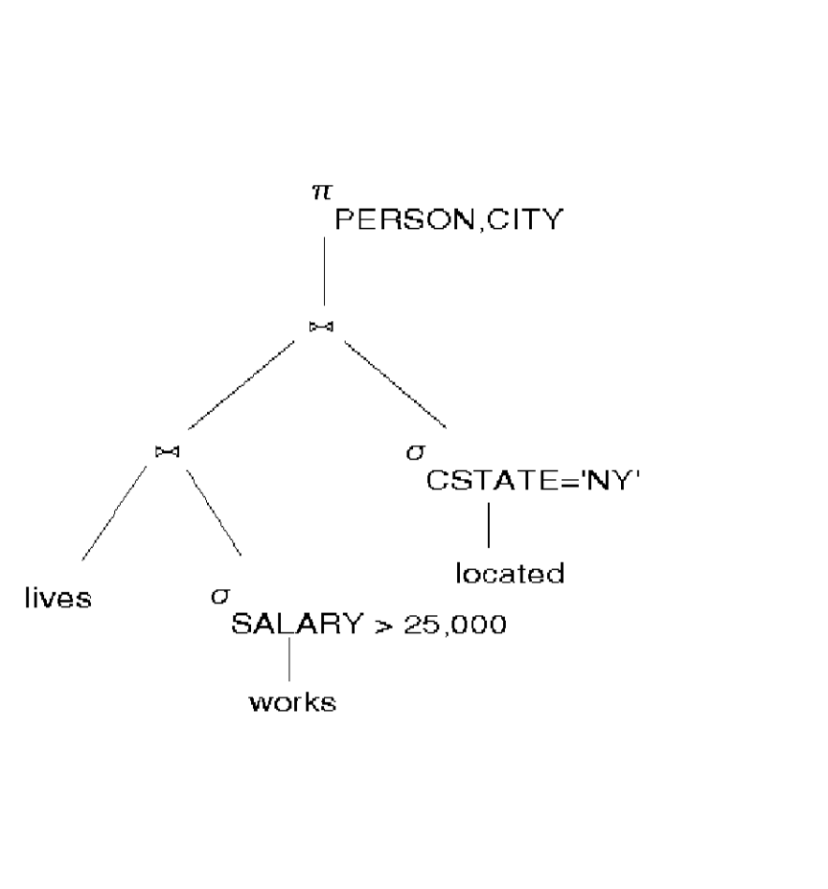
QUERY OPTIMIZATION EXAMPLE
T₀: Initial Query Tree
T₁: Cascade selections and push down tree

Slide 12
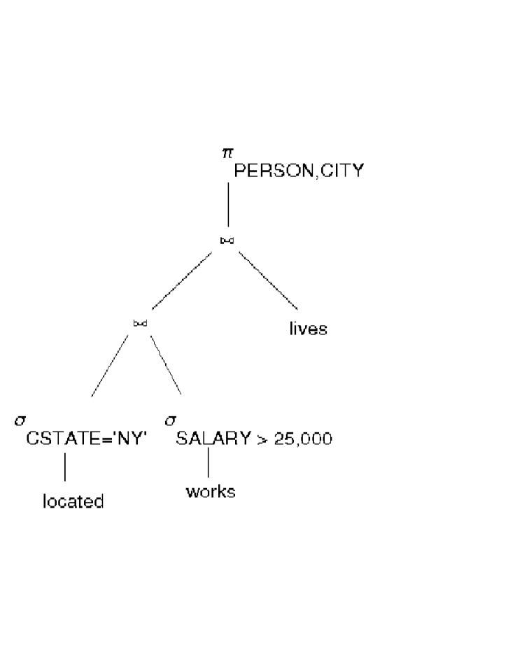
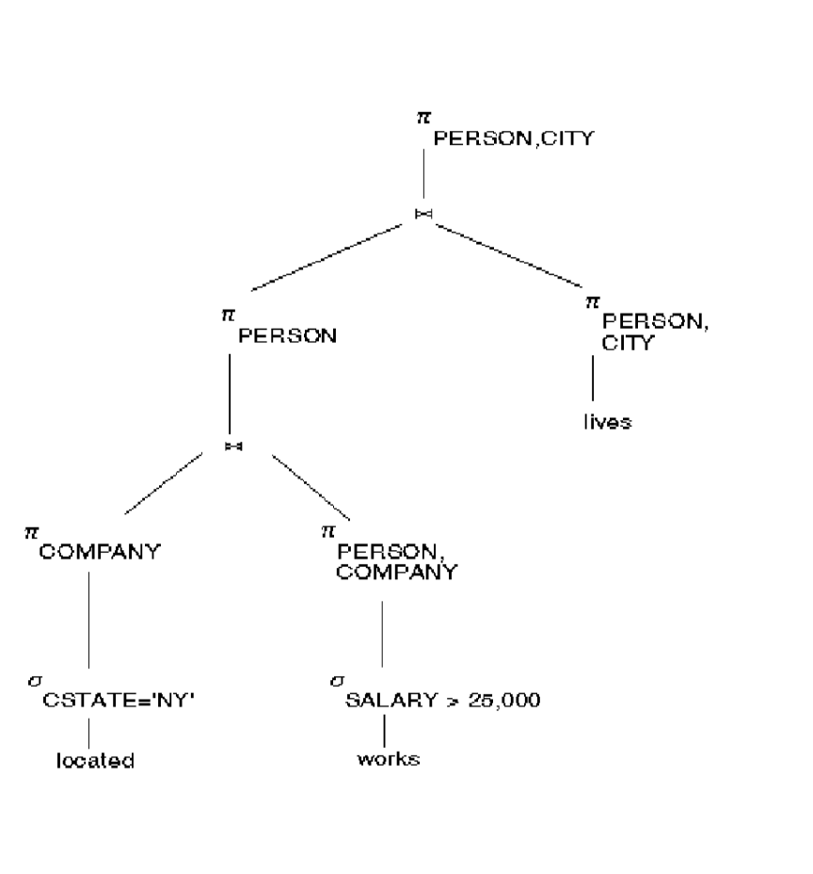
QUERY OPTIMIZATION EXAMPLE
T₂: Using commutativity &
associativity properties of join,
rearrange join order
T₃: Introduce projections

Slide 13
STUDY PROBLEM
Consider the following query that finds the names and salaries of employees working on the ‘ProductX’ project:
π_{fname, lname, salary}
(σssn=essn & pno=pnumber & pname=‘ProductX’
((employee × works_on) × project) )
Give the initial query tree. Show the successive query trees generated during the query optimization process. Give a brief justification at each step.

