Slide 1
CSE 412/598
DATABASE MANAGEMENT
COURSE NOTES
7. RELATIONAL DATABASE DESIGN
Department of Computer Science & Engineering
Arizona State University

Slide 2
RELATIONAL DATABASE DESIGN
Goal: Generate a set of relation schemes that allow us to store information without unnecessary redundancy, yet allows us to retrieve information easily.
Undesirable Properties
Repetition of information
Inability to represent certain information
Loss of information
Desirable Properties
No Repetition of Information (Normal Forms)
Dependency Preservation
Lossless-join Decomposition

Slide 3
UNDESIRABLE PROPERTIES
Repetition of information
suppliers(SNAME, SADDR, ITEM, PRICE)
The address of the supplier is repeated for each item supplied:
⇒ wasted space
⇒ every tuple for a supplier must be updated when there is an address change

Slide 4
UNDESIRABLE PROPERTIES
Inability to represent certain information
suppliers(SNAME, SADDR, ITEM, PRICE)
⇒ Insertion:
we can't record an address for a supplier if that supplier does not currently supply at least one item.
Deletion:
if all the items supplied by one supplier are deleted, we lose the address.

Slide 5
UNDESIRABLE PROPERTIES
Loss of information
addresses(NAME, CITY, ZIP) ≠
addr1(NAME, CITY) addr2(CITY, ZIP)
The join of addr1 and addr2 is not equal to addresses
addresses ≠ addr1 addr2
N C Z N C C Z = N C Z
--------------------- ----------- -------------- --------------------
bill phx 85050 bill phx phx 85050 bill phx 85050
jane phx 85051 jane phx phx 85051 bill phx 85051
jane phx 85050
jane phx 85051

Slide 6
FUNCTIONAL DEPENDENCIES
Definition
Recall superkey defn:
Let R be a relation scheme. A subset K of R is a superkey of R if, in any legal relation r(R), for all pairs t₁ and t₂ tuples in r s.t. t₁ ≠ t₂
t₁[K] ≠ t₂[K]
"No two tuples in any legal relation r(R) may have the same value on attribute set K".
Let V ⊆ R and W ⊆ R. The Functional Dependency (FD) V→W holds on R if in any legal relation r(R), for all pairs of tuples t₁ and t₂ in r s.t. t₁[V] = t₂[V] it is also the case that t₁[W] = t₂[W].
An FD X→Y is trivial if Y ⊆ X.
Note: if K is a superkey of R, then K→R

Slide 7
FUNCTIONAL DEPENDENCIES
Examples
suppliers(SNAME, SADDR, ITEM, PRICE)
R = {SNAME, SADDR, ITEM, PRICE}
F = {f₁: SNAME → SADDR,
f₂: SNAME,ITEM → PRICE}
addresses(NAME, CITY, ZIP)
F = {f₁: NAME → ZIP,
f₂: ZIP → CITY}

Slide 8
MORE ON FUNCTIONAL DEPENDENCIES
A FD is a property of the meaning or semantics of the attributes in a relation schema.
Legal relation instances r of R satisfy the functional dependency constraints.
FDs are used to
provide a set of constraints on the attributes of a relation schema that must hold at all times
provide additional information to be used in the design process

Slide 9
FUNCTIONAL DEPENDENCIES
Company Training Courses Enterprise
Most of the FDs for an enterprise are already included in the conceptual model. Using the ER diagram and the semantics of the enterprise, give the FDs for the company training courses example.

Slide 10
THEORY OF FUNCTIONAL DEPENDENCIES
Example: F = {X→Y, Y→Z}
By definition of FDs, X→Z is "logically implied" by F.
Let F be a set of FDs. Let F⁺ denote the closure of F, which is the set of all FDs logically implied by F.
Rules of Inference for FDs (FD rules)
1. Reflexivity if Y ⊆ X, then X→Y
2. Augmentation if X→Y, then WX→WY
3. Transitivity if X→Y & Y→Z, then X→Z
4. Union if X→Y & X→Z, then X→YZ
5. Decomposition if X→YZ, then X→Y & X→Z
Pseudotransitivity if X→Y & WY→Z, then XW→Z
• Rules 1, 2 & 3 are Armstrong's axioms (complete)
• Rules 4, 5 & 6 follow from Armstrong's axioms

Slide 11
EXAMPLE PROOF OF INFERENCE
Let F = {f₁: Z→A, f₂: B→X, f₃: AX→Y}
Prove that ZB→Y is in F⁺?
ZB→AB Augmentation(f₁,B)
AB→AX Augmentation(f₂, A)
ZB→AX Transitivity(ZB→AB, AB→AX)
ZB→Y Transitivity(ZB→AX, f₃)
What if we just wanted to know whether a FD is in F⁺?
Computing F⁺ is costly. Rather than computing F⁺, we can find the set of attributes functionally determined by the given set of attributes on the left-hand side of the FD to check.

Slide 12
ATTRIBUTE CLOSURE
Let X be a set of attributes.
X⁺ be the closure of X under F, i.e., the set of all attributes functionally determined by X under a set F of FDs.
Algorithm: compute X⁺
Input: F - set of FDs
X - set of Attributes
Output: X⁺ - set of attributes
Result := X; /*reflexivity */
while (changes to Result) do
for each FD Y→Z in F do
if Y ⊆ Result then Result := Result ∪ Z; /* transitivity */
X⁺ := Result;

Slide 13
EXAMPLE: ATTRIBUTE CLOSURE
F = { f₁: Z→A,
f₂: B→X,
f₃: AX→Y}
Is ZB→Y in F⁺?
Equivalently, is Y in (ZB)⁺?
Result: ZB, Given
A, f₁
X, f₂
Y f₃
Yes!

Slide 14
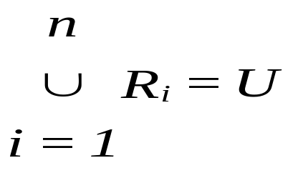
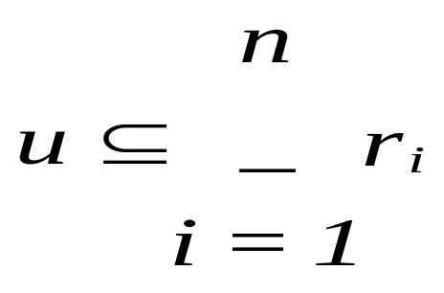
DECOMPOSITION
Let U be a relation scheme.
A set of relation schemes {R₁, R₂, ..., R_{n}} is a decomposition of U if
Let u be a relation on scheme U.
Let r_{i} = π_{Ri}(u), for 1≤ i ≤ n

Slide 15
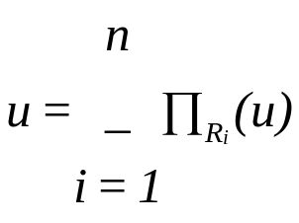
DESIRABLE PROPERTIES
Lossless-join Decomposition
Let C be a set of constraints on the DB. A decomposition {R₁, R₂, ..., R_{n}} of a relation scheme U is a lossless-join decomposition if for all relations u on scheme U that are legal under C
Let R be a relation scheme, F be a set of FDs on R, R₁ & R₂ form a decomposition of R. This decomposition is a lossless-join decomposition of R if at least one of the following holds:
• (R₁ ∩ R₂)→R₁ in F⁺
• (R₁ ∩ R₂)→R₂ in F⁺

Slide 16
LOSSLESS-JOIN DECOMPOSITION
Suppliers Example
suppliers(SNAME, SADDR, ITEM, PRICE)
R = {SNAME, SADDR, ITEM, PRICE}
F = {f₁: SNAME→SADDR, f₂: SNAME,ITEM→PRICE}
Consider the decomposition {R₁,R₂} where
R₁ = {SNAME, SADDR}
R₂ = {SNAME, ITEM, PRICE}
R₁ ∩ R₂ = {SNAME}
SNAME⁺ = {SNAME, SADDR} = R₁
∴ lossless-join decomposition
r₁ = suppaddr(SNAME, SADDR)
r₂ = suppitem(SNAME, ITEM, PRICE)

Slide 17
LOSSLESS-JOIN DECOMPOSITION
Addresses Example
addresses(NAME, CITY, ZIP) F={f₁, f₂}
(a) f₁: NAME→CITY
f₂: ZIP→CITY
Consider the decomposition
R₁ = {NAME, CITY}
R₂ = {CITY, ZIP}
R₁ ∩ R₂ = {CITY}
(CITY)⁺ = {CITY}
∴ NOT a lossless-join decomposition
(b) f₁: NAME→ZIP
f₂: ZIP→CITY
Consider the decomposition
R₁ = {NAME, ZIP}
R₂ = {CITY, ZIP}
R₁ ∩ R₂ = {ZIP}
(ZIP)⁺ = {ZIP, CITY} = R2
∴ lossless-join decomposition

Slide 18
TESTING LOSSLESS-JOIN
INPUT: R = Relation Scheme, having j attributes
D = {R1, ... , Ri} a decomposition of R
F = FDs on R
1. create matrix S with i rows and j columns
2. S(i,j) := b_ij; /* b_ij a distinct symbol */
3. for each row i /* representing a relation in D */
for each column j /* representing an attribute of R */
if Ri includes attribute Aj, then S(i,j) := a_j;
4. repeat until no changes
for each FD X→Y in F
for all rows in S which have the same symbols in the columns corresponding to attrs in X
make these rows have the same value in Y
(choose an “a” symbol over a “b” symbol)
5. lossless-join := exists a row having all “a” symbols;

Slide 19
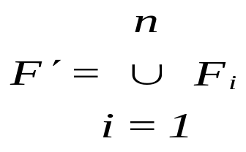
DESIRABLE PROPERTIES
Dependency Preservation
"Update validation without computation of joins"
Let F be a set of FDs on a scheme R, and R₁, ..., R_{n} be a decomposition of R. The restriction of F to R_{i} is the set F_{i} of all FDs in F⁺ that include only attrs of R_{i}. The set of restrictions F₁, F₂, ..., F_{n} is the set of dependencies that can be checked efficiently. Let
In general, F ≠ F'.
A dependency preserving decomposition has the property that (F')⁺ = F⁺, i.e., every dependency in F is logically implied by F'.

Slide 20
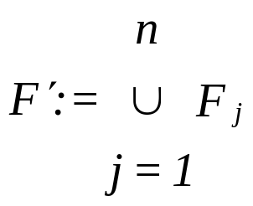
TESTING DEPENDENCY PRESERVATION
compute F⁺
For each scheme R_{i} in D do
F_{i} := the restriction of F⁺ to R_{i};
compute(F')⁺
return((F')⁺ = F⁺)
... Not always necessary to use this algorithm, we can check that each FD in F - F' is logically implied by F'

Slide 21
DEPENDENCY PRESERVATION
Suppliers EXAMPLES
1. suppliers(SNAME, SADDR, ITEM, PRICE)
R = {SNAME, SADDR, ITEM, PRICE}
F = {f₁: SNAME→SADDR, f₂: SNAME,ITEM→PRICE}
R₁ = {SNAME, SADDR} F₁ = {f₁}
R₂ = {SNAME, ITEM, PRICE} F₂ = {f₂}
F' = F,
∴ dependency preserving

Slide 22
DEPENDENCY PRESERVATION
Addresses Example
2. addresses(NAME, CITY, ZIP)
(a) F = {f₁: NAME→CITY, f₂: ZIP→CITY}
R₁ = {NAME, ZIP} F₁ = ∅
R₂ = {ZIP, CITY} F₂ = {f₂}
F' = {f₂} F - F' = {f₁}
Is f₁ logically implied by F' ?
No, ∴ NOT dependency preserving
(b) F ={f₁: NAME → ZIP, f₂: ZIP → CITY}
R₁ = {NAME, ZIP} F₁ = {f₁}
R₂ = {CITY, ZIP} F₂ = {f₂}
F' = F, ∴ dependency preserving
Note:
A decomposition may have a lossless-join w.r.t. F yet not preserve F.
A decomposition could preserve F yet not have a lossless-join.

Slide 23
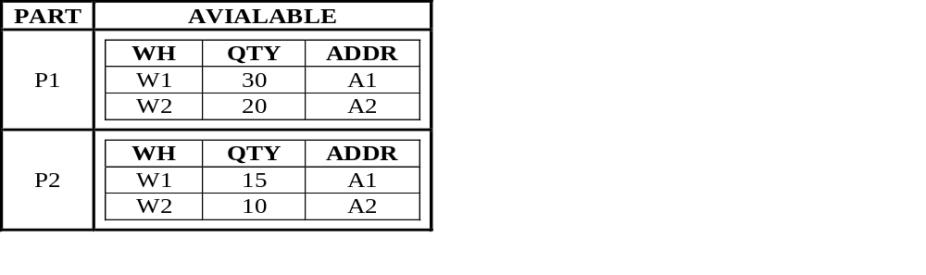
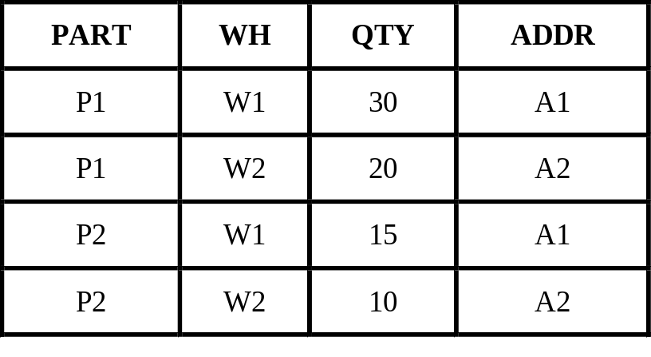
DESIRABLE PROPERTIES
No Repetition Of Information
Normal forms represent degrees of redundancy ...
UNNORMALIZED
1NF
1NF: A relation scheme is in 1NF if the domains of all attributes of R are atomic. (Basic assumption of relational databases)
The 1NF design still exhibits redundancy of data.

Slide 24
NORMAL FORMS
2NF
A relation scheme is in 2NF if each attr A in R either
• appears in a candidate key, or
• is not partially dependent on a candidate key
A FD X→Y is a partial dependency if there is a proper superset Z of X s.t. Z→Y. Y is partially dependent on Z.
Example: R = {PART, WH, QTY, ADDR}
F = {PART, WH→QTY, WH→ADDR} ⇒ R is not in 2NF
2NF:
R₁ = {PART, WH, QTY} PART,WH→QTY
R₂ = {WH, ADDR} WH→ADDR

Slide 25
NORMAL FORMS
3NF
A relation scheme R is in 3NF if for all FDs that hold on R of the form X→Y, where X ⊆ R and Y ⊆ R, at least one of the following holds:
• X→Y is a trivial FD
• X is a superkey
• Y is contained in a candidate key for R
Example: R = {EMP, DEPT, LOC}
F = {f₁: EMP→DEPT, f₂: DEPT→LOC}
R is in 2NF, but not in 3NF since DEPT→LOC violates 3NF.
3NF: R1 = {EMP, DEPT} F₁ = {f₁}
R2 = {DEPT, LOC} F₂ = {f₂}

Slide 26
NORMAL FORMS
Boyce-Codd Normal Form (BCNF)
A relation scheme is in BCNF if for all FDs that hold on R of the form X→Y, where X ⊆ R & Y ⊆ R, at least one of the following holds:
• X→Y is a trivial FD
• X is a superkey for scheme R
Example: R = {EMP, PHONE, PROJECT, HRS}
F = {EMP→PHONE, EMP PROJECT→HRS, PHONE→EMP, PHONE PROJECT→HRS}
candidate keys: EMP PROJECT and PHONE PROJECT
3NF, but not BCNF: EMP/PHONE not superkey
BCNF: R₁ = {EMP, PHONE} F₁ = {EMP→PHONE,
PHONE→EMP}
R₂ = {EMP, PROJECT, HRS} F₂ = {EMP,PROJECT→HRS}

Slide 27
BCNF DECOMPOSITION ALGORITHM
Let R be a given relation scheme, F be the given set of FDs on R.
Result := {R};
Done := FALSE;
compute F⁺;
while (not DONE) do
if there is a scheme R_{i} in Result that is not in BCNF
{Let X→Y be a nontrivial FD on R_{i} s.t.
X→R_{i} is not in F⁺ /* not already in BCNF */
Result := (Result - R_{i}) ∪ (R_{i} - Y) ∪ (X ∪ Y) }
else
DONE := TRUE;
Note: The order in which the Fds are chosen for decomposition affects the resulting schema.

Slide 28
BCNF DECOMPOSITION ALGORITHM
Guarantees Lossless-join property
Result := (Result - Ri) ∪ (Ri - Y) ∪ (X ∪ Y)
The new relations added at each step are:
(Ri - Y) & (X ∪ Y)
Lossless-join check on new relations:
(Ri - Y) ∩ (X ∪ Y) = {X}
We know that X→Y.
The attribute closure of X: (X)⁺ → XY
functionally determines the scheme of (X ∪ Y)
∴ lossless-join decomposition
However, not every BCNF decomposition is dependency preserving.

Slide 29
BCNF & DEPENDENCY PRESERVATION
Counter-example
Let S = {J, K, L}
F = {JK→L, L→K}
S is not in BCNF since L→K but L is not a superkey.
(L)⁺ = {L, K}, missing J.
BCNF decomposition of S using L→K:
S1 = {L, K} L→K
S2 = {J, L}
S1 & S2 preserve only L→K (& trivial dependencies)
but closure of {L→K} does not include JK→L
∴ not dependency preserving, but BCNF and lossless-join

Slide 30
DESIGN QUESTION
As a DBA, if you had to choose between a design being
• BCNF
• Lossless-join
• Not dependency preserving
versus, a design being
• 3NF
• lossless-join
• dependency preserving & lossless-join
which one would you choose?
High performance penalty for data integrity
versus
limited amount of redundancy

Slide 31
DESIGN EXAMPLE
BCNF Decomposition Algorithm
Using FDs for the company enterprise, design a relational schema using the BCNF decomposition algorithm and comment on its properties with respect to lossless-join, dependency preservation and normal form:

Slide 32
MINIMAL FUNCTIONAL DEPENDENCIES
A set of FDs F is minimal if it satisfies the following conditions:
1. “Single attribute RHS”
Every dependency in F has a single attribute on the RHS.
2. "No extraneous attributes"
We cannot replace any dependency X→A in F with a dependency Y→A, where Y is a proper subset of X, and still have a set of dependencies equivalent to F
3. "No redundant FDs"
We cannot remove any dependency from F and still have a set of FDs that is equivalent to F

Slide 33
MINIMAL FUNCTIONAL DEPENDENCIES
Testing Conditions
Use decomposition FD inference rule
if X → YZ, then X → Y & X → Z
2. Let X = Y ∪ B
attribute B is extraneous for X → A iff A is in (Y)⁺ w.r.t. F
3. For no X → A in F is the set F - {X → A} equivalent to F
compute (X)⁺ w.r.t. F - {X → A}
if A in (X)⁺, then X → A redundant
Note: To guarantee minimal cover, apply conditions in order.

Slide 34
RELATIONAL SYNTHESIS
("Bottom-up Decomposition")
Guarantees 3NF, lossless-join & dependency preservation
Find a minimal cover G for F
For each LHS X that appears in G, create a relation scheme
{X ∪ A₁ ∪ ... ∪ A_{m}}, where X→A₁, ..., X→A_{m} are all the dependencies in G with X as a LHS.
3. Replace all remaining (unplaced) attributes in a single relation schema.
4. If none of the relations contains a key for R, create one or more relation schema that contain attributes that form a key of R.

Slide 35
RELATIONAL SYNTHESIS
Supplier Example
F = { SNAME → SADDR,
SNAME ITEM → PRICE}
r₁(SNAME, SADDR)
r₂(SNAME, ITEM, PRICE)

Slide 36
RELATIONAL SYNTHESIS
Addresses Example
a) F = {NAME→CITY, ZIP→CITY}
r₁(NAME, CITY)
r₂(ZIP, CITY)
r₃(NAME, ZIP)
b) F = {NAME→ZIP, ZIP→CITY}
r₁(NAME, ZIP)
r₂(ZIP, CITY)

Slide 37
RELATIONAL SYNTHESIS
Employee-Phone Example
F = { EMP→PHONE, PHONE→EMP, EMP PROJECT→HRS }
r₁(EMP, PHONE)
r₂(PHONE, EMP)
r₃(EMP, PROJECT, HRS)
Due to the similarities of r₁ and r₂, create only one relation:
r_{1 & 2}(EMP, PHONE)
r₃(EMP, PROJECT, HRS)

Slide 38
DESIGN EXAMPLE
Bottom-up Synthesis
Using FDs for the company enterprise, design a relational schema using bottom-up synthesis and comment on its properties with respect to lossless-join, dependency preservation and normal form:

