Slide 1
CSE 412/598
DATABASE MANAGEMENT
COURSE NOTES
4. RELATIONAL DATA MODEL
&
ER MAPPING
Department of Computer Science & Engineering
Arizona State University

Slide 2
RELATIONAL DATA MODEL
Informally, a relational database consists of a collection of tables, each of which is assigned a unique name.
relation ≈ table
tuple ≈ row
attribute ≈ column (name)
Formally,
Let D₁,D₂,...,D_{n} be sets of atomic values, called domains
An n-tuple is an ordered sequence (d₁,d₂,...,d_{n}) s.t. d_{i} ∈ D_{i}
A relation with n attributes is a set of n-tuples, which is a subset of the cartesian product of the domains of the attributes
D₁ × ... × D_{n} where D_{i} is the domain of the i^{th} attribute

Slide 3
RELATIONAL DATABASE
Let |D_{i}| denote the cardinality (number of values) of domain D_{i}
Then the cartesian product specifies all possible combinations of values from the underlying domains and has total number of tuples:
|D₁| * |D₂| * ... * |D_{n}|
A relational database is a set of relations.
Since a relation is a set (unordered collection of unique elements)
of tuples
• The tuples in a relation are unordered.
• There are no duplicate elements in a set, i.e., each tuple is different.

Slide 4
EXAMPLE RELATION
Conceptually, we can view a relation as a table:
student
id | name | major
1111 | Student1 | CSE
2222 | Student2 | EEE
3333 | Student3 | CSE
4444 | Student4 | EEE
5555 | Student5 | CSE
The set of attributes names for a relation schema
student(id, name, major)
is denoted by
STUDENT = {id,name,major}

Slide 5
MAPPING ER TO RELATIONS
The ER approach represents a conceptual design, which provides the database designer with a tool to use in an actual design for a particular data model.
We consider here the mapping of entities and relationships from an ER diagram to the relations for the relational data model. Although this mapping is somewhat flexible, we will consider heuristics for this mapping by looking at examples of various entities and relationships of different cardinality ratios.

Slide 6
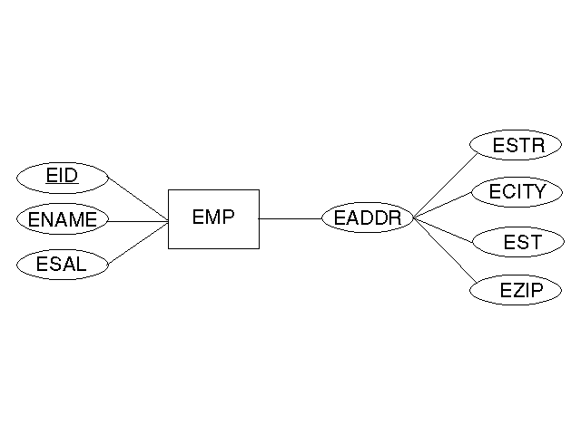
STRONG ENTITY
Attributes: simple attributes of the entity and the simple components of the composite attributes
Candidate Key: candidate key of entity
emp(eID, eName, eSal, eStr, eCity, eSt, eZip)

Slide 7
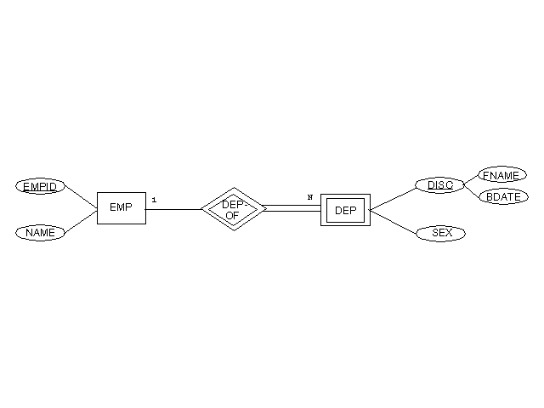
WEAK ENTITY
Attributes: simple attributes and simple components of composite attributes of the entity itself and the attributes corresponding to the primary key of its identifying owner
Candidate Key: combination of the attributes of the primary key of the identifying owner and the discriminator (partial key) of the weak entity
dep(empID, fName, bDate, sex)

Slide 8
RELATIONSHIP TYPES
Attributes: simple attributes and simple components of composite attributes of the relationship type and the attributes corresponding to the primary key of each entity involved in the relationship type.
Candidate Key: dependent on the cardinality ratio of the relationship type
Note that this is a general scheme for mapping relationship types to relations. We will see other alternatives based on the cardinality ratio of the relationship type.

Slide 9
1:1 CARDINALITY RATIO
Candidate Key: each primary key of the entity types involved in the relationship represents a candidate key; choose one as a primary key
mgr(id,dnum)
dept(dnum,dname)
emp(id,name)
Alternative Design:
• No relation for the relationship type itself
• Add to one of the relations:
  - attributes corresponding to the primary key of the other entity involved in the relationship type
  attributes of the relationship type itself (if any);
  If possible, add the attributes to the relation for the entity that has total participation in the relationship type.
dept(dnum,dname,mgrid)
emp(id,name)

Slide 10
1:N CARDINALITY RATIO
Candidate Key: the attributes that form the primary key of the many entity in the relationship
teaches(crsid,tname)
course(crsid,title) teacher(tname,dept)
Alternative Design:
• No relation for the relationship type itself
• Add to the relation for the entity on the many side of the relationship type:
- attributes corresponding to the primary key of the entity on the one side of the relationship type
- attributes of the relationship type itself (if any)
course(crsid,title,tname)
teacher(tname,dept)

Slide 11
M:N CARDINALITY RATIO
Candidate Key: combination of the attributes that form the primary keys of both entities involved in the relationship type
export(cname,pnum,qty)
NOTE:
  The candidate key must be based on the semantics of the enterprise.
  The meaning of the descriptive attributes of the relationship must be considered when determining the candidate key of the relation.

Slide 12
MAPPING EXERCISE
Map the ER diagram for employee training courses into the relational data model:

Slide 13
DB SCHEMA & INSTANCES
(A More Formal Look)
A Relational Database Schema S is a set of relation schemes S={R₁, R₂, ..., R_{m}} and a set of integrity constraints IC.
A Relational Database Instance DB of S is a set of relation instances DB={r₁, r₂, ..., r_{m}} s.t. each r_{i} is an instance of R_{i} and the r_{i}'s satisfy IC.
Integrity Constraints
- Key Constraint:
specify the candidate key of each relation schema.
- Entity Integrity Constraint:
no primary key value can be null.
- Referential Integrity Constraint:
a tuple in one relation that refers to another relation must refer to an existing tuple in that relation.

Slide 14
FOREIGN KEY
Consider a referential integrity constraint between two relation schemes R₁ and R₂. A set of attributes F_{k} in R₁ is a foreign key of R₁ if
1. the attrs of F_{k} have the same domain as the primary key attrs P_{k}
of the relation scheme R₂ that F_{k} references, and
2. let t₁ be a tuple of r₁, either
t₁[F_{k}]=t₂[P_{k}] for some t₂ of r₂
or
t₁[F_{k}] is null.

Slide 15
QUERY LANGUAGES
A query language is a language for requesting data from the database.
PROCEDURAL/IMPERATIVE LANGUAGE:
instructs the system to perform a sequence of operators to compute a result
RELATIONAL ALGEBRA
NON-PROCEDURAL /DECLARATIVE LANGUAGE:
tells what data is to be retrieved but does not tell the system how to retrieve the data
RELATIONAL CALCULUS (Domain/Tuple)
SQL

