Slide 1
CSE 412/598
DATABASE MANAGEMENT
COURSE NOTES
8. RELATIONAL CALCULUS
Department of Computer Science & Engineering
Arizona State University

Slide 2
RELATIONAL CALCULUS
Relational algebra is a procedural language, giving the operations to retrieve the data from the database.
Relational calculus is a declarative (nonprocedural) query language, indicating the properties of the data to retrieve from the database.
Tuple Relational Calculus (TRC) - variables represent tuples
Domain Relational Calculus (DRC) - variables represent domains

Slide 3
TUPLE RELATIONAL CALCULUS (TRC)
{T | cond(T)}
"The set of all tuples T that satisfy the condition".
Formal specification
{T₁.a₁, T₂.a₂, ..., T_{n}.a_{n} | cond(T₁, ..., T_{n}, T_{n+1}, ..., T_{n+m})}
where
T_{i} - tuple variables
a_{i} - attributes
T_{i}.a_{j} - indicates attributes to be projected
cond - is a formula constructed out of atoms, specifying selection (and possibly, join conditions)

Slide 4
ATOMIC FORMULA
ATOM
r(T) where T is a tuple variable and r is a relation
T_{i}.a θ T_{j}.b where θ ∈ {<, ≤, =, ≠, >, ≥}
T_{i}.a θ c where c is a constant

Slide 5
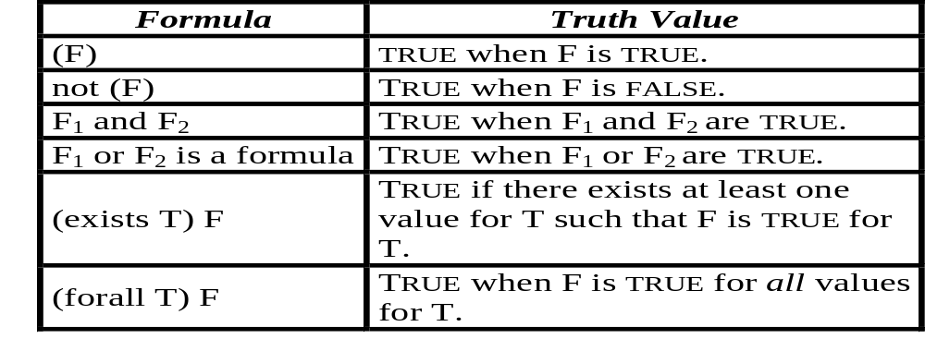
ATOMIC FORMULA
FORMULA
A formula is composed of atoms using the following rules:
An atom is a formula. Its truth value is given by the truth value of the atom.
Let F, F₁ and F₂ be formulas, then the following are formulas:

Slide 6
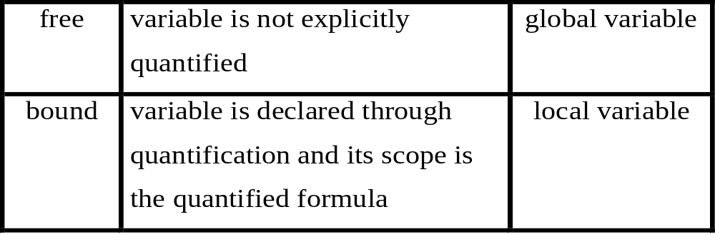
VALID TRC EXPRESSION
Free vs. Bound Variables
A valid TRC expression
{ T1, T2, …, Tn | F(T1, T2, … Tn) }
has only the tuple variables appearing to the left of the vertical bar (|) free in F. Any other variable appearing in F must be bound.

Slide 7
TRC
Fundamental Relational Algebra Operators
r ∪ s: {T | r(T) or s(T)}
e.g. {T | cse_majors(T) or eee_majors(T)}
r - s: {T | r(T) and not(s(T))}
e.g. {T | cse_majors(T) and not(eee_majors(T))}
σ_{P}(r): {T | r(T) and P}
e.g. {T | cse_majors(T) and T.class='SR'}

Slide 8
TRC
Fundamental Relational Algebra Operators
π_{A}(r): {T.a₁, T.a₂, ..., T.a_{n} | r(T)}
where A={a₁, a₂, ..., a_{n}} and A ⊆ attr(r)
e.g. {T.id, T.name | cse_majors(T)}
r x s: {T_{r}.a₁, ..., T_{r}.a_{n}, T_{s}.a_{n+1}, ..., T_{s}.a_{n+m} | r(T_{r}) and s(T_{s})}
where {a₁,...,a_{n}} = attr(r) and {a_{n+1},...,a_{n+m}} = attr(s)
e.g. {P.name, P.office, C.crsid, C.crstitle |
cse_profs(P) and cse_courses(C)}

Slide 9
TRC
Additional Relational Algebra Operators
r ∩ s: {T | r(T) and s(T)}
e.g. {T | cse_majors(T) and eee_majors(T)}
r _{θ} s: {T_{r}, T_{s} | r(T_{r}) and s(T_{s}) and θ}
e.g. {P, T |
cse_profs(P) and teaches(T) and P.name = T.tname}
r s: {T'_{r}, T'_{s} | r(T_{r}) and s(T_{s}) and θ}
where T'_{r}, T'_{s} - conjunction of T_{r} and T_{s} without duplicate attributes
θ - implicit natural join condition
e.g. {P, C| (exists T) (cse_profs(P) and
cse_courses(C) and teaches(T) and
P.name = T.name and C.crsid = T.crsid)}

Slide 10
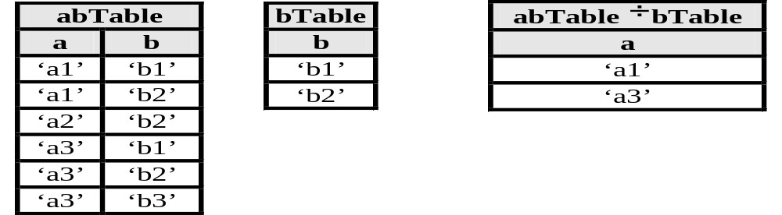
TRC
Division
abTable ÷ bTable
Which a’s are related to all b’s in the bTable?
UNIVERSAL QUANTIFICATION & IMPLICATION
{T.a | abTable(T) and (forall B) (bTable(B) →
(exists AB) (abTable(AB) and AB.a = T.a and AB.b = B.b))};
However, the → symbol is not defined in the TRC language.

Slide 11
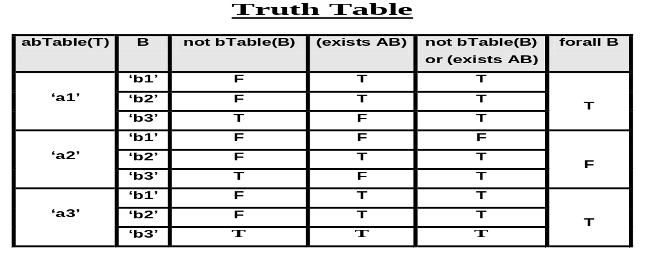
TRC Division: Universal Quantification p → q ≡ not p or q
{T.a | abTable(T) and
(forall B) (not bTable(B) or
(exists AB) (abTable(AB) and
AB.a=T.a and AB.b=B.b))};

Slide 12
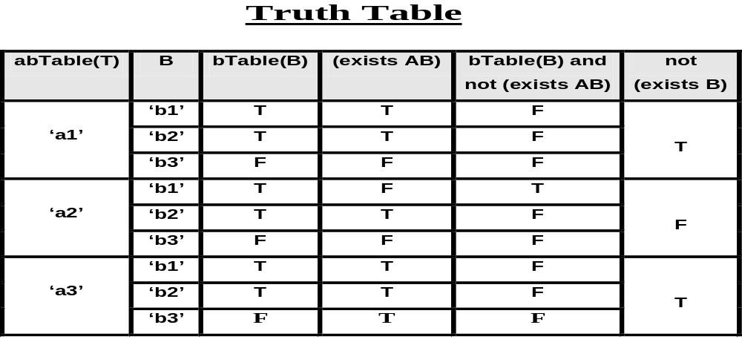
TRC Division: Existential Quantification
(forall X)(F(X)) ≡ not (exists X) not (F(X))
{T.a | abTable(T) and not (exists B)
(bTable(B) and not (exists AB)
(abTable(AB) and AB.a = T.a and AB.b = B.b))};

Slide 13
SAFETY
A property that guarantees a finite number of tuples.
{T | not(db_courses(T))}
e.g., there are infinitely many tuples that are not in the relation db_courses.
Additional aspect w.r.t. Prolog implementation:
Safe:
{T | cse_majors(T) and T.class = 'SR'}
Unsafe (checking the value before assigning a value to the variable):
{T | T.class = 'SR' and cse_majors(T)}

Slide 14
TRC EXERCISES
emp(id, name, sal, dnum) dept(dnum, dname, mgrid)
takes(id, crsid, date) course(crsid, cname, inst, len)
List the names of the employees who took the course with crsid
value ‘DB1’ on '25Jun90'.
What is the name of John Smith’s manager and department?
Which employees took all of the training courses offered by the
company?

Slide 15
DOMAIN RELATIONAL CALCULUS (DRC)
Domain Relational Calculus is a declarative query language. It is quite similar to Tuple Relational Calculus, except that variables range over domains (attributes/columns) instead of tuples (rows).
{X₁, X₂, ..., X_{n} | cond(X₁, ..., X_{n}, X_{n+1}, ..., X_{n+m})}
where
X₁, X₂, ..., X_{n} indicate variables projected in result
cond is a formula specifying selection (or possibly join) conditions

Slide 16
DRC
Formulas, Variable & Expressions
Atomic Formulas:
• r(X₁, X₂, ..., X_{n})
relation of arity n and X_{i} is a domain variable
• X θ Y θ ∈ {<, >, ≤, ≥, =, ≠}
• X θ c
• c θ X
Formulas, free/bound variables, and valid DRC expressions are defined in a similar way to TRC ...

Slide 17
DRC
Fundamental Relational Algebra Operators
r ∪ s: {X₁, X₂, ..., X_{n} | r(X₁, X₂, ..., X_{n}) or s(X₁, X₂,..., X_{n})}
e.g. {Id, Name, Class | cse_majors(Id, Name, Class) or
eee_majors(Id, Name, Class)}
r - s: {X₁, X₂, ..., X_{n} | r(X₁, X₂, ..., X_{n}) and not(s(X₁, X₂, ..., X_{n}))}
e.g. {Id, Name, Class | cse_majors(Id, Name, Class) and
not(eee_majors(Id, Name, Class))}
σ_{P}(r): {X₁, X₂, ..., X_{n}|r(X₁, X₂, ..., X_{n}) and X_{i} θ c} where P is X_{i} θ c
e.g. {Id, Name, Class | cse_majors(Id, Name, Class) and
Class = 'SR'}

Slide 18
DRC
Fundamental Relational Algebra Operators
π_{A}(r): {X_{j1}, ..., X_{jk} | (exists X_{jk+1}, ..., X_{jn})(r(X₁, ..., X_{n}))}
e.g. {Id, Name | (exists Class) (cse_majors(Id, Name, Class))}
r x s: {X₁, ..., X_{n}, Y₁, ..., Y_{m} | r(X₁, ..., X_{n}) and s(Y₁, ..., Y_{m})}
e.g. {Name, Office, CrsId, CrsTitle |
cse_profs(Name, Office) and cse_courses(CrsId, CrsTitle)}

Slide 19
DRC
Additional Relational Algebra Operators
r ∩ s: {X₁, ..., X_{n} | r(X₁, ..., X_{n}) and s(X₁, ..., X_{n})}
e.g. {Id, Name, Class | cse_majors(Id, Name, Class) and
eee_majors(Id, Name, Class)}
r _{θ} s: {X₁, ..., X_{n}, Y₁, ..., Y_{m} | r(X₁, ..., X_{n}) and s(Y₁, ..., Y_{m}) and θ}
e.g. {Name, Office, Tname, Crsid | cse_profs(Name, Office) and
teaches(Tname, Crsid) and Name = Tname}
r s: {X_{j1}, ..., X_{jr}, Y_{k1}, ..., Y_{ks} | (exists X_{jr+1}, ..., X_{jn}, Y_{ks+1}, ..., Y_{km})
(r(X₁, ..., X_{n}) and s(Y₁, ..., Y_{m}) and θ)}
where θ - implicit natural join condition
or use same variable names to perform natural join
e.g. {Name, Office, Crsid, Crstitle | (cse_profs(Name, Office) and
teaches(Name, Crsid) and cse_courses(Crsid, Crstitle)}

Slide 20
DRC
Division
abTable ÷ bTable
Which a’s are related to all b’s in the bTable?
UNIVERSAL QUANTIFICATION & IMPLICATION
{A | abTable(A, _) and (forall B) (bTable(B) → abTable(A, B))};
However, the → symbol is not defined in the DRC language.

Slide 21
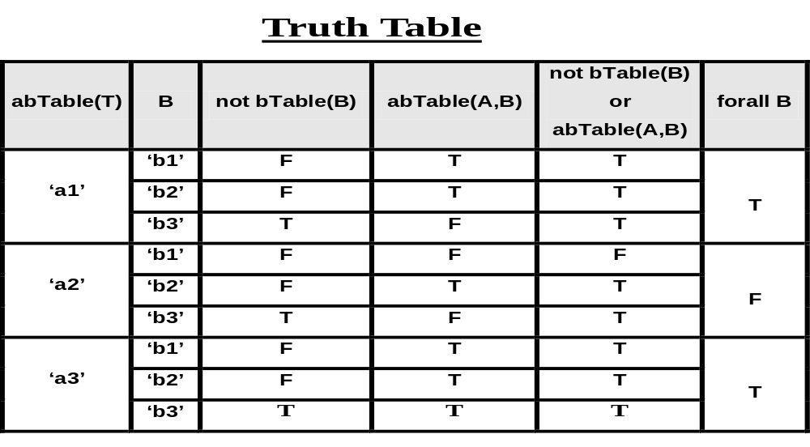
DRC Division: Universal Quantification p → q ≡ not p or q
{A | abTable(A, _) and (forall B) (not bTable(B) or abTable(A,B))};

Slide 22
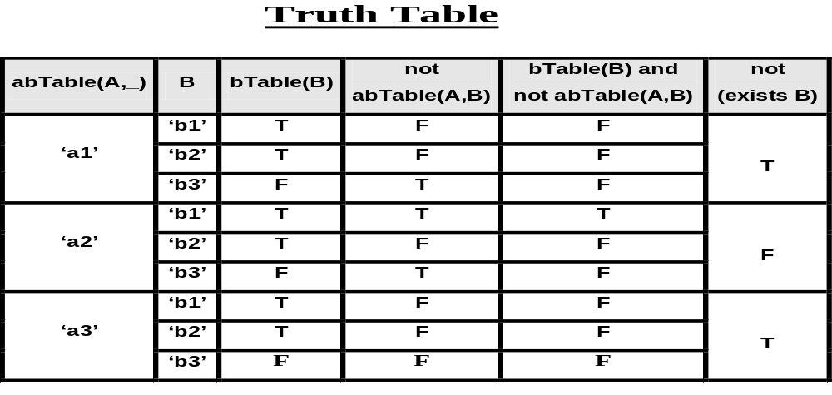
DRC Division: Existential Quantification
(forall X)(F(X)) ≡ not (exists X) not (F(X))
{A | abTable(A, _) and not (exists B)
(bTable(B) and not abTable(A,B))};

Slide 23
SAFETY
A property that guarantees a finite number of tuples.
{DB | not(db_courses(DB))}
e.g. there are infinitely many tuples that are not in the relation db_courses.
Additional aspect with respect to the Prolog implementation:
Safe:
{Id, Name, Class |
cse_majors(Id, Name, Class) and
not(eee_majors(Id, Name, Class)) }
Unsafe (checking the value before assigning a value to the variable):
{Id, Name, Class |
not(eee_majors(Id, Name, Class)) and
cse_majors(Id, Name, Class) }

Slide 24
DRC EXERCISES
emp(id, name, sal, dnum) dept(dnum, dname, mgrid)
takes(id, crsid, date) course(crsid, cname, inst, len)
List the names of the employees who took the course with crsid
value ‘DB1’ on '25Jun90'.
What is the name of John Smith’s manager and department?
Which employees took all of the training courses offered by the
company?

Slide 25
EXPRESSIVE POWER
RELATIONAL
ALGEBRA
SAFE SAFE
TUPLE DOMAIN
RELATIONAL RELATIONAL
CALCULUS CALCULUS

Slide 26
CALCULUS AGGREGATION EXERCISE
“Find the employee(s) with the maximum salary”
emp(ID, NAME, SAL, SUPERID, DNO)
TRC: {E.id, E.name, E.sal | emp(E) and
not((exists T)(emp(T) and T.sal>E.sal))};
DRC: {Id, Name, Sal | emp(Id, Name, Sal, _, _) and
not((exists S)(emp(_, _, S, _, _) and S > Sal))};
How would you modify these query specifications if you were asked to find the employees having the maximum salary in each department…

