Slide 1
CSE 412/598
DATABASE MANAGEMENT
COURSE NOTES
11. TRANSACTIONS, RECOVERY & CONCURRENCY CONTROL
Department of Computer Science & Engineering
Arizona State University

Slide 2
TRANSACTION
an atomic (all or nothing) program unit that performs database access or update, taking a consistent (correct) database state into another consistent database state.
database is consistent here
begin transaction; /* Transfer funds */
balance1 ← balance1 - amount
database is inconsistent here
balance2 ← balance2 + amount
end transaction; /* Transfer funds */
database is consistent here
ACID properties of a transaction
Atomicity, Consistency, Isolation, Durability

Slide 3
ATOMICITY
“The system under test must guarantee that transactions are atomic; the system will either perform all individual operations on the data, or will assure that no partially‑completed operations leave any effects on the data.” [TPCA89]
ATM WITHDRAWAL (amt)
read bal
if bal > amt {
bal ← bal - amt
/* system goes down */
dispense money
}
[TPCA89] TPC BENCHMARKTM A
Standard Specification, 10 November 1989

Slide 4
CONSISTENCY
“Consistency is the property that requires any execution of the transaction to take the database from one consistent state to another.” [TPCA89]
Since the assumption is that a transaction is written so that it is consistent, consistency means that it remains consistent in the presence of the concurrent execution of transactions. (Serializability)
ATM WITHDRAWAL (amt1) ATM WITHDRAWAL (amt2)
read bal
if bal > amt1 read bal
{ if bal > amt2
bal ← bal - amt1 {
dispense money bal ← bal - amt2
} dispense money
}

Slide 5
ISOLATION
The transaction should not reveal its uncommitted results to other transactions ...
ATM WITHDRAWAL (amt1) ATM WITHDRAWAL (amt2)
read bal
if bal > amt1
{
bal <- bal - amt1 read bal
/* trans aborted */ if bal > amt2
dispense money {
} bal ← bal - amt2 dispense money }

Slide 6
DURABILITY
“The test bed system must guarantee the ability to preserve the effects of committed transactions and insure database consistency after recovery” from single failures... [TPCA89]
permanent irrecoverable failure of any single durable
medium containing database or recovery log data
system crash/hang requiring system reboot
memory failure (all or part)

Slide 7
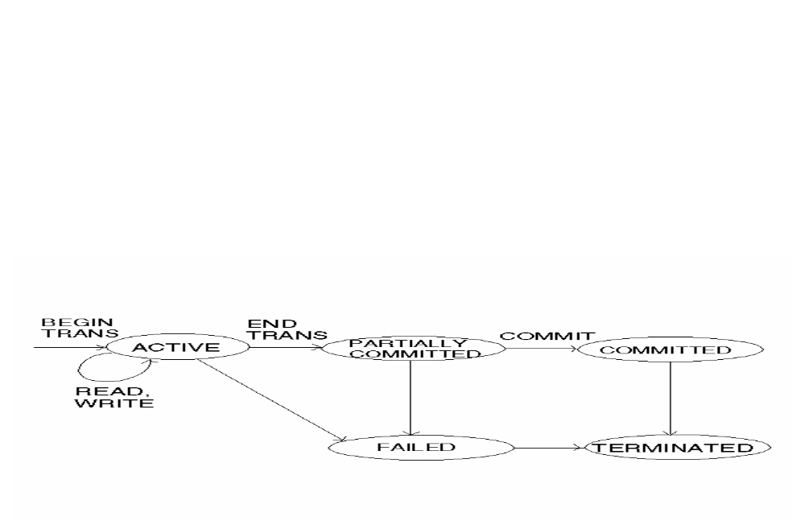
RECOVERY CONTROL
integral part of the DB, responsible for
the detection of failures
restoration of the DB to a (consistent) state that existed prior to the failure.
responsibility of the recovery scheme to ensure atomicity.

Slide 8
SYSTEM LOG
Records all transaction operations that affect the value of database items to be able to recover from failure.
Log is kept on disk & periodically backed up to archival storage.
Let T be a unique transaction ID,
X be a database item.
LOG ENTRIES
[start-transaction, T]
[write-item, T, X, new_value], or
[write-item, T, X, old_value, new_value]
[read-item, T, X]
[commit, T]

Slide 9
SYSTEM LOG ASSUMPTIONS
Transactions are not nested
All permanent changes to the DB occur within transactions; so using the log, operations can be undone or redone based on transaction state.

Slide 10
INCREMENTAL LOG WITH
IMMEDIATE UPDATES
This protocol uses
[start-transaction, T]
[read-item, T, X]
[write-item, T, X, old_value, new_value]
[commit, T]
Log records must be written to “stable storage” before executing an immediate update.

Slide 11
INCREMENTAL LOG WITH
IMMEDIATE UPDATES
Recovery scheme:
Undo(T_{i}) where T_{i} is uncommitted transaction
Redo(T_{j}) where T_{j} is committed transaction
Redo & Undo must be idempotent – “executing it several times is equivalent to executing it once.”

Slide 12
INCREMENTAL LOG WITH
DEFERRED UPDATES
During the execution of a transaction, all the write operations are deferred, recorded on a log and transaction workspace, until the transaction partially commits.
At commit point, log is force written to disk and deferred writes are executed.
This protocol uses entries:
[start-transaction, T]
[write-item, T, X, new_value]
[commit, T]

Slide 13
INCREMENTAL LOG WITH
DEFERRED UPDATES
Recovery scheme
Log entries for uncommitted transactions are ignored because writes are deferred.
Committed transactions must be redone (in order).
Redo must be idempotent.

Slide 14
CHECKPOINTS
Log entry used to improve performance of recovery
[checkpoint] indicates that the system has written to the disk the effect of all write operations of committed transactions.
Transactions that have a commit entry before a checkpoint entry will NOT require their write operations to be redone in case of a system failure.
A checkpoint may contain additional info
list of active IDs
locations of first and most recent records in the log

Slide 15
SYSTEM LOG EXAMPLE
[start-trans T₁]
...
[commit T₁]
[start-trans T₂]
....
A:
[checkpoint]
B: ....
[commit T₂]
C:

Slide 16
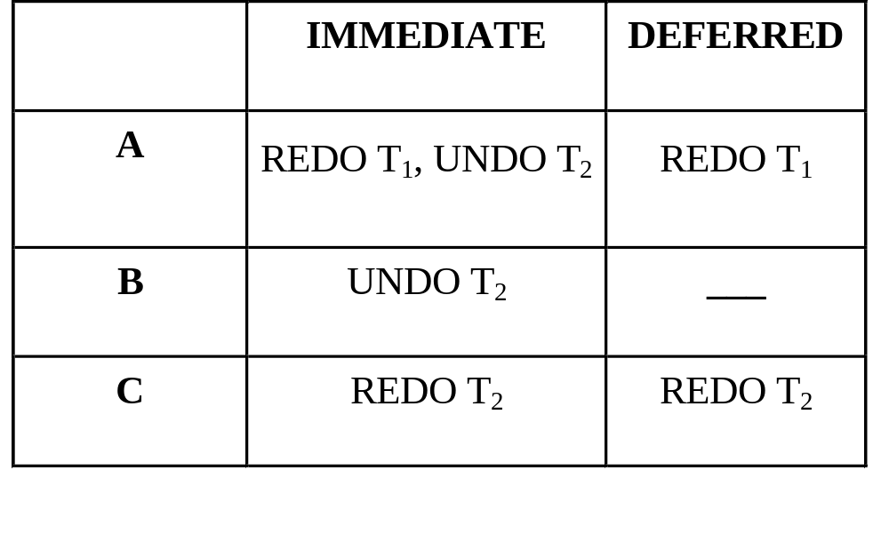
SYSTEM LOG EXAMPLE
Recovery Scheme

Slide 17
CONCURRENCY CONTROL
In a multiprogramming environment where several transactions may be executed concurrently, the system must control the interaction among the concurrent transactions in order to prevent them from destroying the consistency of the database.
SCHEDULE:
an execution sequence that must preserve the order in which the instructions appear in each individual transaction
SERIAL SCHEDULE:
a sequence of instructions from various transactions where the instructions belonging to one single transaction appear together in that schedule (for a set of n transactions, there are n! legal serial schedules)

Slide 18
EXAMPLE SCHEDULES
T₀ T₁
read_item(A) read_item(A)
write_item(A) read_item(B)
read_item(B) write_item(B)
write_item(B)
equivalently:
R₀(A)W₀(A)R₀(B)W₀(B)R₁(A)R₁(B)W₁(B)
Schedule of operations including multiple transactions.
S1: R₀(A)W₀(A)R₀(B)W₀(B)R₁(A)R₁(B)W₁(B) - serial
S2: R₁(A)R₁(B)W₁(B)R₀(A)W₀(A)R₀(B)W₀(B) - serial
S3: R₀(A)W₀(A)R₁(A)R₀(B)W₀(A)R₁(B)W₁(B) - not serial
Is it equivalent to a serial schedule?
Yes, it is equivalent to S1 ⇒ “serializability”

Slide 19
SERIALIZABILITY
ensuring that the outcome of processing a set of transactions concurrently
be the same as one produced by running these transactions serially in
some order
COMPUTATIONALLY EQUIVALENT:
S₁ = S₂ if
1. The set of transactions that participate in S₁ and S₂ are the same.
For each data item X, if in S₁ trans T_{i} executes read(X) and the value of X read by T_{i} was written by T_{j}, then the same will hold in S₂.
For each data item X, if in S₁ trans T_{i} executes the last write(X) instruction, then the same holds in S₂.
S is SERIALIZABLE if there is a serial schedule S' s.t. S=S'.

Slide 20
PRECEDENCE GRAPH
a direct graph G = (V,E) where
V = set of transactions participating in the schedule
E = set of edges T_{i} → T_{j} for which one of the following holds:
T_{i} executes write(X) before T_{j} executes read(X)
(only when T_{j} reads value written by T_{i})
T_{i} executes read(X) before T_{j} executes write(X)
(Intuitively, an edge T_{i} → T_{j} implies that in any serial schedule S‘ equivalent to S, T_{i} must appear before T_{j}.)
CONSTRAINED WRITE ASSUMPTION:
A transaction must read a data item before it can write it.
The schedule S is serializable if the precedence graph for S contains no cycles.

Slide 21
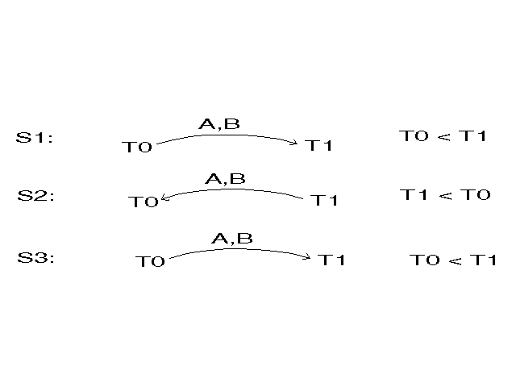
SERIALIZABILITY EXAMPLES

Slide 22
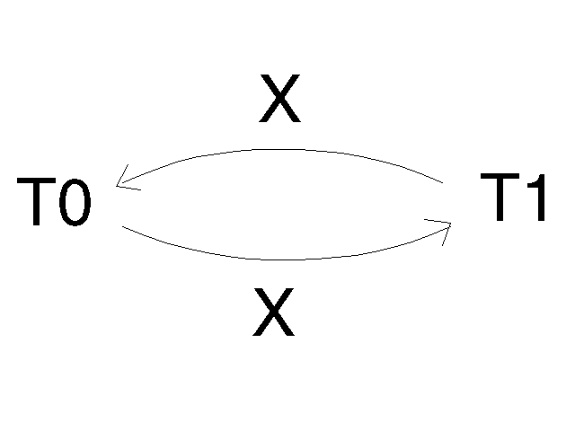
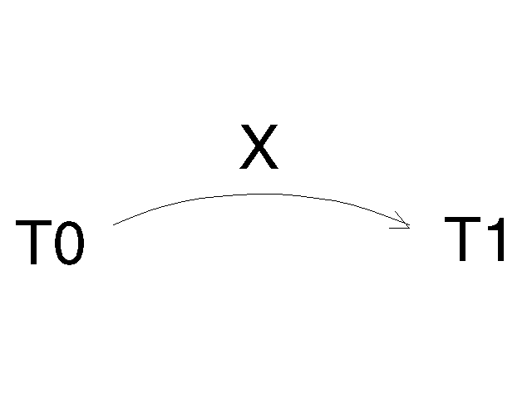
MORE SERIALIZABILITY EXAMPLES
S_{C}: R₀(X)R₁(X)W₀(X)R₀(Y)W₁(X)W₀(Y)
not serializable
S_{D}: R₀(X)W₀(X)R₁(X)W₁(X)R₀(Y)W₀(Y)
serializable
equivalent to serial schedule
R₀(X)W₀(X)R₀(Y)W₀(Y)R₁(X)W₁(X)

Slide 23
SERIALIZABILITY ORDER
a linear order consistent with the partial order of the precedence graph
Impractical to test for serializability ... protocols (sets of rules) are used
to ensure serializability
LOCKING (2PL)
TIMESTAMPS
All schedules allowed by 2PL/timestamps are serializable,
but 2PL/timestamps do not allow all possible serializable schedules.

Slide 24
LOCKING
To ensure serializability require access by locks.
LOCK MODES
READ/SHARED:
if a trans T has obtained a shared mode lock on item X by read_lock(X)/LS(X), then T can read this item but it cannot write X
WRITE/EXCLUSIVE:
if a trans T has obtained an exclusive mode lock on item X by write_lock(X)/LX(X), then T can both read and write X
UNLOCKED:
T unlocks data item X by issuing an unlock_item(X)/UN(X)

Slide 25
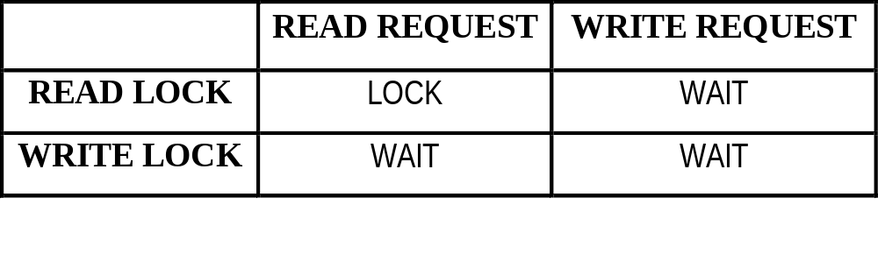
LOCK COMPATIBILITY MATRIX
LOCK:
Lock manager issues lock to requesting transaction
WAIT:
Transaction requesting lock must enter a wait state until lock issued by lock manager.

Slide 26
LOCKING ASSUMPTIONS
Well-formed Assumption:
Every transaction requests a lock in an appropriate mode on data item X depending on the type of operations it will perform on X. (Therefore, locks will not be escalated.) If the data item is already locked by another transaction in an incompatible mode, then T must wait until all incompatible locks held by other transactions have been released.

Slide 27
LOCKING OVERVIEW
If a trans unlocks a data item immediately after its last access of the data item, serializability may not be ensured.
Two‑phase locking protocol (2PL) ‑ ensures serializability.
• Growing phase: a trans may obtain locks but may not release any
locks.
• Shrinking phase: a trans may release locks but may not obtain any
new locks.
To guarantee isolation, locks must be held until the transaction reaches its commit point.
Deadlock can occur ‑ each of two transactions is waiting for the other to release an item.
Livelock can occur - a transaction cannot proceed for an indefinite amount of time while other transactions continue normally (lock manager must be fair).

Slide 28
EXAMPLE TRANSACTIONS
T₁: Display A+B T₂: Inc A & Dec B
R(B) R(A)
R(A) A ← A + 1
Display A+B W(A) R(B) B ← B - 1 W(B)

Slide 29
WELL-FORMED BUT NOT SERIALIAZABLE
T₁ T₂
LS(B)
R(B)
UN(B)
LX(A)
R(A)
A ← A + 1
W(A)
UN(A)
LX(B)
R(B)
B ← B – 1
W(B)
UN(B)
LS(A)
R(A)
UN(A)
Display A+B
S: R₁(B)R₂(A)W₂(A)R₂(B)W₂(B)R₁(A)

Slide 30
2PL: SERIALIAZABLE BUT NOT ISOLATED
T₁' T₂
LX(A)
R(A)
A ← A + 1
W(A)
LX(B)
UN(A)
LS(A)
R(A)
R(B)
B ← B – 1
W(B)
UN(B)
LS(B)
UN(A)
R(B)
UN(B)
Display A+B
S: R₂(A)W₂(A)R₁(A)R₂(B)W₂(B)R₁(B)

Slide 31
2PL & ISOLATION
T₁ T₂ T₃
LS(B)
R(B)
LS(B)
LS(A)
R(A)
R(B)
UN(B)
UN(A)
LX(A)
R(A)
A ← A + 1
W(A)
UN(B)
LX(B)
R(B)
B ← B – 1
W(B)
UN(B)
UN(A)
S: R₁(B)R₁(A)R₃(B)R₂(A)W₂(A)R₂(B)W₂(B)

Slide 32
DEADLOCK
T₁ T₂
LS(B)
R(B)
LX(A)
R(A)
A ← A + 1
W(A)
LS(A)
LX(B)

Slide 33
DEADLOCK
DEADLOCK - waiting for an event that will not occur
Necessary conditions for a deadlock to exist:
mutual exclusion: exclusive control of resources
wait for: resources held while waiting for additional ones
no preemption: resources are held until used to completion
circular wait: each transaction holds one or more resources requested by the next transaction in the circular chain

Slide 34
DEADLOCK APPROACHES
TIMEOUT: abort a transaction after it has been in a wait state for a specified time interval
° may abort a transaction not in deadlock
° difficult to determine appropriate timeout interval
° cascading effect due to system overload
DEADLOCK PREVENTION: a transaction is not allowed to enter a wait state if there is a risk of deadlock
DEADLOCK DETECTION: periodically check if the system is in deadlock and rollback a deadlocked transaction

Slide 35
TIMESTAMPS
A timestamp is a unique identifier assigned to a transaction when it starts. Concurrency control techniques use the timestamps to guarantee serializability. A transaction is aborted and restarted if the execution of its next operation would violate the serializability order. Thus, concurrency control based on timestamps do not suffer from deadlock.
TIMESTAMP ORDERING:
selecting a serializability order in advance between every pair of trans [not exactly ‑ see protocol]

Slide 36
TIMESTAMPS
Implementation
TS(T_{i}): unique fixed timestamp for trans T_{i}; assigned by the db system before Ti starts execution
If a trans T_{i} has timestamp TS(T_{i}) and a new trans T_{j} enters the system, then TS(T_{i}) < TS(T_{j})
Implementation of timestamp:
Use the value of the system clock
Use a logical counter that is incremented after a new timestamp has been assigned
write_TS(X):
the largest timestamp of any trans that successfully executes write(X)
read_TS(X):
the largest timestamp of any trans that successfully executes read(X)

Slide 37
BASIC TIMESTAMP METHOD
Let TS: timestamp of transaction requesting operation
READ(x,TS)
if TS < write_TS(x)
reject & restart
else
execute read
read_TS(x) ← max(read_TS(x), TS)
WRITE(x,TS) /* assume read before write */
if TS < read_TS(x)
reject & restart
else
execute write
write_TS ← TS

Slide 38
NOTES ON TIMESTAMPS
A trans Ti, which is rolled back as a result of the concurrency control scheme, is assigned a unique timestamp and restarted
Serializability ensured
Freedom from deadlock (since no trans ever waits)
May result in cascading rollbacks and livelock (“cyclic restart”)
NEITHER LOCKING NOR TIMESTAMPS ALLOW ALL POSSIBLE
SERIALIZABLE SCHEDULES...
some schedules are possible under each protocol that are not allowed in
the other

Slide 39
TIMESTAMPS OK - NOT 2PL
T₀ T₁ T₂
LX(A)
LX(B)
R-W(A)
UN(A)
LX(A)
R-W(A)
UN(A)
LX(A)
R-W(A)
UN(A)
R-W(B)
UN(B)
R-W(B) ← cannot get lock on B

Slide 40
2PL OK - NOT TIMESTAMPS
T₀ T₁
LS(A)
R(A)
LX(B)
R-W(B)
UN(B)
LS(B)
R(B) ← write-TS(B) = 1 & 0 < 1, ∴ reject & restart
UN(A)
UN(B)

