Slide 1


SaaS Pricing AI Chatbot – Discovery
Maximo
Jenny Qiu
Senior UX Designer
Maximo

Slide 2
Goal: Create a chatbot on IBM.com that provides pricing information for Maximo configurations.
Research plan
Research aims to understand
Current State: How tech sellers currently discuss pricing with clients and the most common questions they receive.
User Needs: When in the buying journey clients seek exact pricing and what they need to understand about configurations.
Ideal Experience: How clients would prefer to interact with an AI pricing tool.
Project artifacts:
Box folder →
Tech sellers interviewed
  Matt Simmons, West ALM (Maximo) SME
  Betsy Autry, ALM Ecosystem Leader, Americas
  Galina Mishiev, ALM Global Sales
  Erin Horbach, MREF Sales Leader
  Gaizka Llona, Senior Sales Specialist

Slide 3
Pre-requisites & recommendation for client solution success
  Pre-requisites for success
  ✅ Provide accurate user license recommendations based on client provided employee roles.
  ✅ Guidance on non-production environments & production DB replica needs.
  ✅ Accurate mapping of client needs → Maximo apps, add-ons, industry solutions.
  ✅ Accurate pricing where final cost = quoted cost or very close.
  ✅ For clients deciding between editions, especially Essentials vs. Standard, clearly explain the differences.
The challenge
This amount of information is too much complexity for a single AI chat conversation → risk of confusion & inaccurate results.
Recommendation:
Start with an interview-style guided workflow. Think TurboTax: step-by-step, conversational, and handling complex information. This can be done with logic.
Phase 1: Start with sellers to validate accuracy. Enable integration with CPQ
[outcome: fill out calculator automatically]
Phase 2: End-users (improve explainability)
Phase 3: expand functionality (eg. Generate spreadsheet quotes with AI, reference slide 8)
Why this approach works:
The sellers are already doing this manually, through questionnaires and guided flows (Figure B and C, slide 7). It simplifies complex decisions by guiding users through clear, step-by-step questions, ensuring accuracy and easy understanding.

Slide 4
Insights and recommendations– on clients
Delay pricing discussions until later in the sales journey
Provide user license recommendation based on client’s organizational roles
Do not present AppPoints to new clients without clear explanation
For clients who are new to MAS SaaS. New clients typically have limited familiarity with MAS, its licensing structure, and its pricing model.
Sellers typically have several calls to explain what MAS SaaS is, clarify AppPoints, outline the differences between editions, address technical questions (with PM and Tech Sales), and finally discuss pricing.
Showing customers the wrong pricing early can be risky if the final price ends up higher than the initial quote.
  Clients struggle to understand user license types (e.g., base, limited, premium, concurrent vs. authorized).
  Mapping job roles to license types is not intuitive and typically requires SME support.
  They often don’t know which licenses they need and simply want to be able to access the product whenever necessary.
Across interviews, sellers consistently reported that clients struggle to understand the AppPoints. Converting user types and modules into point values adds unnecessary complexity and often leads to confusion and delays in the sales process.
It can take up to a year of CSM enablement for customers to fully understand AppPoints and begin to appreciate the concept.
  “I think the potential danger is… if we say, oh, it's 35K for lease and then somebody comes in and says it's 150K to implement.” — Interview 1
  “I typically have 3-4 calls before discussing pricing” — Interview 5
  “They don’t know… Do I want concurrent or authorized? How much do I need in order to not overpay?...They’ll say I have 30 users—do I need all 30 licenses?” — Interview 2
  “What the hell is a field tech? I don’t know what that means.” — Interview 3
  “We received a file of their current people… and sat in Excel and said, oh, that’s probably a base user.” — Interview 1
  “3 clients are like, we don’t like AppPoints. They don’t make sense to us. Why are you doing this? Why is this so complicated? ...It’s another level of abstraction… Instead of just saying the technician costs $20 a month, it’s the technician is 2 AppPoints and 1 AppPoint equals $10." — Interview 1
  “Most of our customers are actually confused at just what an AppPoint is, much less the pricing calculator.” — Interview 2
  “Partners are like, blah… they just don’t [get it].” — Interview 3

Slide 5
Insights and recommendations– on internal tools
Incorporate sellers’ custom materials when designing AI solution
Improve usability of the existing AppPoint calculator
Enable integration between the calculator and CPQ
Recommendations for internal workflows and improvements
  Most sellers avoid showing the calculator to clients because it is too complex.
  Instead, they create their own calculators, questionnaires, and quote decks using elements from seismic presentations to make the information easier to understand.
  The AI solution should generate a pricing breakdown similar to what sellers manually create (see slide 8), based on client criteria outlined in the flow chart (Figure B, slide 7).
  Frequent calculator updates cause sellers to use outdated versions and restart from scratch
  Files must be saved as XLS for CPQ import
  Scrolling through all Essentials options to reach Standard and Premium is cumbersome
  Limited definitions for Premium features (e.g., Enhanced Disaster Recovery, non-shared cluster, industry solutions)
  Sellers must select an edition first, then return to add AI Service
  You cannot copy and paste part numbers from the calculator into CPQ; they must be retyped manually
  Streamlining the connection between the calculator and CPQ will reduce manual work and save seller's time
“Every seller sort of has to do it on their own right now… They’d like to not have to do that. It would be nice if the calculator could just show it.” — Interview 1
“That slide [Figure A, slide 6] is the best one we’ve ever had… Usually if a partner is confused, I send it to them.” — Interview 3
“This [Figure B flow chart, slide 7] must have a connection to the calculator.” – Interview 4
“It is a hot mess. I do not show the pricing calculator to the clients at all.” — Interview 2
“From a UX perspective, I’m sure you agree this is a mess.” — Interview 1
“I would like to collapse all this.” –Interview 4
“There’s no integration right now. The integration is me.” — Interview 4
“It's not only the amount of work that I need to do, but also the approvers. They need to go and confirm that the calculator matches all this” – Interview 4
“We have two files: user conversion TRI to MREF and then 2. users to AppPoints. Then sellers go into CPQ and try to figure out how to set up AppPoints and other required line items in the quoting. Streamline all of that would be great” Interview 1

Slide 6
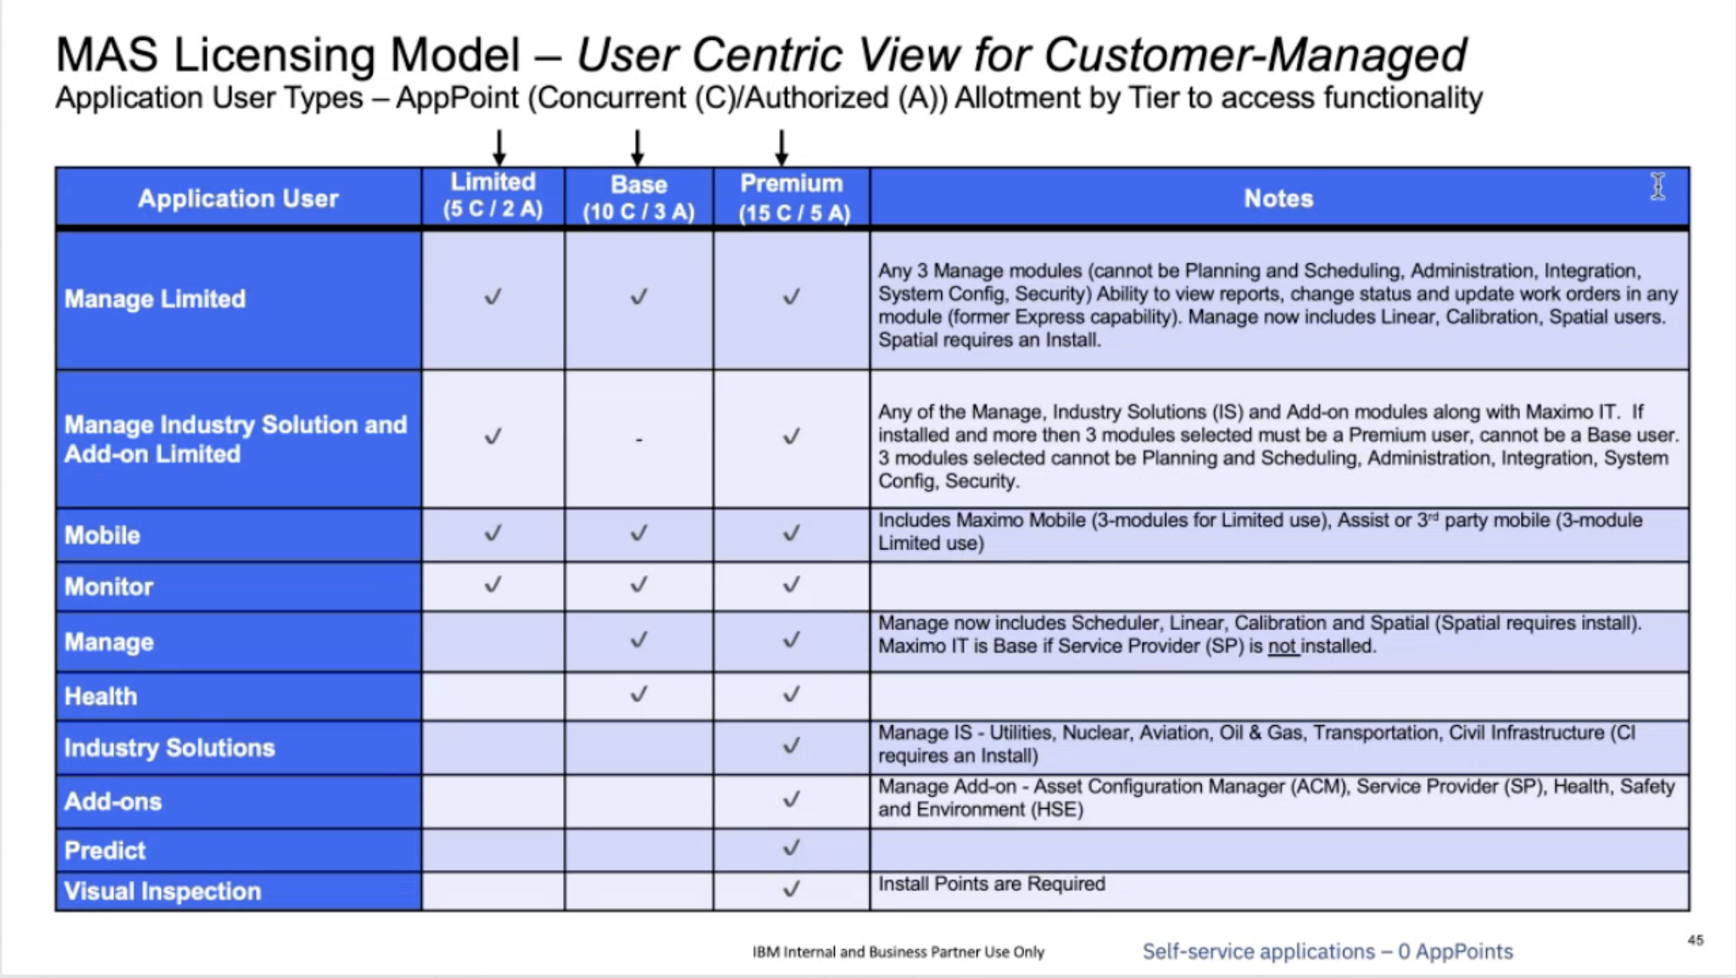
Figure A: User licensing model from June 2024 pricing and packaging deck

Slide 7
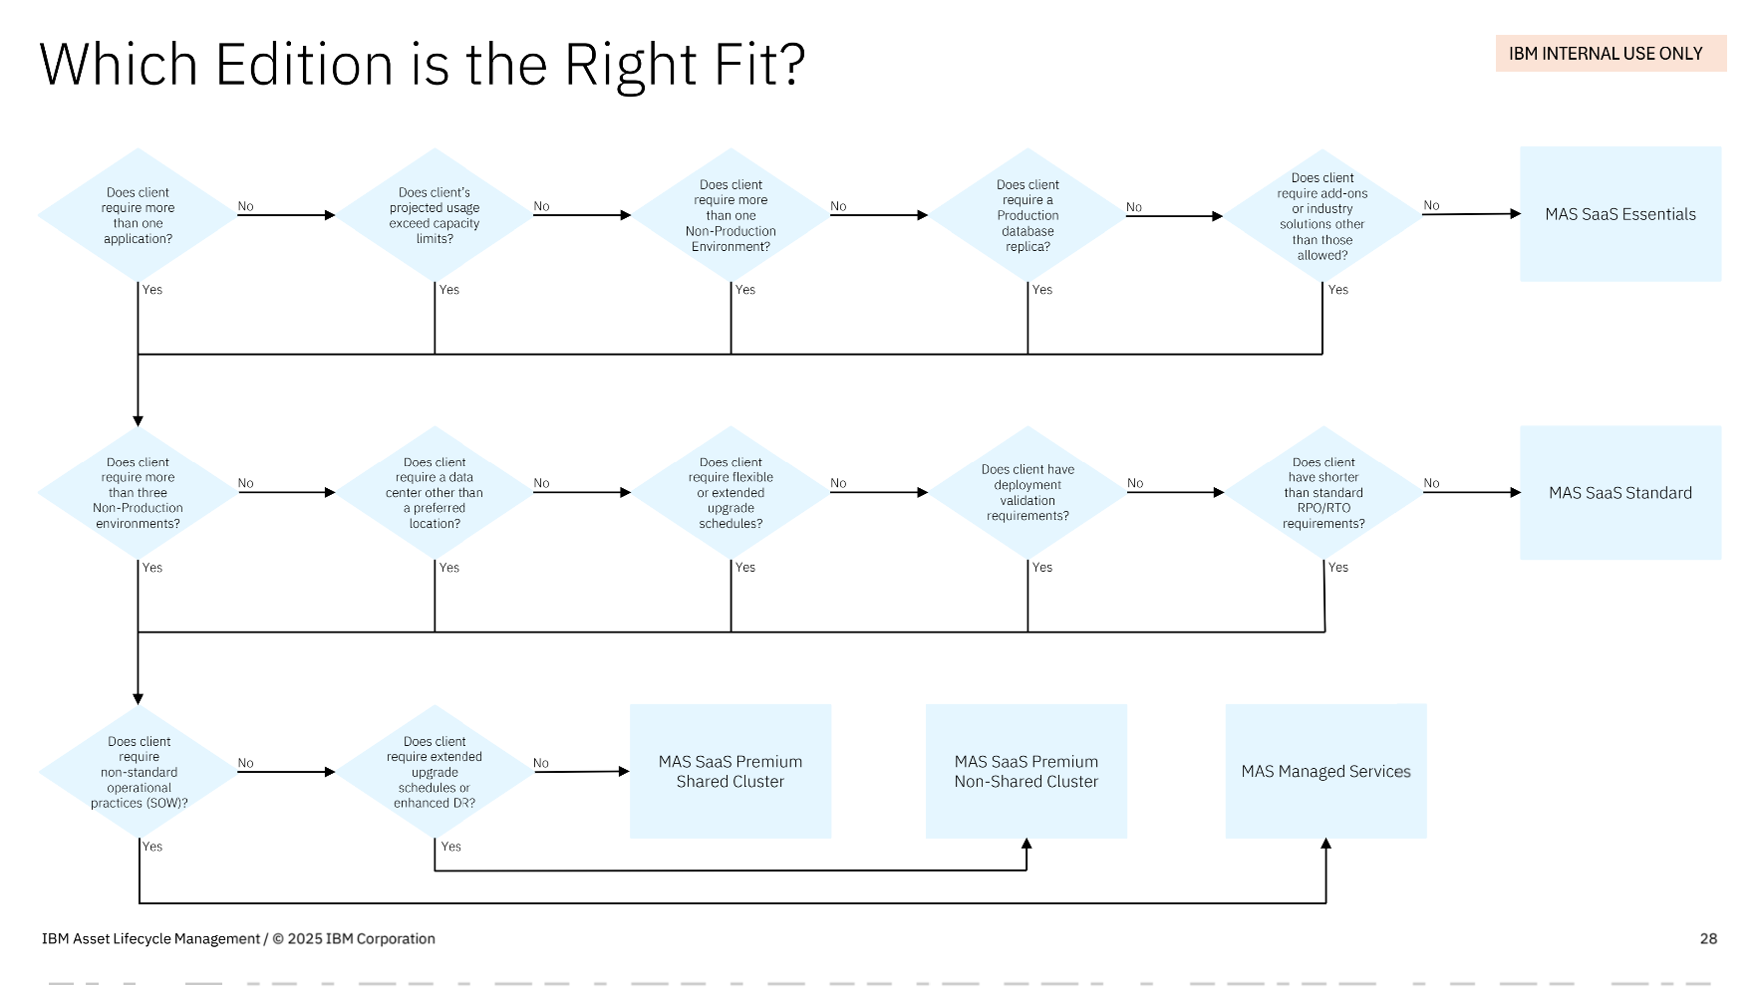
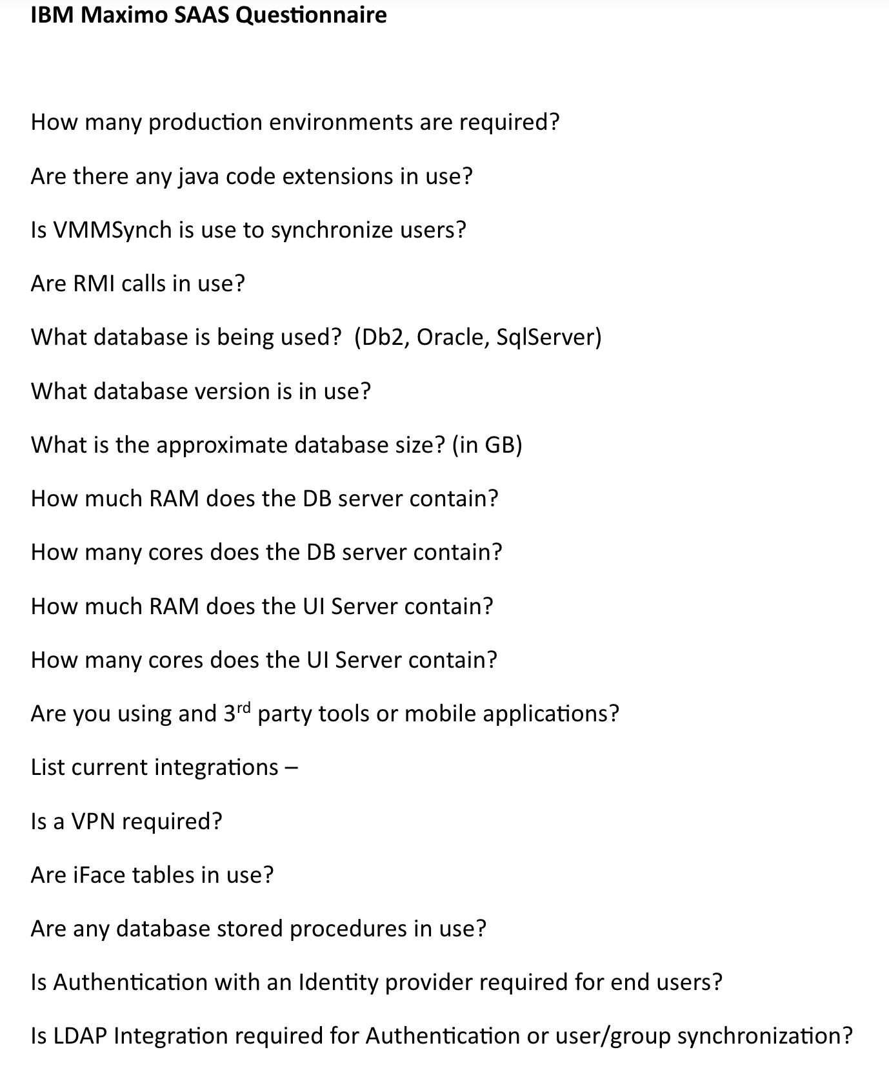
Figure B: MAS SaaS on AWS Overview (9/30/2025 Seismic Link)
Figure C: SaaS Questionnaire (Box link)

Slide 8
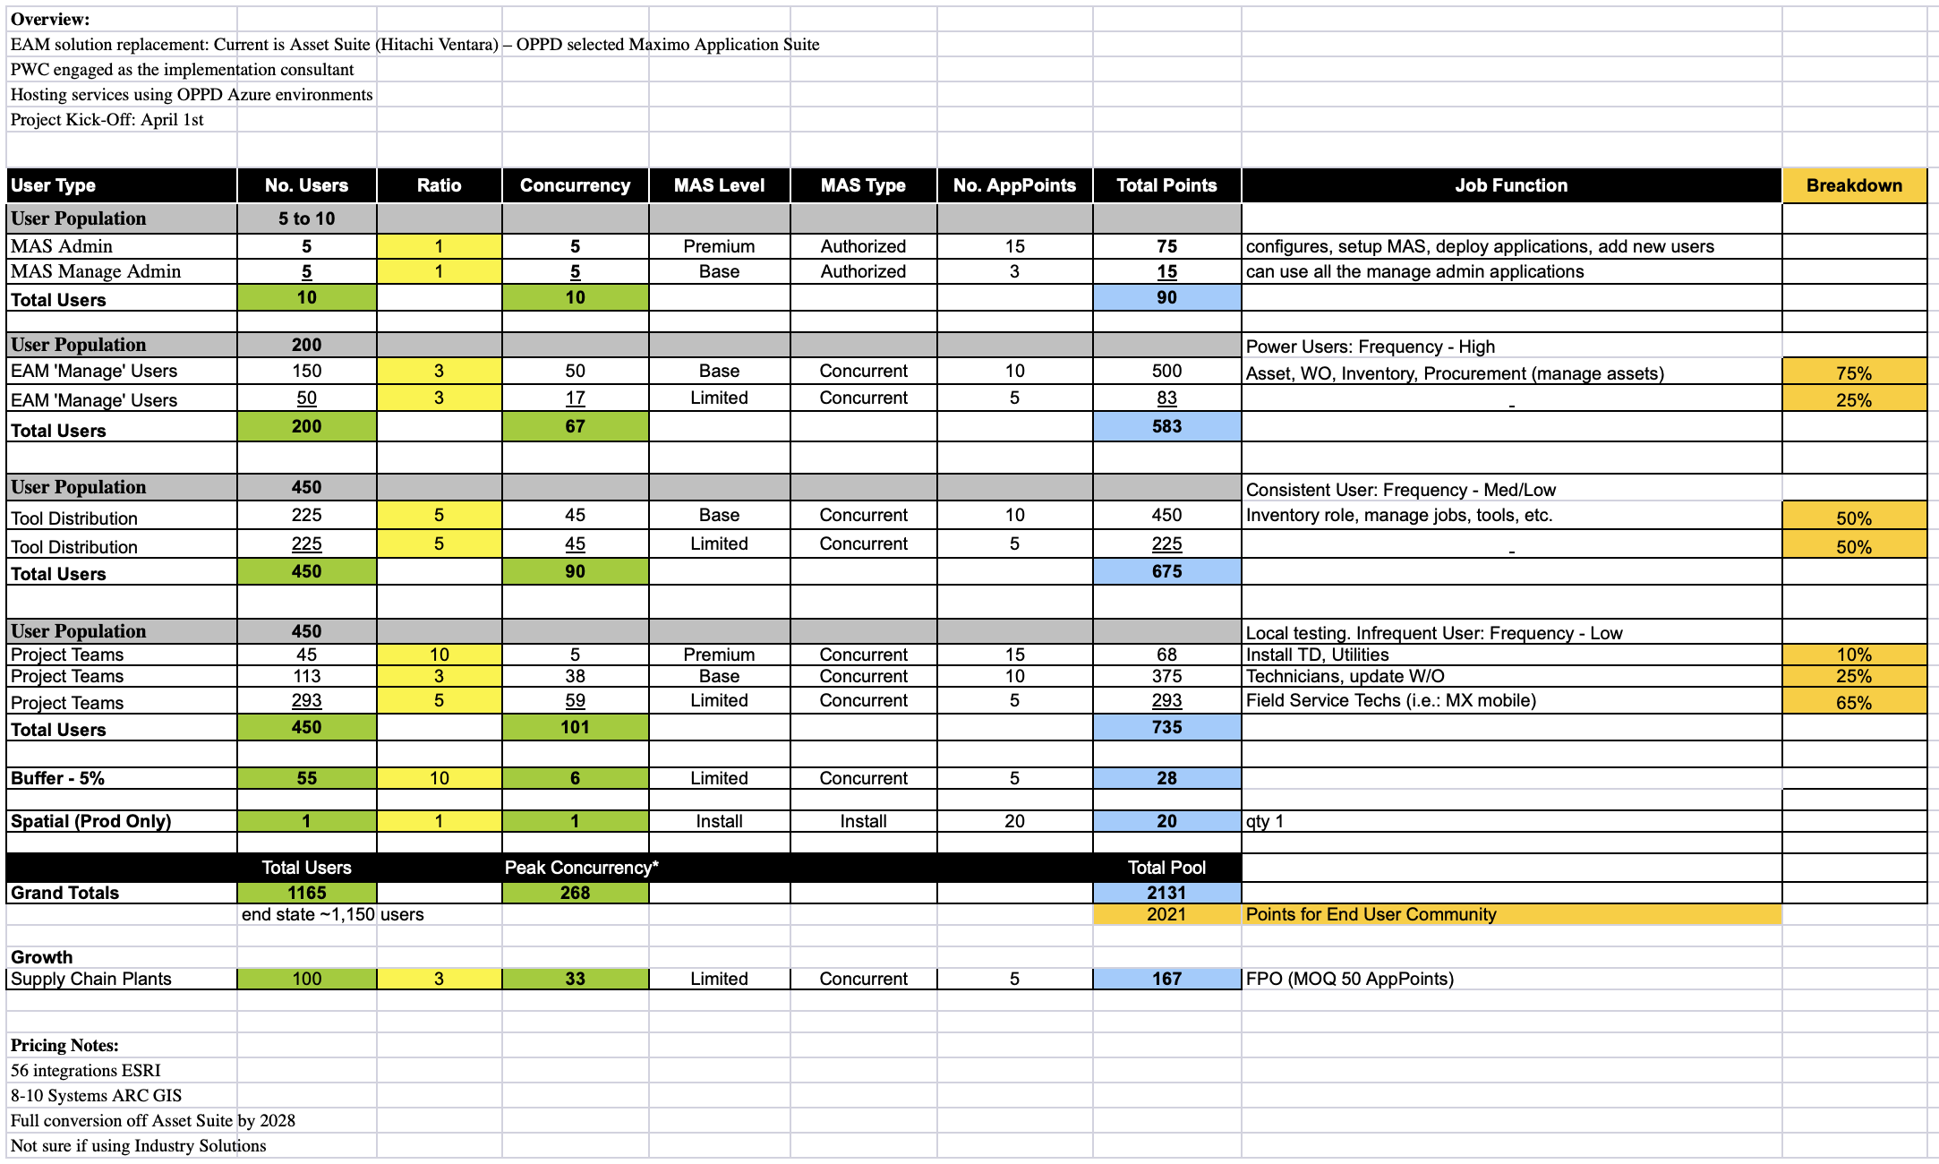
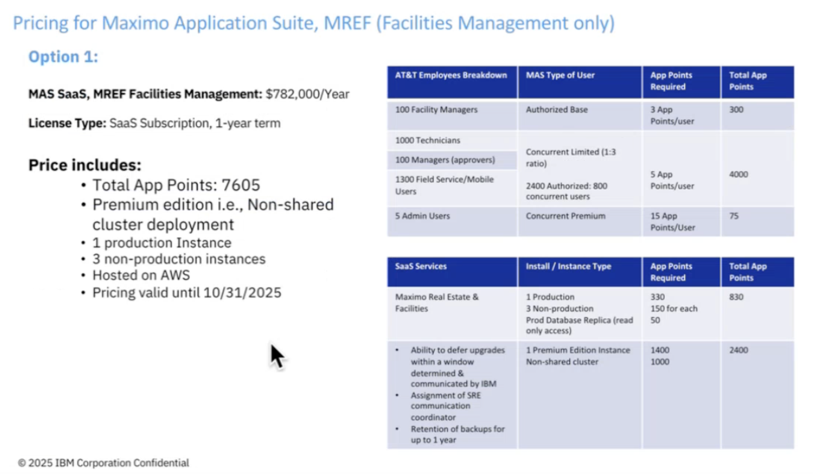
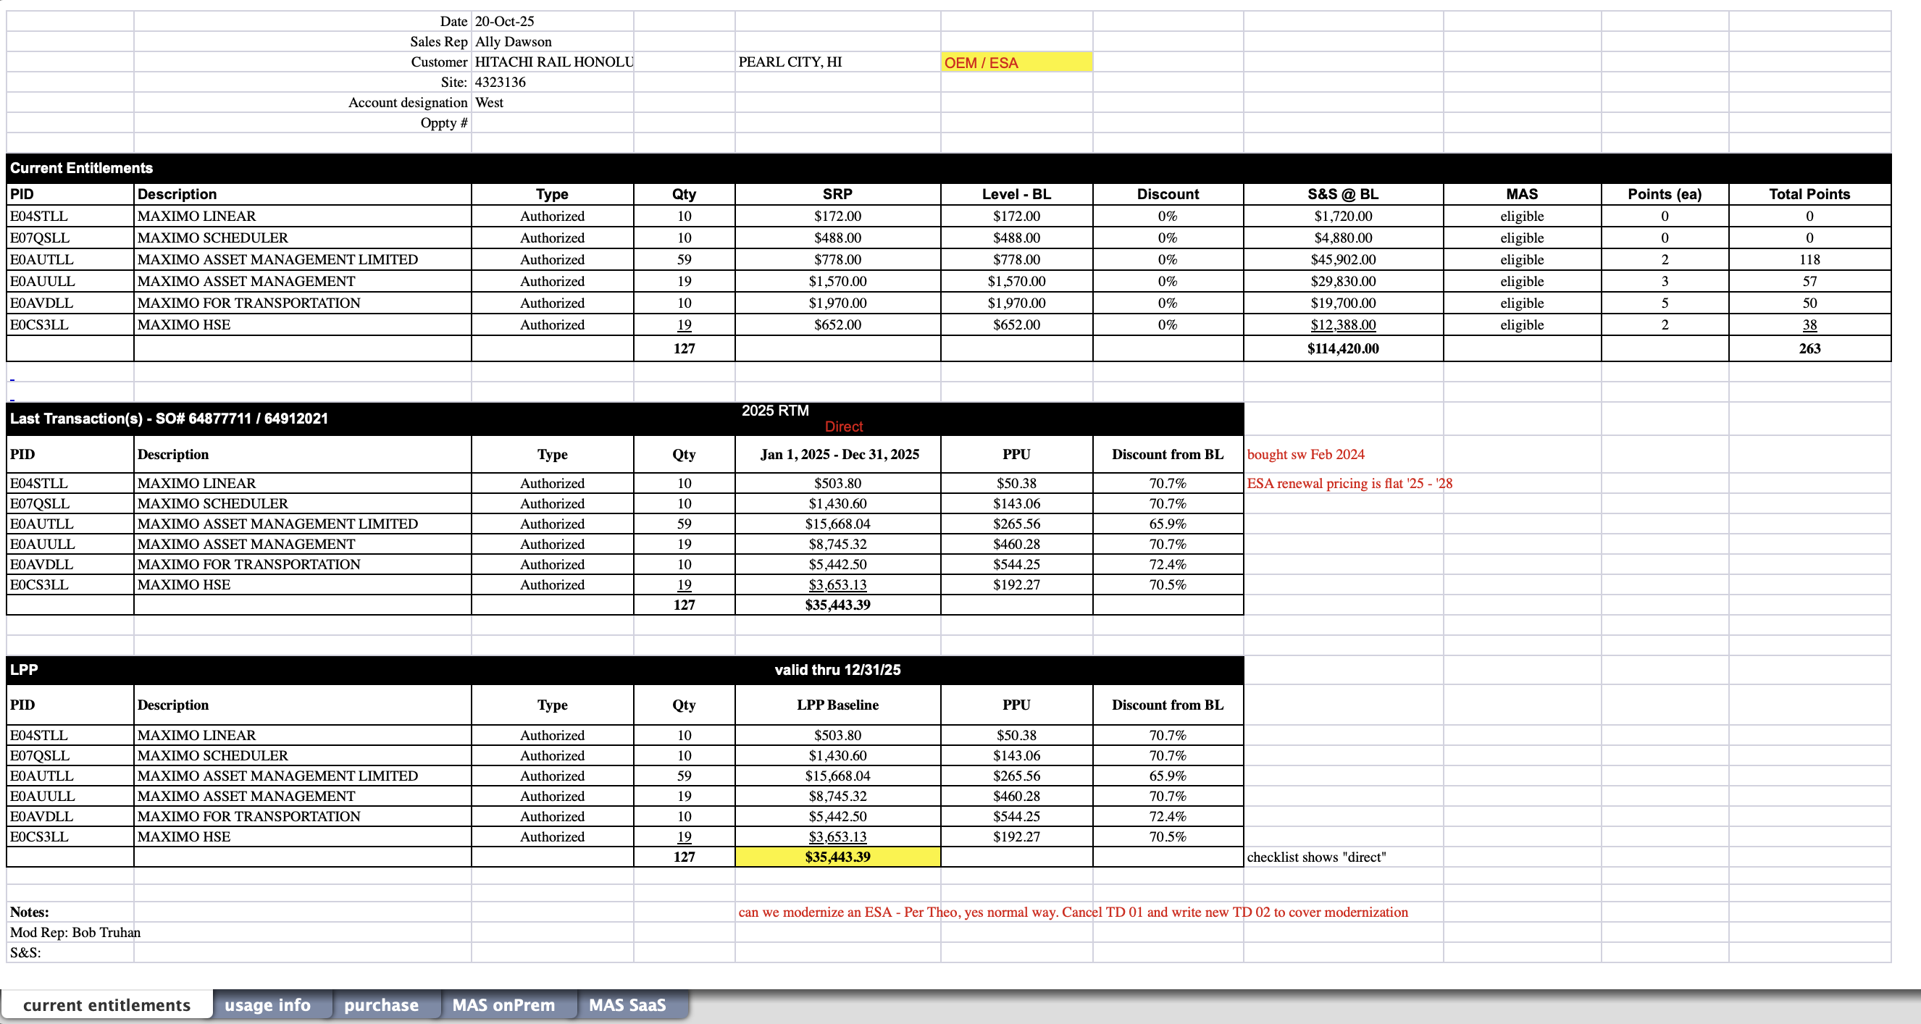
Figure D: User type “scoping” (Box Link)
Figure F: Client pricing breakdown
Figure E: Client pricing summary (Box Link)

Slide 9
Queries Recommendation:
Next steps:
Based on existing user queries from the ibm.com chatbot from July - Sept (link), i’ve extracted the queries related to pricing, products, and AppPoints, along with AI generated based on the file above.
Queries doc link →
Map out logic of the workflow → what are the questions and answers
If the team is open to the recommendation, figure out form factor for this solution
Stress test Prashant’s demo with queries

