Slide 1

Predicting the Spread of COVID-19
DSE 6300: Data Science Application Development
By: Kyle W. Brown
4/27/2020

Slide 2




Overview
Project Proposal
Project Schedule
Data
Pipeline
Models
Visualization
Summary

Slide 3
Project Proposal
Build a functional dashboard in Shiny or Tableau presenting COVID19 virus predictions and data.
Stream COVID data using Kafka or Spark Streaming.
Visualization of predictive analytics model and data.
Predictions or time series analysis based on COVID19, environmental, and economic factors.
Abstract:
Implement a predictive model to identify which factors have the greatest impact on the spread and strength of the COVID-19 virus in a geographic area.

Slide 4

Project Schedule
Shortened Agile Framework
2 (1) week iterations
2 checkpoints indicating updates
Checkpoint 2 is midterm
Agile Schedule used for task list tracking

Slide 5
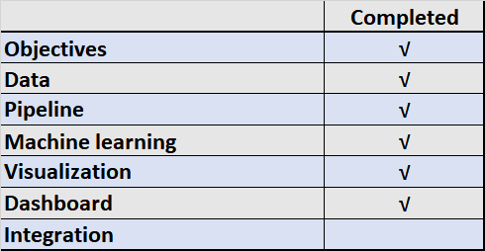
Project Schedule
Project Task List
Final Week Schedule
Thu | Fri | Sat | Sun | Mon | Tue
4/16/2020 | 4/17/2020 | 4/18/2020 | 4/19/2020 | 4/20/2020 | 4/21/2020
Final Modeling | Model update, submit models by 7:00 p.m. | • Group model selection • Kafka setup | • Start ppt • Kafka topics, records, cluster | • Finish ppt parts •Finish pipeline | Finalize ppt

Slide 6
Data
John Hopkins University, GitHub repo
https://github.com/CSSEGISandData/COVID-19/tree/master/csse_covid_19_data/csse_covid_19_daily_reports_us
Daily Reports for United States
Province_State | Last_Update | Lat | Long_ | Confirm | Deaths | Recovered | Active | FIPS | Incident_Rate | People_Tested | People_Hospitalized | Mortality_Rate | Testing_Rate | Hospitalization_Rate
Alabama | 4/15/2020 22:56 | 32.3182 | -86.9023 | 4075 | 118 | 0 | 3957 | 1 | 86.91 | 34077 | 525 | 2.90 | 726.76 | 12.88
Alaska | 4/15/2020 22:56 | 61.3707 | -152.404 | 293 | 9 | 106 | 284 | 2 | 49.02 | 8664 | 34 | 3.07 | 1449.44 | 11.60
American Samoa | 4/15/2020 22:56 | -14.271 | -170.132 | 0 | 0 | 0 | 0 | 60 | 0 | 3 | 0 | 0 | 5.39 | 0
Arizona | 4/15/2020 22:56 | 33.7298 | -111.431 | 3964 | 142 | 385 | 3822 | 4 | 54.46 | 45310 | 590 | 3.58 | 622.50 | 14.88
Arkansas | 4/15/2020 22:56 | 34.9697 | -92.3731 | 1569 | 33 | 489 | 1536 | 5 | 60.60 | 21834 | 130 | 2.10 | 843.33 | 8.29
California | 4/15/2020 22:56 | 36.1162 | -119.682 | 26686 | 861 | 0 | 25825 | 6 | 68.06 | 216486 | 5163 | 3.23 | 552.14 | 19.35
Colorado | 4/15/2020 22:56 | 39.0598 | -105.311 | 7956 | 328 | 0 | 7628 | 8 | 140.40 | 39580 | 1556 | 4.12 | 698.45 | 19.56
Connecticut | 4/15/2020 22:56 | 41.5978 | -72.7554 | 14755 | 868 | 0 | 13887 | 9 | 413.85 | 50143 | 1908 | 5.88 | 1406.42 | 12.93

Slide 7
Data
NY Times COVID-19, GitHub
date | county | state | fips | cases | deaths
1/21/2020 | Snohomish | Washington | 53061 | 1 | 0
1/22/2020 | Snohomish | Washington | 53061 | 1 | 0
1/23/2020 | Snohomish | Washington | 53061 | 1 | 0
1/24/2020 | Cook | Illinois | 17031 | 1 | 0
1/24/2020 | Snohomish | Washington | 53061 | 1 | 0
1/25/2020 | Orange | California | 6059 | 1 | 0
1/25/2020 | Cook | Illinois | 17031 | 1 | 0
1/25/2020 | Snohomish | Washington | 53061 | 1 | 0
https://raw.githubusercontent.com/nytimes/covid-19-data/master/us-counties.csv

Slide 8
Data
STATWORX COVID19 API
date | day | month | year | cases | deaths | country | code | population | cases_cum | deaths_cum
4/16/2020 | 16 | 4 | 2020 | 30148 | 4928 | United_States_of_America | US | 327167434 | 639664 | 30985
4/15/2020 | 15 | 4 | 2020 | 26922 | 2408 | United_States_of_America | US | 327167434 | 609516 | 26057
4/14/2020 | 14 | 4 | 2020 | 25023 | 1541 | United_States_of_America | US | 327167434 | 582594 | 23649
4/13/2020 | 13 | 4 | 2020 | 27620 | 1500 | United_States_of_America | US | 327167434 | 557571 | 22108
4/12/2020 | 12 | 4 | 2020 | 28391 | 1831 | United_States_of_America | US | 327167434 | 529951 | 20608
4/11/2020 | 11 | 4 | 2020 | 35527 | 2087 | United_States_of_America | US | 327167434 | 501560 | 18777
4/10/2020 | 10 | 4 | 2020 | 33901 | 1873 | United_States_of_America | US | 327167434 | 466033 | 16690
4/9/2020 | 9 | 4 | 2020 | 33323 | 1922 | United_States_of_America | US | 327167434 | 432132 | 14817
4/8/2020 | 8 | 4 | 2020 | 30613 | 1906 | United_States_of_America | US | 327167434 | 398809 | 12895

Slide 9
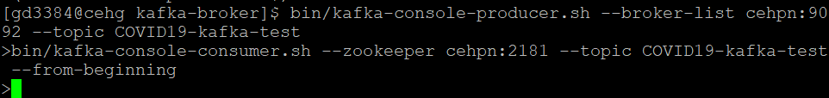
Kafka Pipeline
Kafka directory to Wayne State’s Grid
Creating a COVID19 Test Topic
Quick Test and Consumer contents for Topic in command

Slide 10
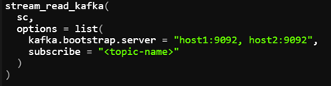
Connecting SparkR and Kafka to WSU Grid
Connected SparkR and Kafka to Grid
Example setup for reading Kafka stream with SparkR in Grid

Slide 11
Models
Regressions
Linear
Mulivariate
Non-Linear
Principal Component Analysis
Time Series
AutoML Deep Learning

Slide 12
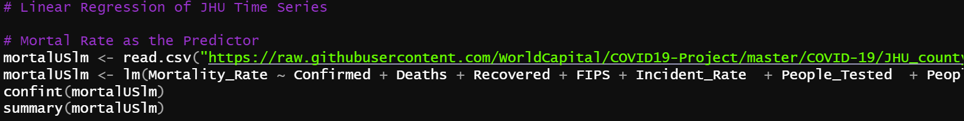
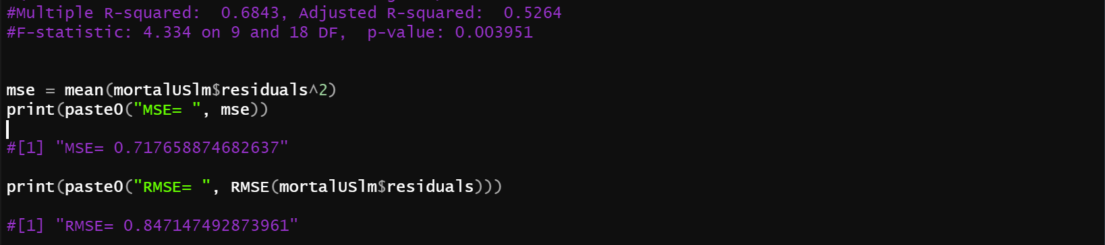
Multivariable Regression

Slide 13
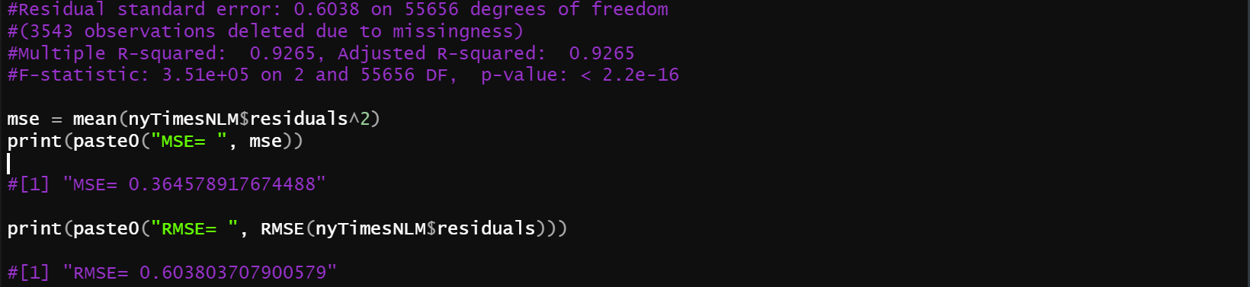
Non-Linear Regressions

Slide 14
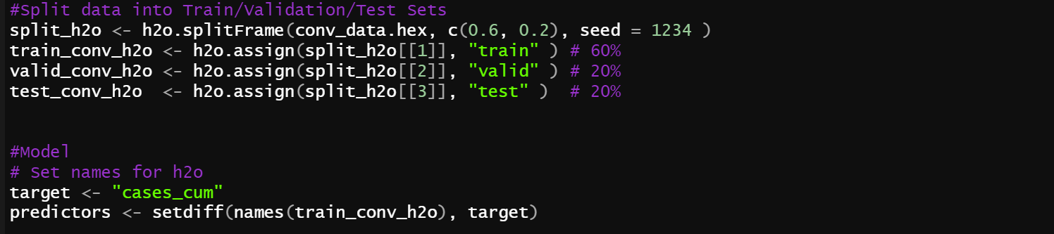
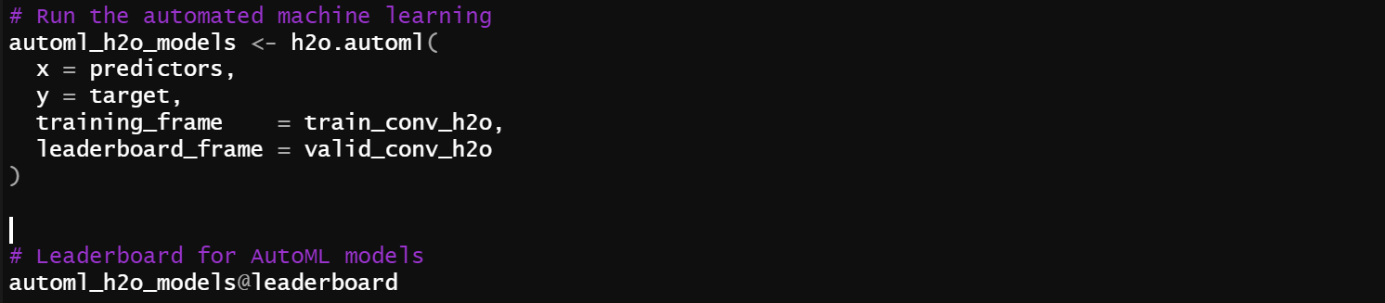
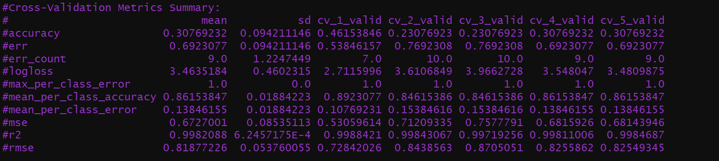
AutoML Models

Slide 15
Model Results
Model | r^2 | rmse | mse
DeepLearning_grid__2_AutoML_20200419_000459_model_6 | 99.80% | 87.24% | 76.10%
GBM_grid__1_AutoML_20200419_000459_model_3 | 99.80% | 84.66% | 71.67%
GBM_grid__1_AutoML_20200419_000459_model_19 | 99.80% | 80.01% | 64.02%
GBM_grid__1_AutoML_20200419_000459_model_11 | 99.80% | 75.51% | 57.02%
GBM_grid__1_AutoML_20200419_000459_model_14 | 99.80% | 75.48% | 56.97%
GBM_grid__1_AutoML_20200419_000459_model_17 | 99.80% | 74.26% | 55.15%
Mortality_Rate_JHU_lm | 52.64% | 71.77% | 84.72%
cases_cum_gbm_AutoML | 99.81% | 67.69% | 82.16%
deaths_cum_gbm_AutoML | 99.76% | 49.60% | 70.25%
Deaths_JHU_nlm | 92.65% | 36.46% | 60.38%

Slide 16
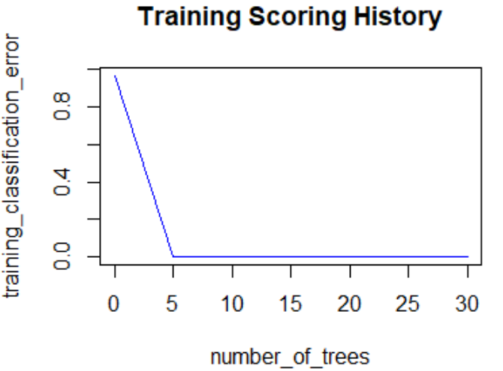
GBM Multinomial AutoML Leader
cases_cum_gbm_model

Slide 17
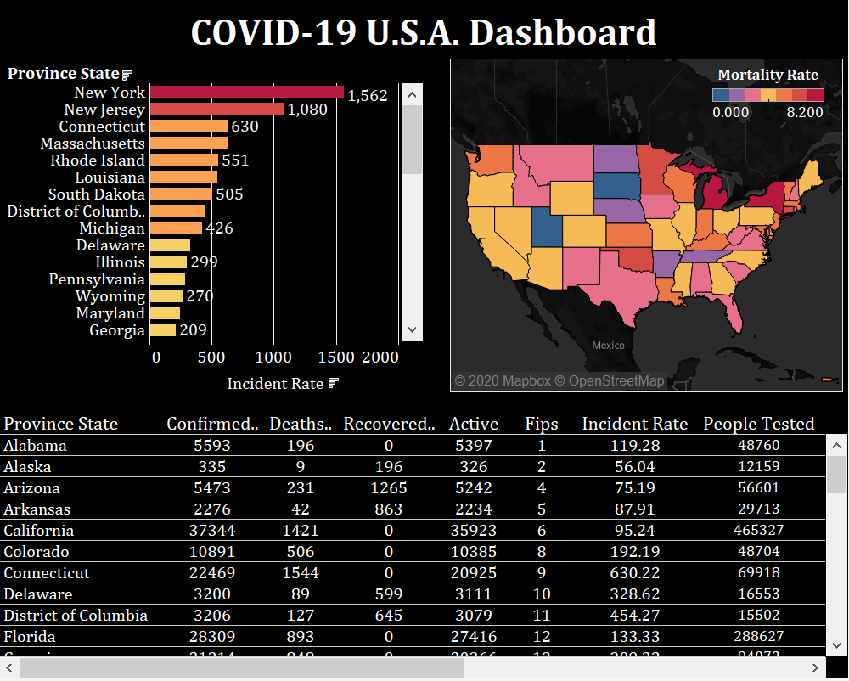

Slide 18
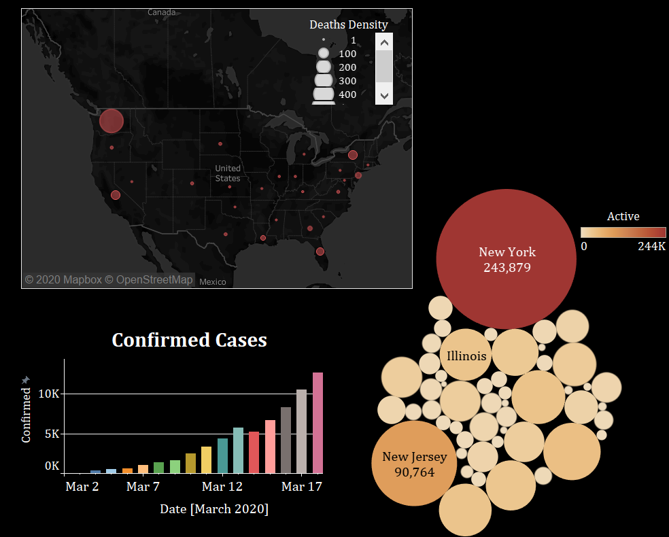

Slide 19
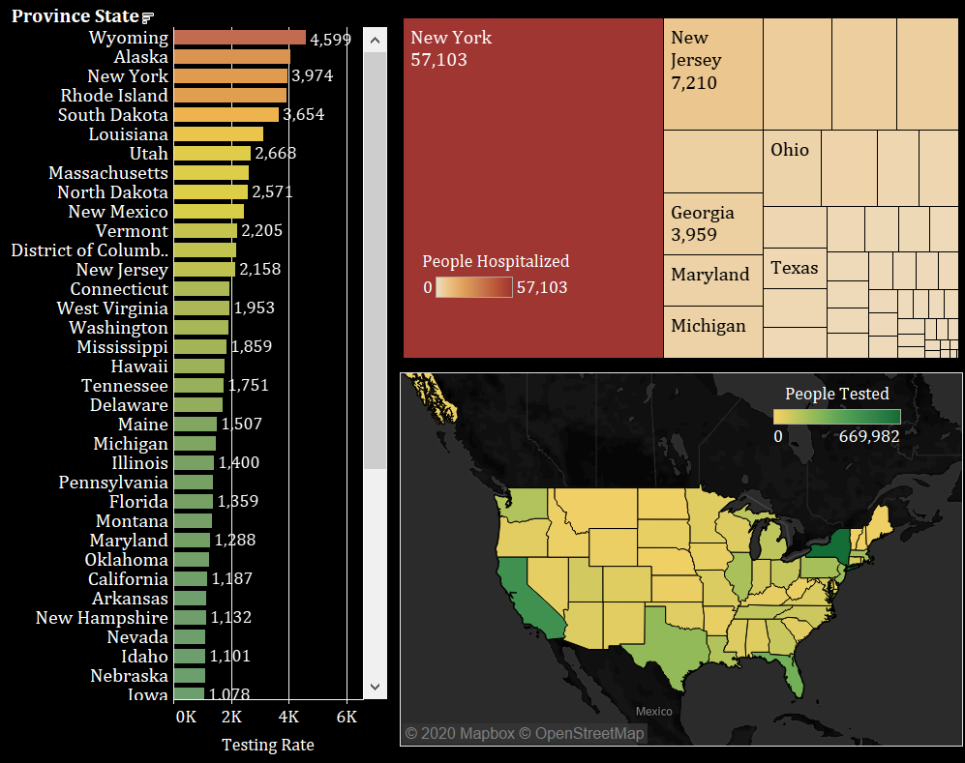

Slide 20
Summary
Provided analysis of COVID19 pandemic to determine any relationships or trends.
Followed shortened Agile framework for project schedule using checkpoints.
Created COVID19 test topic with Kafka pipeline and setup SparkR to read the Kafka stream into WSU’s Grid.
Selected GBM Multinomial model based AutoML model based on 0% training error, 99% R-Squared, and 82.16% RMSE.
Designed Tableau dashboard to display COVID-19 pandemic data.

Slide 21
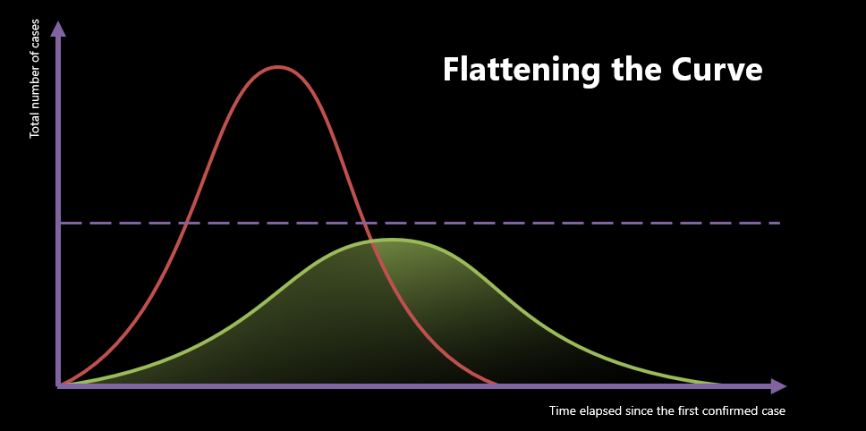
Any Questions or Comments?
Thank you

