Slide 1

M&A Active Gear Acquiring Mercury Athletic Inc
Team #6
Ali Dakroub, Kyle Brown, Emelin Corado, & Hussein Bazzi
August 15, 2018

Slide 2
Covered Topics
Industry Background
AGI & Mercury Athletic Footwear
Problem Overview
Pros & Cons of the Acquisition
Cost of Equity
Weighted Average Cost of Capital-CAPM
Discounted Cash Flow Analysis
Cost of Capital
Valuation
Recommendations

Slide 3
Industry Background
Mature Industry
Highly competitive Industry with low growth
Fairly stable profit margins
Fashion Sensitive industry: Life cycles are short
Casual segment competes on style, price, and quality
Athletic segment competes on brand image, engineering, performance and price

Slide 4
Active Gear Inc. (AGI)
Founded in 1965 produce high quality golf and tennis shoes.
In 1970s AGI moved into casual and recreational footwear.
2006 revenue $470.3 million, operating Income: $60.4 million which 42% of revenues came from athletic shoes.
AGI's casual footwear was sold in more than 5,700 North American stores (wholesalers and independent distributors
Athletic footwear is sold through independent distributors.

Slide 5
Mercury Athletic Footwear
Distributes branded athletic and casual footwear to the youth market.
Was purchased by West Coast Fashion.
Products were distributed to department stores and large discount retailers.
The company had developed an operational infrastructure intended to help it adapt quickly to changes.
Production is based in China.

Slide 6
Problem Overview
John Liedtke, the head of business development for Active Gear, Inc is currently thinking whether to acquire Mercury Athletic.
AGI’s executives feel its small size was becoming a competitive disadvantage.
Is Mercury an appropriate target for AGI?

Slide 7
Pros & Cons
If Active Gear Acquires Mercury Athletic
+
-
Increasing Debt-Capacity
Economies of Scale Advantages
Growing AGI’s Size to Meet Supplier Demands
Diversify Risk
Lowering Mercury’s DSI down to 42.5 days
Mercury’s Different Product Offerings Could Hurt AGI’s Brand Image
Mercury’s Low Margins Impacting AGI

Slide 8
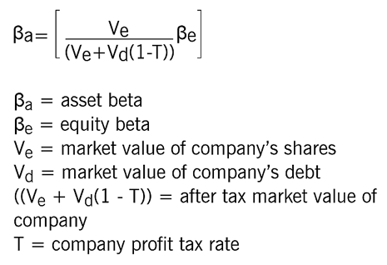
Cost of Equity
Using Data on Public Footwear Companies (March 15, 2017)
Calculated Asset Beta for All Companies:

Slide 9
Cost of Equity – cont’d
Asset Beta
2.27280234
2.03260441
1.60902747
0.862847
0.85835325
1.7667773
1.08476387
1.05209524
0.78035805
1.36884766
Then, we calculated the mean of all the companies’ asset betas.
Our Estimated Asset Beta Was
1.3688

Slide 10
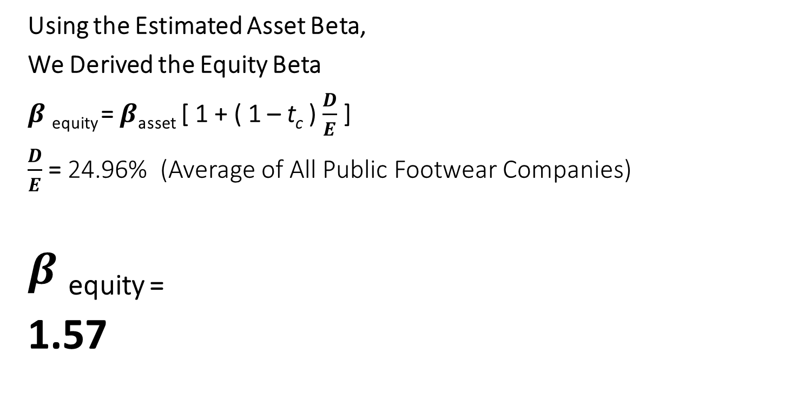
Cost of Equity – cont’d
Using the Estimated Asset Beta,
We Derived the Equity Beta
$β$ _{equity} = $β$_{asset} [ 1 + ( 1 – t_{c} ) $\frac{D}{E}$ ]
$\frac{D}{E}$ = 24.96% (Average of All Public Footwear Companies)
$β$ _{equity =}
1.57

Slide 11
Cost of Equity – cont’d
Capital Asset Pricing Model (CAPM)
Calculated Equity Beta | 1.57
Risk-free Rate (10-year Treasury) | 4.73%
EMRP | 5.00%
Cost of Equity | 12.60%

Slide 12
Weighted Average Cost of Capital
Calculating the Weighted Average Cost of Capital
D/V | 20.00%
Cost of Debt | 6.00%
E/V | 80.00%
Cost of Equity | 12.60%
Corporate Tax Rate | 40.00%
Weighted Average Cost of Capital (WACC) | 10.80%

Slide 13
Discounted Cash Flow Analysis (DCF)
 | 2007 | 2008 | 2009 | 2010 | 2011
Consolidated Revenues | 479,328 | 489,028 | 532,136 | 570,319 | 597,717
Operating Expenses | 423,836 | 427,334 | 465,110 | 498,535 | 522,522
Corporate Overhead | 8,487 | 8,659 | 9,422 | 10,098 | 10,583
EBIT | 47,005 | 53,035 | 57,604 | 61,686 | 64,612
Add: Dep. & Amort. | 9,587 | 9,781 | 10,643 | 11,406 | 11,954
EBITDA | 56,592 | 62,816 | 68,247 | 73,092 | 76,566
Less: Chg. In NWC | 4,569 | 2,614 | 9,434 | 8,359 | 5,998
Less: CAPEX | 11,983 | 12,226 | 13,303 | 14,258 | 14,943
Less: Taxes (40%) | 18,802 | 21,214 | 23,042 | 24,674 | 25,845
Unlevered FCF | 21,238 | 26,762 | 22,468 | 25,801 | 29,780
Discount Rate (WACC) | 10.80%
Discounted Cash Flows | 19,168.00 | 21,799.42 | 16,518.17 | 17,119.17 | 17,833.79
n | 1 | 2 | 3 | 4 | 5

Slide 14
Cost of Capital
Comps EBITDA Multiple Median = 6.3x
Purchase Offer $326,372 (EBITDA Multiple)
Terminal Value = $3,709,693

Slide 15
Sensitivity Analysis

Slide 16
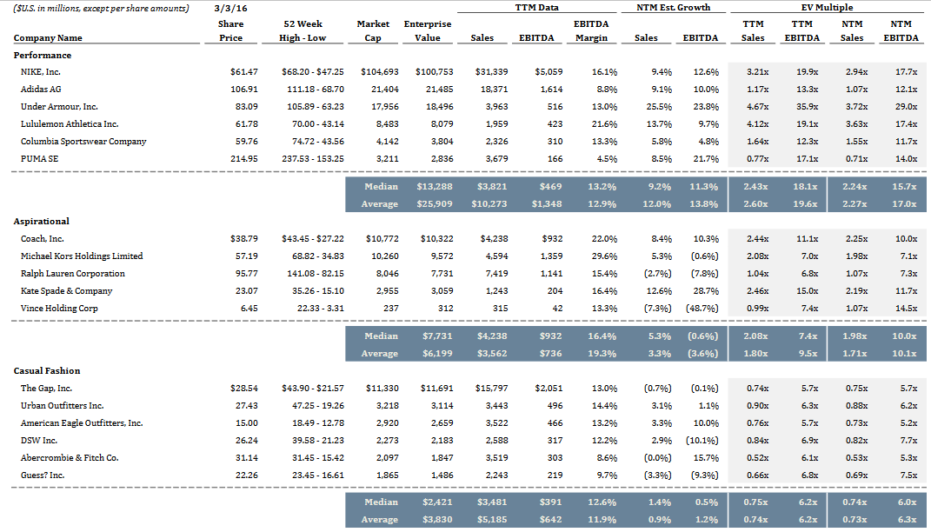
ARI Multiple
Mercury Multiple

Slide 17
Valuation

Slide 18
Valuation

Slide 19
Valuation

Slide 20
Valuation

Slide 21
Recommendations
Positive NPV, DCF upside, and terminal value indicate huge potential with minimal downside - Acquire.
Synergies Valuation create an additional $36.5 million per year.
Introduce Women’s Casual Footwear in Discount Retailers will generate close to $4m per year.

Slide 22
Conclusion
Overview and analysis of the Athletic Footwear industry, AGI, and Mercury Athletics.
Calculated acquisition costs providing DCF, WACC, sensitivity analysis, valuation, and financial model.
Recommendations of new outlet & synergies provide additional $41.5m per year.
Amazing opportunity for AGI to expand revenue growth and FCF with a terminal value of $3.7 billion.

Slide 23
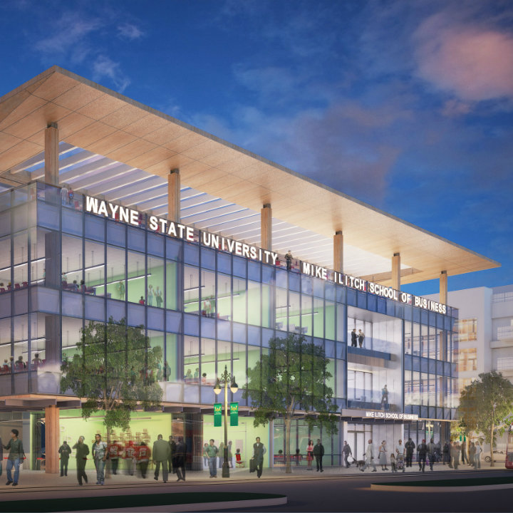
Any Questions or Comments?
Thank you

