Slide 1
Fully Convolutional Networks for Semantic Segmentation
Ajou Univ. software dep. 201920723 김동욱
Kim Dong Wook

Slide 2
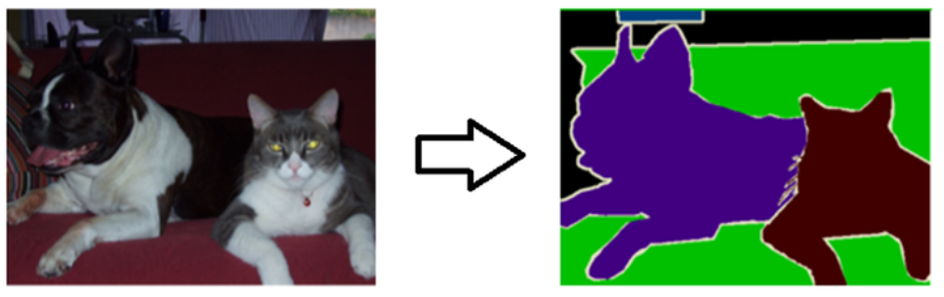
Semantic Segmentation?
Classification, localization, detection…
Pixel wise prediction

Slide 3
Fully Connected Layer’s Problem
Input size is fixed
Lose location information
So FCL is not good for segmantation

Slide 4
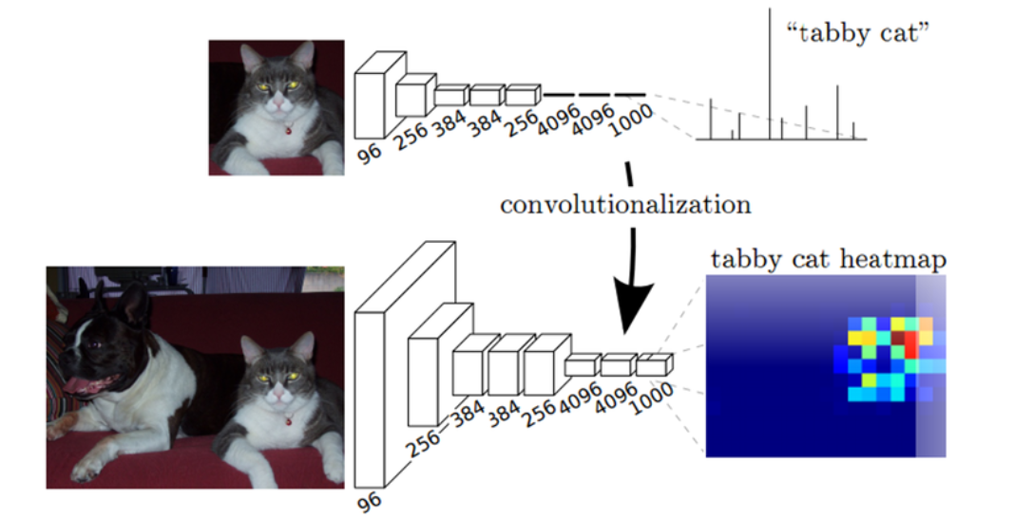
From FCL to FCN
OverFeat, GoogLeNet
Change all fully connected layers to 1 by 1 convolution

Slide 5
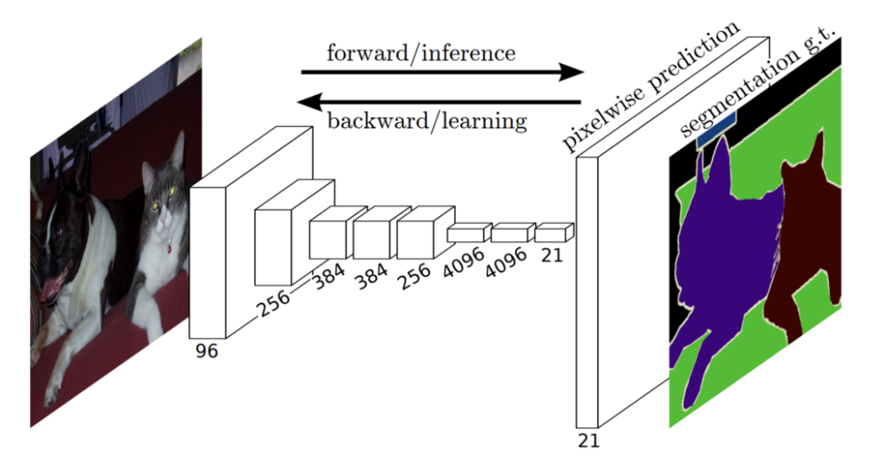
loss
per-pixel multinomial logistic loss(pixel wise cross entropy)

Slide 6
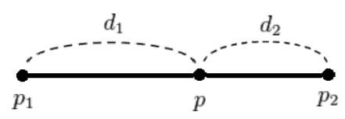

Upsampling – 1. bilinear interpolation

Slide 7
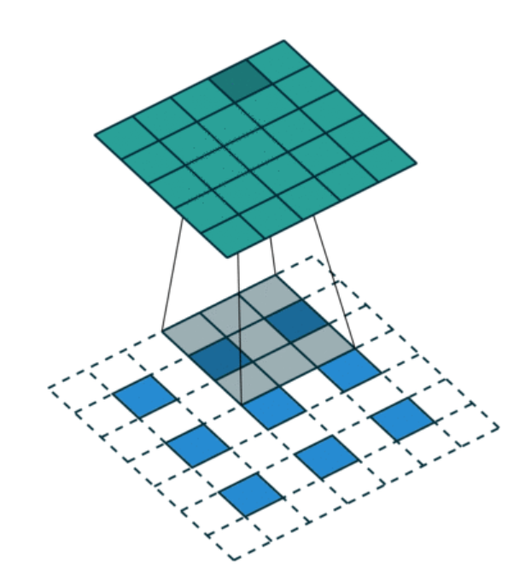
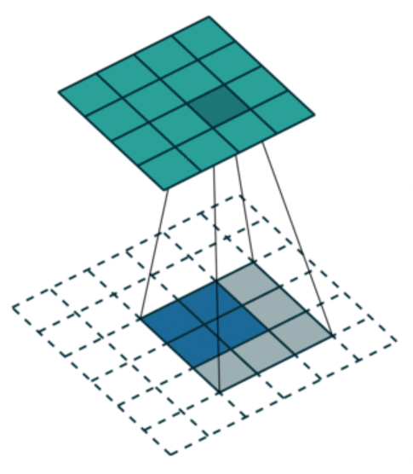
Upsampling – 2. deconvolution
Also called up convolution, transposed convolution

Slide 8
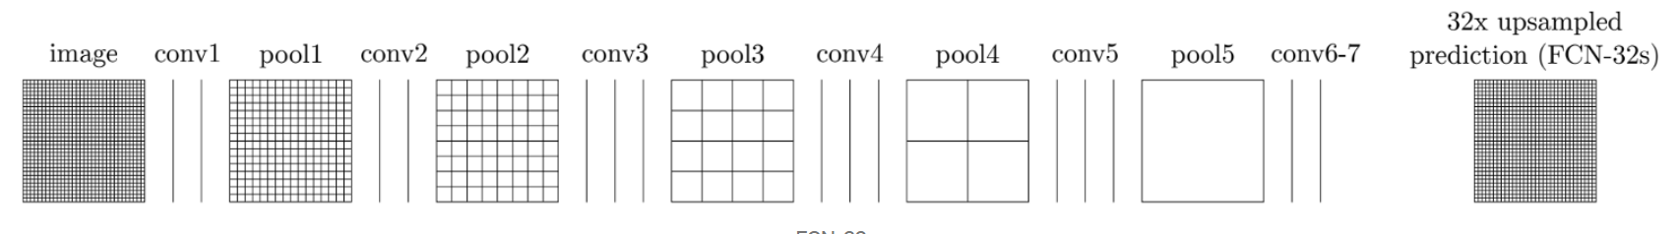
but it’s too coarse
Last feature map is too small(coarse)

Slide 9
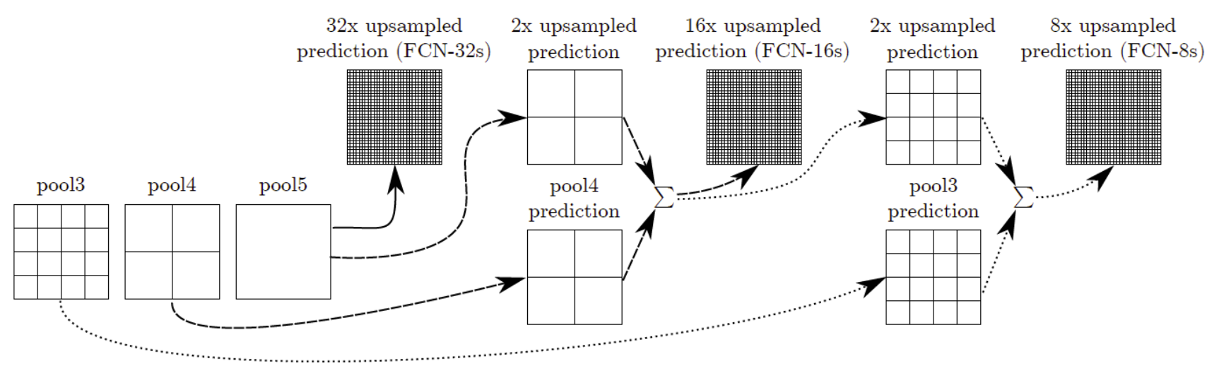
Skip connect

Slide 10
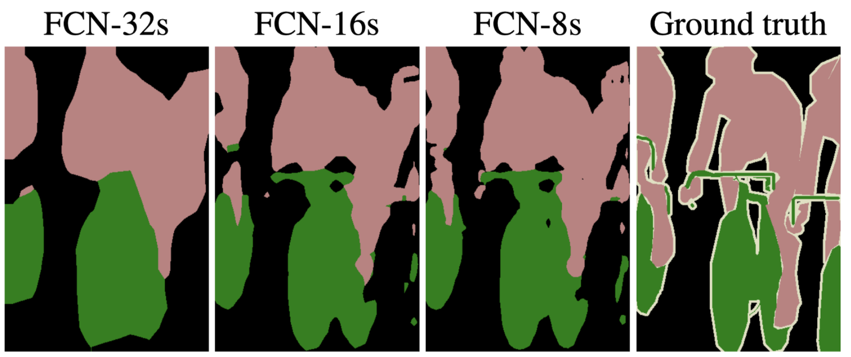
results

Slide 11
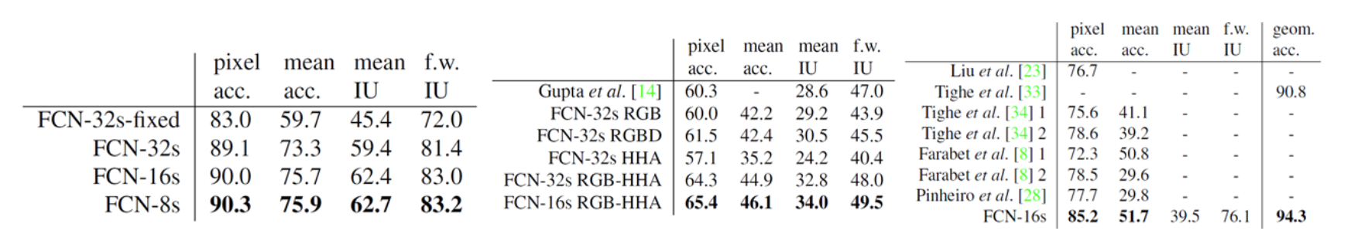
results

Slide 12
1 by 1 convolution
to control number of channel
Computation reduction
Non-linearity

