Slide 1
U-Net: Convolutional Networks for Biomedical Image Segmentation
Ajou Univ. software dep. 201920723 김동욱
Kim Dong Wook
MICCAI 2015

Slide 2
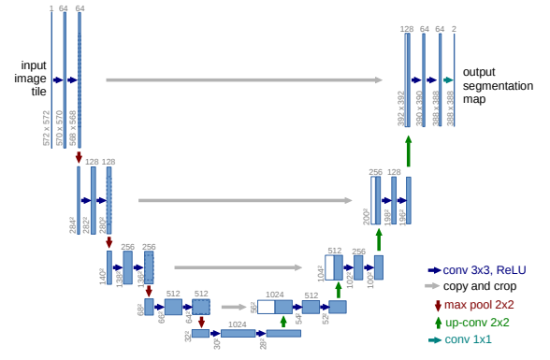
Why U?

Slide 3
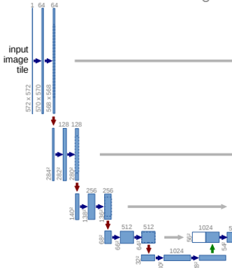
Network Architecture – contracting path
For detail context
No padding, 3x3 conv 2 times, ReLU
Double channel, halve size(MP, s=2)

Slide 4
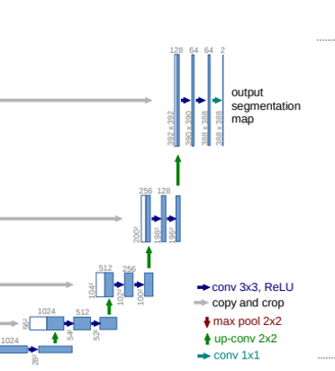
Network Architecture – expanding path
For localization info, dense prediction
No padding, 3x3 conv 2 times, ReLU
Halve channel, double size(2x2 up conv)
Concatenate up-conved feature map with
cropped contracting path’s feature map
1x1 conv at last layer

Slide 5
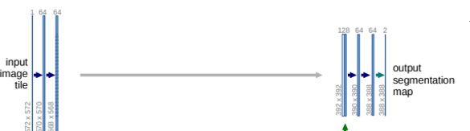
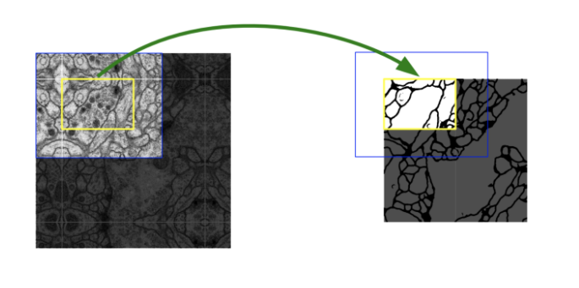
Overlap-Tile Strategy

Slide 6
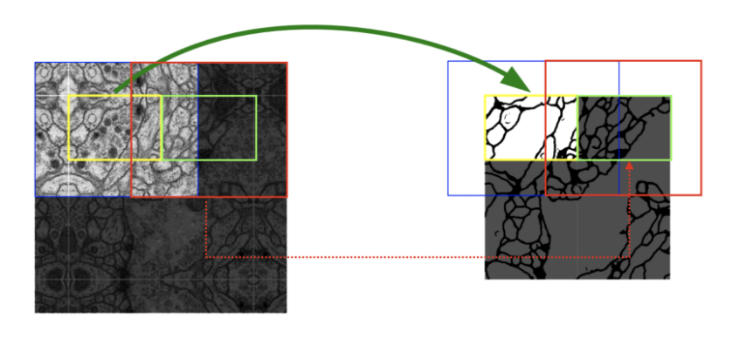
Overlap-Tile Strategy
Mirroring extrapolation used(no padding)

Slide 7
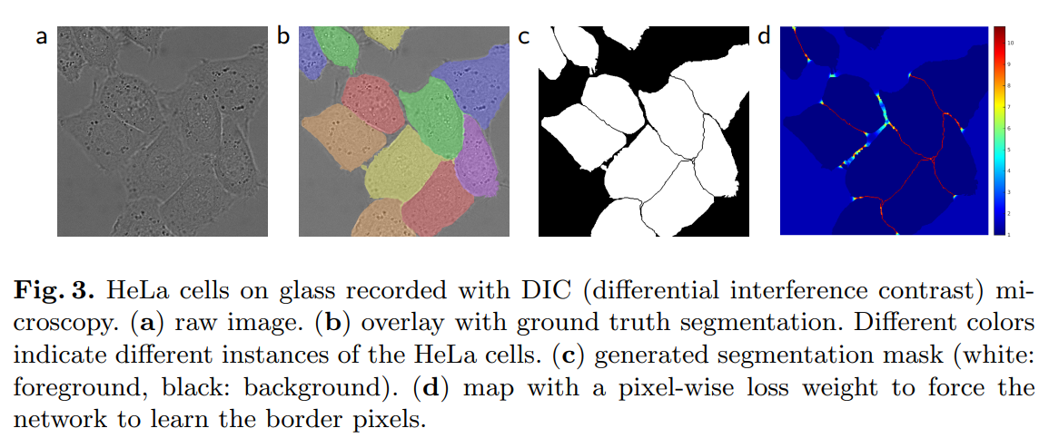
Touching cells problem

Slide 8

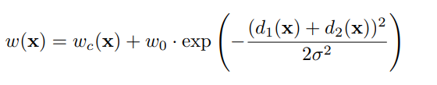
Touching cells problem & Training
ㅇ

Slide 9
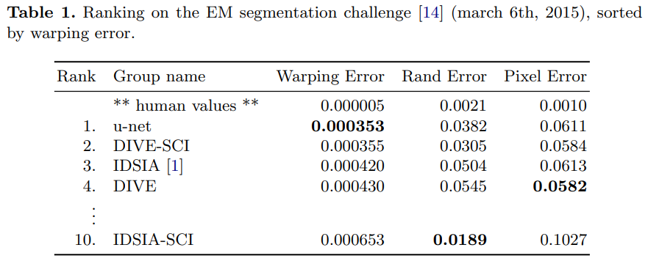
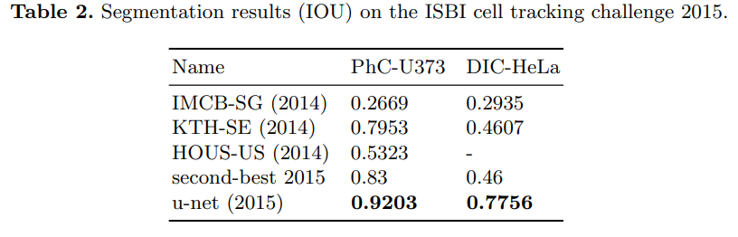
Results

