Slide 1

Voice Capsule
By The Voice Capsulators
December 1st, 2021
Team member names
Daniel Zuniga - Developer
Jovita Martinez - Developer
Kyle Won - Developer, Scrum Master
Marianna Marcelline - Product Owner/Dev.
Ricardo Gonzalez - Developer

Slide 2

Voice Capsule
The voice capsule app acts like a time capsule, but instead of storing random items, it stores voice notes. These can be sent to yourself or to friends and it can only be opened on a specified date in the future.
Motivation for Project Choice
The project owner -- forgot a friends birthday
Innovation and simple design.
Intended Users & Problem Addressed
User is anyone with an android phone, who would benefit from receiving and making voice notes. This is open to the user’s creativity!
Solves the problem of wanting to sending a voice message in advance, with a specific time or date in mind... such as an anniversary message.
Notes:
Brief introduction into problem/application domain
The voice capsule app acts like a time capsule, but instead of storing photos, news clippings and random items, it stores voice notes. These can be sent to yourself or to friends and it can only be opened on a specified date in the future.
Wouldn’t you like to send a birthday message way in advance, or set reminders for yourself? What is there was a tool that made this possible?
Motivation for your choice of project
The motivation for this project was innovation and simple design. The concept itself is very interesting, and executable which was very important to the team.
Discuss intended users, problem or opportunity addressed
The user is anyone with an android phone, who would benefit from receiving and making voice notes. This is open to the user’s creativity. It could be anything from: Reminders of an upcoming homework deadline. A happy birthday message for a friend or parent. A message declaring deep friendship and love. A student who needs a reminder about their class presentation.
This application solves the problem of wanting to sending a voice message in advance, AND only at a specific time or date... such as an anniversary message.

Slide 3
Project Goals
Minimal Viable Product Goals:
Record voice notes, store and access them on a database
Send Voice Capsules to self which can only be opened on a specific day
Have an aesthetically pleasing, easy to navigate user interface
Other Goals:
See a list of all received and openable Voice Capsules in the app
Add other users as ‘friends’ and send Voice Capsules to them
Download received Voice Capsules to device local storage
Notes:
The following goals were: Goals you – set out to achieve – have achieved

Slide 4
Challenges
& Accomplishments
Challenges
Database Connection and Organization
Dart
Working in Scrum
Time Constraints
Accomplishments
Achieved MVP and more!
Meeting up despite time constraints
Using Git
Communicating effectively
App functionalities
Documentation

Slide 5
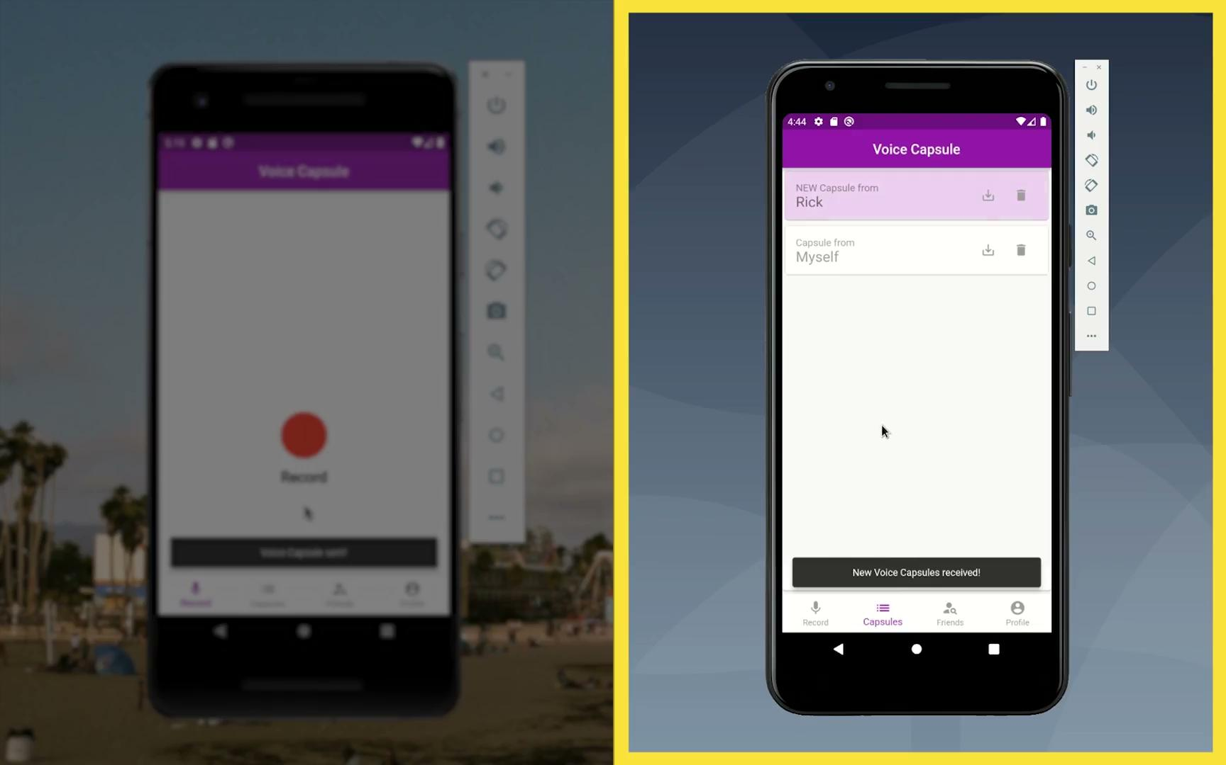
Demo:

Slide 6
Diagram Overview
Structural outline of how our Flutter app is organised
Voice Capsule
Flutter
User Auth
Firebase
Dart
Fire Store
Storage
Flutter Libraries
UI
authentication.dart
capsules.dart
contacts.dart
playback.dart
recorder.dart
themes.dart
utils.dart
voice_capsule.dart
widgets.dart

Slide 7
Database Diagram
Users
{email, UID,
email, UID,
email, UID} ...
…..
UID: 1
Email: __@email.com
Contacts:
Sent Capsules:
Pending Capsules:
receiver UID:
OpenDateTime:
receiver UID:,
URL:
Sender UID:
OpenDateTime:
URL:
UID: 2
...

Slide 8





Technologies
Framework:
Flutter
Open-source, UI software development kit. Allows cross platform development.
Version Control:
GitHub
Communication:
Discord
Used to allow each team member to contribute code, and work on different branches, then merge all changes into final product
Programming Language:
Dart
Object-oriented, class-based, C-style syntax
Backend:
Firebase and Firestore
NoSQL document database for automatic scaling
We used this to talk to one another, organise meetings, talk about issues

Slide 9
Management Techniques
Maintained consistent Scrum stand-up meetings every M/W/F for 15 minutes
Pings/reminders issued 5 minutes before meetings
Maintained the three meeting per week pattern
Post-Scrum meetings purposed for short demos and tech workshops
Extra meeting was held each week for technical catch-ups
Used to address items blocking members from progress
Pair programming as necessary in order to catch bugs while in the process of adding features
Quick, frequent inspections using incremental updates to the dev build of the app
Version control via git in order to integrate feature branches in parallel

Slide 10
Project Positives
Got to know excellent, cooperative team members over the quarter
Seeing the product evolve over time gave our team pride
Using development techniques learned in class translated to progress acceleration in real time
Learned the basics of Android development for future use

Slide 11
Project Negatives
Steep learning curve at the beginning
large amount of documentation to trudge through, sometimes in the wrong language (i.e. Java or Kotlin instead of Dart)
Meeting times were occasionally inconvenient due to other commitments
Juggling classes at the same time as the project was challenging

Slide 12
Lessons Learned
Worked/Keep doing
Reminders before meetings
Discord Server -- Constant communication
Delegating work -- Group mindset
Didn’t Work/Stop doing
Scrum Meetings -- Going over time
Splitting up tasks inefficiently
Start Doing
Refrain from scheduling meetings too early, or other unusual hours.
Reminders before meetings via VoCap!
Notes:
what worked/what you will keep doing
Reminders before meetings, and assignments
Discord server -- Keep communicating with each other: Maintain flexibility, and empathy when team members miss deadlines or meetings especially during midterms or holiday events. Reach out after your own absence to ensure work and deadlines are being met. Try to maintain a positive and inclusive attitude. Discord is the best way to communicate for all of us and features enough tools for collaboration
Delegating work with a group in mind
what didn’t work/what you will stop doing
Having scrum meetings go over time
Splitting up tasks in a way that requires us to wait for each other to finish work to continue
things you wished you had done (that you would start doing in the future)
In future scrums, be honest about schedule (8am TA meeting)

