Slide 1
Breaking News
Pullin Trade
Move2Move
Kyle Hughes
$Dis
11/13/2019

Slide 2
SMB TRAINING is NOT a Broker Dealer. SMB Training engages in trader education and training. SMB TRAINING offers a number of products and services, both electronical (over the internet through smbtraining.com) and in person. SMB TRAINING also offers web-based, interactive training courses on demand.
The seminars given by SMB TRAINING are for educational purposes only. This information neither is, nor should be construed, as an offer, or a solicitation of an offer, to buy or sell securities. You shall be fully responsible for any investment decision you make, and such decisions will be based solely on your evaluation of your financial circumstances, investment objectives, risk tolerance, and liquidity needs.
This material is being provided to you for educational purposes only. No information presented constitutes a recommendation by SMB TRAINING or its affiliates to buy, sell or hold any security, financial product or instrument discussed therein or to engage in any specific investment strategy. The content neither is, nor should be construed as, an offer, or a solicitation of an offer, to buy, sell, or hold any securities. You are fully responsible for any investment decisions you make. Such decisions should be based solely on your evaluation of your financial circumstances. Such decisions should be based solely on your evaluation of your financial circumstances, investment objectives, risk tolerance and liquidity needs.
SMB Training and SMB Capital Management, LLC are separate but affiliated companies.
No relevant positions
Please note: Hypothetical computer simulated performance results are believed to be accurately presented. However, they are not guaranteed as to accuracy or completeness and are subject to change without any notice. Hypothetical or simulated performance results have certain inherent limitations. Unlike an actual performance record, simulated results do not represent actual trading. Since, also, the trades have not actually been executed; the results may have been under or over compensated for the impact, if any, of certain market factors such as liquidity, slippage and commissions. Simulated trading programs in general are also subject to the fact that they are designed with the benefit of hindsight. No representation is being made that any portfolio will, or is likely to achieve profits or losses similar to those shown. All investments and trades carry risks.”

Slide 3
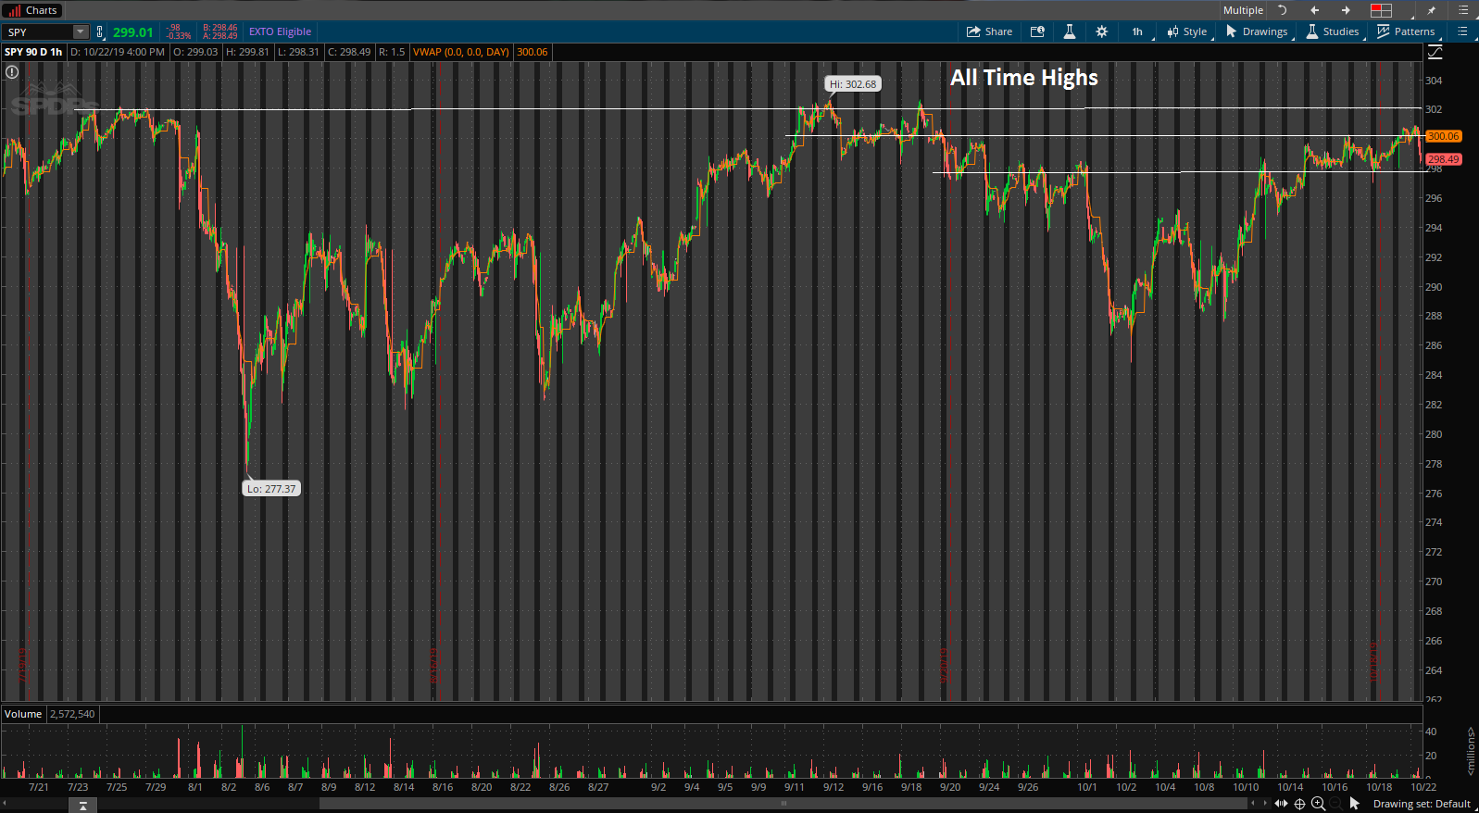
Big Picture
Spy’s recently broke out of a 6 month wedge/consolidation and are now holding at ATH’s

Slide 4
Intraday Fundamentals
Disney launched its long-awaited and highly anticipated Disney+ streaming service across the U.S., Canada, and the Netherlands. The platform was initially overwhelmed by the demand, as legions of hardcore fans flooded its servers, causing technical glitches and site outages. Citing "extraordinary demand," the company said on Wednesday it reached a "major milestone," with the Disney+ subscriber rolls exceeding 10 million signups when the service debuted Tuesday. Analysts were calling for 8 Million which was already optimistic
ATR – 3
RVOL - 3
AVOL – 9.7M
Float – 1.8B
Inst Ownership – 66%
Short Float – 1%

Slide 5
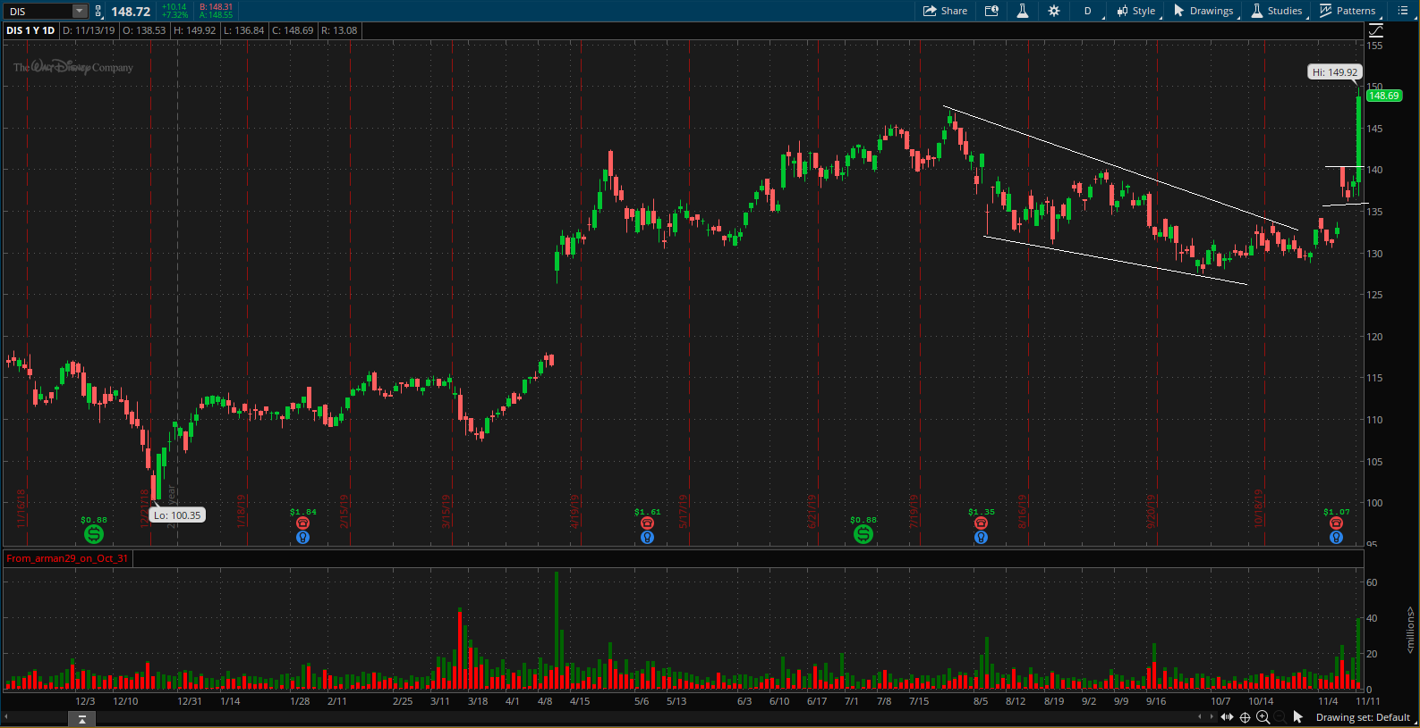
Technical Analysis Daily

Slide 6
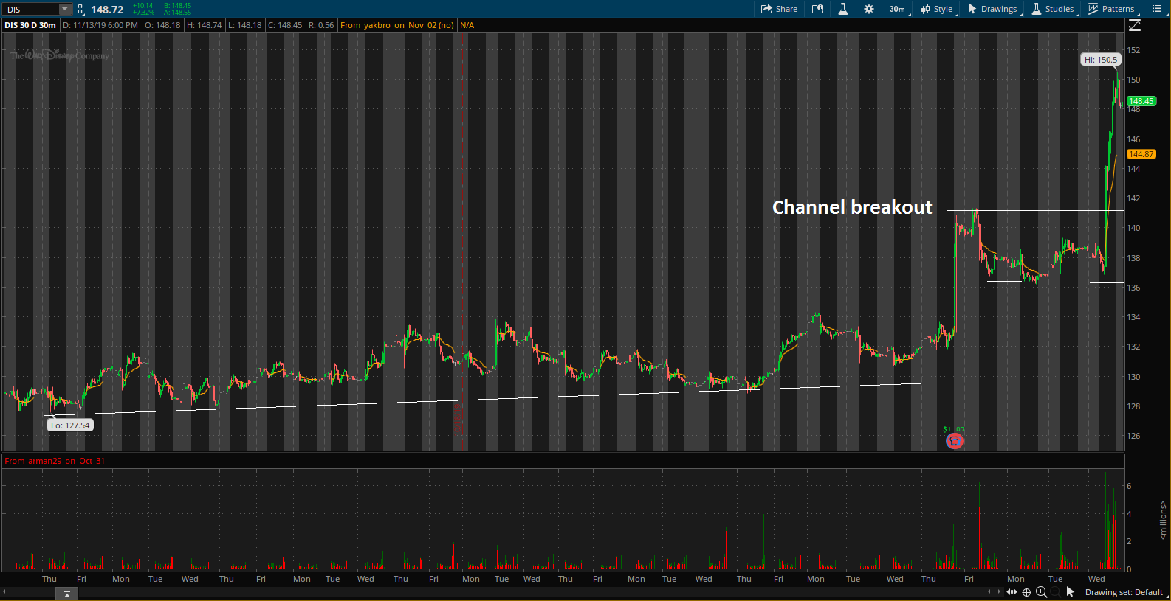
Technical Analysis 1 Month

Slide 7
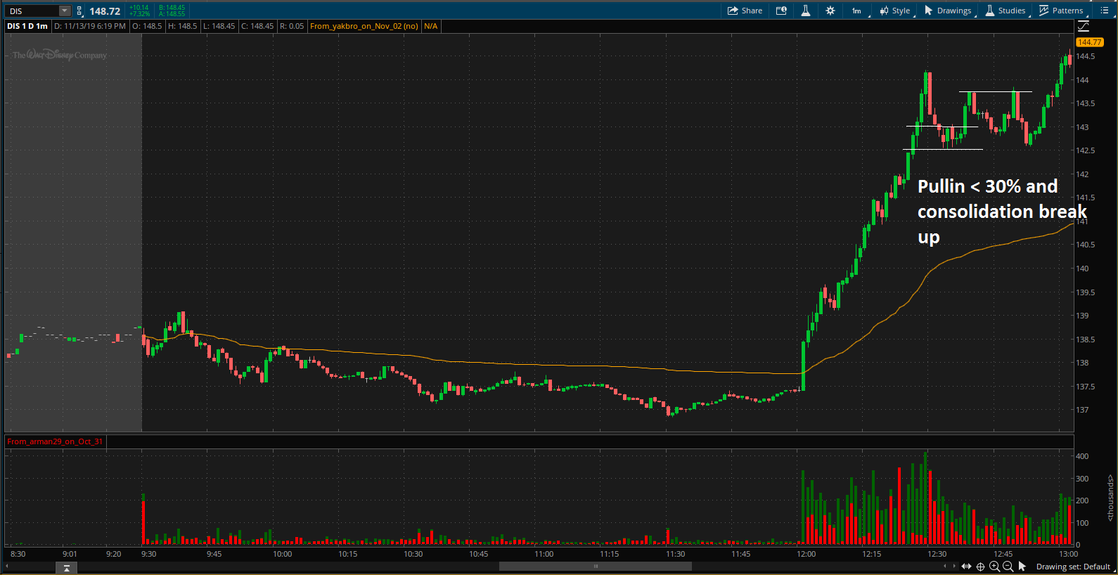
Setup

Slide 8
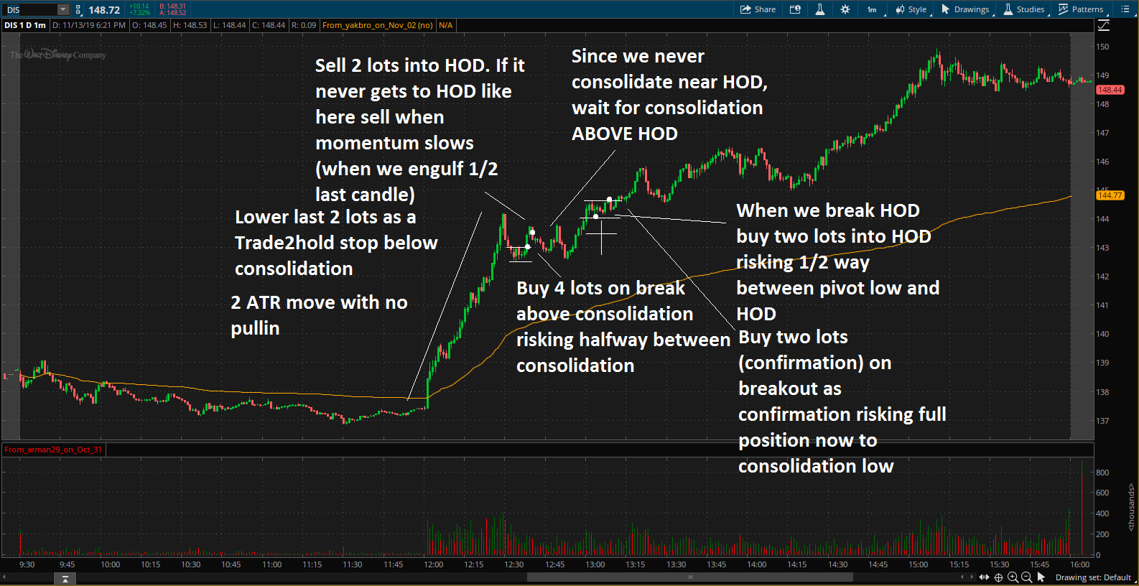
Trade Management

Slide 9
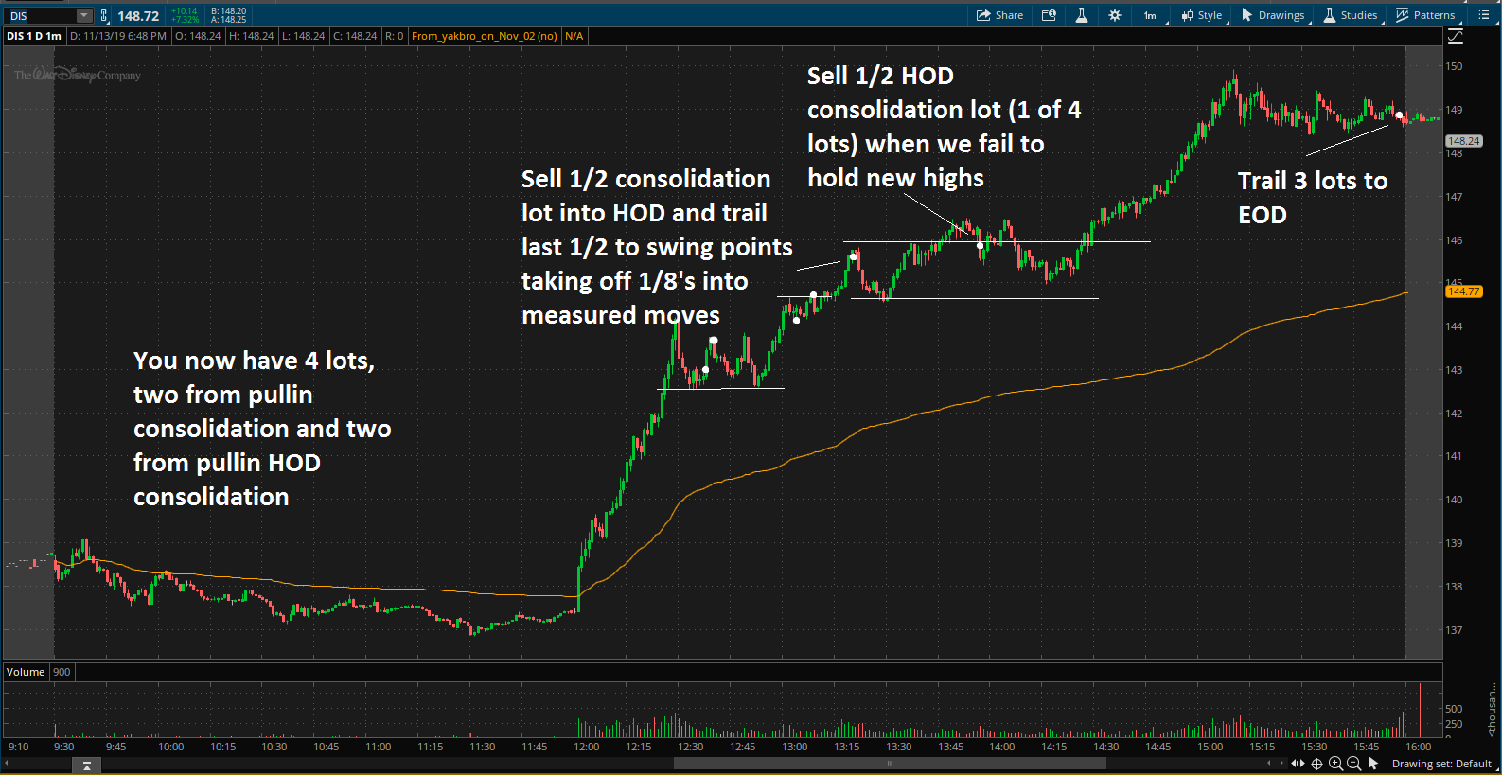
Trade Management Profits

