Slide 1
Breaking News
Pullin Trade
Momentum
Kyle Hughes
$LYFT
10/22/2019

Slide 2
SMB TRAINING is NOT a Broker Dealer. SMB Training engages in trader education and training. SMB TRAINING offers a number of products and services, both electronical (over the internet through smbtraining.com) and in person. SMB TRAINING also offers web-based, interactive training courses on demand.
The seminars given by SMB TRAINING are for educational purposes only. This information neither is, nor should be construed, as an offer, or a solicitation of an offer, to buy or sell securities. You shall be fully responsible for any investment decision you make, and such decisions will be based solely on your evaluation of your financial circumstances, investment objectives, risk tolerance, and liquidity needs.
This material is being provided to you for educational purposes only. No information presented constitutes a recommendation by SMB TRAINING or its affiliates to buy, sell or hold any security, financial product or instrument discussed therein or to engage in any specific investment strategy. The content neither is, nor should be construed as, an offer, or a solicitation of an offer, to buy, sell, or hold any securities. You are fully responsible for any investment decisions you make. Such decisions should be based solely on your evaluation of your financial circumstances. Such decisions should be based solely on your evaluation of your financial circumstances, investment objectives, risk tolerance and liquidity needs.
SMB Training and SMB Capital Management, LLC are separate but affiliated companies.
No relevant positions
Please note: Hypothetical computer simulated performance results are believed to be accurately presented. However, they are not guaranteed as to accuracy or completeness and are subject to change without any notice. Hypothetical or simulated performance results have certain inherent limitations. Unlike an actual performance record, simulated results do not represent actual trading. Since, also, the trades have not actually been executed; the results may have been under or over compensated for the impact, if any, of certain market factors such as liquidity, slippage and commissions. Simulated trading programs in general are also subject to the fact that they are designed with the benefit of hindsight. No representation is being made that any portfolio will, or is likely to achieve profits or losses similar to those shown. All investments and trades carry risks.”

Slide 3
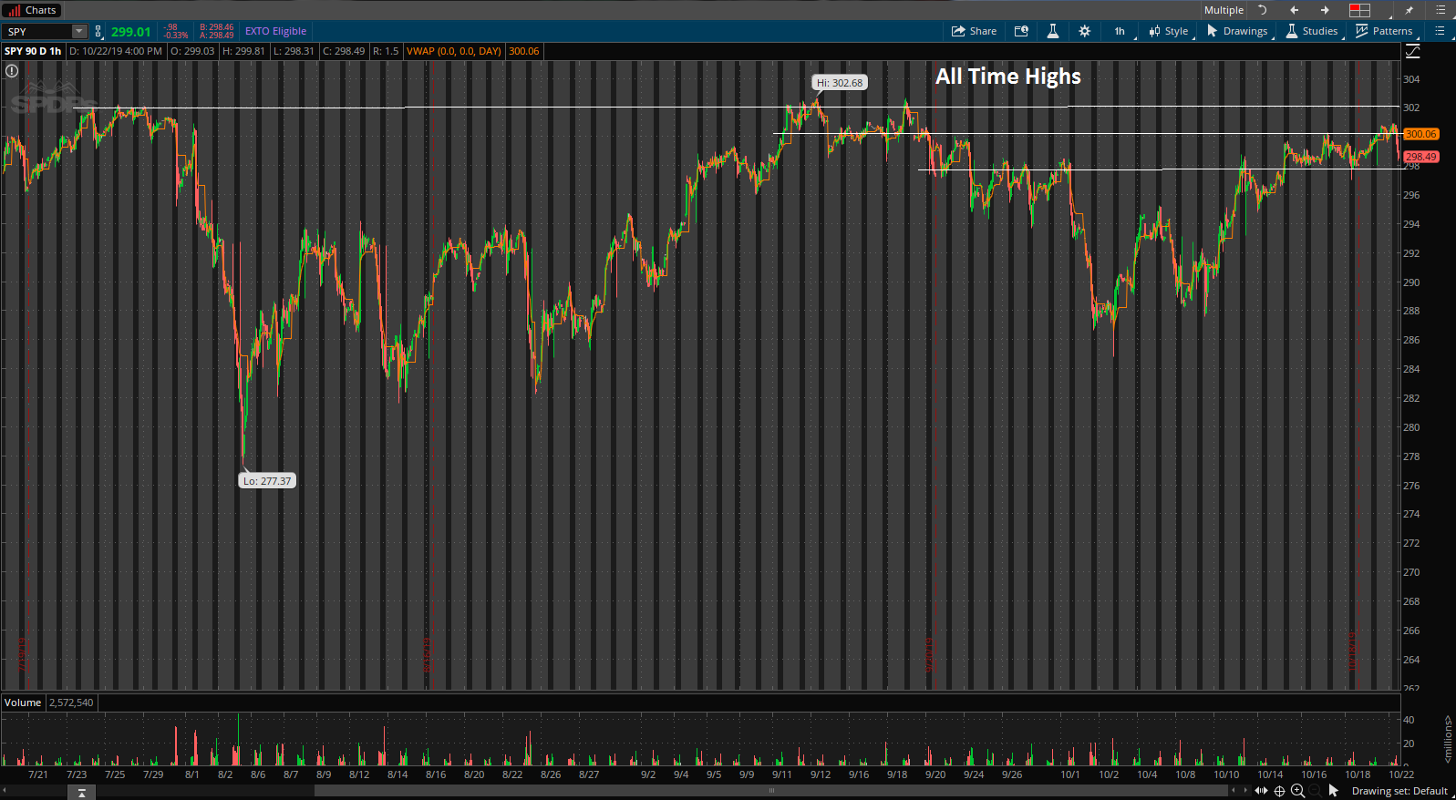
Big Picture
SPY’s are in a choppy market with the trade war news however it has calmed down slightly recently. Trading near all time highs resistance

Slide 4
Intraday Fundamentals
LYFT came out mid day and said they will be profitable in Q4 of 2021, a year before analysts expected when speaking with the Wall Street Journal’s Tech Live. This was big news since one of the biggest concerns for many of these new companies/IPO’s is their profitability especially in the ride sharing space with Uber and Lyft.
ATR – 1.86
RVOL - 5
AVOL – 6.4M
Float – 196M
Inst Ownership – 36%
Short Float – 10%

Slide 5
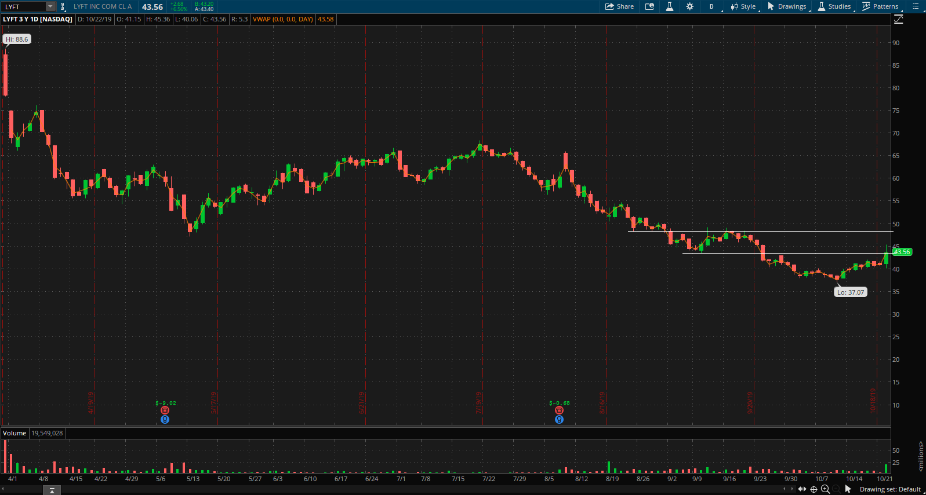
Technical Analysis Since IPO

Slide 6
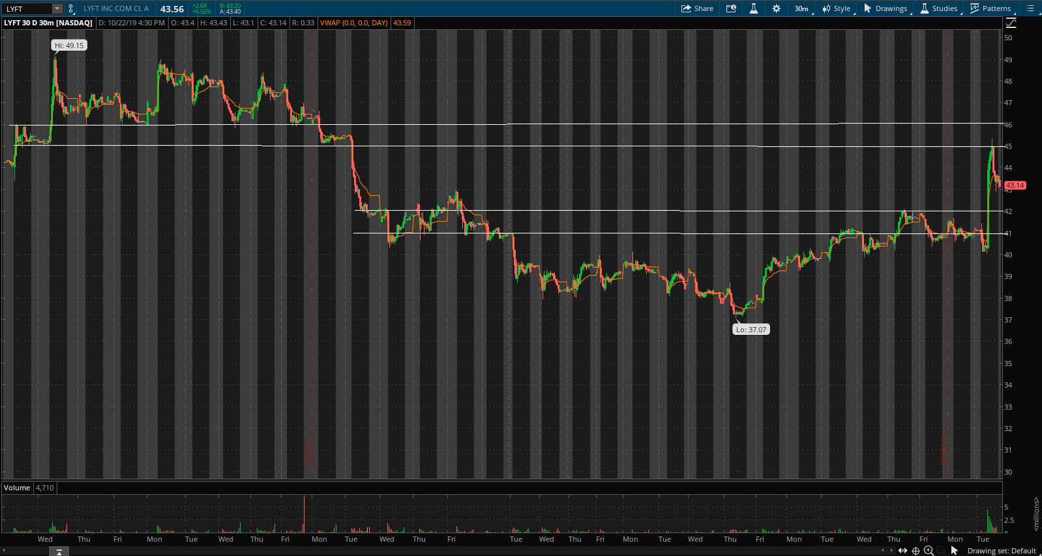
Technical Analysis 1 Month

Slide 7
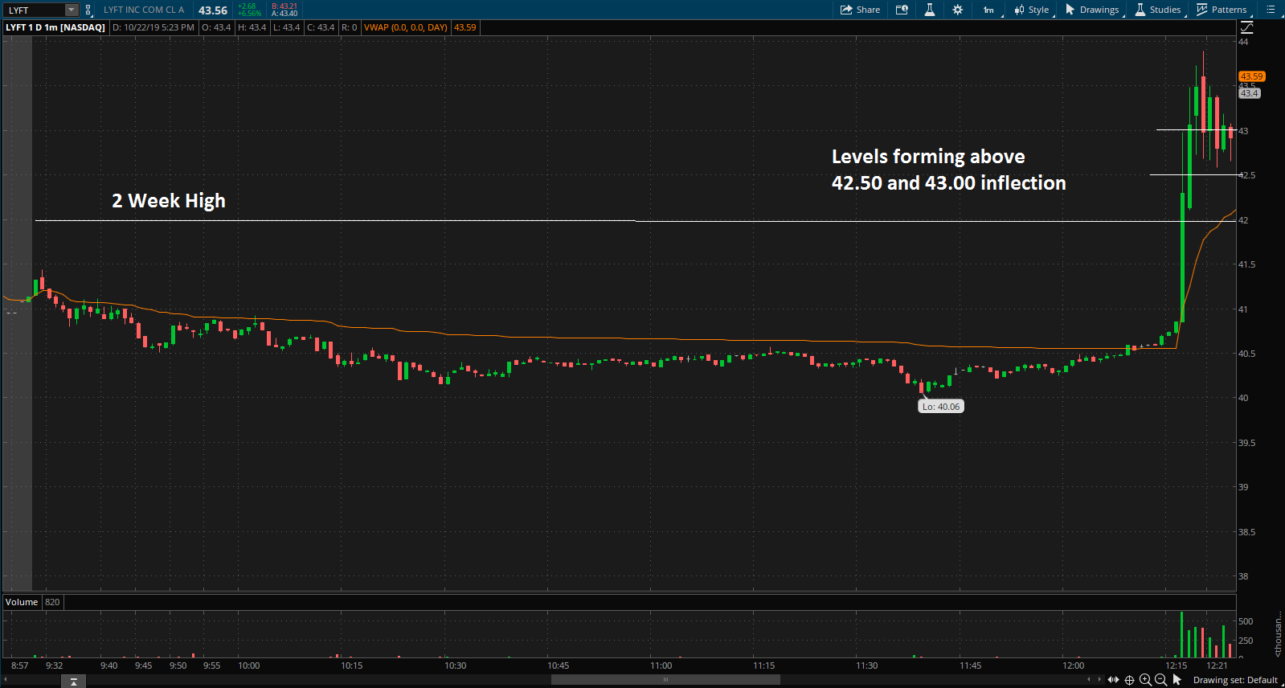
Setup

Slide 8
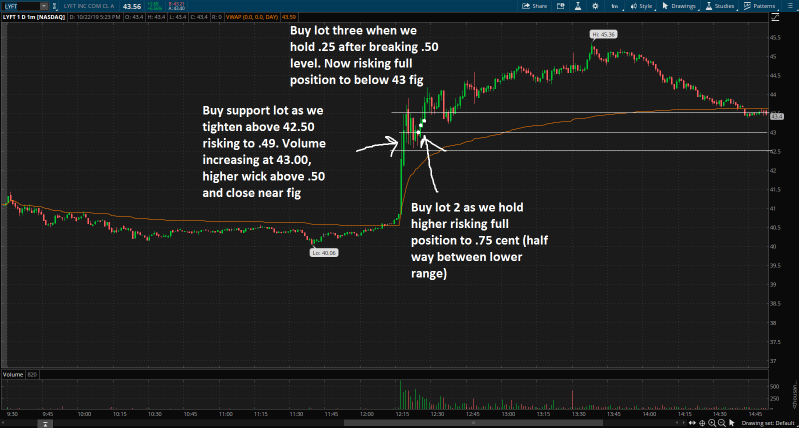
Trade Management

Slide 9
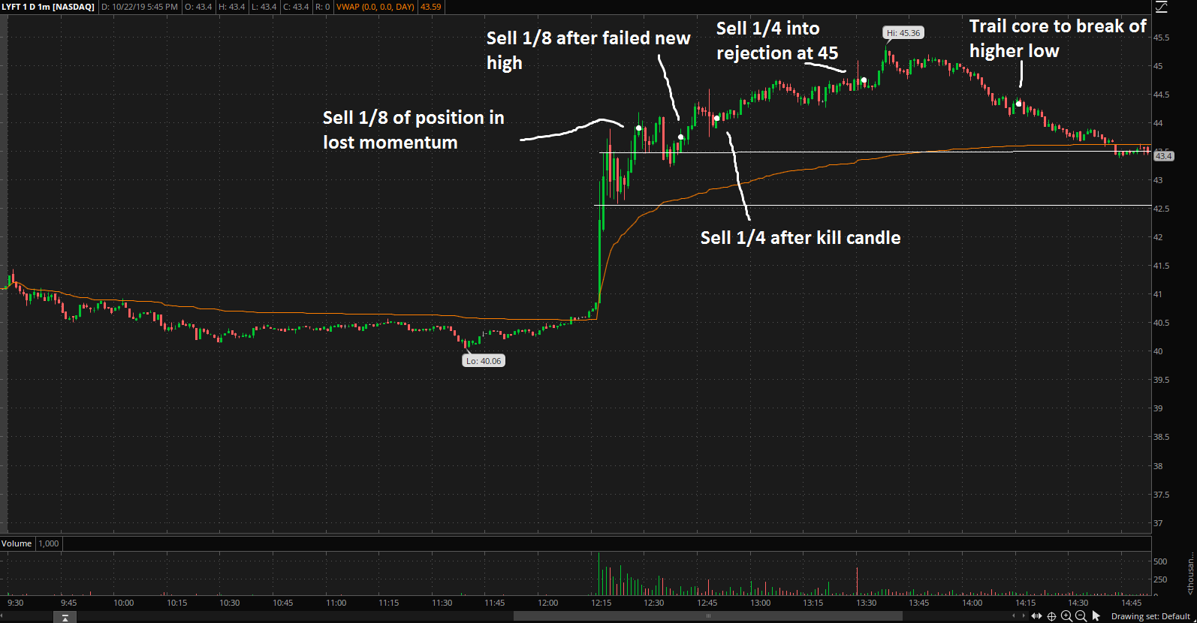
Trade Management

Slide 10
Trade Variables
Breaking news that changes the fundamentals of the company
RVOL – > 3
Identifiable levels
Know the risk
  Whats the tape pullin look like
  Where are the bids supporting when it starts to work

