Slide 1
Semantic Analysis of Midterm Election Candidates
Kyle Arbide and Asare Buahin

Slide 2
Problem Statement
What are the strategies that will be used by Democrats and Republicans in the upcoming midterm election surrounding student loan forgiveness and climate change?
Notes:
Fightin’ Words: Lexical Feature Selection and Evaluation for Identifying the Content of Political Conflict

Slide 3
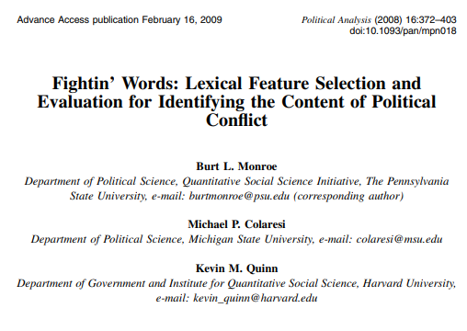
Who will care
Political Scientists and Researchers
Insight into the political strategy used during the election
US Voters
Understanding of where their candidates lie on the political strategy
Candidates
Ability to quickly discern strategies of the opponent.
Monroe, B., Colaresi, M., & Quinn, K. (2017). Fightin' Words: Lexical Feature Selection and Evaluation for Identifying the Content of Political Conflict. Political Analysis, 16(4), 372-403. doi:10.1093/pan/mpn018

Slide 4
Types of Questions
Inductive
Deductive
Abductive
How are politicians approaching the topic of student loans based on their semantics during political speeches and social media posts?
Does each party approach/talk about student loans differently than the other? What are common strategies used when approaching this topic?
Given that we observe different semantics in both parties, can we attribute the difference in speech to political strategy?
Notes:
Deductive
How politicians approaching the topic of student loans based on their semantics during political speeches and social media posts?
Inductive
Does each party approach/talk about student loans differently than the other? What are common strategies used when approaching this topic?
Abductive
Given that we observe different semantics in both parties, can we attribute the difference in speech to political strategy?
Decide which version is best suited to your overall goal and justify why.
ANSWER THIS

Slide 5
Types of Questions
Inductive
Deductive
Abductive
How are politicians approaching the topic of student loans based on their semantics during political speeches and social media posts?
Does each party approach/talk about student loans differently than the other? What are common strategies used when approaching this topic?
Given that we observe different semantics in both parties, can we attribute the difference in speech to political strategy?
Notes:
Deductive
How politicians approaching the topic of student loans based on their semantics during political speeches and social media posts?
Inductive
Does each party approach/talk about student loans differently than the other? What are common strategies used when approaching this topic?
Abductive
Given that we observe different semantics in both parties, can we attribute the difference in speech to political strategy?
Decide which version is best suited to your overall goal and justify why.
ANSWER THIS

Slide 6



Type of Questions cont
Descriptive
What are the semantics for each politician on student loan forgiveness and climate change?
Relational
How does the nature of a political party affect the semantics expressed in their rhetoric?
Causal
When a candidate is facing a more extremist opponent, what kind of approach are they likely to take?

Slide 7
Type of Questions cont
Relational
How does the nature of a political party affect the semantics expressed in their rhetoric?
Directly compare the difference in semantics as a result of political party

Slide 8
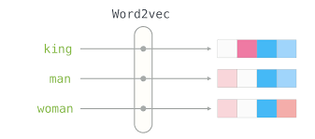
Units of Analysis
Term Frequency - Inverse Document Frequency (TF-IDF)
word2vec
doc2vec
Each of these are methods for understand the weight and similarity between terms in a given corpus
Similar approaches have been used for this kind of project in the past
Alammar 2019. https://jalammar.github.io/illustrated-word2vec/

Slide 9
Time Horizon of Question
Longitudinal
To best understand the effects of the change in legislature regarding student loan forgiveness and climate change on semantics used during the upcoming midterm election, we think it’s best to perform a longitudinal study from before and after these events

Slide 10
Questions using different specificity
Too broad
What kind of rhetoric is used by different political candidates?
Too specific
What are the most frequent words used by far-right republicans and far-left democrats?
Just right
What are the key differences in structure of speech and term usage between candidates of different political parties when speaking on student loan forgiveness and climate change, and how has this been affected by change in legislation?
It investigates the relation between two variables while specifying a strategy and topics

Slide 11
Feasibility of our question
Time
Ethicality
Critical Path
Our data collection will run through the end of the election in November. If we start our analysis before we finish the data collection, we should feasibly be able to finish soon after we finish collecting data
We are consuming public information directed at voters(us) and in no way affects the outcome of the elections.
The elections and campaign trail need to happen to carry on with our project (and they likely will).

Slide 12
Feasibility of our question
Cost
Scope
Twitter API and Youtube API are available for free, unless we need additional calls to Youtube
By narrowing down the issues being considered for our project(student loan forgiveness,climate change), we reduce the scope enough to answer a specific question that can be completed in a semester

Slide 13
A winning research question
What are the key differences in structure of speech and term usage between candidates of different political parties when speaking on student loan forgiveness and climate change, and how has this been affected by the change in legislation?
Formulating a question that can’t lose
Our goal is to understand if a relationship exists between political parties and semantics. If we cannot find a relationship, we can examine what the similarities are and why there is no measurable difference. If we do, we can dive into what the relationship is and how it might vary from election to election

