Slide 1

Monthly Web Stats
April 2011
Kyle Bird – Kbird@accubid.com

Slide 2

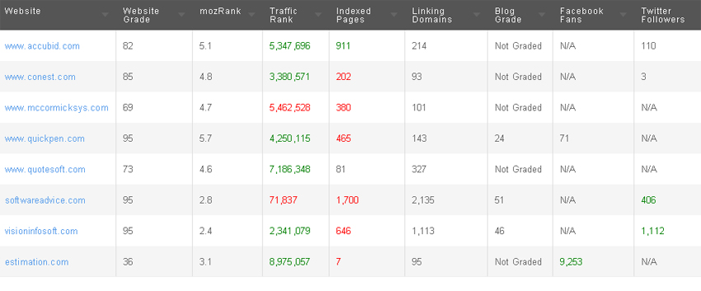
Website Competitor Comparison
Accubid fairs well against market competitors.
I fear that if we don’t have some fresh content soon, the Accubid site might start to suffer.
Website Grade = higher number is better. MozRank = lower number is better. Traffic Rank = lower number is better. Blog Grade = Higher is better

Slide 3
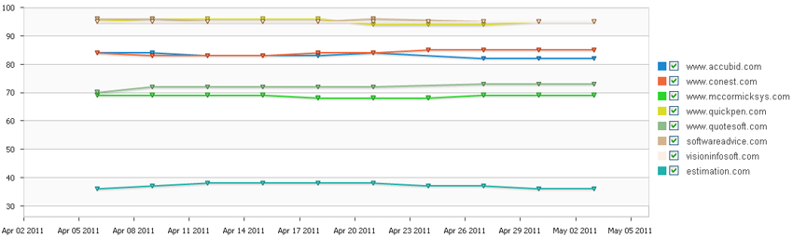
Website Competitor Comparison
1 Month ‘Website Grade’ competitor comparison.
1 month competitor ‘Website Grade’ comparison

Slide 4
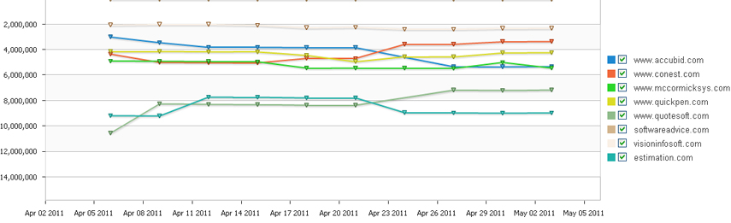
Website Competitor Comparison
1 Month ‘Traffic Rank’ competitor comparison.
Steady pace for most companies, Accubid dipped down in 3rd week of April.
3 month competitor ‘Traffic Rank’ comparison

Slide 5
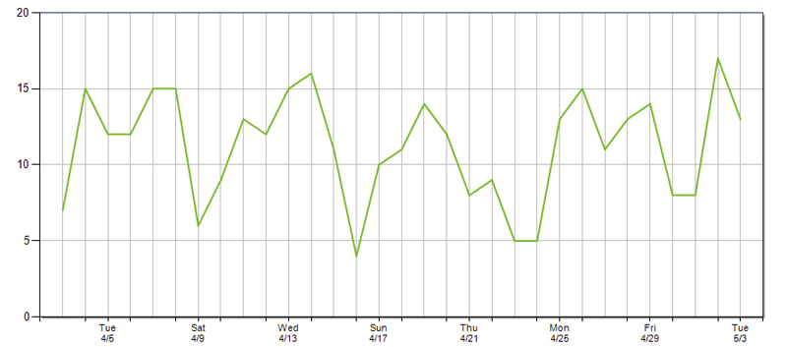
Website Keywords
Monthly Keyword summary loosely following work-week patterns.
Monthly traffic-producing keywords

Slide 6
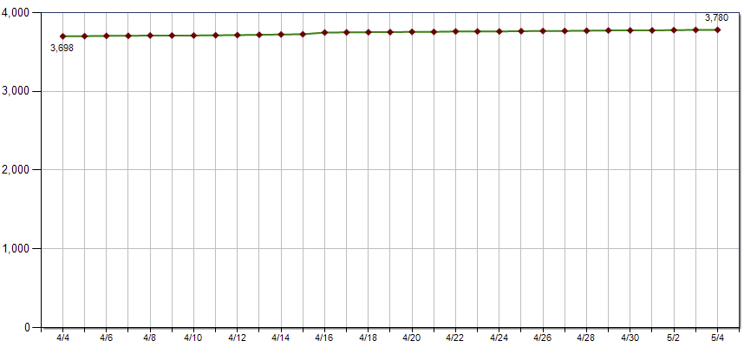
Website Inbound Links
Monthly Inbound links demonstrates steady increase in inbound links
Monthly inbound links

Slide 7
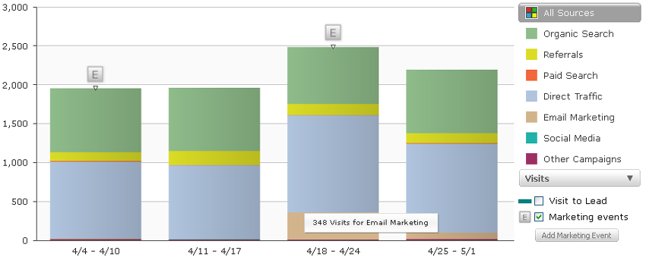
Website Traffic
Our Extensions newsletter email was released on April 21st.
Monthly traffic sources

Slide 8
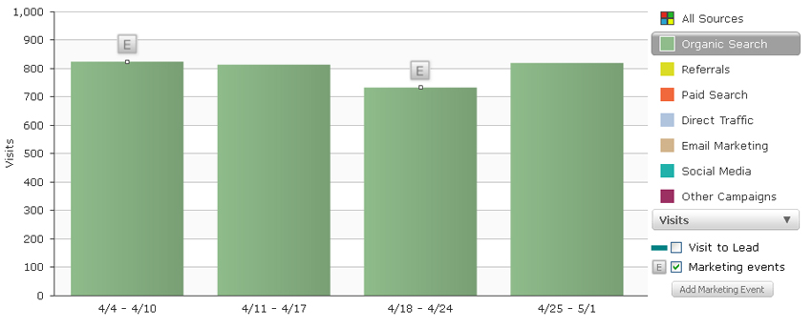
Website Organic Search
Organic search, including all major search engines.
1 Month organic search

Slide 9
Website Organic Search Terms
Top traffic-producing organic search Terms
keyword | Search Engine | Visits | Leads
accubid | Google | 1,227 | 12
accubid | Bing | 147 | 3
accubid.com | Google | 91 | 0
accubid | Yahoo | 81 | 2
electrical estimating software | Google | 78 | 1
accubid.com | Bing | 66 | 0
accubid pro | Google | 60 | 0
accubid systems | Google | 56 | 0
acubid | Google | 36 | 1
accubid cost | Google | 28 | 0
constructjob | Google | 25 | 0
accubid software | Google | 24 | 0
accubid estimating | Yahoo | 23 | 0
www.accubid.com | Google | 20 | 0
accubid.com | Yahoo | 19 | 0
accu bid | Google | 17 | 0
accubid training | Bing | 15 | 0
electrical estimating software | Yahoo | 15 | 0
bidwinner | Google | 15 | 0
electrical estimating software | Bing | 14 | 0
electrical bidding software | Google | 13 | 0
electrical drafting | Google | 11 | 0
mechanical estimating software | Google | 11 | 0
electrical estimating classes | Google | 11 | 0
mechanical estimating | Google | 10 | 0
accubid bidwinner plus | Google | 9 | 0
electrical estimating programs | Google | 9 | 0
construct job | Google | 9 | 0
www.accubid.com | Bing | 9 | 0
accubid tutorial | Google | 9 | 0
electrical estimating | Google | 9 | 0
accubid estimating software | Google | 8 | 1
accubid constructjob | Google | 8 | 0
electrical estimating courses | Google | 8 | 0
change order pro | Google | 8 | 0
accubid training classes | Google | 7 | 0
change order software | Google | 7 | 0
accubid classes in canada | Google | 7 | 0
www.accubid.com | Yahoo | 7 | 0
accubid electrical estimating software | Bing | 7 | 0
structured cabling estimating software | Google | 7 | 0
accubid | Ask | 7 | 0
accu bid | Yahoo | 7 | 0
electrical estimatimg software | Yahoo | 7 | 0
accubid systems ltd | Google | 7 | 0
accubid training | Google | 7 | 0
labor risk ratio | Google | 6 | 0
acubid | Bing | 6 | 0
accubid t&m | Google | 6 | 0
Monthly organic search terms

Slide 10
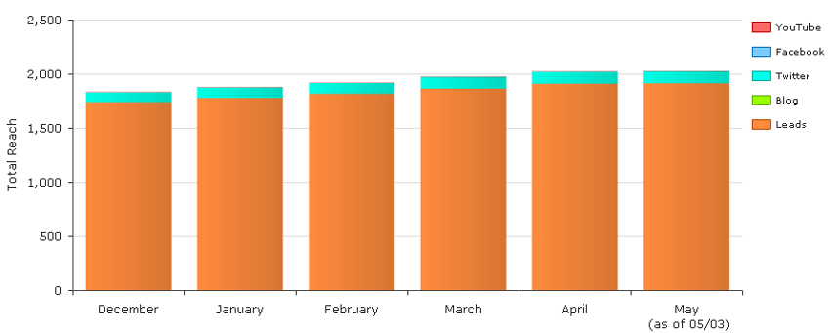
Website ‘Reach’
“Reach” refers to the sites ability to generate traffic via various avenues.
Monthly ‘Reach’

Slide 11
Monthly Web Stats
Ending April 2011
Kyle Bird - kbird@accubid.com

