Slide 1
Deep Learning Framework for Pricing Options
By: Kyle Bistrain
Faculty Advisors:
Dr. Ruiz, Dr. Frame, and Dr. Ramezani

Slide 2
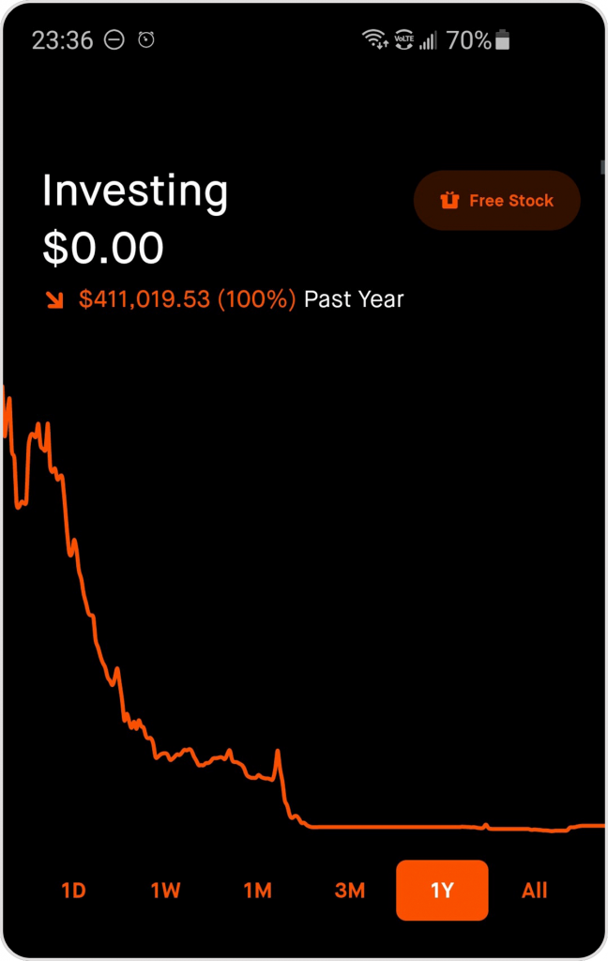
Before we begin 🚀
No, I didn’t find an Infinite Money Glitch (thankfully, this is not my account!)

Slide 3
Plan
Background
DATA
Models
Results
Conclusion

Slide 4
What are Options?
Contract Parties
Long (Buyer): Pays premium for rights granted by the option
Writer (Seller): Receives premium and takes on obligation
Call Option
Grants the right, but not the obligation, to buy the underlying asset at the strike price
Put Option
Grants the right, but not the obligation, to sell the underlying asset at the strike price

Slide 5
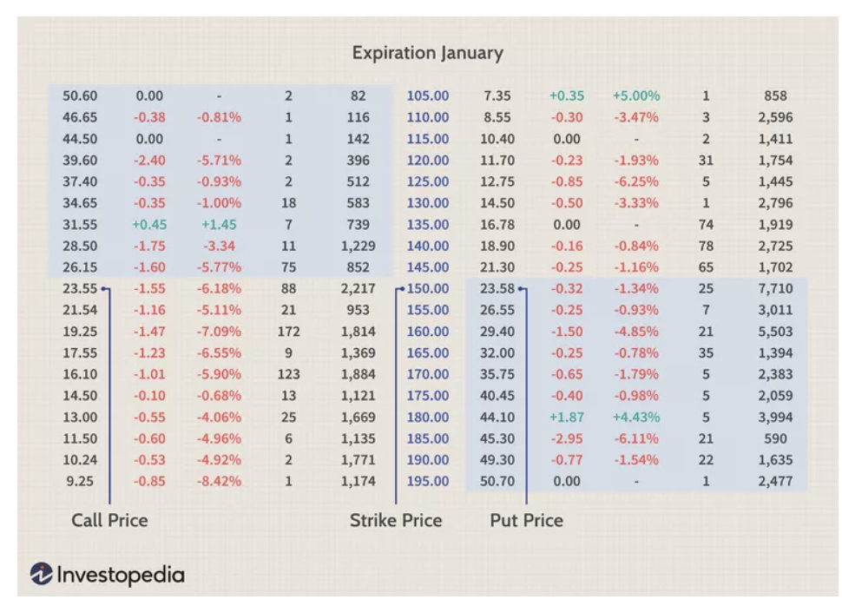
Example Option Order book

Slide 6
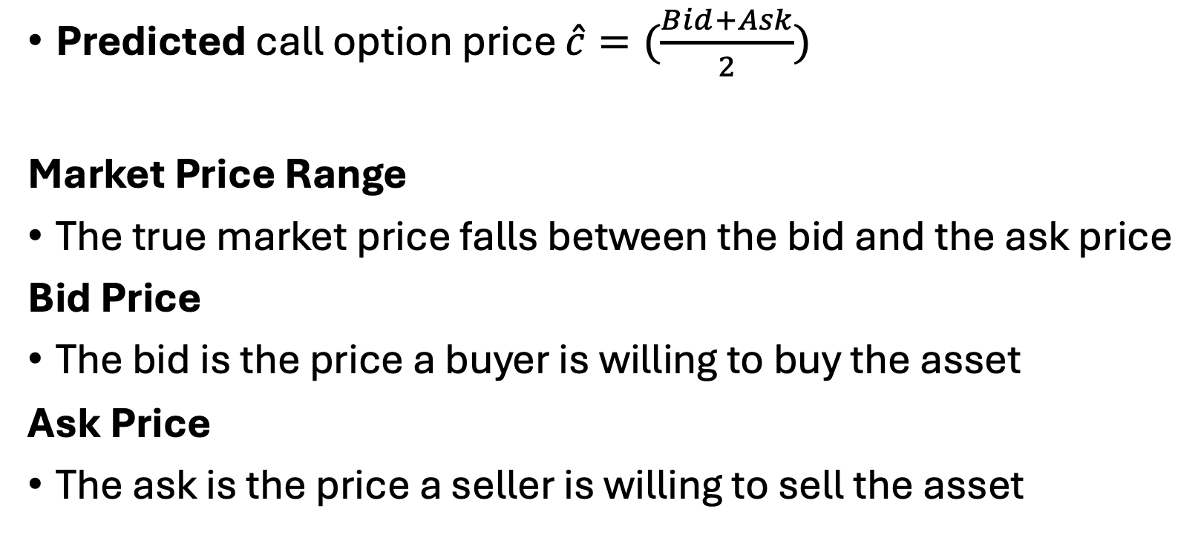
Response Feature
Predicted call option price $\hat{c}=(\frac{Bid+Ask}{2})$
Market Price Range
The true market price falls between the bid and the ask price
Bid Price
The bid is the price a buyer is willing to buy the asset
Ask Price
The ask is the price a seller is willing to sell the asset

Slide 7
Why Do We Care About Option Pricing?
Accurate option prices are the backbone of any serious trading strategy—they let us act decisively when it’s time to buy or sell.
Real-time model updates keep risk in check and help us rebalance quickly when markets shift.
Precise pricing isn’t just a technical goal—it’s what makes arbitrage detection, hedging, and strategy evaluation possible.

Slide 8

Input Features
Underlying SPY Price ($S_{0}$)
Strike (K)
Time to Expiry (T) - # trading days to expiry / 252
Risk-free Interest rate (r) – dependent on Time to Expiry
Volatility($σ$) – Rolling average volatility
Dividend(q) – Rolling annualized dividend
is_ex_date – 1 if ex-dividend date, else 0

Slide 9
Computing Historical Volatility
Historical) Volatility is computed from log returns
$$Log(\frac{S_{t}}{S_{t−1}})$$
𝐿𝑜𝑔(𝑆_𝑡/𝑆_(𝑡−1) )
volatility windows (63 days)
Notes:
Emphasize that this is most important feature

Slide 10
Data
Comprehensive SPY Option Dataset from February 2012 to May 2024 from Delta Neutral

Slide 11
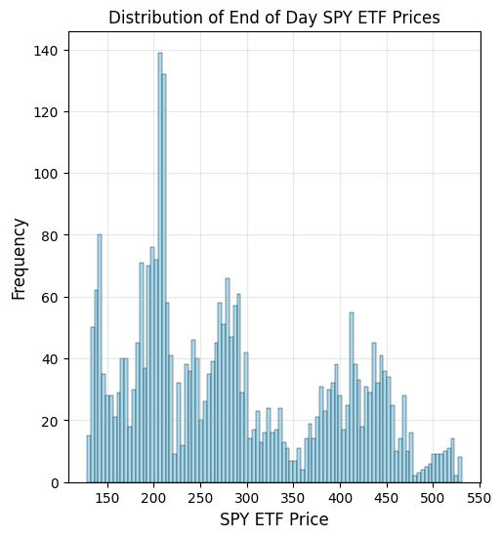
Distribution of SPY Asset Price

Slide 12
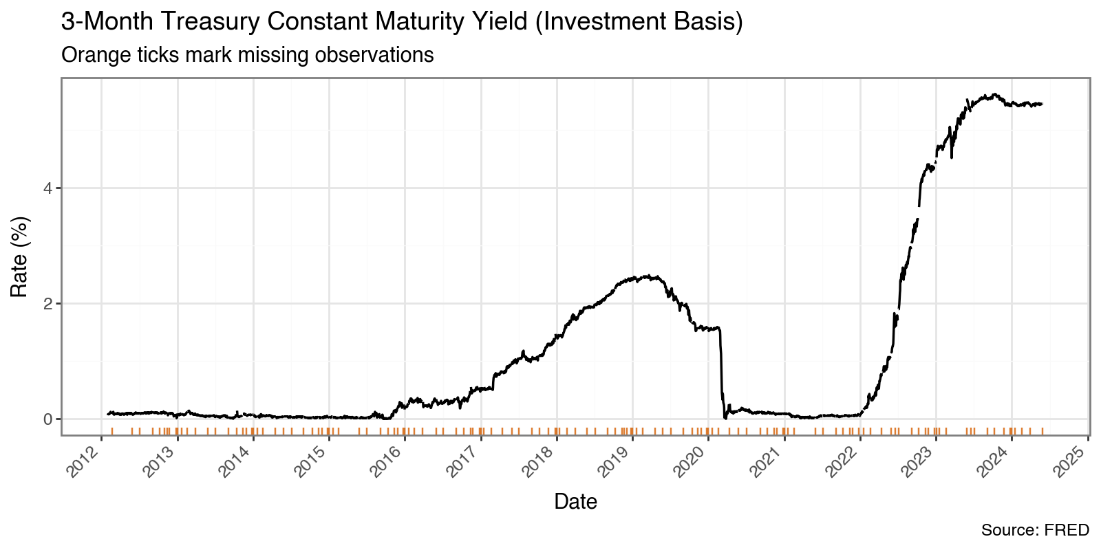

Slide 13
Bid-Ask Spread
Definition:
Spread = Ask price − Bid price
Liquidity Indicator:
Tight (Low) Spread: High trading volume, deep order books → lower transaction costs
Wide (High) Spread: Thin markets, greater slippage risk → higher execution cost
Drivers of Spread:
Trading Volume & Open Interest
Implied Volatility
Time to Expiration
Moneyness (ITM, ATM, OTM)
Practical Implications:
Use spread thresholds to improve model robustness and reduce slippage

Slide 14
Black Scholes Model
Closed form solution to pricing a European call and put
(Black and Scholes, 1973)

Slide 15
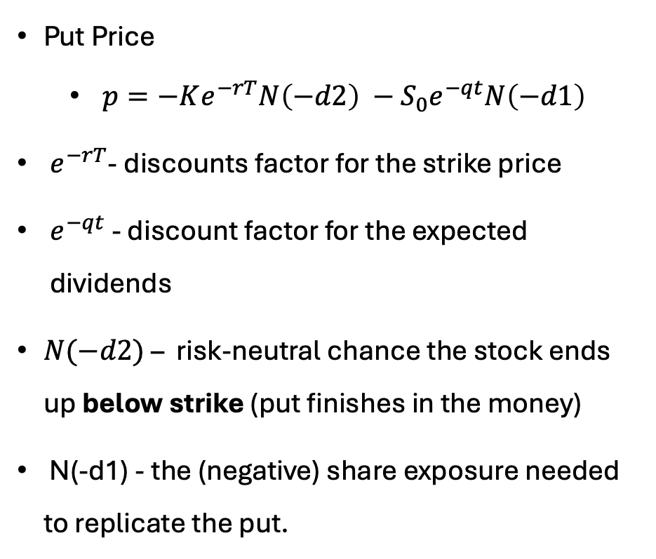
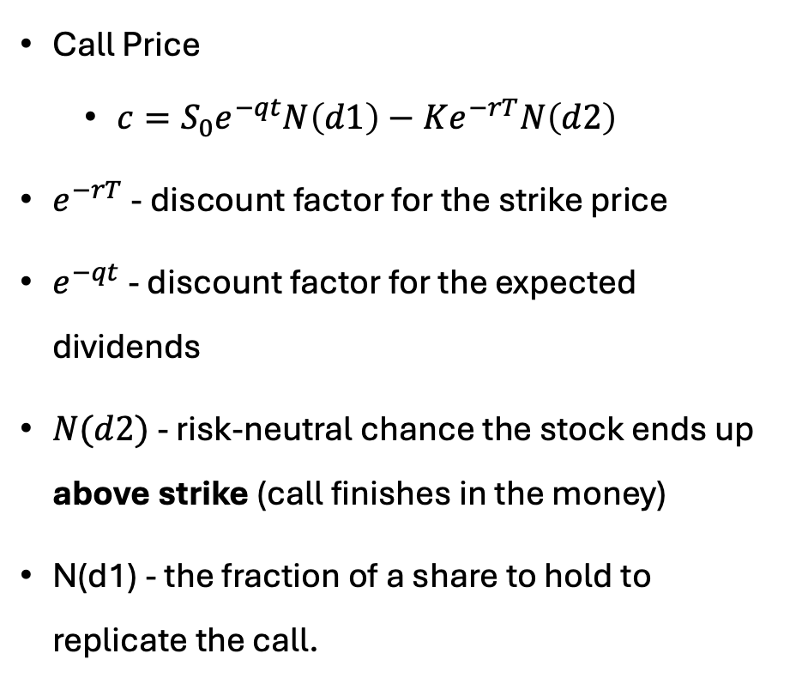
European Call and Put Pricing under Black Scholes with Continuous Dividends
Call Price
$c=S_{0}e^{−qt}N\left(d1\right)−Ke^{−rT}N\left(d2\right)$
$e^{−rT}$- discount factor for the strike price
- discount factor for the expected dividends
$N(d2)$ - risk-neutral chance the stock ends up above strike (call finishes in the money)
N(d1) - the fraction of a share to hold to replicate the call.
Put Price
$p={−Ke^{−rT}N\left(−d2\right) −S}_{0}e^{−qt}N\left(−d1\right)$
$e^{−rT}$- discounts factor for the strike price
$e^{−qt}$ - discount factor for the expected dividends
$N(−d2)$ – risk-neutral chance the stock ends up below strike (put finishes in the money)
N(-d1) - the (negative) share exposure needed to replicate the put.

Slide 16
Black Scholes with Dividends Main Assumptions
Continuously compounded returns are normally distributed over time
Volatility of returns is constant and known
Continuous dividends
Risk-free interest rate is known and constant
No taxes and transaction costs

Slide 17
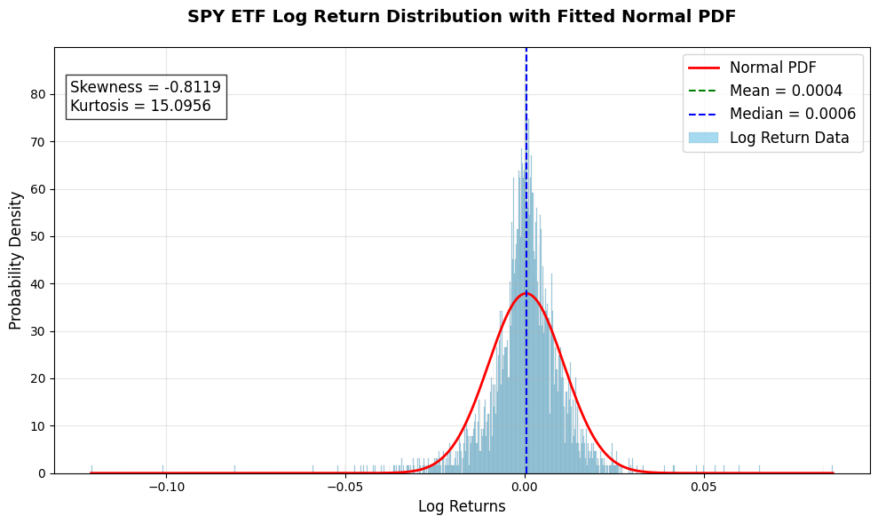
Notes:
The distribution is left-skewed.

Slide 18
Payoff Diagram

Slide 19

Deep Learning Framework
Utilize a feed-forward neural network (MLP) with multiple hidden layers to approximate option prices directly
Ingest core inputs: underlying price ($S_{0}$), strike (K), time-to-maturity(, risk-free rate, and historical volatility features

Slide 20
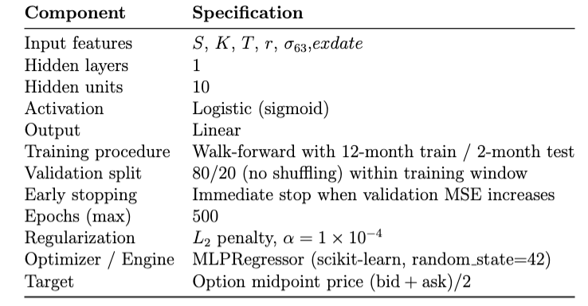
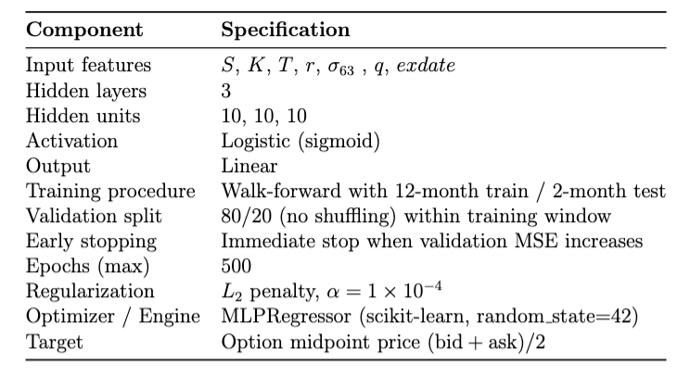
MLP Architectures
Fit both architectures for Call and Puts across 3-month, 6-month, and 1- year expiration dates

Slide 21
Walk forward Approach
Segmented data into 134 train-val-test splits from 2012 to 2024
Ran 6 Models for Calls and Puts at 3-month, 6 month and 1 year expiry
Example:
Fold 1
Train: February 14, 2012 to December 14, 2012
Validation: December 15, 2012 to February 14, 2013
Test: February 15, 2013 to April 14, 2013
Notes:
Combine with the previous slide but only include walk forward

Slide 22
Research Questions
How well does Black Scholes price SPY American calls across maturities & strikes?
Can a Multilayer Perceptron leverage only end-of-day data plus historical volatility to beat Black–Scholes out-of-sample?
To what extent do unconstrained neural networks violate no-arbitrage conditions when pricing American options?

Slide 23

Results

Slide 24
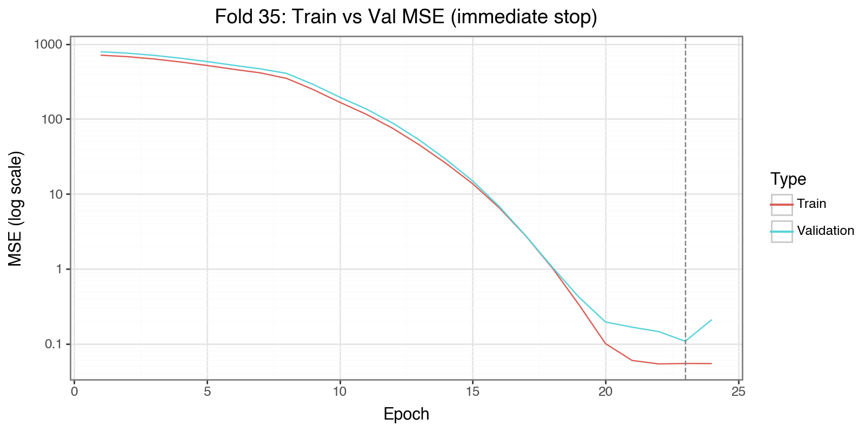

Slide 25
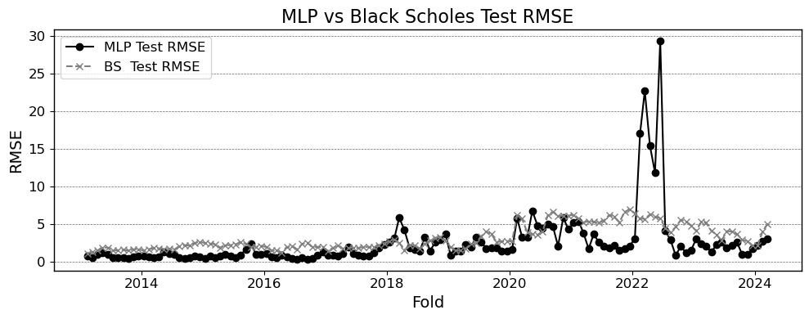

Slide 26
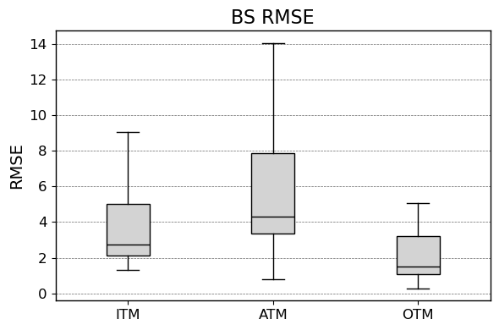
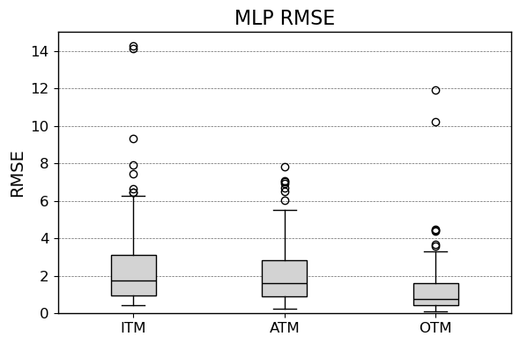
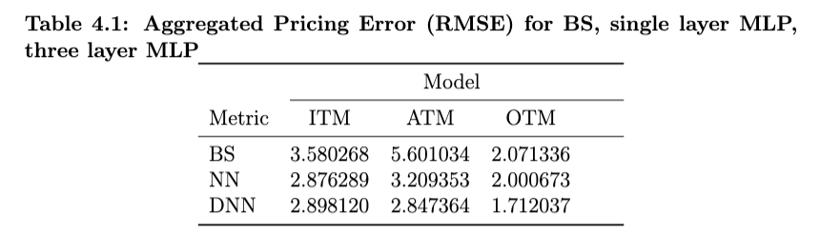
3 Month Call Option Empirical Results
Notes:
# add black scholes into into
replace fold with date
suggestion:
side-by-side boxplots (adding in BSM pricing errors)
separate panels by interest rate environments

Slide 27
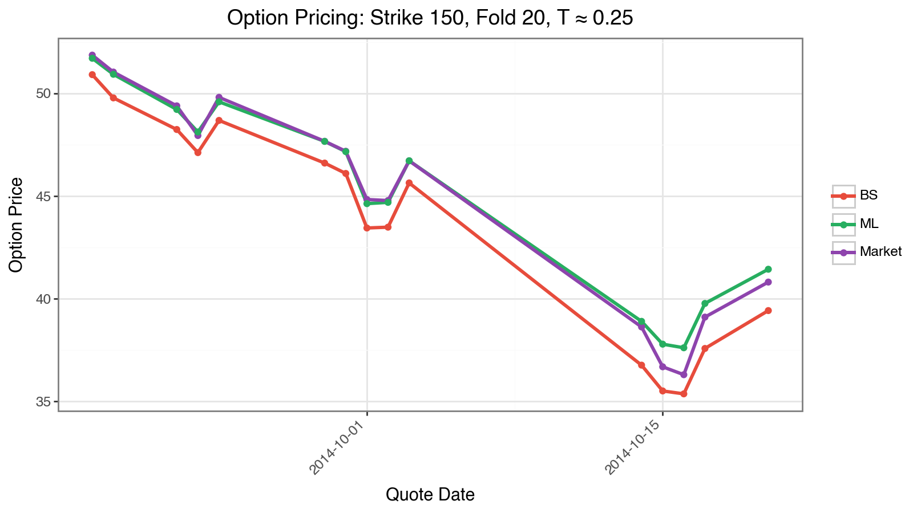
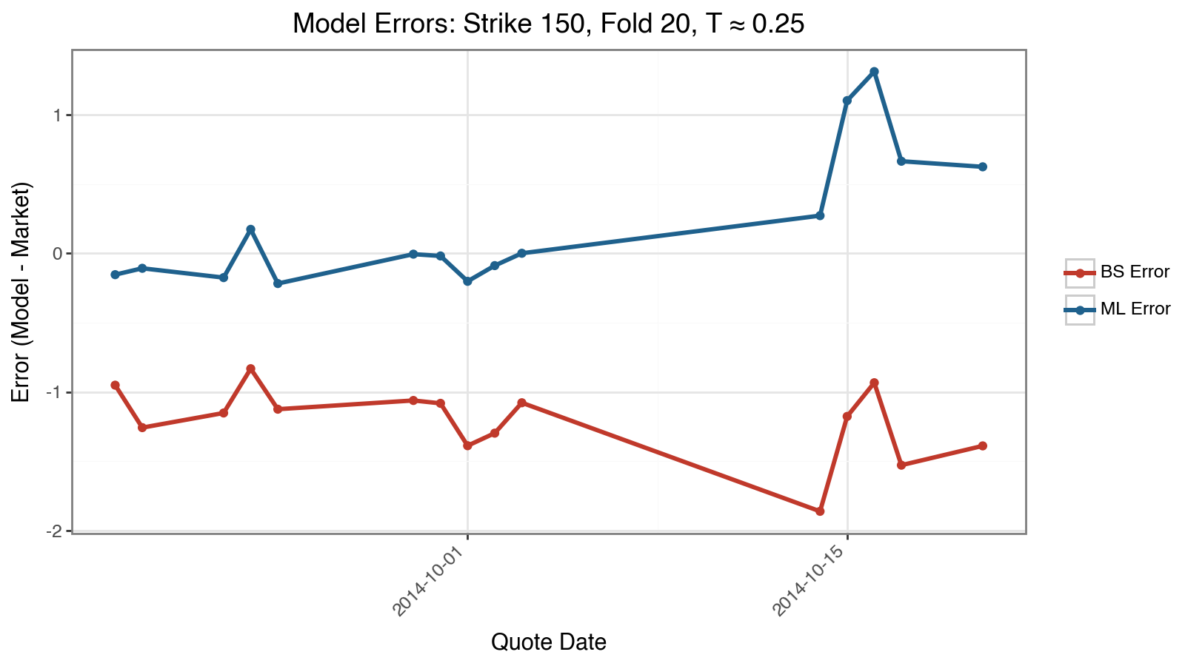
Case Where MLP Succeeds

Slide 28
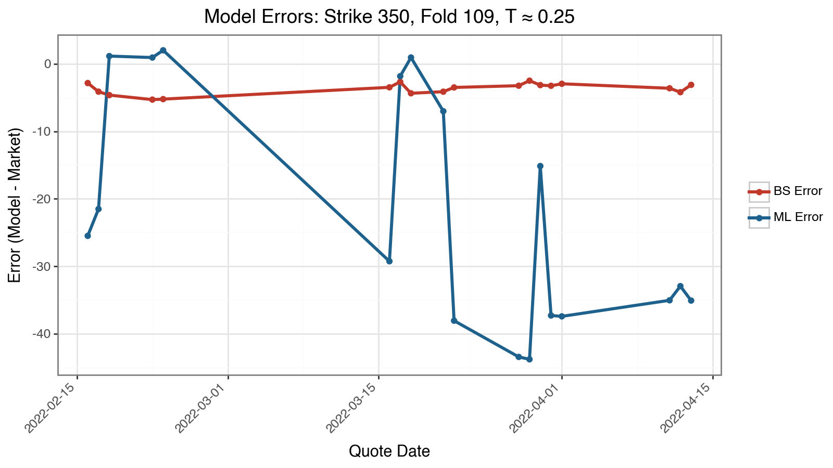
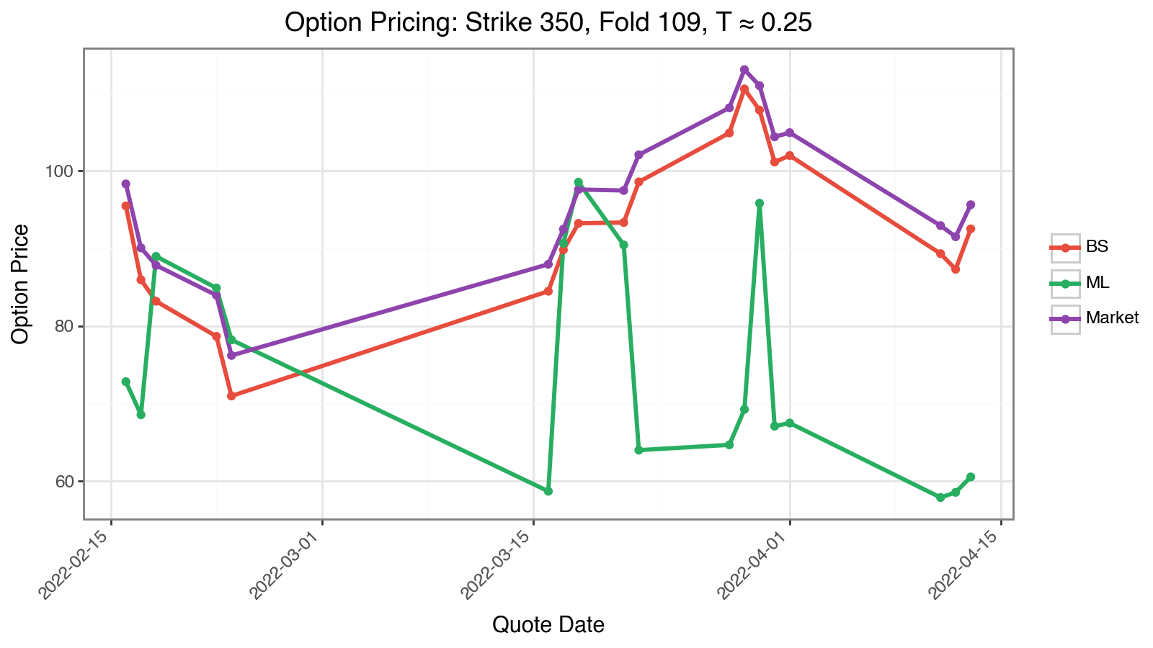
Case Where MLP Fails
Notes:
Maybe not absolute worst case

Slide 29
The Importance of No-Arbitrage
No-arbitrage means prices can’t allow “free money.”
Example: You pay nothing up front but are guaranteed profit → that’s arbitrage.
To avoid this, prices should follow:
Convexity – price curves the right way across strikes
Monotonicity – value should move logically with inputs
Time consistency – Prices should not drop as expiration gets further away, assuming everything else stays the same.
Neural nets don’t naturally follow these rules - we have to build them in.

Slide 30
The Greeks
Delta – How much the option price moves when the stock moves $1
Gamma – How much Delta changes when the stock moves
Theta – How much value the option loses each trading day day (time decay)
Vega – How much the option price moves with a 1% change in volatility
Rho – How much the option price moves with a 1% change in interest rates

Slide 31
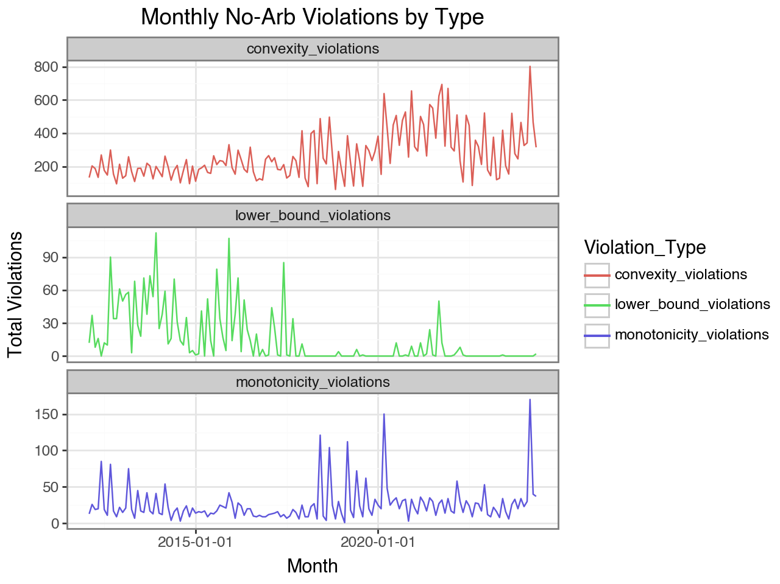
Checking for No Arbitrage Violations

Slide 32
Does It Work Better?
Yes
For the given input data, my MLP model outperforms Black Scholes on average across all windows
No
My model violates lower bound, monotonicity and convexity conditions

Slide 33
Conclusions
MLPs offer a flexible way to capture the non-linear behavior in options prices, especially for out-of-the-money (OTM) contracts.
However, unconstrained MLPs may violate key no-arbitrage principles, which limits their reliability in financial applications.
Incorporating constraints into the loss function or architecture may significantly improve model robustness and practical applicability.

Slide 34
Next Steps / Future Work
Next Steps
Restricting Bid – Ask spread
Realized Volatility – Intraday Data
Future Work
Deep Volatility Modeling
Reinforcement Learning for AI Delta Hedging
PINNs

Slide 35
Acknowledgments
Big thanks to Dr. Ruiz for all the support and helpful advice throughout this project!

