Slide 1
Machine Learning III

Slide 2
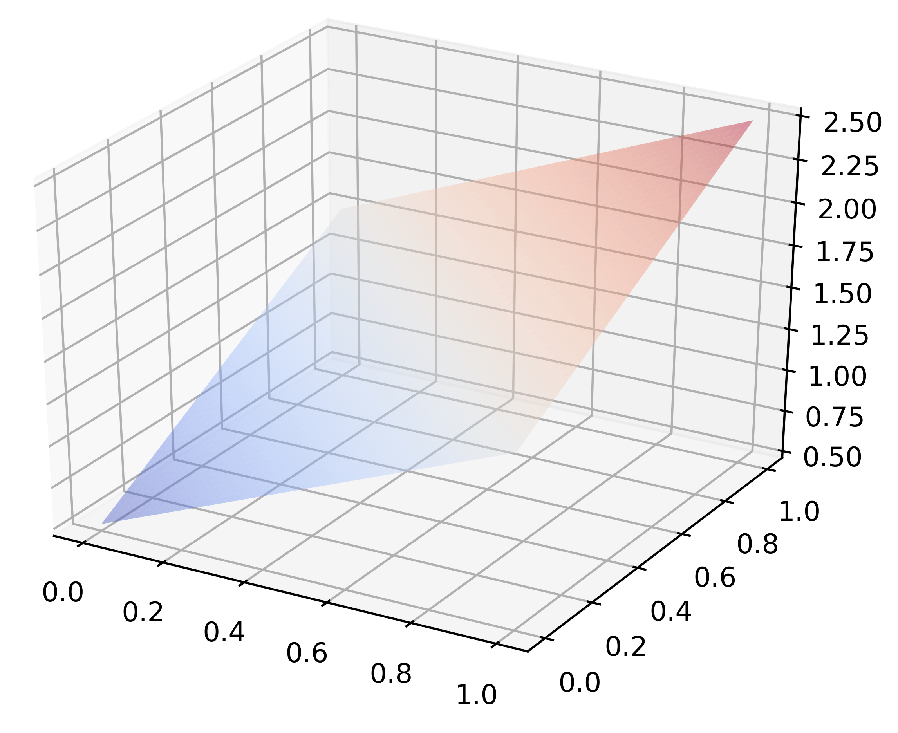
Linear models and error
$$\hat{f}(x)$$
$$y$$
$$\hat{f}(x)$$
$$y$$
$$E\left(x_{i}\right)=\hat{f}\left(x_{i}\right)−y_{i}$$
$$x_{i}$$
$$x$$
$$x_{2}$$
$$x_{1}$$
simple linear regression
multiple linear regression

Slide 3
How do we fit a linear model to data?
We want the error between our estimates and predictions to be small

Slide 4
How do we measure error?
$$\hat{y}=\hat{f}(x)=\sum_{i=0}^{p}{w_{i}x_{i}}$$
How well does approximate ?
$$y$$
$$\hat{y}$$
$$y$$
Error: difference between our estimate and our training data
$$\text{error}=\hat{y}−y$$
We use mean squared error to quantify training (in-sample) error:
$$E_{in}(\hat{f})=\frac{1}{N}\sum_{n=1}^{N}{{\left(\hat{f}(x_{n})−y_{n}\right)}^{2}}$$
Training (in-sample) error:
We call this our Cost Function
(a.k.a. loss, error, or objective)

Slide 5
$$E_{in}(\hat{f})=\frac{1}{N}\sum_{n=1}^{N}{{\left(\hat{f}(x_{n})−y_{n}\right)}^{2}}$$
Cost Function:
Training error is a function of our model and the training data
We can’t change the data, we must adjust our model to minimize cost
We choose model parameters that minimize cost
This is an optimization problem

Slide 6
How to fit our model to the training data?
Equivalently: how do we choose $w$ to minimize cost (error)
$$E_{in}(\hat{f})=\frac{1}{N}\sum_{n=1}^{N}{{\left(\hat{f}(x_{n})−y_{n}\right)}^{2}}$$
$$\hat{f}\left(x_{n}\right)=w^{T}x_{n}$$
where
$$E_{in}(w)=\frac{1}{N}\sum_{n=1}^{N}{{\left(w^{T}x_{n}−y_{n}\right)}^{2}}$$
We want to minimize
…by varying $w$
How do we do that?

Slide 7
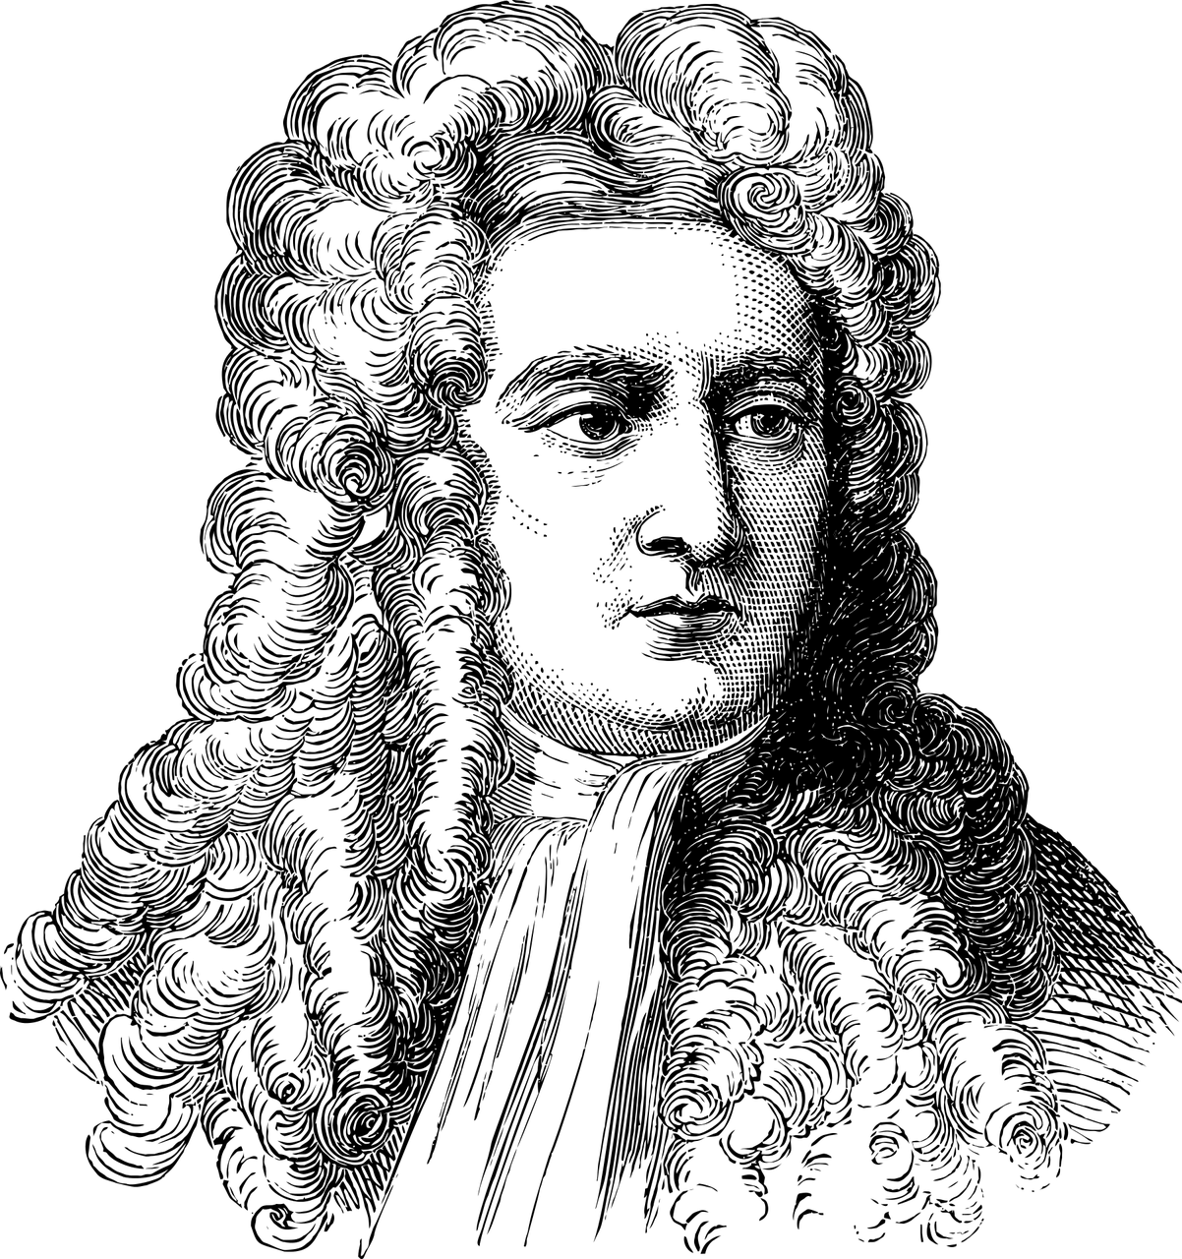
Calculus

Slide 8
A moment of calculus
Function of one variable
Function of multiple variables
$$f\left(x\right)=ax+bx^{2}$$
$$f\left(x_{1},x_{2}\right)=ax_{1}+bx_{2}$$
Derivative
Partial Derivative
Gradient
$$\frac{df}{dx}=a+2bx$$
$$\frac{∂f}{∂x_{1}}=a$$
$$∇_{x}f=\left[\begin{aligned}\frac{∂f}{∂x_{1}} \\ \frac{∂f}{∂x_{2}}\end{aligned}\right]$$
$$\frac{∂f}{∂x_{2}}=b$$
$$=\left[\begin{aligned}a \\ b\end{aligned}\right]$$
May also treat parameters as variables and take their partial derivative
$$\frac{∂f}{∂b}=x_{2}$$

Slide 9
How to fit our model to the training data?
Take the derivative with respect to $w$, set it to zero, and solve for $w$
$${∇_{w}E}_{in}(w)=∇_{w}\left(\frac{1}{N}\sum_{n=1}^{N}{{\left(w^{T}x_{n}−y_{n}\right)}^{2}}\right)$$
$p$ = number of predictors
$N$ = number of data points
$${∇_{w}E}_{in}\left(w\right)=\left[\begin{aligned}\begin{matrix}\frac{∂E_{in}}{∂w_{0}} \\ \frac{∂E_{in}}{∂w_{1}} \\ ⋮\end{matrix} \\ \frac{∂E_{in}}{∂w_{p}}\end{aligned}\right]=0$$
Here we walk through the ordinary least squares (OLS) closed-form solution.
Could have used an iterative approach like gradient descent
Size: $\left[p+1×1\right]$ or $ℝ^{p+1×1}$

Slide 10
Common paradigm for model fitting
Choose a hypothesis set of models to train (e.g. linear regression with 4 predictor variables)
Identify a cost function to measure the model fit to the training data (e.g. mean square error)
Optimize model parameters to minimize cost (e.g. closed form solution using the normal equations for OLS)

Slide 11
Much of machine learning is optimizing a cost function

Slide 12
What about classification?

Slide 13
Moving from regression to classification
$$y=\sum_{i=0}^{p}{w_{i}x_{i}}$$
Regression
$$y=\left\{\begin{matrix}1 \sum_{i=0}^{p}{w_{i}x_{i}}>0 \\ −1 else \end{matrix}\right.$$
$$y=sign\left(\sum_{i=0}^{p}{w_{i}x_{i}}\right)$$
Classification
(perceptron model)
where
$$sign\left(x\right)=\left\{\begin{matrix}1 & x>0 \\ −1 & else\end{matrix}\right.$$
Source: Abu-Mostafa, Learning from Data, Caltech

Slide 14
Moving from regression to classification
Linear Regression
Linear Classification
(perceptron)
$$\hat{f}(x)=\sum_{i=0}^{p}{w_{i}x_{i}}$$
$$\hat{f}(x)=sign\left(\sum_{i=0}^{p}{w_{i}x_{i}}\right)$$
$$x_{0}$$
$$x_{0}$$
$$w_{0}$$
$$w_{0}$$
$$x_{1}$$
$$w_{1}$$
$$x_{1}$$
$$w_{1}$$
$$x_{2}$$
$$w_{2}$$
+
$$\hat{f}(x)$$
$$x_{2}$$
$$w_{2}$$
+
$$\hat{f}(x)$$
$$w_{p}$$
$$w_{p}$$
$$⋮$$
$$⋮$$
$$x_{p}$$
$$x_{p}$$
Activation function
Source: Abu-Mostafa, Learning from Data, Caltech

Slide 15
Takeaways
Linear models are linear in the weights
Linear models can be used for both regression and classification
Model fitting/training (valid beyond linear models):
Choose a hypothesis set of models to train
Identify a cost function
Optimize the cost function by adjusting model parameters

Slide 16
How can we…
model nonlinear relationships?
use linear models for classification?
choose the parameters to fit our model to training data

Slide 17
Can we model nonlinear relationships?

Slide 18
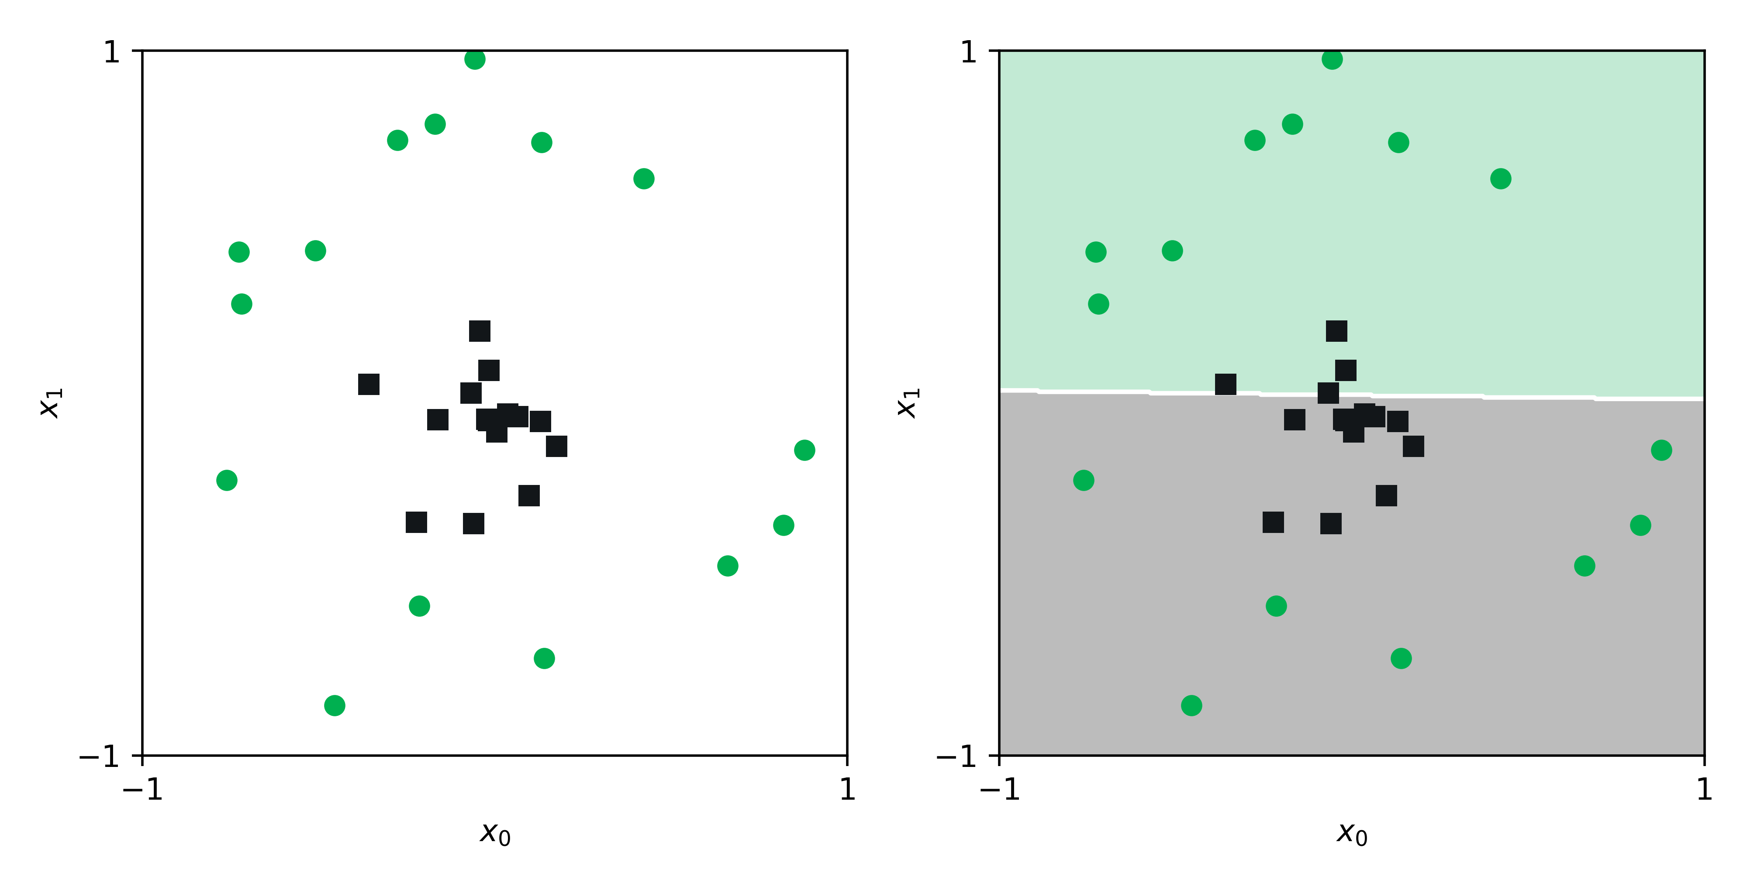
Limitations of linear decision boundaries
Original data
Classify the features in this $X$-space
$$x$$
$${\hat{f}}_{x}(x)=\text{sign}(w^{T}x)$$

Slide 19
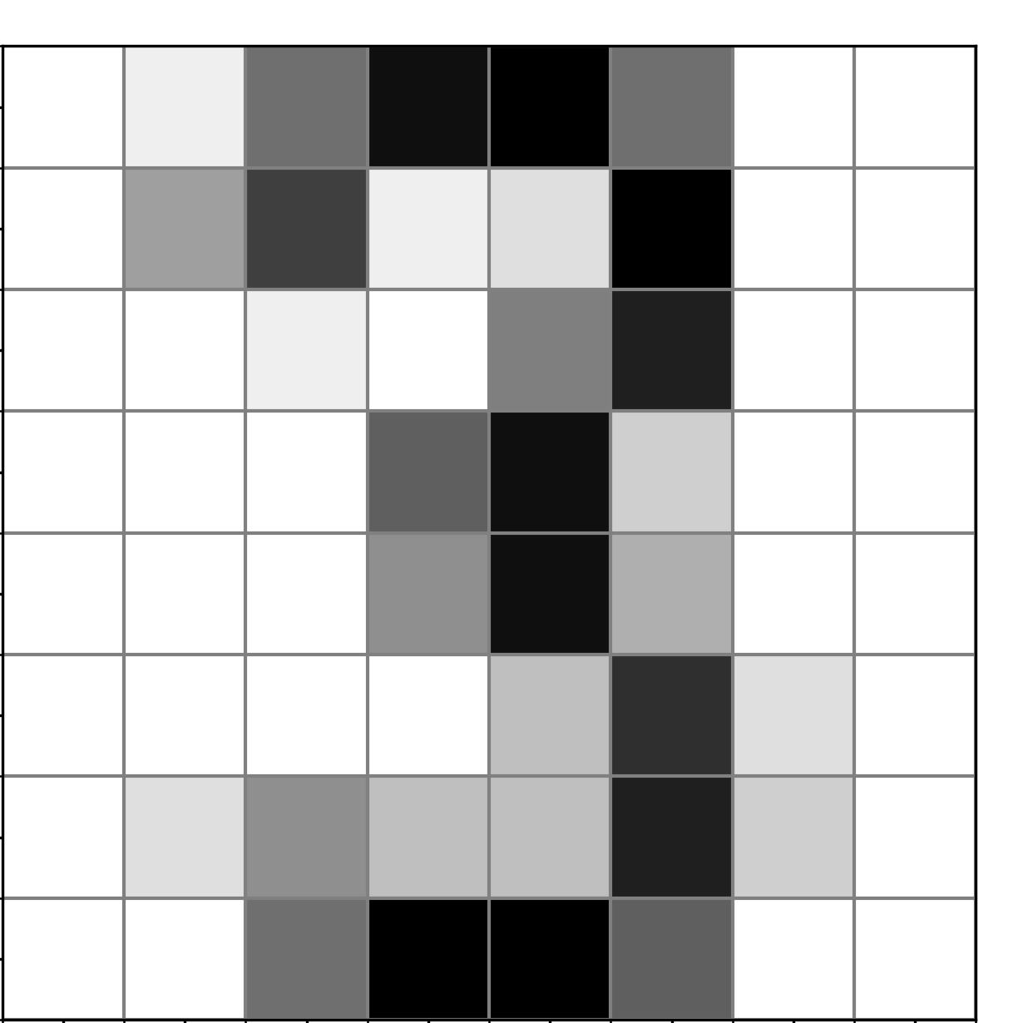
Transformations of features
Consider a digits example…
$$x=[x_{1}, x_{2},x_{3}, …,x_{64}]$$
We could create features based on the raw features. For example:
$$z=[x_{3}x_{5},x_{3}^{2},\frac{x_{64}}{x_{42}}]$$
Which can be written simply as variables in a new feature space:
$$z=[z_{1},z_{2}, z_{3}]$$
Source: Abu-Mostafa, Learning from Data, Caltech

Slide 20
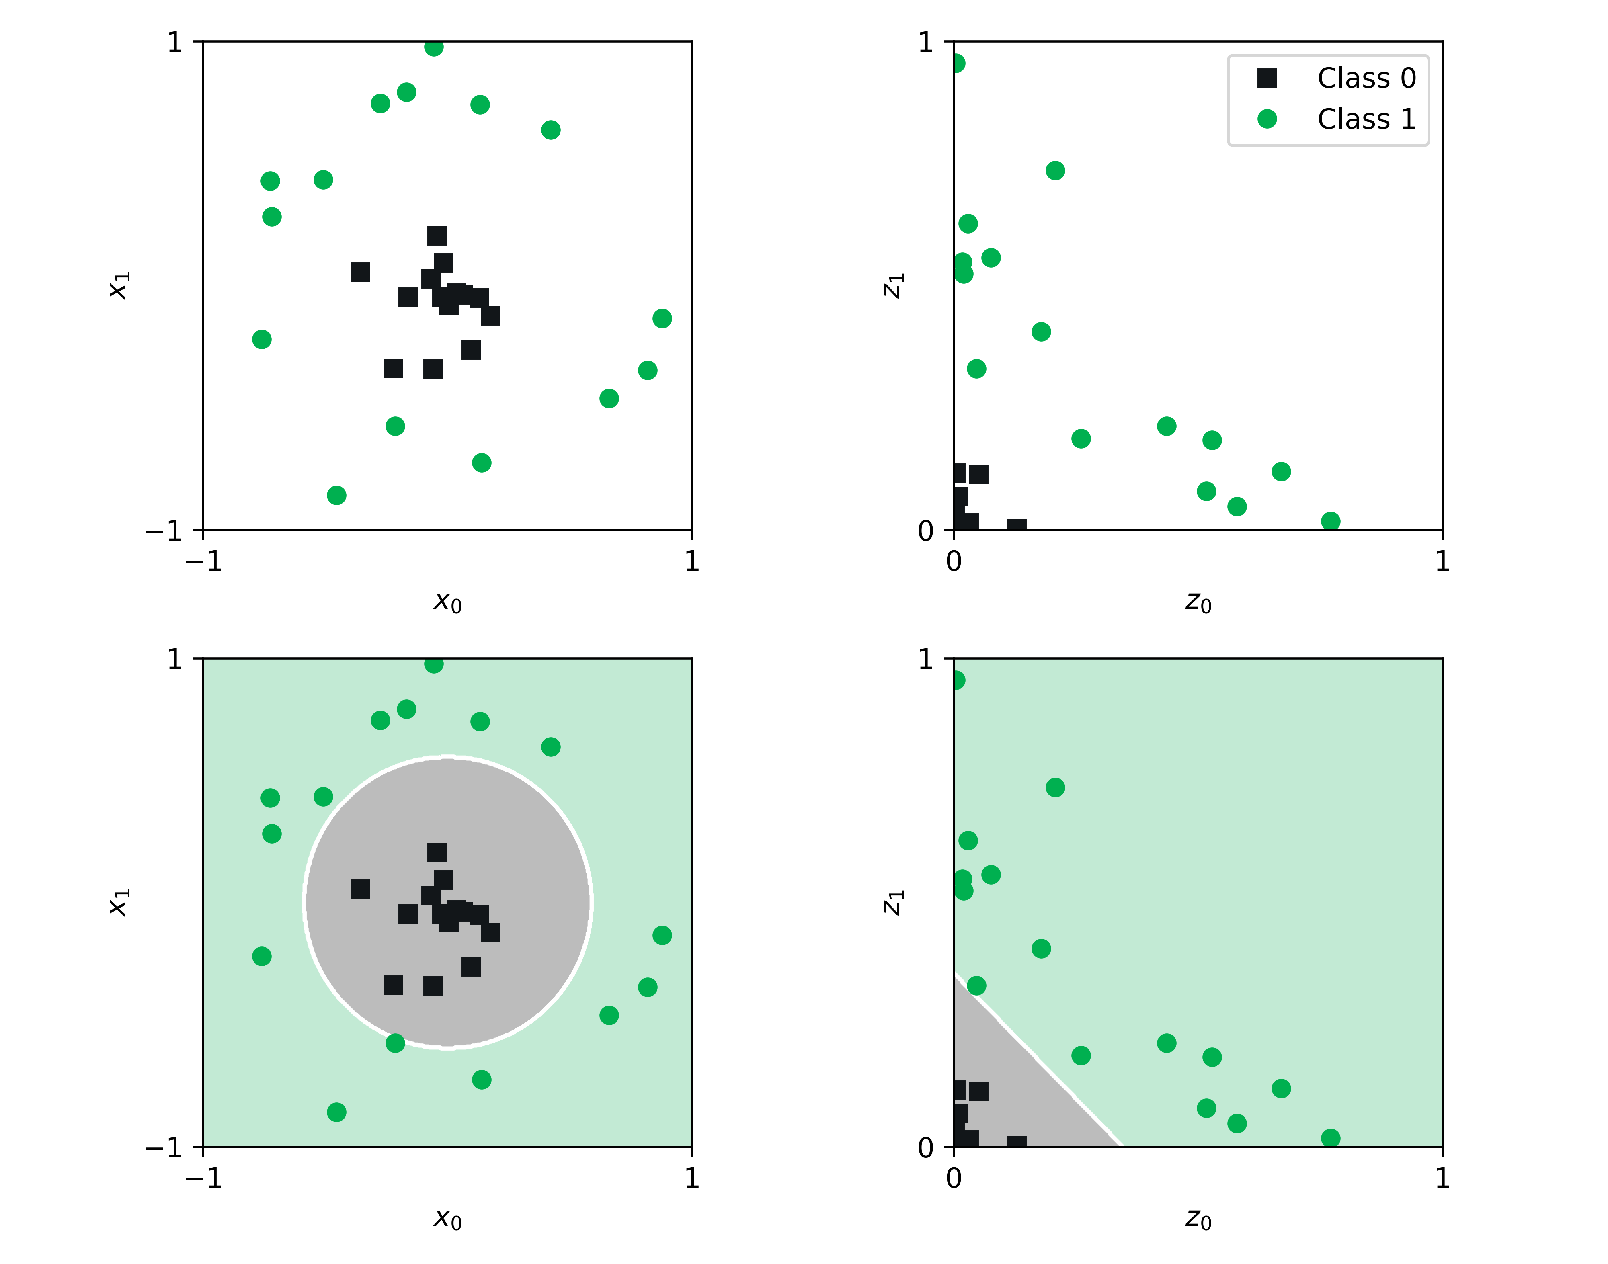
1
transform the data
2
$$z=Φ(x)$$
This example transform is quadratic
Original data
$$z_{i}=Φ\left(x_{i}\right)=x_{i}^{2}$$
$$x$$
$$z_{0}=x_{0}^{2}$$
$$z_{1}=x_{1}^{2}$$
Classify the features
in this $Z$-space
$$x=Φ^{−1}(z)$$
$${\hat{f}}_{z}(z)=\text{sign}(w^{T}z)$$
Predictions in the original $X$-space
transform
the data back
$$\hat{f}(x)={\hat{f}}_{z}\left(Φ\left(x\right)\right)$$
A new representation
of our data
$$x_{0}=z_{0}^{1/2}$$
$$x_{1}=z_{1}^{1/2}$$
4
3

