Slide 1
Decision Theory

Slide 2
Performance evaluation review
Experimental Design
Set of decisions to fairly compare models to determine what impacts model performance
Metrics & Evaluation
(regression/classification metrics, ROC curves)
Quantify model performance
Model Comparison
Fairly compare model generalization performance
Performance Evaluation
Estimate generalization performance

Slide 3
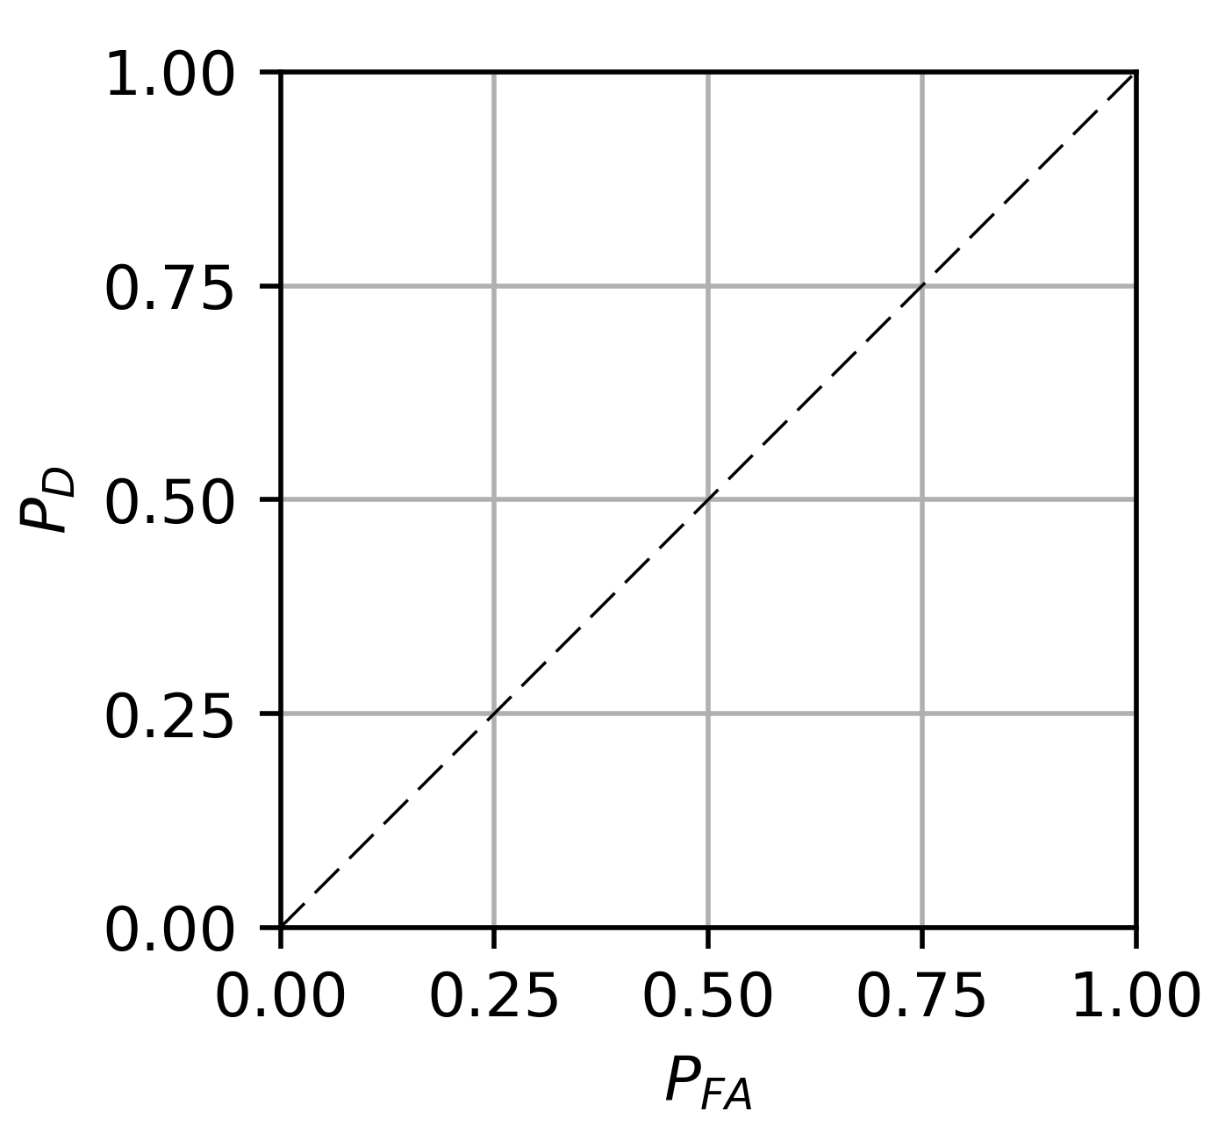


Performance Evaluation → Application
How do we use this information…
True Positive Rate ($P_{TP}$)
…to make practical predictions?
False Positive Rate ($P_{FP}$)

Slide 4
Time to make a decision…
Exercise inspired by Mausam, University of Washington, CSE573

Slide 5
How to invest
$10,000?
State of Nature
Poor market performance
Good market performance
Payoff
Payoff
-1,000 | 1,700
-2,000 | 2,100
500 | 500
Buy Apple
-10% to
+17% return
Action
Buy Google
-20% to
+21% return
Buy bonds
Guaranteed
5% return

Slide 6
Maximax
Optimism
Select the maximum of the maximum payoff
State of Nature
Criterion
Poor market performance
Good market performance
Maximum payoff for an action
Payoff
Payoff
-1,000 | 1,700
-2,000 | 2,100
500 | 500
1,700
2,100
500
Buy Apple
Action
Buy Google
Maximax
Buy bonds

Slide 7
Maximin
Pessimism
Select the maximum of the minimum payoffs
State of Nature
Criterion
Poor market performance
Good market performance
Minimum payoff for an action
Payoff
Payoff
-1,000 | 1,700
-2,000 | 2,100
500 | 500
-1,000
-2,000
500
Buy Apple
Action
Buy Google
Buy bonds
Maximin

Slide 8
Minimax
Select the minimum maximum regret
State of Nature
Criterion
Poor market performance
Maximum regret for an action
Good market performance
Payoff
Regret
Payoff
Regret
-1,000
-2,000
500
1,500
2,500
0
1,700
2,100
500
400
0
1,600
1,500
2,500
1,600
Buy Apple
Minimax
Action
Buy Google
Buy bonds
Regret = Opportunity Loss
Which decision would I regret least?
Difference between a decision made and an optimal decision

Slide 9
Next: factor in probabilities of different outcomes

Slide 10
Expected Payoff: Equal likelihood
State of Nature
Criterion
Select the highest average payoff ASSUMING all states are of equal probability
Poor market performance
Good market performance
Expected reward/
payoff
Payoff
Payoff
-1,000 | 1,700
-2,000 | 2,100
500 | 500
350
50
500
Buy Apple
Action
Buy Google
Maximum Expected Reward
Buy bonds
State Probability:
0.5
0.5

Slide 11
Expected Payoff
State of Nature
Criterion
Select the highest average payoff assuming state probabilities from prior knowledge
Poor market performance
Good market performance
Expected reward/
payoff
Payoff
Payoff
Maximum Expected Reward
-1,000 | 1,700
-2,000 | 2,100
500 | 500
890
870
500
Buy Apple
Action
Buy Google
Buy bonds
State Probability:
0.3
0.7

Slide 12
Decision making design pattern
Define a measure of risk or reward
Select the action that optimizes that metric

Slide 13
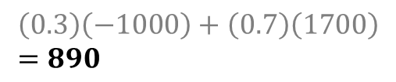






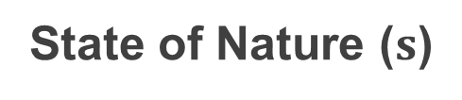



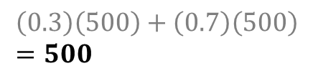


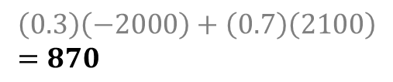




Notation
$$EV\left(a_{i}\right)=λ\left(a_{i} | s_{0}\right)P\left(s_{0}\right)+λ\left(a_{i} | s_{1}\right)P(s_{1})$$
State of Nature ($s$)
Expected reward
Poor market performance
Excellent market performance
Expected Reward
$$EV\left(a_{i}\right)$$
$$s=s_{0}$$
$$s=s_{1}$$
$$λ\left(a_{0} | s_{0}\right)$$
-1,000 | 1,700
-2,000 | 2,100
500 | 500
$$λ\left(a_{0} | s_{1}\right)$$
Buy Apple
$$\left(0.3\right)\left(−1000\right)+\left(0.7\right)\left(1700\right) \\ =890$$
$$a=a_{0}$$
$$λ\left(a_{1} | s_{0}\right)$$
$$λ\left(a_{1} | s_{1}\right)$$
Action
Buy Google
$$\left(0.3\right)\left(−2000\right)+\left(0.7\right)\left(2100\right) \\ =870$$
$$a=a_{1}$$
$$λ\left(a_{2} | s_{0}\right)$$
$$λ\left(a_{2} | s_{1}\right)$$
$$\left(0.3\right)\left(500\right)+\left(0.7\right)\left(500\right) \\ =500$$
Buy bonds
$$a=a_{2}$$
State Probability:
$$P\left(s_{0}\right)=$$
0.3
$$P\left(s_{1}\right)=$$
0.7

Slide 14
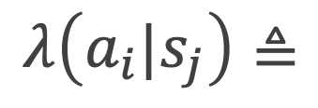
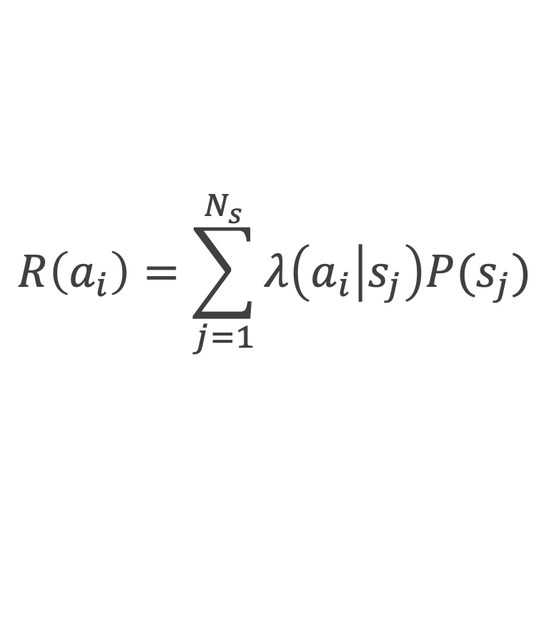
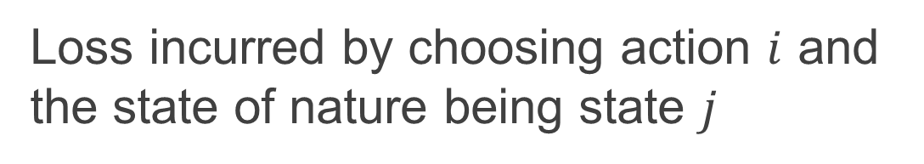
Risk = expected loss
(cost)
Loss:
$$λ\left(a_{i}|s_{j}\right)≜$$
Loss incurred by choosing action $i$ and the state of nature being state $j$
$$R\left(a_{i}\right)=\sum_{j=1}^{N_{s}}{λ\left(a_{i} | s_{j}\right)P(s_{j})}$$
Risk:
Expected loss
Goal: Select action $i$ for which $R(a_{i})$ is minimum

Slide 15
Payoff
Loss
(here we define loss in terms of opportunity cost)
State of Nature
State of Nature
Poor market performance
Good market performance
Poor market performance
Good market performance
-1,000 | 1,700
-2,000 | 2,100
500 | 500
1,500 | 400
2,500 | 0
0 | 1,600
Buy Apple
Buy Apple
Action
Buy Google
Action
Buy Google
Buy bonds
Buy bonds

Slide 16
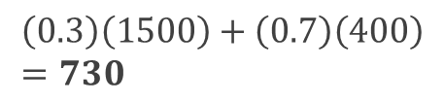










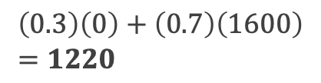


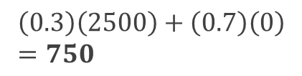




Investments: loss
$$R\left(a_{i}\right)=λ\left(a_{i} | s_{0}\right)P\left(s_{0}\right)+λ\left(a_{i} | s_{1}\right)P(s_{1})$$
State of Nature ($s$)
Risk (Expected loss)
Poor market performance
Excellent market performance
Risk (Expected Loss)
$$R\left(a_{i}\right)$$
$$s=s_{0}$$
$$s=s_{1}$$
$$λ\left(a_{0} | s_{0}\right)$$
1,500 | 400
2,500 | 0
0 | 1,600
$$λ \left(a_{0} | s_{1}\right)$$
Buy Apple
$$\left(0.3\right)\left(1500\right)+\left(0.7\right)\left(400\right) \\ =730$$
$$a=a_{0}$$
$$λ \left(a_{1} | s_{0}\right)$$
$$λ \left(a_{1} | s_{1}\right)$$
Action
Buy Google
$$\left(0.3\right)\left(2500\right)+\left(0.7\right)\left(0\right) \\ =750$$
$$a=a_{1}$$
$$λ \left(a_{2} | s_{0}\right)$$
$$λ \left(a_{2} | s_{1}\right)$$
$$\left(0.3\right)\left(0\right)+\left(0.7\right)\left(1600\right) \\ =1220$$
Buy bonds
$$a=a_{2}$$
State Probability:
$$P\left(s_{0}\right)=$$
0.3
$$P\left(s_{1}\right)=$$
0.7

Slide 17
We can use risk to choose where to operate along an ROC curve

Slide 18

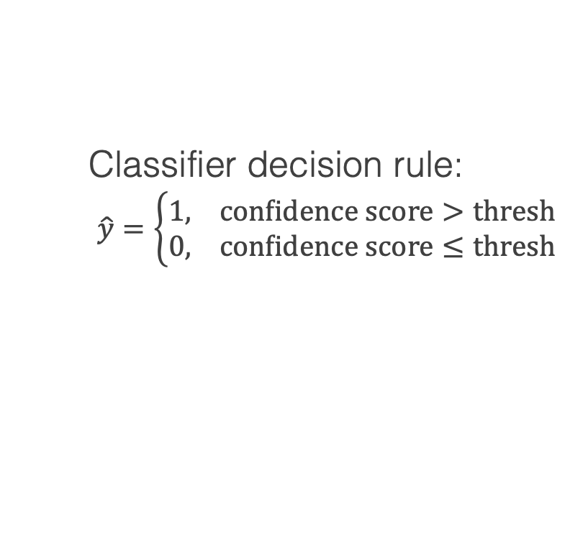
Performance Evaluation → Application
The "actions" we can evaluate here are which point along the ROC curve to operate?
In other words – what threshold do I pick for my classifier decision rule?
True Positive Rate ($P_{TP}$)
action
Classifier decision rule:
$\hat{y}=\left\{\begin{matrix}1, \text{confidence} \text{score}>\text{thresh} \\ 0, \text{confidence} \text{score}≤\text{thresh}\end{matrix}\right.$
False Positive Rate ($P_{FP}$)
Note: we define: $τ≡thresh$

Slide 19
Performance Evaluation → Application
Each point along the ROC represents a different confusion matrix and different rates for TP, FP, TN, FN
Raw values
Rates / probabilities
Predicted Class
Predicted Class
True Positive Rate ($P_{TP}$)
Class 1
Class 0
Class 1
Class 0
TP
FN
TPR
FNR
0
50
0
1.0
Class 1
[50]
Class 1
[50]
True Class
True Class
FP
TN
FPR
TNR
0
50
0
1.0
Class 0
[50]
Class 0
[50]
False Positive Rate ($P_{FP}$)

Slide 20
Performance Evaluation → Application
Each point along the ROC represents a different confusion matrix and different rates for TP, FP, TN, FN
Raw values
Rates / probabilities
Predicted Class
Predicted Class
True Positive Rate ($P_{TP}$)
Class 1
Class 0
Class 1
Class 0
TP
FN
TPR
FNR
50
0
1.0
0
Class 1
[50]
Class 1
[50]
True Class
True Class
FP
TN
FPR
TNR
25
25
0.5
0.5
Class 0
[50]
Class 0
[50]
False Positive Rate ($P_{FP}$)

Slide 21
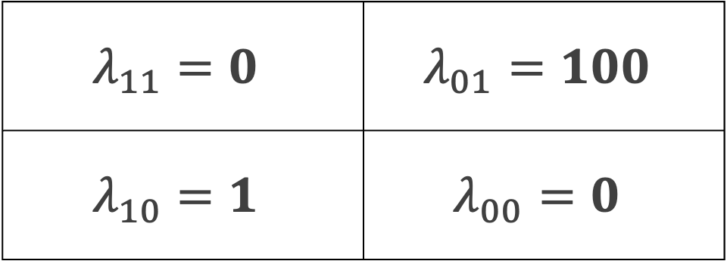


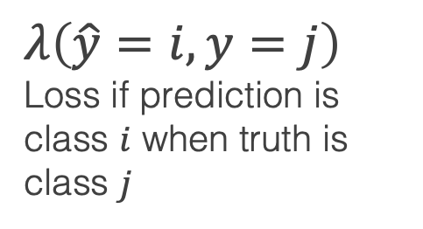
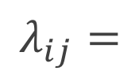
Where to operate along ROC?
Estimate
Class 1
Class 0
True Positive Rate ($P_{TP}$)
True Positive
False negative
$$λ_{11}=0$$ | $$λ_{01}=100$$
$$λ_{10}=1$$ | $$λ_{00}=0$$
Class 1
Truth
False Positive
True Negative
Class 0
False Positive Rate ($P_{FP}$)
$$λ_{ij}=$$
$$λ\left(\hat{y}=i,y=j\right)$$
Loss if prediction is class $i$ when truth is class $j$
Assume for our problem a false negative is 100 times worse than a false positive
Correct predictions incur no penalties

Slide 22
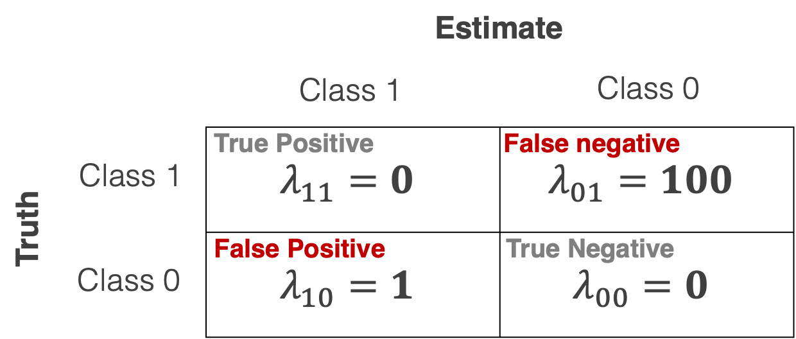


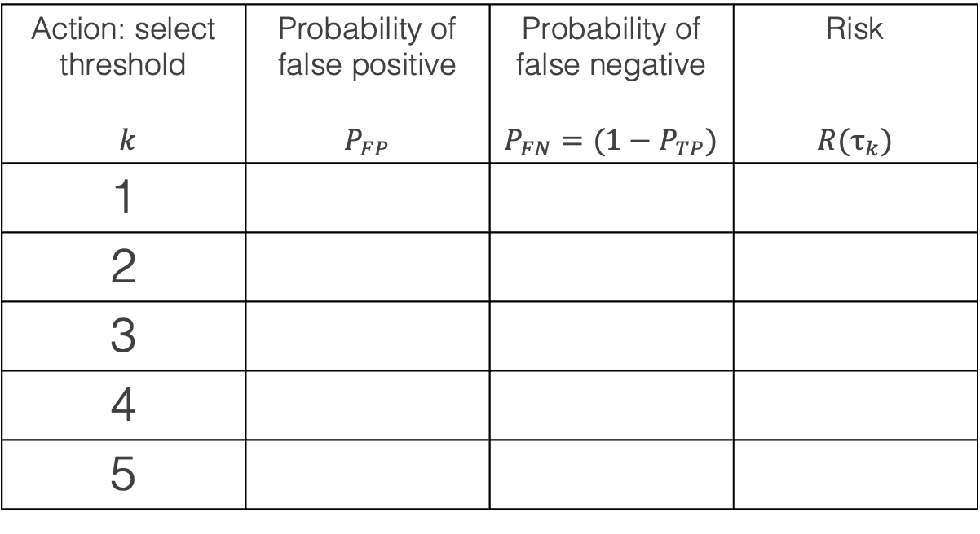
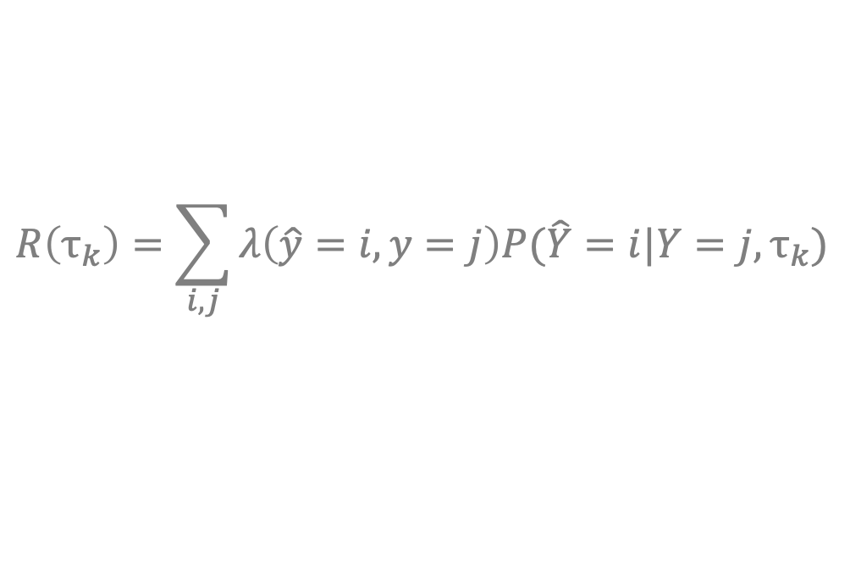
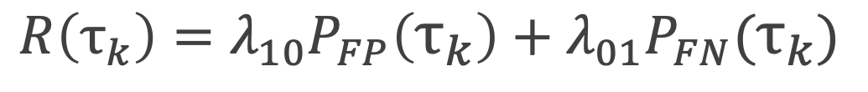
Choose where to operate
4
5
Action: select threshold $k$ | Probability of false positive $$P_{FP}$$ | Probability of false negative $$P_{FN}=(1−P_{TP})$$ | Risk $$R(τ_{k})$$
1
2
3
4
5
2
3
True Positive Rate ($P_{TP}$)
1
False Positive Rate ($P_{FP}$)
$$R\left(τ_{k}\right)=\sum_{i,j}{λ\left(\hat{y}=i,y=j\right)P(\hat{Y}=i|Y=j,τ_{k})}$$
$$R\left(τ_{k}\right)=λ_{10}P_{FP}\left(τ_{k}\right)+λ_{01}P_{FN}(τ_{k})$$

Slide 23
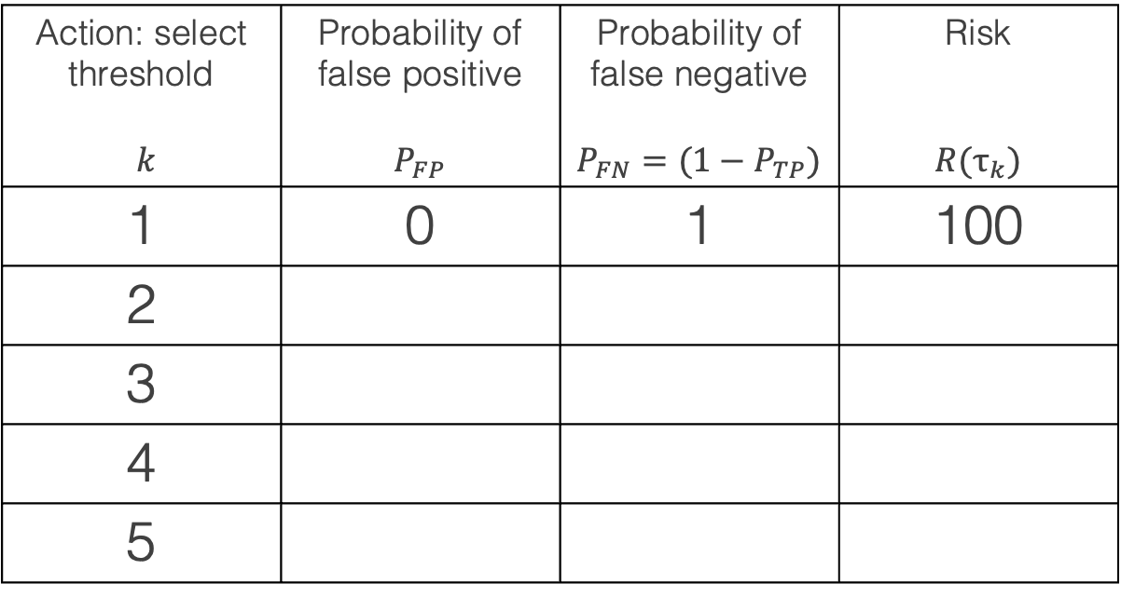
Choose where to operate
4
5
Action: select threshold $k$ | Probability of false positive $$P_{FP}$$ | Probability of false negative $$P_{FN}=(1−P_{TP})$$ | Risk $$R(τ_{k})$$
1 | 0 | 1 | 100
2
3
4
5
2
3
True Positive Rate ($P_{TP}$)
1
False Positive Rate ($P_{FP}$)
$$R\left(τ_{k}\right)=\sum_{i,j}{λ\left(\hat{y}=i,y=j\right)P(\hat{Y}=i|Y=j,τ_{k})}$$
$$R\left(τ_{k}\right)=λ_{10}P_{FP}\left(τ_{k}\right)+λ_{01}P_{FN}(τ_{k})$$

Slide 24
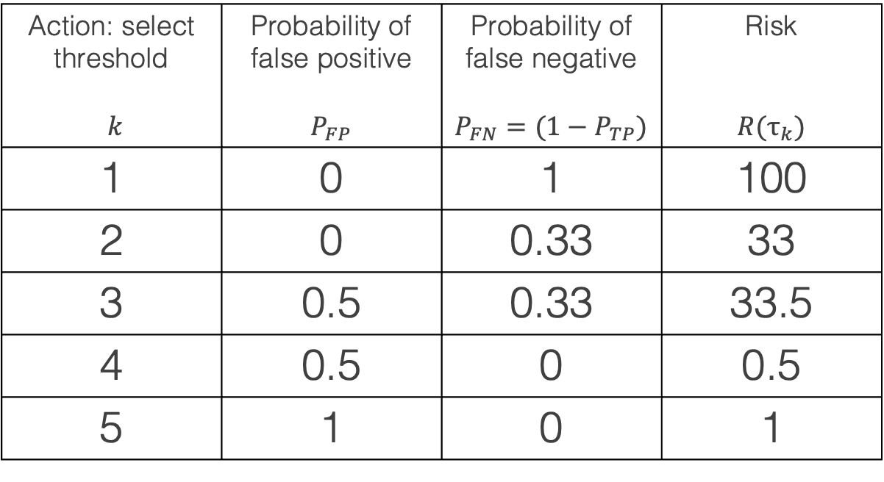
Choose where to operate
4
5
Action: select threshold $k$ | Probability of false positive $$P_{FP}$$ | Probability of false negative $$P_{FN}=(1−P_{TP})$$ | Risk $$R(τ_{k})$$
1 | 0 | 1 | 100
2 | 0 | 0.33 | 33
3 | 0.5 | 0.33 | 33.5
4 | 0.5 | 0 | 0.5
5 | 1 | 0 | 1
2
3
True Positive Rate ($P_{TP}$)
1
Least risk
False Positive Rate ($P_{FP}$)
$$R\left(τ_{k}\right)=\sum_{i,j}{λ\left(\hat{y}=i,y=j\right)P(\hat{Y}=i|Y=j,τ_{k})}$$
$$R\left(τ_{k}\right)=λ_{10}P_{FP}\left(τ_{k}\right)+λ_{01}P_{FN}(τ_{k})$$

Slide 25
This makes a critical assumption about how the data are distributed by class…
Note: in the previous examples, if we wanted risk to equal expected loss, we would need to have assigned a probability of 0.5 to each class

Slide 26
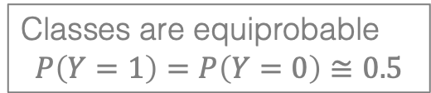
Performance Evaluation → Application
Each point along the ROC represents a different confusion matrix and different rates for TP, FP, TN, FN
Raw values
Rates / probabilities
Predicted Class
Predicted Class
True Positive Rate ($P_{TP}$)
Class 1
Class 0
Class 1
Class 0
TP
FN
TPR
FNR
50
0
1.0
0
Class 1
[50]
Class 1
[50]
True Class
True Class
FP
TN
FPR
TNR
25
25
0.5
0.5
Class 0
[50]
Class 0
[50]
False Positive Rate ($P_{FP}$)
Precision = 50 / 75 = 0.67
Classes are equiprobable
$$P\left(Y=1\right)=P\left(Y=0\right)≅0.5$$

Slide 27
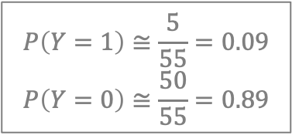
Performance Evaluation → Application
Each point along the ROC represents a different confusion matrix and different rates for TP, FP, TN, FN
Raw values
Rates / probabilities
Predicted Class
Predicted Class
True Positive Rate ($P_{TP}$)
Class 1
Class 0
Class 1
Class 0
TP
FN
TPR
FNR
5
0
1.0
0
Class 1
[5]
Class 1
[5]
True Class
True Class
FP
TN
FPR
TNR
25
25
0.5
0.5
Class 0
[50]
Class 0
[50]
False Positive Rate ($P_{FP}$)
$$P\left(Y=1\right)≅\frac{5}{55}=0.09$$
$$P\left(Y=0\right)≅\frac{50}{55}=0.89$$
Precision = 5 / 30 = 0.17

Slide 28
ROC curves are not sensitive to class imbalances – TPR and FPR are class-conditional
This means we need to factor in the prevalence of each class

Slide 29


Where to operate along ROC?
Estimate
Class 1
Class 0
True Positive Rate ($P_{TP}$)
True Positive
False negative
$$λ_{11}=0$$ | $$λ_{01}=100$$
$$λ_{10}=1$$ | $$λ_{00}=0$$
Class 1
$$π_{1}=P\left(Y=1\right)$$
Truth
False Positive
True Negative
Class 0
False Positive Rate ($P_{FP}$)
$$π_{0}=P\left(Y=0\right)$$
$$λ_{ij}=$$
$$λ\left(\hat{y}=i,y=j\right)$$
Loss if prediction is class $i$ when truth is class $j$
Class prevalence also needs to be factored in!

Slide 30


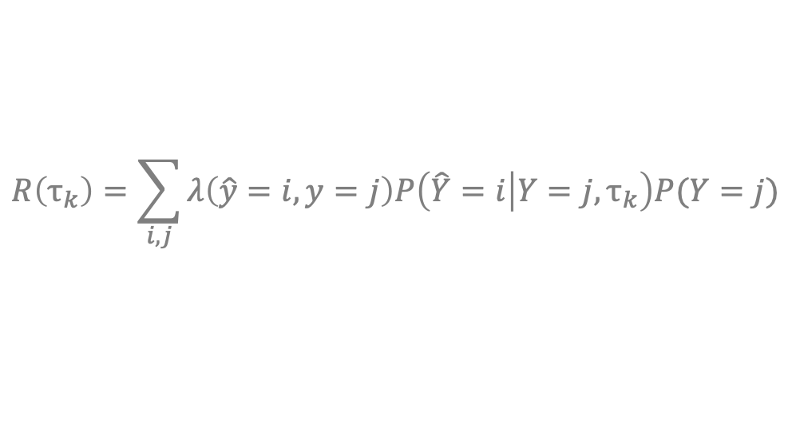
Choose where to operate
4
5
Action: select threshold $k$ | Probability of false positive $$P_{FP}$$ | Probability of false negative $$P_{FN}=(1−P_{TP})$$ | Risk $$R(τ_{k})$$
1
2
3
4
5
2
3
True Positive Rate ($P_{TP}$)
1
False Positive Rate ($P_{FP}$)
$$P\left(Y=0\right)≅0.99$$
$$P\left(Y=1\right)≅0.01$$
$$R\left(τ_{k}\right)=\sum_{i,j}{λ\left(\hat{y}=i,y=j\right)P\left(\hat{Y}=i | Y=j,τ_{k}\right)P(Y=j)}$$
$$π_{i}=P\left(Y=i\right)$$
$$R\left(τ_{k}\right)=λ_{10}P_{FP}\left(τ_{k}\right)π_{0}+λ_{01}P_{FN}\left(τ_{k}\right)π_{1}$$

Slide 31
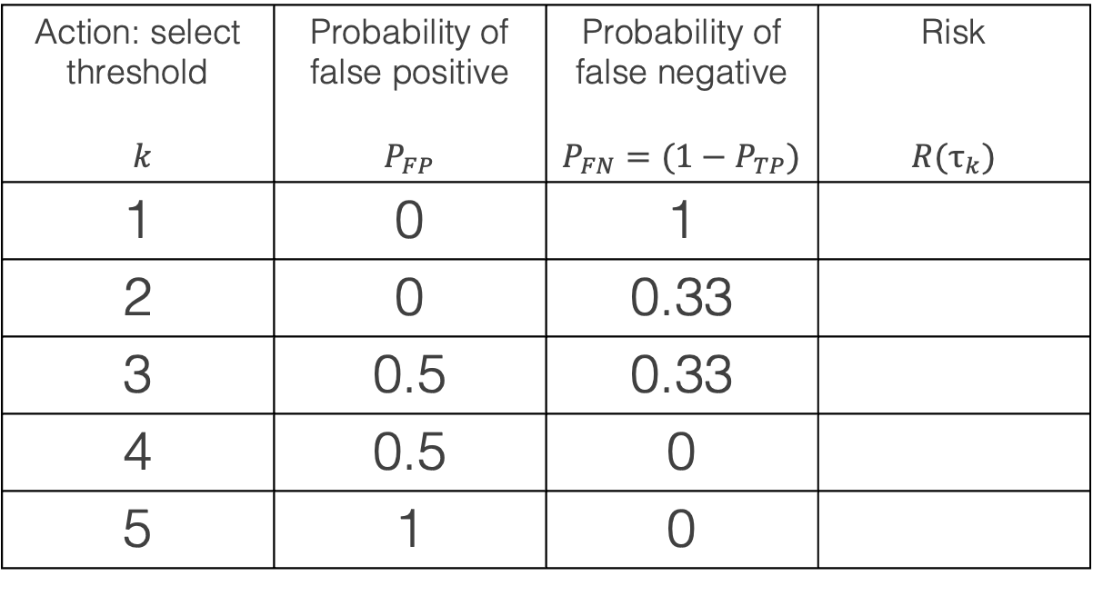
Choose where to operate
4
5
Action: select threshold $k$ | Probability of false positive $$P_{FP}$$ | Probability of false negative $$P_{FN}=(1−P_{TP})$$ | Risk $$R(τ_{k})$$
1 | 0 | 1
2 | 0 | 0.33
3 | 0.5 | 0.33
4 | 0.5 | 0
5 | 1 | 0
2
3
True Positive Rate ($P_{TP}$)
1
False Positive Rate ($P_{FP}$)
$$P\left(Y=0\right)≅0.99$$
$$P\left(Y=1\right)≅0.01$$
$$R\left(τ_{k}\right)=\sum_{i,j}{λ\left(\hat{y}=i,y=j\right)P\left(\hat{Y}=i | Y=j,τ_{k}\right)P(Y=j)}$$
$$π_{i}=P\left(Y=i\right)$$
$$R\left(τ_{k}\right)=λ_{10}P_{FP}\left(τ_{k}\right)π_{0}+λ_{01}P_{FN}\left(τ_{k}\right)π_{1}$$

Slide 32
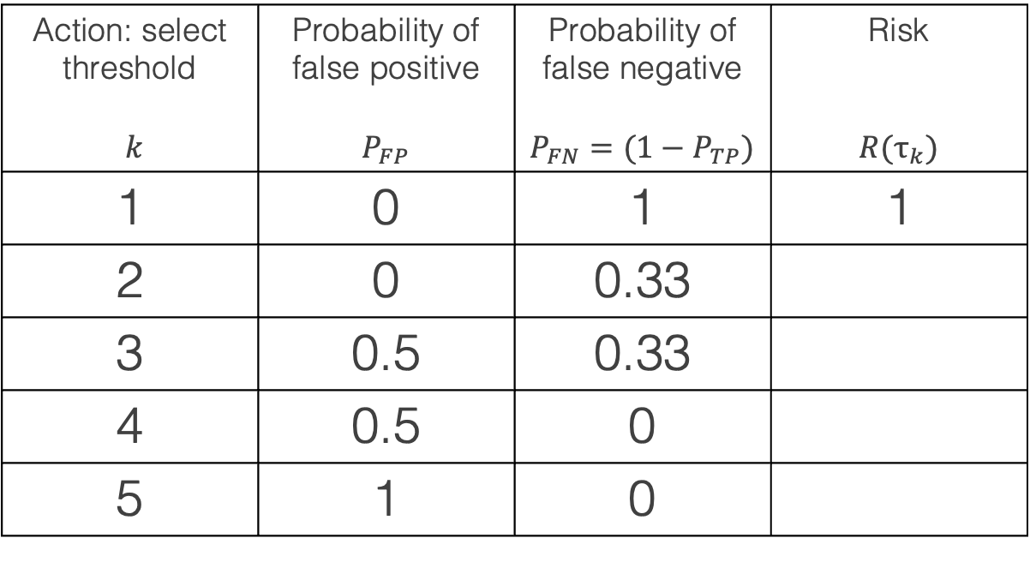
Choose where to operate
4
5
Action: select threshold $k$ | Probability of false positive $$P_{FP}$$ | Probability of false negative $$P_{FN}=(1−P_{TP})$$ | Risk $$R(τ_{k})$$
1 | 0 | 1 | 1
2 | 0 | 0.33
3 | 0.5 | 0.33
4 | 0.5 | 0
5 | 1 | 0
2
3
True Positive Rate ($P_{TP}$)
1
False Positive Rate ($P_{FP}$)
$$P\left(Y=0\right)≅0.99$$
$$P\left(Y=1\right)≅0.01$$
$$R\left(τ_{k}\right)=\sum_{i,j}{λ\left(\hat{y}=i,y=j\right)P\left(\hat{Y}=i | Y=j,τ_{k}\right)P(Y=j)}$$
$$π_{i}=P\left(Y=i\right)$$
$$R\left(τ_{k}\right)=λ_{10}P_{FP}\left(τ_{k}\right)π_{0}+λ_{01}P_{FN}\left(τ_{k}\right)π_{1}$$

Slide 33
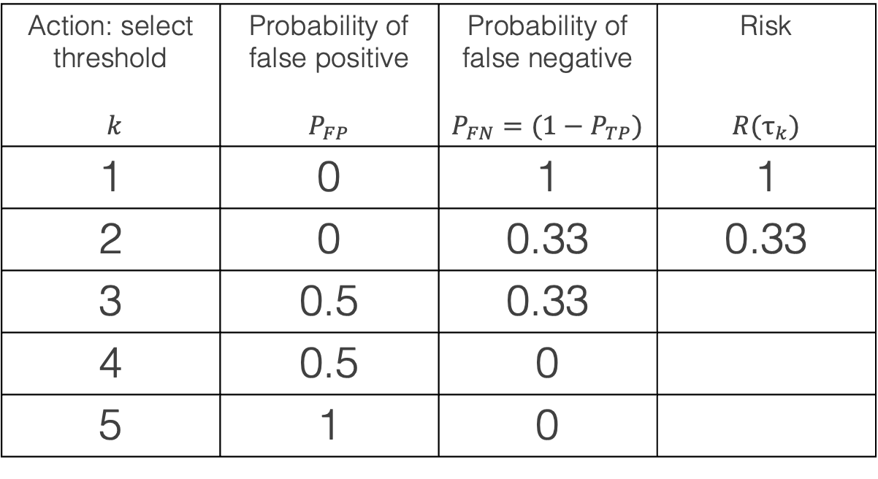
Choose where to operate
4
5
Action: select threshold $k$ | Probability of false positive $$P_{FP}$$ | Probability of false negative $$P_{FN}=(1−P_{TP})$$ | Risk $$R(τ_{k})$$
1 | 0 | 1 | 1
2 | 0 | 0.33 | 0.33
3 | 0.5 | 0.33
4 | 0.5 | 0
5 | 1 | 0
2
3
True Positive Rate ($P_{TP}$)
1
False Positive Rate ($P_{FP}$)
$$P\left(Y=0\right)≅0.99$$
$$P\left(Y=1\right)≅0.01$$
$$R\left(τ_{k}\right)=\sum_{i,j}{λ\left(\hat{y}=i,y=j\right)P\left(\hat{Y}=i | Y=j,τ_{k}\right)P(Y=j)}$$
$$π_{i}=P\left(Y=i\right)$$
$$R\left(τ_{k}\right)=λ_{10}P_{FP}\left(τ_{k}\right)π_{0}+λ_{01}P_{FN}\left(τ_{k}\right)π_{1}$$

Slide 34
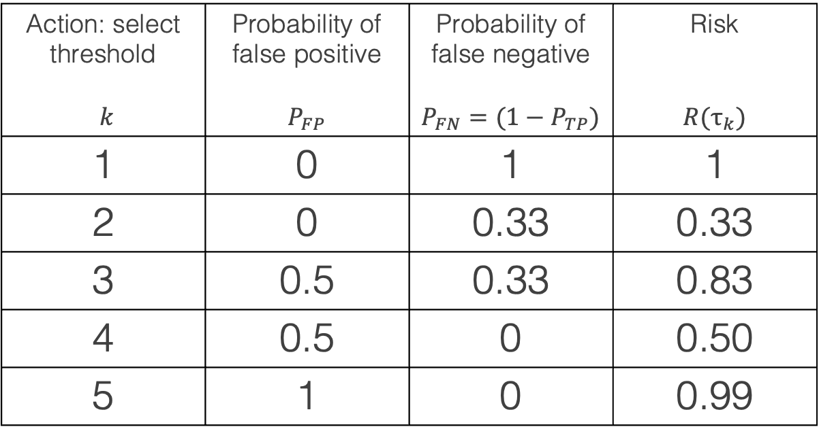
Choose where to operate
4
5
Action: select threshold $k$ | Probability of false positive $$P_{FP}$$ | Probability of false negative $$P_{FN}=(1−P_{TP})$$ | Risk $$R(τ_{k})$$
1 | 0 | 1 | 1
2 | 0 | 0.33 | 0.33
3 | 0.5 | 0.33 | 0.83
4 | 0.5 | 0 | 0.50
5 | 1 | 0 | 0.99
2
3
True Positive Rate ($P_{TP}$)
Least
risk
1
False Positive Rate ($P_{FP}$)
$$P\left(Y=0\right)≅0.99$$
$$P\left(Y=1\right)≅0.01$$
$$R\left(τ_{k}\right)=\sum_{i,j}{λ\left(\hat{y}=i,y=j\right)P\left(\hat{Y}=i | Y=j,τ_{k}\right)P(Y=j)}$$
$$π_{i}=P\left(Y=i\right)$$
$$R\left(τ_{k}\right)=λ_{10}P_{FP}\left(τ_{k}\right)π_{0}+λ_{01}P_{FN}\left(τ_{k}\right)π_{1}$$

Slide 35
Takeaways
Models make predictions, but these need to be contextualized to transform them into a decision
To make a decision, we minimize expected loss (risk):
  Define a measure of risk
  Select the action that optimizes that metric (for binary classification, this is often the decision rule threshold)
Decision theory systematically incorporates the relative importance of different error types and the prevalence of the types of classes
Requires application domain knowledge to reflect real-world importance

