Slide 1
ECE571 Project: Drone
Chianna Alexander, Kyle Thompson, Shamili Sampath

Slide 2
Project Importance for this Class
Developing modules to model Drone functionality
Creating testbenches for those models
Feedback loop presents an interesting challenge for testbench
Small enough to focus on SystemVerilog concepts and validation, but not trivial
Because it seemed like fun!
Notes:
Note for chianna: Mention paper with motor thrust dynamics

Slide 3
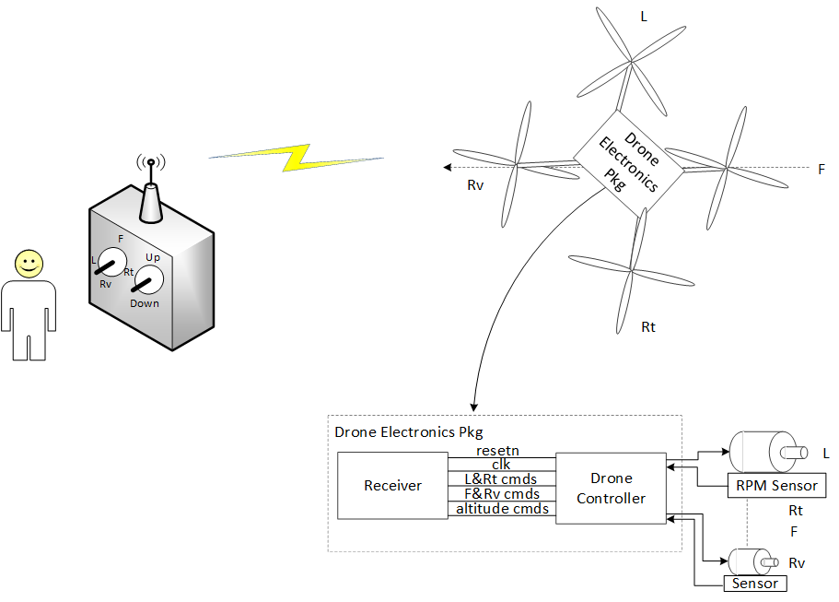
Project Overview
Receiver demodulates signal from transmitter and sends Drone controller command data.
Data are sent in parallel to Drone controller.
Receiver sends to Drone controller data every clock cycle regardless if command data has changed.
Receiver generates resetn at power on.
Receiver generates 40kHz clock.
Notes:
Typical (low cost) drones
I have a small Drone and Controller that I will bring to class. Not intending to fly the Drone...just a visual aid.

Slide 4
Assumptions, design choices
Altitude Control is based on a neutral buoyancy of the drone. Neutral buoyancy is achieved when the force of thrust equals force of gravity. Motor speed faster than 3000 rpm makes the drone climb in altitude and slower motor rpm will make the drone lose altitude.
Receiver will not issue a resetn other than at power on (POR).
Motor Model: “A Transfer Function Model of Thrust Dynamics for Multi-Rotor Helicopters”, Myunggon Yoon, International Journal of Engineering Research & Technology, Vol. 5, Issue 01, January-2016
Graphs Thrust vs RPM, and Transfer Function for the motor
Note: Propeller diameter was 18”.
Notes:
More should go here but i can’t think of anything right now.

Slide 5
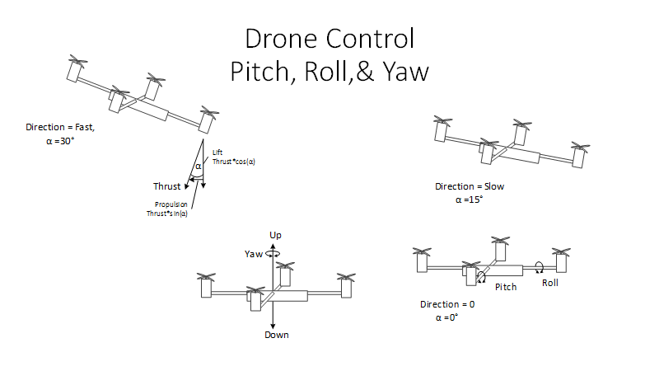
Drone Flight Basics
Notes:
Varying the motor speed puts the drone into a pitch or yaw causing lateral thrust and vertical thrust
Yaw is not implemented

Slide 6
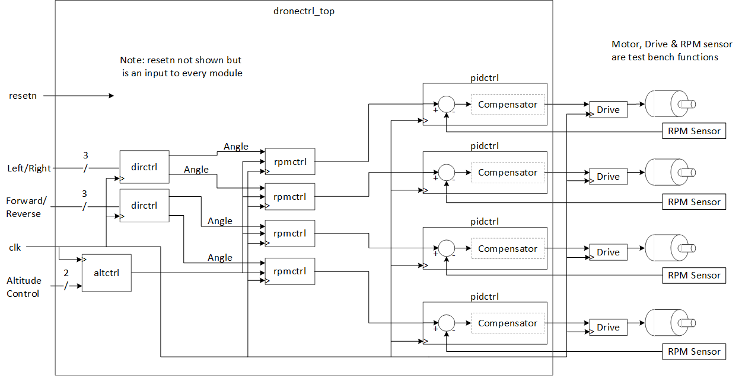
Top Level Module Architecture
Notes:
Replaced PWM with Drive. Drive provides the power to the motor. Holds the present rpm_set to the motor and doesn’t change until the pidctrl drives it to a different rpm.
The rpm sensor closes the loop from the pidctrl and the motor rpm.
The closed loop system keeps the motor rpm at a constant angular speed. If something were to

Slide 7
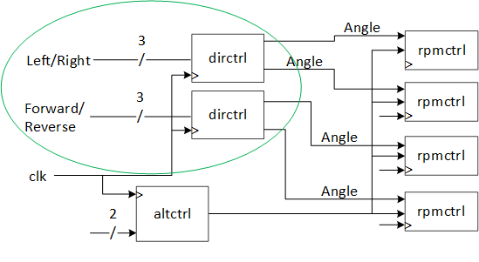
dirctrl
The dirctrl (direction_controller) gets a 3 bit input command from the controller to decide the rpm with which the motor spins. The lookup table gives the respective rpm to the left and right motors.
Inputs | Left_forward | Right_backward
000 | 0 | 0
001 | -102 | 102
010 | -218 | 218
011 | -402 | 402
100 | 0 | 0
101 | 102 | -102
110 | 218 | -218
111 | 402 | -402
Notes:
Shamili - please expand to explain how the rpm is modified for each pair of motors. For example, if the drone needs to turn left what happens to the motor rpm. Show the important part of the code. Use a little math to explain what is happening if need be.
This is where you should spend some deep thought, because if you can’t get the idea across your audience will be left wondering how it works.
Try to put yourself in the position of the listener who is trying to figure out how this works from your explaination. If there are things you want to say but are not on the slide, then write them down in this section. Let’s get all of the important points written down.

Slide 8
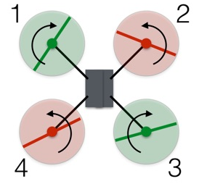
Calculations for the motor rpm
One motor = nominal rpm * (1 - cosine (angle))
Eg: 3000 * (1 - cosine (15)) = 102
Other motor = {- nominal rpm * (1 - cosine (angle))}
Eg : - 3000 * (1 - cosine (15)) = - 102
With the two sets of rotors rotating in opposite directions,
the total angular momentum is zero

Slide 9
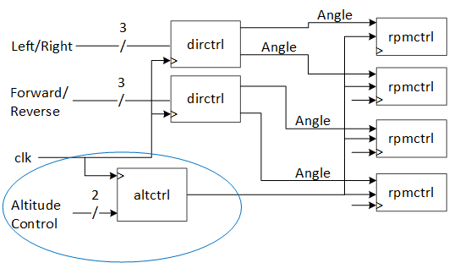
Altctrl
The nominal rpm in our project is set to be 3000. With the help of lookup table the altitude is decided for every 3bit input to the altitude controller.
Inputs | Value
000 | 3000
001 | 3300
010 | 3600
011 | 3900
100 | 3000
101 | 2700
110 | 2400
111 | 2100

Slide 10
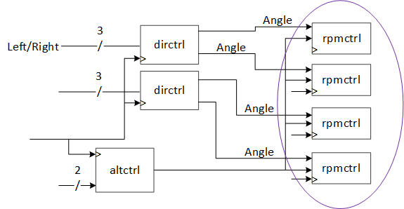
The rpm controller then receives the input rpm speed from the direction controller and the altitude input from the altitude controller to fix the rpm for the motors. The output of the rpm_controller then goes to the pid controller.
Inputs | Value
00 | Cosine(0)=1
01 | Cosine (15)=0.96
10 | Cosine(22)=0.93
11 | Cosine(30)=0.87

Slide 11
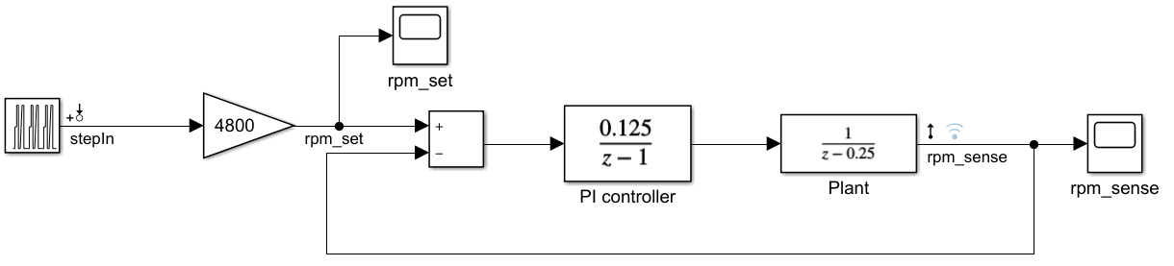
Matlab model
Simulation in Z domain
Once model is finished in Z, straight forward math to get to implementation.
Notes:
This is a digital systems so must model in Z domain

Slide 12
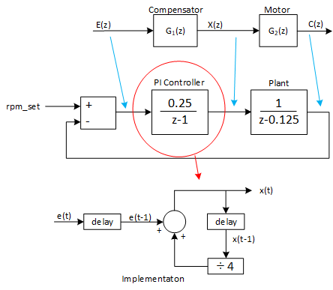
pidctrl
E(z) & X(z) -> Z domain of system.
To implement controller, must convert to time domain using inverse Z transform.
e(t) is error (difference of rpm_set and rpm_sense).
x(t) is output of PI controller provides the reference drive to the motor.
Notes:
The rpm sensor closes the loop from the pidctrl and the motor rpm.
The closed loop system keeps the motor rpm at a constant angular speed. If something were to impair the motor rpm (e.g. tree branch) the rpm sensor would change and the PI controller would act to drive the motor rpm back to the proper amount.
Do we want to show the code for each module...could lead to many questions and extend the length of the presentations.
Alternately , showing the code...this is a code class...something to think about. Maybe hold all questions till the end, although, that nevers happens at work.

Slide 13
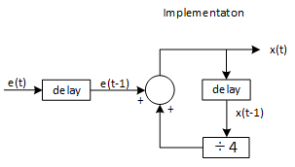
Implementation of PID controller
err[0] - the current sample of the error.
err[1] - the previous (time delayed) error sample.
xt[0] - the current (time) output
xt[1] - the previous (time delayed) output
else begin err[1] = err[0]; err[0] = rpm_set-rpm_sense; xt[1] = xt[0]>>>2; xt[0] = err[1] + xt[1]; end

Slide 14
Test Coverage Plan
Matlab simulations of PID controller
Individual test benches
Comprehensive testing is possible, low number of input pins
Targeted for QuestaSim because they execute quickly
Top level test bench
No induced error:
Solution space is small, can do comprehensive testing
Induced error:
Constrained random testing: set initial error term, watch system correct for error
Requires test module to modify error term based on how system is reacting

Slide 15
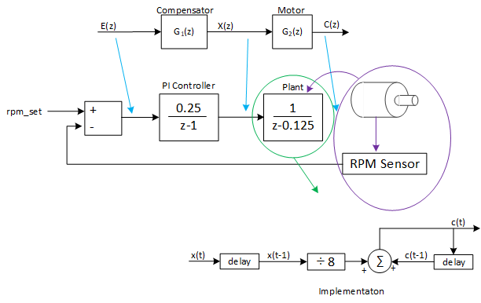
Motor Control
cq[0] - the current (stored) motor rpm output
cq[1] - the previous (time delayed) motor rpm.
xt[0] - the current PI output
xt[1] - the previous (time delayed) PI output
rpm_sense - current rpm feed back to the PI controller
@(posedge clk) begin
cq[1] = cq[0];
xq[1] = xq[0]>>>3;
xq[0] = mot_set;
rpm_sense = xq[1] + cq[1];
// motor rpm boundary code here
cq[0] = rpm_sense;
Notes:
The plant is the motor, rpm sensor and motor driver (not shown here).
The PI controller will force the motor to a new rpm. The PI controller will either be positive, negative or zero. If zero, the motor holds the current rpm. If x(t) signal is non-zero then the motor driver will increase/decrease the voltage or (PWM duty cycle) to reach the desired rpm.
If an impairment causes the rpm to change, the PI controller will drive the x(t) to compensate and bring the rpm back to the desired rpm, which is the rpm_set.

Slide 16
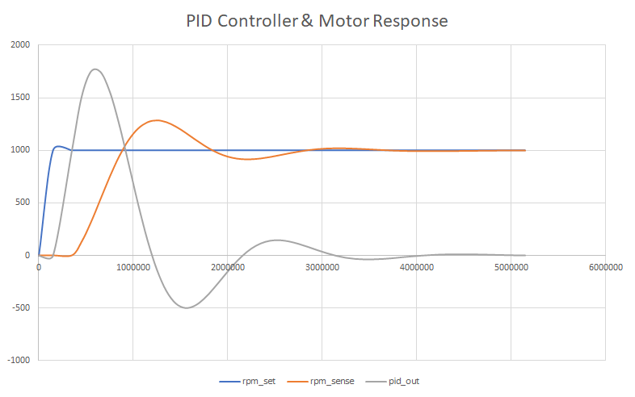
Test Bench results
Under damped controller
Notes:
rpm_set - the input to the PID controller. step function to a desired motor rpm
rpm_sense - the motor rpm - feedback to the PID controller
pid_out - the drive to the motor to get to the desired motor rpm. pid controller output/motor input

Slide 17
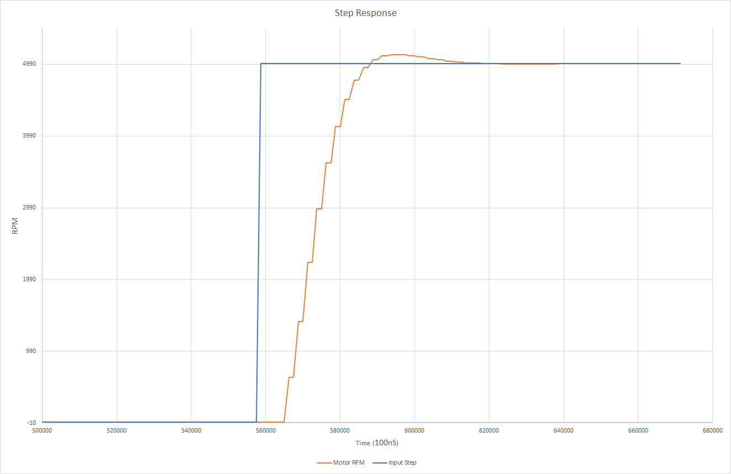
Test Bench results
Critically damped controller
Notes:
rpm_set - the input to the PID controller. step function to a desired motor rpm
rpm_sense - the motor rpm - feedback to the PID controller
pid_out - the drive to the motor to get to the desired motor rpm. pid controller output/motor input

Slide 18
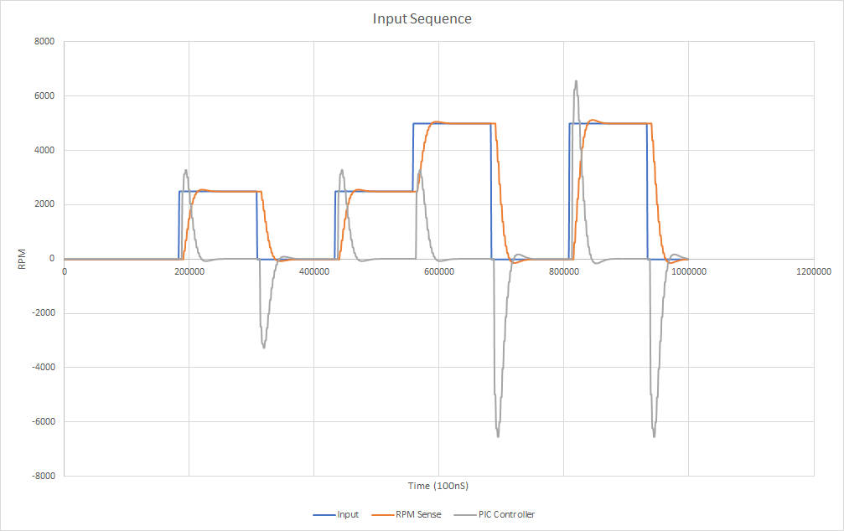
Input Sequence, PID response, Motor response

Slide 19
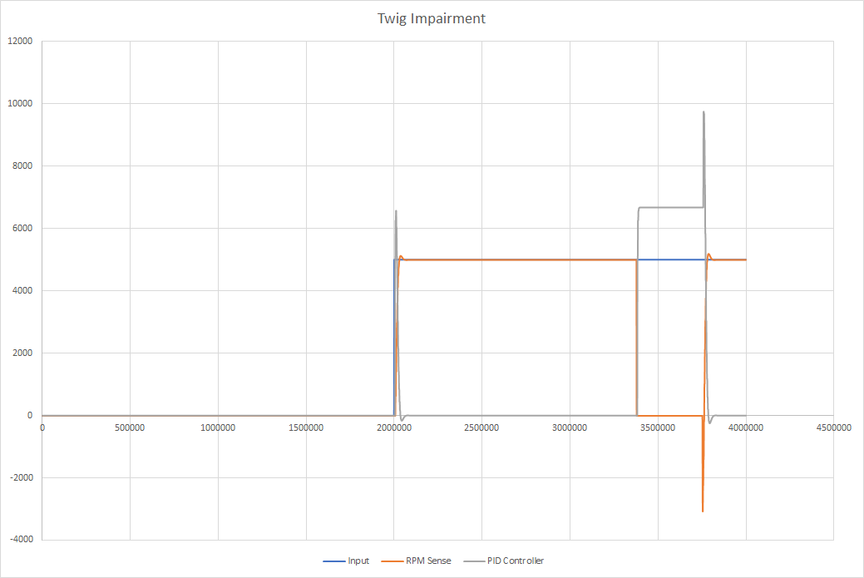
Twig Impairment

Slide 20
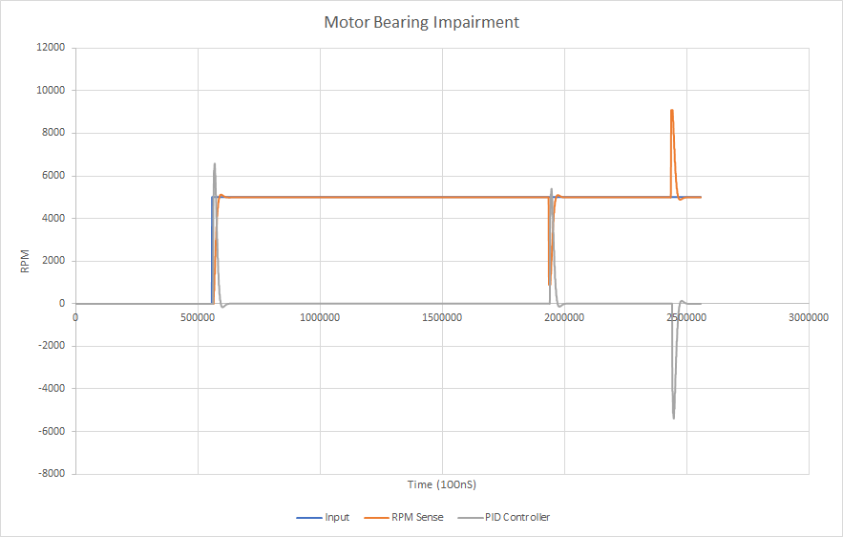
Motor Bearing Impairment

Slide 21
Emulation With Veloce
Chosen emulation strategy was to use TBX mode with BFM pattern
Pros:
Everything is written in SystemVerilog
Don’t have to write a custom transactor; it’s build into the BFM interface
Don’t have to deal with pipes
Good abstraction and modularity (it’s not obvious that the testbench is targeted for the emulator)
Cons:
Module potential redesign to use an interface (overkill for simple module IO)
Communication between HVL and HDL is implicit (pipes are explicit)
Started with small, well tested module (custom PWM module) using Veloce examples
Building up to testing the top level module on the emulator

Slide 22
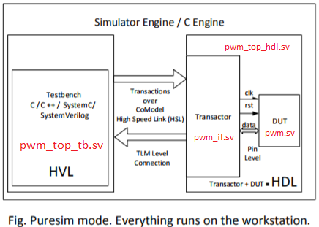
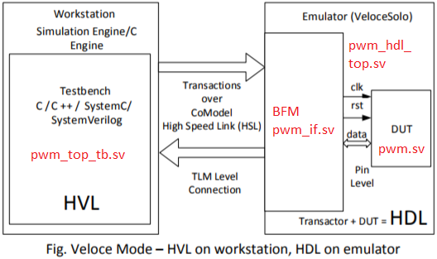
PWM Emulation Block Diagram
Full drone controller module will follow this pattern.
Courtesy of PSU Veloce “Getting Started” documentation

Slide 23
SystemVerilog Constructs used
Always_comb, always_ff
Interfaces
Classes
Immediate and concurrent assertions
Structs, associative arrays,
Unique case
Program Blocks
Will have:
Constrained randomization

Slide 24
Custom Build Script
Bash script was created to replace the sample makefile
Limitations of makefile
Use model better suited for C/C++
Example is using a makefile like a script, might as well turn it into a script
Not easy to modify for new code, too much copy-pasting
Benefits of bash script
More modular and readable
Only need to update a couple variables to change what gets compiled, simulated, and run on emulator
Exits on first failure
Custom command line interface

Slide 25
Remaining Work
Integrate all modules into top level module
Get basic top level testbench working
Plan for testing error term feedback loop
Get top level testbench running on emulator
Stretch goals:
Incorporate RPM->PWM signal translation

Slide 26
Questions?

Slide 27
Backup

Slide 28
Flight FAQs
Weight of Drone: 4.1kg
Thrust of each Motor Prop: 0 to 35N
Want a 3:1 ratio of Thrust to Weight
Nominal 35N Thrust per motor. 4 motors=140N
Fgravity = 4.1kg*9.8m/s2~40N All props must generate a combine thrust of 40N to be neutral buoyant.
Desired acceleration of 5 m/s2 ~20.5N
Total thrust for 5m/ s2 vertical climb: 40N +20.5N = 60.5N
Notes:
In case someone ask

Slide 29
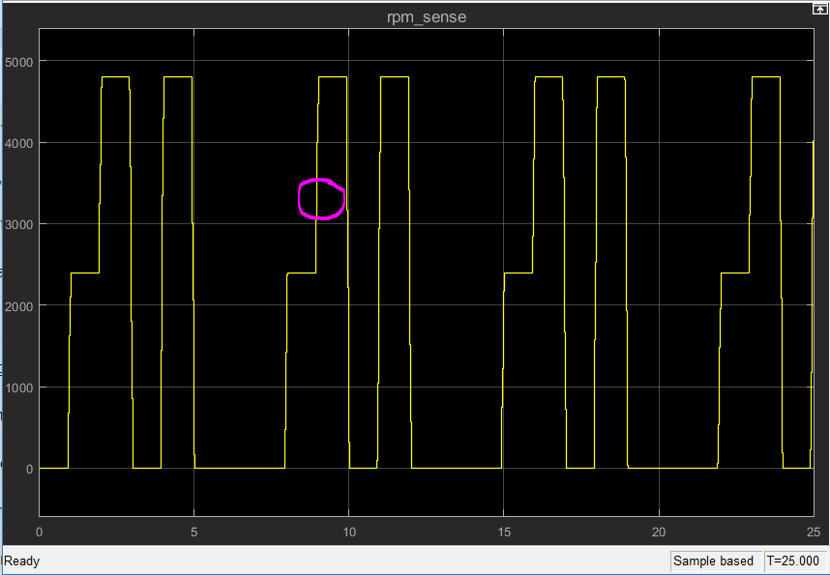
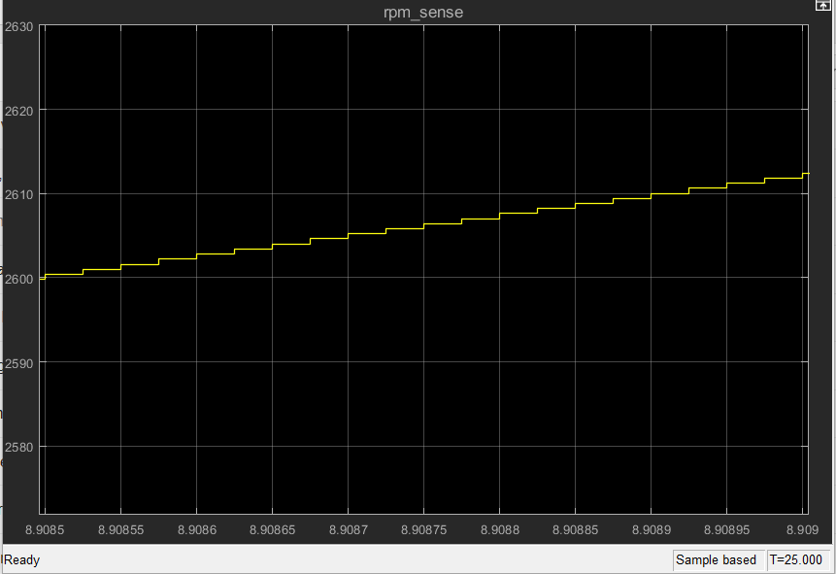
Quantized results

Slide 30
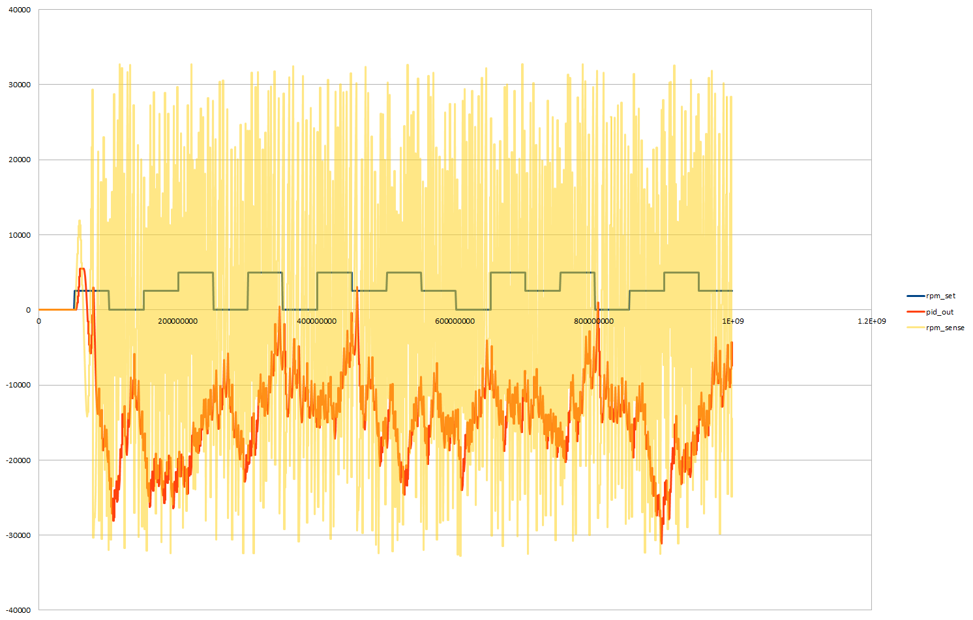
Unstable system
err[1] = err[0];
err[0] = rpm_set-rpm_sense;
xt[1] = xt[0]>>>0;
xt[0] = err[1] + xt[1];

Slide 31
Improvement Ideas
Look at bash script for automating build
Future plans for running multiple testbenches in the single script
Collecting results in a result summary file
Ideas for increasing emulation speedup

Slide 32
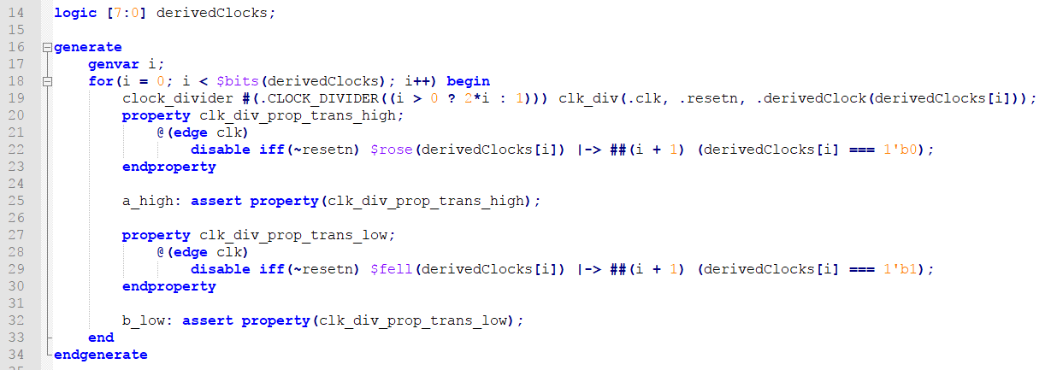
Generating Parallel DUTs with concurrent assertions - Clock Divider

Slide 33
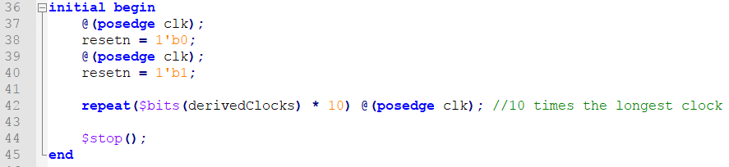
Stimulus

