Slide 1
Field Experiments II:
Opening My Laptop
John A. List
University of Chicago, NBER, IZA, and RFF
Framed Field Experiment: Classroom Performance
Artefactual Field Experiment: Gender and Competition
Natural Field Experiment: Experiments with Firms
D. Concluding Remarks

Slide 2
B. Framed Field Experiment: Using Incentives
To Improve Educational Achievement

Slide 3
Introduction
In September 2008, we began a year-long Chicago Heights Miracle program among freshmen at two high schools in Chicago Heights, IL
We are comparing this year-long program with short-term, one-time achievement incentives among eighth and tenth graders
This comparison crossed with who receives the pecuniary rewards permits us to test certain theoretical predictions and speak to policymakers.
Our goal is to develop rigorously tested cost-effective programs that can be applied in schools facing similar challenges
Notes:
Ninth grade: based on feedback from the school leadership

Slide 4
Chicago Heights
Changing demographics:
  In-migration from Chicago housing projects
  Middle class families have migrated to the suburbs or opted out of the public school system
  Percentage of low-income students in the public high schools increased from 39.5% in 1999 to 68.7% in 2008*
Low achievement:
  High school dropout rate is 53%**
  80% of 11th graders score below state standards*
Chicago Heights Promise was founded with the goals of:
  Improving high school graduation and college attendance rates
  Bringing families back into the city and the public school system
  Stimulating economic and community development
*Source: Illinois Report Card
**Source: Chicago Heights Promise Working Group
Notes:
Challenges described to us by leaders in Chicago Heights
Several leaders in in Chicago Heights founded Chicago Heights Promise
Our experimental incentives are designed to help Chicago Heights meet these goals.

Slide 5
Chicago Heights Miracle: Incentives
Treatment variables: 1. Award Recipient: Students vs. Parents
2. Award Distribution: Piece-rate vs. Lottery
Piece-rate: $50 awarded to each eligible student monthly
Lottery: $500 awarded monthly to up to 10 students (randomly chosen out of ~100)
Students qualify for incentives if they meet monthly achievement standards:
Grades: No Ds or Es in any class at the end of the month
Behavior: No all day suspensions in-school or out-of-school
Attendance: No more than one unexcused absence
Standardized test performance: Meet grade level reading score or improve on fall test score (February and May only)
Notes:
Constant expected budget across treatments

Slide 6
Chicago Heights Miracle: Experimental Design
Treatment Assignment: Baseline (All Dates)
 | Piece Rate | Lottery
Student Rewards | N = 187(193) | N = 193 (199)
Parent Rewards | N = 197 (202) | N = 198 (203)
Control Group | N = 188 (193)

Slide 7
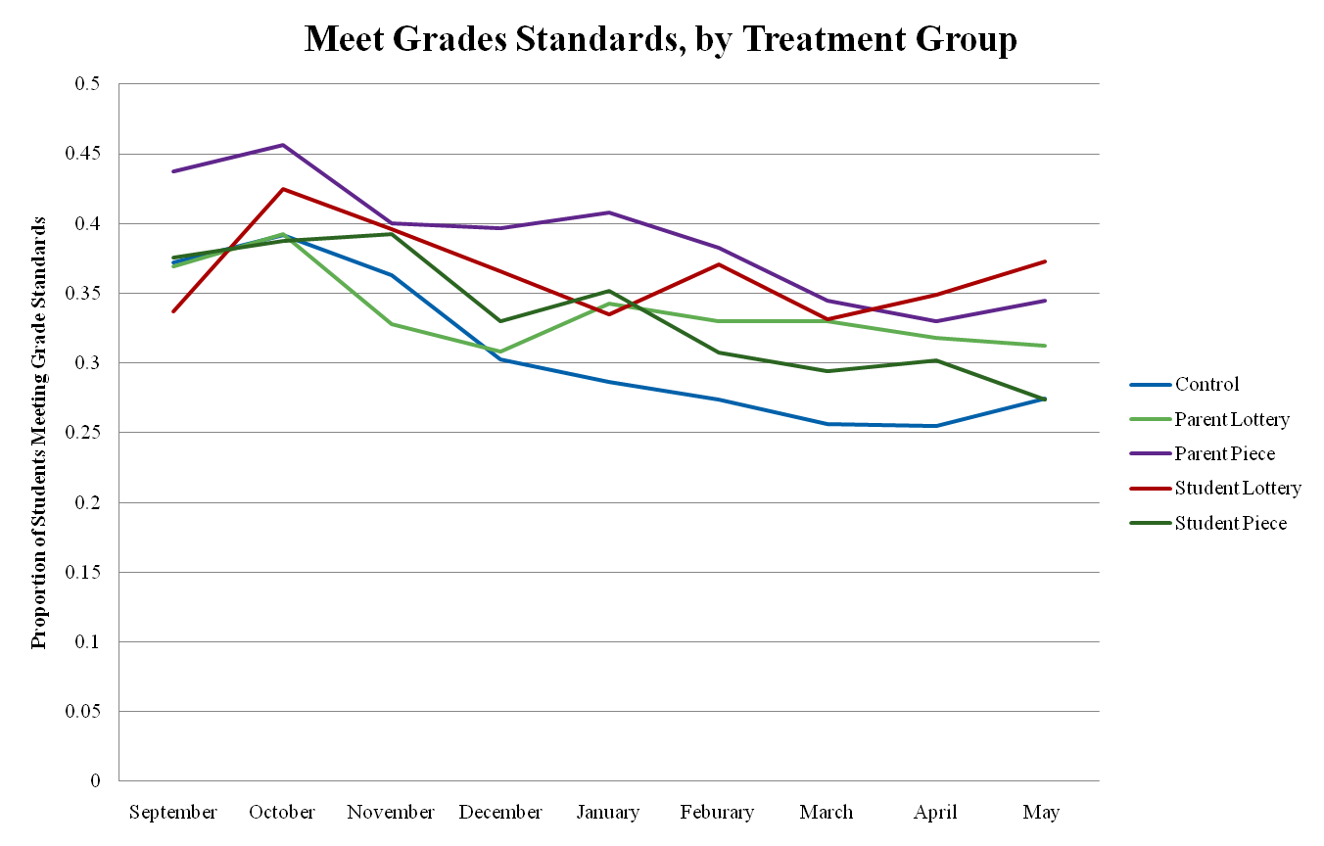
Meet Grades

Slide 8
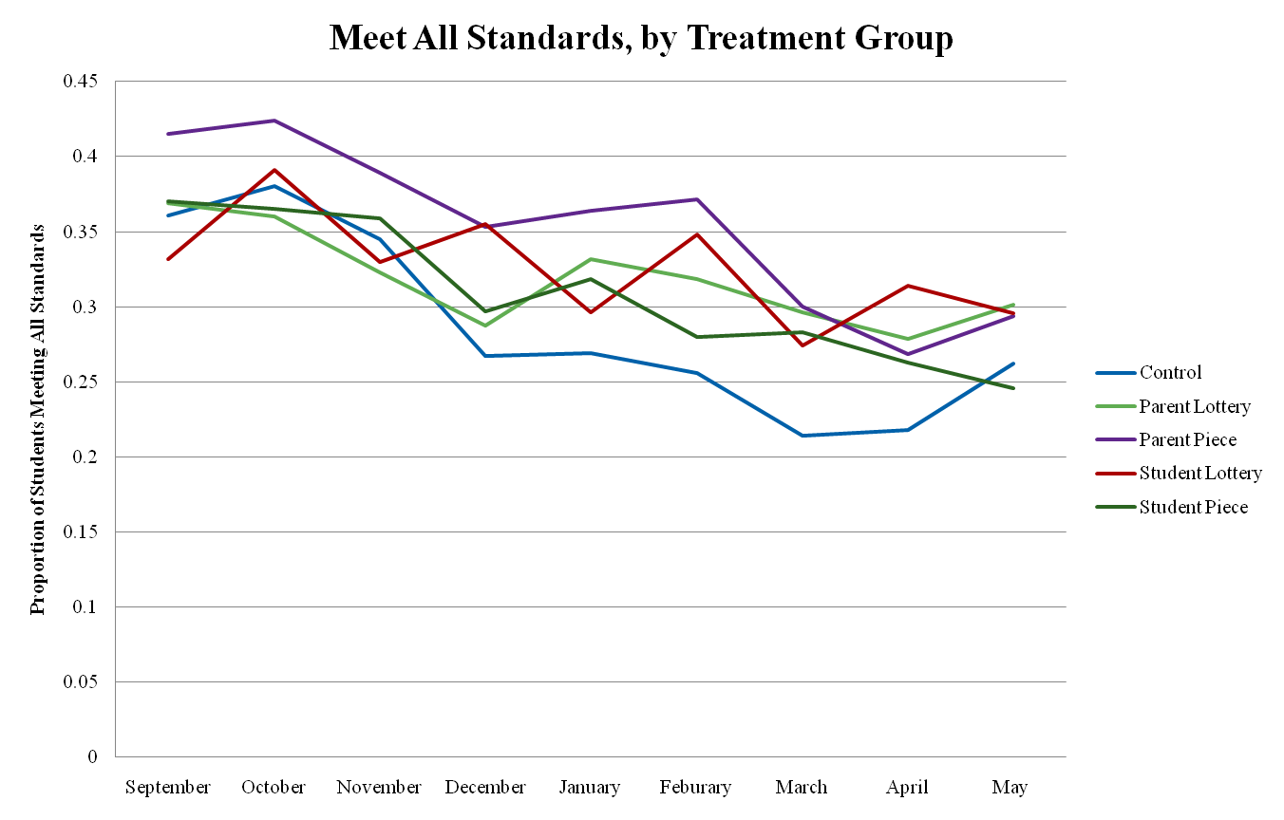
Meet All: By Group

Slide 9
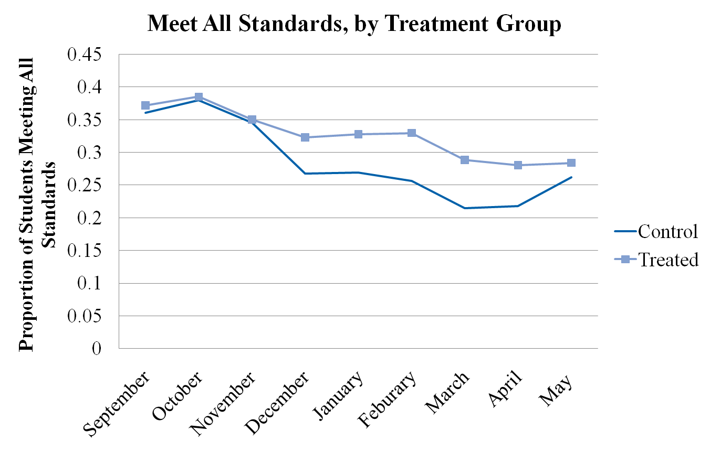
Meet All: Collapsed

Slide 10
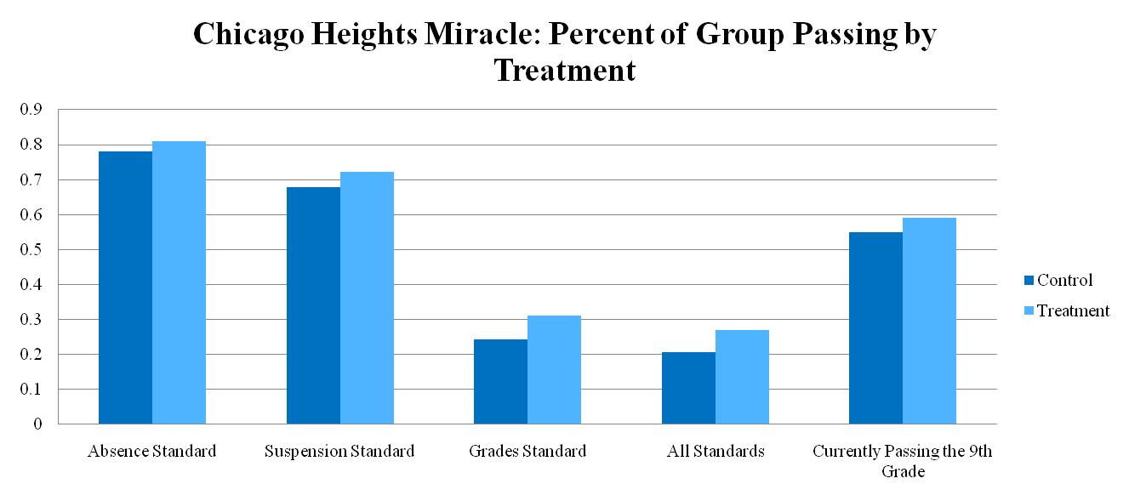
Chicago Heights Miracle: Results
We are spending $160/student on 700 students to get a 5-7% boost in 9th grade passing rates. This equates to about 35-50 extra passing students, or between $2,300 and $3,300 per passed student.
Chicago Heights spends approximately $7,700 instructional expenditure per student ($13,000 operational), or $13,000 per passed student.

Slide 11
One-time Incentives: Experimental Design
The one-time incentives have a narrow focus, aimed solely at increasing effort on standardized tests.
Students and Standardized tests:
  10th graders at Bloom High School: STAR Reading Test (~15 minutes)
  8th graders in District 170 (feeds into Bloom): ThinkLink Reading and Math tests (20-60 minutes each)
  Both STAR and ThinkLink are “low-stakes” diagnostic tests
Incentive to improve upon fall test score ($1, $10 or $20)
  Announced immediately before test
  Reward given in cash immediately after test completed
Notes:
Randomized over classrooms
10th grade stratified by track (Remedial, Regular, Honors)
8th grade stratified by school and subject (Reading, Math)

Slide 12
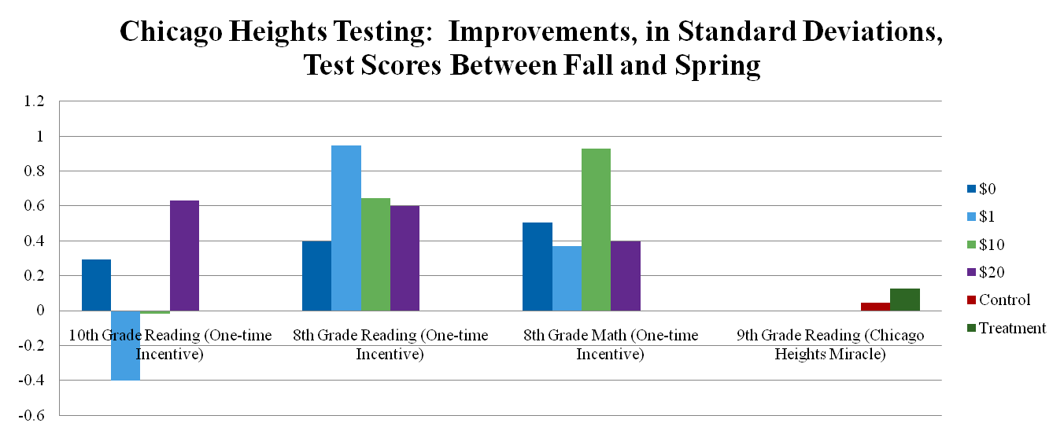
Chicago Heights Testing: Results
Comparing $0 and $20 treatments, we would spend:
10th Grade Math Scores: $59/SD improvement
8th Grade Reading Scores: $99/SD improvement
8th Grade Math Scores: We did not improve 8th Grade Math Scores
Chicago Heights Miracle: $253/SD improvement

Slide 13
Future Work: Ongoing and Planned Incentive Programs
Early Education and Intervention
  Chicago Heights Elementary School District 170
  Compare intensive pre-k program to parental incentives for investing in children before they enter school
Teacher incentives
  Chicago Heights Elementary and High School Teachers
  Design incentives to encourage greater individual effort and teamwork
  Base incentives on value-added (potentially more cost-effective than individual student incentives)

