Slide 1
Project of Bachelor Thesis
Chia-Hao Chang
Goethe Universität Frankfurt am Main
Fachbereich 12 Informatik und Mathematik
B.Sc. InformatikChia-Hao Chang
Why Is Active Learning With Query Methods Often Just Marginal Better Than Ramdom Sampling?
Name: Chia-Hao Chang
Matrikelnummer: 7119583
Mailadresse: s4065070@stud.uni-frankfurt.de
Supervisor: Dustin Eisenhardt by MLO
Professor: Dr. Florian Büttner by MLO
Notes:
Good afternoon everyone, This is Kyle. Today I will present the project for my bachelor thesis. This research was inspired by a question in the field: "Why is Active Learning with query methods often only marginally better than random sampling?"

Slide 2
Agenda
Chia-Hao Chang
1. Introduction
2. Motivation
3. Experiment
4. Aktueller Zustand
5. Q&A

Slide 3
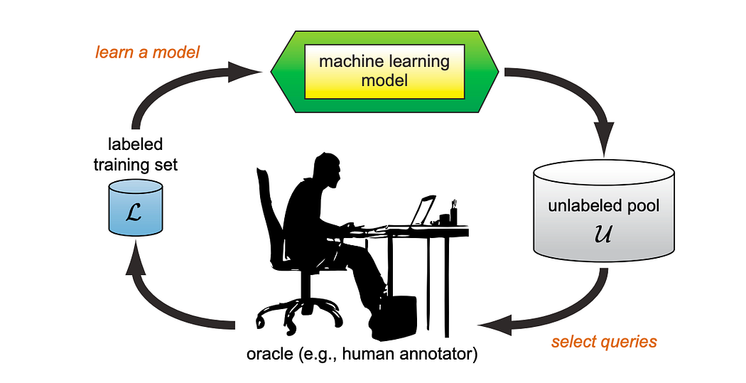
1. Introduction
1.1. Active Learning
1.2. Goal of AL
1.3. Query Methods
Uncertainty-based
Diversity-based
Hybrid
Chia-Hao Chang
1.4. Procedure
Step 1: A small set of labeled data is used to train a machine learning model so that it has basic knowledge.
Step 2: The model selects data from an unlabeled data pool using a query method.
Step 3: Oracle annotates the selected data and adds it to the training dataset.
Step 4: The model is retrained with the updated training dataset.
Step 5: Steps 2-4 are repeated until the model is well-trained.
Notes:
I will skip the general introduction to Active Learning, as I assume most of you are already familiar with the framework.

Slide 4
2. Motivation
Chia-Hao Chang
Why are Query Methods Often Just Marginal Better Than Random Sampling?
There is literature that shows there are subsets with yield significantly better performance than random. So why is there no query method that performs similarly well? (Ref: Werner, T., Burchert, J., Stubbemann, M., & Schmidt-Thieme, L. (2024). A Cross-Domain Benchmark for Active Learning. Advances in Neural Information Processing Systems, 37, 62875–62911. https://doi.org/10.52202/079017-2009)
Notes:
Why am I conducting this research? Literature shows that certain subsets can yield significantly better results than random queries. This raises the question: why isn't there a query method that consistently finds these optimal subsets?

Slide 5
Hopythesis: The percentage of 'good' subsets in the dataset is low so that it is hard to find the subsets that can be used to train the neural network well.
2. Motivation
Chia-Hao Chang
Why are Query Methods Often Just Marginal Better Than Random Sampling?
Goal: To find an approximation method to approximate the accuracy distribution over subsets in a larger dataset.
Notes:
My hypothesis is that the percentage of "good" subsets in a dataset is very low, making it difficult to identify the specific subsets needed to train a neural network effectively. Therefore, the goal of my project is to develop an approximation method to estimate the accuracy distribution over subsets in larger datasets.

Slide 6
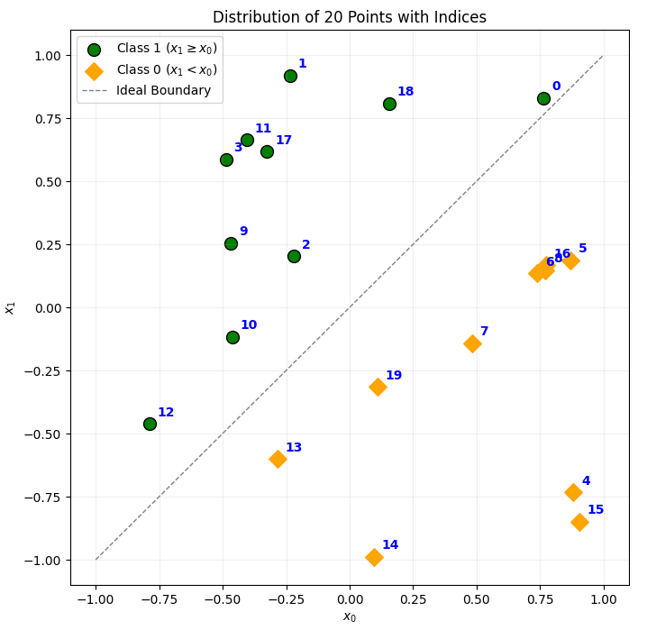
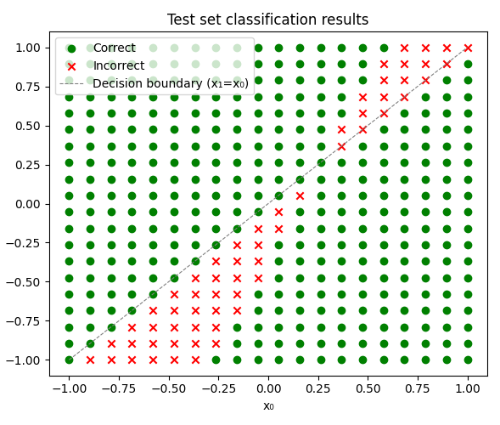
3. Experiment
Phase 1: Toy Dataset (Exhaustive Evaluation)
Build a small neural network (NN) for classification on a toy dataset.
Model: A neural network with 2 inputs (axis x, axis y),
1 output (1/0) and no hidden neuron.
Training Dataset: 2D points within [-1,1]^2
Decision Boundary: main diagonal line (x=y)
Unlabeled Pool: 20 points.
Labeling Budget: 4 points.
Test Dataset: 20x20 2D points within [-1,1]^2
Goal: To see the subsets distribution upon accuracy after NN model trains with all combinations (4845 Subsets),
Exhaustive Evaluation: > 125K Trainings
Phase 2: Scaling to larger datasets (Approximation)
Find an approximation method to apply on a large dataset.
Potential Datasets: Honeypot, Diverging Sine, CIFAR-10 (+ LT).
Notes:
I am conducting my experiment in two phases. The first phase is an exhaustive evaluation on a toy dataset. We train a small neural network on subsets of 4 points selected from a 20-point training set. The task is a 2D classification problem. The second phase focuses on finding an approximation method to estimate the accuracy distribution on larger datasets.

Slide 7
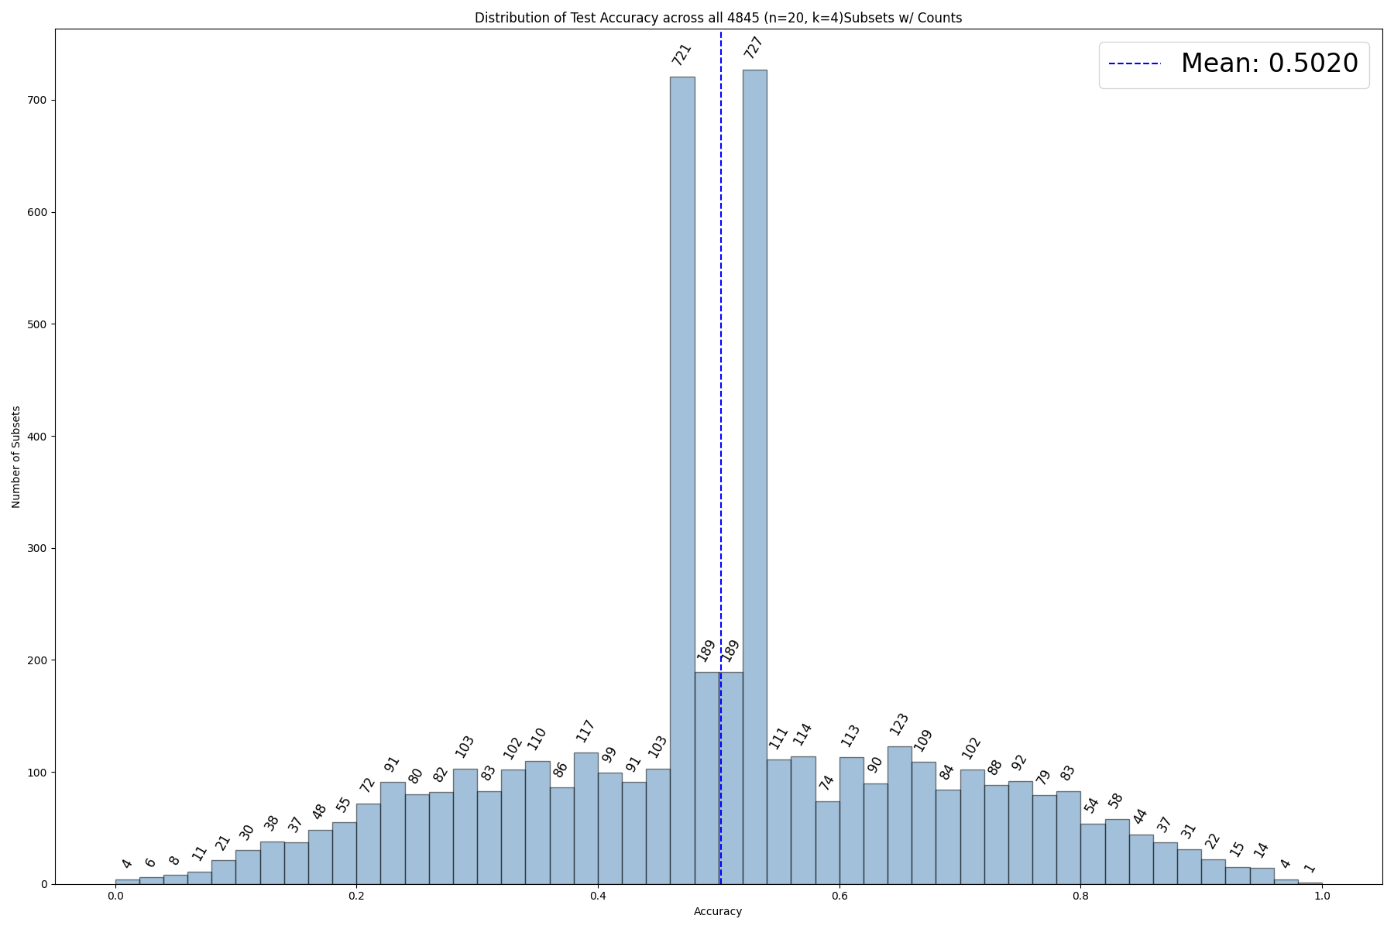
4. Current Status
Warm-up: the 4845 subsets distribution upon accuracy
Chia-Hao Chang
Numberr of Subsets
Accuracy
Notes:
Now, I will show the results I obtained so far. After evaluating the neural network on my test dataset, I obtained this accuracy distribution. We can see that a large portion of subsets (around one-third) achieve an accuracy of only about 0.5, while very few subsets achieve high performance.

Slide 8
4. Current Status
Chia-Hao Chang
Exploring different n and k settings to see if the accuracy distribution changes
Notes:
To see if the distribution would change, I adjusted the experimental settings by increasing the number of unlabeled points and the labeling budget. I focused on these five n-k combinations for further testing.

Slide 9
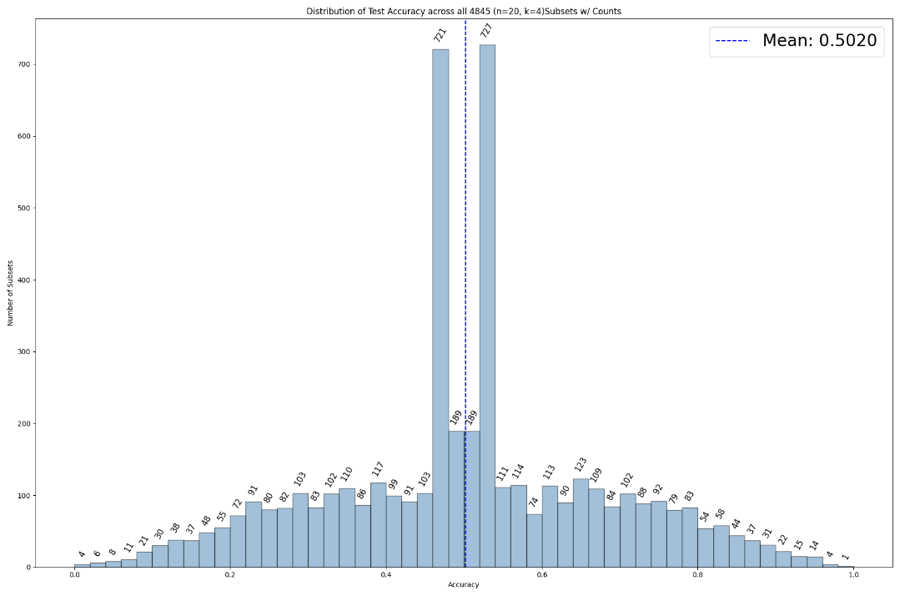
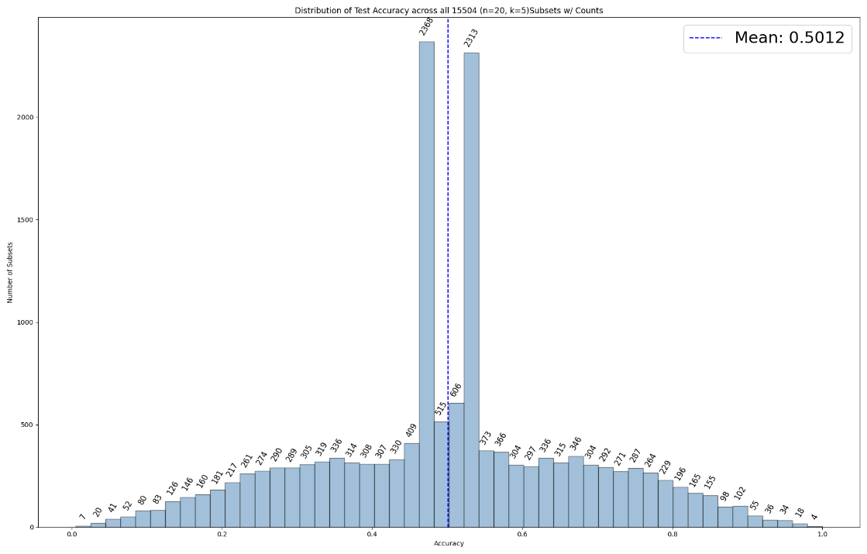
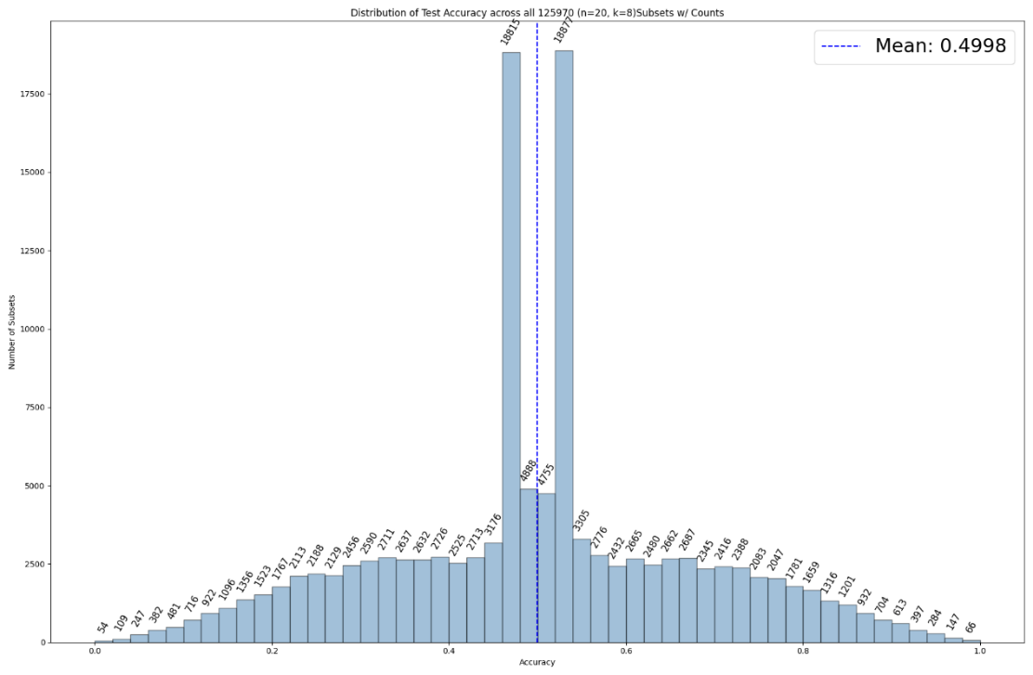


4. Current Status
.
Results after increasing the unlabeled points and labeling budget: The other idea: Change the learning rate? No different
Chia-Hao Chang
n=20, k=4
n=20, k=5
n=20, k=8
n=30, k=4
n=30, k=5
Notes:
Here are the results of the different combinations. As you can see, the distributions remained very similar to the initial result, with a significant number of subsets still performing at around 0.5 accuracy.

Slide 10
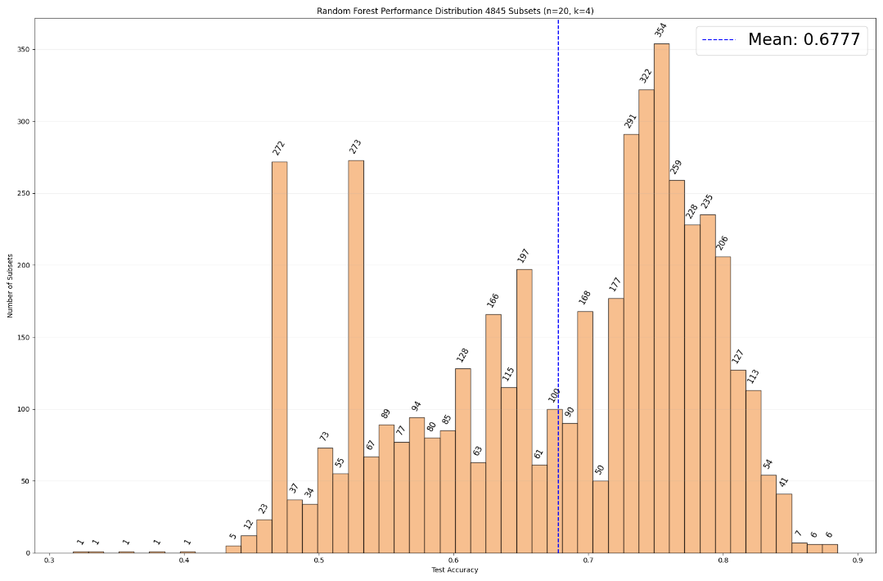
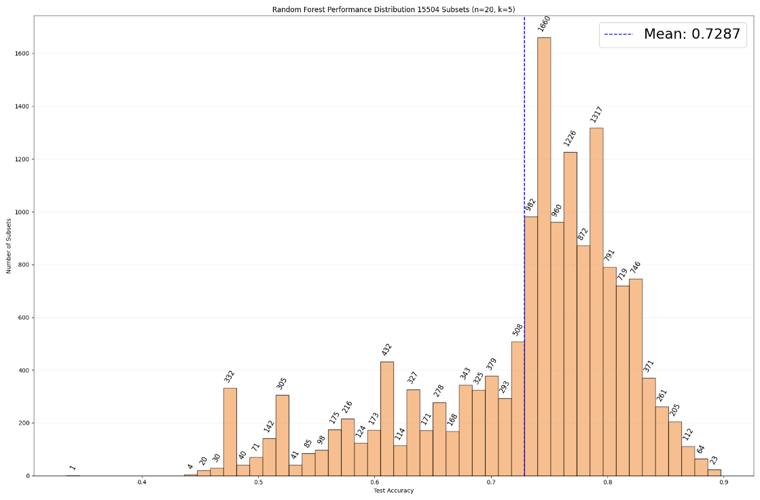
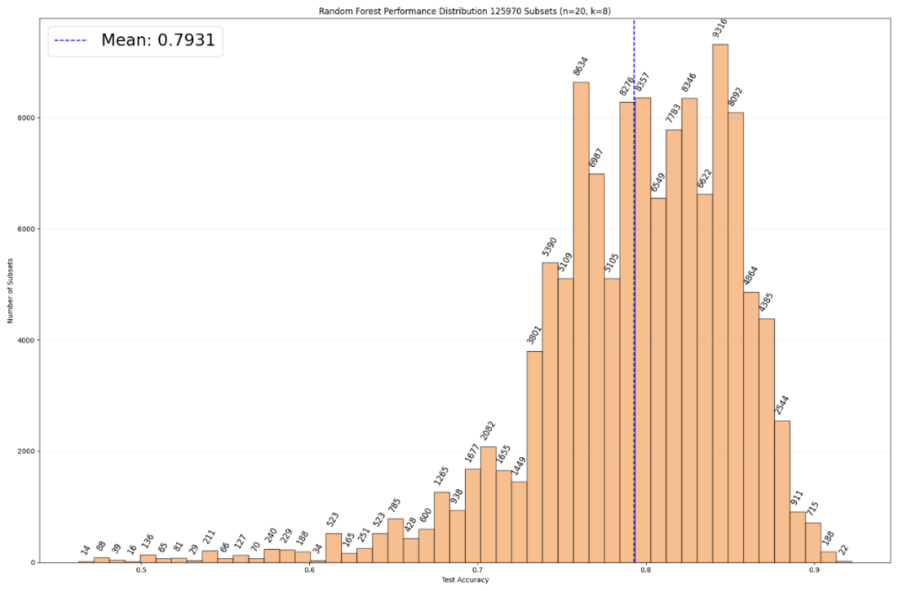
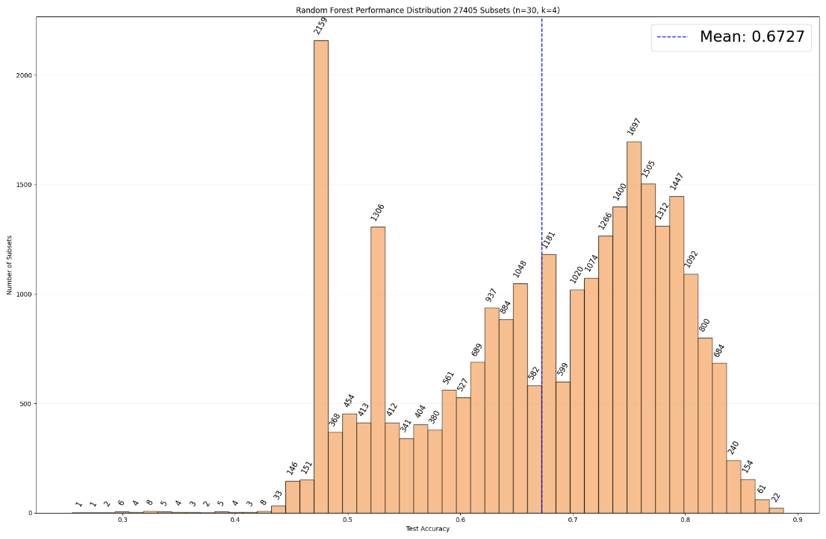
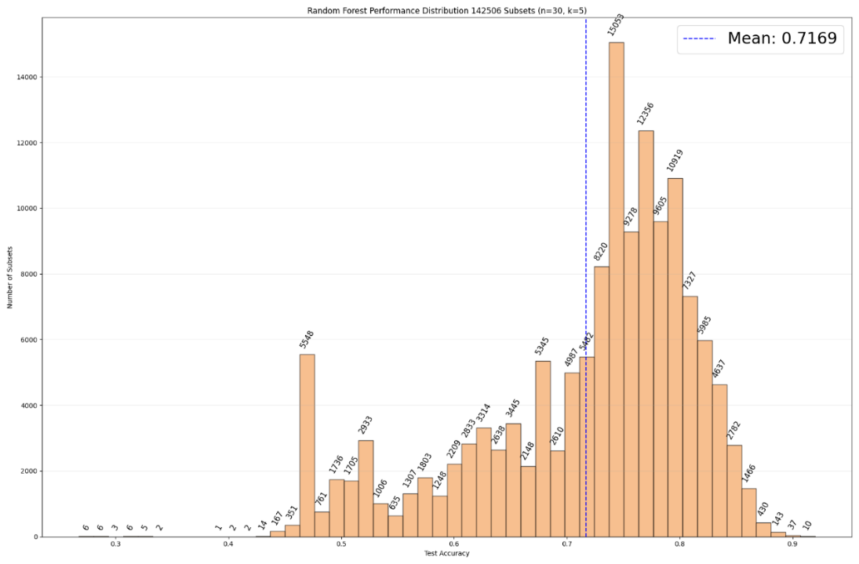
4. Current Status
Chia-Hao Chang
Using Random Forest (RF) with the same training dataset:
n=20, k=4
n=20, k=5
n=20, k=8
n=30, k=4
n=30, k=5

Slide 11
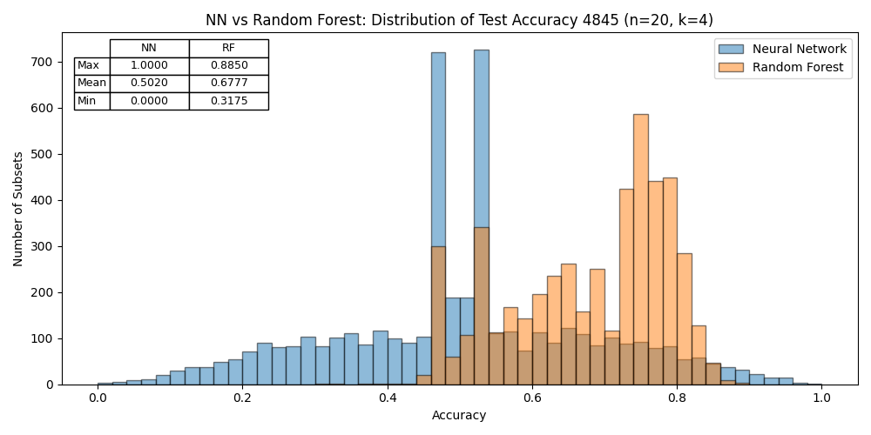
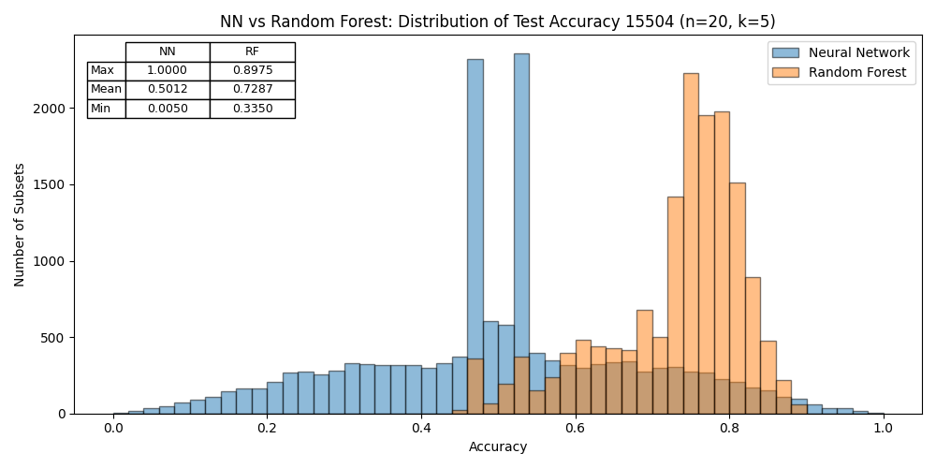
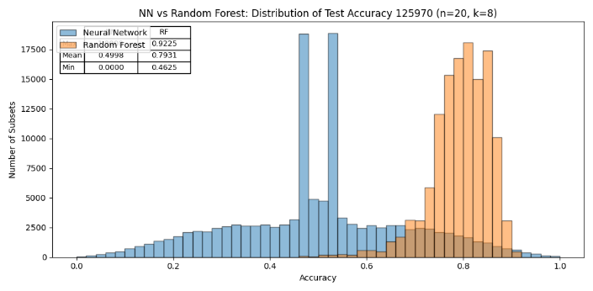
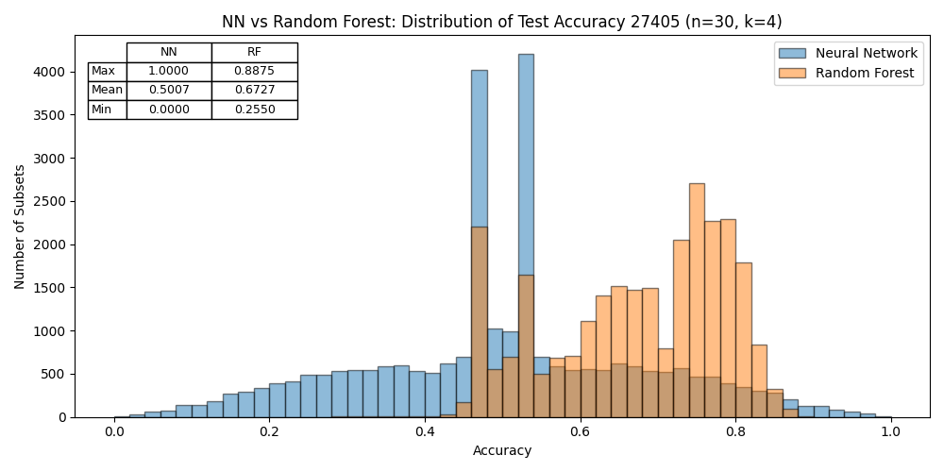
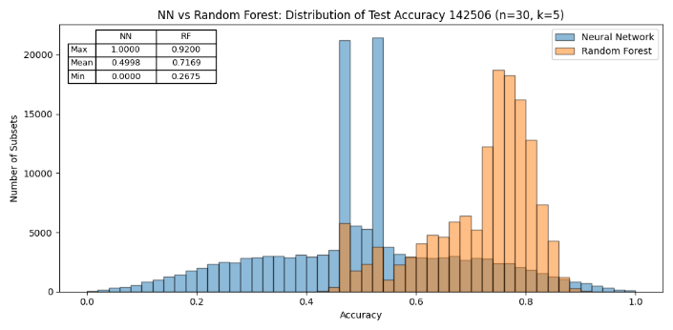
4. Current Status
Chia-Hao Chang
Comparing the results of NN from RF
n=20, k=4
n=20, k=5
n=20, k=8
n=30, k=4
n=30, k=5
Notes:
Next, I used a Random Forest model to see if its distribution followed the same pattern as the Neural Network. Comparing the two distributions shows that their performance curves are quite different; specifically, Random Forests appear to be less sensitive to the choice of subset.

Slide 12
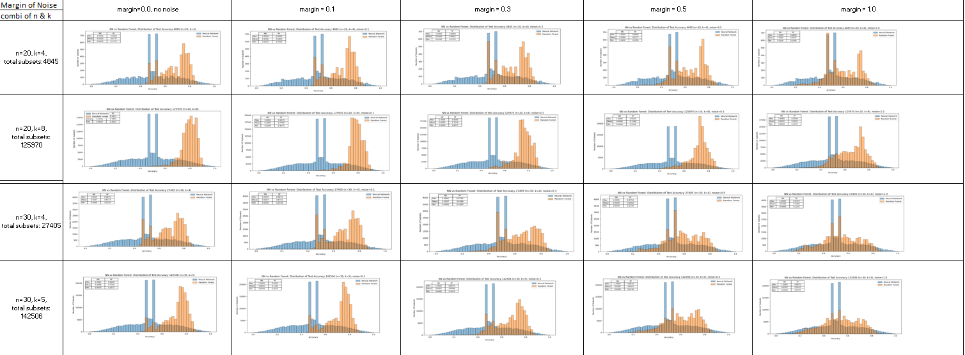
4. Current Status
Chia-Hao Chang
Results of creating noises: noise did not influence the result of NN, but RF
Notes:
I also introduced noise into the training dataset by creating a margin along the decision boundary. The results show that while noise did not significantly impact the NN distribution across different margins, the RF distribution changed as the margin increased.

Slide 13
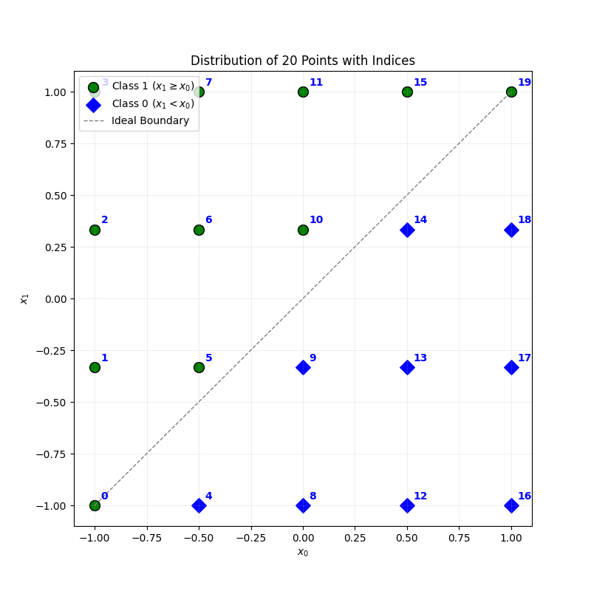
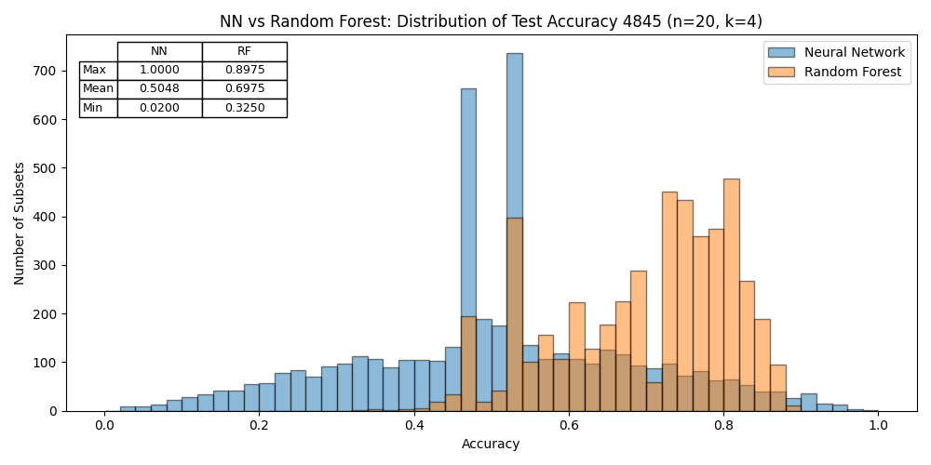
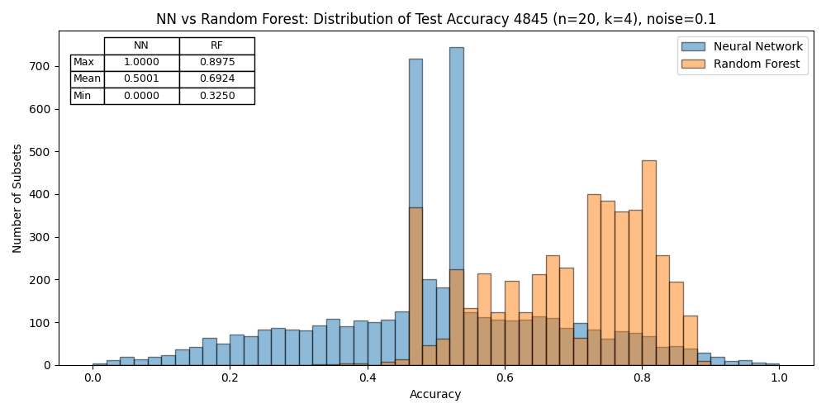
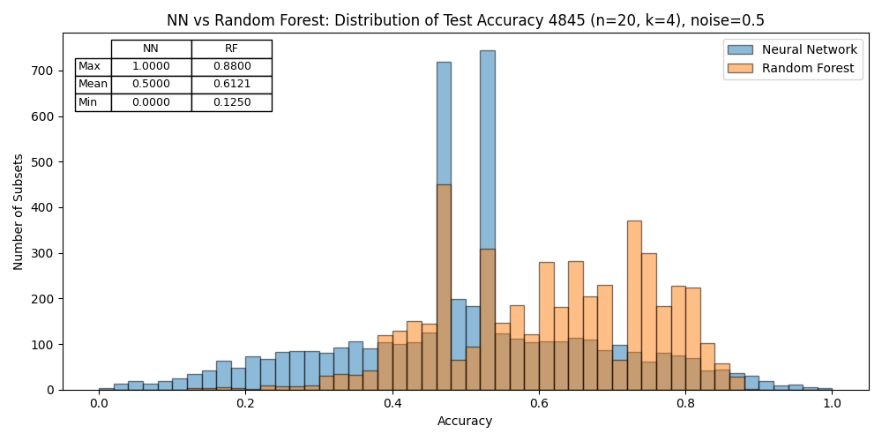
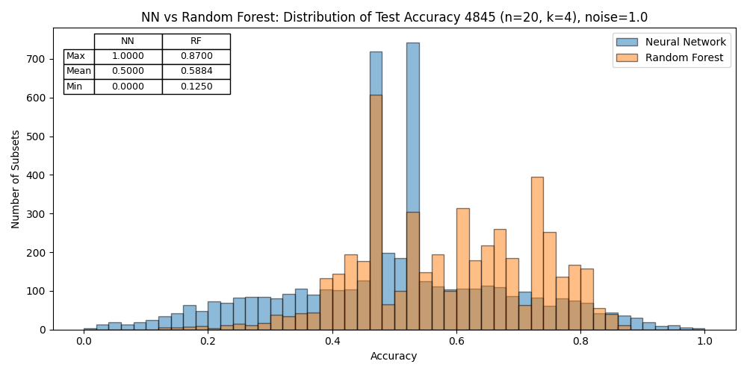
4. Current Status
Chia-Hao Chang
Results of training dataset where the points eqaully distributed on the 2D area
Notes:
I then shifted the training data from randomly distributed points to equally distributed points. However, as the figures show, the NN distributions remained the same.

Slide 14
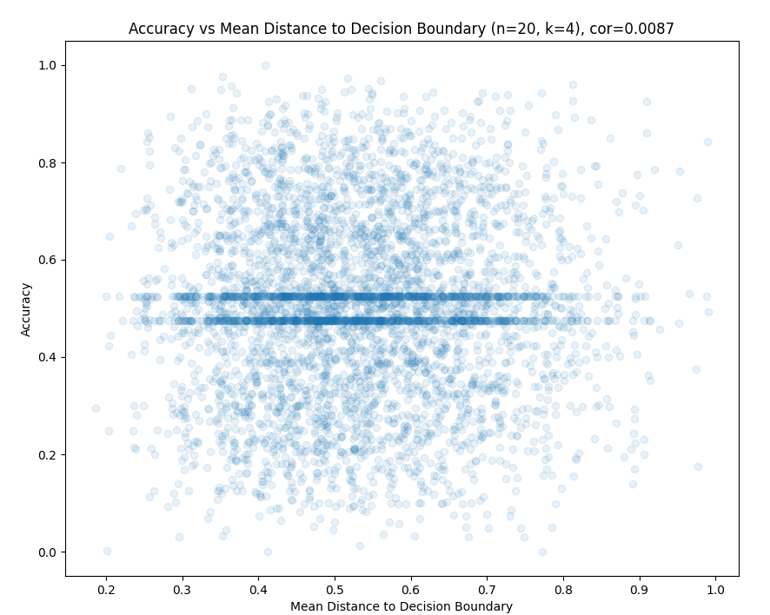
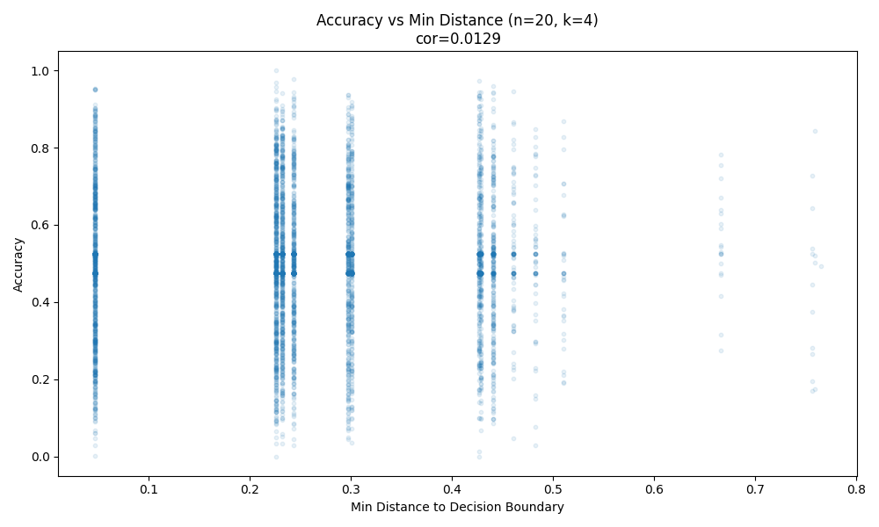
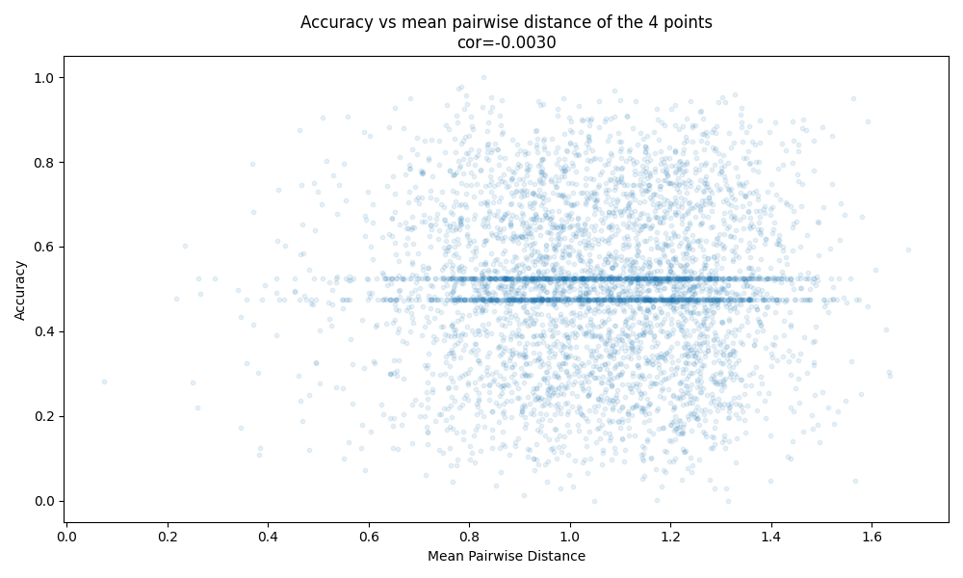
4. Current Status
Chia-Hao Chang
Most Subsets do not help NN to learn the Decision Boundary (DB)
Which properties of subests might affect accuracy?
Average distance between points and DB?
Min distance to DB (closet point to DB) ?
Average distance of each two points?
Label ratio ?
If the DB in Convex Hull
Accuracy
Mean Distance of Subsets to Decision Boundary
Accuracy
Accuracy
Min Distance of Subsets to Decision Boundary
Mean Pairwise Distance of Subsets to Decision Boundary
Notes:
Since changing the settings did not impact the NN distribution, I began investigating whether specific properties of the subsets affect accuracy. I tested several metrics, such as the average distance of the 4 points to the decision boundary and the label ratio within the subset. However, the results show that the correlation is very low between these features and the accuracy.

Slide 15
4. Current Status
Chia-Hao Chang
The distance between points in SubSet (SS) and DB?
Average distance of 4 points in SS to DB.
distances = (data[:, 1] - data[:, 0]).abs() / (2 ** 0.5)

Slide 16

4. Current Status
Chia-Hao Chang
The distance between points in SubSet (SS) and DB?
Average pairwise distance of 4 points in SS.
pair_distances = [torch.dist(points[i], points[j]).item() for i, j in pairs]

Slide 17
4. Current Status
Chia-Hao Chang
The distance between points in SS and DB? Distance between the closest points in SS and DB

Slide 18
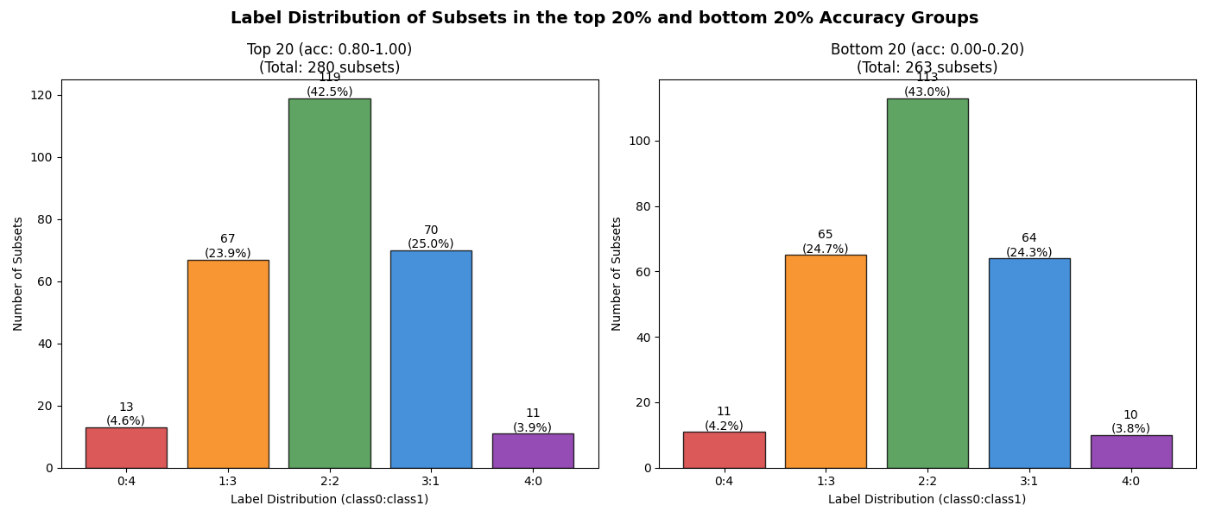
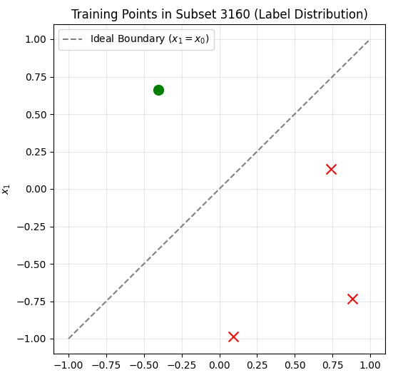
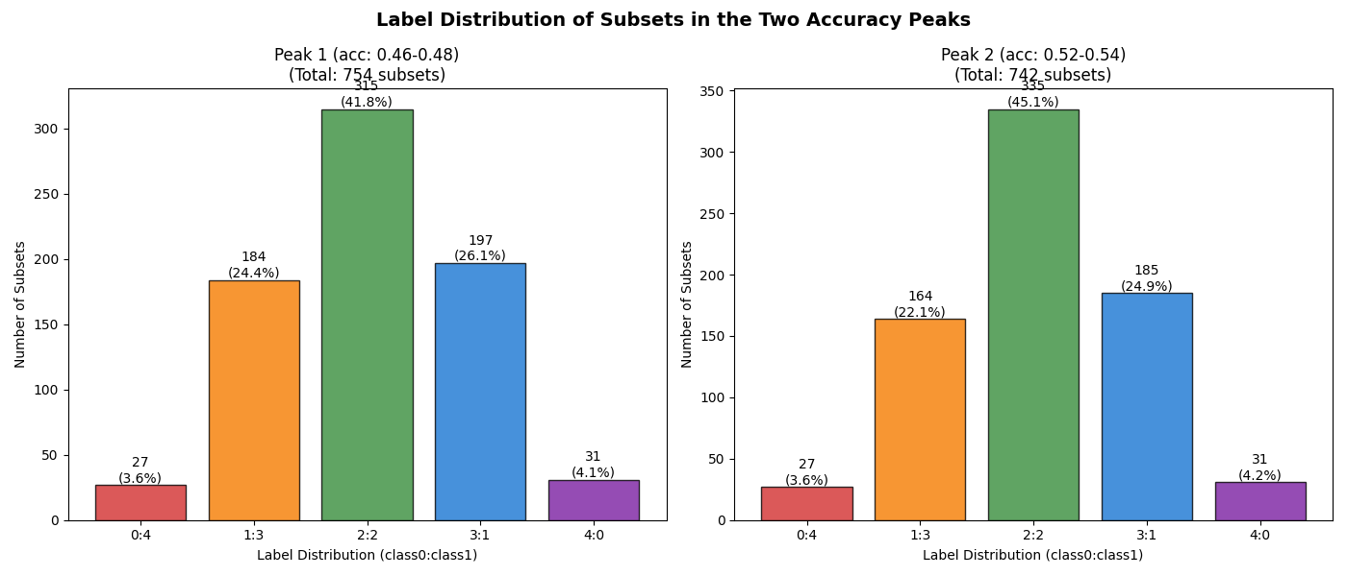
4. Current Status
The point label ratios in subsets in different accuracy ranges (two peaks & top/btm20).
Chia-Hao Chang
Notes:
As shown here, the label ratios for subsets in the low-accuracy range (0 to 0.2) and the high-accuracy range (0.8 to 1.0) are very similar.

Slide 19
4. Current Status
The point label ratios in subsets in different accuracy ranges (two peaks & top/btm20).
Chia-Hao Chang

Slide 20
4. Current Status
Chia-Hao Chang
Take a look at some specific Subsets

Slide 21
4. Current Status
Accuracy when DB in/out of Convex Hull? 4425 subsets cross the decision boundary and 420 subsets do not cross the decision boundary
Chia-Hao Chang

Slide 22
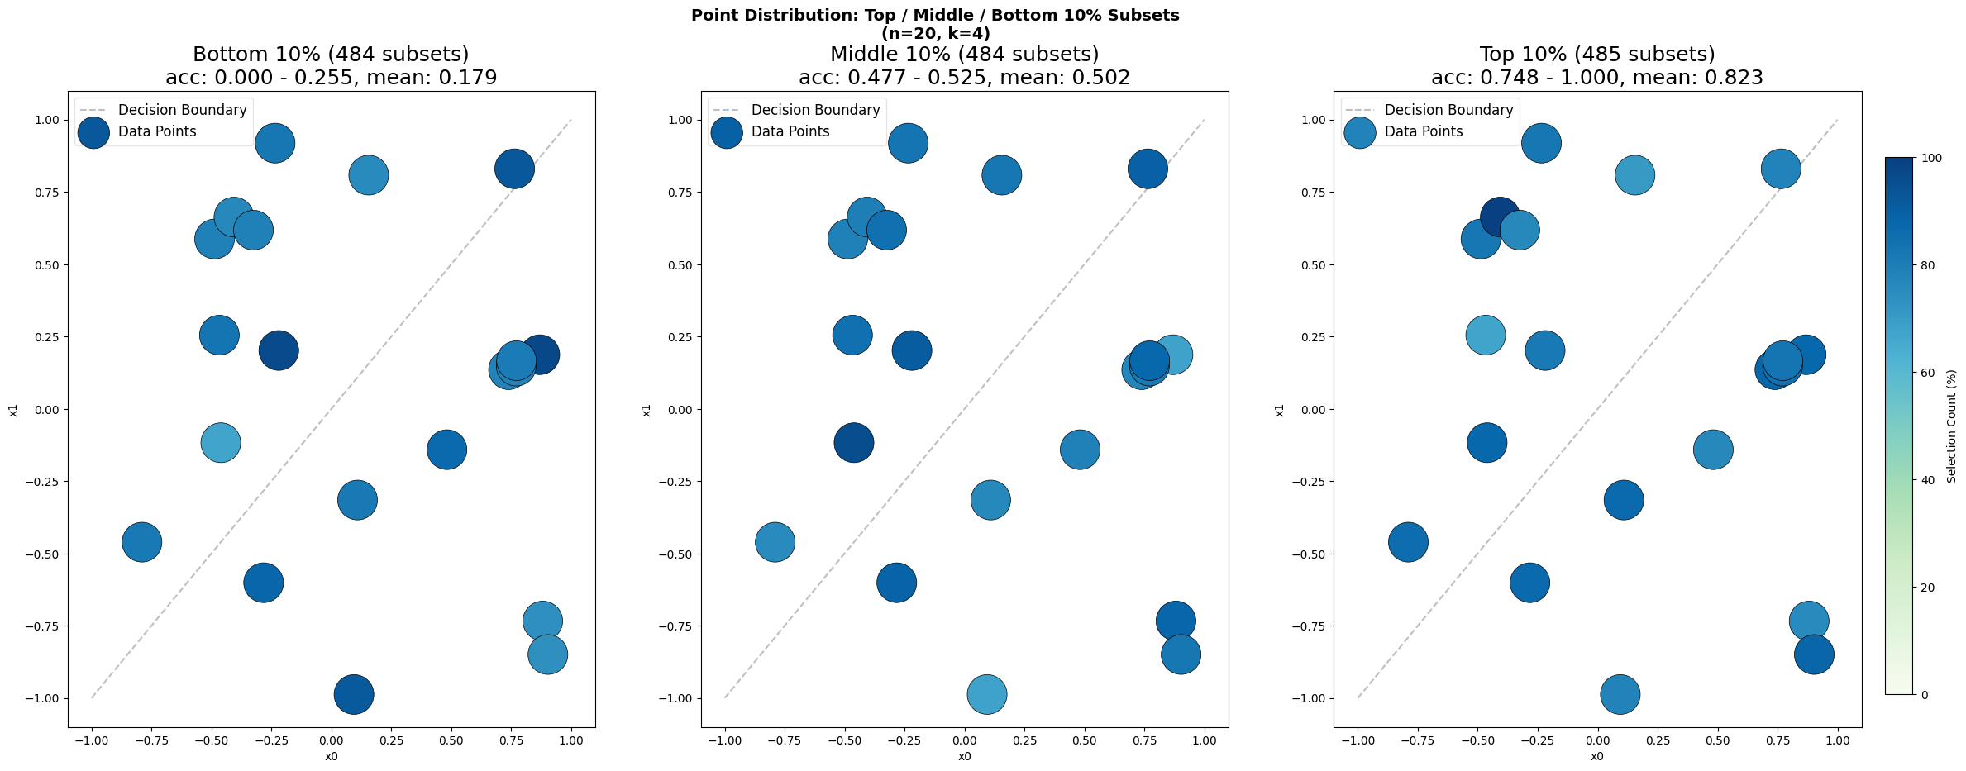
4. Current Status
Chia-Hao Chang
Take a look at the contribution of each points in different accuracy ranges.
Notes:
Furthermore, these figures illustrate point contributions across three accuracy ranges: top 10%, middle 10%, and bottom 10%. While there are some differences, they are not significant. In summary, my exhaustive evaluation shows that the accuracy distribution over subsets appears unpredictable using simple features.

Slide 23
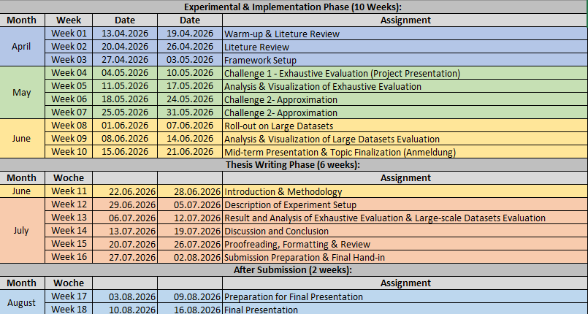
5. Schedule
Chia-Hao Chang

Slide 24
5. Next Steps
Approximation Method:
Goal: To approximate the full performance distribution of a dataset using only a fraction (e.g., 10%) of all possible subsets.
Validation on Toy Dataset:
Perform Monte Carlo sampling on the 4845 exhaustive results.
Measure approximation error using KL Divergence / Wasserstein Distance against the true distribution.
Investigate if other methods (e.g. stratified sampleing) provide a better approximation than simple random sampling.
Scaling Up: Apply the validated sampling strategy to larger rollout datasets (Honeypot, CIFAR-10) to estimate their performance landscapes without exhaustive training.
Chia-Hao Chang
Notes:
This brings me to the next phase of my research: Distribution Approximation.
My next step is to find a method that can approximate the full performance distribution of a dataset by using only a small fraction (e.g., 10%) of its subsets. I will validate this sampling strategy on my toy dataset before applying it to larger datasets like CIFAR-10.

Slide 25
6. Q&A
Chia-Hao Chang
6.1. Q & A
6.2. Feedback
Thank you for the attention!!!
Notes:
That concludes my presentation. Thank you for your attention. I am now happy to take any questions or comments you may have.

