Slide 1
J2312+53: an eclipsing binary with a 22 µm excess
Listed in Gaia DR3 and VSX eclipsing-binary catalogues

Slide 2
Summary
6.85 d
χ²ᵣ 0.39
12.6σ
Detached eclipsing binary of two ~9,900 K stars
PHOEBE binary model fits the TESS light curve
22 µm (W4) excess above the binary
The excess is real and not from a neighbour, but the star sits on extended dust emission, so a disk is not yet proven.

Slide 3
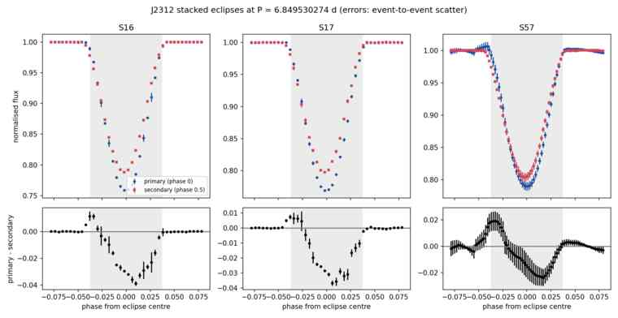
Unequal eclipse depths fix the period at 6.85 d
Primary is deeper than secondary (118σ)
Secondary is 16 min early: slight eccentricity
Matches both catalogue periods: Gaia DR3 6.8494 d, VSX 6.8495 d
Stacked eclipses in TESS sectors 16, 17 and 57. Blue = primary, red = secondary.

Slide 4
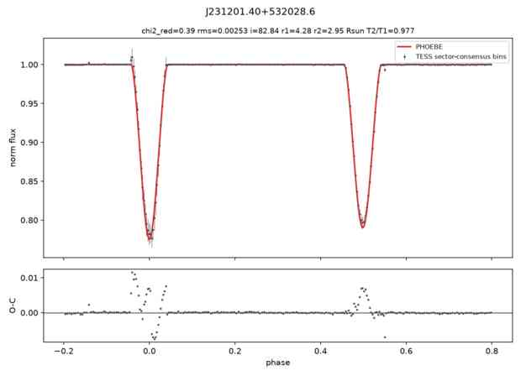
Two near-twin A stars on a nearly circular orbit
Inclination | 82.8°
R₁ / R₂ | 4.28 / 2.95 R☉
T₁ / T₂ | 9,932 / 9,700 K
Eccentricity | ≈ 0.01
χ²ᵣ | 0.39
Sectors disagree on eclipse depth by up to 3%; a per-sector fit is still needed.
TESS data (black), PHOEBE model (red), residuals below.

Slide 5
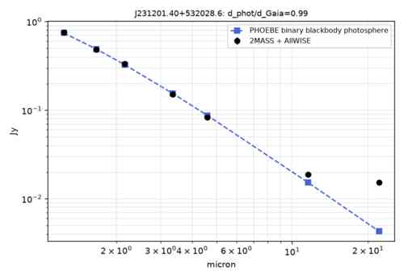
W4 is 3.6× brighter than the binary predicts
Near-IR matches the photosphere
Excess: W3 7.0σ, W4 12.6σ
2MASS + AllWISE photometry (black) vs the binary photosphere (blue).

Slide 6
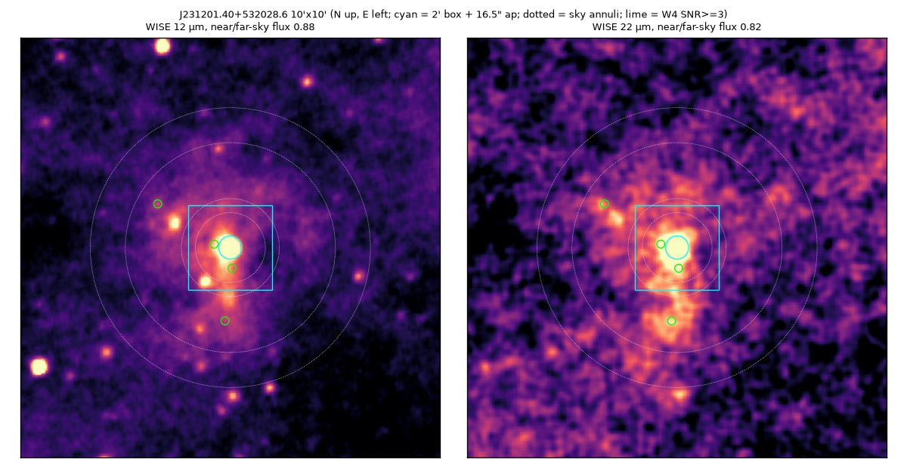
AllWISE images: the star sits on a ridge of dust emission
10′ × 10′ AllWISE W3 (12 µm, left) and W4 (22 µm, right). Cyan circle = the star; green = faint neighbours.

Slide 7
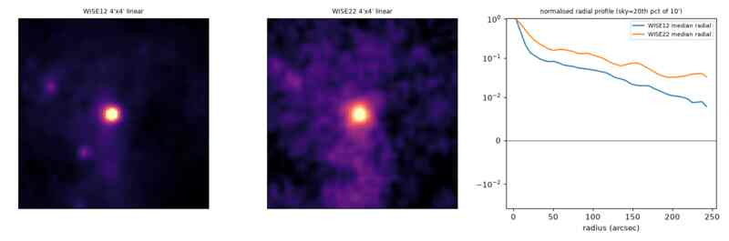
But the 22 µm light is extended, not a point source
4′ × 4′ W3 and W4 cutouts and radial profiles.
W4 stays at 15–20% of peak out to 100″; a point source would fade within ~30″. The star sits on a ridge of dust emission.

Slide 8
No neighbour explains the excess or dilutes the eclipses
≤ 4.1
0
1.8%
W4 SNR of any AllWISE source within 3′
Gaia sources within 12″
Flux from Gaia sources at 12–60″ (TESS dilution)

Slide 9
Excess real, origin uncertain
Next: excess vs aperture size; Spitzer 24 µm or Herschel images; per-sector light-curve fit.

