Slide 1
Who Takes Home the Gold?
Kyle Chou, Jaewon Jeong, Pamela Mukuyu, Victoria Shirk

Slide 2
Why This Project
With the Olympic Games currently underway, we were curious about the factors that might influence the results and which countries have shown the most improvement over time. We decided to focus our study on one of the most iconic Olympic sports: swimming. This focus led us to explore three key questions:
Does an athlete's height and weight influence their performance?
Is there a home-field advantage?
Which country has shown the most improvement in swimming over the years?

Slide 3
Our Data
We used a historical olympic dataset from Kaggle that consists of the Olympic Games Results from Athens 1896 to Beijing 2022.
Included in our dataset are 6 different CSVs:
Olympic Athlete Bio: Includes each athlete’s ID, name, sex, year of birth, height, weight, country they represent, and special notes
Olympic Athlete Event Results: Includes game edition, country code, sport, event, athlete, position and medal
Olympic Games Medal Tally: Includes game edition, year, country, and medal tally for bronze, silver, gold, and total
Olympic Results: Result ID, event, edition, sport, date, host country, participants and results
Olympic Country: Country and country code
Olympic Games: Edition, year, city, flag, and start, end and completion dates.

Slide 4
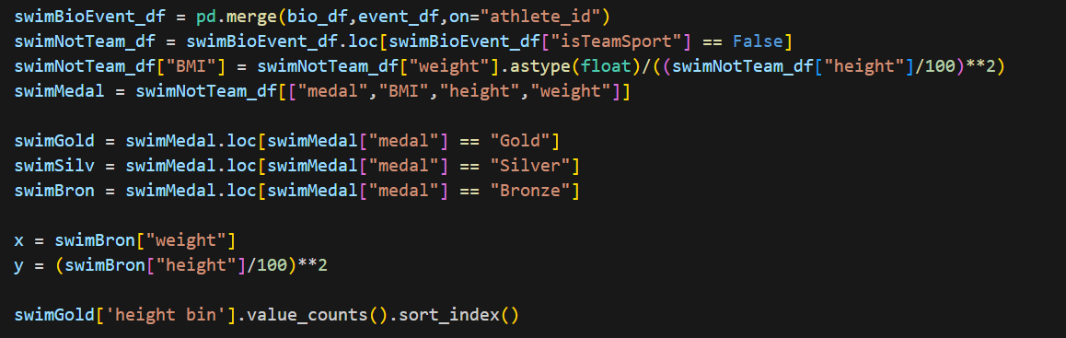
Weight vs Height Data
DataFrame from merging “Olympic_Athlete_Bio.csv” and “Olympic_ Athlete_Event_Result.csv” with focus on individual swimming events.
“Medal”, “height”, “weight” pulled from the DataFrame
“BMI” calculated from (weight(kg))/(height(cm)/100)^2
Group data using .loc on different medals.
P value from ANOVA between the Gold, Silver, and Bronze DataFrame

Slide 5
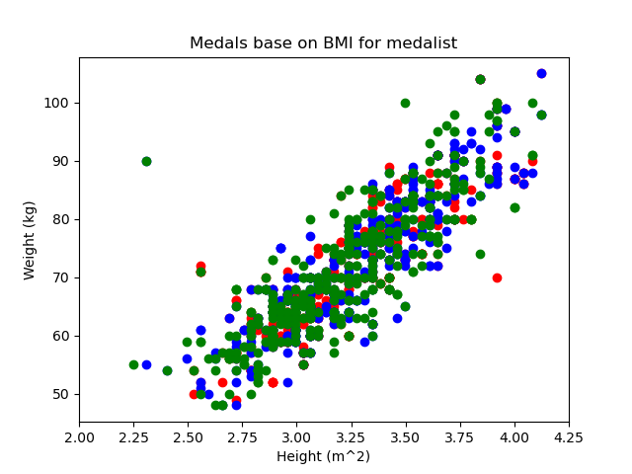
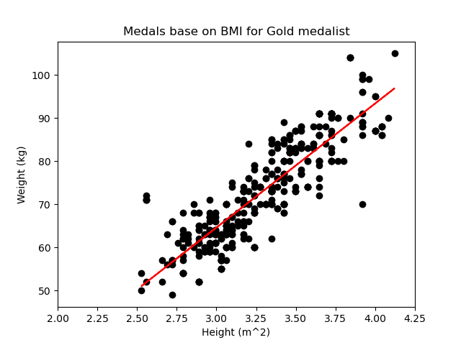
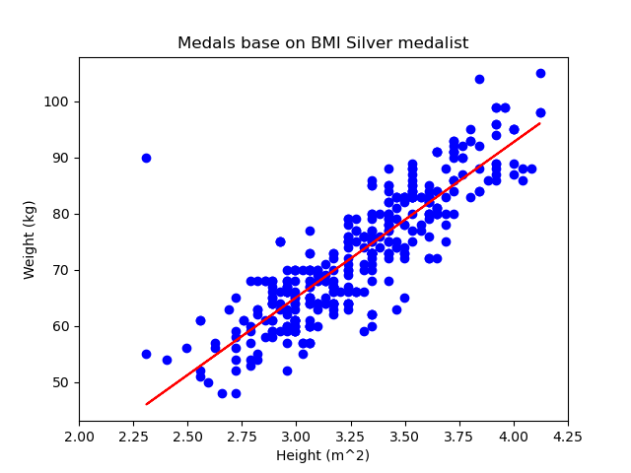
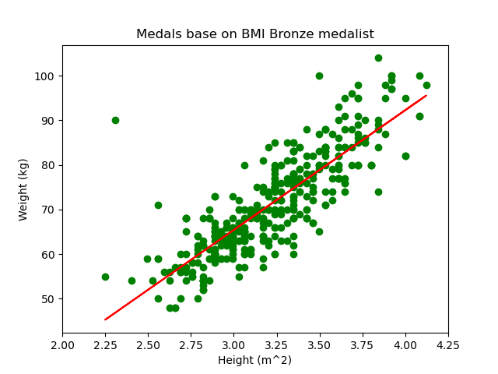
Olympic Swimming
Medalist
Gold Best fit - 28.77x-21.66
Silver Best fit - 27.66x-17.92
Bronze Best fit - 26.89x-15.25
Gold BMI Mean - 22.11; Max - 28.12; Min - 17.86
Silver BMI Mean - 22.14; Max - 38.95; Min - 17.58
Bronze BMI Mean - 22.10; Max - 38.95; Min - 17.92
P Value by BMI - 0.853
P Value by weight - 0.745
P Value by height - 0.010

Slide 6
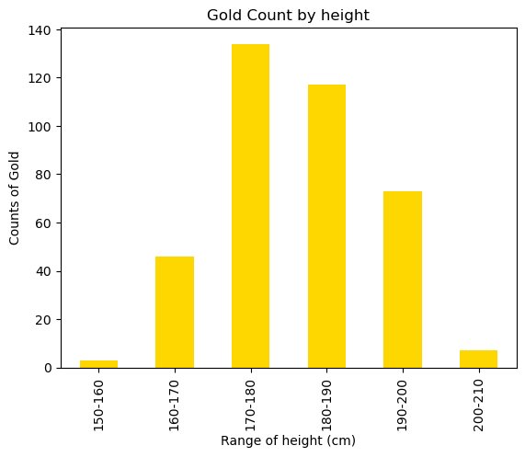
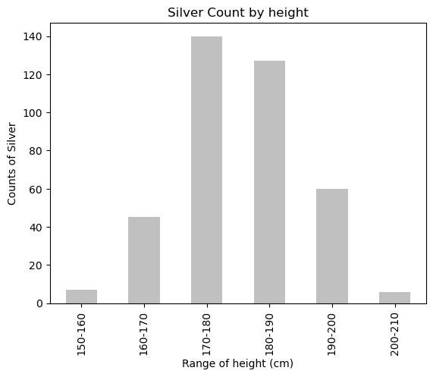
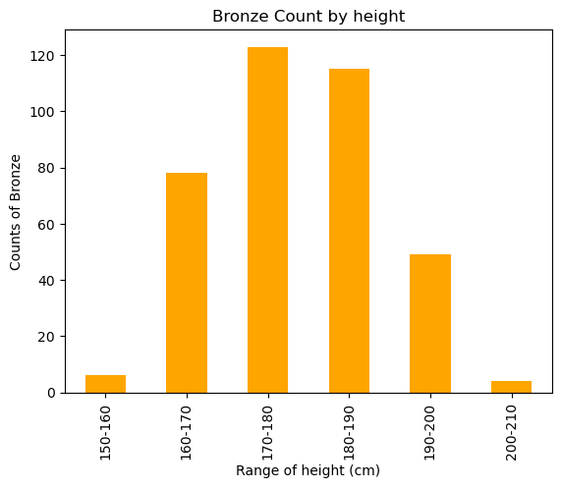
Medals By Height Range
From the scatter plot, there is no real correlation between BMI, height, or weight vs chances of winning a medal. Only trend observed is the slope of weight vs height square line tend to increase from Bronze to Gold, but fundamentally the line represent the 22 average BMI between all medalist.
The p value of BMI and weight between different medalist are too high to indicate relationships, at 0.7 and 0.8. The p value for height is the only one under the 0.05 mark, at 0.01. The count of medals by height ranges were plotted, but the resulting bar charts showed no discernible difference. Therefore, we conclude that weight or height do not significantly affect the result.

Slide 7
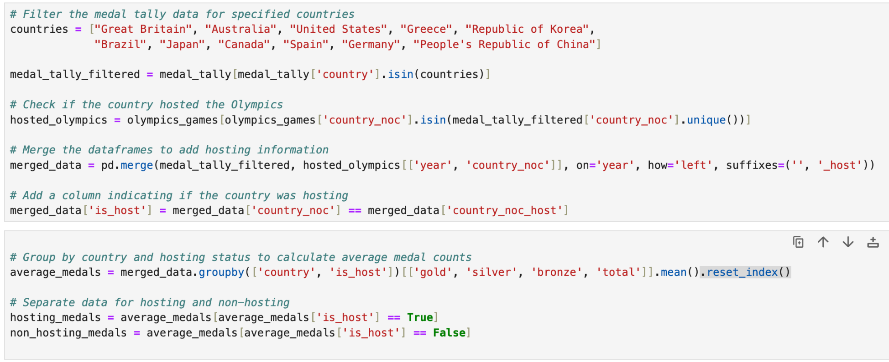
Is There a Home Field Advantage for the Olympics?
For this question, I used the medal tally and olympic games CSVs.
Python Analysis Overview:
Filtered the medal tally data to only include the countries I wanted
Merged it with the olympic games data
Added a column indicating if hosting
Grouped by country and hosting status
Calculated average metals
Conducted a t-test

Slide 8
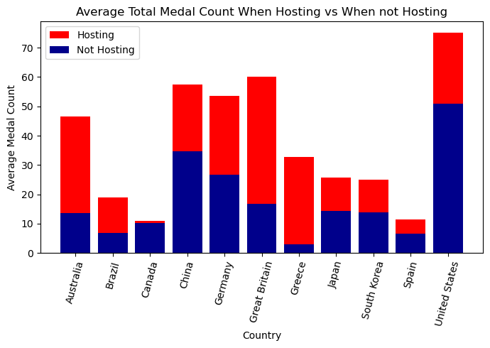
Is There a Home Field Advantage for the Olympics?
Yes! There is a home field advantage.
For average medal count hosting vs non hosting, the p-value was 0.0188 which is significantly lower than 0.05. This means that there is statistically significant evidence to suggest that the average medal count is different when a country is hosting the Olympics compared to when it is not.

Slide 9
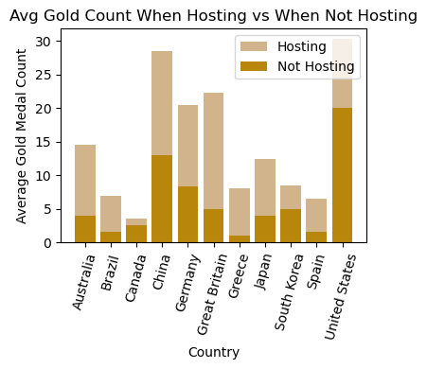
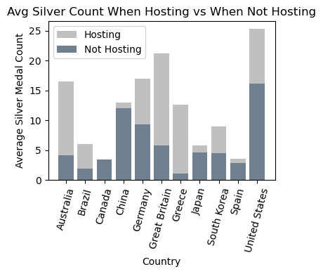
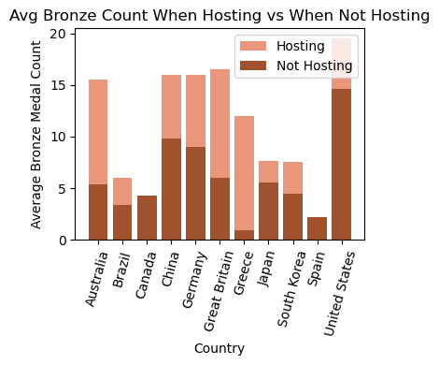
Home Field Advantage Broken Down by Medal

Slide 10
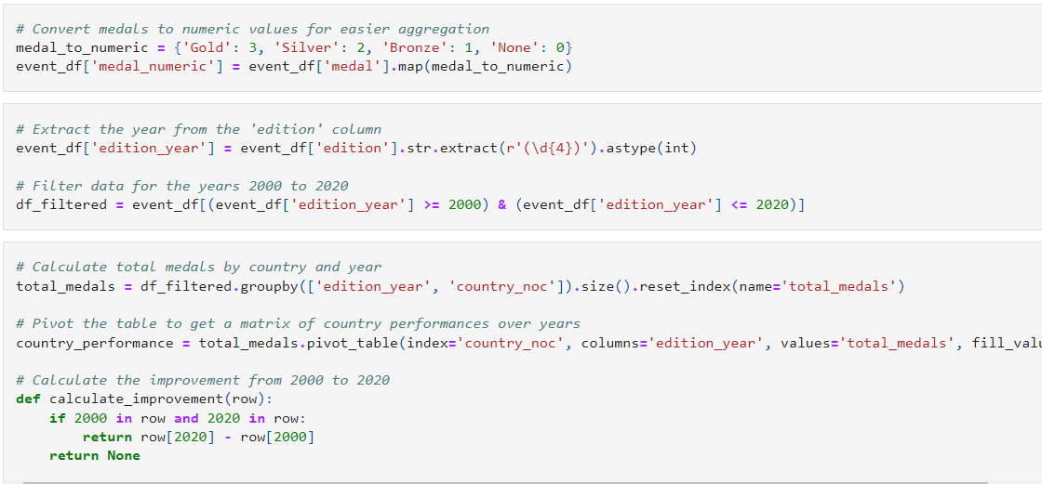
Most improved countries in medal count and change in medal count per medal
Data Preparation
Filtered data to include only swimming events.
Converted medal types to numeric values for easier analysis.
Extracted and filtered data for the years 2000 to 2020.
Data Aggregation
Calculated total medals by country and year.
Created a pivot table to summarize country performances over the years.
Computed the improvement in medal counts from 2000 to 2020
Analysis:
Identify and display the top 10 countries based on total medals in 2020.
Sort and display the most improved countries based on changes in medal counts.
Visualize: Create plots to illustrate the top countries and improvements

Slide 11
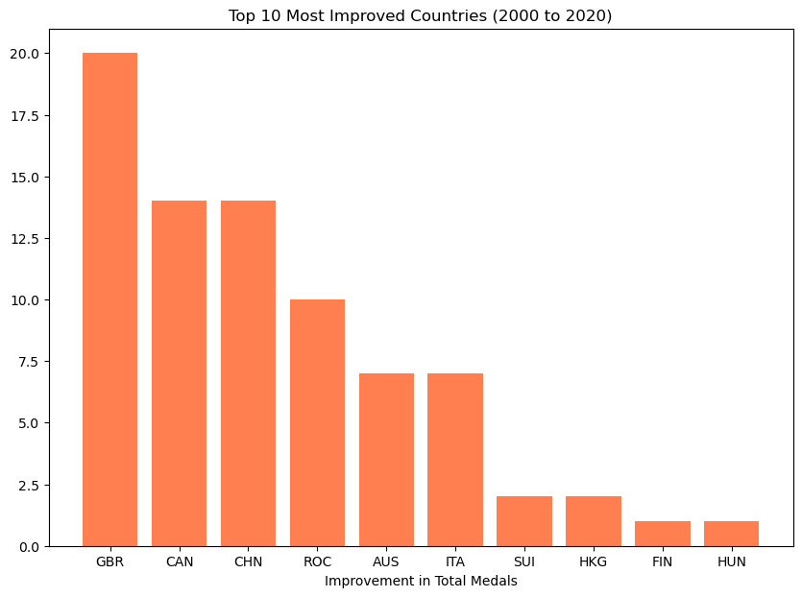
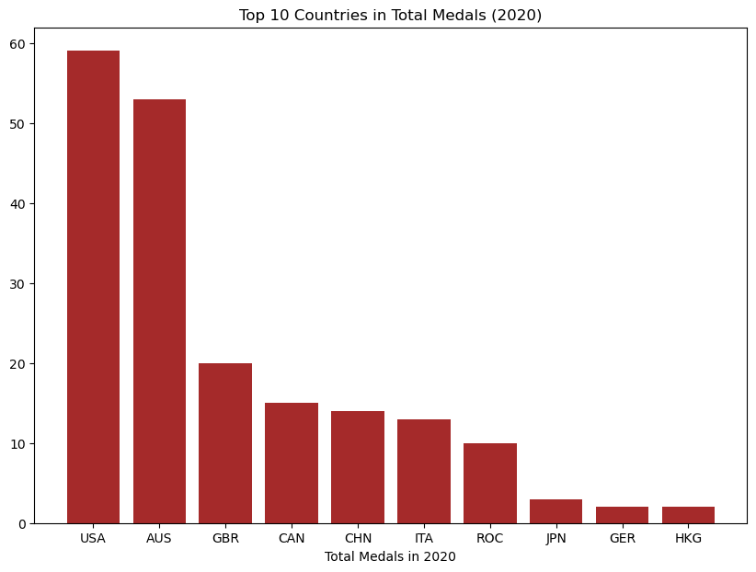
Most improved countries and Top 10 countries in medal count
From 2000 - 2020
USA Had the overall highest number of medals during the period from 2000 – 2020.
GBR recorded the greatest improvement in total medal count with a 20 medal increase during the same period and overall ranking was 3rd after Australia
The improvement in medal count for GBR may have been due to home field advantage, as they hosted the olympics during this period

Slide 12
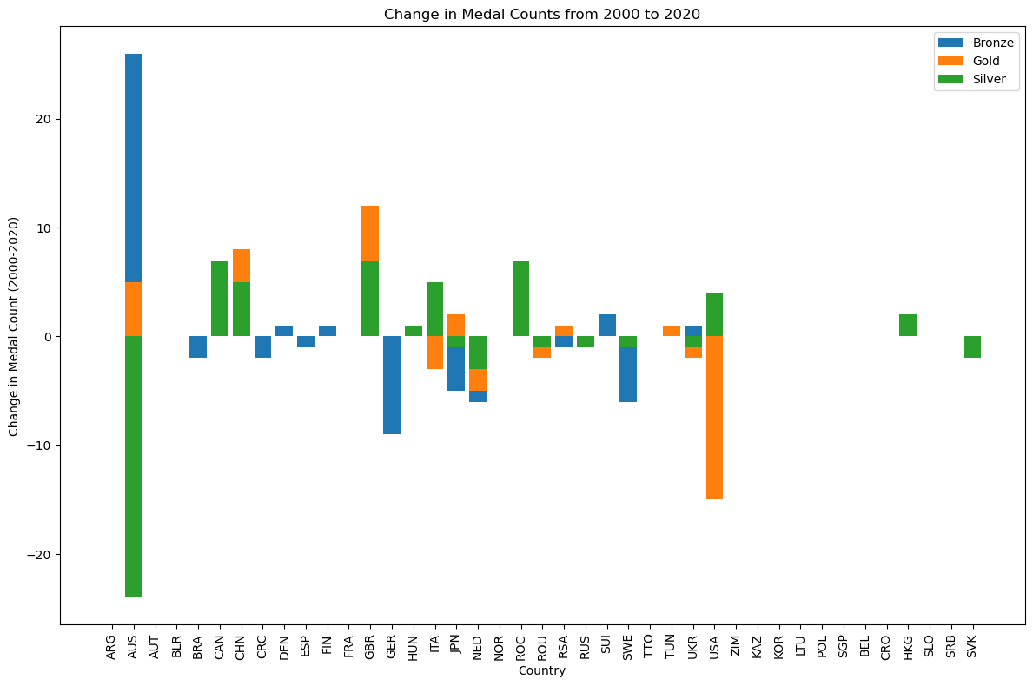
Change in medal count per medal type
From 2000 to 2020
Medal count per medal was either positive or negative.
Australia had an increase in bronze medals by 26 medals. Increase in Gold by 5 and a decline in silver by 24
GBR recorded more gold and silver medals.
We can also note that though USA had the highest number of medals, their gold medal count declined
.

Slide 13

Thanks!
Do you have any questions?

