Slide 3
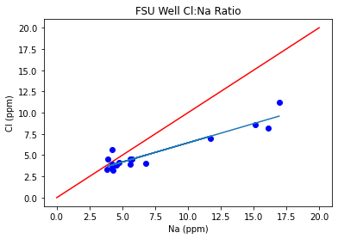

Slide 4
At first opening, the majority of the lake drained (Most amount of water draining)
Calcium depleted water in Well since this is MORE surface water hitting the well than normal
Higher Sodium/Phosphate/sulfate than Well or Lake due to water flowing through Hawthorne clays around sinkhole(congruent with Katz Report for source)
Sodium enriched to Chloride
Additional Rain puts sinkhole underwater
Initial Decrease in sodium/phosphate/sulfate, dilution due to much water entering quickly
Over time, water starts to interact with clays again and we see a small increase again

Slide 7
