Slide 1
Driver Circuit MOSFET Version
Step-by-Step

Slide 2
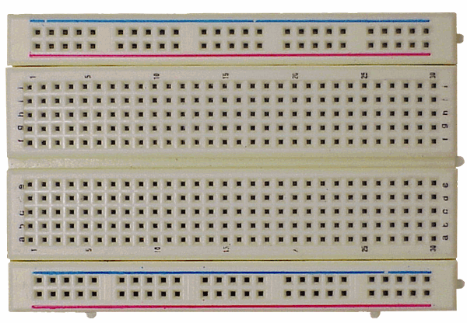
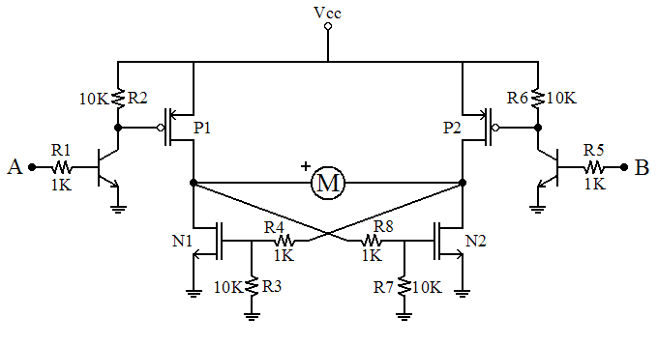
List of Parts for both motors
Red P-Channel MOSFETS (4)
Blue N-Channel MOSFETS (4)
2N3904 (4)
¼ W 1 KΩ (8)
¼ W 10 KΩ (8)
DC Motor (2)
Mini-bread board (1)
This presentation will cover building one of the drivers.
The second is exactly like the first, but built on the other side of the breadboard.

Slide 3
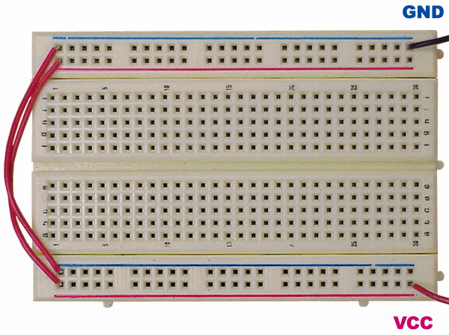
Power and Ground Breadboard
Always make sure that power (Vcc) and ground (GND) are connected first so they are available for the circuit.

Slide 4
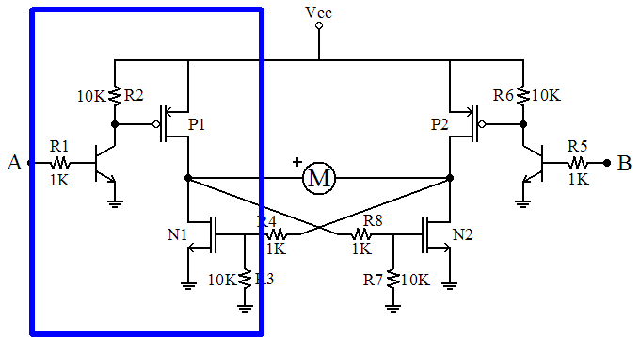
Phase 1
First we will build the P-N FET combo on the left.

Slide 5
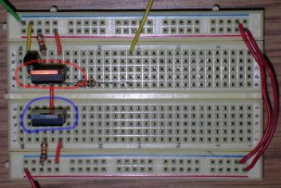
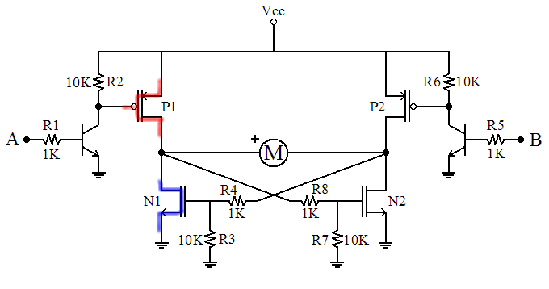
Insert MOSFETs
Add one P-Channel and one N-Channel MOSFETs.
FETs should have three extra columns to the left.

Slide 6
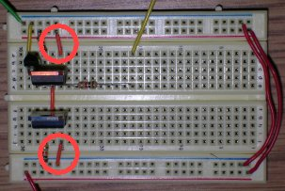
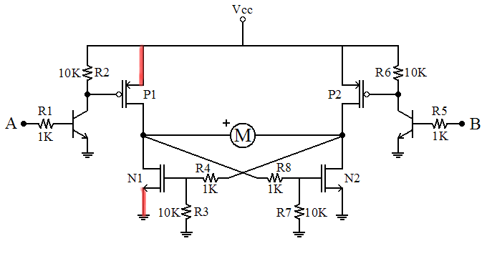
MOSFET sources
The source terminal of a FET is the one with the arrow. It is the one on the right.
The P-Channel is connected to VCC.
The N-Channel is connected to GND.
.

Slide 7
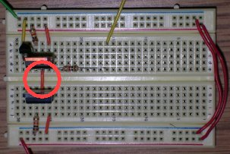
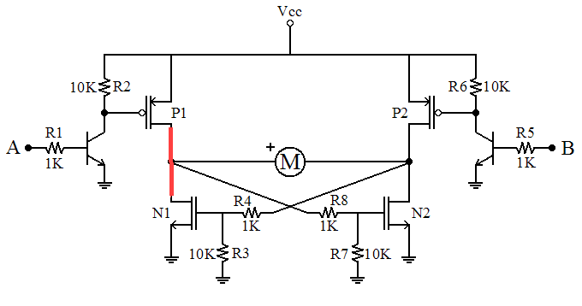
MOSFET drains
The drain terminal of a FET is opposite the source. It is the one in the middle.
The P-Channel and N-Channel drains are connected together, over the valley.
.

Slide 8
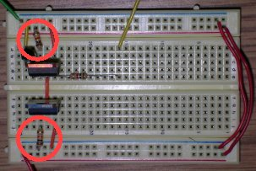
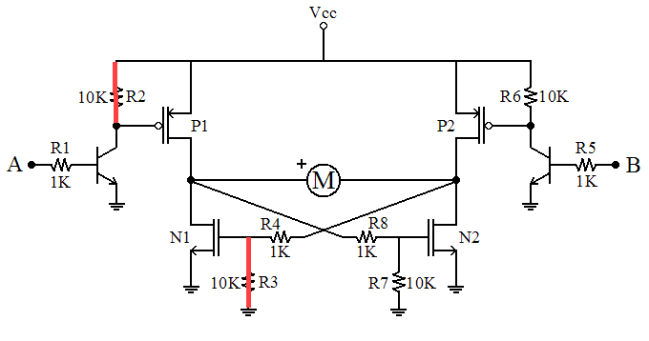
MOSFET gates
The gate terminal is the input to the FET. It is the one on the left.
Both the P-Channel and N-Channel gates have a 10kΩ resistor; the P goes to VCC and the N goes to GND.
.

Slide 9
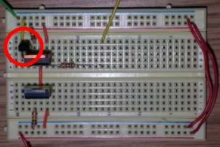
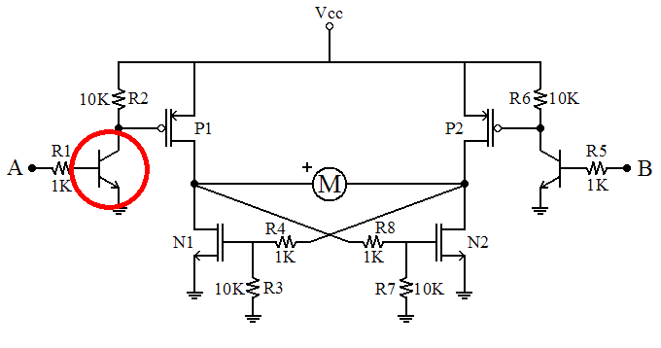
BJT
Now add the BJT.

Slide 10
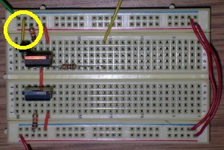
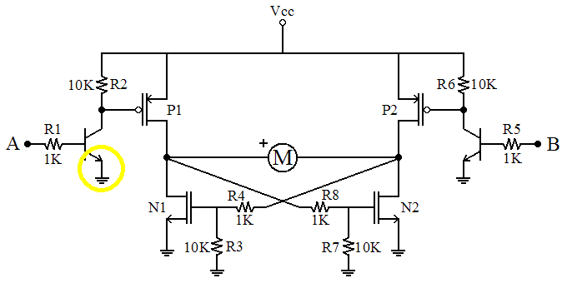
BJT
The emitter connects to GND.

Slide 11
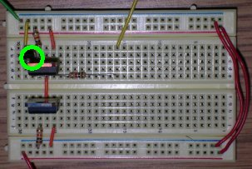
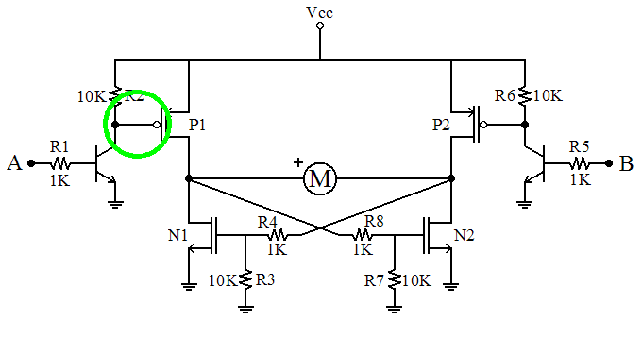
BJT
The collector of the BJT connects to the gate of the P-FET.

Slide 12
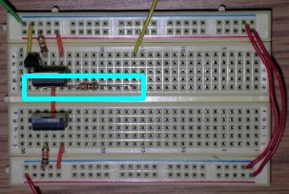
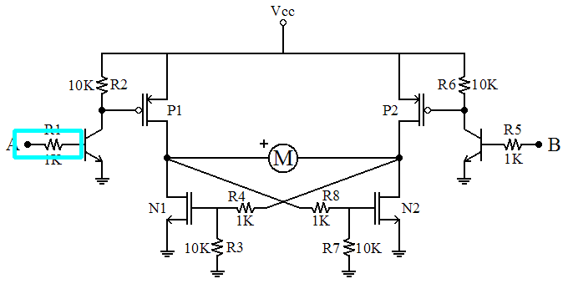
BJT
The base connects to a 1 kΩ resistor.
The other side of the resistor (the yellow wire) is input A. Eventually this will go to your PIC.

Slide 13
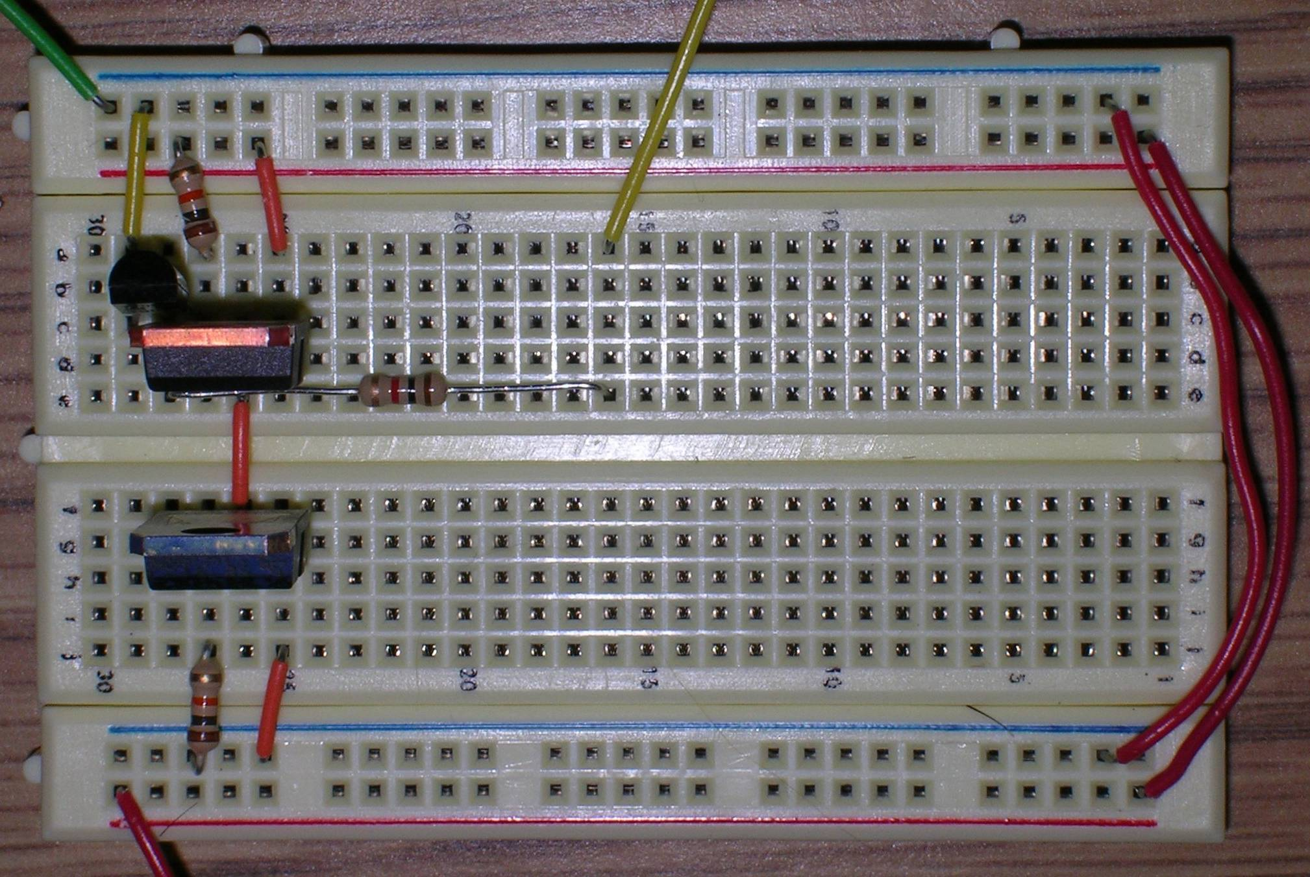
Here is a high res version of what you just built…

Slide 14
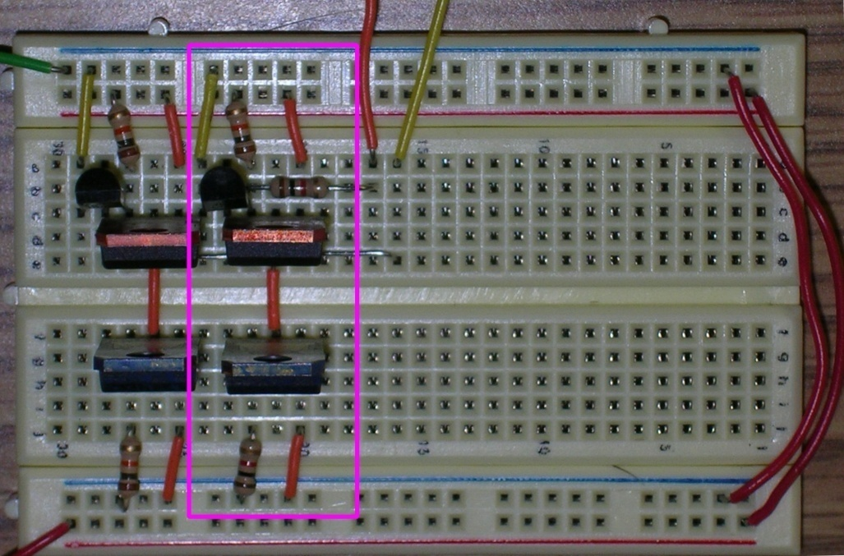
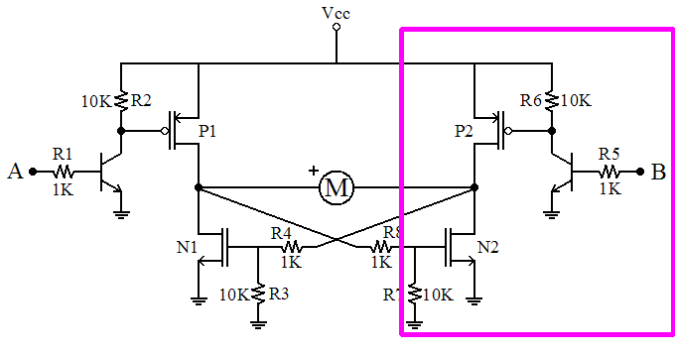
Phase 2
Now repeat the process for the right part of the circuit.
The orange wire heading off the top is your B input to the driver.

Slide 15
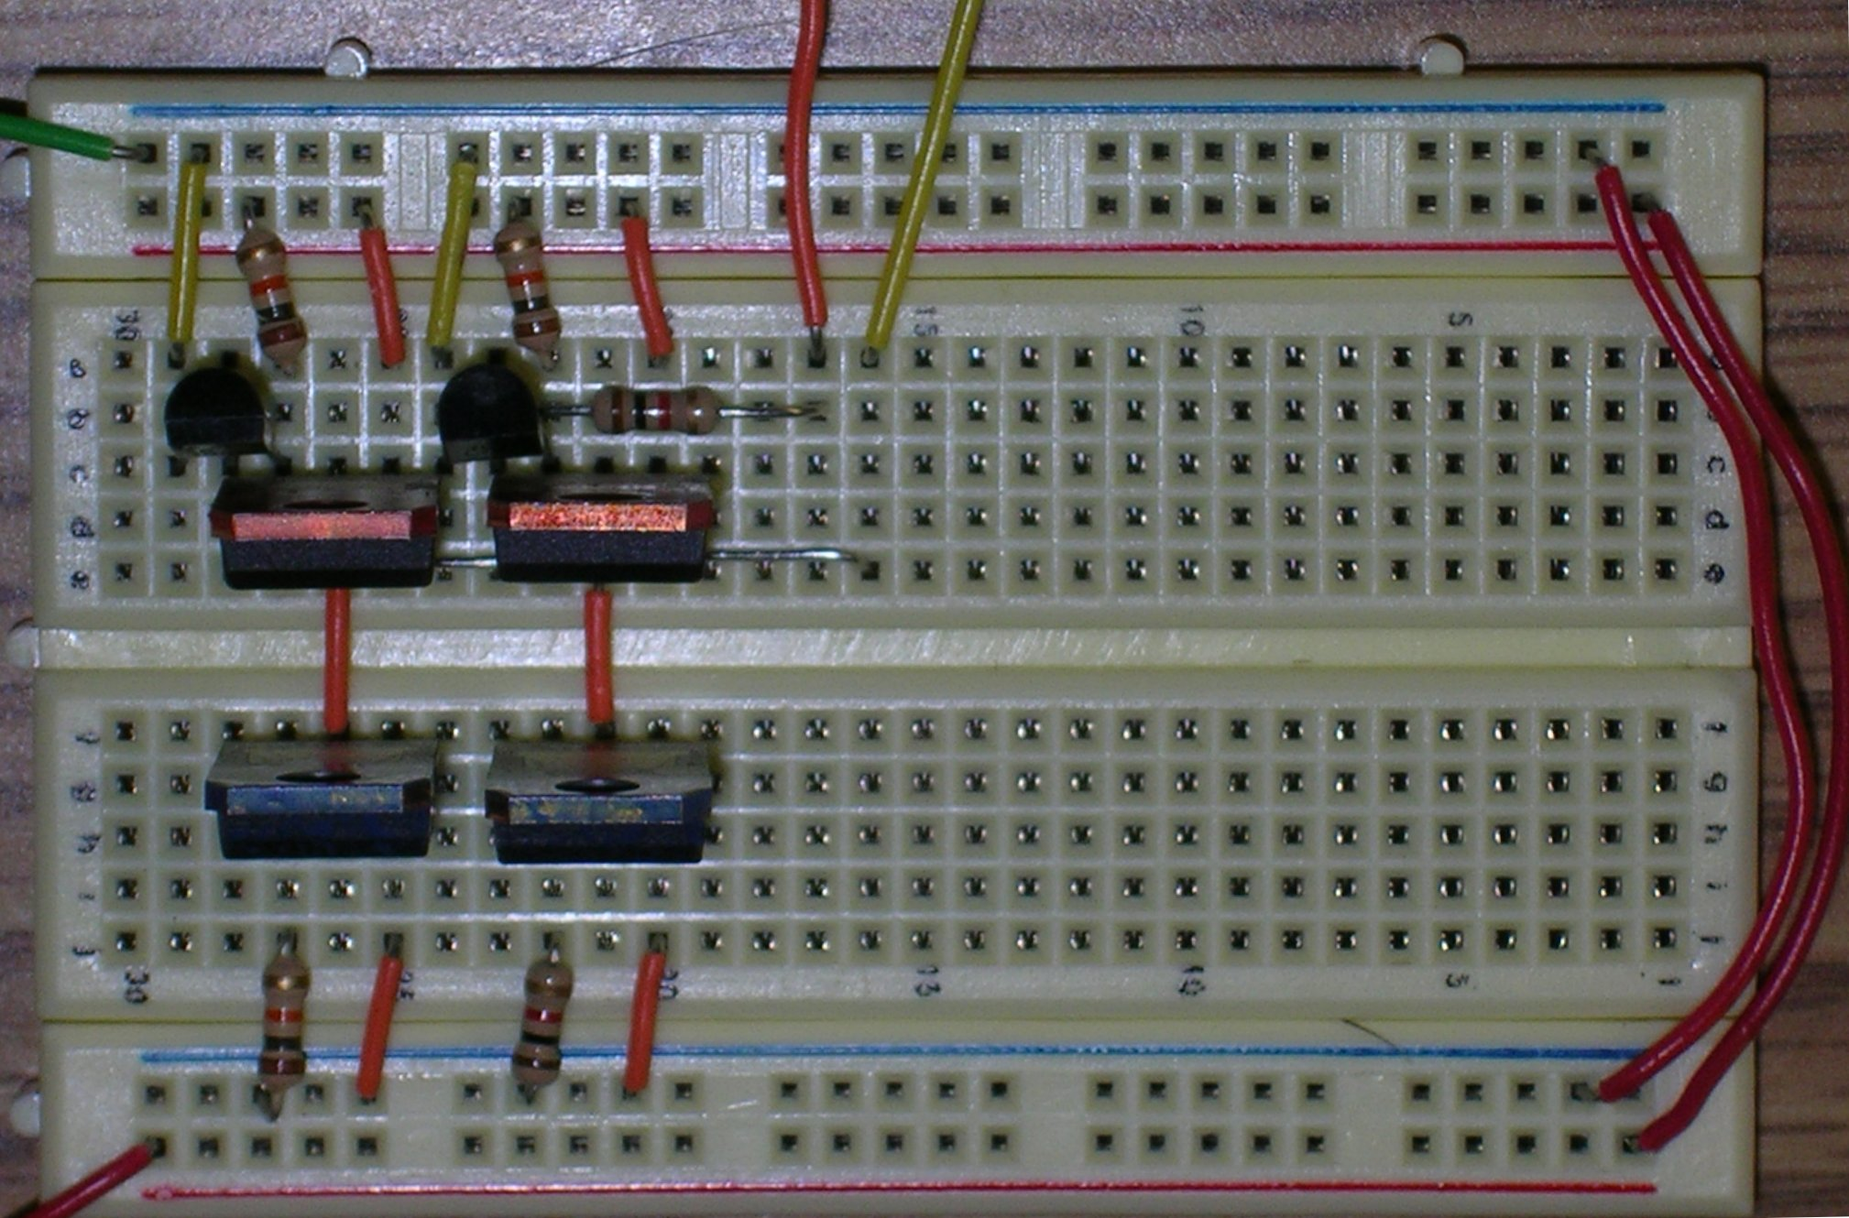
Here is a high res version of what you just built…

Slide 16
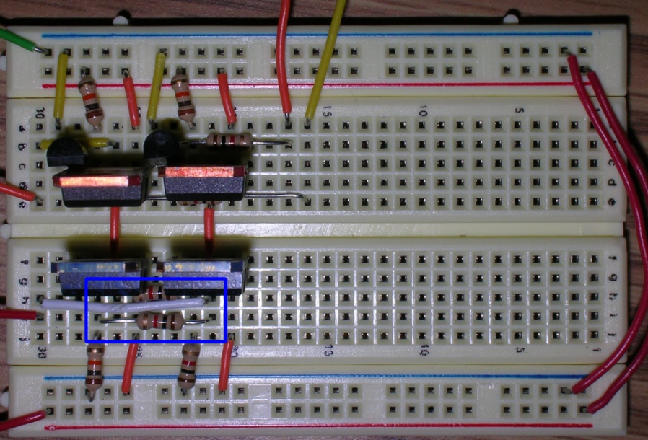
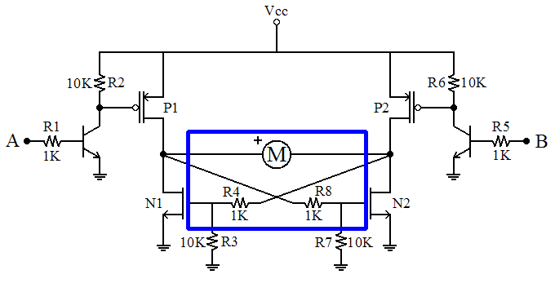
Phase 3
The last step for this driver is to add the motor connections and the cross-coupled resistors.
First the Resistors R4 and R8

Slide 17
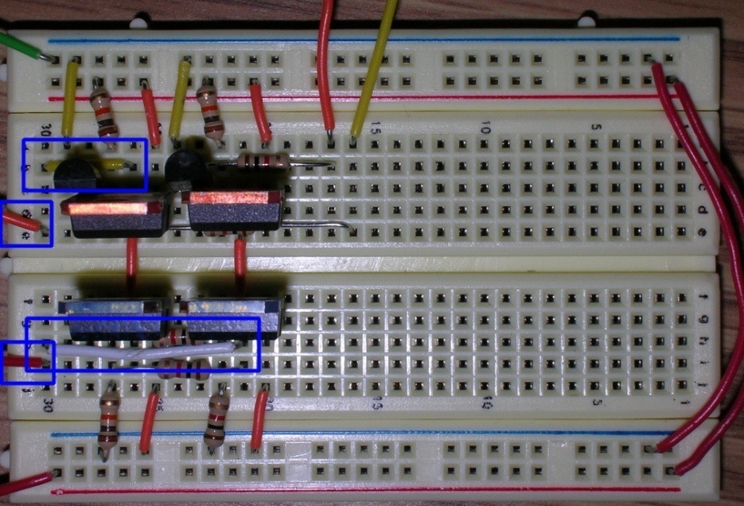
Phase 3
Then add the connections to the motor.
Here the white and yellow wires take the connection to the last column.
From there, the two orange wires lead to the motor.

Slide 18
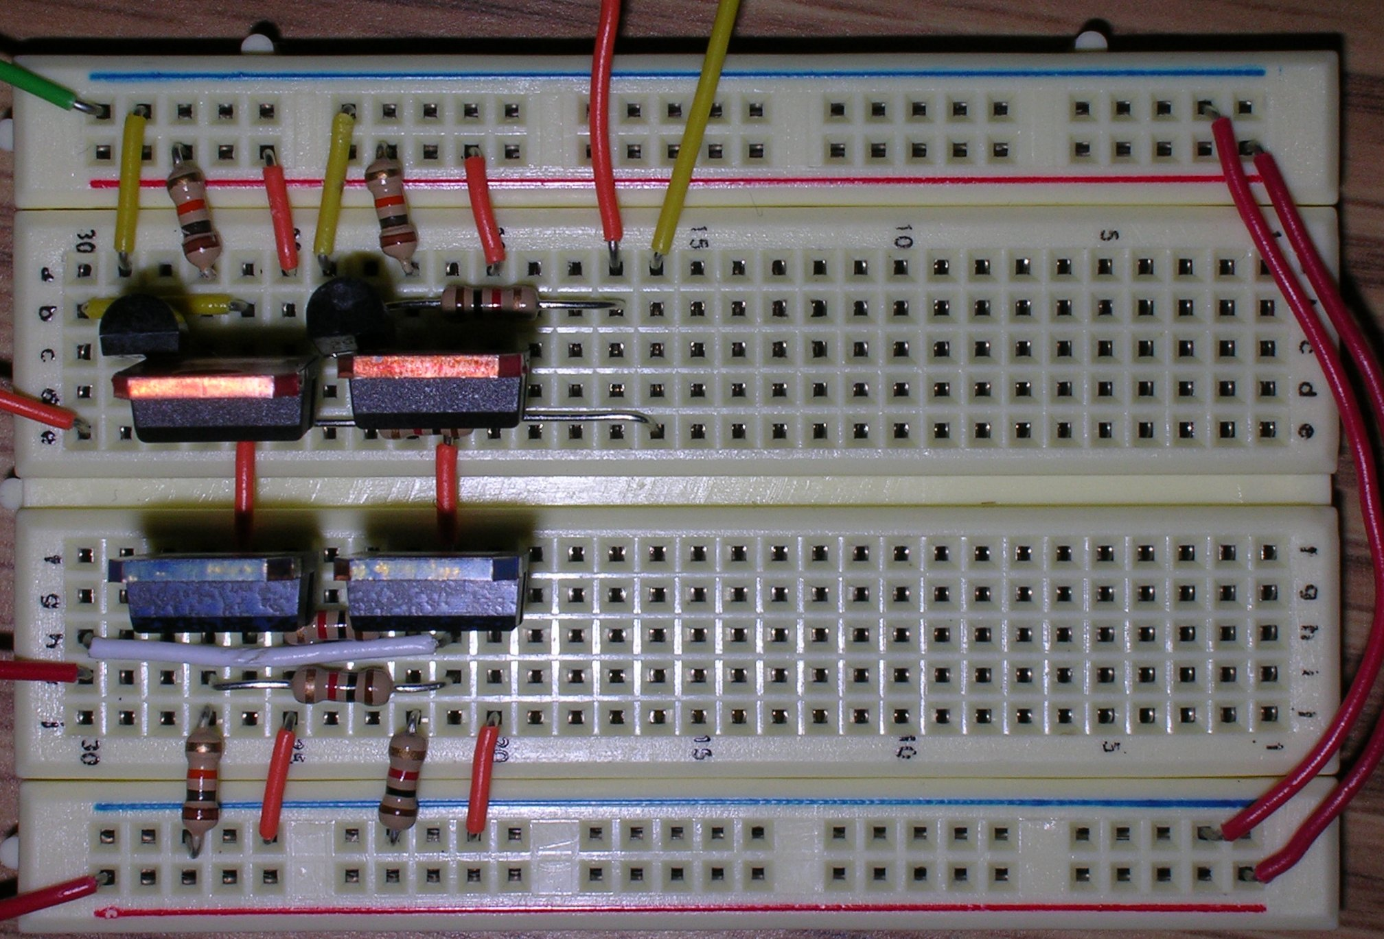
Here is a high res version of what you just built…

Slide 19
Phase 3
Finally, two different views of the finished driver.

Slide 20
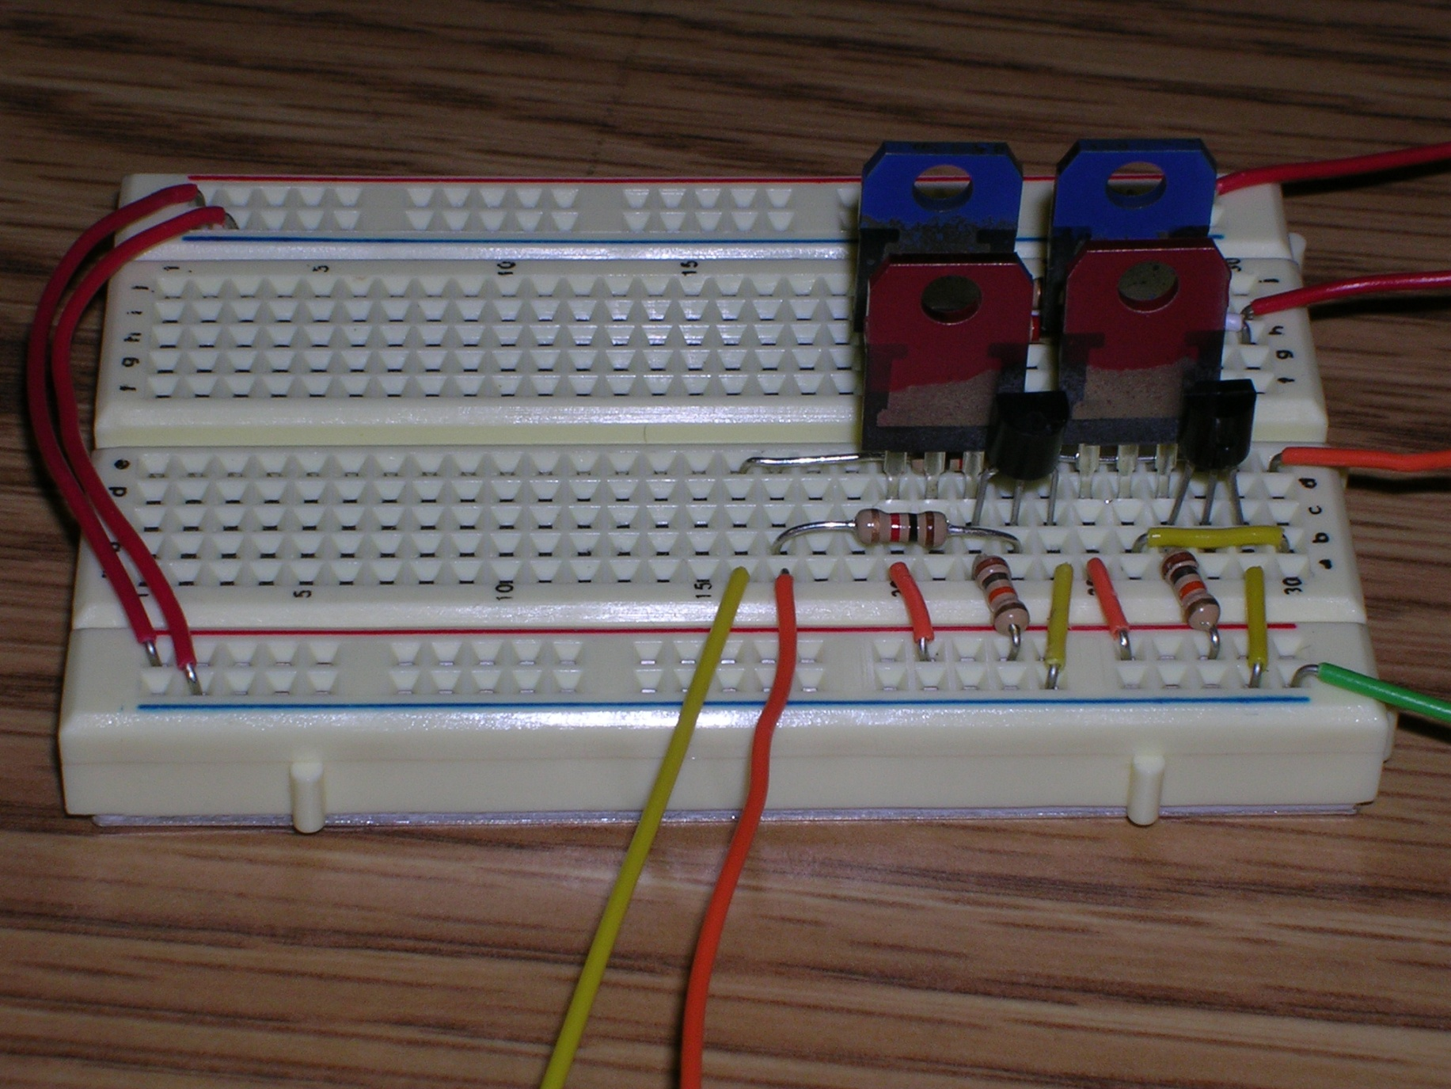
View from the P-FET side

Slide 21
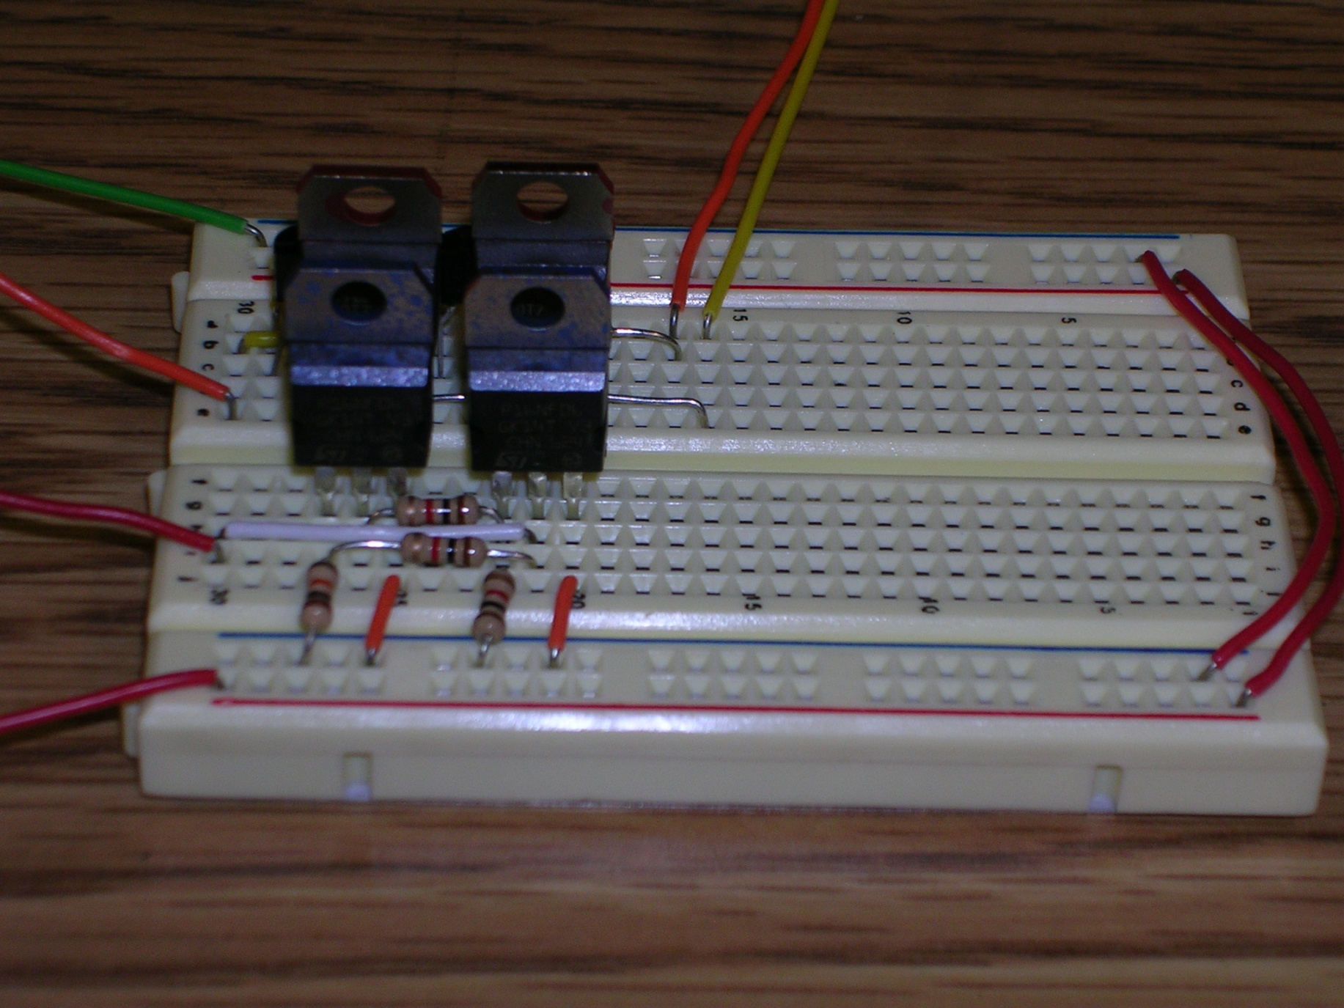
View from the N-FET side

Slide 22
Complete!
You have built one of your drivers!
You will need to repeat these steps and build the second driver.
It is important that you wind up with the motor connection points to be on the edge, and the driver inputs be in the middle. This will involve minor modifications from the first driver circuit.

