Slide 1
Timer Circuit
Step-by-Step

Slide 2
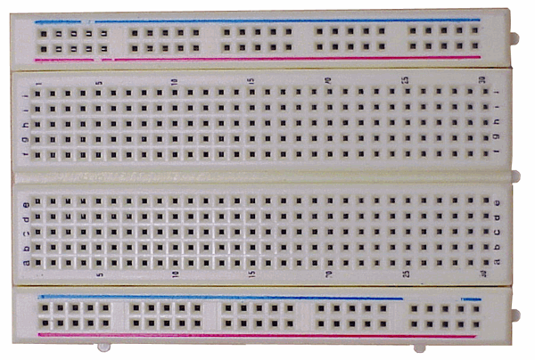
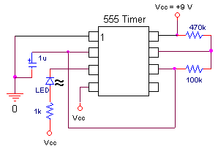
List of Parts
555 Timer Chip
1 kΩ
100 kΩ
LED
470 kΩ
1 μF

Slide 3
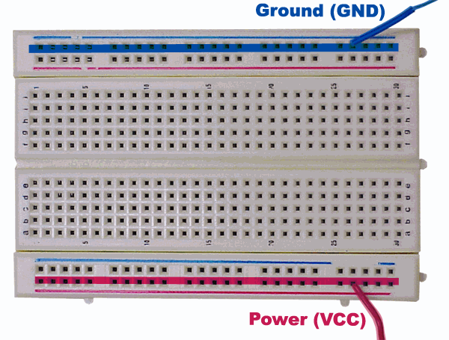
Power and Ground
The first thing you do is define your power and ground for your board.

Slide 4
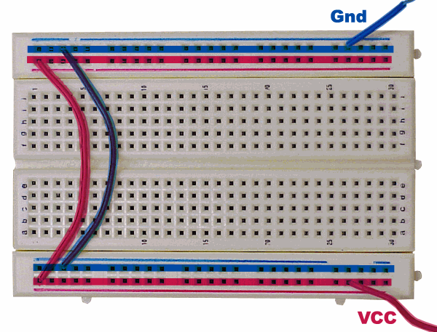
Power and Ground
Make sure that both sides of the board are connected so you can use either side.

Slide 5
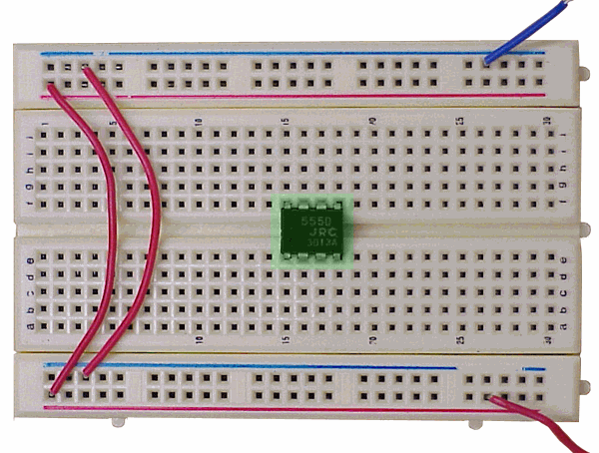
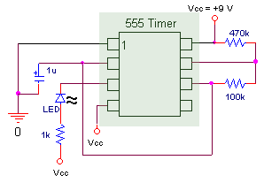
555 Timer Chip
Make sure that the 555 Timer chip straddles the middle of the board so that the pins of the chip are not connected to each other.

Slide 6
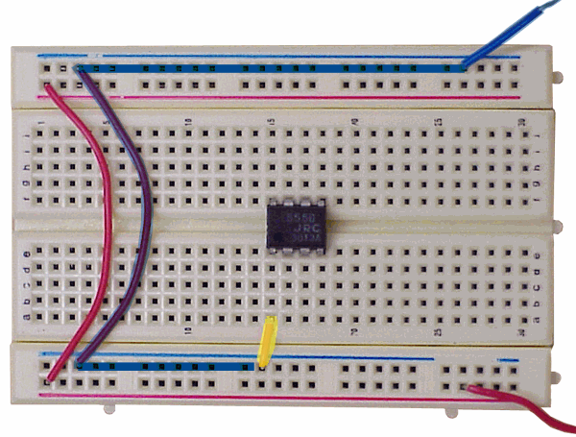
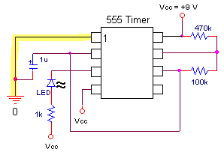
Pin 1 to Ground
Begin at Pin 1. To find Pin 1, find the notch in the chip. Pin 1 is to the left of it. The numbering then goes counter clockwise around the chip. Connect Pin 1 to GND.

Slide 7
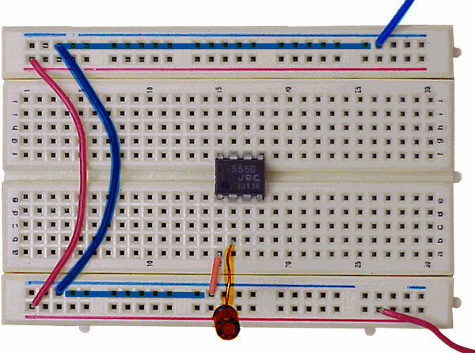
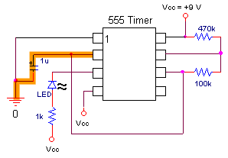
Pin 2 to 1uF
At Pin 2, the positive (longer) side of the 1uF capacitor is connected to the chip and the negative (shorter) side is connected to GND.

Slide 8
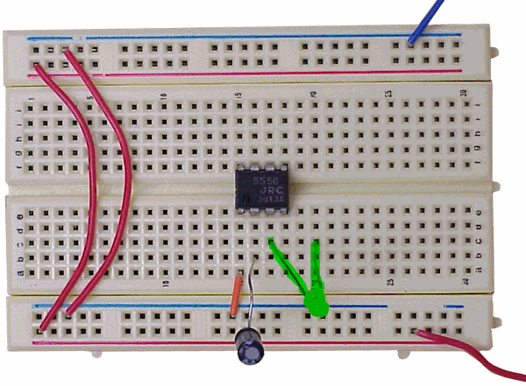
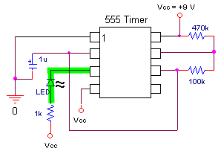
Pin 3 to LED
The negative (shorter) side of the LED connects to Pin 3 since the straight line on the schematic is on the side of the pin. The positive (longer) connects to an unused row to the right.

Slide 9
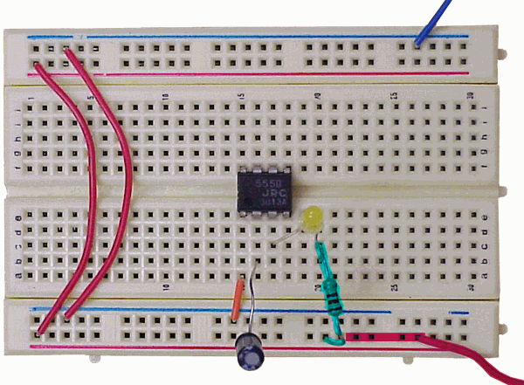
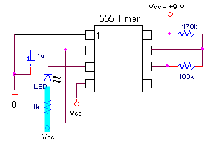
LED to 1k
On the other side of the LED, a 1k resistor connects to Vcc.

Slide 10
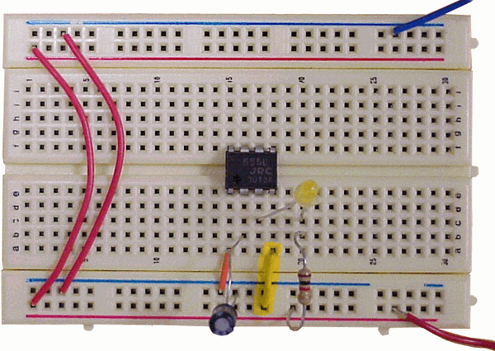
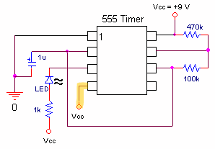
Pin 4 Power
Pin 4 goes directly to Vcc.

Slide 11
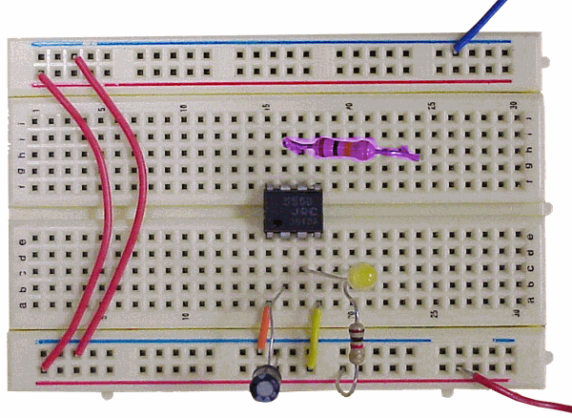
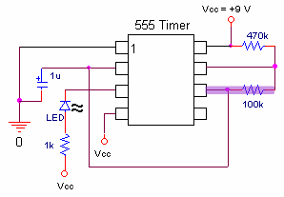
Pin 6 to 100k
Nothing connects to Pin 5, but Pin 6 connects to a 100k resistor. The other side of the resistor connects to an unused row.

Slide 12
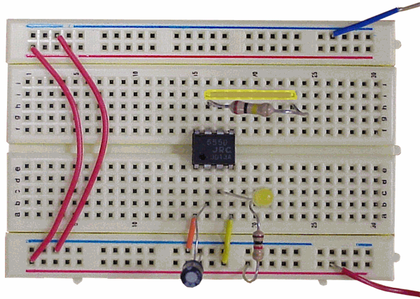
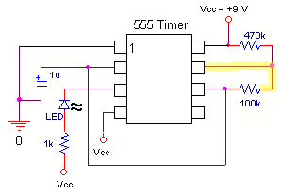
Pin 7 to Row of 100k
Pin 7 is connected to the other side of the 100k resistor.

Slide 13
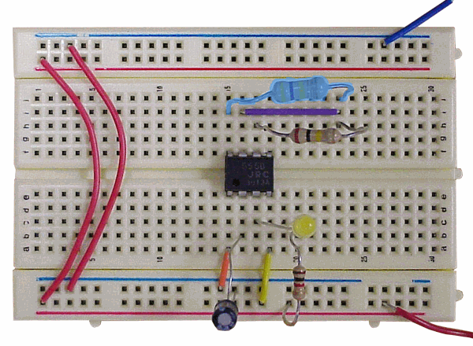
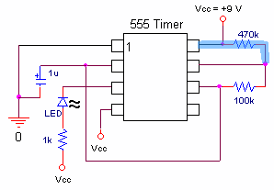
Pin 8 through 470k
A 470k resistor connects Pin 8 to Pin 7 and the 100k resistor.

Slide 14
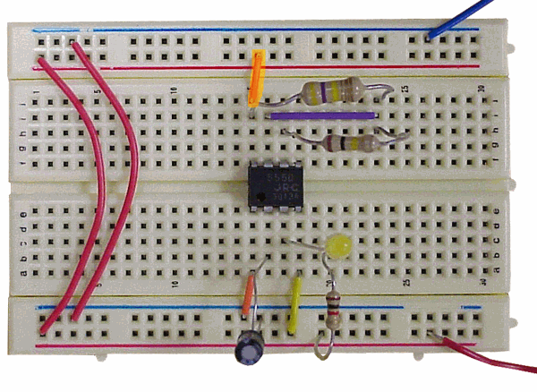
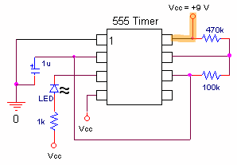
Pin 8 to Power
Then, Pin 8 is connected directly to Vcc.

Slide 15
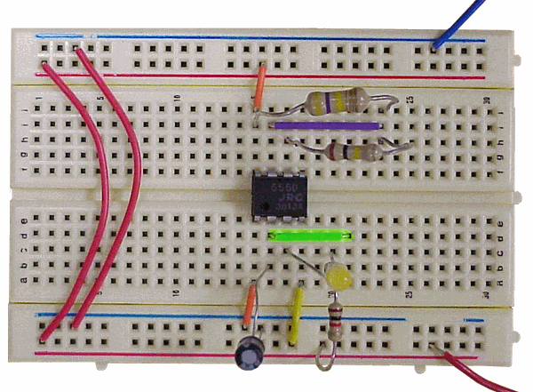
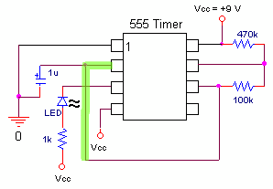
Pin 2 to Pin 6 wire 1
To connect Pin 2 to Pin 6 the short wires are used to keep the breadboard clean and accessible.

Slide 16
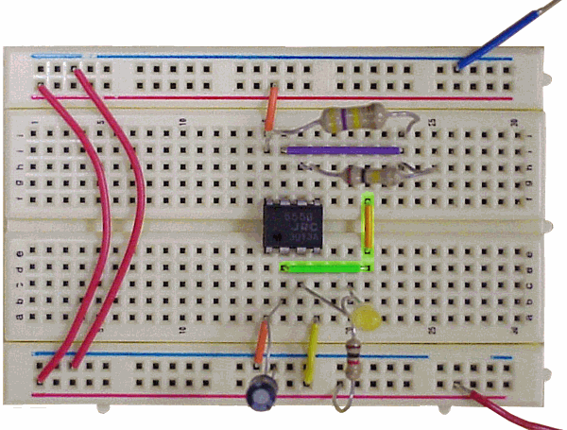
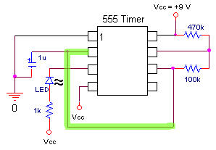
Pin 2 to Pin 6 wire 2
Once the first wire is away from the chip a jumper wire is used to cross the middle.

Slide 17
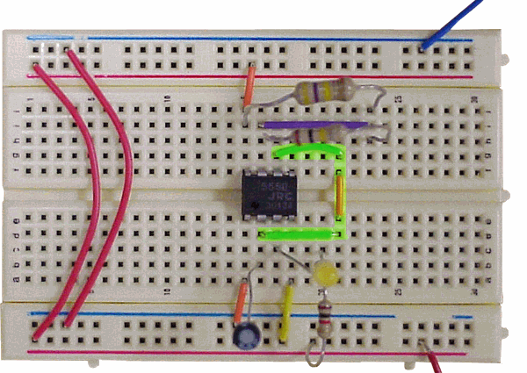
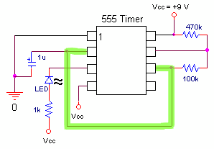
Pin 2 to Pin 6 wire 3
Finally, a third wire is used to connect to Pin 6 making the connection from Pin 2 to Pin 6.

Slide 18
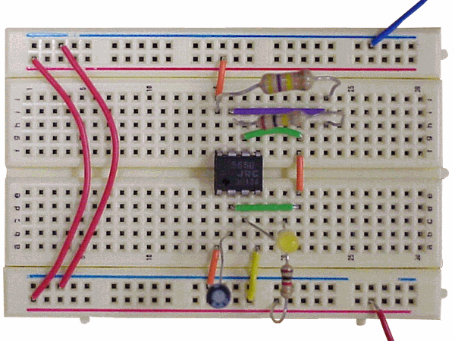
Final Working Circuit
Your circuit should be finished now and look something like this. Now connect your power and ground to the power supply at 9V and turn the power supply on. Your LED should blink.

