Slide 1

Modulo Revenue Management
Platform Feature Overview
Dynamic pricing · Competitor intelligence · AI-driven insights

Slide 2
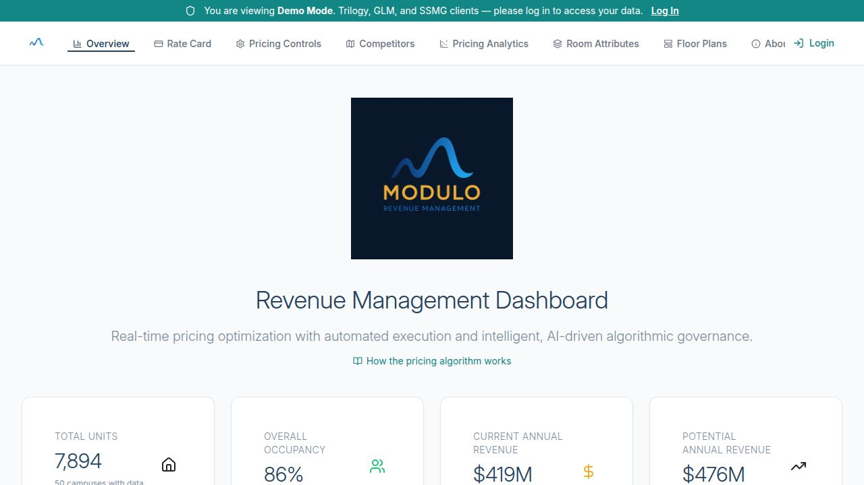
Dashboard Overview
Portfolio-wide KPI summary across 50 campuses
7,894 total units · 86% average occupancy
$419M current annual revenue · $476M potential
Revenue growth trend charts by service line
Modulo Revenue Management

Slide 3
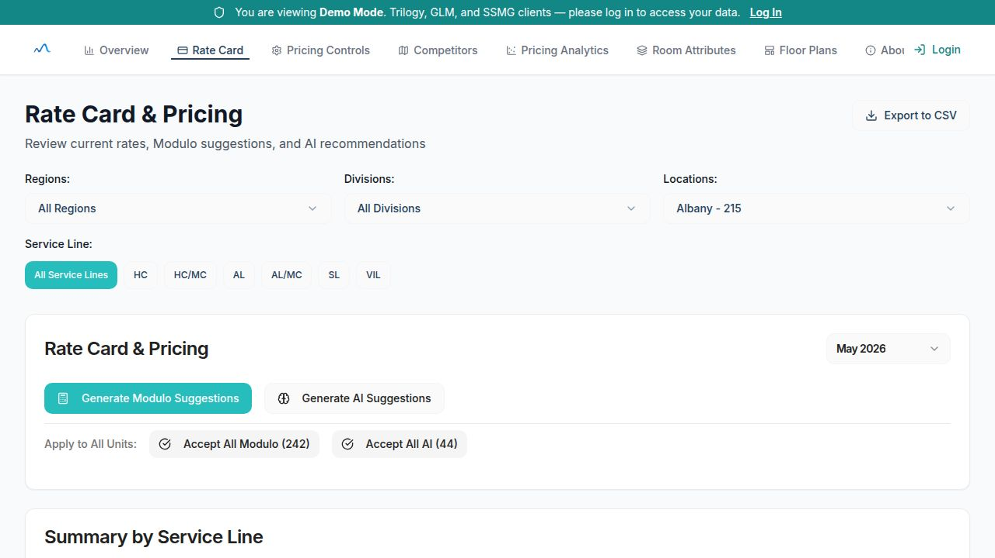
Rate Card & Pricing
Unit-level current, street, and suggested rates
One-click Modulo and AI rate generation
Accept individual or bulk AI/Modulo suggestions
Filter by region, division, location, and service line
Modulo Revenue Management

Slide 4
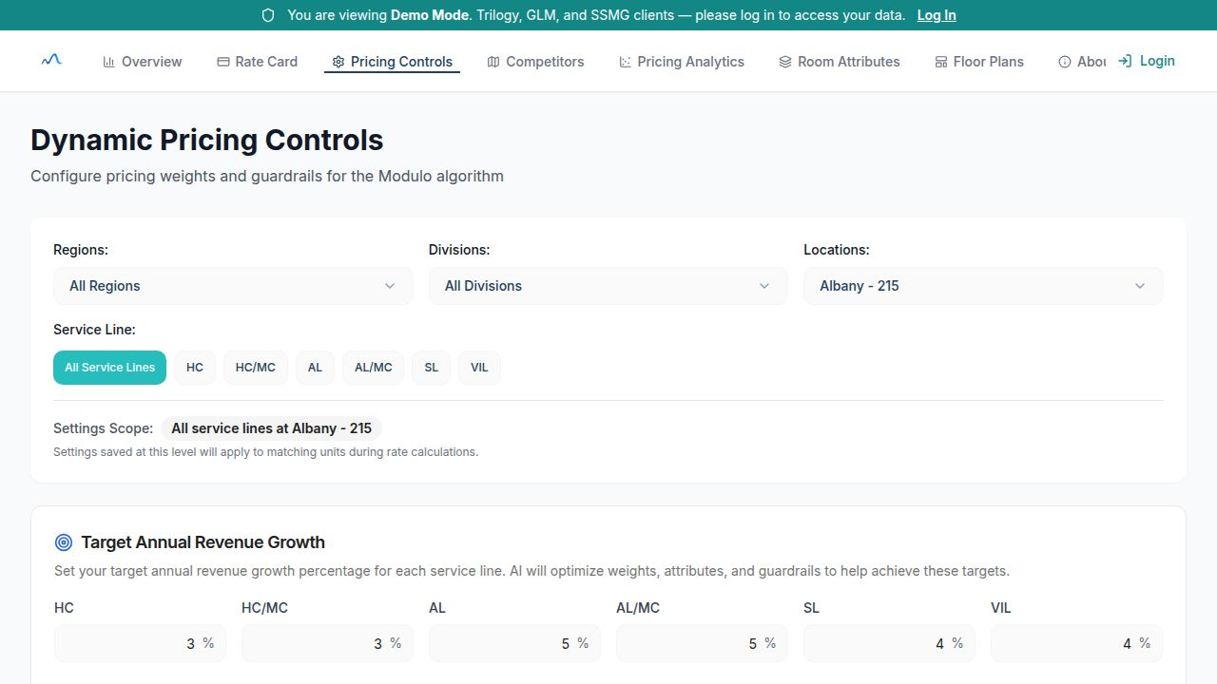
Dynamic Pricing Controls
Hierarchical pricing weights by location & service line
AI-powered target revenue growth generator
Guardrails: min/max rate constraints per service line
3-tier fallback: location → portfolio → global defaults
Modulo Revenue Management

Slide 5
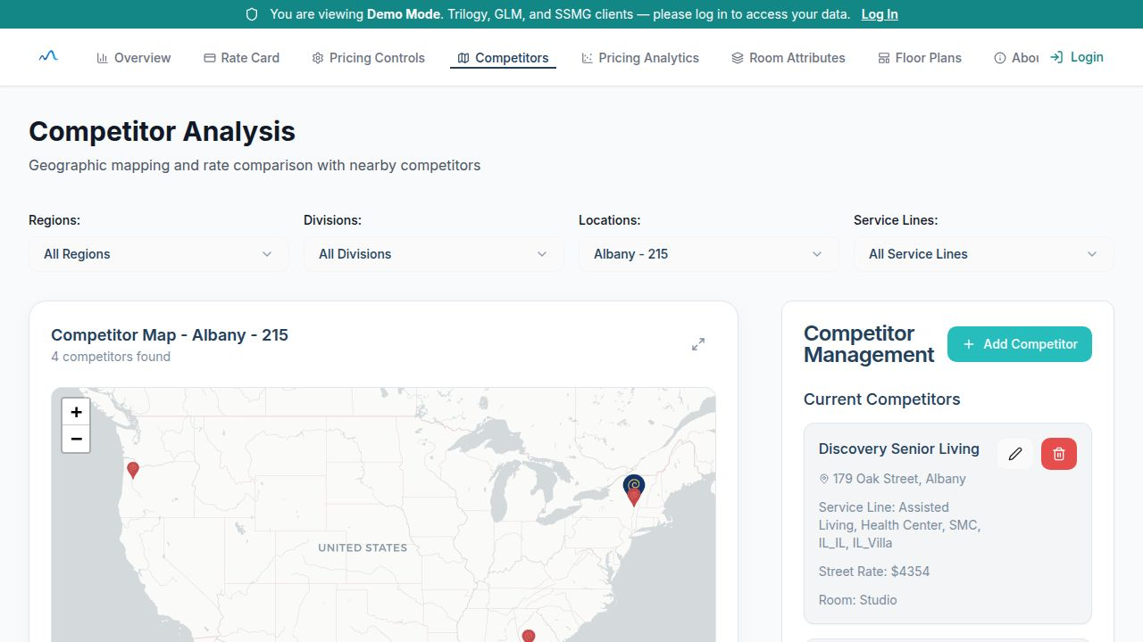
Competitor Analysis
Interactive Leaflet map of nearby competitors
Auto-matched competitor rates to rent roll units
Care-level adjusted rate comparisons
Bulk import via competitive survey Excel uploads
Modulo Revenue Management

Slide 6
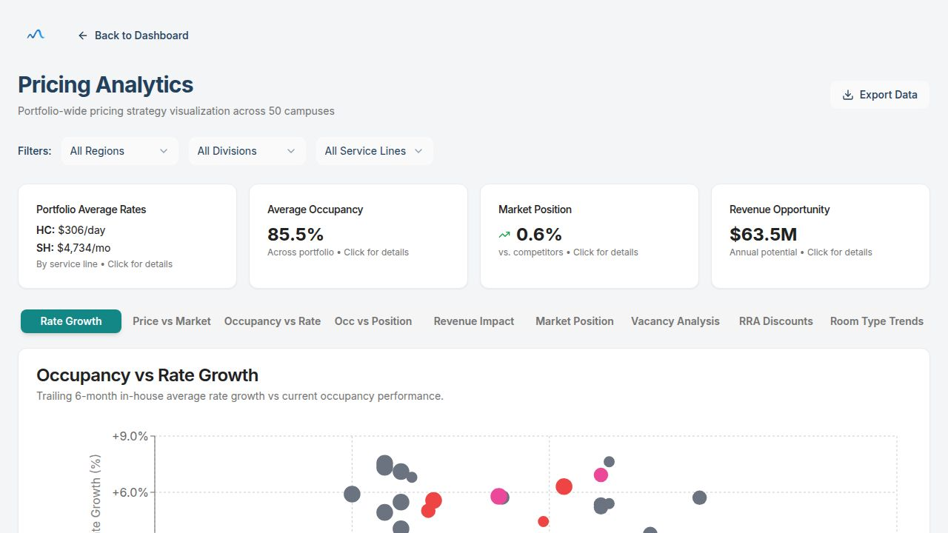
Pricing Analytics
9 chart views: Rate Growth, Market Position, RRA Discounts, and more
Portfolio average rates & revenue opportunity ($63.5M)
Occupancy vs rate growth scatter analysis across all campuses
Room type trends and vacancy analysis tabs
Modulo Revenue Management

Slide 7
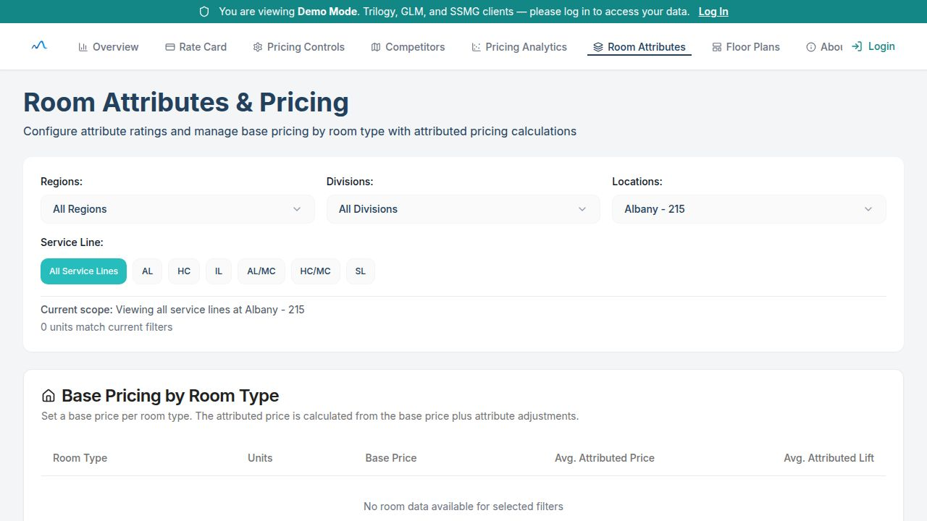
Room Attributes & Pricing
Base pricing per room type with attribute uplift
Attribute ratings (view, floor, amenities) drive pricing delta
Preview impact of attribute changes before applying
Filter by service line for targeted configuration
Modulo Revenue Management

Slide 8
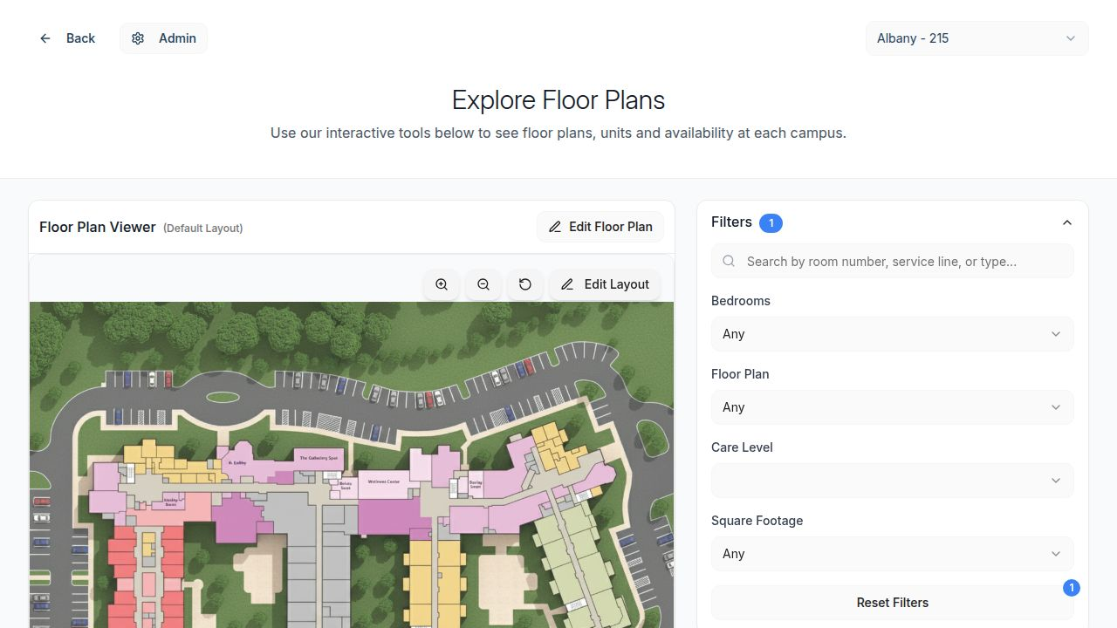
Interactive Floor Plans
Campus aerial / SVG floor plan viewer
Color-coded unit availability by care level
Drag-and-drop unit assignment and polygon detection
Filter by bedrooms, floor, care level, and square footage
Modulo Revenue Management

Slide 9
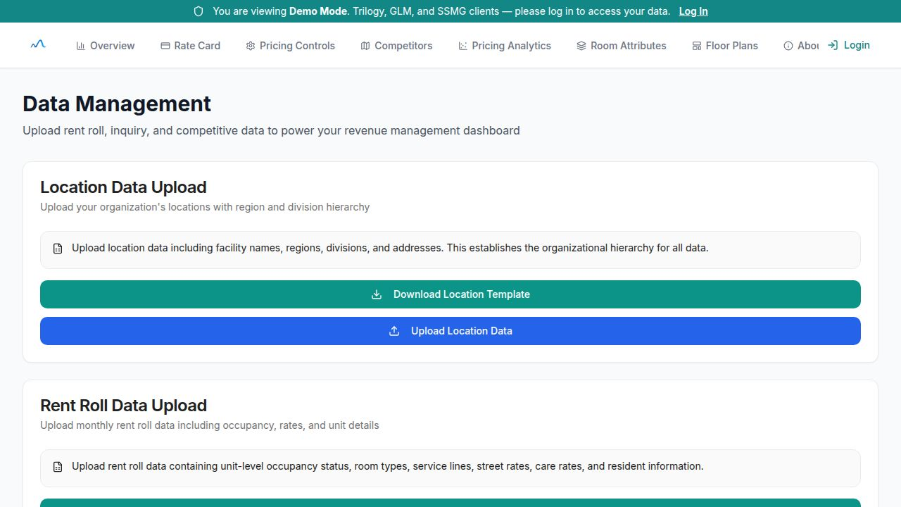
Data Management
Upload rent roll, location, inquiry, and competitive data
Multi-file CSV/Excel uploads with live progress tracking
Intelligent column mapping with fuzzy matching
Transaction-safe import with duplicate prevention
Modulo Revenue Management

Slide 10
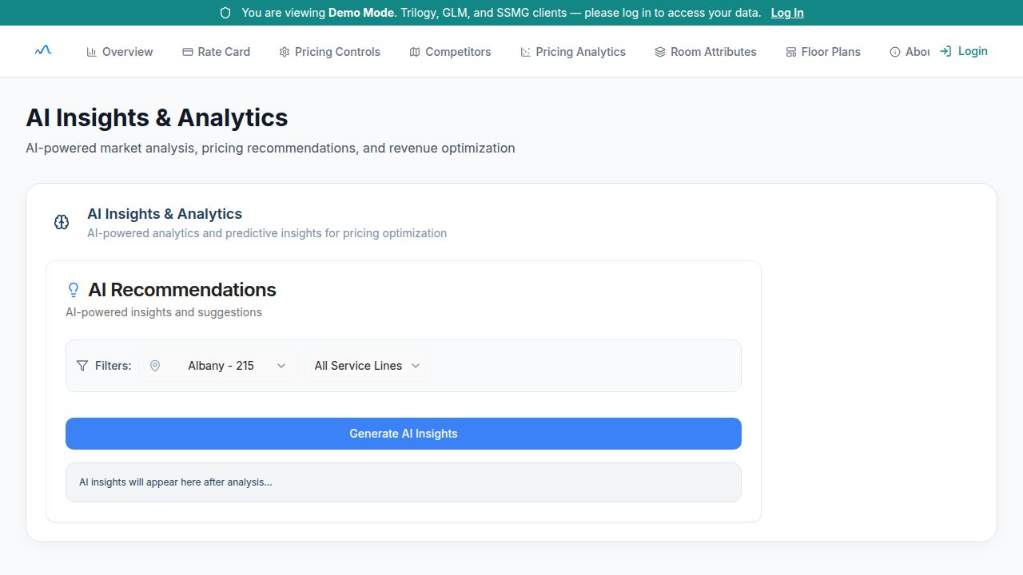
AI Insights & Analytics
GPT-5 powered market analysis and rate recommendations
Filter insights by location and service line
Narrative explanations with supporting data
ML learning loop: self-improving pricing weights daily
Modulo Revenue Management

Slide 11
Modulo Revenue Management
Optimize revenue. Outperform the market.
50 campuses · 7,894 units · $419M revenue under management
Dynamic pricing · AI insights · Competitor intelligence · Interactive floor plans

