Slide 1
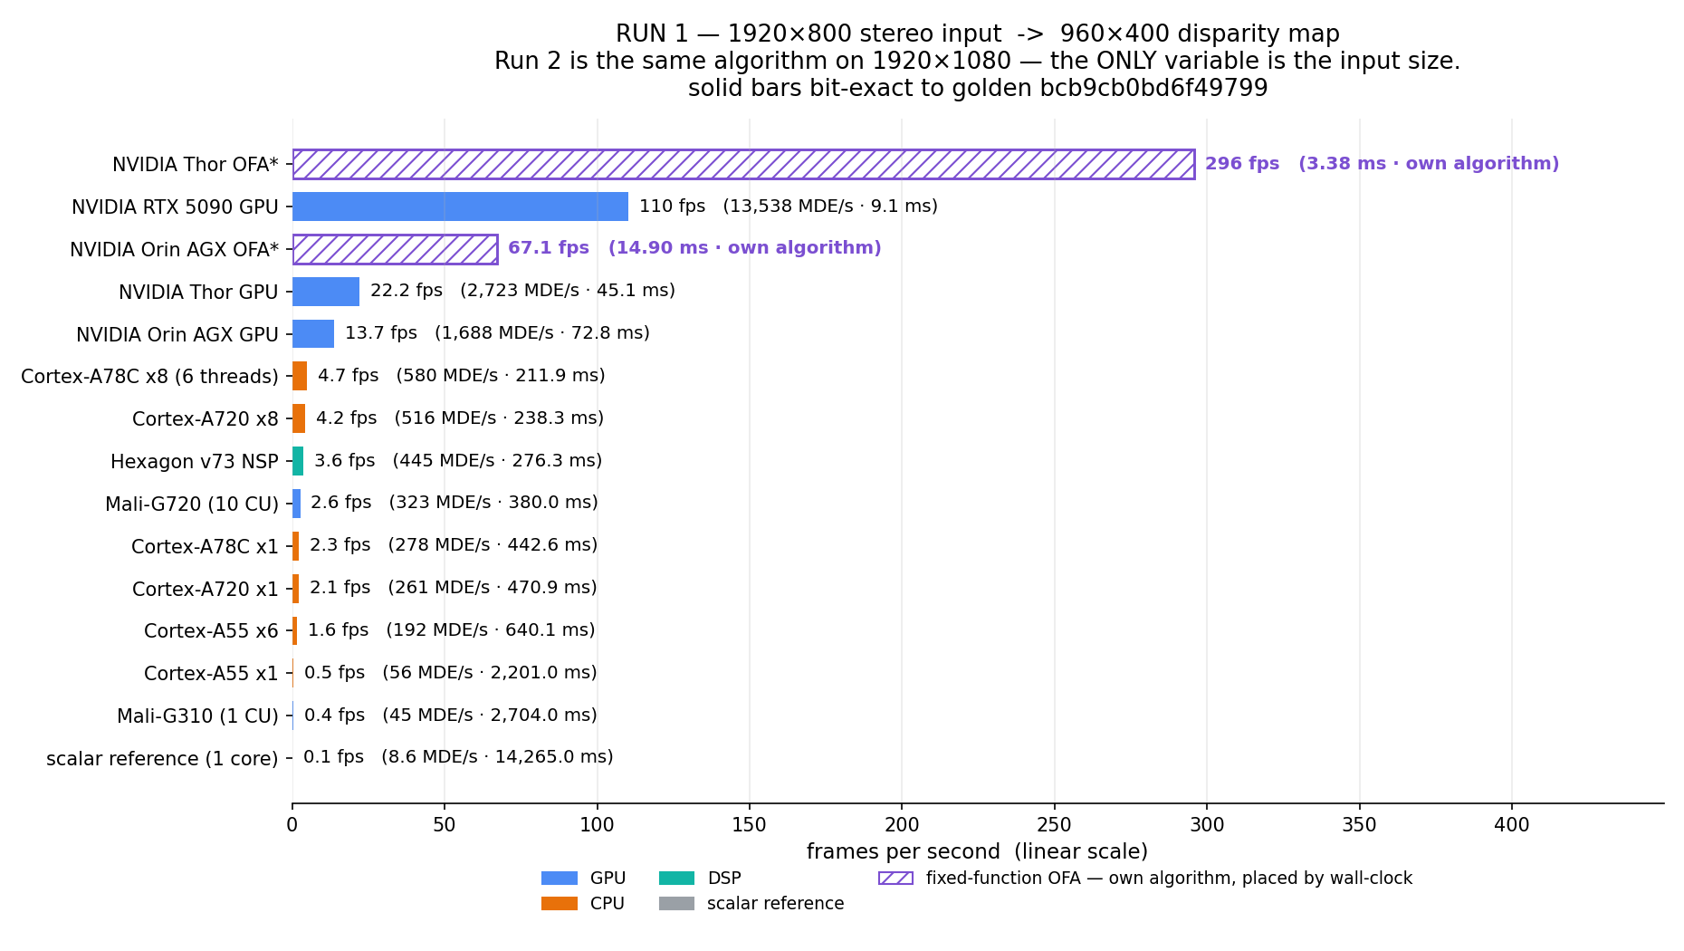
Frame rate on a linear axis. Each bar carries its fps, and in parentheses the work rate (MDE/s) and the wall-clock milliseconds behind it.

Slide 2
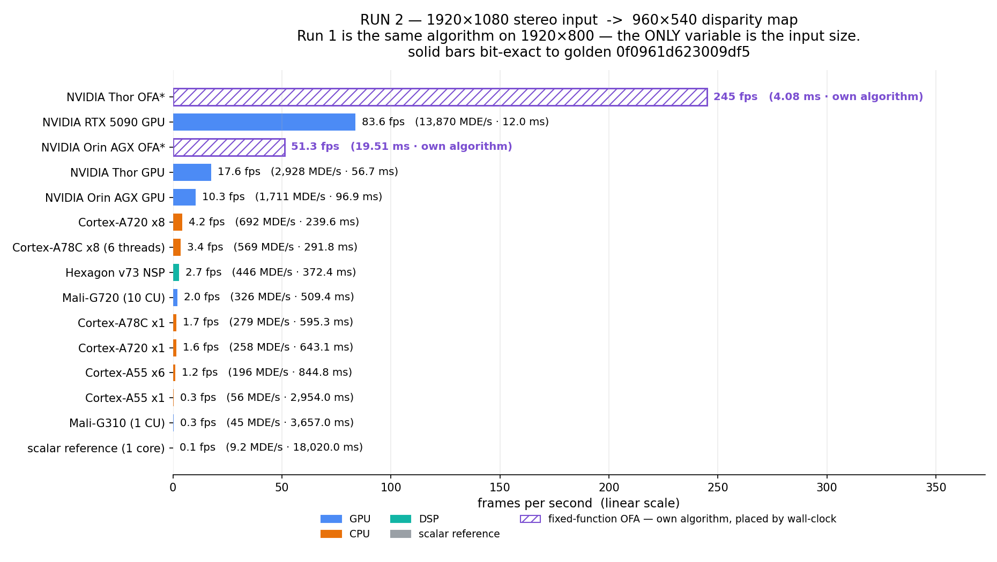
The same roster and the same algorithm at the other input size — the only variable between these two slides is the input size.

