Slide 1
One SGM workload, two input resolutions
The workload: dense stereo depth by Semi-Global Matching — two FULL 64-disparity searches, one at input resolution and one at half, data costs averaged (multi-scale fusion), census 9x7 on a SobelX-prefiltered image, 8 aggregation paths with direction-weighted P1 (40/20/10), P2=200 saturating, half-resolution output.
Run 1: 1920 x 1080 stereo input -> 960 x 540 disparity map
Run 2: 1920 x 800 stereo input -> 960 x 400 disparity map
Same algorithm, same parameters, same hardware roster — fifteen processing units from four silicon vendors. The ONLY variable between the runs is the input size. Acceptance: for each resolution a scalar oracle defines a golden disparity map, and every implementation must reproduce it byte-for-byte in the same invocation that is timed, or the timing is void. The fixed-function OFA engines (which run their own frozen algorithm) are measured beside the roster at the same geometry, labelled as such.
Every number is MEASURED (medians of repeated runs; spreads recorded). Code, scenes, goldens and instruments: github.com/kylefoxaustin/sgm-bench

Slide 2
Run 1 — 1920×1080 input
960×540 output · golden 0f0961d623009df5 · MDE/s(work) = (2.074 + 0.518) Mpx × 64 / time
processing unit | class | runtime | fps | MDE/s (work) | vs scalar reference
NVIDIA Thor OFA | HW | 4.08 ms | 245 | — | 4,417x (time only)
NVIDIA RTX 5090 | GPU | 11.96 ms | 83.6 | 13,870 | 1,507x faster
NVIDIA Orin AGX OFA | HW | 19.51 ms | 51 | — | 924x (time only)
NVIDIA Thor GPU | GPU | 56.70 ms | 17.6 | 2,928 | 318x faster
NVIDIA Orin AGX GPU | GPU | 96.90 ms | 10.3 | 1,711 | 186x faster
Cortex-A720 x8 | CPU | 239.60 ms | 4.17 | 692 | 75x faster
Cortex-A78C x8 (6 threads) | CPU | 291.80 ms | 3.43 | 569 | 62x faster
Hexagon v73 NSP | DSP | 372.40 ms | 2.69 | 446 | 48x faster
Mali-G720 (10 CU) | GPU | 509.40 ms | 1.96 | 326 | 35x faster
Cortex-A78C x1 | CPU | 595.30 ms | 1.68 | 279 | 30x faster
Cortex-A720 x1 | CPU | 643.10 ms | 1.55 | 258 | 28x faster
Cortex-A55 x6 | CPU | 844.80 ms | 1.18 | 196 | 21x faster
Cortex-A55 x1 | CPU | 2,954.00 ms | 0.34 | 56 | 6x faster
Mali-G310 (1 CU) | GPU | 3,657.00 ms | 0.27 | 45 | 5x faster
scalar reference | REF | 18,020.00 ms | 0.06 | 9.2 | the floor (1x)
Every software row byte-identical to golden 0f0961d623009df5, hash-gated in the timed run. OFA rows: the fixed-function engines running their OWN algorithm at matched input/output geometry (D=128) — throughput only, not bit-exact, MDE/s undefined for a different algorithm.

Slide 3
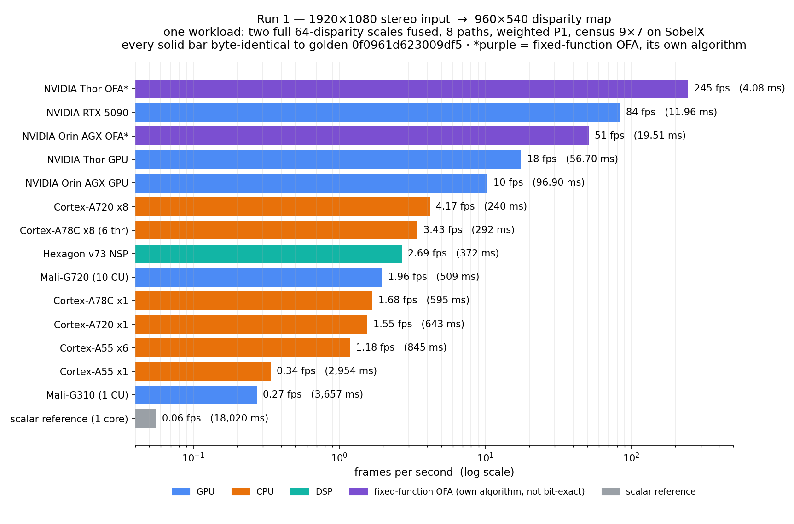
Run 1 — 1920×1080, in frames per second

Slide 4
Run 2 — 1920×800 input
960×400 output · golden bcb9cb0bd6f49799 · MDE/s(work) = (0.384 + 1.536) Mpx × 64 / time
processing unit | class | runtime | fps | MDE/s (work) | vs scalar reference
NVIDIA Thor OFA | HW | 3.38 ms | 296 | — | 4,220x (time only)
NVIDIA RTX 5090 | GPU | 9.08 ms | 110.1 | 13,538 | 1,571x faster
NVIDIA Orin AGX OFA | HW | 14.90 ms | 67 | — | 957x (time only)
NVIDIA Thor GPU | GPU | 45.10 ms | 22.2 | 2,723 | 316x faster
NVIDIA Orin AGX GPU | GPU | 72.80 ms | 13.7 | 1,688 | 196x faster
Cortex-A78C x8 (6 threads) | CPU | 211.90 ms | 4.72 | 580 | 67x faster
Cortex-A720 x8 | CPU | 238.30 ms | 4.20 | 516 | 60x faster
Hexagon v73 NSP | DSP | 276.30 ms | 3.62 | 445 | 52x faster
Mali-G720 (10 CU) | GPU | 380.00 ms | 2.63 | 323 | 38x faster
Cortex-A78C x1 | CPU | 442.60 ms | 2.26 | 278 | 32x faster
Cortex-A720 x1 | CPU | 470.90 ms | 2.12 | 261 | 30x faster
Cortex-A55 x6 | CPU | 640.10 ms | 1.56 | 192 | 22x faster
Cortex-A55 x1 | CPU | 2,201.00 ms | 0.45 | 56 | 6x faster
Mali-G310 (1 CU) | GPU | 2,704.00 ms | 0.37 | 45 | 5x faster
scalar reference | REF | 14,265.00 ms | 0.07 | 8.6 | the floor (1x)
Every software row byte-identical to golden bcb9cb0bd6f49799, hash-gated in the timed run. OFA rows: the fixed-function engines running their OWN algorithm at matched input/output geometry (D=128) — throughput only, not bit-exact, MDE/s undefined for a different algorithm.

Slide 5
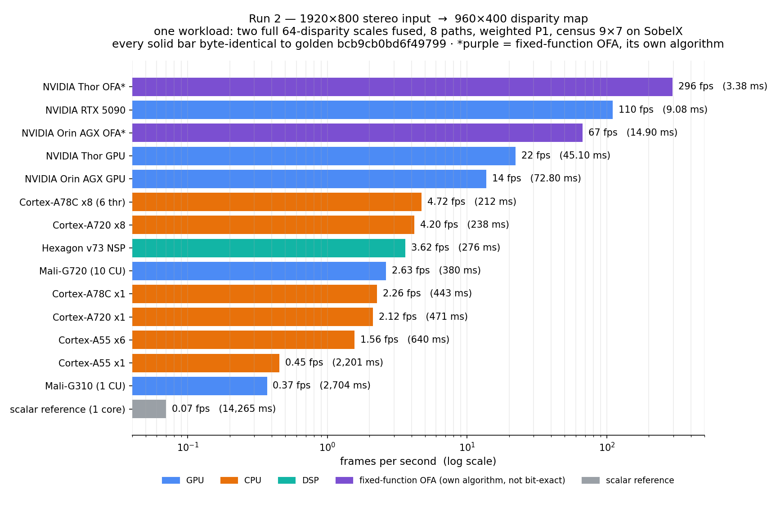
Run 2 — 1920×800, in frames per second

Slide 6
The two runs agree: performance scales with input size
1920x1080 has 1.35x the pixels of 1920x800, so run 1 should take ~1.35x run 2's time on every chip. It does:
NVIDIA RTX 5090: 1.32x
NVIDIA Thor GPU: 1.26x
NVIDIA Orin AGX GPU: 1.33x
Cortex-A78C x8: 1.38x
Hexagon v73 NSP: 1.348x — and identical MDE/s both runs
Mali-G720: 1.34x
Mali-G310: 1.35x
single Arm cores: 1.32x – 1.37x
OFA engines: 1.21x / 1.31x
Cortex-A720 x8: 1.01x — THE exception: the 8-thread cluster was never work-limited at 1920x800 (thread scaling 1.98x vs 2.68x), so the extra 35% of pixels ride in its slack for free
Which is the point of running both: a benchmark whose two resolutions scale by exactly the pixel ratio, bit-exact at each size, is measuring the workload — not an artifact of either scene.

Slide 7
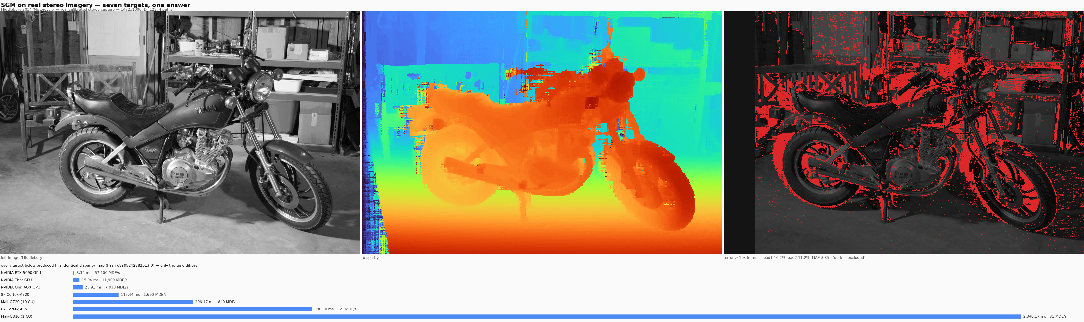
The same kernels on real stereo imagery
Middlebury 2014 'Motorcycle' — real calibrated two-camera capture, dense structured-light ground truth, 1482x1000, D=128
Seven targets produce the identical golden e8a95242882013f0 on the real capture — the picture is the same, only the time differs. Accuracy vs dense ground truth: bad>1px 16.2%, bad>2px 11.2%, MAE 3.35 — confirmed to 0.05 points by a second scoring derived from the ground-truth arrays.

