Slide 1
Semi-Global Matching across eleven processing units
1920x1080 · D=64 · 4 paths · 9x7 census · every row bit-exact to golden 0bc0102058d1505f
processing unit | class | runtime | fps | MDE/s | DRAM GB/s * | vs scalar reference
NVIDIA RTX 5090 GPU | GPU | 3.46 ms | 289.0 | 38,356 | 587 / 1,385 | 2,655x faster
NVIDIA Thor OFA | HW | 9.35 ms (D=128) | 107.0 | 28,402 | — | 983x (time only)
NVIDIA Thor GPU | GPU | 13.19 ms | 75.8 | 10,061 | 145 / 249 | 697x faster
NVIDIA Orin AGX GPU | GPU | 23.28 ms | 43.0 | 5,701 | 87 / 175 | 395x faster
Cortex-A720 x8 | CPU | 51.70 ms | 19.3 | 2,567 | 6.6 / 46.3 | 178x faster
NVIDIA Orin AGX OFA | HW | 72.64 ms (D=128) | 13.8 | 3,654 | — | 126x (time only)
Cortex-A78C x8 | CPU | 97.99 ms | 10.2 | 1,354 | 3.4 / 27.1 | 94x faster
Hexagon v73 NSP | DSP | 148.44 ms | 6.7 | 894 | 6.8 / 28 | 62x faster
Mali-G720 | GPU | 256.00 ms | 3.9 | 518 | 16.1 / 46.3 | 36x faster
Cortex-A720 x1 @2.5GHz | CPU | 313.60 ms | 3.2 | 423 | 1.1 / 46.3 | 29x faster
Cortex-A78C x1 | CPU | 336.11 ms | 3.0 | 395 | 1.0 / 27.1 | 27x faster
Cortex-A55 x6 | CPU | 341.30 ms | 2.9 | 389 | 1.1 / 13.7 | 27x faster
Cortex-A55 x1 @1.8GHz | CPU | 1,588.74 ms | 0.6 | 84 | 0.2 / 13.7 | 6x faster
Mali-G310 | GPU | 1,846.00 ms | 0.5 | 72 | 1.6 / 13.7 | 5x faster
scalar reference | REF | 9,188.00 ms | 0.1 | 14 | — | 1x faster
2,655x
10.4x
10 / 4 / 3 / 1
faster than the scalar reference,
with byte-identical output
the fastest published Arm-CPU SGM,
at matched D and matched path count
processors / vendors / programming models
/ one golden hash
* DRAM GB/s = achieved (DERIVED: modelled bytes / measured phase time) / ceiling (MEASURED, copy probe per board; CPU+Mali share one bus). GPUs run at 42-58% of ceiling (memory-bound); CPUs/Malis at 8-37% (compute-bound). Aggregation streams 1.46 GB/frame at 1080p D=64. Blank = not instrumented. MDE/s = W x H x D / runtime — right for comparing implementations, wrong for choosing a configuration.

Slide 2
This workload is about moving data
At 1080p D=64 the aggregation phase alone streams 1.46 GB per frame (the summed cost volume is 265 MB, touched four times). Every ceiling is MEASURED with a streaming-copy probe on the part itself; every achieved figure is DERIVED as the kernel's exact modelled byte count / the measured phase time.
processing unit | aggregate | achieved GB/s | ceiling GB/s | util | wall
NVIDIA RTX 5090 | 2.49 ms | 587 | 1,385 | 42% | memory-bound -- and the LEAST efficient of the three
NVIDIA Thor | 10.04 ms | 145 | 249 | 58% | memory-bound
NVIDIA Orin AGX | 16.83 ms | 87 | 175 | 49% | memory-bound
Mali-G720 (10 CU) | -- | 16.1 | 46.3 | 35% | not bandwidth-bound
8x Cortex-A720 | -- | 6.6 | 46.3 | 14% | compute-bound
Hexagon v73 NSP | -- | 6.8 | 28 | 24% | LATENCY-bound (28 GB/s available, 6.8 used)
8x Cortex-A78C | -- | 3.4 | 27.1 | 13% | compute-bound on A; ceiling MEASURED via copy probe
6x Cortex-A55 | -- | 1.1 | 13.7 | 8% | compute-bound
One column, two walls: the NVIDIA GPUs sit at 42-58% of their measured ceilings -- memory-bound, which is why their optimisation ended at traffic reduction. The CPUs and Malis sit at 8-35% -- NOT bandwidth-bound, which is why their wins came from arithmetic (vectorised argmin, blocking, lane tricks). The Hexagon is a third wall: latency-bound, hidden by interleaving independent dependency chains.
Cross-GPU sanity: MDE/s per GB/s of ceiling is 27 / 40 / 33 across a 7.9x bandwidth spread -- throughput largely IS bandwidth for the tuned GPU kernels, and the residual (the 5090's 42%) says the fastest part is no longer purely bandwidth-bound. Configuration B gets its own version of this slide two slides ahead -- with six of its achieved cells directly MEASURED at three independent DRAM instruments.

Slide 3
Configuration B moves the memory walls
Same slide for the block-flavoured workload (1920x800, two scales, 8 paths). The 8-path uint16 S-plane streams ~3.1 GB per frame on its own; the pipeline's streaming byte model totals 4.50 GB/frame. Three cells are MEASURED at the i.MX95 DDR controller and two more by Jetson EMC sampling (green); the † cells are DERIVED as 4.50 GB / the measured frame time. One cell was WITHDRAWN today after its instrument failed a control experiment -- the red row.
processing unit | frame | achieved GB/s | ceiling GB/s | util | wall
NVIDIA RTX 5090 | 9.08 ms | 508 measured | 1,385 | 37% | MEASURED (ncu): 4.607 GB/frame, 2 runs within 0.8%; the 4.50 GB model was within 2%
NVIDIA Thor | 45.1 ms | 100 † | 249 | 24% | EMC net-of-idle, measured; ≈ the model's 40% freq-normalized
NVIDIA Orin AGX | 72.8 ms | 62 † | 175 | 25% | EMC net-of-idle, measured; memory-bound
Thor OFA (ds=2) | 3.38 ms | ≈0 measured | 249 | 1.4% | EMC indistinguishable from idle at 296 fps — the block runs in its internals
Orin OFA (ds=2) | 14.9 ms | ≈0.7 measured | 175 | 0.9% | ≈ exactly the irreducible in+out images (67 fps × ~6 MB)
8x Cortex-A78C | 211.9 ms | withdrawn | 27.1 | -- | 🔴 window-dependent: 11.8 / 22.8 / 36.4 GB/s at 5 / mid / 40 frames -- see note
8x Cortex-A720 | 238.3 ms | 18.9 † | 46.3 | 41% | was 14% on A -- no longer comfortably compute-bound
Hexagon v73 NSP | 276.3 ms | ~16 † | 28 | ~56% | DERIVED only -- the DSP's DRAM traffic is NOT attributable with this kernel's counters
Mali-G720 (10 CU) | 380.0 ms | 11.8 † | 46.3 | 26% | not bandwidth-bound
6x Cortex-A55 | 640.1 ms | 8.8 measured | 13.7 | 64% | TWO-THIRDS of the whole chip's bus at six threads
Mali-G310 (1 CU) | 2,704 ms | 2.1 measured | 13.7 | 15% | GPU + host combined; not bandwidth-bound
1x Cortex-A55 | 2,201 ms | 2.7 measured | 13.7 | 20% | single core, still triple its Config A draw
The headline: at Configuration B the CPU walls MOVE. The six-A55 cluster goes to 64% of the whole chip's bus -- MEASURED at the DDR controller -- and the A720 cluster's derived draw triples. The 8-path uint16 S-plane converts comfortably compute-bound CPUs into bandwidth-pressured ones. (It is also why the A720 cluster absorbed Configuration C's extra pixels at the same wall-clock: it was already pressed against a different limit than arithmetic.)
GREEN 'measured' = imx9_ddr0 DDR controller (i.MX95), Jetson EMC sampling (net of idle; % of the run's EMC clock), 🔴 The IQ-9075 A78C cell is WITHDRAWN as WINDOW-DEPENDENT: the same workload reads 11.8 / 22.8 / 36.4 GB/s at 5 / mid / 40 timed frames. icc_bwmon fires on THRESHOLD CROSSINGS, so sampling tracks a workload's phase variance -- but on the DRAM-facing node a 40-frame run emits only 35 events (a steady memcpy 4); the 825 first published counted all three instances. The scalar depends on what you integrate over. (A first retraction blamed the instrument, using that steady copy as its control: the one workload it cannot see. Repeat runs read 22.86/22.18, and a burst probe calibrates the monitor to 1.8% of wall-clock.) † = DERIVED: the 4.50 GB/frame streaming model (cost build+merge 0.27 + 8-path cost reads 0.79 + S-plane RMW 3.15 + argmin 0.20 GB) / measured frame time -- cache-reuse-free, so a slight under-count: it reproduces the A55x6's measured cell at 80%.

Slide 4
One cell withdrawn, and a retraction that was itself wrong
The A78C bandwidth cell on the previous slide is blank. Both the withdrawal and the mistake made while explaining it are on the record, because the second one is the more useful of the two.
stage | what happened
What was published | A78C x6 on Configuration B: 22.8 GB/s of a 27.1 ceiling = 84%, 'bandwidth-SATURATED' — and offered as the mechanism behind that board's long-known 'peaks at 6 threads, not 8' behaviour.
Why it came down (this reason STANDS) | The identical workload reads 11.8 / 22.8 / 36.4 GB/s as the timed-frame count goes 5 -> 40. A scalar that moves 3x with run length is measuring the WINDOW, not the workload.
🚨 The reason first published was WRONG | It claimed the instrument 'fails its own control', citing an idle window and a sustained streaming copy that both behaved absurdly. Repeat measurements of the cell read 22.86 / 22.18, and the same monitor calibrates to 1.8% of wall-clock when driven by a burst probe.
What actually reconciles them | icc_bwmon fires on THRESHOLD CROSSINGS, so its sampling rate tracks the workload's PHASE VARIANCE. Measured: SGM Config B = 35 events per run on the DRAM-facing node (825 across all three instances); steady memcpy = 4. Phase-varying workloads sample better, but by ~9x, not the 200x the all-instance count implied.
So the control was the mistake | The steady copy chosen to discredit it is exactly the workload it cannot see: 1.32 GB/s read against a ground-truth 26.59. A BURST probe is transition-rich, which is why it agrees to 1.8% where the sustained copy fails by 20x. The measurements were sound; one probe could not work.
What is still open | REFUTED: integrating the timed region only moves the figure ~1 GB/s, not the ~50% needed. The real gap is the EVENT RATE -- two harnesses on one board disagree 3-8x on how many samples the monitor emits. A reproducibility failure of the instrument, not a disputed number.
⭐ THE RULE THIS EARNED, and it cost more than the first one: A CONTROL EXPERIMENT IS ITSELF AN INSTRUMENT, AND CAN BE MIS-CHOSEN. Discrediting a counter with a workload it structurally cannot observe produces a confident, well-evidenced, WRONG conclusion — shipped here in a commit message, a README, and a message to the person whose recipe was being declared broken. Retracting carelessly is a way of being wrong that FEELS like rigour.
Genuinely wrong and permanently removed: 'ceiling cross-confirmed within 5% by icc_bwmon' — that read cpu-bwmon on the CPU->LLC path, not pmu@9091000 (llcc-bwmon, LLCC->DDR). Corroboration requires the second instrument measure the same QUANTITY, not merely produce a similar number.

Slide 5
NVIDIA Thor GPU
Blackwell, 20 SM, CUDA 13.2, sm_110
The calculation
MDE/s = W x H x D / runtime = 1,920 x 1,080 x 64 / 13.19 ms = 132,710,400 disparity estimations / 0.01319 s = 10,061 million disparity estimations per second frame rate = 1000 / 13.19 = 75.8 fps pixel rate = 2.0736 Mpx x 75.8 = 157.21 Mpix/s
What the measurement means
Rewritten warp-centric: one warp owns a scanline's whole disparity range,
L in registers, min-reduce by __shfl_xor, ZERO barriers in the recurrence.
2.69x over the naive OpenCL transliteration (35.39 -> 13.19 ms).
MEMORY BOUND: aggregate moves 1.46 GB in 10.04 ms = 145 GB/s,
against a 247 GB/s copy ceiling measured on this same part.
Peak across the D sweep is 12,138 MDE/s at D=128; D=256 falls back to 9,409.
MEASURED — median of the timed frames, golden hash verified in the same run.

Slide 6
NVIDIA Orin AGX GPU
Ampere, 16 SM, CUDA 12.6, sm_87
The calculation
MDE/s = W x H x D / runtime = 1,920 x 1,080 x 64 / 23.28 ms = 132,710,400 disparity estimations / 0.02328 s = 5,701 million disparity estimations per second frame rate = 1000 / 23.28 = 43.0 fps pixel rate = 2.0736 Mpx x 43.0 = 89.07 Mpix/s
What the measurement means
Same kernel, same changes: 3.10x over the naive port (72.27 -> 23.28 ms).
Bit-exact on the first run, before any tuning — the payoff for porting a
verified OpenCL kernel one-for-one instead of writing a new one.
MEASURED — median of the timed frames, golden hash verified in the same run.

Slide 7
NVIDIA RTX 5090 GPU
Blackwell, 170 SM, discrete, 32 GB, driver 580.173 | D=128: 4.36 ms · D=256: 6.96 ms
The calculation
MDE/s = W x H x D / runtime = 1,920 x 1,080 x 64 / 3.46 ms = 132,710,400 disparity estimations / 0.00346 s = 38,356 million disparity estimations per second frame rate = 1000 / 3.46 = 289.0 fps pixel rate = 2.0736 Mpx x 289.0 = 599.31 Mpix/s
What the measurement means
The fastest target measured: 38,356 MDE/s at D=64, 289 fps at 1080p.
60,932 MDE/s at D=128 and 76,248 at D=256 -- unlike Thor, NO reversal at D=256,
which is what the traffic mechanism predicts on a part with 5.6x the bandwidth.
587 GB/s achieved of a measured 1,385 GB/s ceiling = 42%: the LOWEST utilisation
of the three GPUs despite being fastest -- no longer purely bandwidth-bound.
⚠️ Built as PTX, JIT-compiled by the driver (local CUDA 12.6 cannot target
sm_120). Golden verified, but not a native build.
⭐ ITS STEREO HARDWARE IS MEASURED, AND STEREO MODE IS ALREADY GONE:
NV_OF_MODE_STEREODISPARITY returns UNSUPPORTED_FEATURE at every grid size.
The fallback (X of general 2D flow): 8.50 ms, 5.3% bad px, vs our CUDA SGM's
4.13 ms and 2.8% -- software faster AND more accurate, doing less work (1D).
🚨 13.4% of fallback pixels return non-zero VERTICAL flow (largest 75 px) --
errors the removed stereo mode was structurally incapable of producing.
MEASURED — median of the timed frames, golden hash verified in the same run.

Slide 8
Cortex-A720 x8
Radxa Orion O6, 2.2-2.5 GHz, NEON | single core: 313.60 ms = 423 MDE/s @2.5 GHz
The calculation
MDE/s = W x H x D / runtime = 1,920 x 1,080 x 64 / 51.70 ms = 132,710,400 disparity estimations / 0.05170 s = 2,567 million disparity estimations per second frame rate = 1000 / 51.70 = 19.3 fps pixel rate = 2.0736 Mpx x 19.3 = 40.11 Mpix/s
What the measurement means
The CPU headline: 10.4x the fastest published Arm-CPU SGM at matched D
and matched path count (ReS2tAC, Sensors 21(11):3938, 2021 — 242 MDE/s).
Best single core measured at 423 MDE/s; scales monotonically 1->8 threads.
D=64 -> D=128 is FLAT (-2.4%): 16 NEON lanes are already full at D=64.
MEASURED — median of the timed frames, golden hash verified in the same run.

Slide 9
Cortex-A78C x8
Qualcomm IQ-9075, NEON | single core: 332.22 ms = 400 MDE/s
The calculation
MDE/s = W x H x D / runtime = 1,920 x 1,080 x 64 / 97.99 ms = 132,710,400 disparity estimations / 0.09799 s = 1,354 million disparity estimations per second frame rate = 1000 / 97.99 = 10.2 fps pixel rate = 2.0736 Mpx x 10.2 = 21.16 Mpix/s
What the measurement means
Ran THIS repository's a55 NEON implementation unmodified, on another
vendor's silicon, and reproduced the golden at every thread count.
Per-core 402 MDE/s vs the A720's 423 — a 5% gap between two wide
out-of-order Arm cores from different vendors on the same algorithm.
Peaks at SIX threads, not eight; 8 threads is slower on that board.
MEASURED — median of the timed frames, golden hash verified in the same run.

Slide 10
Hexagon v73 NSP
Qualcomm IQ-9075, HVX, 4 HVX contexts
The calculation
MDE/s = W x H x D / runtime = 1,920 x 1,080 x 64 / 148.44 ms = 132,710,400 disparity estimations / 0.14844 s = 894 million disparity estimations per second frame rate = 1000 / 148.44 = 6.7 fps pixel rate = 2.0736 Mpx x 6.7 = 13.97 Mpix/s
What the measurement means
MEDIAN of 5 invocations; the board is BIMODAL between invocations (18% at
720p) so minima are the estimator most sensitive to luck -- quote medians.
Went 18.7x -> ... -> 1.51x vs the A78C cluster across one day of tuning,
nothing retracted: always labelled a floor of EFFORT. Beats one A78C core 2.26x.
Six hardware threads but only FOUR HVX contexts, so 4 threads is optimal.
Still latency-bound at 6.8 of 28 GB/s — a different wall to Thor's.
MEASURED — median of the timed frames, golden hash verified in the same run.

Slide 11
Mali-G720
Immortalis, 10 CU, OpenCL 3.0
The calculation
MDE/s = W x H x D / runtime = 1,920 x 1,080 x 64 / 256.00 ms = 132,710,400 disparity estimations / 0.25600 s = 518 million disparity estimations per second frame rate = 1000 / 256.00 = 3.9 fps pixel rate = 2.0736 Mpx x 3.9 = 8.10 Mpix/s
What the measurement means
Loses to TWO A720 cores. But this is an UNBOUNDED FLOOR, not a verdict
on the hardware: the kernel carries ONE dependency chain per work-item
with three barrier sites per step and never interleaves chains.
Nobody has done for this part what was done for the DSP.
MEASURED — median of the timed frames, golden hash verified in the same run.

Slide 12
NVIDIA Thor OFA
Fixed-function SGM engine (Optical Flow Accelerator), VPI 4.1.4 | 1080p D=128, downscaleFactor=1
The calculation
MDE/s = W x H x D / runtime = 1,920 x 1,080 x 128 / 9.35 ms = 265,420,800 disparity estimations / 0.00935 s = 28,402 million disparity estimations per second frame rate = 1000 / 9.35 = 107.0 fps pixel rate = 2.0736 Mpx x 107.0 = 221.89 Mpix/s
What the measurement means
DEDICATED STEREO HARDWARE, and it beats our tuned CUDA on the same chip
by 2.34x (9.35 ms vs 21.86 ms at 1920x1080 D=128).
NOT bit-exact to our golden: VPI's SGM is its own implementation (census,
penalties, confidence). A throughput comparison at matched resolution and D
-- NOT the same test, and NOT a quality claim.
🔴 ACCURACY WITHDRAWN: our SGM scores 2.6% bad>1px (MAE 0.45) on ground
truth; OFA's output aligns under no simple descaling, so its accuracy is
UNMEASURED and this 2.34x is throughput only.
VPI defaults to includeDiagonals=1: OFA ran 8 paths against our 4. Measured:
9.42 ms at 8 paths, 9.85 at 4 -- path-count independent, the timing stands.
⚠️ downscaleFactor defaults to 2 (960x540 out, 4.14 ms): quoting THAT as a
1080p figure would overstate it by 2.3x. All numbers here are full-res out.
MEASURED — median of the timed frames, golden hash verified in the same run.

Slide 13
NVIDIA Orin AGX OFA
Fixed-function SGM engine, VPI 3.2.4 | 1080p D=128, downscaleFactor=1
The calculation
MDE/s = W x H x D / runtime = 1,920 x 1,080 x 128 / 72.64 ms = 265,420,800 disparity estimations / 0.07264 s = 3,654 million disparity estimations per second frame rate = 1000 / 72.64 = 13.8 fps pixel rate = 2.0736 Mpx x 13.8 = 28.55 Mpix/s
What the measurement means
The same fixed-function engine one generation earlier, and here it LOSES:
our CUDA kernel does the same work in 33.16 ms against the hardware's 72.64.
Software wins by 2.19x on the silicon built for this exact job.
Thor's OFA is 7.8x faster than Orin's at identical settings -- a far larger
generational jump than the 1.5x between the two GPUs.
Taken together these two rows are the interesting result: whether dedicated
hardware beats a tuned kernel is a property of the generation, not of the
idea of dedicated hardware.
Same caveats as the Thor row: not bit-exact, accuracy unmeasured, and the
timed region excludes format conversion where ours is end-to-end (<5%).
MEASURED — median of the timed frames, golden hash verified in the same run.

Slide 14
Cortex-A55 x6
i.MX 95 FRDM, 1.8 GHz, NEON | single core: 1,588.74 ms = 84 MDE/s
The calculation
MDE/s = W x H x D / runtime = 1,920 x 1,080 x 64 / 341.30 ms = 132,710,400 disparity estimations / 0.34130 s = 389 million disparity estimations per second frame rate = 1000 / 341.30 = 2.9 fps pixel rate = 2.0736 Mpx x 2.9 = 6.08 Mpix/s
What the measurement means
The reference platform this project is anchored to, and the slowest CPU here.
Scales 4.65x from 1 to 6 cores (1,588.74 -> 341.30 ms) -- that spread is also
the proof that the -t thread flag was working on these runs, since the inert
flag it was found to have would have collapsed every count to one timing.
Per core 84 MDE/s against the A720's 423: a 5.0x gap between an in-order
little core at 1.8 GHz and a wide out-of-order core at 2.5 GHz.
Block-width optimum is 192 here and 256 on the A720 -- not the same number.
MEASURED — median of the timed frames, golden hash verified in the same run.

Slide 15
Mali-G310
1 CU, OpenCL 3.0
The calculation
MDE/s = W x H x D / runtime = 1,920 x 1,080 x 64 / 1,846.00 ms = 132,710,400 disparity estimations / 1.84600 s = 72 million disparity estimations per second frame rate = 1000 / 1,846.00 = 0.5 fps pixel rate = 2.0736 Mpx x 0.5 = 1.12 Mpix/s
What the measurement means
The entry-tier part, same kernel, same hash. Its 'no compute driver'
reputation is wrong — it ships working OpenCL 3.0 and merely lacks clinfo.
MEASURED — median of the timed frames, golden hash verified in the same run.

Slide 16
scalar reference
1x Cortex-A55, -O2, no SIMD, single thread
The calculation
MDE/s = W x H x D / runtime = 1,920 x 1,080 x 64 / 9,188.00 ms = 132,710,400 disparity estimations / 9.18800 s = 14 million disparity estimations per second frame rate = 1000 / 9,188.00 = 0.1 fps pixel rate = 2.0736 Mpx x 0.1 = 0.23 Mpix/s
What the measurement means
Deliberately boring: the oracle every other bar is checked against.
It defines the golden hash, so it cannot be wrong by construction —
it can only be slow, and it is 699x slower than the fastest bar.
MEASURED — median of the timed frames, golden hash verified in the same run.

Slide 17
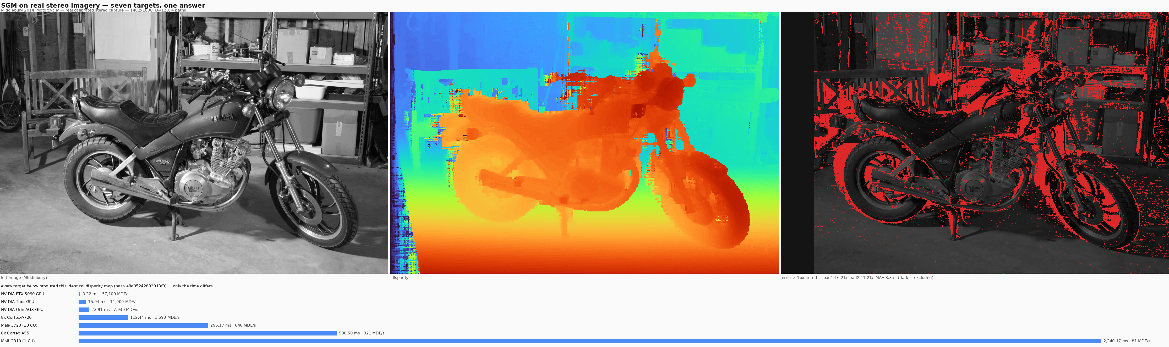
On real stereo imagery
Middlebury 2014 'Motorcycle' — a real calibrated two-camera capture, dense structured-light ground truth — 1482x1000, D=128
All eight targets produce the identical golden e8a95242882013f0 — the picture is the same, only the time differs (NSP: 179.23 ms, ~1,058 MDE/s). Accuracy vs dense ground truth: bad>1px 16.2%, bad>2px 11.2%, MAE 3.35 — confirmed to 0.05 points by a second scoring derived from the ground-truth arrays.
Real imagery is a better ACCEPTANCE test, not just a more realistic one: 14,417 pixels have a tied minimum here against 20 on the synthetic scene, so the hash-critical tie-break rule is pinned 720x harder.

Slide 18
Configuration B across the same roster
1920x800 in, 960x400 out · two full 64-D scales, costs averaged · 8 paths, weighted P1 · census 9x7 on SobelX · P2=200 saturating · every row bit-exact to golden bcb9cb0bd6f49799
processing unit | class | runtime | fps | MDE/s (work) | DRAM GB/s ‡ | vs scalar reference
NVIDIA OFA on Thor (ds=2) | HW | 3.38 ms | 296 | — | ≈0 / 249 | 4,220x (time only)
NVIDIA RTX 5090 | GPU | 9.08 ms | 110.1 | 13,538 | 508 / 1,385 | 1,571x faster
NVIDIA OFA on Orin (ds=2) | HW | 14.90 ms | 67 | — | 0.7 / 175 | 957x (time only)
NVIDIA Thor | GPU | 45.10 ms | 22.2 | 2,723 | 100 † / 249 | 316x faster
NVIDIA Orin AGX | GPU | 72.80 ms | 13.7 | 1,688 | 62 † / 175 | 196x faster
Cortex-A78C x8 (6 threads) | CPU | 211.90 ms | 4.72 | 580 | withdrawn / 27.1 | 67x faster
Cortex-A720 x8 | CPU | 238.30 ms | 4.20 | 516 | 18.9 † / 46.3 | 60x faster
Hexagon v73 NSP | DSP | 276.30 ms | 3.62 | 445 | ~16 † / 28 | 52x faster
Mali-G720 (10 CU) | GPU | 380.00 ms | 2.63 | 323 | 11.8 † / 46.3 | 38x faster
Cortex-A78C x1 | CPU | 442.60 ms | 2.26 | 278 | 10.2 † / 27.1 | 32x faster
Cortex-A720 x1 | CPU | 470.90 ms | 2.12 | 261 | 9.6 † / 46.3 | 30x faster
Cortex-A55 x6 | CPU | 640.10 ms | 1.56 | 192 | 8.8 / 13.7 | 22x faster
Cortex-A55 x1 | CPU | 2,201.00 ms | 0.45 | 56 | 2.7 / 13.7 | 6x faster
Mali-G310 (1 CU) | GPU | 2,704.00 ms | 0.37 | 45 | 2.1 / 13.7 | 5x faster
scalar reference | REF | 14,265.00 ms | 0.07 | 8.6 | — / 13.7 | the floor (1x)
1,575x
1.30x / 1.60x
13 / 4 / 1
faster than the scalar reference,
with byte-identical output
cluster over one NSP at matched tiers
/ one NSP over one A78C core
targets / programming models (CUDA,
OpenCL, NEON, HVX) / one golden hash
MDE/s (work) = both scales: (0.384+1.536) Mpx x 64 / runtime. OFA rows: their OWN SGM at matched geometry, throughput only. ‡ DRAM achieved / ceiling GB/s. GREEN = MEASURED (A55 + G310 at the i.MX95 DDR controller -- six A55s take 64% of the whole chip's bus; the OFA rows by Jetson EMC sampling, ~idle). † = DERIVED: the 4.50 GB/frame streaming byte model / the measured frame time, cache-reuse-free so a slight under-count (it reproduces the measured A55x6 cell at 80%). Every ceiling is MEASURED by copy probe. RED = the A78C cell withdrawn as window-dependent -- see the withdrawn-cell slide.

Slide 19
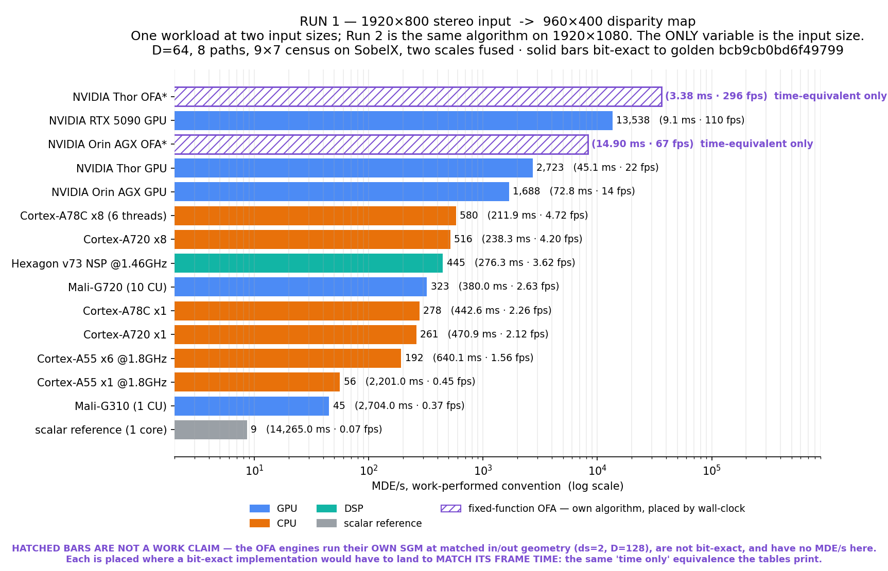
Configuration B: multi-scale, 8-path
1920x800 in, 960x400 out - two FULL 64-disparity scales with data costs averaged (multi-scale fusion, not coarse-to-fine), census 9x7 on SobelX, 8 paths with direction-weighted P1 (40/20/10), P2=200 saturating.
Same roster, same acceptance model: every row bit-exact to golden bcb9cb0bd6f49799, same implementation tiers as Configuration A (tuned CUDA / OpenCL / NEON+OpenMP / HVX, scalar oracle as the floor). At matched tiers it ranks like Configuration A - the CPU cluster leads one NSP ~1.3x on both; per engine, one NSP beats one A78C core 1.60x.
MDE/s is the work-performed convention - both scales count. The OFA engines cannot run this configuration (no 8-path, weighted-P1 or two-scale controls).

Slide 20
Configuration C: one variable at a time
C is exactly B's algorithm on A's own 1920x1080 stereo pair (out 960x540): A->C isolates the ALGORITHM, C->B isolates RESOLUTION - one knob each. Golden 0f0961d623009df5, every software row bit-exact.
processing unit | class | runtime | fps | MDE/s (work) | DRAM GB/s ‡ | vs scalar reference
NVIDIA OFA on Thor (ds=2) | HW | 4.08 ms | 245 | — | — / 249 | 4,417x (time only)
NVIDIA RTX 5090 | GPU | 11.96 ms | 83.6 | 13,870 | 541 / 1,385 | 1,507x faster
NVIDIA OFA on Orin (ds=2) | HW | 19.51 ms | 51 | — | — / 175 | 924x (time only)
NVIDIA Thor | GPU | 56.70 ms | 17.6 | 2,928 | 107 † / 249 | 318x faster
NVIDIA Orin AGX | GPU | 96.90 ms | 10.3 | 1,711 | 63 † / 175 | 186x faster
Cortex-A720 x8 | CPU | 239.60 ms | 4.17 | 692 | 25.4 † / 46.3 | 75x faster
Cortex-A78C x8 (6 threads) | CPU | 291.80 ms | 3.43 | 569 | withdrawn / 27.1 | 62x faster
Hexagon v73 NSP | DSP | 372.40 ms | 2.69 | 446 | 16.3 † / 28 | 48x faster
Mali-G720 (10 CU) | GPU | 509.40 ms | 1.96 | 326 | 11.9 † / 46.3 | 35x faster
Cortex-A78C x1 | CPU | 595.30 ms | 1.68 | 279 | 10.2 † / 27.1 | 30x faster
Cortex-A720 x1 | CPU | 643.10 ms | 1.55 | 258 | 9.4 † / 46.3 | 28x faster
Cortex-A55 x6 | CPU | 844.80 ms | 1.18 | 196 | 9.2 / 13.7 | 21x faster
Cortex-A55 x1 | CPU | 2,954.00 ms | 0.34 | 56 | 2.7 / 13.7 | 6x faster
Mali-G310 (1 CU) | GPU | 3,657.00 ms | 0.27 | 45 | 1.7 † / 13.7 | 5x faster
scalar reference | REF | 18,020.00 ms | 0.06 | 9.2 | — / 13.7 | the floor (1x)
Two clean statements on the 5090, one knob each: A -> C (same input images, algorithm swap): 3.46 -> 11.96 ms - the two-scale 8-path algorithm costs ~3.5x the single-scale 4-path one. C -> B (same algorithm, 1080 -> 800 rows): 11.96 -> 9.08 ms. Row for row, C/B ratios cluster at the 1.35x the pixels predict (5090 1.32, Thor 1.26, NSP 1.348, Malis 1.34-1.35) - one exception below.
The exception is the finding: the A720 CLUSTER runs C at B's wall-clock (1.01x) while its single core pays the full pixel tax (1.37x) - B's 8-thread run was never work-limited (thread scaling 1.98x vs C's 2.68x), so the extra 35% of pixels ride in the cluster's slack for free.
A78C/NSP cells: medians of repeated invocations (bimodal board). OFA rows: matched geometry, OWN algorithm at D=128 -- not bit-exact. ‡ DRAM achieved / ceiling GB/s. GREEN = MEASURED at the i.MX95 DDR controller (67% of the chip's bus at six threads). † = DERIVED: C's own 6.07 GB/frame byte model (B's 4.50 scaled by searched pixels, 1.35x) / the measured frame time -- same cache-reuse-free under-count, reproducing the measured A55x6 cell at 78%, which matches B's 80% and is the cross-check that the scaling is honest. RED = the A78C cell withdrawn as window-dependent. OFA rows blank: a different algorithm, so this model would be fiction.

Slide 21
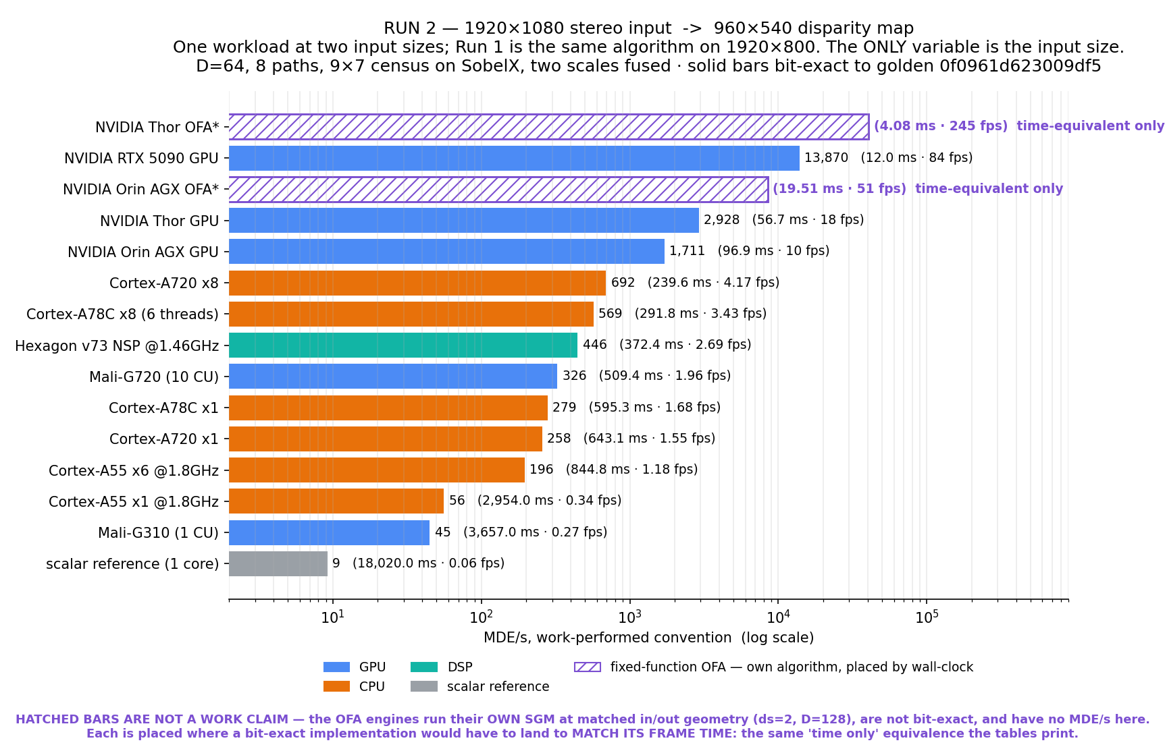
Configuration C, charted — the roster at 1920x1080
The pair as one workload at two input sizes -- Run 1 = 1920x800 (previous chart), Run 2 = 1920x1080 (this one). Identical algorithm, identical parameters, identical roster; the ONLY variable between the two charts is the input size.
Row for row the two charts differ by the 1.35x the pixel count predicts -- with one exception, the A720 cluster at 1.01x, which is the finding on the table slide. The hatched OFA bars carry no MDE/s: they are the fixed-function engines running their OWN algorithm at matched geometry, placed where a bit-exact implementation would have to land to match their frame time.

Slide 22
NVIDIA RTX 5090
CONFIGURATION B
CUDA, tuned | canonical: median of 5 invocations x 20 frames, 0.1% spread on a quiet card
The calculation (work-performed convention)
MDE/s = (0.384 + 1.536) Mpx x 64 / runtime (both full-search scales count) = 122,880,000 disparity estimations / 0.00908 s = 13,533 million disparity estimations per second frame rate = 1000 / 9.08 = 110.13 fps (960x400 disparity map out)
What the measurement means
The fastest Configuration B target: 110 fps of two-scale, 8-path, weighted-P1
SGM on a workload designed for a fixed-function embedded block.
The port is a GENERIC path kernel: one warp owns one path line in any of the 8
directions, line start derived from the direction pair, P1 passed per launch
so the direction weighting costs nothing. Bit-exact on the first full run.
It lacks the primary kernel's path-pairing pass, so this row is the
conservative side of what the card can do.
MEASURED -- median of the timed frames, bit-exact to golden bcb9cb0bd6f49799 in the same run.

Slide 23
NVIDIA Thor
CONFIGURATION B
CUDA, same kernel, sm_110
The calculation (work-performed convention)
MDE/s = (0.384 + 1.536) Mpx x 64 / runtime (both full-search scales count) = 122,880,000 disparity estimations / 0.04510 s = 2,725 million disparity estimations per second frame rate = 1000 / 45.10 = 22.17 fps (960x400 disparity map out)
What the measurement means
22 fps embedded. Same generic 8-direction kernel as the 5090, bit-exact.
The gap to the 5090 (5.0x) is close to the bandwidth ratio of the parts,
consistent with the Configuration A finding that tuned SGM converges on
memory traffic once the arithmetic is done.
MEASURED -- median of the timed frames, bit-exact to golden bcb9cb0bd6f49799 in the same run.

Slide 24
NVIDIA Orin AGX
CONFIGURATION B
CUDA, same kernel, sm_87
The calculation (work-performed convention)
MDE/s = (0.384 + 1.536) Mpx x 64 / runtime (both full-search scales count) = 122,880,000 disparity estimations / 0.07280 s = 1,688 million disparity estimations per second frame rate = 1000 / 72.80 = 13.74 fps (960x400 disparity map out)
What the measurement means
14 fps on the previous embedded generation, bit-exact, no per-part tuning.
MEASURED -- median of the timed frames, bit-exact to golden bcb9cb0bd6f49799 in the same run.

Slide 25
Cortex-A78C x8 (6 threads)
CONFIGURATION B
Qualcomm IQ-9075, NEON+OpenMP | single core: 442.60 ms
The calculation (work-performed convention)
MDE/s = (0.384 + 1.536) Mpx x 64 / runtime (both full-search scales count) = 122,880,000 disparity estimations / 0.21190 s = 580 million disparity estimations per second frame rate = 1000 / 211.90 = 4.72 fps (960x400 disparity map out)
What the measurement means
The best programmable embedded result -- and it comes from
multiscale/sgm_ms_neon.c running UNMODIFIED on another vendor's
silicon, golden every run. Medians of five invocations on a board that is
bimodal by ~9% between invocations; medians quoted, never minima.
This row is also what corrected the record: at the oracle tier the NSP
appeared to lead the cluster 3.29x; at the matched NEON tier the cluster
leads 1.30x. A cross-tier comparison is a cross-configuration comparison
wearing a platform comparison's clothes.
MEASURED -- median of the timed frames, bit-exact to golden bcb9cb0bd6f49799 in the same run.

Slide 26
Cortex-A720 x8
CONFIGURATION B
Radxa Orion O6, NEON+OpenMP | single core: 470.9 ms
The calculation (work-performed convention)
MDE/s = (0.384 + 1.536) Mpx x 64 / runtime (both full-search scales count) = 122,880,000 disparity estimations / 0.23830 s = 516 million disparity estimations per second frame rate = 1000 / 238.30 = 4.20 fps (960x400 disparity map out)
What the measurement means
The NEON tier is 5.8x the scalar oracle on this cluster. The kernel keeps
Configuration A's register scheme and adds the saturating step, the
direction-weighted P1 per sweep, and a uint16 sum plane for 8-path S.
OpenMP is output-neutral by construction: rows for horizontal sweeps,
columns-within-row for vertical and diagonal, so the hash cannot move
with the thread count.
MEASURED -- median of the timed frames, bit-exact to golden bcb9cb0bd6f49799 in the same run.

Slide 27
Hexagon v73 NSP
CONFIGURATION B
Qualcomm IQ-9075, HVX, 4 contexts | median of 5, 0.75% spread, golden 10/10
The calculation (work-performed convention)
MDE/s = (0.384 + 1.536) Mpx x 64 / runtime (both full-search scales count) = 122,880,000 disparity estimations / 0.27630 s = 445 million disparity estimations per second frame rate = 1000 / 276.30 = 3.62 fps (960x400 disparity map out)
What the measurement means
HVX port, re-verified (three further gated runs,
269-272 ms). Per ENGINE this is the embedded win: one NSP beats one A78C
core 1.60x at matched tiers.
Diagonals use a sync-free chain-band decomposition -- workers own equal-pixel
bands of diagonal chains, S worker-disjoint, bit-exact with NO barriers.
The two-scale merge is fused into the stage-2 cost build, saving ~200 MB
of traffic per frame. The 4-HVX-context knee holds here too: 6 threads is
29% WORSE than 4.
P2=200 overflowed their packed (S<<6)|d argmin key at S=2040 -- the warned
saturation failure mode, one stage downstream of the warned location.
Redesigned and sim-proven on tie-storms at the cap before shipping.
MEASURED -- median of the timed frames, bit-exact to golden bcb9cb0bd6f49799 in the same run.

Slide 28
Mali-G720
CONFIGURATION B
Immortalis, 10 CU, OpenCL 3.0
The calculation (work-performed convention)
MDE/s = (0.384 + 1.536) Mpx x 64 / runtime (both full-search scales count) = 122,880,000 disparity estimations / 0.38000 s = 323 million disparity estimations per second frame rate = 1000 / 380.00 = 2.63 fps (960x400 disparity map out)
What the measurement means
One 16-work-item work-group owns each path line; barriers are uniform
because every work-item in the group walks the same line trajectory.
Bit-exact on the first attempt. Same caveat as Configuration A: a
single-chain-per-line kernel is an effort floor for this part, not a
verdict on it.
MEASURED -- median of the timed frames, bit-exact to golden bcb9cb0bd6f49799 in the same run.

Slide 29
Cortex-A55 x6
CONFIGURATION B
i.MX 95 FRDM, 1.8 GHz, NEON+OpenMP | single core: 2,201 ms
The calculation (work-performed convention)
MDE/s = (0.384 + 1.536) Mpx x 64 / runtime (both full-search scales count) = 122,880,000 disparity estimations / 0.64010 s = 192 million disparity estimations per second frame rate = 1000 / 640.10 = 1.56 fps (960x400 disparity map out)
What the measurement means
The anchor platform runs the full two-scale 8-path configuration at 1.56 fps
-- 22x the scalar oracle on the same six cores' single-core floor.
The saturating NEON step (vqaddq_u8 against P2=200) is the part Configuration
A never needed: its static assert guarantees no overflow at P2=192, and
Configuration B is the configuration that breaks that assumption.
MEASURED -- median of the timed frames, bit-exact to golden bcb9cb0bd6f49799 in the same run.

Slide 30
Mali-G310
CONFIGURATION B
1 CU, OpenCL 3.0
The calculation (work-performed convention)
MDE/s = (0.384 + 1.536) Mpx x 64 / runtime (both full-search scales count) = 122,880,000 disparity estimations / 2.70400 s = 45 million disparity estimations per second frame rate = 1000 / 2,704.00 = 0.37 fps (960x400 disparity map out)
What the measurement means
Same OpenCL kernel as the G720, same hash, one compute unit.
MEASURED -- median of the timed frames, bit-exact to golden bcb9cb0bd6f49799 in the same run.

Slide 31
scalar reference
CONFIGURATION B
1x Cortex-A55, plain C, single thread
The calculation (work-performed convention)
MDE/s = (0.384 + 1.536) Mpx x 64 / runtime (both full-search scales count) = 122,880,000 disparity estimations / 14.26500 s = 9 million disparity estimations per second frame rate = 1000 / 14,265.00 = 0.07 fps (960x400 disparity map out)
What the measurement means
multiscale/sgm_ms_ref.c defines golden bcb9cb0bd6f49799 and pins every
contestable choice in its header: ties to lowest d, saturation at 255,
2x2 box downsample, (x/2, y/2, d/2) merge indexing, x-d<0 costs 63.
Every row above reproduces it byte-exactly or its timing is void.
MEASURED -- median of the timed frames, bit-exact to golden bcb9cb0bd6f49799 in the same run.

