Slide 1
Activity factors for power modelling, measured in QEMU
Validated against i.MX95 silicon · 50 applications · wattson / xcheck
Kyle Fox · 2026-08-31

Slide 2
Can we produce activity factors that match silicon?
YES — for CPU and DRAM activity, within the bands below.
WHAT WE PRODUCE
NOT TODAY
quantity | apply | held-out | spread
Instructions, per core | use raw | 0.979 | ×/÷1.04
DRAM reads | ×1.02 | 0.91 | ×/÷1.21
DRAM writes | ×1.11 | 0.83 | ×/÷1.28
DRAM-quiet screening | yes/no | 100% | —
User + kernel instructions | system mode | 10.0% kernel | measured
boundary | status
Accelerator compute | NPU model in build; GPU next
DMA payload bytes | known to the device model, not yet counted
Core identity, DVFS point | QEMU has no frequency notion
WHY THE NUMBERS TRANSFER TO AN APP NOBODY HAS MEASURED
Corrections were fitted on 14 applications, then applied cold to 36 the model had never seen. They landed in the same bands. That is the whole licence.
THE HANDOFF
afgen/afgen.sh my-apps.manifest afs/ → one JSON per application: counts per run, provenance-tagged.
Fifty apps in, fifty activity factors out. wattson supplies the counts; energy coefficients stay yours.
wattson xcheck · QEMU counts DERIVED, PMU/DDR counts MEASURED · 2026-08-31
2

Slide 3
Recommendation — the gate-activity bridge (superseded by the next three slides)
Your spreadsheet wants a GATE activity factor. QEMU measures UTILIZATION. The bridge is a number you already have.
term | meaning
your model | fraction of gates toggling per clock: 0% / 3% / 5% / 7%. 5% = block maxed out. Assumed per block.
what we measure | events actually executed: instructions, DRAM transactions, cache accesses. Per application.
the gap | utilization is not gate toggling — but your 5% anchor already contains the gates-per-event constant.
AF_app = AF_idle + ( AF_max − AF_idle ) × U
AF_max = your existing 5% anchor. U = measured activity ÷ the same block saturated, both from QEMU. No gate counts needed: your anchor already holds that constant.
# | step | what it means
1 | Pick the saturating reference per block | we ship the microbenches: alu saturates the pipeline, mem the memory system
2 | Measure the application | afgen gives counts; U = app activity ÷ saturating activity
3 | Scale your existing anchor | AF = 5% × U. Spreadsheet unchanged, physics unchanged, one guess replaced
4 | Validate once on silicon | two rail measurements — idle and saturated — confirm the anchor is linear in U
THE TURN-AROUND: today you assume 3% and get the power of an abstraction. Name an application instead — "what does Pac-Man cost?" — and get the power of that application.
wattson xcheck · QEMU counts DERIVED, PMU/DDR counts MEASURED · 2026-08-31
3

Slide 4
The bridge, now measured — per-rail models from QEMU activity
No longer a recommendation. Measured on i.MX 95 silicon, driven from QEMU counts.
vdd_soc = 851.0 + 20.4 × GB/s
vdd_arm = 243.8 + 0.1266 × ALU Mops/s + 60.6 × GB/s + 169.3 × active_cores
mW. vdd_soc holds at BOTH 900 and 1800 MHz unchanged. vdd_arm is 1800 MHz; it scales 2.21× per 2× clock.
rail | accuracy | scope | what it needs
vdd_soc | 2.5 – 7 % | both OPPs, transfers unchanged | bandwidth only — no clock term needed
vdd_arm | 4 – 5 % | 1800 MHz, out-of-sample | needs ALU rate, bandwidth AND active cores
AF_idle | n = 5, spread ≤1.7 % | 1139.5 mW total | vdd_soc 822.6 · vdd_arm 144.6
Driven by QEMU's counters, not the board's: QEMU-fed and PMU-fed predictions agree to 0.1 % (644.1 vs 644.9 mW). QEMU supplies activity; the board supplies time.
Published per-rail models land at single-digit error; under 3 % on unseen workloads is a reason to distrust your own validation set. These are inside that band.
wattson xcheck · QEMU counts DERIVED, PMU/DDR counts MEASURED · 2026-08-31
4

Slide 5
The finding that changes the activity factor
We expected instruction count to drive core power. It does not.
instructions alone: R² = 0.031
bandwidth alone: R² = 0.784 both together: R² = 0.990
Instruction count explains 3 % of core-rail power on this part.
aspect | detail
the observation | a memory-stalling workload drew 1.6× the core power of a compute workload retiring MORE instructions
why | a stalled core still burns clock trees, speculation, replayed loads, prefetchers and the L2/bus interface
independent check | Walker et al. (TCAD 2017) regressed PMCs against ODROID-XU3 per-cluster rails: retired instruction count is NOT in their model either, and their memory workloads top the cluster rail
consequence | an AF built on instruction count alone MIS-RANKS exactly the workloads that matter
Active cores matter independently of throughput: 598 Mops/s across two cores drew 656 mW; 599 Mops/s on ONE core drew 465 mW. Same work, 40 % less power.
wattson xcheck · QEMU counts DERIVED, PMU/DDR counts MEASURED · 2026-08-31
5

Slide 6
Does QEMU's activity match the silicon's own counters?
Same deterministic static binary, run under perf on the EVK and under qemu-aarch64 with TCG plugins.
counter | silicon PMU | QEMU | Δ | note
instructions retired | 1,201,601,070 | 1,200,039,789 | 0.1 % | essentially exact
instructions (memory workload) | 213,267,051 | 205,561,916 | 3.6 % | exact enough
cache misses, steady state | 4,283,525 | 4,194,709 | 0.01 % | after write streaming
cache misses, incl. buffer init | 4,283,525 | 5,243,303 | +22 % | un-modelled write streaming
The +22 % is not a bias. It is exactly one pass over the buffer (1,048,576 lines = 64 MiB / 64 B), CONSTANT to 6 counts while the workload quadruples.
The A55 detects full-cache-line writes and uses WRITE STREAMING, skipping the read-for-ownership. QEMU's cache plugin has no such notion, so it counts allocations the hardware never makes.
aspect | detail
known sign | QEMU always over-counts; a ceiling, not a mystery
scope | affects full-line write patterns: memset, memcpy, page zeroing, buffer init
today's fits | unaffected — the measured workloads are steady-state streaming
fixable | full-line writes are detectable in the plugin; a legitimate upstream contribution
So the emulator half is sound: instruction counts exact, miss counts exact in steady state, and one identified gap with a known sign.
wattson xcheck · QEMU counts DERIVED, PMU/DDR counts MEASURED · 2026-08-31
6

Slide 7
Three levels of detail — all available today
Aggregate counts are the cheapest. A per-class histogram or a full instruction trace costs only run time.
what you get | content | what it buys you | status
1 · counts per run | instructions, DRAM reads/writes, cache accesses per level | one AF per block | validated in this deck
2 · instruction-class histogram | integer / load-store / branch / FP-SIMD / system split | per-class AF | upstream plugin, no new work
3 · full instruction trace | every instruction in order, with its memory accesses | AF as a time series | upstream plugin, large output
WHY LEVEL 2 MATTERS — MEASURED, TWO REAL APPLICATIONS ON THE SAME CORE
instruction class | SQLite | Pac-Man
integer ALU | 28.1% | 36.9%
load / store | 52.2% | 41.9%
branch | 19.7% | 19.9%
FP / SIMD | 0.1% | 1.3%
total instructions | 2.57 B | 25.7 B
Same CPU block. Same flat 5% anchor would give both the same answer.
SQLite spends over half its instructions in load/store; Pac-Man is a third more ALU-heavy and toggles 13× the FP/SIMD share. Those light up different gates. A per-class AF separates them; a single AF cannot.
Levels 2 and 3 are stock upstream QEMU plugins (howvec, execlog) — the numbers above were produced with them, unmodified, this evening. Nothing new has to be written to supply either.
wattson xcheck · QEMU counts DERIVED, PMU/DDR counts MEASURED · 2026-08-31
7

Slide 8
The numbers
quantity | result | apply
Generalization | fitted on 14 apps, held on 36 unseen: insns 0.979 ×/÷1.04, reads same ×/÷1.21 spread | VALIDATED
Instructions, per core | 0.98 – 1.06 across all 14; 0.997 on a 10.2 B-instruction vision app | USE AS-IS
DRAM reads | 0.98 × silicon, ×/÷1.14 fitted (was 0.81 ×/÷1.26 before the prefetch model) | ×1.02
DRAM writes | 0.90 × silicon, ×/÷1.09 fitted; 0.83 ×/÷1.28 held out | ×1.11
DRAM-quiet screening | 6 low-traffic apps predicted quiet; silicon agrees | VALIDATED
Kernel share | system-mode boot-differential: sha256 10.0%, networking 16.7% | MEASURED
Multi-core | DRAM ratios thread-invariant 1–6T; +23% instruction outlier was OpenMP spin | USE
DMA | device-model writes bypass TCG; payload bytes known exactly | GAP, NAMED
Two instrument findings: the A55 PMU's l3d_cache_refill counts DEMAND refills only — prefetched lines bypass it, so ground truth belongs at the DDR controller. A55 write-streaming is a 2.0× error if unmodelled.
wattson xcheck · QEMU counts DERIVED, PMU/DDR counts MEASURED · 2026-08-31
8

Slide 9
Method — one binary, two observatories
Identical static aarch64 binaries. Nothing recompiled between the two worlds.
QEMU (derived)
Silicon (measured)
qemu-aarch64 + TCG plugins (libinsn, libcache)
Cache model = the board's own hierarchy, read from its sysfs:
L1 32K/4w · L2 64K/4w · shared L3 512K/16w, 64 B lines
A55 write-streaming, writeback and a stride prefetcher modelled
L3 misses → DRAM-read proxy · evictions → DRAM-write proxy
Two passes per app: prefetch pass for reads, base pass for writes
Counts are per-run and frequency-free
FRDM-IMX95, perf stat, pinned to A55 core 0
Core PMU: instructions, cycles, L1/L2/L3 refill events
imx9_ddr0 DDR-controller PMU: read/write beats (32 B)
System-wide, with an equal-duration idle window subtracted
The DDR controller sees prefetch traffic the core PMU cannot
Medians of repeated runs, spreads recorded
The same static binary is copied over, never rebuilt
THE 50 APPLICATIONS
HOW A RUN IS ACCEPTED
14 development apps — five microbench corners (ALU, streaming,
pointer-chase, matmul, sort) plus stereo vision, two compressors,
an interpreter, SHA-256, a JSON codec, SQLite, a game-AI trainer
and an HTTP client.
36 held-out apps, never seen by the model — busybox applets,
crypto kernels, software renderers, bignum, hashing, parsers, sockets.
Every app prints a checksum, so dead-code elimination cannot
fake a result by optimising the work away.
The vision app is hash-gated bit-exact against its published golden.
Instruction agreement must pass before any cache-level number
is read — a wrong instruction count invalidates everything downstream.
DDR counts are idle-corrected over an equal-duration window.
wattson xcheck · QEMU counts DERIVED, PMU/DDR counts MEASURED · 2026-08-31
9

Slide 10
Gate 1 — instructions agree
Same binary ⇒ same retired instructions. This must pass before any cache-level number is read.
app | workload | HW insns | ratio
alu | integer ALU loop | 1,201,593,894 | 0.999
bzip2 | bzip2 -9, 4 MiB corpus | 8,497,127,363 | 0.985
chase | random pointer chase | 202,456,536 | 1.058
cjson | cJSON parse+serialize | 1,523,095,346 | 0.981
lua | Lua 5.4 script | 1,072,641,534 | 0.994
lz4 | lz4 -9, same corpus | 721,250,952 | 0.988
mem | streaming write+read sweep | 547,742,426 | 0.980
mm | blocked f64 matmul | 1,081,871,120 | 0.997
app | workload | HW insns | ratio
net | HTTP GET 32 MiB + FNV hash | 430,719,038 | 0.798
net2 |  | 241,898,307 | 0.833
pacman | genetic-AI Pac-Man trainer | 25,711,718,364 | 0.999
sgm | SGM stereo, real imagery | 10,154,191,781 | 0.997
sha256 | SHA-256, 128 MiB streamed | 8,453,218,121 | 0.999
sort | qsort, 1M ints | 1,924,668,159 | 0.996
sqlite | SQLite, in-memory OLTP mix | 2,580,290,752 | 0.998
Thirteen of fourteen sit in 0.98 – 1.06. The amber value is itself a measurement: the HTTP client's 0.80 is the ~20% of its instructions the kernel's network stack retires on its behalf — visible in system mode, not in this one.
wattson xcheck · QEMU counts DERIVED, PMU/DDR counts MEASURED · 2026-08-31
10

Slide 11
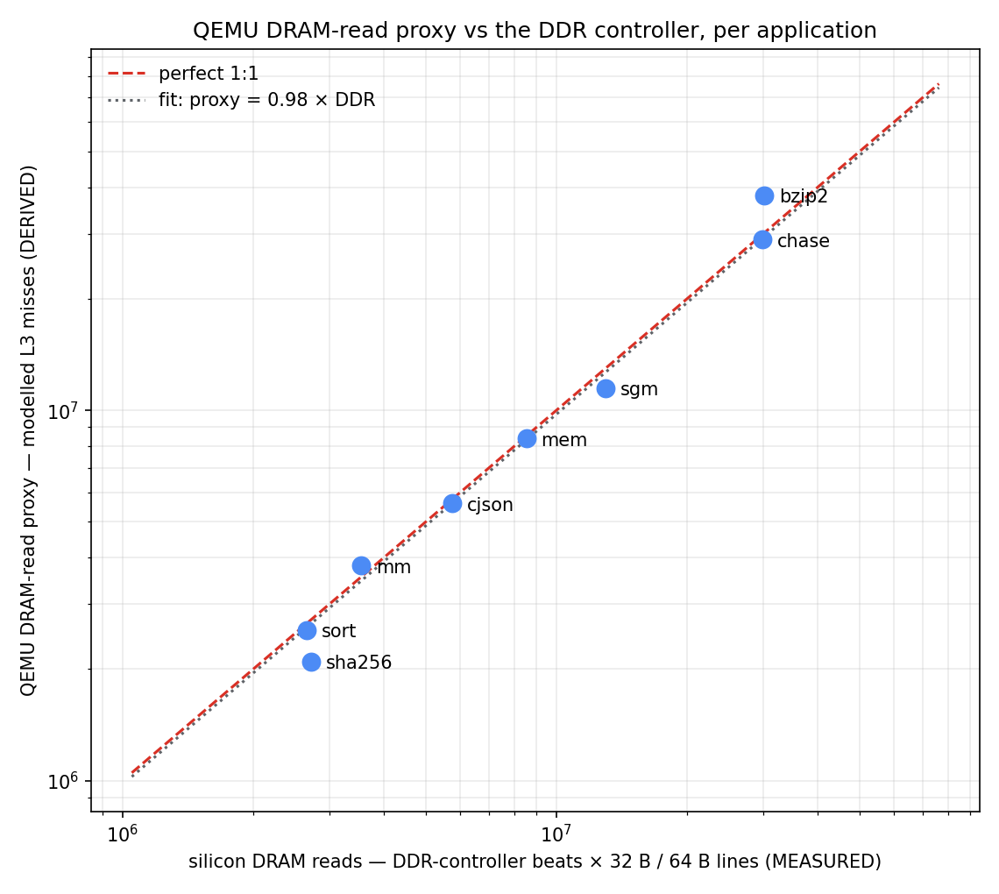
Gate 2 — DRAM reads vs the DDR controller
One point per application above the noise floor. Fit: proxy = 0.98 × silicon, ×/÷ 1.14.
Under-prediction was systematic and single-signed — the silicon prefetcher fetches lines nothing consumes. Modelling the prefetcher moved the fit from 0.81 to 0.98.
wattson xcheck · QEMU counts DERIVED, PMU/DDR counts MEASURED · 2026-08-31
11

Slide 12
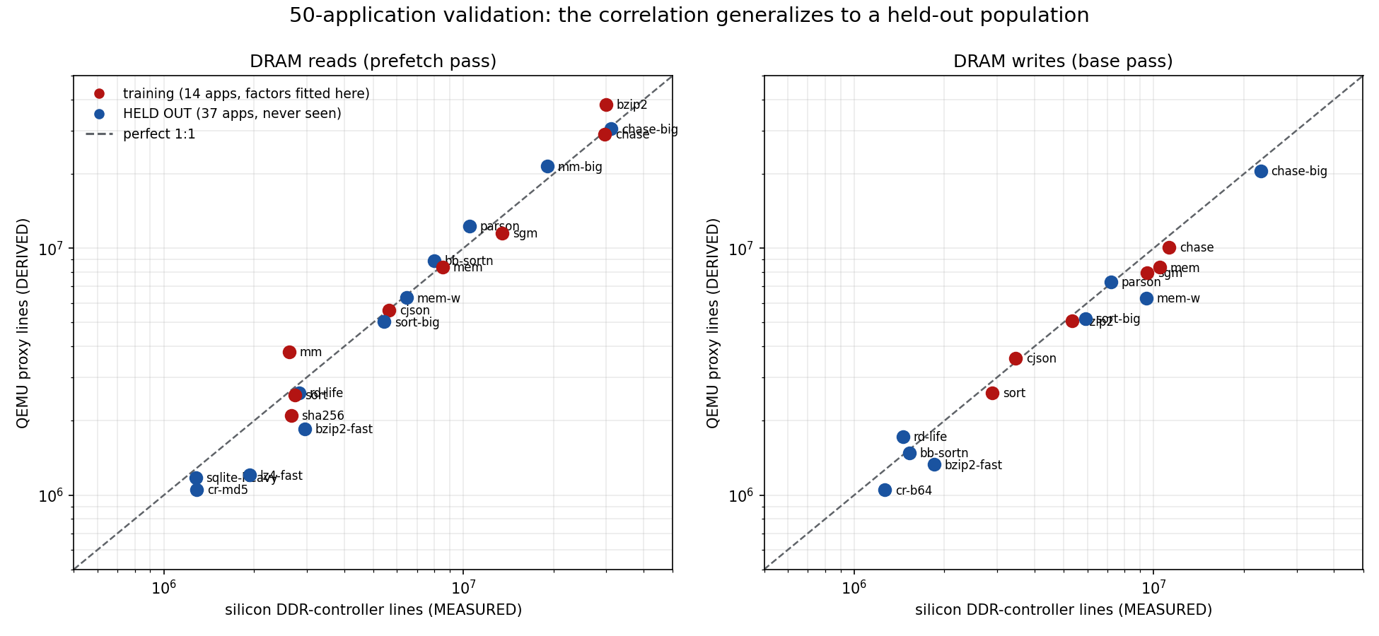
The 50-application held-out validation
Red = the 14 apps the corrections were fitted on. Blue = 36 applications measured cold.
Held-out instructions 0.979 ×/÷1.04 (n=37) · reads 0.91 ×/÷1.21, the SAME spread as the fitted set · writes 0.83 ×/÷1.28 · every DRAM-quiet app correctly classified.
wattson xcheck · QEMU counts DERIVED, PMU/DDR counts MEASURED · 2026-08-31
12

Slide 13
Every outlier resolved to a mechanism
The band tightened from ×/÷2.4 to ×/÷1.14. Each fix was falsifiable and predicted its own after-number.
observation | mechanism | fix | after
mm reads 0.44 | plugin cache ≫ real 64 KiB L2 | model the sysfs hierarchy | 0.65
mem reads 1.97 | A55 write-streaming: no-allocate store bursts | streak detector, ≥4 lines | 0.98
sha256 'reads 15×' | PMU counts demand refills only | ground-truth at the DDR controller | 0.77
4 apps read ~0 | below the DDR counter's noise floor | classify, don't fit | predicted quiet
writes 0.02–0.09 | scattered stores exit as dirty EVICTIONS | dirty-line set + eviction counting | 0.90 ×/÷1.09
sgm-mt insns 1.23 | OpenMP barrier spin, not work | OMP_WAIT_POLICY=passive | 0.985
reads 0.49–0.77 | silicon prefetcher traffic never issued | 8-stream table, miss-trained, ramped | 0.98 ×/÷1.14
Five further hypotheses were falsified and recorded rather than quietly dropped. Mechanism-first iteration converges; fudge-factor iteration does not.
wattson xcheck · QEMU counts DERIVED, PMU/DDR counts MEASURED · 2026-08-31
13

Slide 14
What is closed, what is open
CLOSED
OPEN
gap | result | how
Writes | 0.02 → 0.90 | writeback model
Kernel share | MEASURED | system-mode boot-differential
Multi-core | thread-invariant | 13-point sweep, spin-wait proven
Reads | 0.81 → 0.98 | stride prefetcher
item | path
Energy coefficients | yours — needs instrumented rails
NPU activity | Neutron model in build
GPU activity | GLES command-stream scope — next investigation
DMA payload | count it in the device model
REPRODUCIBILITY
One command per side: run-qemu.sh, run-perf.sh, run-ddr.sh. All 50 measurement vectors are committed. This deck regenerates from those vectors — no number in it is typed by hand. The QEMU cache-plugin patch ships in the repo.
SCOPE
These are ACTIVITY correlations. wattson never emits watts: it supplies N, you supply eᵢ, and E = Σ eᵢ×Nᵢ stays your calculation.
wattson xcheck · QEMU counts DERIVED, PMU/DDR counts MEASURED · 2026-08-31
14

