Slide 1
MIS 4173 SYSTEMS ANALYSIS AND DESIGN · SPRINT 2 REVIEW
QuickPhone Repair
Tracking System
Requirements and analysis: what the system must do, and how the models fit together
Kyle Robertson · Ehsanullah Pardisi · Bara Abusamhan · Leonard Mann
Checked In
Diagnosing
Awaiting Approval
In Repair
Ready for Pickup
Closed
Every repair, from check-in to pickup, at both stores
Notes:
Introduce the team and the client: Quick Phone Repair & Designs, two stores in Raleigh, owner Ashiqullah Pardisi.
Sprint 2 was requirements and analysis. We'll cover the problem, the requirements we're defending, how the models connect, the value, and what we need from you for Sprint 3.
The chain along the bottom is the job status list. It runs through the use cases, the DFDs and the ERD, and you'll see it again.

Slide 2
Two stores, no shared view of repairs
1 Problem 2 Requirements 3 Models 4 Value 5 Reflection
Sprint 1 problem statement, unchanged after the client interview
Staff cannot see, in one place, where each repair stands and which parts it needs.
50%
fewer "where's my phone?" calls per store, within 60 days
1
Customers call to ask where their device is
Front Desk stops work to find the answer
50%
fewer jobs stuck on parts for more than 5 days
2
Jobs stall waiting on parts
Low stock is noticed too late to reorder
3
Devices can be lost or released to the wrong person
No consistent tag or release check
0
devices lost or released to the wrong person, per quarter
Targets from Sprint 1; baseline figures still to confirm with the owner.
QuickPhone Repair Tracking System · Sprint 2
2
Notes:
The problem hasn't changed since Sprint 1: there's no single, shared view of repair jobs and parts across both stores.
That causes three things: status calls, jobs stalled on parts, and the risk of a lost or wrongly released device.
Those three map to the success measures on the right. They're still targets: we don't yet have the owner's baseline figures, which we'll come back to under limitations.

Slide 3
What changed since Sprint 1
1 Problem 2 Requirements 3 Models 4 Value 5 Reflection
The 21 September client interview confirmed seven requirements; four of them changed the design
SPRINT 1 ASSUMPTION
SPRINT 2, CLIENT-CONFIRMED
Purchasing
The Manager orders parts on their own authority
The Owner approves every purchase order (new use case UC-09)
Parts
Parts are reserved for a job, then consumed
Parts are deducted automatically when a technician logs them
Customer email
Alerts on several status changes
One completion email, sent from the store's account
Who can email
Any staff member
Owner, Manager and Front Desk only, never Technicians
Also confirmed: four roles, the intake-to-closure workflow, and email as the only customer channel.
QuickPhone Repair Tracking System · Sprint 2
3
Notes:
The client interview on 21 September confirmed seven requirements. Four of them changed what we're building.
Purchasing gains a control step: every PO now waits for the Owner, which adds a use case and new PO statuses.
Reservation is gone: a part leaves stock when the technician logs it.
Email is narrower than Sprint 1 assumed: one completion email, from the store's account, and Technicians can't send it.

Slide 4
The requirements that shape the design
1 Problem 2 Requirements 3 Models 4 Value 5 Reflection
Each one is client-confirmed and changes what a user does, not just what the screen shows
CLIENT-CONFIRMED
CLIENT-CONFIRMED
Owner approves every purchase order
Gives the Owner control of spending. Adds an approval queue and a "Pending Approval" status.
Parts deduct automatically on use
Keeps stock accurate without a reservation step. Stock cannot go below zero.
CLIENT-CONFIRMED
CLIENT-CONFIRMED
Completion email only, never from Technicians
One trusted channel from the store's account. Sending is limited to Owner, Manager and Front Desk.
Release only after tag match and photo ID
Delivers the "no lost devices" goal. Who released the device is recorded on the job.
QuickPhone Repair Tracking System · Sprint 2
4
Notes:
Of our 24 requirements, these four do the most to shape the design. All four came out of the client interview.
PO approval adds a whole use case and a control the Owner asked for.
Automatic deduction replaced the reservation design we had in Sprint 1.
The email rule decides who sees the notification screen.
Release checks are how we meet the "no lost devices" target.

Slide 5
Our catalog versus the AI catalog
1 Problem 2 Requirements 3 Models 4 Value 5 Reflection
Our catalog: 18 functional and 6 nonfunctional requirements, 11 confirmed by the client
Claude Opus 5.5 produced 31 requirements from the same interview notes. We sorted every one.
11 restate ours
10 salient
7 spurious
3 conflict
Kept: 3 gaps we added
Rejected: 7 with no client source
✓
Awaiting Parts status
Shows which jobs are held up by stock
✕
Revenue and productivity reports
The Owner asked only for open repairs and parts
✓
Receiving against an approved PO
Closes the purchasing loop
✕
Editable email templates, warranty tracking
Never raised; warranty is still an open question
✓
Daily backup
Protects the shop's only record of open repairs
✕
2-second pages, 99.5% uptime, 5-minute email
Invented targets with no client basis
Limitation: the AI session had already seen our draft, so the comparison was not fully independent.
QuickPhone Repair Tracking System · Sprint 2
5
Notes:
We gave Claude Opus 5.5 the same 21 September interview notes and asked for a complete catalog. It returned 31 requirements.
11 restated what we already had. 10 were salient, and three of those exposed real gaps that we added: the Awaiting Parts status, receiving against an approved PO, and daily backup.
7 were spurious, with no source in the interview, so we rejected them. The performance targets are the clearest example: they sound professional, but nobody at Quick Phone asked for them.
The 3 conflicts are on the next slide.

Slide 6
Conflicts we resolved, and why we can stop
1 Problem 2 Requirements 3 Models 4 Value 5 Reflection
Where stakeholders pull in different directions, and how the catalog settles it
Owner vs Manager
The Owner wants to approve every PO; the Manager needs parts fast.
Why elicitation can stop
→ Manager creates, Owner approves; a spending limit is still open.
✓
The interview brought confirmations, not new processes
Client rule vs AI catalog
✓
Every Must traces to the client or the Sprint 1 process model
The AI emailed customers automatically when a technician marked a job done.
→ Drafted as staff-sent, so a Technician can never trigger the email.
✓
The AI's 31 items added refinements, but no new user or process
Front Desk vs Owner
A busy counter wants fast pickups; the Owner wants zero wrong releases.
✓
We reopen only if the two blocking answers add scope
→ Tag match and photo ID come before payment, every time.
QuickPhone Repair Tracking System · Sprint 2
6
Notes:
Three tensions mattered most.
Owner versus Manager: control of spending against speed. We kept creation with the Manager and approval with the Owner, so the control means something. Whether small or urgent orders skip approval is still a question for the owner.
The AI's automatic email would have let a Technician trigger a customer email, which the client ruled out, so we drafted it as staff-sent.
Front Desk speed versus release safety: the ID check comes first.
Why we can stop eliciting: the last interview confirmed what we had instead of revealing new processes, every Must is traceable, and the AI found refinements but nothing new. Two blocking questions remain, and if either adds scope we reopen elicitation for that item only.

Slide 7
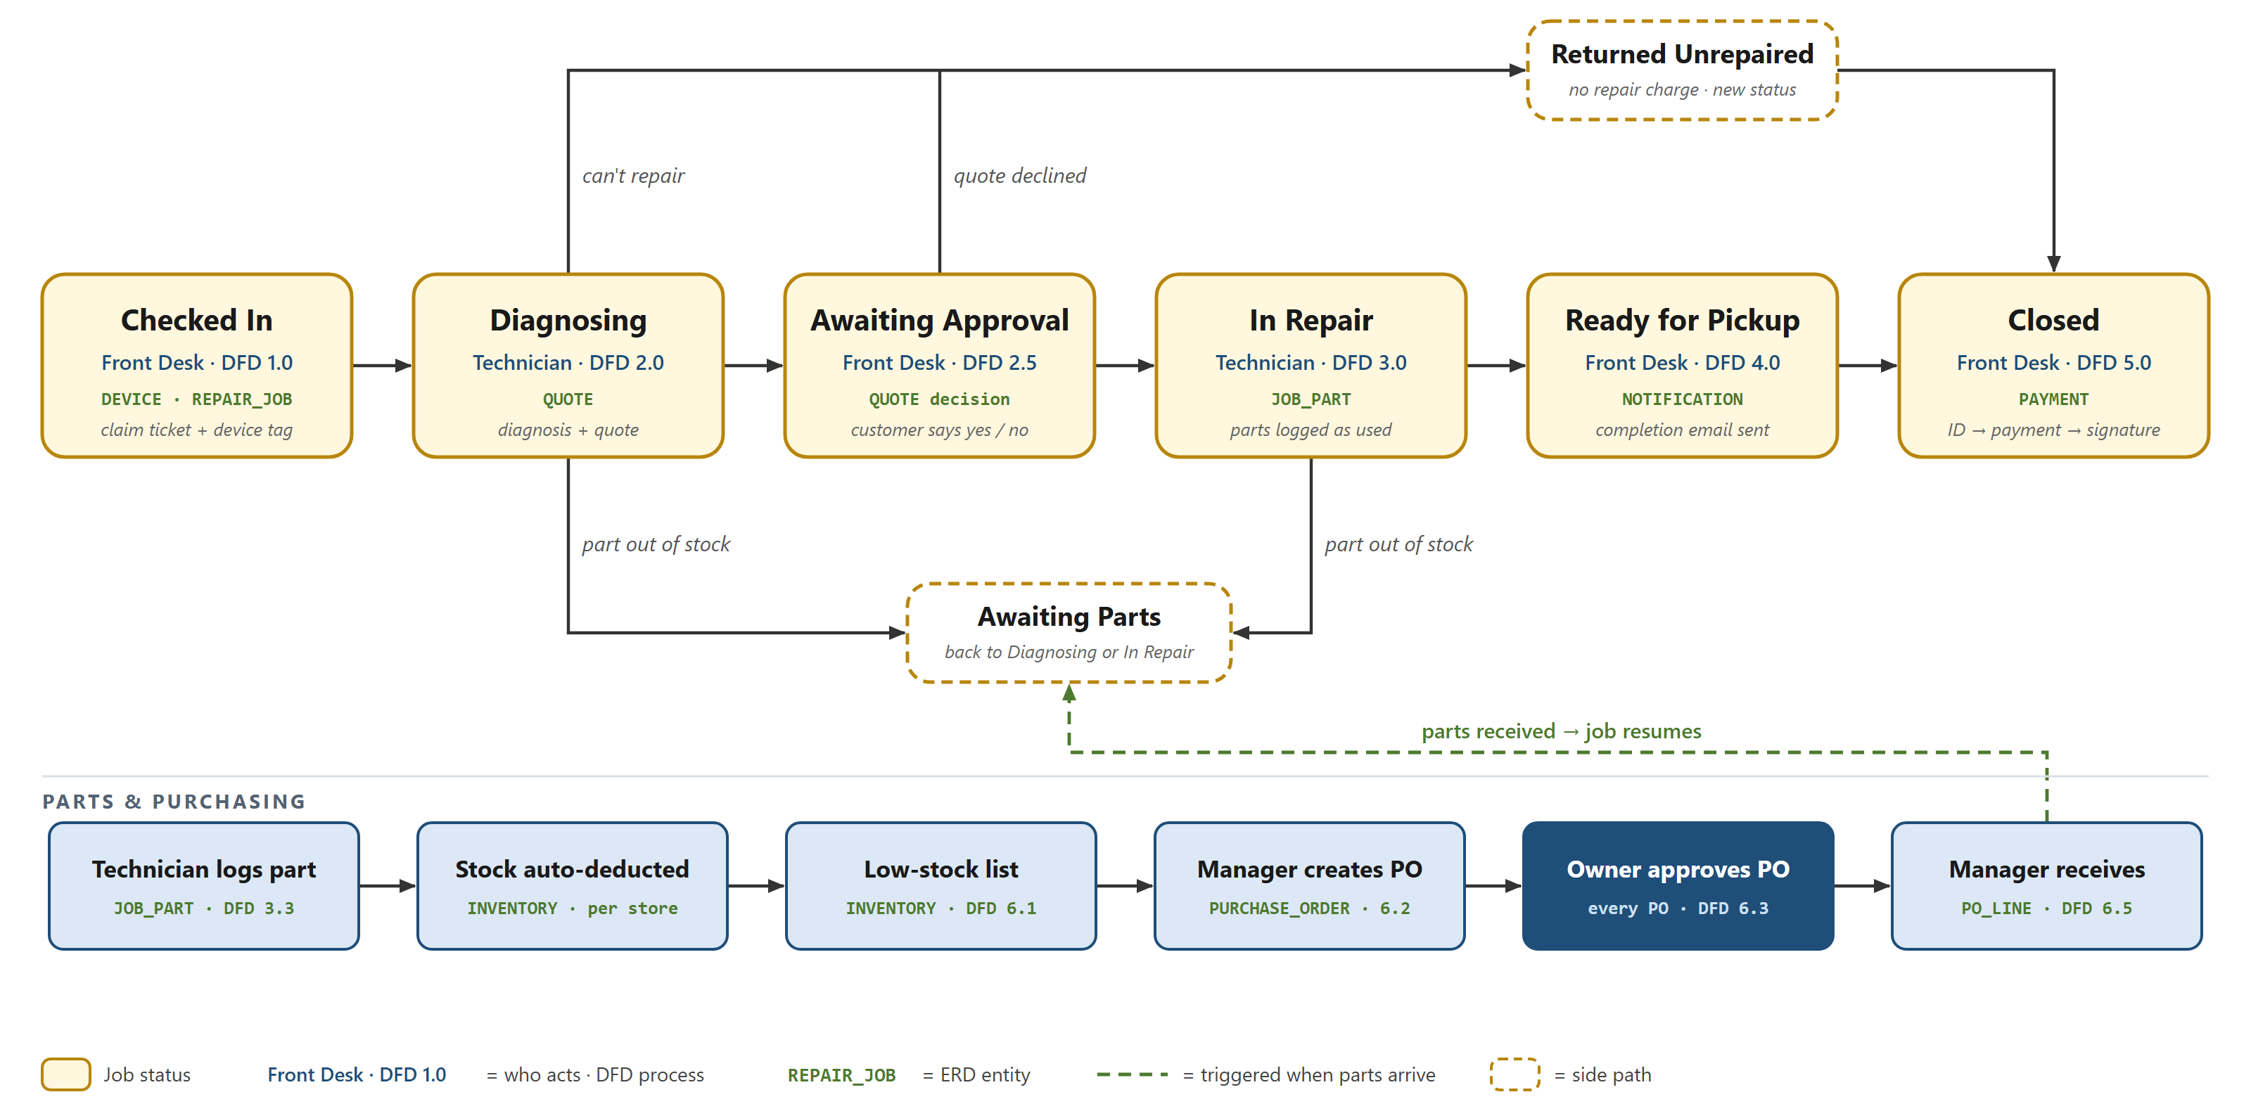
One repair, three models
1 Problem 2 Requirements 3 Models 4 Value 5 Reflection
Every user step in the use cases maps to a DFD process and the ERD entities it writes
QuickPhone Repair Tracking System · Sprint 2
7
Notes:
Walk one job through all three models: UC-06 Release Device. Front Desk is the actor; DFD 5.0 verifies ID, records payment and takes the signature; the data lands in PAYMENT and REPAIR_JOB.
Then the owner control: UC-09 Approve Purchase Order runs through DFD 6.3 and is stored as ApprovedByEmployeeID on PURCHASE_ORDER.
The seven DFD data stores hold the 23 ERD entities, and one status list runs through all three models.

Slide 8
Where the models disagreed
1 Problem 2 Requirements 3 Models 4 Value 5 Reflection
Four people built the models in parallel; we checked each one against the client's 21 September confirmations
Fixed, and why
Still open for the owner
✓
Dropped part reservation
The client confirmed parts deduct automatically on use
?
Unpaid release approver
Drafted as the Manager, with the reason saved on the job
✓
Added Returned Unrepaired
Declined jobs no longer get a "repair complete" email
?
Completion email
Sent by staff, or automatically when the repair is done?
✓
ID check before payment
The wrong person is never charged or handed a device
?
PO spending limit
And an urgent path when the Owner is unavailable
✓
DFDs renumbered
Every diagram now matches the final 11 use cases
?
Appointments and dashboard
Both are in the catalog, but neither has a use case yet
QuickPhone Repair Tracking System · Sprint 2
8
Notes:
The models were built in parallel, so they drifted. We cross-checked the catalog, use cases, DFDs and ERD against the client's confirmations.
Fixed: reservation was never confirmed, so it's gone. Declined jobs were landing in Ready for Pickup and would have triggered a "repair complete" email, so we added Returned Unrepaired. The DFD took payment before checking ID, so we swapped them. The DFDs cited an older use case numbering.
Still open: these go to the owner before Sprint 3 design.

Slide 9
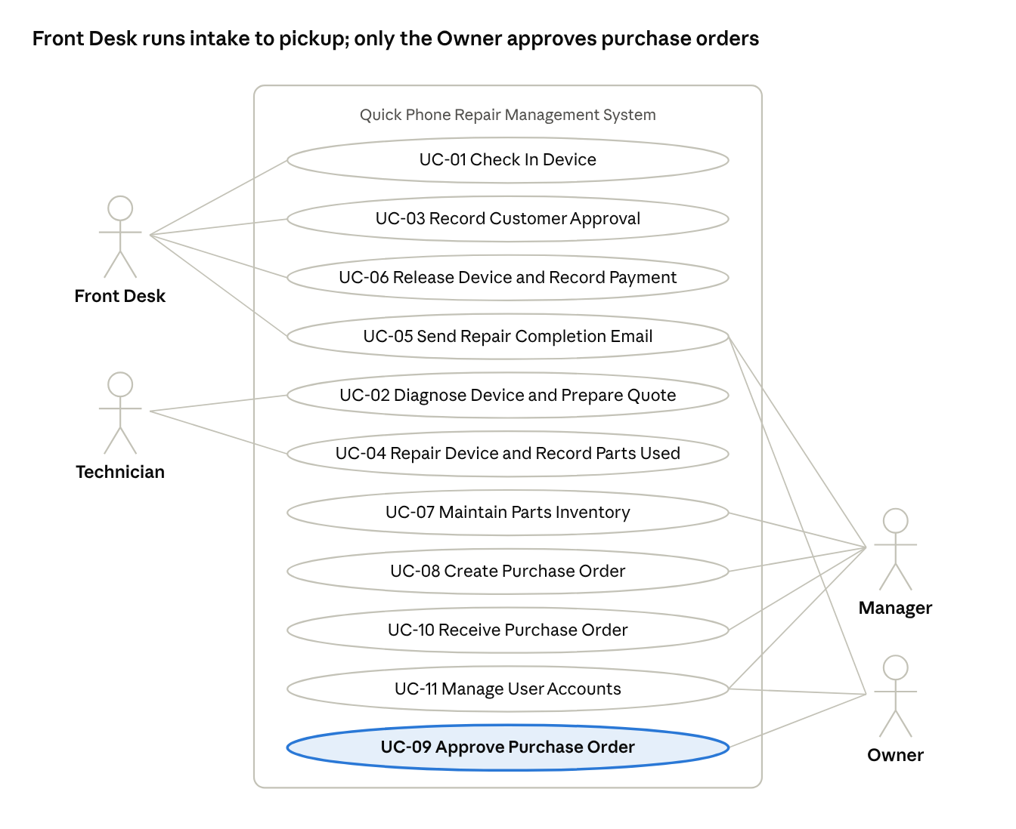
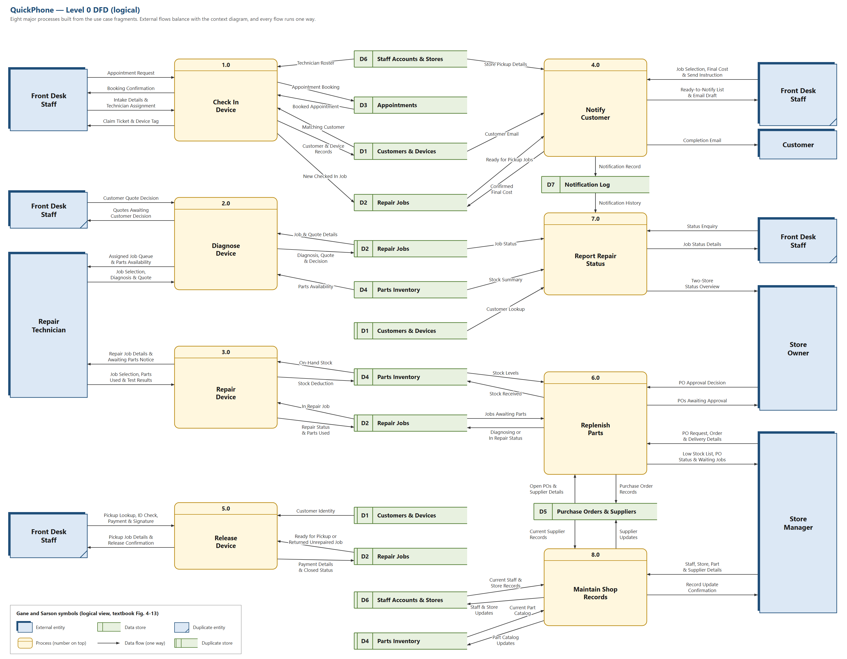
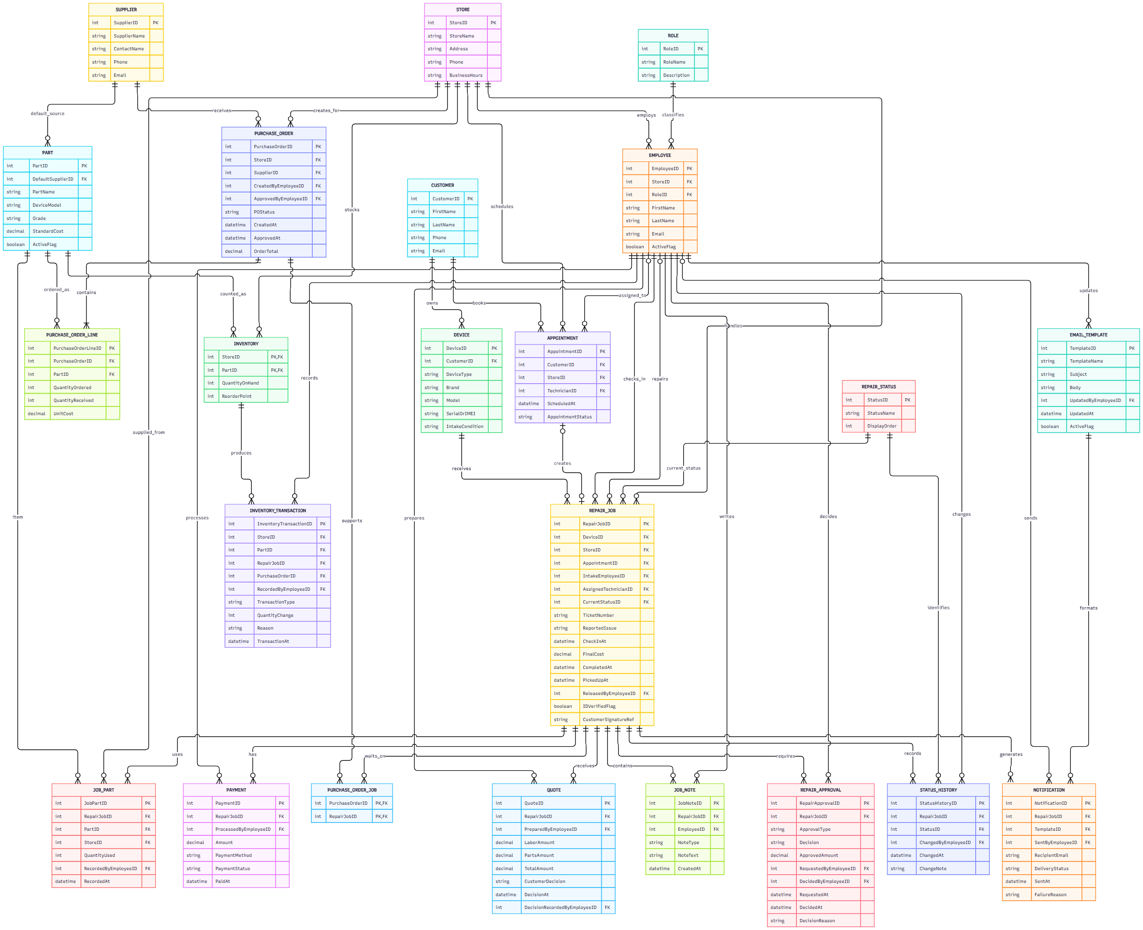
The Sprint 2 increment
1 Problem 2 Requirements 3 Models 4 Value 5 Reflection
An analysis package the owner can sign to freeze the MVP scope before design starts
24
11
9
23
requirements
use cases
data flow diagrams
ERD entities
11 client-confirmed
4 roles
context, Level 0, 7 Level 1
in 7 data stores
Use case diagram
Level 0 DFD
Logical ERD
Done means: every requirement has an acceptance check and a source, the DFDs balance, and all four models agree.
QuickPhone Repair Tracking System · Sprint 2
9
Notes:
This is the Sprint 2 PSPI: the requirements catalog and memo, 11 use cases, nine DFDs and the logical ERD.
It's potentially shippable because the owner can act on it: signing the catalog freezes the MVP scope, so Sprint 3 design starts from a fixed target.
Our definition of done: every requirement has an acceptance check and a source, the DFDs balance with the context diagram, and the four models were cross-checked against each other.

Slide 10
From models to outcomes
1 Problem 2 Requirements 3 Models 4 Value 5 Reflection
Each Sprint 1 goal now has a defined process, the data behind it and a clear beneficiary
GOAL
WHAT SPRINT 2 DEFINED
WHO BENEFITS
50%
A completion email from the store account (UC-05) and instant status lookup (DFD 7.0)
Front Desk gets fewer interruptions; customers know without calling
fewer status calls
50%
Awaiting Parts status, a low-stock list, and POs linked to the jobs waiting on them
Technicians resume sooner; the Manager reorders before stock runs out
fewer jobs stuck on parts
0
A device tag at check-in, then tag match and photo ID before payment and release
The Owner and customers: every release has a named staff member
lost devices
Estimated value: about $8,952 a year in staff time and fewer lost devices (Sprint 1 estimate, based on analyst assumptions).
QuickPhone Repair Tracking System · Sprint 2
10
Notes:
Rather than list features, here is how the work connects to the three goals.
Status calls: the completion email and instant lookup take the question away from the counter.
Parts: the Awaiting Parts status and PO links make delays visible before they become complaints, and jobs move back to the technician when parts arrive.
Lost devices: the tag and release checks put a named person on every release.
The Sprint 1 estimate puts this at about $8,952 a year in staff time, but those volumes are our assumptions until we have the owner's baseline.

Slide 11
Three AI decisions that shaped Sprint 2
1 Problem 2 Requirements 3 Models 4 Value 5 Reflection
We used AI to check our work, and kept the decisions with the team
1
2
3
AI catalog as a check, not a source
Rejected the automatic email
AI cross-check of all four models
WHAT THE AI DID
WHAT THE AI DID
WHAT THE AI DID
Claude generated 31 requirements from the same interview notes.
The AI sent the email when a technician marked a job done.
An AI review compared the catalog, use cases, DFDs and ERD.
WHAT WE DECIDED
WHAT WE DECIDED
WHAT WE DECIDED
We kept 3 gaps it found and rejected 7 with no client source.
That would let a Technician email customers, so we drafted it as staff-sent.
It caught reservation, status and numbering drift; we chose each fix.
QuickPhone Repair Tracking System · Sprint 2
11
Notes:
Three AI decisions mattered most.
One: we treated the AI catalog as a check on our own, not as the source. That's where the Awaiting Parts gap came from, and it's also why we rejected seven items the client never raised.
Two: the AI's automatic email looked efficient but broke a client rule, because a technician marking a job done would have emailed the customer.
Three: an AI-assisted review compared all four models and found where they disagreed. The team decided each fix, such as dropping reservation and adding Returned Unrepaired.

Slide 12
Limitations, and what we need from you
1 Problem 2 Requirements 3 Models 4 Value 5 Reflection
Your answers decide what we design in Sprint 3
Limitations
Feedback for Sprint 3 design
!
Only the owner was interviewed
No front desk or technician input yet
?
Staff-sent or automatic completion email?
Decides whether the pickup screen has a Send button
?
A PO spending limit, or an urgent path?
Decides the Owner's approval queue
!
Value figures are estimates
No baseline counts of calls, delays or lost devices
?
Who may release an unpaid device?
Drafted as the Manager
!
The AI comparison was not independent
The AI session had already seen our draft
?
Signature at pickup: keep it or drop it?
Sprint 1 removed it; our use case still captures it
!
Two catalog versions exist
They must be merged before sign-off
?
Do our intake fields match the counter today?
Sets the check-in form
QuickPhone Repair Tracking System · Sprint 2
12
Notes:
Limitations: we've only interviewed the owner; our value figures are estimates without a baseline; the AI comparison wasn't fully independent; and the catalog exists in two versions that we'll merge before sign-off.
Then ask for feedback. Each of these questions changes a Sprint 3 screen: the email decision changes the pickup screen, the PO threshold changes the approval queue, and the signature question decides whether we design a signature capture at all.
Ask the audience which one matters most for Sprint 3.

