Slide 1
Telecom Churn Prediction
Kyle Lawrence
May 24, 2018
Class: Mar 20 Part Time Data Science

Slide 2
Agenda
Problem statement
Data Source & Features
Exploratory Data Analysis
Model Selection
Conclusions

Slide 3
Problem Statement
How can we predict customer churn in the telecom industry?
A customer churns when they leave a product/service
Customer churn is important to understand:
  Customer retention costs are high
  Customer acquisition is even higher ^{[1]}
  Churn bleeds revenue to competitors
Annual rate of churn in telecom at 30% and growing as competition increases ^{[1]}

Slide 4
Data Source & Features
Retreived from Kaggle
Before cleansing: 7043 rows, 21 columns
Features include:
Product attributes
Customer attributes
Billing attributes
TARGET: churned (Y/N)
Dummy conversion:
has_internet_service
3 classes
contract
3 classes
payment_method
4 classes
Feature engineering:
Number of products
Hierarchical clustering
2 clusters
Silhouette score = 0.371
Post engineering: 7032 records, 25 features

Slide 5
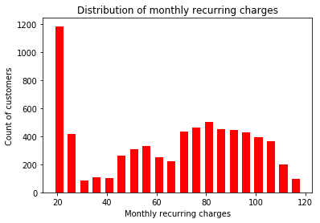
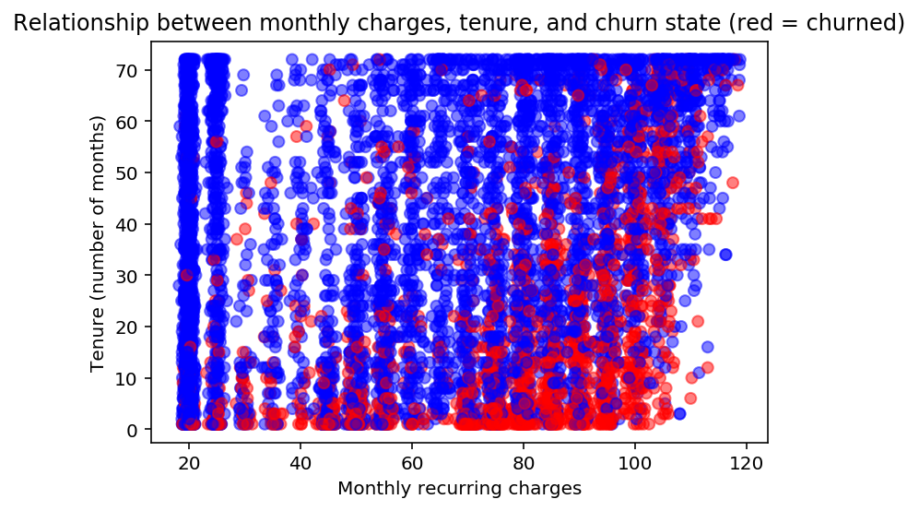
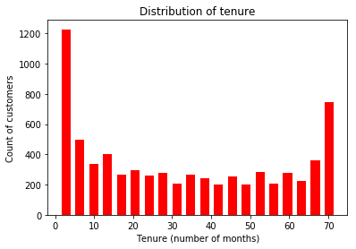
Exploratory Data Analysis
26% of dataset churned
Sex is insignificant
90% have phone service
Most churners had 2 to 5 products
Lot’s of multicollinearity between features, particularly problematic:
total_charges
num_products (doh!)
Generally low correlation between target and features
Some non-normal distributions
remove this feature
remove these features

Slide 6
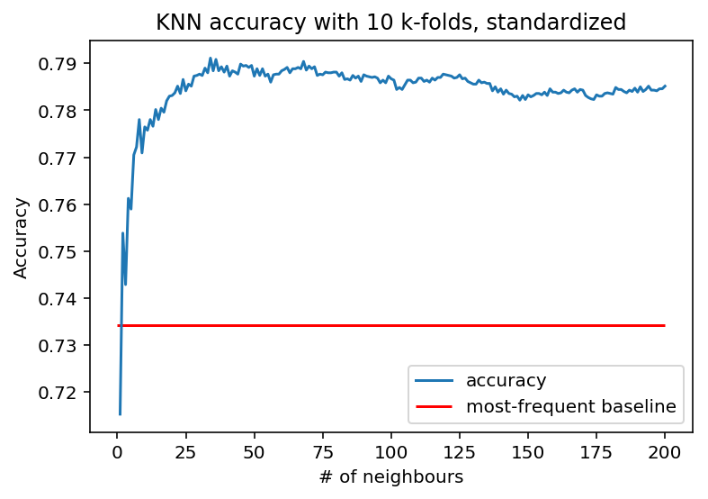
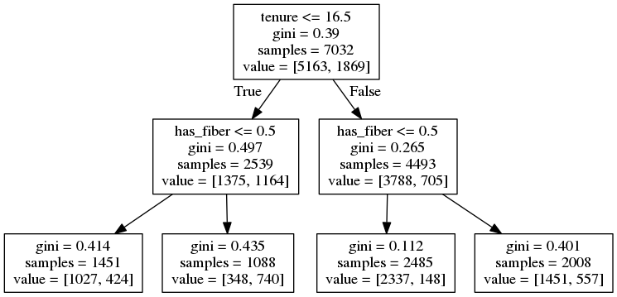
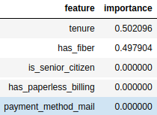
Modelling
K-Nearest-Neighbours
Why: good with irregular decision boundaries,
robust on standardized data
Standardized through sklearn.pipeline
22 features
Score=0.791, 5.7% better than baseline
Best k=34
Decision Tree (DT)
Why: not impacted by feature irrelevance, interpretable, fast
22 features
Score=0.789, 5.5% better than baseline
Best depth = 2
Grid search across 3 params: only depth matters
Gini coefficient only good on one node
Tenure and has_fiber are the only important features

Slide 7
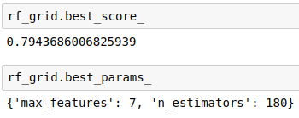
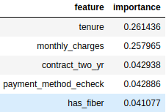
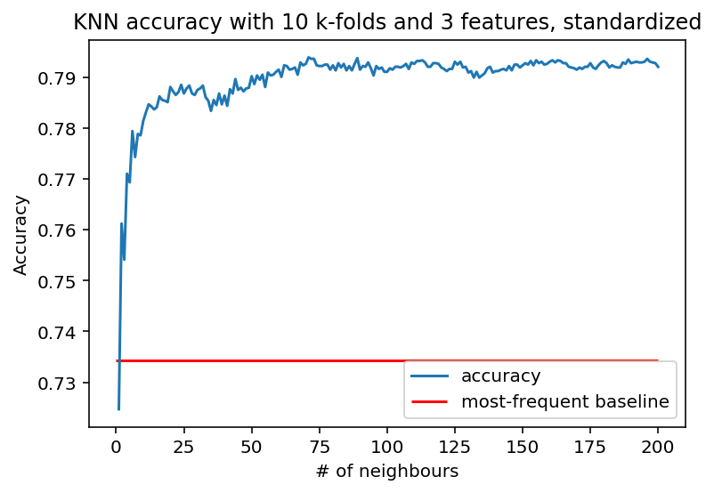
Modelling (cont’d)
Random Forest Classifier (RFC)
Why: better accuracy, competitive with best supervised learning
22 features
Best score = 0.794
Grid search yields max features=7, n_estimators=180
Tenure and monthly_charges important, but worse than decision tree
0.5% better than decision tree
K Nearest Neighbours, 3 features
Why: KNN does well absent of feature irrelevance
Based on DT, RFC: tenure, monthly_charges, has_fiber
Score = 0.794
Best k = 71
Negligibly better than high-dimension KNN

Slide 8
Conclusions
None of the models performed much better than the baseline – only about 6% more accurate than predicting no churn for everyone
Next steps:
Normalize distributions
More dimensionality reduction
Possible rebalancing of some classes
Investigate other models (logistic & linear classifier)

Slide 9
References
[1] https://ieeexplore.ieee.org/document/6340176/

