Slide 1

DriverPass System Analysis
Kyle Hake
Notes:
[No speaker notes required for this slide.]

Slide 2

System Requirements
Functional Requirements
The system shall have different types of users with different levels of access to various parts of the platform.
The system shall have a scheduling system so that the students can make/cancel appointments for on-the-road training.
Non-Functional Requirements
Adaptability: The system should be updatable as DMV rules and regulations change.
Performance Requirements: The system shall be built in the cloud to maximize resources and scalability.
Notes:
We are going to start today by going over the system requirements for the DriverPass system. There are quite a few functional and non-functional requirements of the system that need to be met in order for it to work the client. The system will need to have various user roles and different levels of access for these roles. This gives the CEO/CIO more control over the system, as well as the ability to block users, reset passwords, and other admin tasks. The system also needs to have a scheduling system for the on-the-road training for the students. This is paramount because packages made by DriverPass will be purchased by students so that they can complete training to get ready for their driving tests. Having a schedule that updates quickly and efficiently will provide the best overall experience for the customer.
The non-functional requirements are important as well because they can impact compliance as well as company growth. The system needs to be adaptable so that it can stay current will all changes in the DMV rules and regulations. If material is outdated, it could lead to legal issues with local and state level agencies. The system also needs to be cloud based so that I can expand and contract as the company grows and changes in the future.

Slide 3
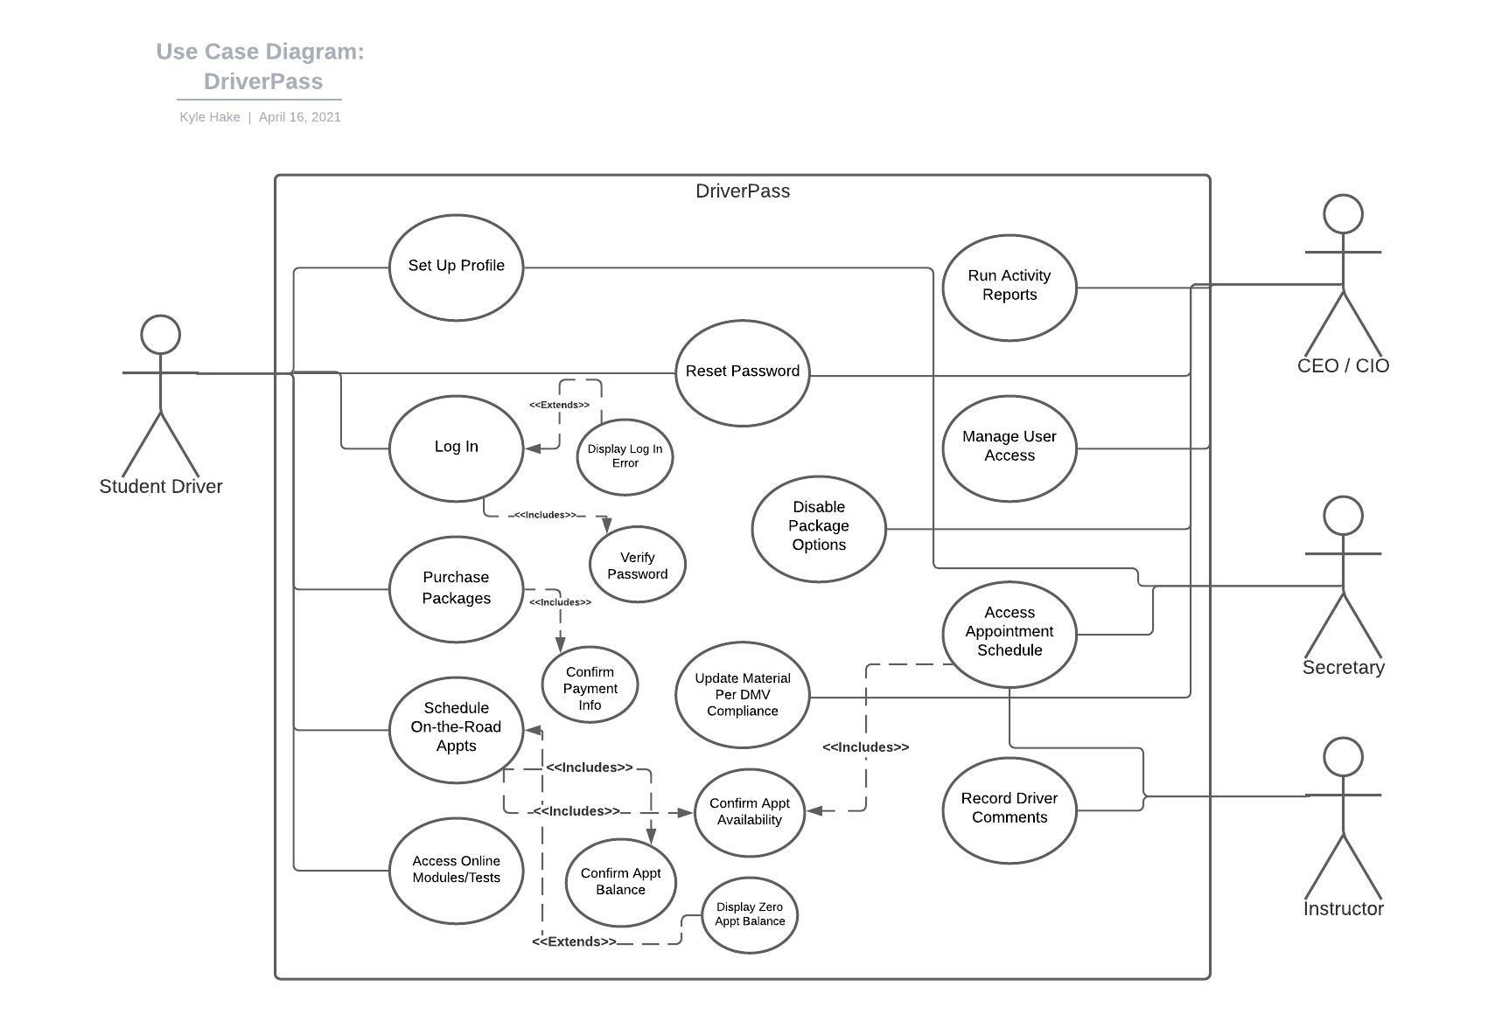
Use Case Diagram
[Insert your use case diagram here.]
Notes:
In this diagram, we are going to take a look at the different people that could be involved in the system, and what different activities they need to be able to take in the system in order for DriverPass to be functional. On the left, we have the student driver. The student needs to be able to make an online profile, purchase packages for driver training, as well as make on-the-road appointment and access learning modules and tests. These functions are all important for the student driver to be able to practice and learn to pass their driver’s tests. On the right, we have different people involved on the company’s side of the system.
At the top we have the CEO, or admin level employees that need the most access to the system so that they can add or remove access by others, update learning modules in accordance with the DMV, as well as update package options and run activity reports to have a transparent view of the system. The secretary needs to be able to make appointments on behalf of the students, and the driving instructors need to be able to see what their teaching load and leave drivers notes for the students.

Slide 4
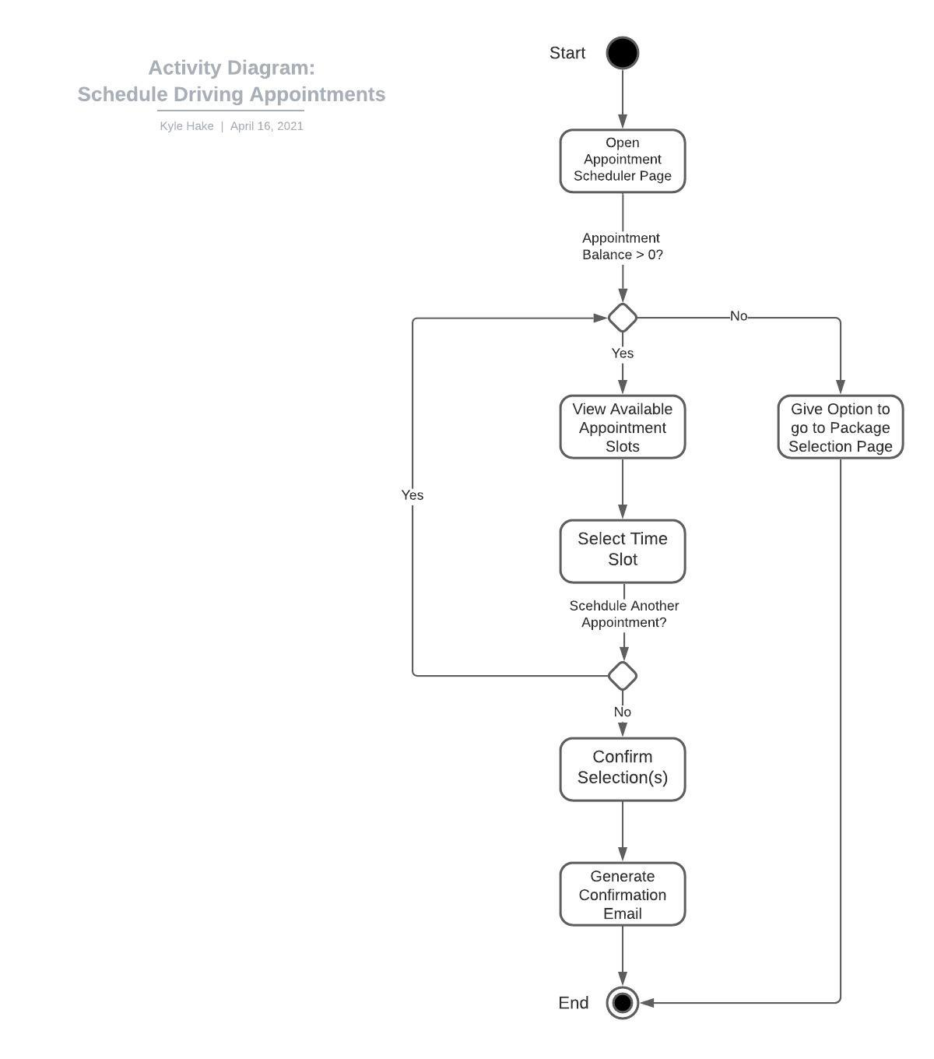
Activity Diagram
[Insert one of your activity diagrams here.]
Notes:
The previous diagram can be further broken down into each activity, and what each activity might look like from start to finish. In this example, we will look at the process of the student scheduling an appointment in our DriverPass system. When the student navigates to the appointment scheduler, the system first needs to check and see if the student has any available one-the-road hours left to be able to use for their appointment. If the student’s balance is zero, they should be prompted to move to the package selection page to be able to buy on-the-road training. If there are hours available, the scheduler should allow the student to filter by day and time to figure which time slots would works best for them. Once a day and time is selected, the student can then enter pick-up details like the street address, so the instructor knows where to meet. Once the appointment is booked, the student can then go back and repeat the process if they want to book more than one appointment at a time. Once selections have been made and the pick-up details entered, the student should be able to review and confirm the appointments. After confirmed, confirmation emails should be sent to the student with the details of the appointment for their own calendar/records.

Slide 5
Security
User access, different levels of users
Admin
Students
Instructors
Data modification limitations
Notes:
In terms of security, the system design as a few different considerations that will help protect the system from unauthorized access. The system will have different levels of accessibility from a data standpoint, with admin privileges being only given to a handful pf people. Also, with this system being a cloud-based application, data modification will only be able to happen with a secure connection to the cloud.

Slide 6
System Limitations
The system is cloud based and must have internet access.
The system can only accept digital forms of payment (credit card, etc.)
Notes:
Overall, there are very few limitations to this system design. The system is cloud-based, so it must have an internet connection to be functional. This includes both the customer facing side and company side of the application. The system also only allows digital forms of payment (no cash).

