Slide 1
The Facets of Agile
The Scrum – Agile Approach of Project Management
Notes:
Hello everyone, my name is Kyle and I am here to talk about the Scrum-agile approach, the differences between agile and the traditional or waterfall approach to project management, roles in the scrum-agile team, and when to consider one over the other in different situations.

Slide 2
What is Agile?
Change in the process of project management
Adaptive vs. Rigid
Team Focused
Client - Oriented
Notes:
”Agile” or the agile approach is a change in the process of project management. It is an adaptive approach to project management that has evolved from the waterfall method from back into the 1970s to what we see today. The biggest difference seen between the two methods is that the waterfall method is a step by step or sequential, whereas the agile approach is much more simultaneous in terms of many different steps happening at once. This evolution of this process was driven heavily by the tech and software development sectors, but can be used in many different areas as well.

Slide 3
The Agile Manifesto
Individuals and interactions over processes and tools
Working software over comprehensive documentation
Customer collaboration over contract negotiation
Responding to change over following a plan
(Beck et al., 2001)
Notes:
The Agile Manifesto is a set of four “rules” or concepts that separates itself from the waterfall approach, and more importantly what it values in its approach over traditional project management. It pulls away from the traditional rigid structure by providing a more flexible, adaptive approach to project management. Each of these principles are what contrasts the agile approach to the waterfall method. Agile focuses on individual value to the team and process and that daily collaboration and interaction is important over strict processes and tools. This doesn’t mean that agile has no processes or tools, but that its processes are adaptive in nature and not set in stone. It values working software to present to clients at the end of each sprint by developing and testing simultaneously to deliver results. The agile method is much more customer or client centered in that it keeps the client in the loop continually through the processes so that changes or additions can be made easily if warranted instead of waiting until the end of a project for the client to be unhappy with the result. Its an adaptive approach that allows a quicker response to change or challenges instead of following a set plan that might derail too late in the game to remedy.

Slide 4


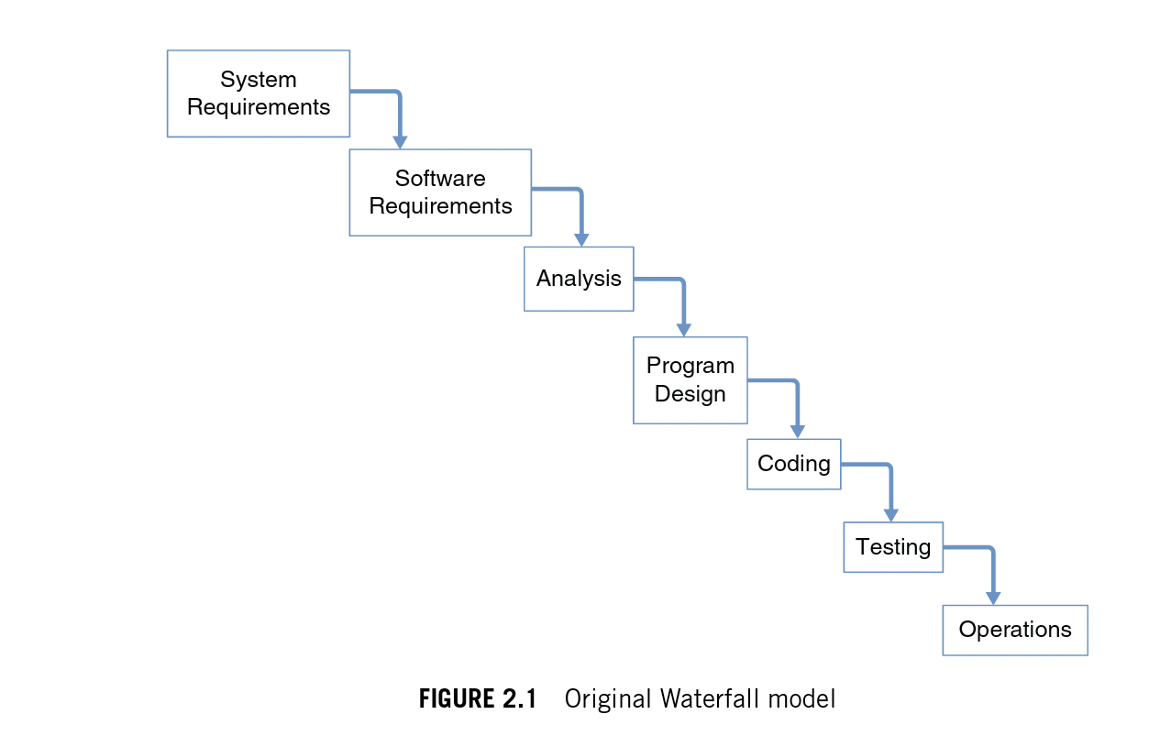

The Software Development Lifecycle: the Waterfall Approach
z
(Cobb, 2015)
Notes:
Now that we have talked a little about the agile approach in better detail, I wanted to go over the stark differences between it and the traditional or waterfall approach to project management. The waterfall approach is the more traditional approach to project management. It is sequential, with each step beginning after the other is completed until a finished product is released to the client. It is a very structured approach, but does have its drawbacks, which is why agile methods have become more popular in recent years. The more obvious issue is that the higher up an issues isn’t caught or presented in the waterfall method, the further a project can be setback once the issue arises. Also, with such a structured approach, the client isn’t as involved as with the agile, this can help cut down the ”wants” a client thinks should be in the final product. Having the client review and submit changes as the project goes cuts out unnecessary work that might have been an issue if he client gave everything they wanted at the beginning without them being edited periodically as the project went along. This give more of a balance of client/development team ownership in the final project as well.

Slide 5
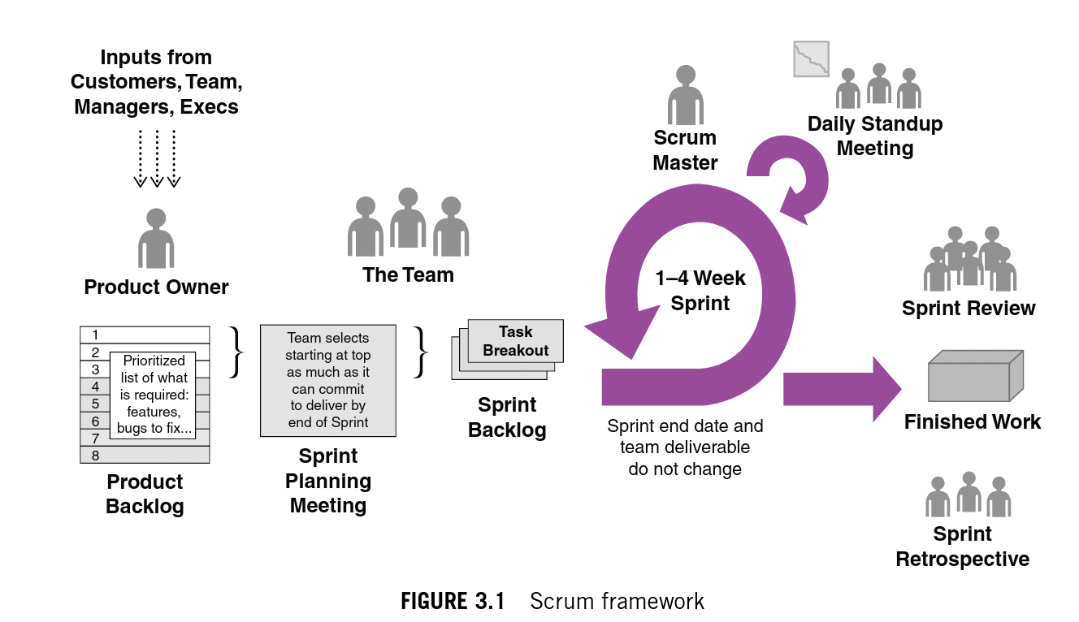
The Software Development Lifecycle: the Agile Approach
z
(Cobb, 2015)
Notes:
The agile approach is quite a bit different than the waterfall approach because it focuses on shorter, quicker, “sprints” that each ultimately delivers a workable iteration of the project that has been tested and cleared for the client to look at and evaluate. This a team centric approach in which the product owner works with the client, other managers, and stakeholders to build a product backlog. The backlog is a list of user stories that describes the features that are wanted or needed in the final product. This backlog is constantly being reviewed and edited; a process called “backlog refinement”. This is a process done by the product owner so that sprints can be planned with the rest of the team. At the beginning of sprint, a planning meeting is held with the whole team to pull items from the product backlog and develop what will be worked on during the sprint. This helps define the goals of the sprint so that everyone knows exactly what’s getting done for this particular sprint. The ”Sprint” is a 1 – 4 week-long process of which daily meeting (Scrum meetings) are held by the scrum master, product owner, and the team to work through the sprint backlog to develop, test, and deliver a workable product at the end of the sprint. At the end of each sprint, there is a review of what got finished, what got pushed back or didn’t get finished, and what might be on the list for the next sprint. This meeting is more of the quality improvement piece of the content of the sprint, and not the retrospective, which is of the process itself. The sprint retrospective is a review of the agile process itself, of what work, what didn’t and what can be done differently to optimize the upcoming sprint. This is the quality control of the team for the process so that improvements can be made going into the next sprint.

Slide 6
Scrum Roles
Product Owner
Scrum Master
The Development Team (Developers/Testers)
Notes:
So now that we have a foundational knowledge of what Agile is and how it compares to traditional approaches, there are a few roles to describe in the agile setting that might be be unfamiliar or have new responsibilities in the agile process that are important to review. The product owner oversees the product back log and works with the client and other stakeholders to figure out what needs to be on the backlog for the product to be a success. This includes refining and ordering the backlog, making sure that the whole team has access to the backlog, clarifying any misunderstanding of backlog items as issues arise, and providing direction to the team of how to work through the backlog. The Scrum Master is the agile process “servant – leader” of the team. The Scrum Master makes sure that manages external communications between outside members and the team to make sure the team can maximize efficiency during each sprint. The role is process driven, so the focus is on facilitating scrum events, working on finding techniques to effectively manage the backlog and keeping it clear and concise. The Scrum Master also coaches the team to be cross-functional and self-organized to create high-value products, as well as removes any distractions so the team can continue to progress. The Scrum Master is the cheerleader of the process to the entire organization to help adopt this type of methodology and its benefits to the company. The development team is in anyone on the the team that oversees taking user stories to produce deliverables at the end of each sprint. The team is cross-functional and self-organizing and work as a whole unit without subgroups or titles. They are responsible for the incremental work done through each sprint.

Slide 7
Agile v. Waterfall? – The SNHU Travel Project
Consistent communication
Clarifications as needed
The “Wellness/Detox” Pivot
Resolution
Notes:
The SNHU Travel project was a great starting point in getting our company familiar with the agile method and there were a few moments during the project in which the project would have had a few set-backs or delays that could have resulted in a suboptimal or overall failed product. The consistent communication with the team members of the Scrum team helped hammer out any details or “needs” from each other that could be addressed promptly to keep the project moving at a rapid pace. The waterfall method in this case may or may not have impacted the timeline, depending on the communication style of the traditional team. Unclear or miscommunications happen throughout the duration of any project, but keeping the client as involved as possible will help get a prompt response when clarification is needed that is outside of the realm of the team. In the waterfall method, this type of contact with the client isn’t always as defined, so a product might get to the end of the process before a client sees the issue because it wasn’t clarified as soon as possible. The biggest point in this project that really could have derailed a waterfall approach is the client’s pivot to wellness and detox approach to their project over the top destinations. The flexibility of the agile approach made it easy for the product owner to come back to the team with the change and everyone adapt the user stories and test cases to be able to satisfy the new need of the client. In waterfall, the rigid structure of the process might have caused a set back of several weeks because the product would have to go backwards a few steps to correct what is needed for the client. Overall, the project benefited from the agile approach because of its foundational concepts in communication, transparency, and the focus on the client.

Slide 8
Agile v. Waterfall – When to Choose Which?
One approach is not inherently better than the other
Understanding when to apply either or both
Level of Uncertainty
Notes:
In conclusion, the two approaches are vastly different in concept and in execution, but that doesn’t mean that one isn’t a better option than the other. If something was completely adaptable without any structure, then it might be hard to set starting points and direction of the project. On the other side however, complete inflexibility could lead to delays if changes needed to be made to the project. Finding a middle ground and when to apply which approach or a combination of the two is the art of project management and what will lead to the best chance of success. The only factor that might lend to a more agile approach is the level of uncertainty of a project. The more uncertain the structure and scope the project is, the more adaptable the project management approach will need to be to pivot when challenges and problems arise.

Slide 9
References
Beck, K., Beedle, M., Grenning, J., Fowler, M., Cunningham, W., Cockburn, A., & Van Bennekum, A. (2001). Manifesto for Agile Software Development. Retrieved December 10, 2020, from http://agilemanifesto.org/
Cobb, C. G. (2015). The project manager's guide to mastering agile: Principles and practices for an adaptive approach. Hoboken, NJ: John Wiley.

