Slide 1
ENEE759U Project Automated ILP Scheduling
Kyle Jiun-Guei Wu
Github repo:
https://github.com/kylejgwu/ENEE759-U---CAD-of-Digital-Circuits-Final-Project/tree/main

Slide 2
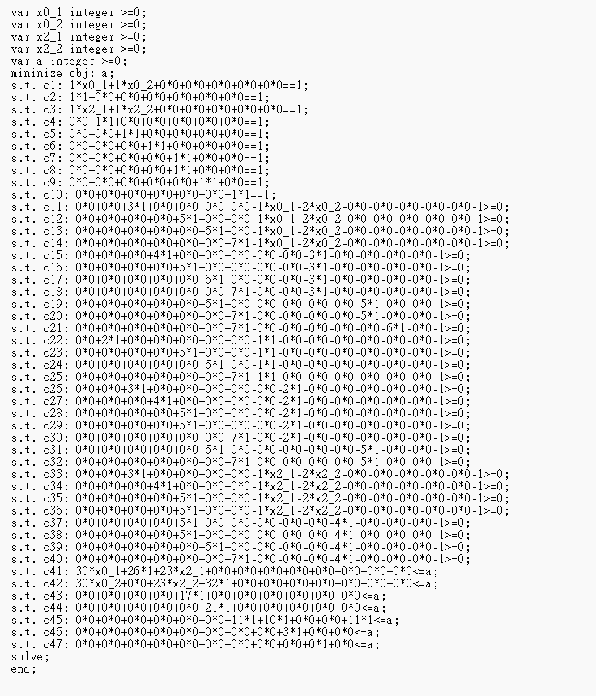
Current progress
Final goal: complete automatic
Current progress:
Mathprog file generated
separated from GLPK

Slide 3

Graph preprocessing
Edge list
Start node
Node 0
Node 0
End node
16
Memory
(Resource)
10
6
Node 4
Node 4
11
0
6
5
0
0
…

Slide 4
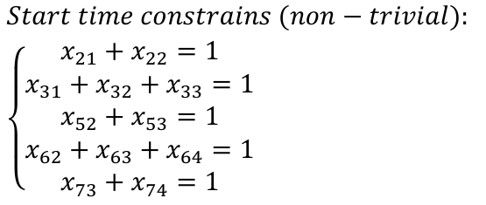
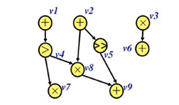
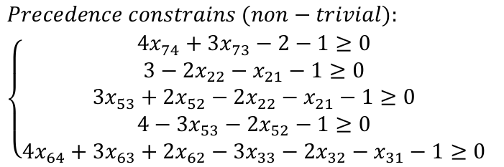
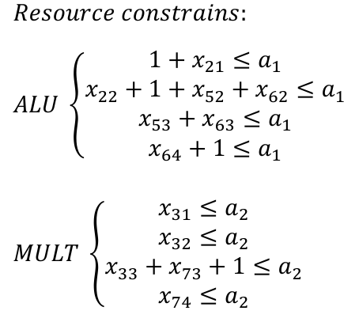
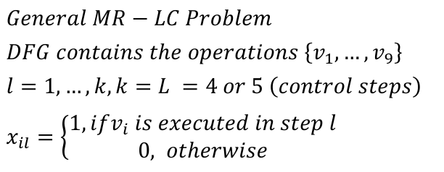

Problem mapping
1.
2.
3.
4.

Slide 5










Start time constrains
…
…
…
…
…
…
…
…

Slide 6
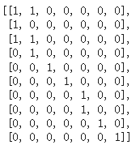
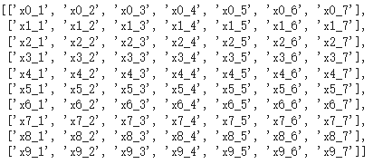
Start time constrains
0
1
2
ASAP & ALAP finding slacks
Example: testbench rand_DFG_s10_1.edgelist, l=7
3
4
5
6
7
8
9

Slide 7
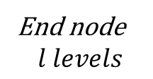
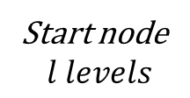













Precedence constrains
…
…
…
…
…
…
…
…

Slide 8










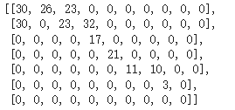
Resource constrains
…
…
…
…
…
…
…
…

Slide 9
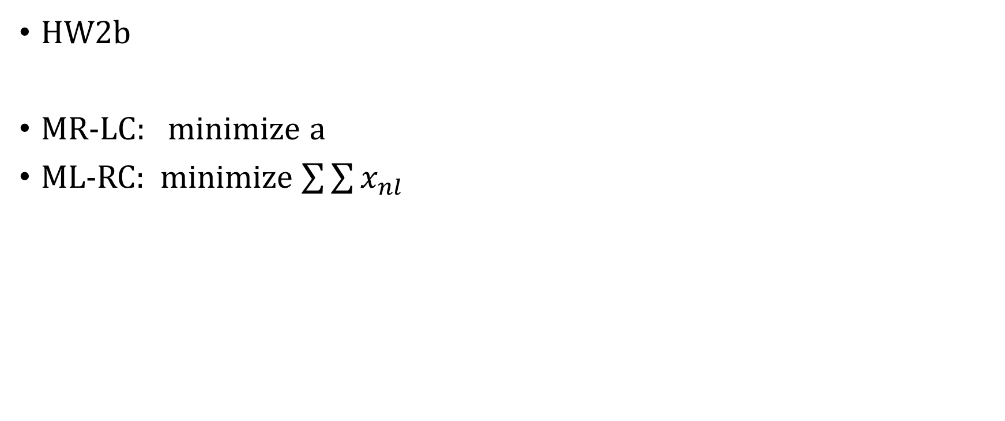
Objective function

Slide 10
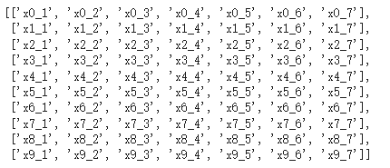
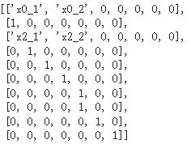
Pruning
Remove trivial terms by slacks

Slide 11
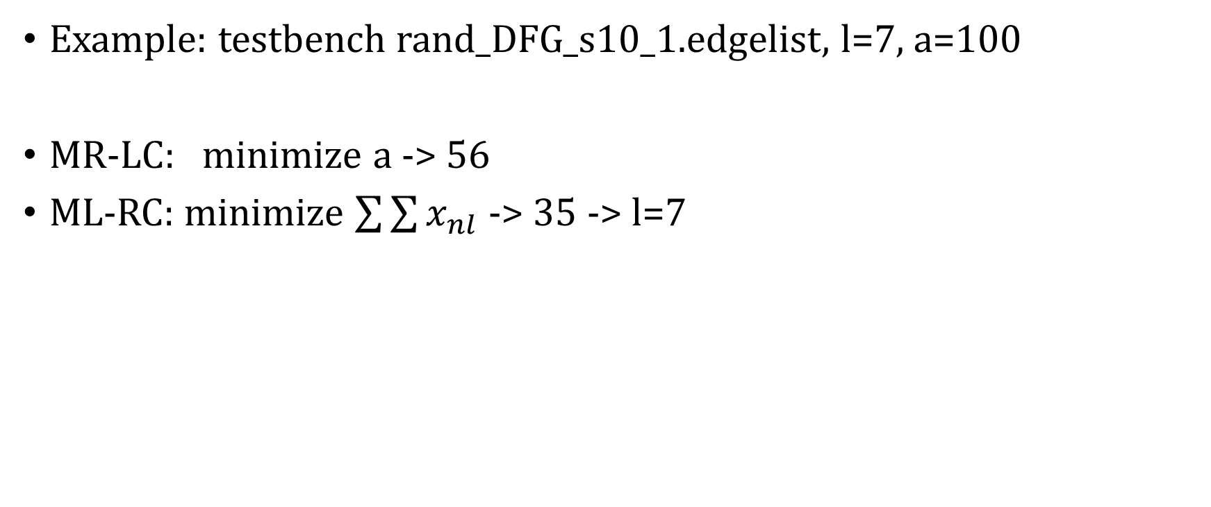
Results
0
1
2
3
4
5
6
7
8
9

Slide 12
End

Slide 13
Revision

Slide 14
Memory constraints
Previous solution:
memory constraints too optimistic
minimum memory = 11 (FALSE)
10
6
10
4
11
11
11
Correct answer: minimum memory = 15

Slide 15

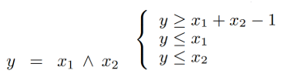
Memory constraints
Cutline determine
If the start node timestep < cutline < end node timestep -> using the memory
Quadratic formula simplification
edge 0
e edges
start node
1…t
end node
t+1…l

Slide 16
Pareto optimal analysis
Use ASAP to find L for starting point
Use MRLC with an input L to find M for starting point
Decrease L and increase M to find more points
Increase L and decrease M to find more points

Slide 17
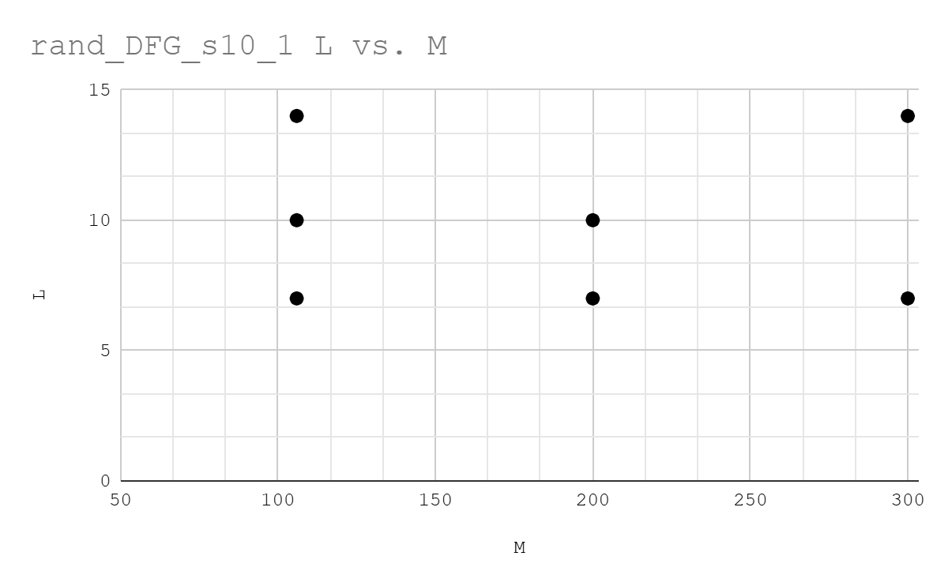
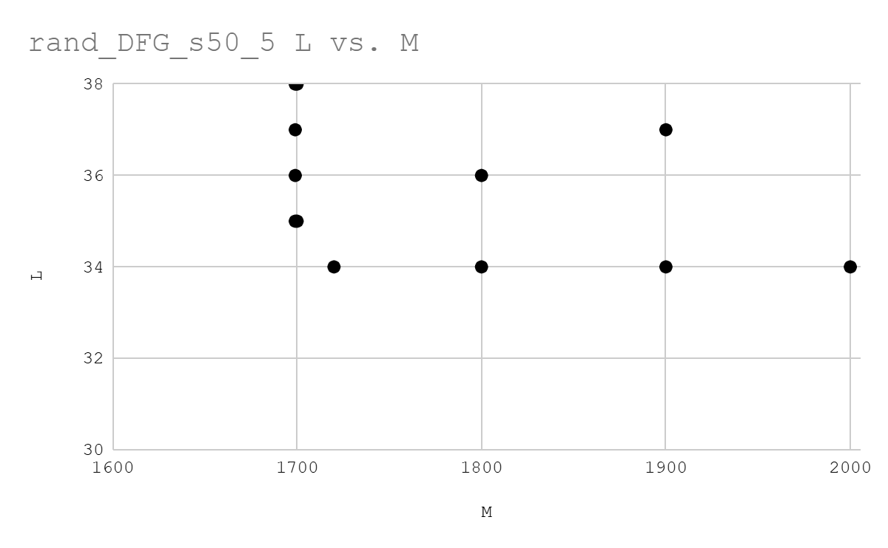
Results
MRLC
input
MLRC
input
Pareto-optimal front end
Pareto-optimal front end

Slide 18
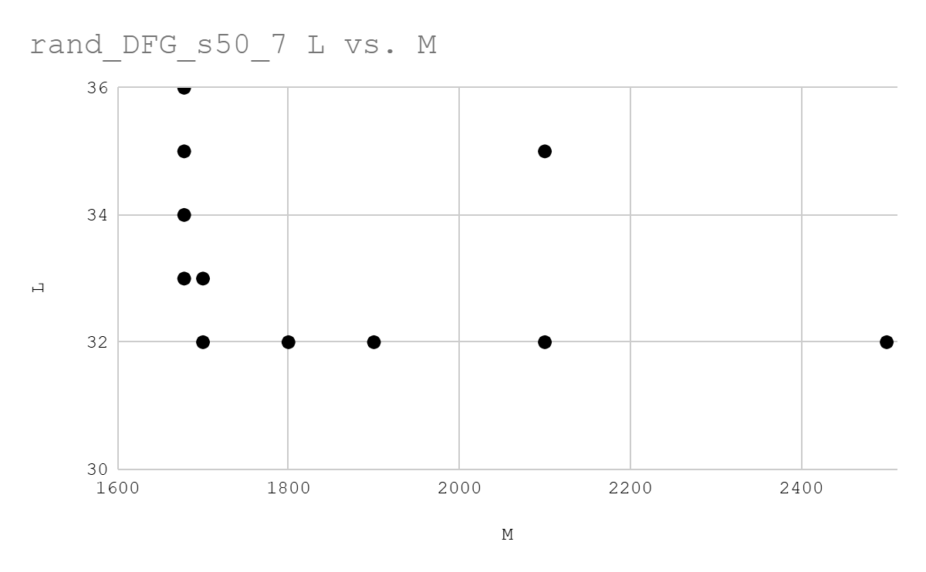
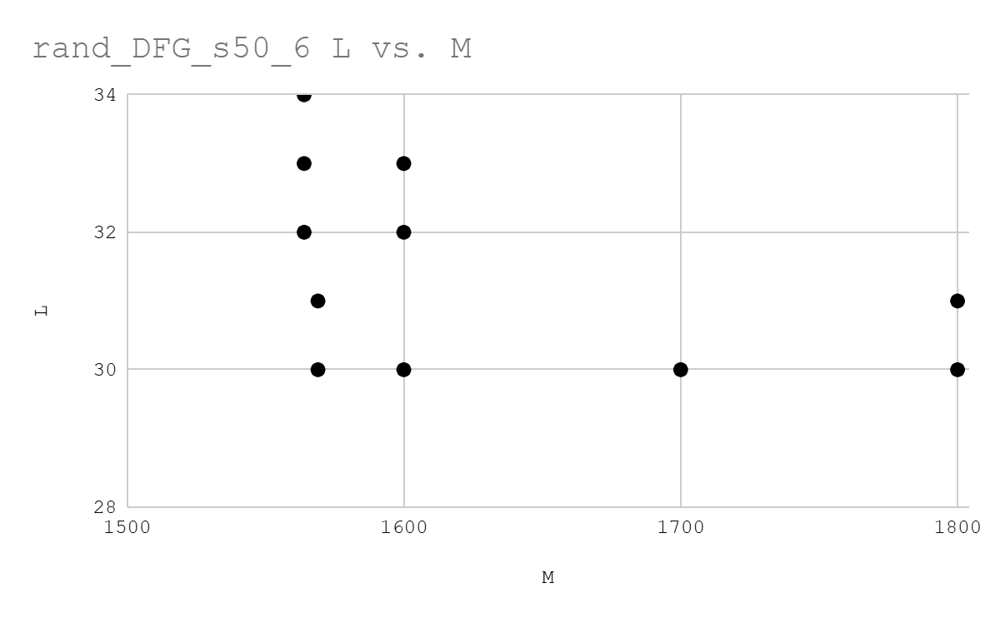
Results
Pareto-optimal front end
Pareto-optimal front end

Slide 19
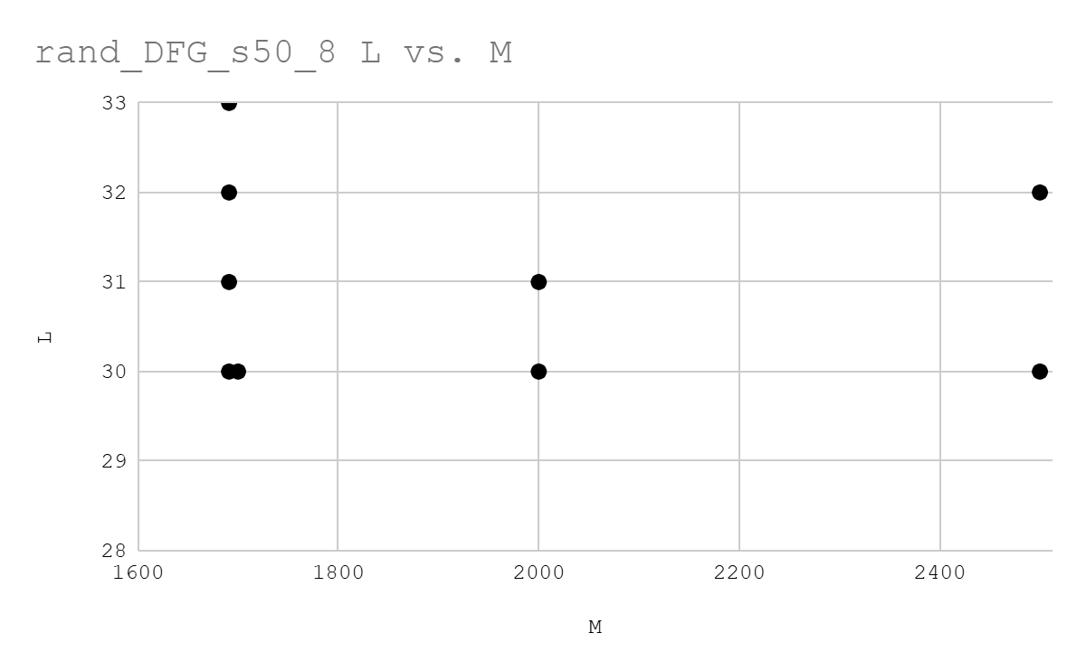
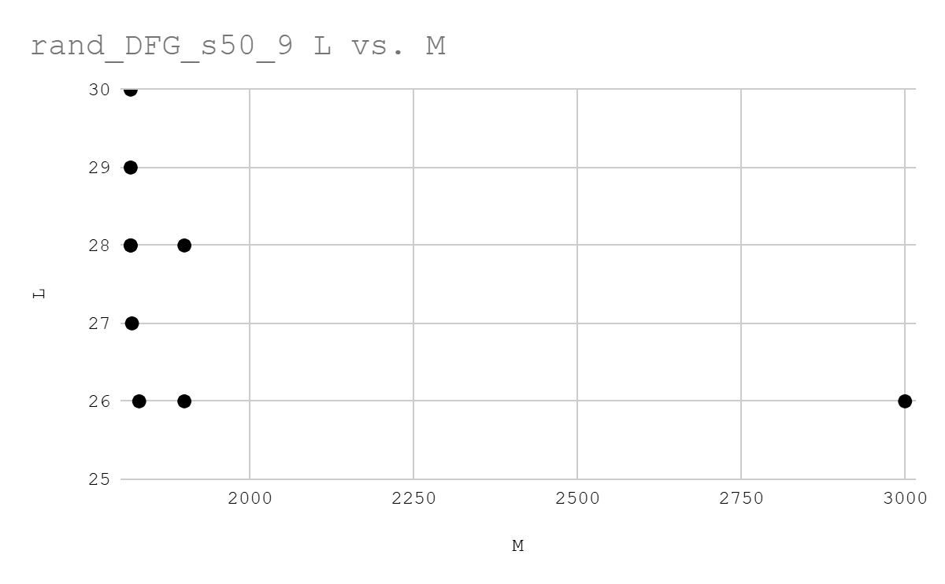
Results
Pareto-optimal front end
Pareto-optimal front end

Slide 20
IEEE Xplore Full-Text PDF:
REference

