Slide 1
Big Data
By
Naveen Kumar shella
Sahaja Reddy Naredla

Slide 2
Overview
Due to the advent of new technologies, devices, and communication like social networking sites, the amount of data produced by mankind is growing rapidly every year.
Till 2003 was 5 billion gigabytes.
If you pile up the data in the form of disks it may fill an entire football field.
Same amount was created in every two days in 2011, and in every ten minutes in 2013.

Slide 3
Introduction
Big Data:
Big data is an evolving term that describes any voluminous amount of structured, semi structured and unstructured data that has the potential to be mined for information.

Slide 4
Big Data
Big Data is a collection of large datasets that cannot be processed using traditional computing techniques. It is not a single technique or a tool, rather it involves many areas of business and technology
Big data involves the data produced by different devices and applications.

Slide 5
Continuation
Fields that come under the umbrella of Big Data.
Black Box Data
Social Media Data
Stock Exchange Data
Power Grid Data
Transport Data
Search Engine Data

Slide 6


Slide 7
Thus Big Data includes high volume, high velocity and extensible variety of data. The Data will be of three types:
Structured Data : Relational Data
Semi Structured Data: XML Data
Unstructured Data ; Word, Pdf, Text, Media logs.

Slide 8
3V’s
Volume:
2.7 Zetabytes of data exist in the digital universe today (2012)
Ford’s modern hybrid Fusion model generates up to 25 GB of data per hour
Google processes 20 PB a day (2008)
Facebook has 30+ PB of user generated data
CERN’s Large Hydron Collider (LHC) generates 15 PB a year .
A petabyte (PB) is 10¹⁵ bytes of data, 1,000 terabytes (TB) or 1,000,000 gigabytes (GB).

Slide 9
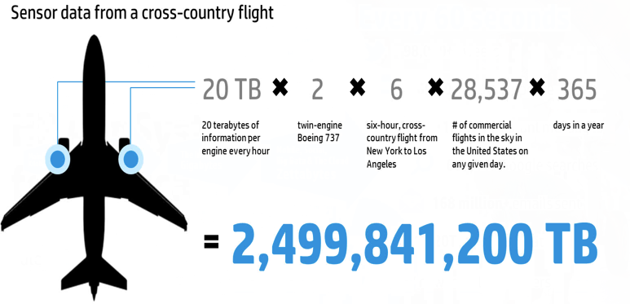
Volume

Slide 10
Velocity
YouTube users upload 48 hours of new video every minute
The LHC experiments represent about 150 million sensors delivering data 40 million times per second.
Twitter has 50 million tweets per day (2012)
Prozone tracks 10 data points per second for every player, or 1.4 million data points per game

Slide 11
Variety
Big Data isn't just numbers, dates, and strings. Big Data is also geospatial data, 3D data, audio and video, and unstructured text, including log files and social media.
Traditional database systems were designed to address smaller volumes of structured data, fewer updates or a predictable, consistent data structure.
Big Data analysis includes different types of data

Slide 12
Processing Big Data
Integrating disparate data stores
Mapping data to the programming framework
Connecting and extracting data from storage
Transforming data for processing
Subdividing data in preparation for Hadoop MapReduce
Employing Hadoop MapReduce
Creating the components of Hadoop MapReduce jobs
Distributing data processing across server farms
Executing Hadoop MapReduce jobs
Monitoring the progress of job flows

Slide 13
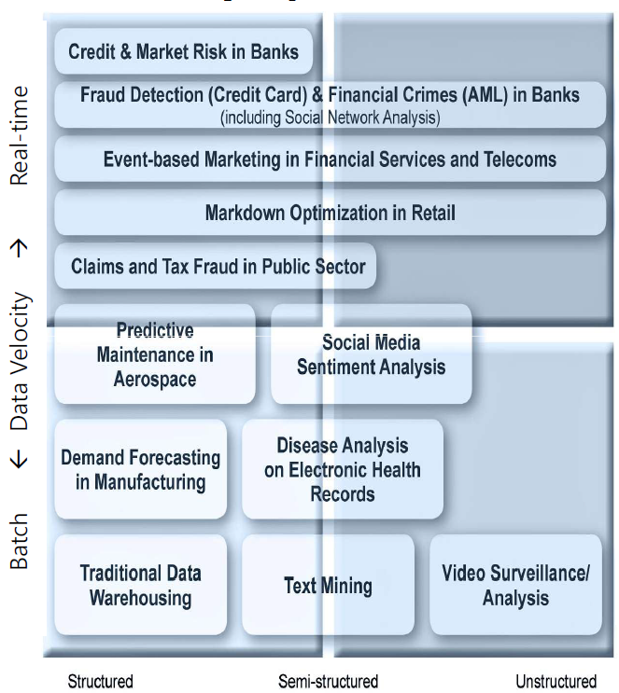
The Structure of Big Data
Structured
Most traditional data sources
Semi-structured
Many sources of big data
Unstructured
Video data, audio data

Slide 14
Big Data sources
Users
Application
Large and growing files
(Big data files)
Systems
Sensors

Slide 15
Types of tools used in Big-Data
Where processing is hosted?
Distributed Servers / Cloud (e.g. Amazon EC2)
Where data is stored?
Distributed Storage (e.g. Amazon S3)
What is the programming model?
Distributed Processing (e.g. MapReduce)
How data is stored & indexed?
High-performance schema-free databases (e.g. MongoDB)
What operations are performed on data?
Analytic / Semantic Processing

Slide 16
Big Data challenges
The major challenges associated with big data as follows.
Capturing Data
Curation
Storage
Searching
Sharing
Transfer
Analysis
Presentation

Slide 17
Big Data Solutions
Traditional Enterprise Approach
Database vendors such as Oracle, IBM, etc. In this approach, the user interacts with the application, which in turn handles the part of data storage and analysis.
Less voluminous data that can be accommodated by standard database servers,
when it comes to dealing with huge amounts of scalable data, it is a hectic task to process such data

Slide 18
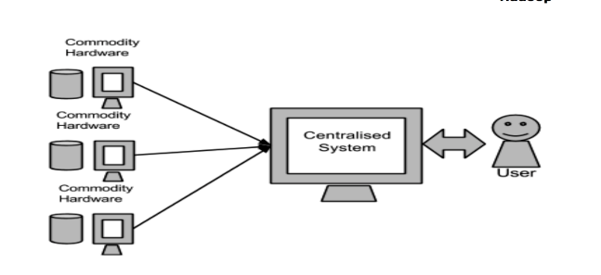
Continuation
Google’s Solution
Google solved this problem using an algorithm called MapReduce. This algorithm divides the task into small parts and assigns them to many computers, and collects the results from them which when integrated, form the result dataset.

Slide 19
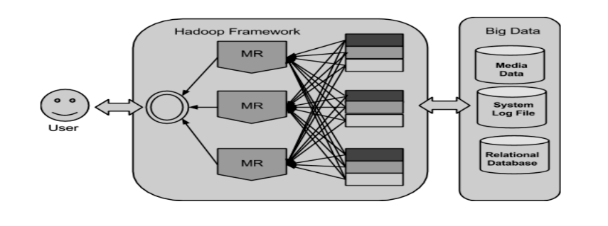
Google Solution : Hadoop
Using the solution provided by Google, Doug Cutting and his team developed an Open Source Project called HADOOP.
Hadoop runs applications using the MapReduce algorithm, where the data is processed in parallel with others. In short, Hadoop is used to develop applications that could perform complete statistical analysis on huge amounts of data.

Slide 20
What is MapReduce?
Parallel programming model meant for large clusters
User implements Map() and Reduce()‏
Parallel computing framework
A framework
Libraries take care of the rest
Data partition and distribution
Parallel computation
Fault tolerance
Load balancing
Useful model for many practical tasks (large data)

Slide 21
Example: Counting Words
Map()‏
Input <filename, file text>
Parses file and emits <word, count> pairs
eg. <”hello”, 1>
Reduce()‏
Sums values for the same key and emits <word, TotalCount>
eg. <”hello”, (3 5 2 7)> => <”hello”, 17>

Slide 22
Counting words in a large set of documents
map(string key, string value)‏
//key: document name
//value: document contents
for each word w in value
EmitIntermediate(w, “1”);
reduce(string key, iterator values)‏
//key: word
//values: list of counts
int results = 0;
for each v in values
result += ParseInt(v);
Emit(AsString(result));

Slide 23
How MapReduce Works
User to do list:
indicate:
Input/output files
M: number of map tasks
R: number of reduce tasks
W: number of machines
Write map and reduce functions
Submit the job
This requires no knowledge of parallel/distributed systems!!!
What about everything else?

Slide 24
Execution (map)‏
Map workers read in contents of corresponding input partition
Perform user-defined map computation to create intermediate <key,value> pairs
Periodically buffered output pairs written to local disk
Partitioned into R regions by a partitioning function

Slide 25
Partition Function
Example partition function: hash(key) mod R
Why do we need this?
Example Scenario:
Want to do word counting on 10 documents
5 map tasks, 2 reduce tasks

Slide 26
Execution (reduce)‏
Reduce workers iterate over ordered intermediate data
Each unique key encountered – values are passed to user's reduce function
eg. <key, [value1, value2,..., valueN]>
Output of user's reduce function is written to output file on global file system
When all tasks have completed, master wakes up user program

Slide 27
Observations
No reduce can begin until map is complete
Tasks scheduled based on location of data
If map worker fails any time before reduce finishes, task must be completely rerun
Master must communicate locations of intermediate files
MapReduce library does most of the hard work for us!

Slide 28
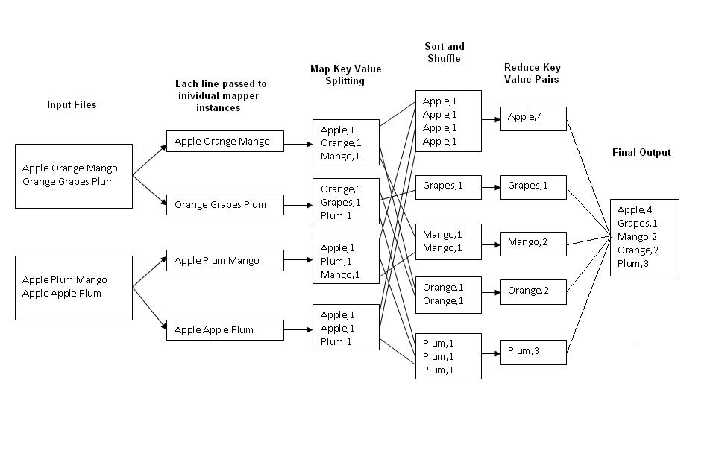

Slide 29
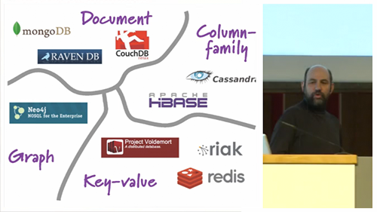
Types of Nosql

Slide 30
MongoDB
It is one of the most popular document based NoSQL database as it stores data in JSON like documents.
Mongodb are designed for high performance and high availability and scalability.

Slide 31
Querying in MongoDB
To create a database in mongodb
Syntax: use DATABASE_NAME
To drop a database in mongodb
Syntax: db.dropDatabase()
To create collection in mongodb
Syntax: db.createCollection(name, options)

Slide 32
Example
>use test
switched to db test
>db.createCollection("mycollection")
{ "ok" : 1 }
>db.createCollection("mycol", { capped : true, autoIndexID : true, size : 6142800, max : 100 } )
{ "ok" : 1 }
>

Slide 33
To insert a data into mongodb collection
Syntax: >db.COLLECTION_NAME.insert(document)
Example :
db.inventory.insert(
{
item: "ABC1",
details: {
model: "14Q3",
manufacturer: "XYZ Company“
},
stock: [ { size: "S", qty: 25 }, { size: "M", qty: 50 } ], category: "clothing"
}
)

Slide 34
To retrieve documents from a collection
Syntax: db.collection.find()
Example:
db.inventory.find( { type: { $in: [ 'food', 'snacks' ] } } )
db.inventory.find(
{
$or: [ { qty: { $gt: 100 } }, { price: { $lt: 9.95 } } ]
}
)

Slide 35
update() and save() methods are used to update document into a collection.
Syntax: >db.COLLECTION_NAME.update()
db.inventory.update(
{ item: "MNO2" },
{
$set: {
category: "apparel",
details: { model: "14Q3", manufacturer: "XYZ Company" }
},
}
)
To remove document from a collection
Syntax: >db.COLLECTION_NAME.remove()

Slide 36
NEO4J
Neo4j is a open source graph database
Graph Databases are mainly useful to store more connected data.
If we use RDBMS Databases to store more connected data, then they do not provide proper performance for traversing large amount of data.
It has CQL as query language.
To create a node in neo4j
Syntax: CREATE (<node-name>:<label-name>)
Example:
CREATE (emp:Employee)

Slide 37
To create a node with properties
Syntax:
CREATE (
<node-name>:<label-name>
{
<Property1-name>:<Property1-Value>
........
<Propertyn-name>:<Propertyn-Value>
}
)
Example:
CREATE (emp:Employee{id:123,name:“John",sal:35000,deptno:10}

Slide 38
To retrieve the properties of a node
Syntax:
RETURN
<node-name>.<property1-name>,
........
<node-name>.<propertyn-name>
To retrieve data from database we should combine match and return commands.
Example:
MATCH (dept: Dept)
RETURN dept.deptno,dept.dname

Slide 39
WHERE clause in CQL MATCH command to filter the results of a MATCH Query.
Syntax:
WHERE <condition>
Example:
MATCH (emp:Employee)
WHERE emp.name = 'Abc' OR emp.name = 'Xyz'
RETURN emp

Slide 40
Neo4j CQL DELETE clause is used
To delete a Node.
To delete a Node and associated Nodes and Relationships.
Example:
MATCH (e: Employee) DELETE e
REMOVE clause is used to remove existing properties of Nodes or Relationships.
Example:
MATCH (book { id:122 })
REMOVE book.price
RETURN book
It is similar to the below SQL Command.
ALTER TABLE BOOK REMOVE COLUMN PRICE; SELECT * FROM BOOK WHERE ID = 122;

Slide 41
Set command is used to set the values.
Syntax:
SET <property-name-list>
Example:
MATCH (dc:DebitCard)
SET dc.atm_pin = 3456
RETURN dc

Slide 42
Redis
It is another Open Source NoSQL database which is mainly used because of its lightening speed. Some benefits and strengths of redis are
Data structures
Redis as cache
Very fast
Up to 4 million key-value pairs in redis
Maximum allowed key size is 512mb

Slide 43
Using the SET and the GET commands we can set and retrieve a string value.
Syntax:
> SET KEY_NAME VALUE
> GET KEY_NAME
Example:
> set mykey redis
OK
> get mykey
“redis“
> GETRANGE mykey 0 2
“red"

Slide 44
We can also use incr to increment the integer value of a key.
set count 100
OK
> incr counter
(integer) 101
> incr counter
(integer) 102
To set or retrieve the value of multiple keys we use MSET and MGET
> mset a 10 b 20 c 30
OK
> mget a b c
1) "10"
2) "20“
3) "30"

Slide 45
EXISTS command returns 1 or 0 to signal if a given key exists or not in the database.
> set mykey hello
OK
> type mykey
string
> exists mykey
(integer) 1
> del mykey
(integer) 1
> exists mykey
(integer) 0
Using expire
> expire mykey 5
(integer) 1
> ttl key
(integer) 9

Slide 46
Redis lists
Redis lists are implemented via Linked Lists.
Commands used:
Lpush
Rpush
Lpop
Rpop
Lrange

Slide 47
>RPUSH mylist "hello"
(integer) 1
>RPUSH mylist "foo"
(integer) 2
>RPUSH mylist "bar"
(integer) 3
> LRANGE mylist 0 -1
"hello"
2) "foo"
3) "bar"
>LPUSH list1 "foo"
(integer) 1
> LPUSHX list1 "bar"
(integer) 2
> LPUSHX list2 "bar"
(integer) 0
> LRANGE list1 0 -1
1) "foo"
2) "bar"
>RPUSH list1 "foo"
(integer) 1
> RPUSH list1 "bar"
(integer) 2
> LPOP list1
"foo"
>RPUSH mylist "hello"
(integer) 1
> RPUSH mylist "hello"
(integer) 2
> RPUSH mylist "foo”
(integer) 4
> RPOP mylist
“foo”

Slide 48
Are there any Hybrid DataBases(both Nosql and Rdbms)
Alchemy Database is a Hybrid Relational-Database/NoSQL datstore.
This is an RDBMS datastore embedded in redis.
It is fast on commodity hardware and memory efficient.

Slide 49
Why Big Data tends to be paired with Nosql?
NoSQL is often used for storing Big Data.
This is a new type of database which is becoming more and more popular among web companies today.
Proponents of NoSQL solutions state that they provide simpler scalability and improved performance relative to traditional relational databases.
These products excel at storing “unstructured data,” and the category includes open source products such as Cassandra, MongoDB, and Redis.

Slide 50
Why not Rdbms for Big Data?
Relational databases haven't necessarily adapted well to changes in the types and quantities of data now being generated, such as the unstructured data that is prevalent in big data applications.
In addition, expanding traditional databases to accommodate rapid growth is costly.

Slide 51
References
http://www.forbes.com/sites/davefeinleib/2012/10/08/big-data-and-nosql-five-key-insights/
http://searchdatamanagement.techtarget.com/essentialguide/Relational-database-management-system-guide-RDBMS-still-on-top
https://code.google.com/p/alchemydatabase/
https://www.mongodb.com/compare/mongodb-mysql
http://dba.stackexchange.com/questions/5/what-are-the-differences-between-nosql-and-a-traditional-rdbms

Slide 52
Thank You

